Slide 1
Comments on the U.S. Federal Reserve System:
1 History
2 Current Functioning
3 Powers
SUE PETERS
Member, American Monetary Institute
Member, GreensForMonetaryReform.org
Member, Alliance for Just Money
PRESENTATION: 4-10-2019 WED. 7-9PM
THE NEW SCHOOL
6 E. 16TH ST.: Wolff Conference Room D1103

Slide 2
1 History

Slide 3
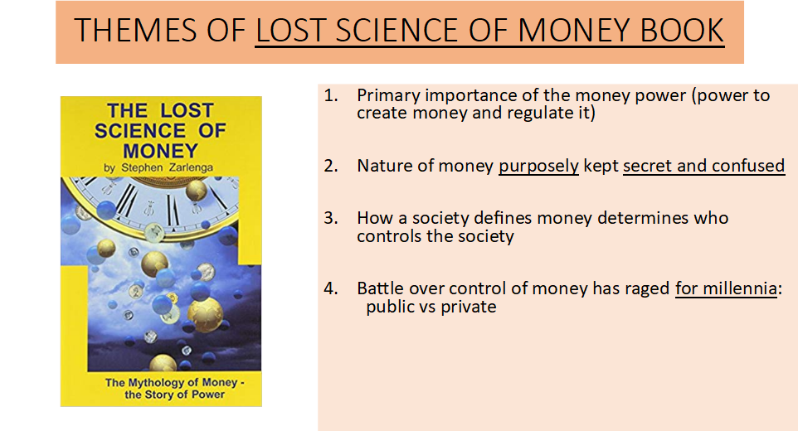

Slide 4
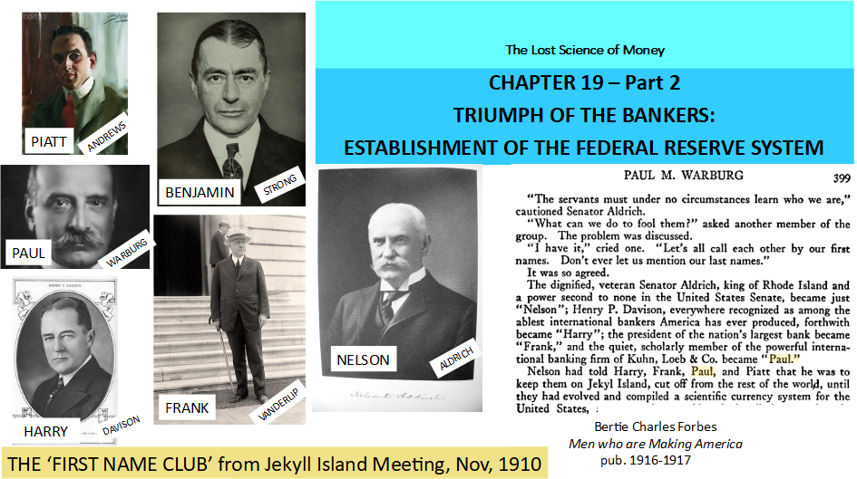

Slide 5
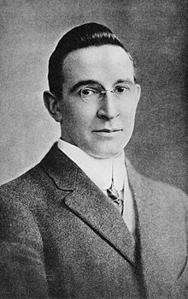
The meeting of Wall Street bankers to write what would be the Federal Reserve bill was kept secret.
The bankers understood that the country did not want a banking system ruled by Wall Street.
“Picture a party of the nation’s greatest bankers stealing out of New York on a private railroad car
under cover of darkness, stealthily hieing hundreds of miles South… I am giving to the world,
for the first time, the real story of how the famous Aldrich currency report, the foundation of our
new currency system, was written… the real birth of the present Federal Reserve System, the
plan done on Jekyll Island… Warburg… more than any one man has made the system possible
as a working reality.” B.C. Forbes, CURRENT OPINION, Dec 1916
Forbes revelation did not get much response. First, it was two years after the bill was passed;
secondly, it was dismissed as preposterous. In a book published in 1930, a biographer of Aldrich calls it “a mere yarn”.
Nathaniel Stephenson, Nelson W. Aldrich, A Leader in American Politics, pub. 1930
B.C. Forbes (1880 – 1954)
founder of Forbes Magazine
in 1917

Slide 6
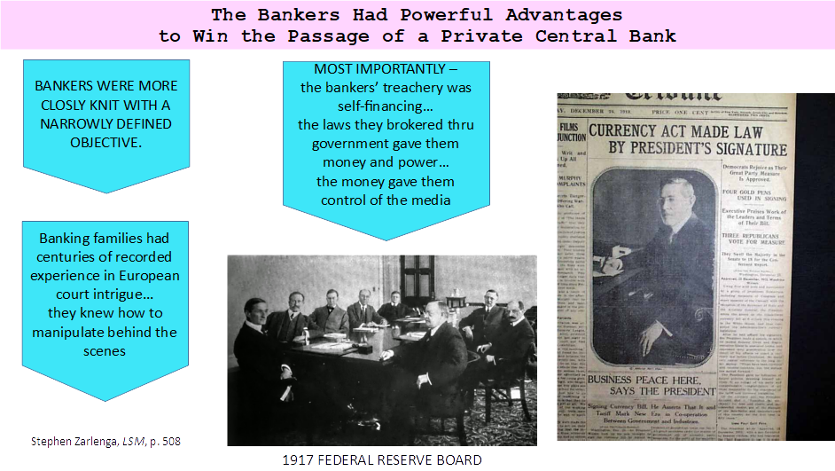

Slide 7
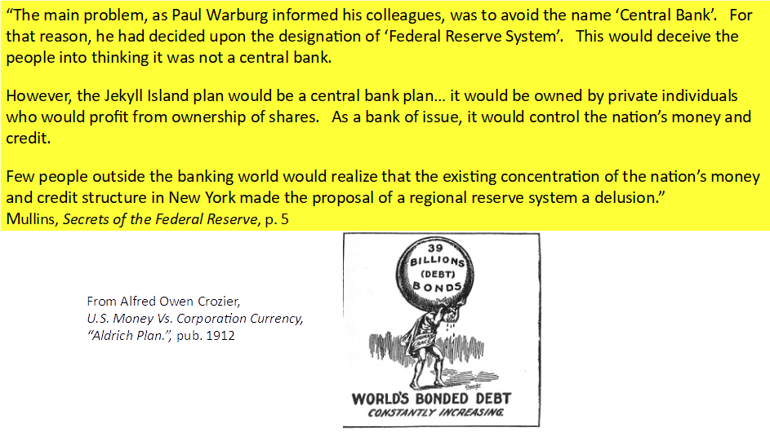

Slide 8
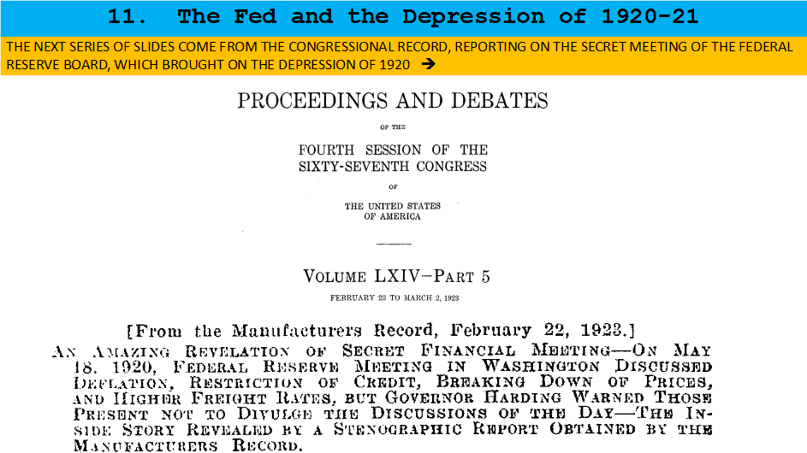

Slide 9
Current Functioning:
HOW THE MONEY SYSTEM WORKS

Slide 10
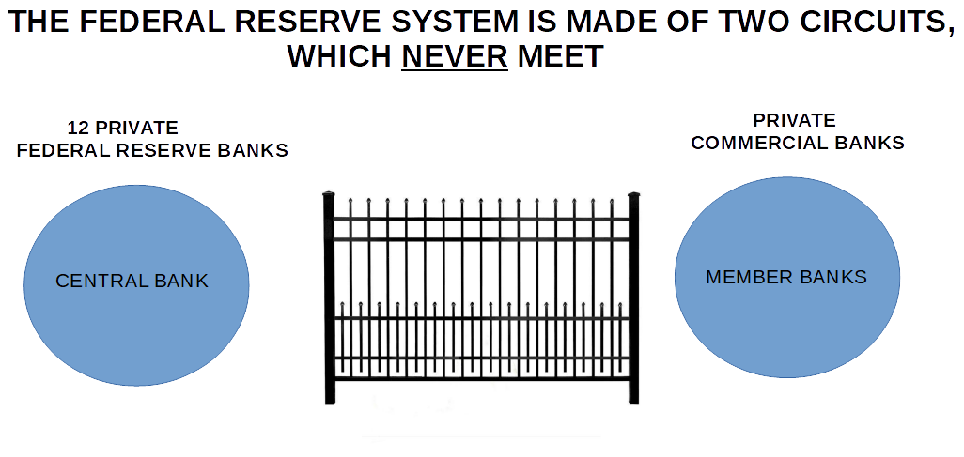
Reserve money (CB-created money)
circulates between banks’
reserve accounts
Bankmoney (bank-created money)
circulates among customers’ accounts
(checking and savings accounts)

Slide 11
Ownership of reserves moves
between the reserve accounts
of the member banks
Ownership of bankmoney moves
between the checking/savings accounts
of the banks’ customers

Slide 12
#2
#1
During ‘check clearing’, my bank’s reserve
account at the Fed has the check amount
subtracted, and the reserve account of the
recipient’s bank has the check amount added.
When I write a check to someone, they deposit it in their bank. During ‘check clearing’, my balance is marked down.
But, before their balance is marked up, the reserves must be
moved between the reserve accounts of our banks at the Fed.

Slide 13
ABOUT 30 YEARS AGO,
THE CENTRAL BANK STOPPED TRY TO CONTROL THE COMMERCIAL BANKS.
THE COMMERCIAL BANKS, CREATORS OF BANKMONEY,
BECAME THE DRIVER OF THE SYSTEM.
COMMERCIAL BANKS
‘BANKMONEY (CREDIT)’
CENTRAL BANK
‘RESERVES’
FOR EXAMPLE……...

Slide 14
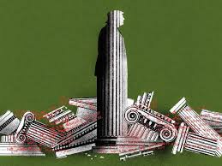
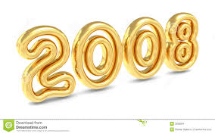
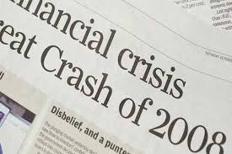
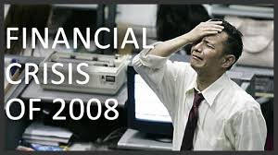
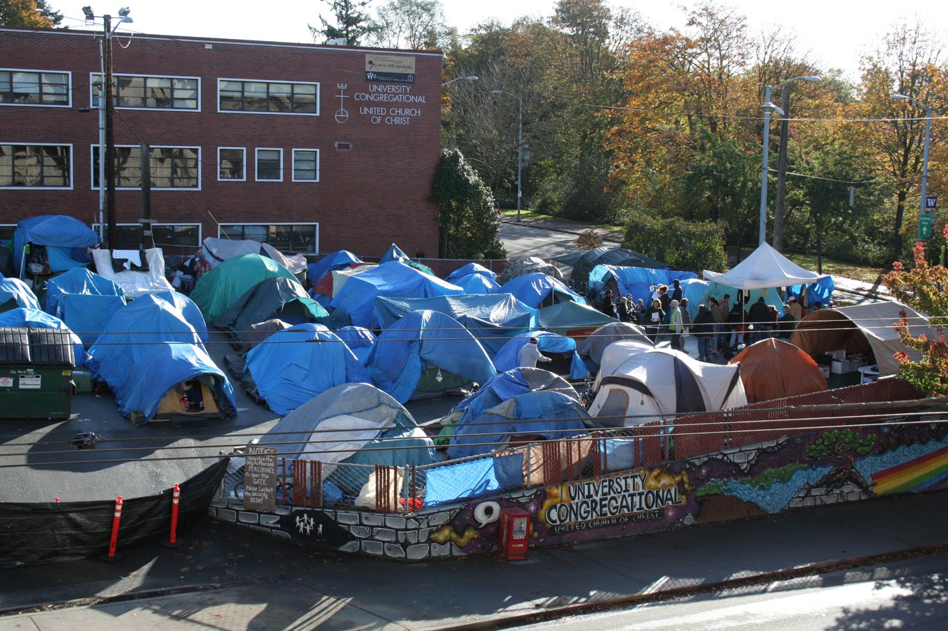

TENT CITY, SEATTLE, WASH. 2010

Slide 15
WHO’S IN CHARGE?

Slide 16
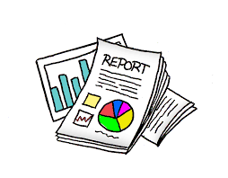

Slide 17
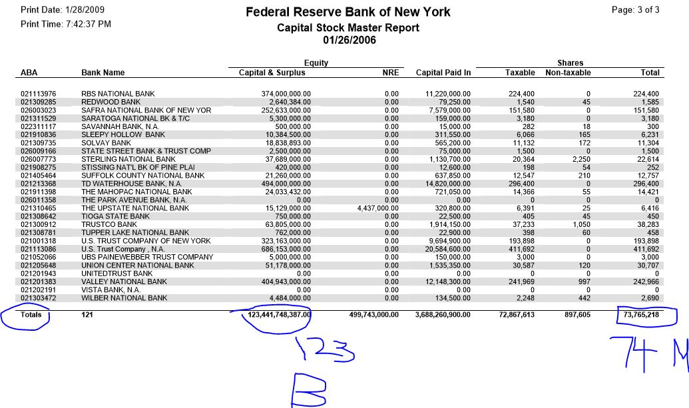

Slide 19
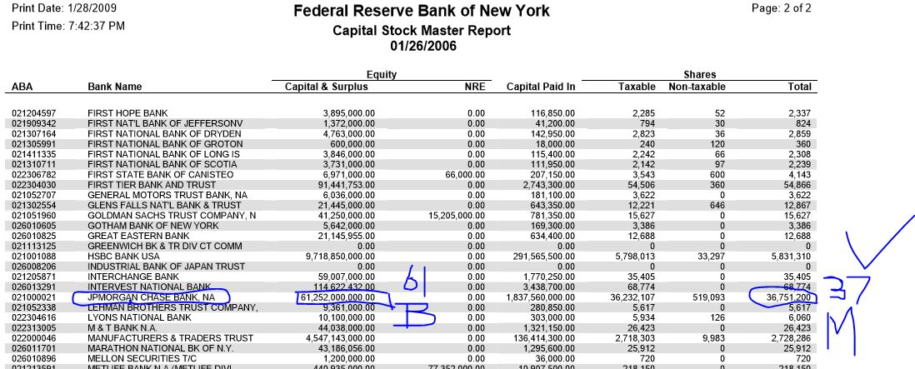

Slide 21
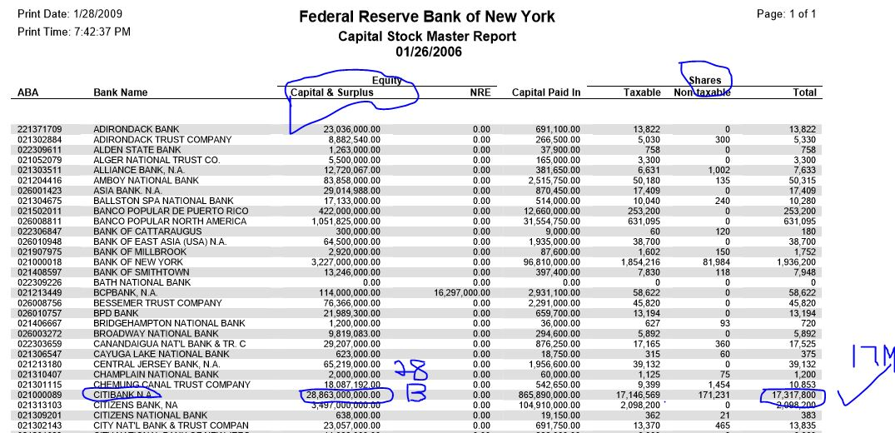

Slide 22
3 Powers

Slide 23
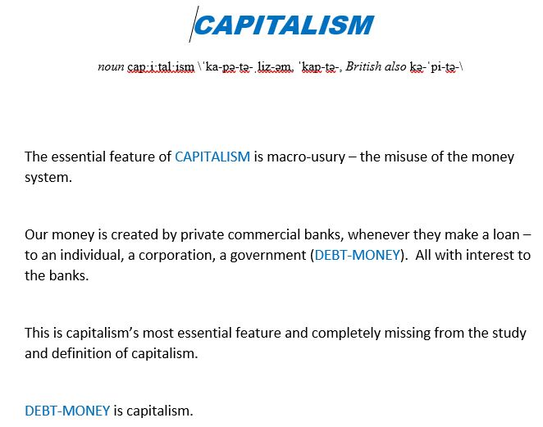

Slide 24
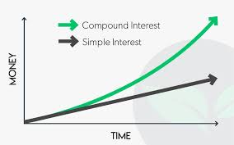
#1
PRIVATE COMMERCIAL BANKS – WITH THE POWER TO CREATE MONEY FROM DEBT -
MINUTE BY MINUTE…
REGARDLESS OF DISASTERS TO PEOPLE (STORMS, WAR…)
CONTINUALLY GATHER COMPOUND INTEREST ON OUR MONEY SUPPLY

Slide 25

WITHOUT DOING ANY WORK!

Slide 26
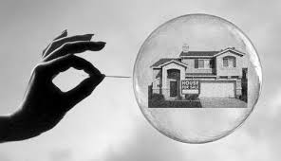
#2
PRIVATE COMMERCIAL BANKS – WITH THE POWER TO CREATE MONEY FROM DEBT -
CREATE FINANCIAL BUBBLES AND FINANCIAL BUSTS
(THEY BENEFIT ON BOTH THE UP AND THE DOWN!)

Slide 27
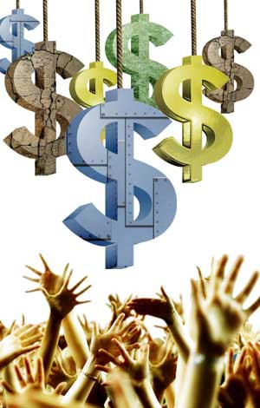
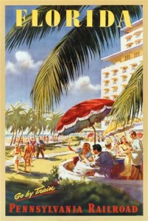

The banks, not the government, fueled the 1920’s:
Banks financed the financial bubble from 1921 to 1929
LOANS FOR SECURITIES
increased 121%
LOANS FOR REAL ESTATE
increased 178%
LOANS FOR INVESTMENTS
increased 67%

Slide 28
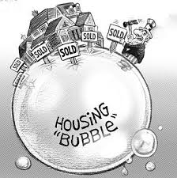
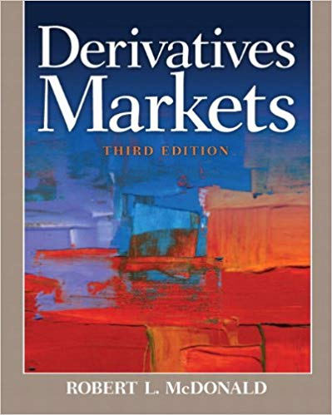

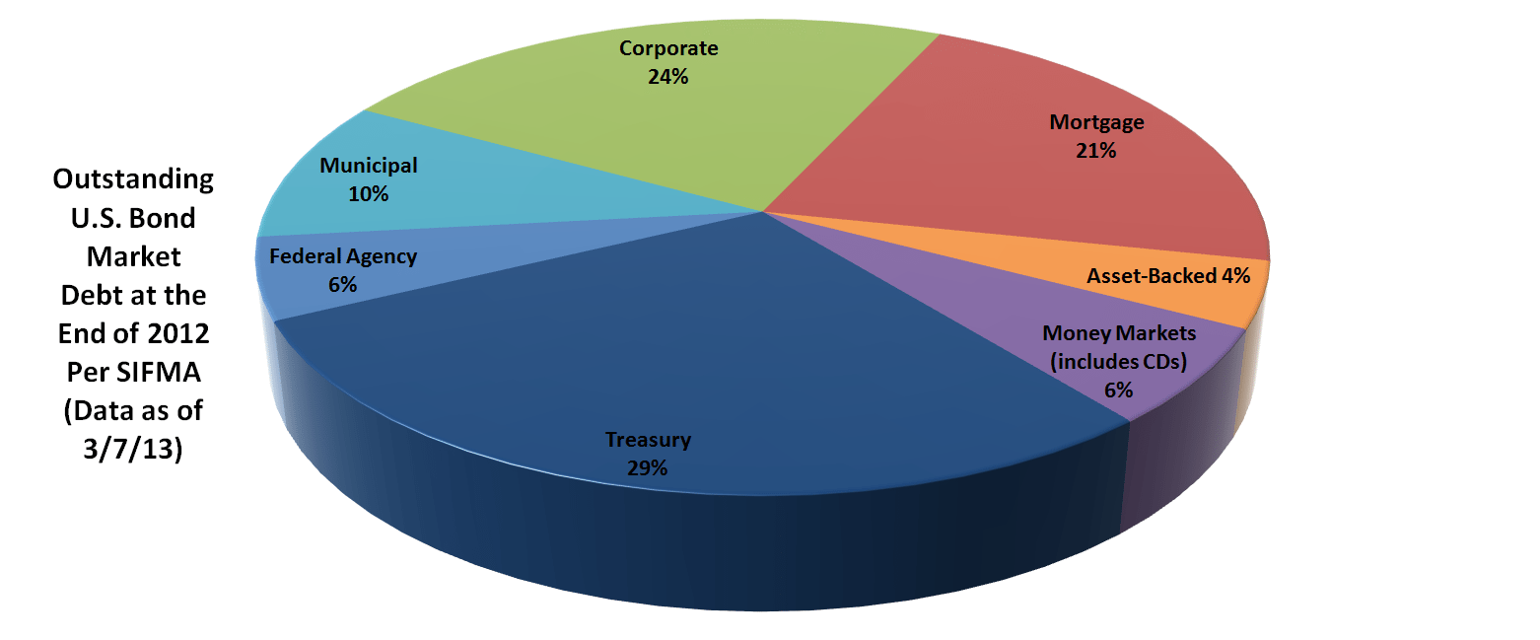
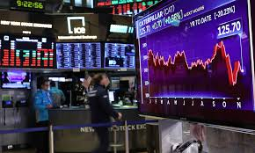
#3
PRIVATE COMMERCIAL BANKS – WITH THE POWER TO CREATE MONEY FROM DEBT -
DECIDE WHO GETS MONEY (LOANS)!
STOCK MARKET
STOCK MARKET
BOND MARKETS

Slide 29
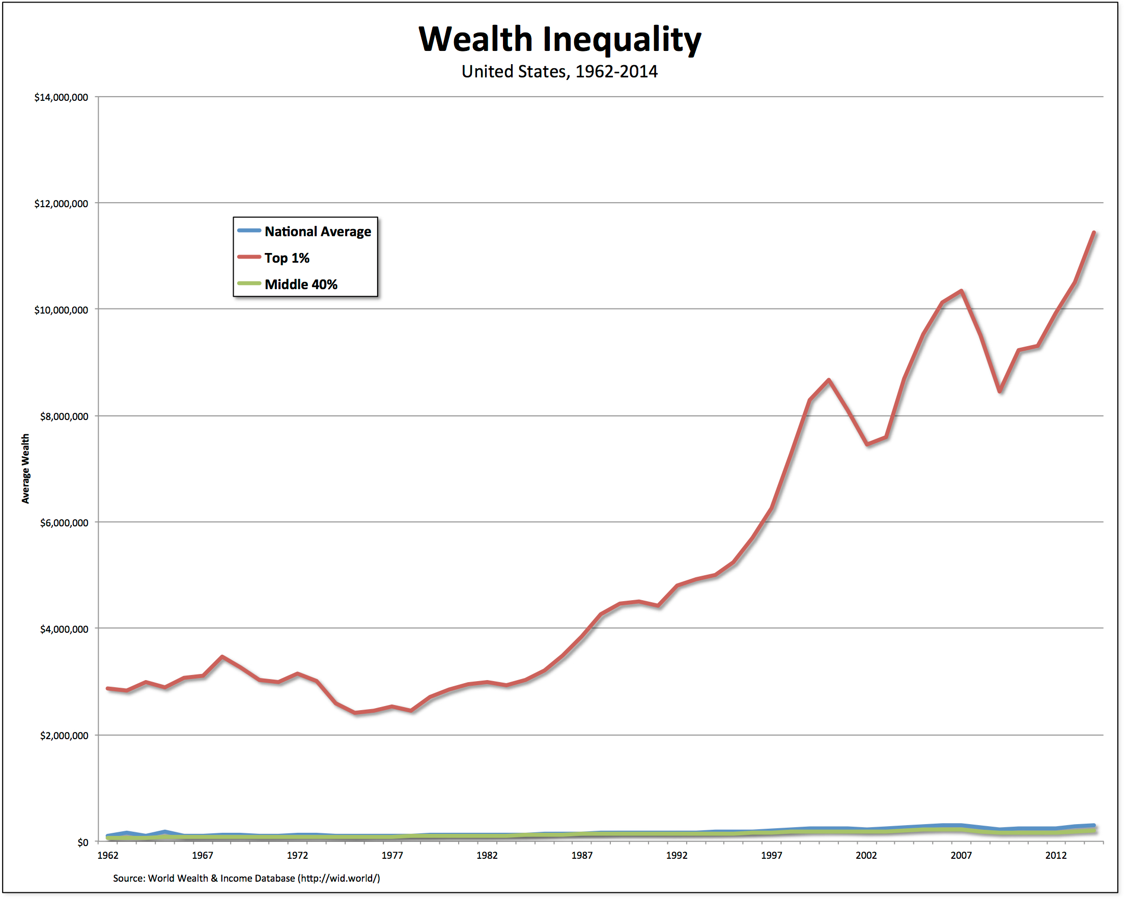
#4
PRIVATE COMMERCIAL BANKS – WITH THE POWER TO CREATE MONEY FROM DEBT -
STARVE THE REAL ECONOMY…
CAUSING MASSIVE WEALTH INEQUALITY

Slide 30
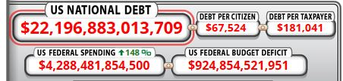
#5
PRIVATE COMMERCIAL BANKS – WITH THE POWER TO CREATE MONEY FROM DEBT -
KEEP OUR NATIONAL GOVERNMENT IN DEBT
(SO THE CENTRAL GOVERNMENT CANNOT CLAIM
ITS CONSTITUTIONAL POWER TO CREATE PUBLIC MONEY)

Slide 31
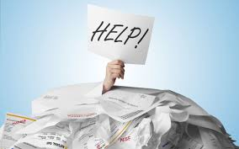

#6
AS MORE AND MORE INTEREST IS SUCKED UP TO THE 1%,
THE 99% IS MORE AND MORE IN DEBT

Slide 32

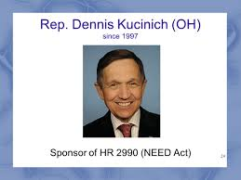
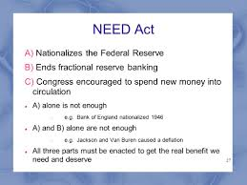
THE POWER TO CREATE AND DESTROY MONEY
IS AN AWESOME POWER!
AND MUST NOT BE LEFT IN PRIVATE HANDS!
WE MUST CHANGE THE SYSTEM...

Slide 33
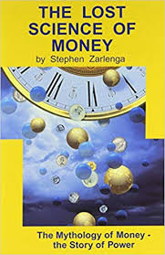

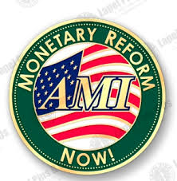
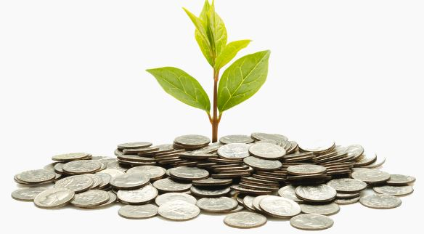
1. LEARN ABOUT MONETARY HISTORY AND THE MONETARY SYSTEM
2. JOIN WITH OTHERS TO EDUCATE THE AMERICAN PUBLIC
3. EDUCATE OUR ELECTED GOVERNMENT OR RUN FOR OFFICE YOURSELF!
TEACHING MATERIALS:
LOST SCIENCE OF MONEY BOOK
ALLIANCE FOR JUST MONEY
GreensForMonetaryReform
AMERICAN MONETARY REFORM

Slide 34
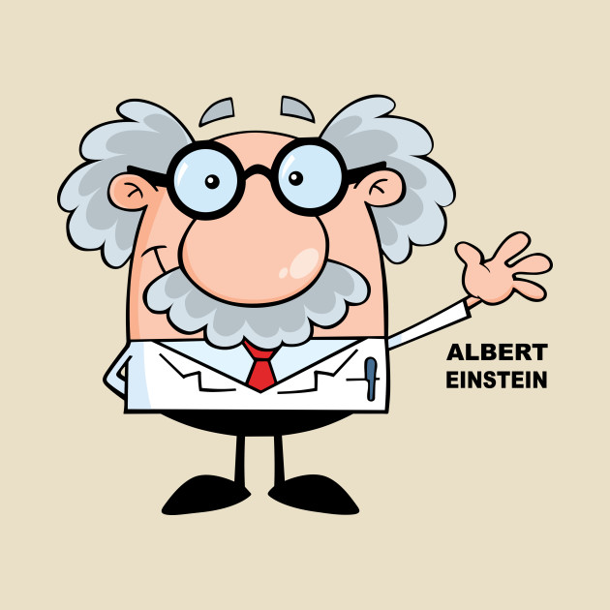
THE END
HELP TAKE THE POWER TO CREATE MONEY
FROM PRIVATE BANKS
GIVE IT BACK TO THE GOVERNMENT
WHERE IT BELONGS, UNDER PUBLIC CONTROL
Albert Einstein

