Slide 1
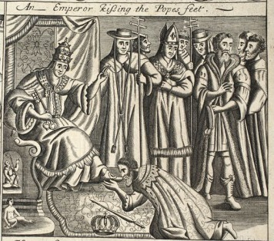
BANKING SYSTEM
Vote ‘NO’ to Proposal #922…..
Keep ‘Greening the Dollar’
in the platform
Give our nation debt-free money
CORPORATIONS
KISS THE BANKERS’ FEET

