Slide 1

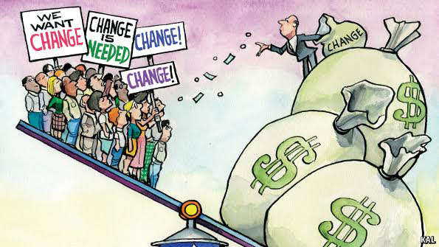
MONETARY REFORM IN THE GREEN PARTY NATIONAL PLATFORM:
‘GREENING THE DOLLAR’
Green Party US National Meeting
Salt Lake City, Utah
1PM Heritage – Seminar 1 Room
THURSDAY, JULY 19
&
2:45 Guest House – Alpine Room
FRIDAY, JULY 20
Sue Peters
NY County Green
Delegate, NYS Committee
Advisor on money reform, GPUS National Committee
GreensforMonetaryReform.org

Slide 2
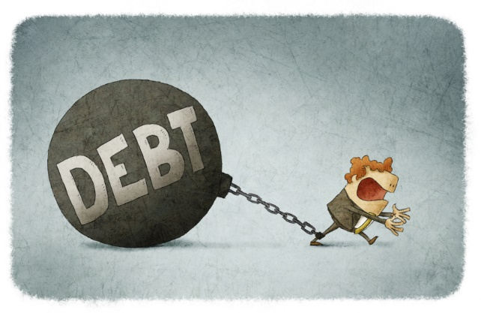
MONETARY REFORM
…the US doesn’t have a money supply, but its Orwellian opposite of a ‘debt supply.’ Banks … create what we use for money as debts, then charge the 99% interest for its use.” - Carl Herman, 2012

Slide 3
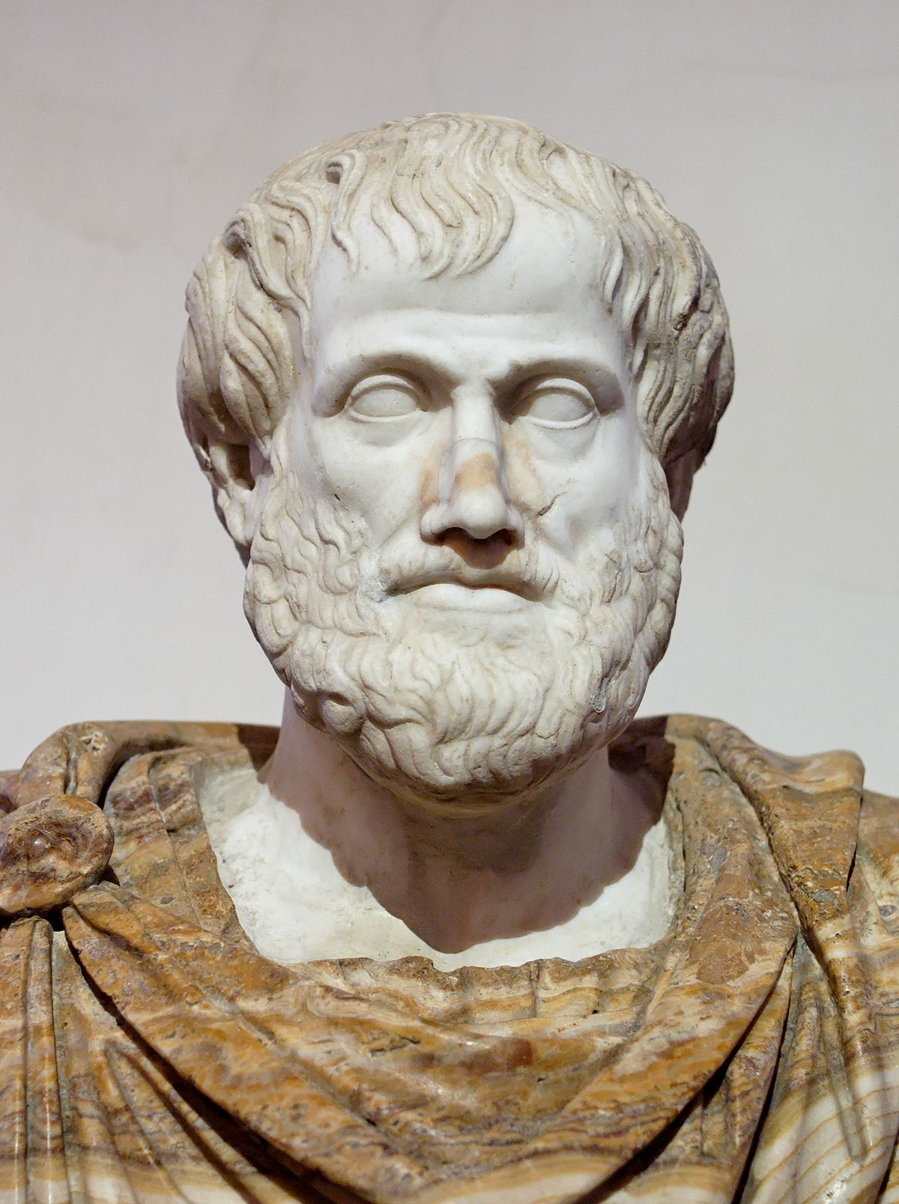
MONETARY REFORM
“For money was intended to be used in exchange,
but not to increase at interest.”
Aristotle

Slide 4
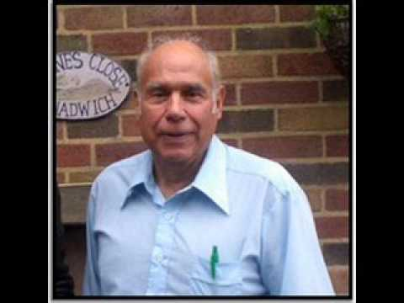
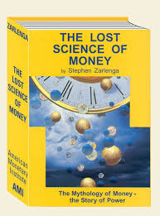
MONETARY REFORM
“Over time, whoever controls the money system, controls the nation.”
- Stephen Zarlenga (1941 – 2017)

Slide 5
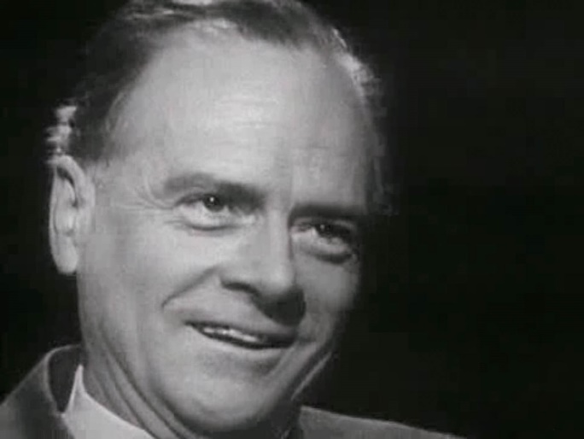
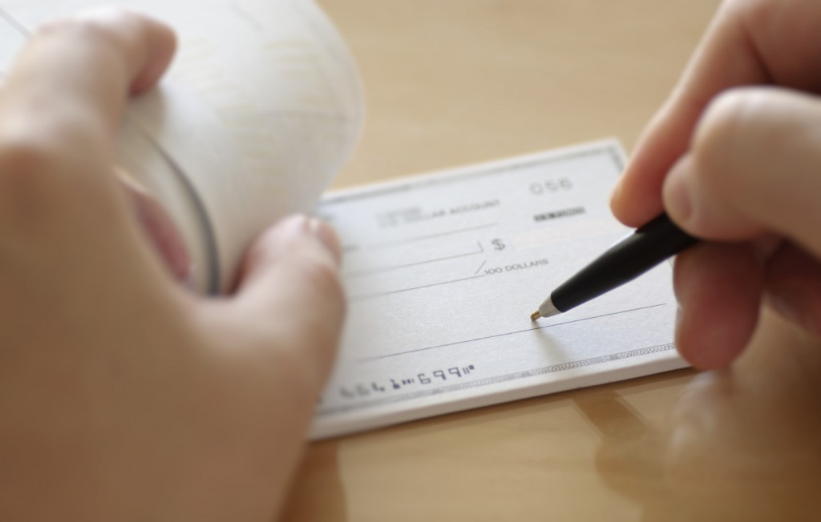
MONETARY REFORM
Only the small secrets need to be
protected. The large ones are kept
secret by public incredulity.
-- Marshall McLuhan
GREG COLERIDGE, Northeast Ohio American Friends Service Committee:
The general public is unwilling or unable to believe that the vast majority of the money of our nation isn’t created by our public government, but by private financial entities out of thin air as debt.

Slide 6

PART 1 THE SYSTEM
PART 2 ITS CONSEQUENCES
HI! I’m going to talk about two things:

Slide 7
PART 1
THE SYSTEM
Listen up!

Slide 8
Private banks create the money we need…
Meet the system!

Slide 9

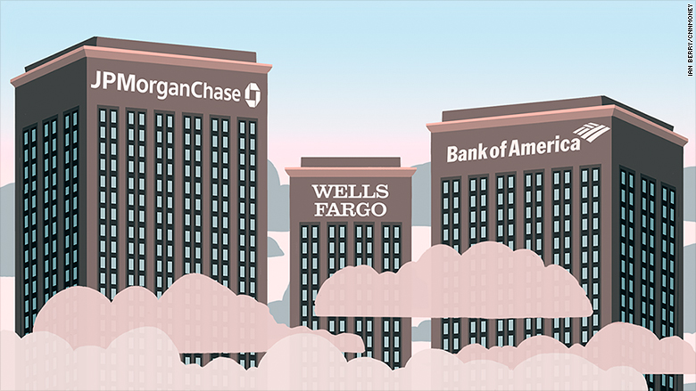
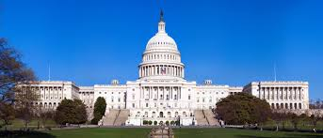
Private banks create our money! Not our government?
I don’t believe it… It’s too hard to believe…
You don’t have to believe me. Here… listen to others ➔ ➔ ➔ ➔

Slide 10
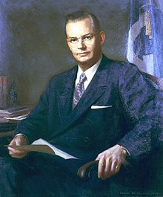
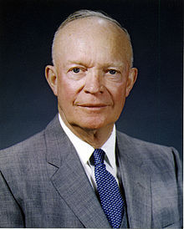
Robert B. Anderson, Secretary of the Treasury under President Eisenhower:
"When a bank makes a loan it simply adds to the borrowers’ deposit account in the bank by the amount of the loan.
The money is not taken from anyone else's deposit…
It's new money, created by the bank for the use of the borrower.“
Robert B. Anderson
Secretary of the Treasury, 1957-1961
President Dwight D. Eisenhower
1953-1961

Slide 11
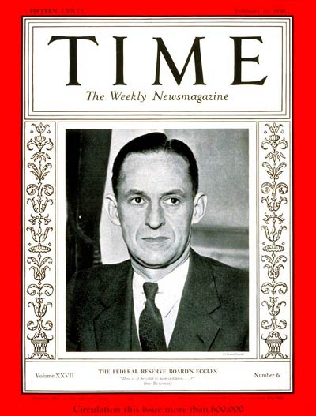
“That is what our money system is.
If there were no debts in our money system, there wouldn’t be any money.”
Mariner S. Eccles
Chairman, Federal Reserve
under President Franklin D. Roosevelt

Slide 12
Let’s look at the money system.
How does it work?

Slide 13
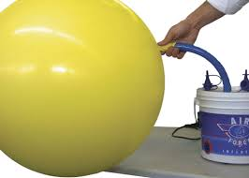
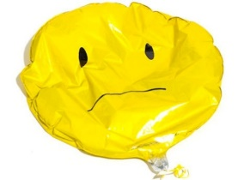

#1
When a private commercial bank makes a loan, it CREATES MONEY.
(The money supply grows.)
When the loan is repaid, the MONEY DISAPPEARS.
(The money supply shrinks.)
What! This can't be! We all need that money! It mustn’t go away!

Slide 14
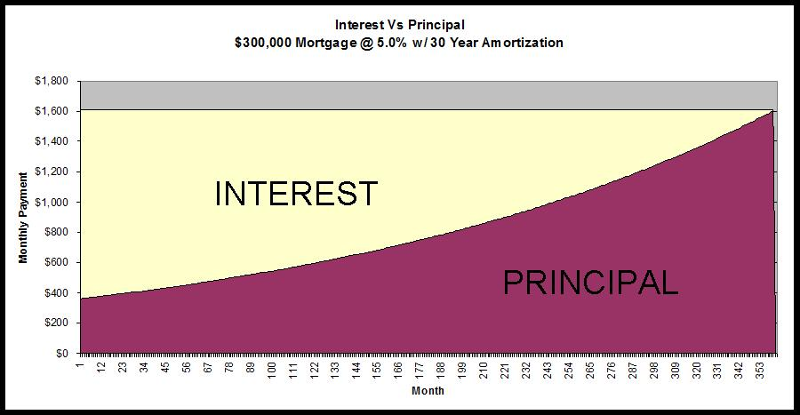
#2
Of course, we know that every borrower must pay interest.
The problem is that banks NEVER CREATE THE MONEY FOR THE INTEREST. Only for the principal of the loan.
Oh, my goodness.
This is getting really confusing. Why not create the INTEREST?
NEVER CREATED➔

Slide 15
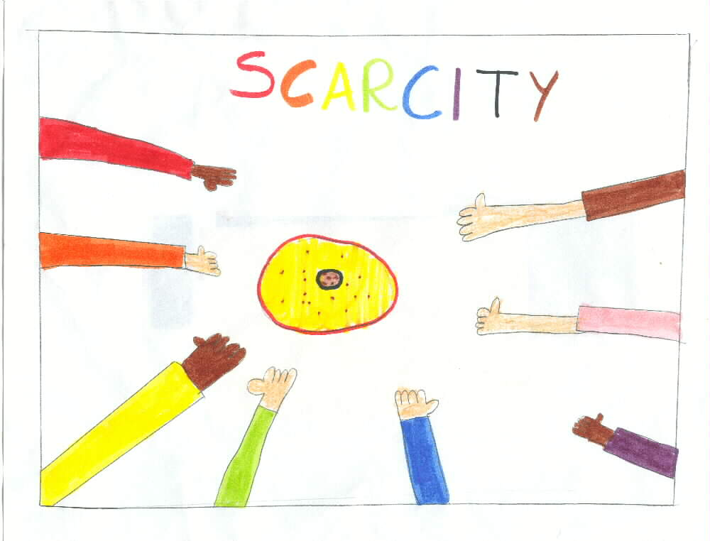
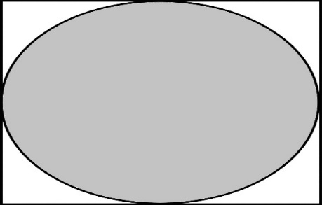

Since the money for interest is never created, money is always SCARCE.
Where will I get the money to pay the interest !!!
PRINCIPAL ONLY
LOOK HERE ➔ ➔

Slide 16


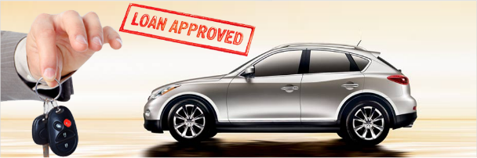



With more loans!!!
CREDIT CARD DEBT
CAR LOAN DEBT
STUDENT DEBT
HOME MORTGAGE DEBT

Slide 17
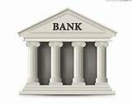
Or the bank gets the wealth -- ah -- excuse, me –
I meant ‘collateral’
DEBT SLAVE

Slide 18
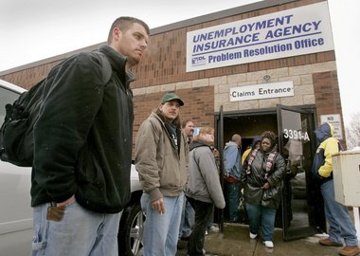
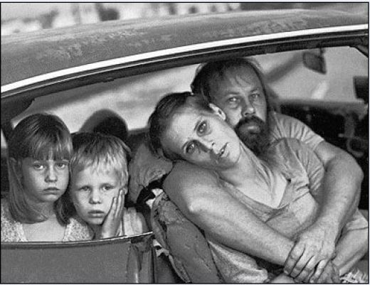
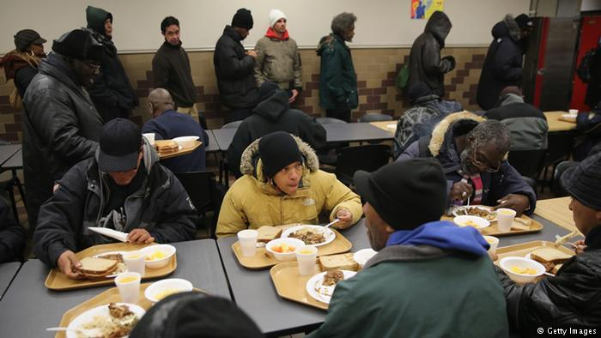
The SYSTEM DEMANDS that more loans be created,
OR ELSE the money supply will shrink and there will be defaults, foreclosures, bankruptcies, unemployment, recessions, depressions…

Slide 19

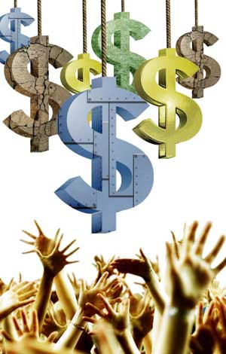
The bankers decide…
Who gets money… How much…
Umm. I don’t like the sound
of this….

Slide 20

The private bankmoney system is the
ROOT CAUSE and DRIVER of …
CORPORATE CAPITALISM
The essential feature of CAPITALISM is
the misuse of the money system.
This is capitalism’s most essential feature and completely missing from the study and definition of capitalism.

Slide 21

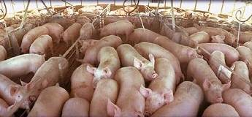
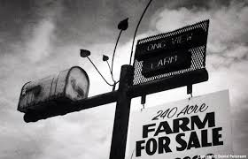

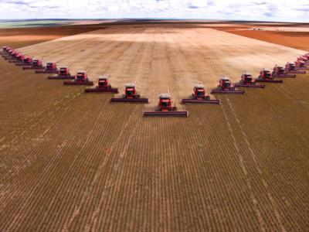
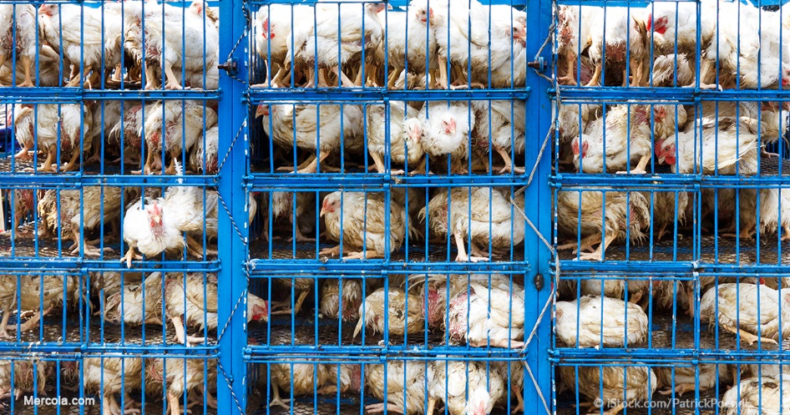
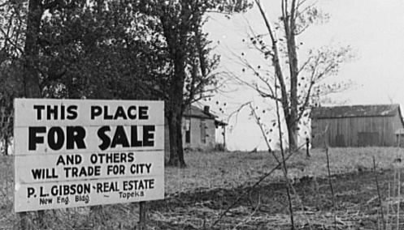
EMPOWERS factory farming –
over small farmers

Slide 22
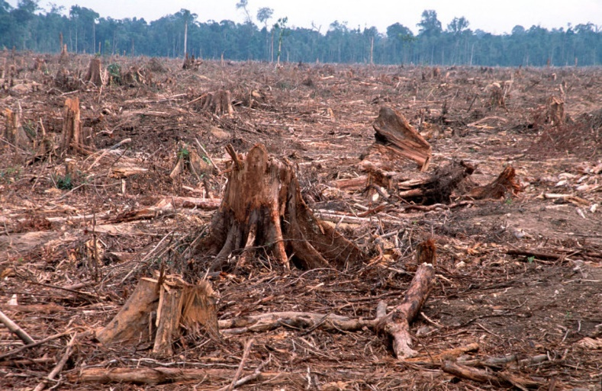
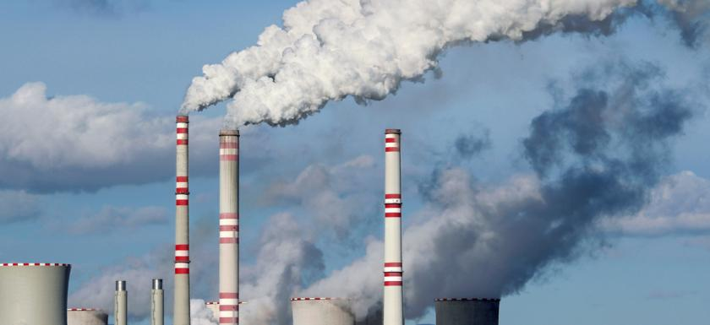
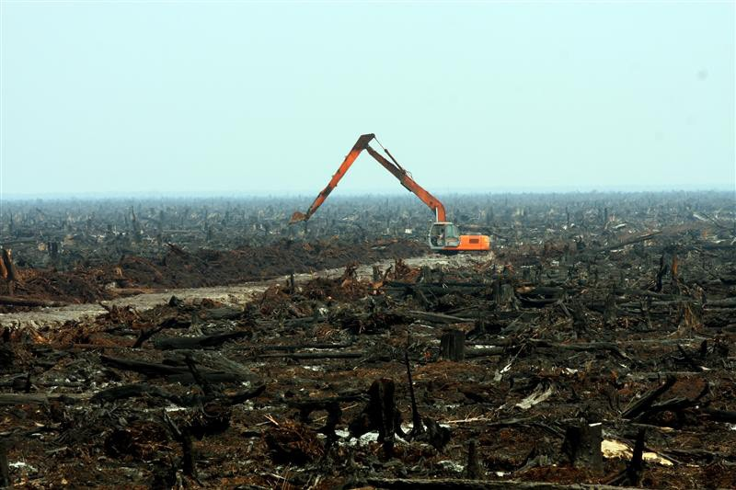
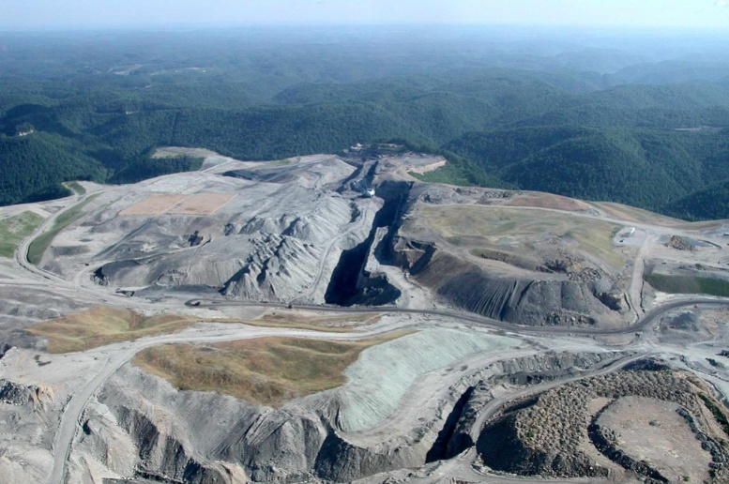
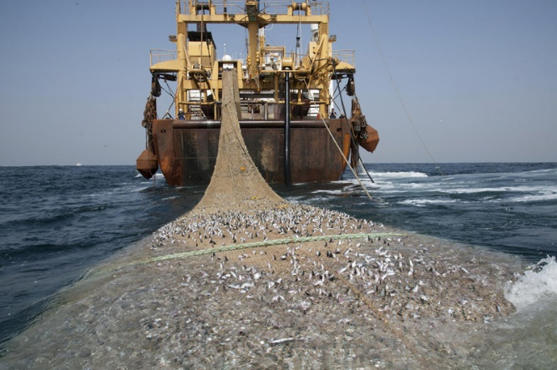
EMPOWERS MULTINATIONALS –
WHO DESTROY THE ENVIRONMENT
POLLUTING OUR AIR
DESTROYING THE RAIN FORESTS
DESTROYING THE LAND
PRIVATE BANKS CREATE MONEY
FOR MULTINATIONALS.
PROFIT IS FIRST (TO PAY DEBTS TO BANK)….
NATURE COMES LAST.
OVERFISHING THE OCEANS

Slide 23
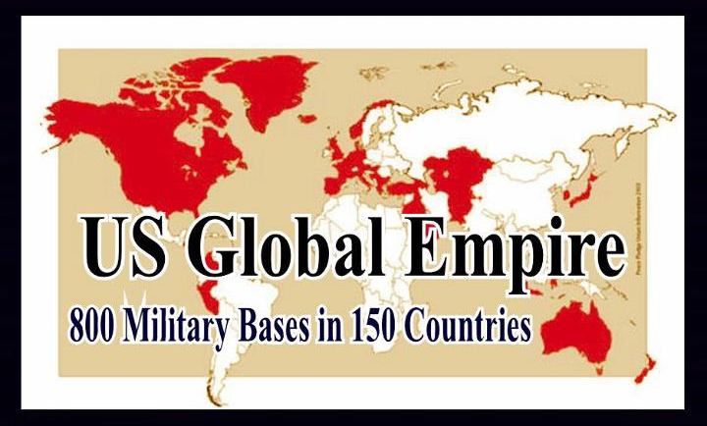
THE SYSTEM FUNDS WARS
In 2018 …
The U.S. maintains the largest military in the ENTIRE HISTORY OF THE WORLD ...
which Fed member banks support by creating bankmoney and giving loans of billions and billions of dollars to the arms industry.
And the Fed and its member banks are the
single largest owner of U.S. Bonds.

Slide 24
THIS SYSTEM CAN BE CHANGED!
Remember that!

Slide 25
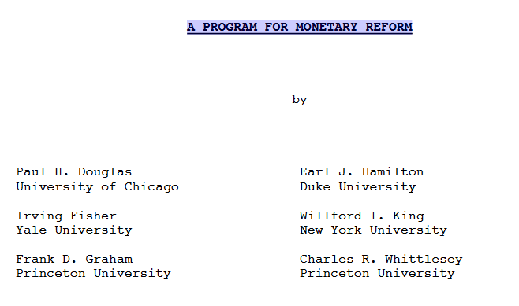
CHANGING THE SYSTEM
“Greening the Dollar” is based on the work of respected U.S. economists
In 1939, over 400 economists publicly supported the Fisher-Douglas-Graham paper for reform,
labeled “The Chicago Plan”
faculty.chicagobooth.edu/amir.sufi/research/monetaryreform_1939.pdf
Can anyone find
a parallel of
economist support?

Slide 26
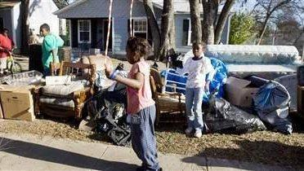

CHANGING THE SYSTEM
“Greening the Dollar” is based on the work of respected U.S. economists
“The banks thus exercise what has always, and justly, been considered a prerogative of sovereign power. As each bank exercises this power independently without any centralized control,the resulting changes in the volume of the circulating medium are largely haphazard. This situation is a most important factor in booms and depressions.”
p. 14, A PROGRAM FOR MONETARY REFORM
2008 FINANCIAL CRISIS

Slide 27
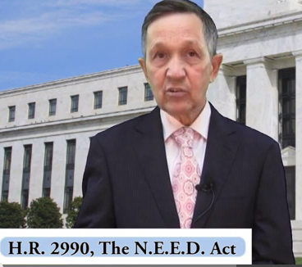
In 2011-2012 Rep. Dennis Kucinich submitted to Congress
‘Greening the Dollar’ as a bill ‘THE NEED ACT’
THE SOLUTION: DEBT-FREE MONEY
POWER TO CREATE MONEY IS TAKEN AWAY FROM PRIVATE BANKS, WITH A SIMPLE ACCOUNTING CHANGE
USING FEDERAL, STATE, & MUNICIPAL LEVELS OF GOVERNMENT, CONGRESS SPENDS DEBT-FREE GOVERNMENT MONEY ON PHYSICAL INFRASTRUCTURE, EDUCATION, HEALTH CARE - CREATING MILLIONS OF JOBS
THE GOVERNMENT BUYS ALL THE SHARES OF THE 12 FEDERAL RESERVE BANKS FROM THE MEMBER COMMERCIAL BANKS.
DENNIS KUCINICH
THE NEED ACT 2011-2012

Slide 28
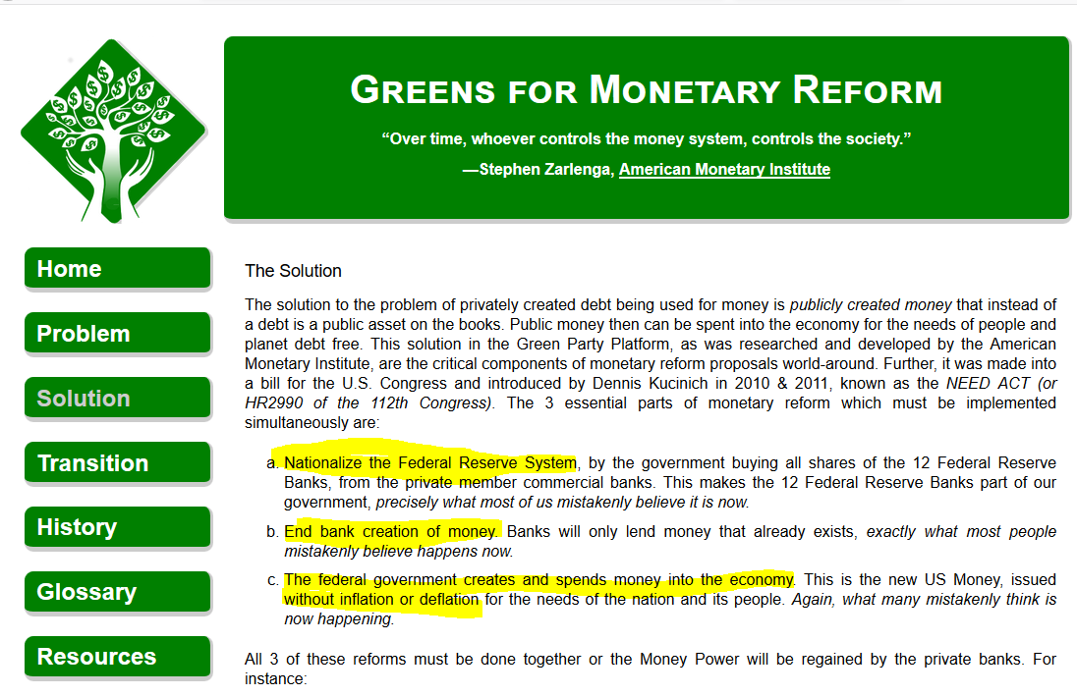

Slide 29
THE END
Support
“Greening the Dollar”

