Slide 1
BIRTH OF THE
FEDERAL RESERVE PRIVATE BANKING SYSTEM
Jerry Kann
Fed Group of Upper West Side
June 2, 2018 4-5:50pm 1.114room

Slide 2
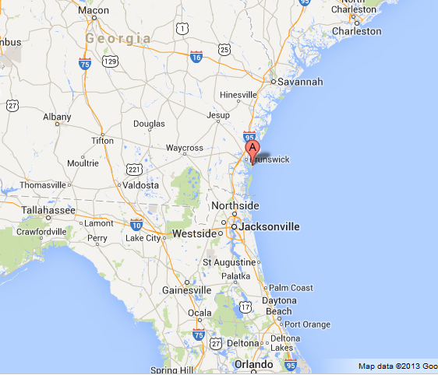
JEKYLL ISLAND, GEORGIA
BIRTH OF THE
FEDERAL RESERVE PRIVATE BANKING SYSTEM
The Federal Reserve Bill was secretly written
by Wall Street Bankers in November of 1910.
The bankers went to Jekyll Island, Georgia,
by private railway car. While on the island,
new servants were hired and the bankers
used only first names between themselves
to keep anonymity.

Slide 3
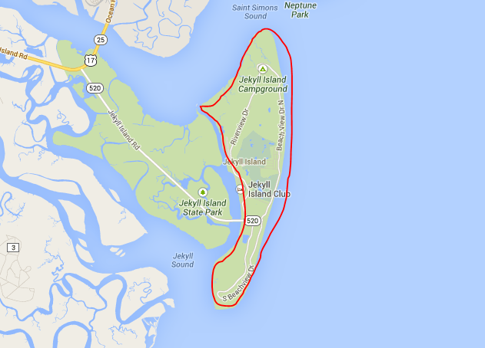
JEKYLL ISLAND, GEORGIA
Jekyll Island was
isolated from the
mainland and
privately owned.

Slide 4
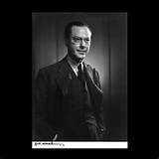
WHY IS THE CREATION OF THE FEDERAL RESERVE BANKING SYSTEM DANGEROUS?
GRAHAM TOWERS
GOVERNOR, BANK OF CANADA, 1934-54
"Each and every time a bank makes a loan, new bank credit is created - new deposits - brand new money."
With interest to the private banks……
Why do private corporations have this power ? ? ? ?

Slide 5
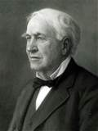
1921 THOMAS EDISON QUOTE IN THE NEW YORK TIMES
If our nation can issue a dollar bond*, it can issue a dollar bill**. The element that makes the bond good makes the bill good... it is the people who constitute the basis of Government credit.
* DEBT
** MONEY – DEBT FREE, INTEREST FREE
WHY DOES OUR GOVERNMENT BORROW…
WHEN IT CAN CREATE DEBT-FREE INTEREST-FREE MONEY ? ? ? ?

Slide 6
WHAT THE PUBLIC WAS TOLD
To fool the public, the system was divided into twelve regional Federal Reserve Banks.
But, given the concentration of money and credit in New York, the Federal Reserve Bank of New York controlled the system, making the regional concept initially nothing but a ruse.

Slide 7
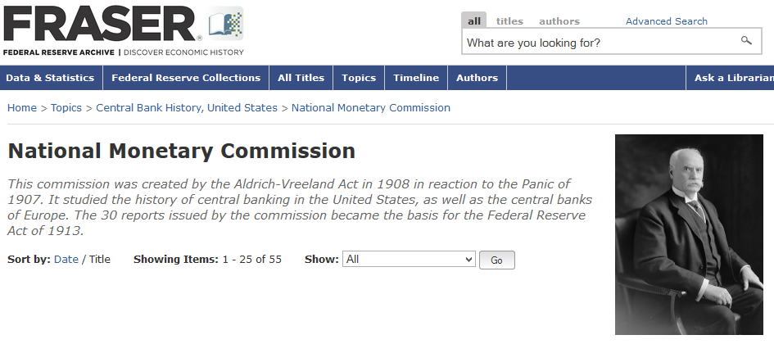
WHAT THE PUBLIC WAS TOLD
Today the Federal Reserve Archive says: The National Monetary Commission “became the basis for the Federal Reserve Act of 1913”

Slide 8
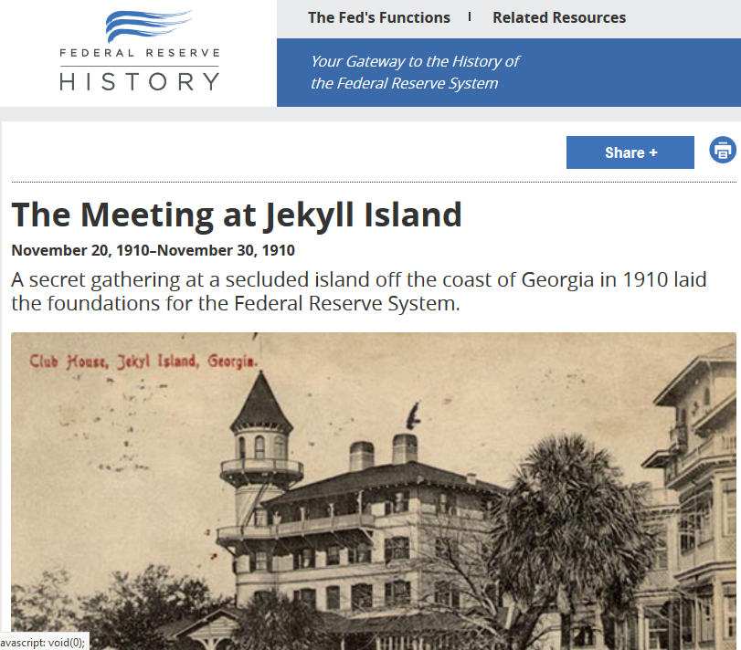
WHAT IS NOW ADMITTED BY THE FED
But, in 2010, the Federal Reserve itself commemorated the 1910 meeting on Jekyll Island, where bankers secretly met to write the Federal Reserve Bill
“The participants themselves denied the meeting had occurred for twenty years, until the publication of Aldrich’s biography in 1930. The impetus for coming clean was probably the publication in 1927 of Carter Glass’s memoir, An Adventure in Constructive Finance. In it, Glass, by now a senator, claimed credit for the key ideas in the Federal Reserve Act, which prompted the Jekyll Island participants to reveal their roles in creating the Federal Reserve.
Warburg was especially critical of Glass’s description of events. In 1930, he published a two-volume book describing the origins of the Fed, including a line-by-line comparison of the Aldrich bill and the Glass-Owen bill to prove their similarity.”
Quoted on Minneapolis Fed website –FederalReserveHistory.org

Slide 9
Accompanying Senator Aldrich and A. Piatt Andrew, Asst. Sec. of the Treasury, to Jekyll Island were:
ROCKEFELLER
Frank Vanderlip – president, National City Bank of New York (today, CITIBANK)
MORGAN
Henry P. Davison - senior partner, J.P. Morgan Company (today, J.P.MORGAN CHASE)
Charles D. Norton – president, First National Bank of New York (Morgan)
Benjamin Strong - a lieutenant of J.P. Morgan
KUHN, LOEB & WARBURG GERMAN BANK
Paul Warburg - recent German immigrant, partner Kuhn, Loeb and Company, New York and Warburg Bank of Hamburg & Amsterdam. Warburg directed the proceedings and wrote the primary features of what would be called the Aldrich Plan.

Slide 10
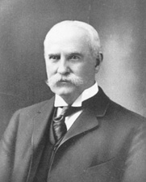
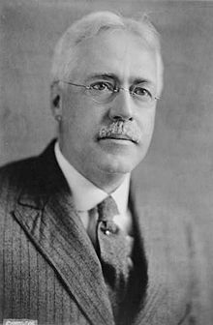
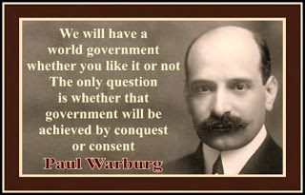
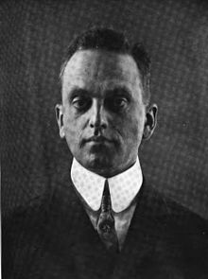
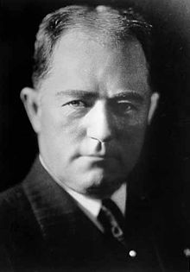
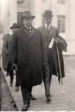
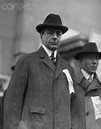
If the public had realized
that the Federal Reserve Act
was parented by the same
industry it was supposed to
control, there would have
been great opposition to it,
and it never would have been
enacted into law.
ROCKEFELLER
Aldrich
ROCKEFELLER
KUHN, LOEB, EUROPE
Andrew
Vanderlip
Warburg
Davidson
Norton
Strong
MORGAN????
ROCKEFELLER????
KUHN, LOEB, EUROPE????
MORGAN
MORGAN
MORGAN

Slide 11
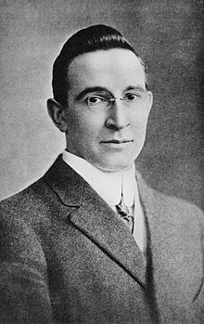
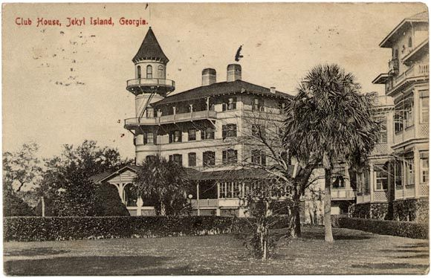
The Secret Meeting is Talked About
The meeting of Wall Street bankers to write what would be the Federal Reserve bill was kept secret. The bankers understood that the country did not want a banking system ruled by Wall Street.
“Picture a party of the nation’s greatest bankers stealing out of New York on a private railroad car
under cover of darkness, stealthily hieing hundreds of miles South… I am giving to the world,
for the first time, the real story of how the famous Aldrich currency report, the foundation of our
new currency system, was written… the real birth of the present Federal Reserve System, the
plan done on Jekyll Island… Warburg… more than any one man has made the system possible
as a working reality.” B.C. Forbes, CURRENT OPINION, Dec 1916
Forbes revelation did not get much response. First, it was two years after the bill was passed;
secondly, it was dismissed as preposterous. In a book published in 1930, a biographer of Aldrich calls it “a mere yarn”.
Nathaniel Stephenson, Nelson W. Aldrich, A Leader in American Politics, pub. 1930
B.C. Forbes (1880 – 1954)
founder of Forbes Magazine
in 1917

Slide 12
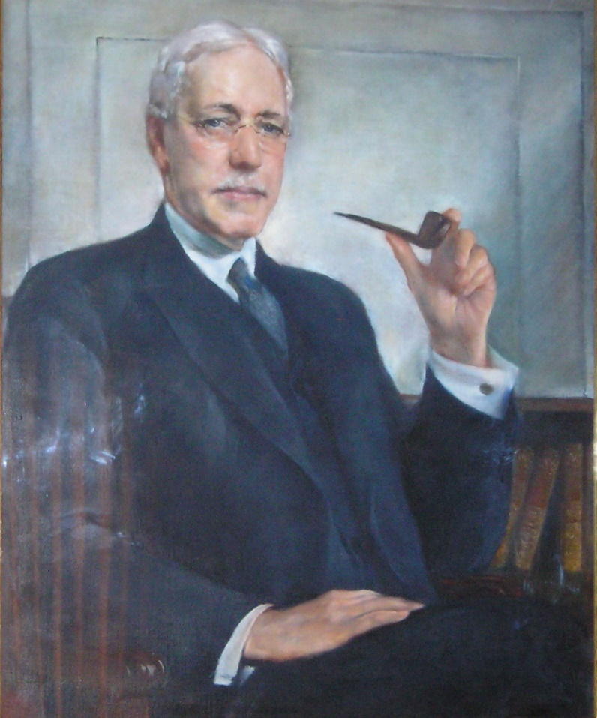
The Secret Meeting is Talked About
However, as the men of the First Name Club wrote their memoirs, the facts came out.
Frank Vanderlip (‘Frank’) wrote in the Saturday Evening Post, Feb 9, 1935:
“Despite my views about the value to society of greater publicity for the affairs of corporations, there was an occasion near the close of 1910, when I was as secretive, indeed, as furtive, as any conspirator… I do not feel it is any exaggeration to speak of our secret expedition to Jekyl Island as the occasion of the actual conception of what eventually became the Federal Reserve System.”
The National City Bank of New York, 1909
Directors
James Stillman (Chairman) Stephen S. Palmer
Francis M. Bacon George W. Perkins
Cleveland H. Dodge James H. Post
Charles S. Fairchild M. Taylor Pyne
Henry C. Frick William Rockefeller
Joseph P. Grace Jacob H. Schiff
Edward H. Harriman Samuel Sloan
Cyrus H. McCormick William Douglas Sloane
Edwin S. Marston Henry A.C. Taylor
John W. Sterling Moses Taylor
P.A. Valentine Frank A. Vanderlip (President)
Frank A. Vanderlip, Sr.
(1864 – 1937)

Slide 13
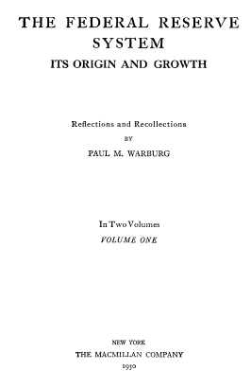
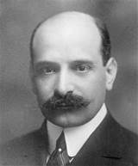
The Secret Meeting is Talked About
However, as the men of the First Name Club wrote their memoirs, the facts came out.
Paul Warburg, the true architect of the Federal Reserve bill, wrote in 1930 in volume 1 of his book, The Federal Reserve System, Its Origin and Growth:

Slide 14
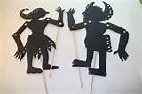
Ben S. Bernanke, chairman of the Federal Reserve and former Fed Chairman Alan Greenspan chat before taking the stage.
On November 5–6, 2010, Ben Bernanke stayed on Jekyll Island to commemorate the 100-year anniversary of this original meeting. The Conference was the first official confirmation of the secret meetings by the banking elites that wrote the Federal Reserve Bill.

Slide 15
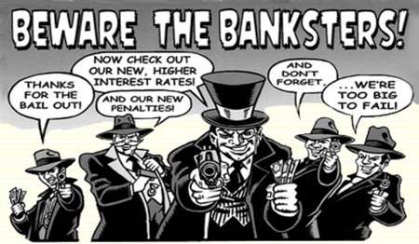
THE FEDERAL RESERVE LAW OF 1913 GAVE THE GOVERNMENT’S POWER TO CREATE AND ISSUE MONEY TO PRIVATE BANK CORPORATIONS

Slide 16
Q & A

