Slide 1
TRANSITION:
The Revolving Fund or
‘How to Get Rid of Treasury Debt and more ...’

Slide 2



REVOLVING FUND
Hey, Jeremy! Have you heard about our new Revolving Fund?
No. What is it?
A new investment opportunity?

Slide 3
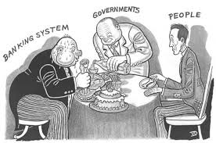
REVOLVING FUND
No, I’m working for monetary reform!
The Revolving Fund has just been implemented in our
Treasury Department in Washington, D.C.
Oh, no, our government has
some trick up their sleeve!

Slide 4

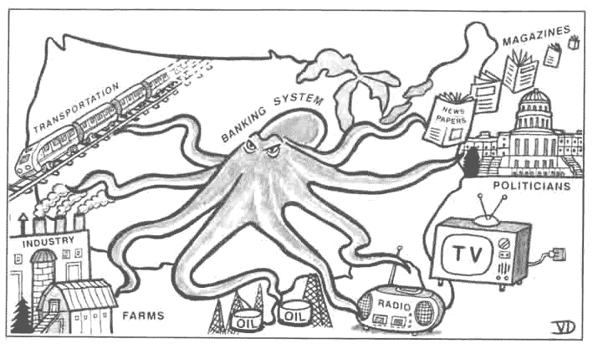
REVOLVING FUND
No, no. The NEED Act has just been implemented!
The banks no longer make our money ‘out of thin air’ when they make loans.
THEY CAN’T CREATE MONEY AND BUY OUR POLITICIANS…
MEDIA… RESOURCES… SERVICES… !!!!

Slide 5


REVOLVING FUND
Really?
You mean our money can now be working for all of us,
instead of working for the 1%?
YES!
THE BANKS WON’T BE ABLE TO CREATE MONEY AND
CAUSE INFLATION AND DEFLATION, FINANCIAL CRISES, BANK BAILOUTS....
to make themselves more powerful!
BANKS

Slide 6



REVOLVING FUND
You mean our money will be used to ensure all citizens have decent housing, healthcare, and JOBS?
YES!
ONLY OUR GOVERNMENT WILL CREATE NEW MONEY WHEN NEEDED,
TO ENSURE PRICES REMAIN STABLE. No more inflation or deflation.

Slide 7





What a wonderful stupendous
glorious relief !!!!

Slide 8

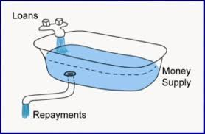
STABLE MONEY SUPPLY
Yes, yes, yes.... tell me, what is this Revolving Fund?
Okay, think about this: today, on this day of TRANSITION –
what is our money supply?
Create
Loans
You’re making me think, and ... and .... it’s FUN!
Unpaid Loans
Today, our money supply was created by commercial banks making loans.
So our money supply ... is ...
unpaid loans owed to banks!

Slide 9

STABLE MONEY SUPPLY
Right! Yesterday, the day before TRANSITION,
if a borrower repaid his loan, the principal repayment would have been ‘extinguished’,
meaning money would disappear from the books of the bank.
And... now?

Slide 10
STABLE MONEY SUPPLY
Starting at TRANSITION, the commercial banks must make loans
from money they own, borrow, or get from investors.
And when these loans are repaid, the money doesn’t disappear! It gets returned
to the bank to lend out again.
They can’t create or destroy money by creating bank loans any more.
I’m sorry.
I have to repeat myself, I’m sorry!
➔ ➔ ➔

Slide 11

What a wonderful stupendous glorious relief !!!!

Slide 12
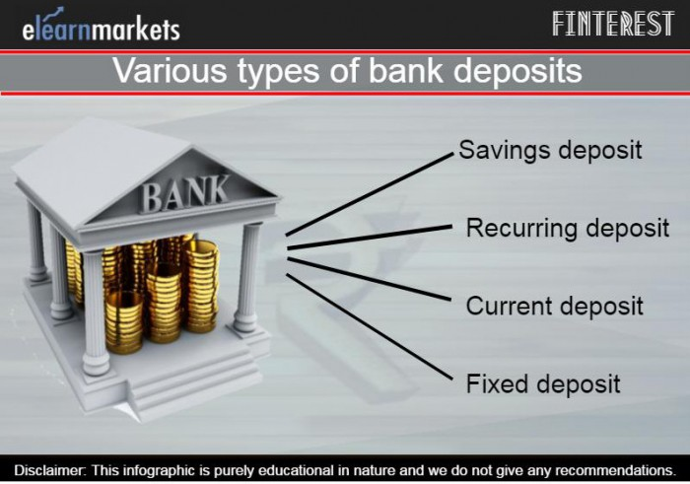

STABLE MONEY SUPPLY
Wait! Why do we need a Revolving Fund if the government will now create our money DEBT-FREE?
Good question. The Revolving Fund ensures we have a permanent, stable money supply at
TRANSITION and in the future.
Today’s pre-TRANSITION money supply is 12 Trillion Dollars! This money, created by bank loans, is found in all types of deposit accounts in banks:
savings ... checking ... time deposits ... etc.
This is the life blood of our economy. We all
need it ... and we need all of it.

Slide 13

STABLE MONEY SUPPLY
WHAT HAPPENS TO OUR MONEY SUPPLY?
The Revolving Fund makes sure our money supply stays STABLE!!!
BEFORE TRANSITION
AFTER TRANSITION
MONEY SUPPLY = BANK LOANS
MONEY SUPPLY: DEBT-FREE PUBLIC MONEY
DISAPPEARING WITH REPAYMENT
PERMANENTLY CIRCULATING

Slide 14


STABLE MONEY SUPPLY
The 12-trillion pre-TRANSITION money supply must
not ‘disappear’ when the bank loans are repaid,
or we will have deflation.
The 12-trillion pre-TRANSITION money supply must not be kept by the banks, when the bank loans are repaid, or they will be wealthy beyond compare!
So, what do we do?

Slide 15






STABLE MONEY SUPPLY
At TRANSITION, the banks will legally owe the Treasury’s Revolving Fund 12 trillion dollars – the pre-TRANSITION bank loans. Repayments of these loans must be passed to the Revolving Fund to be SPENT or LOANED into the money supply.
pre-TRANSITION
pre-TRANSITION
PRINCIPAL PAYMENTS
PRINCIPAL PAYMENTS
BORROWER
REVOLVING FUND
Ah!
STABLE MONEY SUPPLY

Slide 16


STABLE MONEY SUPPLY
Over time, WE RECYCLE the 12-trillion pre-TRANSITION bank loans back into the money supply, so the economy remains stable.
The bank gets its interest, the borrower pays off debt, and the economy has a stable money supply. All debts are payable!
ECONOMY
DEBT-FREE
MONEY SUPPLY
3
BORROWERS
REPAY LOANS
FUND SPENDS BACK
1
2
PRINCIPAL REPAYMENTS
REVOLVING FUND
BANKS KEEP INTEREST

Slide 17
#1 Loans to Banks
So, how will the Treasury recycle the funds?
Well, first, the Treasury can lend the funds to banks, if the bank needs money to make a loan. The Treasury will charge less interest than the bank charges its customer.
This will ensure the banks will always have enough money to lend into our economy!
ECONOMY WITH
MONEY SUPPLY
REVOLVING FUND
BANKS
ECONOMY
LOANED TO BANKS
LOANED TO
CUSTOMERS
MONEY
SUPPLY

Slide 18


#2 Lender of Last Resort
Also, if there is a national emergency, the Treasurer, advised by the Monetary Authority and authorized by Congress, shall draw out from the fund up to 80% of the Revolving Fund.
REVOLVING FUND
ECONOMY
80%
MONEY SUPPLY
SPEND

Slide 19





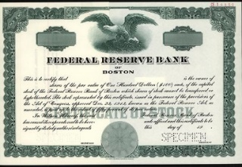
#3 Public Buys All Shares in 12 Federal Reserve Banks
All shares of the 12 Federal Reserve Banks will be bought
by the Treasury Department from funds in the Revolving Fund.
The Fed becomes a bureau in the Treasury, under public
scrutiny.
PRIVATELY OWNED FED
PUBLICLY OWNED FED
SHARES
The NEED Act authorizes the Treasury Secretary to buy all the assets of the private
Federal Reserve System. The Fed is then publicly owned in the Treasury Department.
The Treasury Secretary will be able to use the funds in the Revolving Fund
to buy the shares in the 12 Fed Banks.

Slide 20
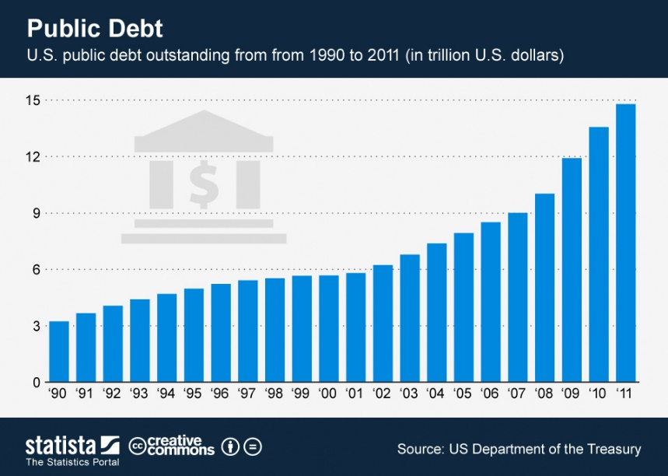


#4 Pay Down Public Debt
Also….. the Treasurer can use the Revolving Fund to pay off our public debt.
Our country could be debt-free.
No public debt? Debt-free?
Impossible! You’re nuts!

Slide 21



#4 Pay Down Public Debt
No, no! Listen! It’s hard to believe but it’s true!
As Treasury bonds, notes, bills come into the Treasury to be repaid to the borrowers, the Treasurer will use funds from the Revolving Fund to pay them off.

Slide 22

#4 Pay Down Public Debt
Listen! We can leave our children
with a debt-free government!

Slide 23

#4 Pay Down Public Debt
Listen! Our taxes will go DOWN, not up.
We will no longer have to pay interest on our national debt, cause there will be no national debt.

Slide 24
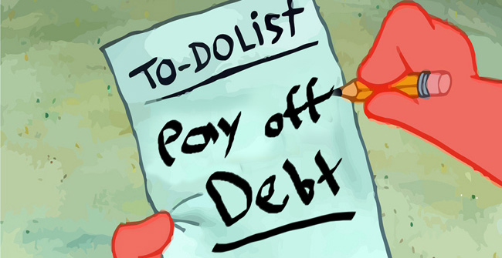
#5 Encourage Repayment of Private Debts
In fact, the Revolving Fund makes it even more possible for PRIVATE DEBTS to be repaid!
WHAT!?
No, No! It’s not nuts.
A PERMANENT money supply will encourage a steady economy –
one without asset bubbles, stock market highs and lows, inflation, deflation.
Slowly, over time, individuals, businesses, corporations will gain confidence in the
economy. They will be encouraged to pay down their private debts, and better able
to do so, since the economy will be stabilized.
PRIVATE DEBT
PAID OFF
OVER TIME

Slide 25

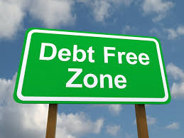

THE REVOLVING FUND – Take a Bow!
Incredible!
Wow!
Wow!
Wow!
You said it!
Wow!
Wow!
Wow!

Slide 26
I LOVE THE REVOLVING FUND!

Slide 27
THE END

