Slide 1
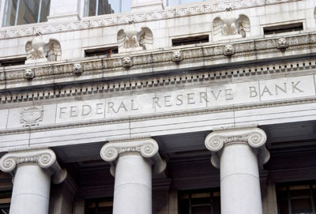
TRANSITION:
We Buy all Shares ... in the 12 Fed Banks

Slide 2


Jeremy! Jeremy! WHERE ARE YOU!
Calm down, calm down,
what’s up?

Slide 3

Nothing’s wrong. But I just figured out
how ordinary people will be helped when
the government buys the 12 Federal Reserve Banks!
What’s this?
We’re buying the FED banks?
Why for God’s sake?

Slide 4
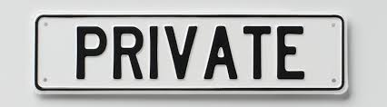


Well, you see. It’s part of passing the NEED Act in Congress,
to give the power of money creation back to our government.
Oh, yes. I remember.
The NEED Act makes sure the commercial
banks can’t create money any more...
out of nothing!

Slide 5





Right now, ONLY commercial banks
who are Fed members own shares.
So the NEED Act includes our government buying all the shares from the member banks and making the 12 Federal Reserve banks public.
A FEW OF THE
MEMBER BANKS
Hold on! Now I remember real well. The 12 Fed banks are private.
p.s.: their websites say .org (not .gov) –
www.newyorkfed.org

Slide 6
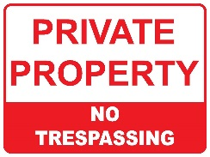
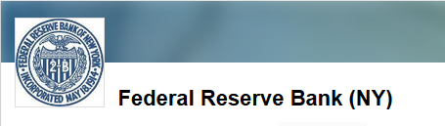
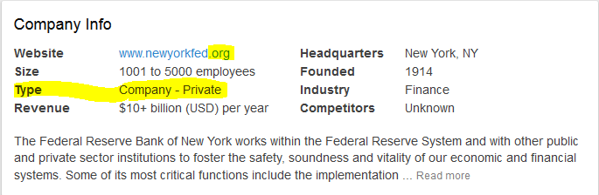
And… if you search the internet for a job at the NY Fed,
you apply for a private job, not a government job!

Slide 7
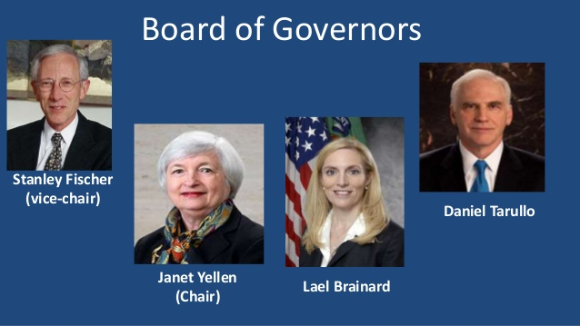
Yes, the Board of the Federal Reserve is the only part
of the Fed system owned by the government.
But there is no money there – it’s all in the 12 Fed banks.
That’s scary! Our central bank is not owned by us!

Slide 8

Yes, exactly!
Could that be why our economy
keeps having crisis after crisis?
Well, this system is, of course, rigged for the 1%.
Every crisis, the 1% get more and more of the wealth.
People get more and more....
Poorer and in debt!

Slide 9

But now we can
change it!
So tell me how.
I want to do something.
Here, like I said, our government in the NEED Act
will buy ALL the shares of the 12 Federal Reserve Banks.
How many shares?
What do they cost?
This sounds impossible!

Slide 10

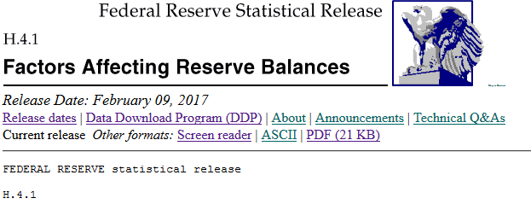
Let’s look at all 12 Federal Reserve Banks.
What is the value of all the shares (= ‘net assets’) of these 12 banks – in 2017?
How do we do that!
If you have a computer with access to the internet,
you can find a weekly report from the New York Fed with this info – it’s called ‘H.4.1’.
Let’s do it!

Slide 11
Go to this internet address:
https://www.federalreserve.gov/releases/h41/current/
And look for the report that says:
Statement of Condition of Each Federal Reserve Bank
In that report, look for the “total capital” amount:
Total Capital** 40.5 billion dollars
So, our government could buy all the shares in the 12 Fed banks
for only 40.5 billion dollars!
Our 12 Fed banks will cost us only 40.5 billion dollars!!!!
**Total Capital (Net Assets) = total assets (4.46 trillion) minus total liabilities (4.42 trillion)

Slide 12
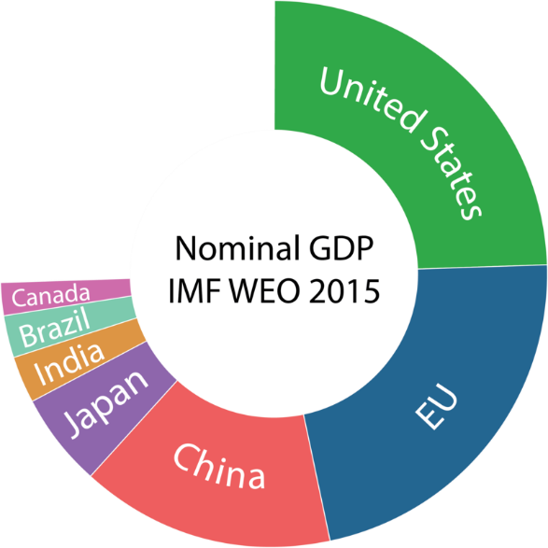
And remember, the Fed is the central bank of the most important economy of the world ... the U.S. accounts for 25 percent of the world’s GDP –
the market value of all final goods and services produced.

Slide 13
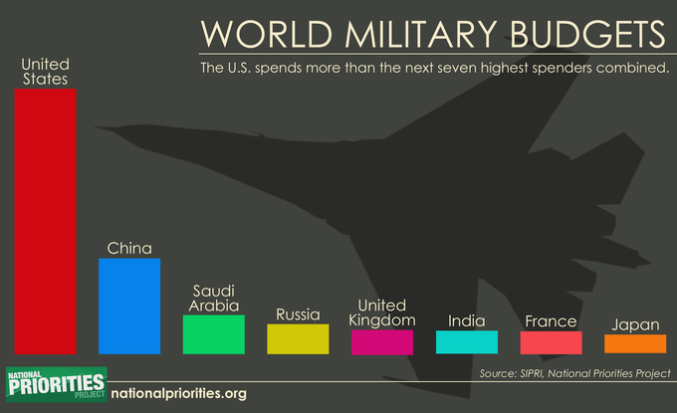
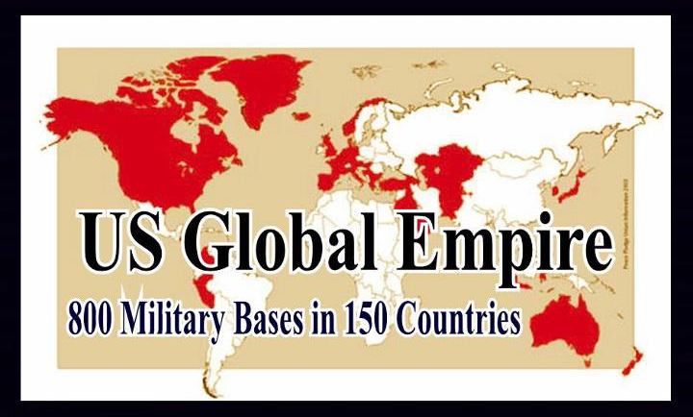

And the U.S. maintains the largest military in the ENTIRE HISTORY OF THE WORLD ... which Fed member banks support with their
loans of billions and billions of dollars to the arms industry.
The U.S. is the largest exporter of arms to the world.

Slide 14
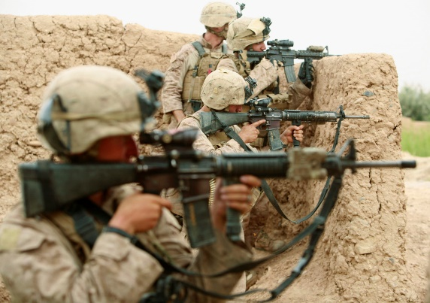




Well, yes, the FED member banks support this empire.
But, remember, when the government buys the 12 Fed banks ...
at the same time, the Fed member banks will not be allowed to
create their bank credit out of thin air anymore,
but must find real money to lend.
Yeah! Less war, less war, less war.
Less speculation in the stock market ...
and in all the massive financial markets.
Less of everything that hurts ordinary people.
stocks
bonds
Foreign currencies
commodities
Speculation in FINANCIAL MARKETS

Slide 15

Yes yes yes !!!
Ok, let’s get on with buying these 12 Fed banks.
Who gets paid? How much?

Slide 16




The Treasury Department buys ALL the shares ...
and pays a TOTAL of 40.5 billion dollars!
That’s dirt cheap!
For the central bank of the largest empire in world history....
the largest economy in the world....
Yeah! And besides making the world safer for people,
guess what else we get for this.
What?

Slide 17

Well, the 12 Fed banks own assets worth 4.5 Trillion dollars.
Most of it is composed of these securities:
2.5 Trillion dollars of U.S. Treasury Bonds
1.8 Trillion dollars of Mortgage Backed Security Bonds
------------------------
4.3 Trillion dollars Total
Seems like a real good deal for all of us 99%!
For 40.5 Billion dollars, we get assets worth
4.5 Trillion!
You bet! And when the government owns these
4.5 trillion dollars worth of assets, you know what?
What?

Slide 18

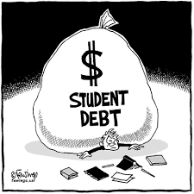
Our Treasury Department does not need these assets sitting there.
Our Treasury can sell them back into the market and
provide funding for the needs of the ordinary person.
Yes. Like a onetime tax-free dividend to all
citizens living in the U.S. That’s in the NEED
Act too.
Let’s free people from some economic insecurity.
You bet!
Like using this money to pay off all student debt –
not only what is still owed but also what has
already been paid!
Yes. Our students should not have to be debt slaves
to get an education.

Slide 19

Like funding single payer health care for ALL!
Yeah! Yeah! Yeah!
And....
Wait... wait.... I have to calm down.
So much is changing! Wow! Wow!

Slide 20

What a glorious change!
For all of us.

Slide 21
THE END

