Slide 1
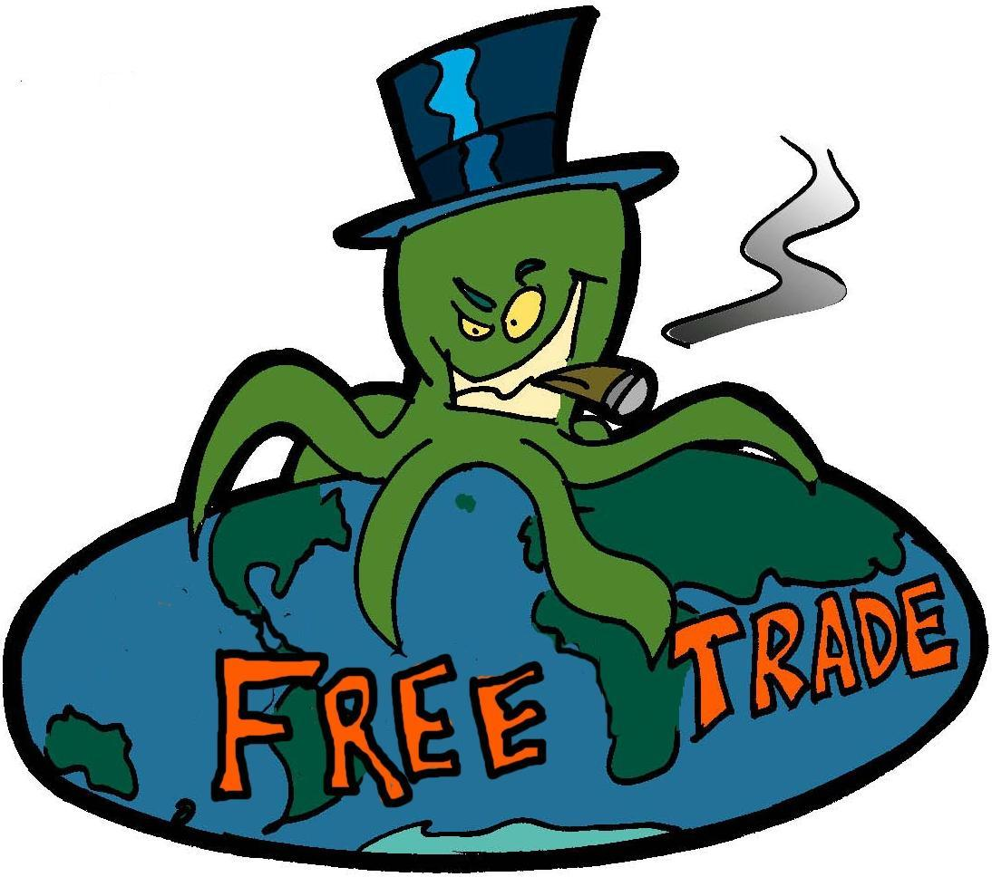
EQUITABLE TRADE …
NOT CORPORATE TRADE
BARBARA SIMPSON
NY Ethical Culture
Interagency Council on Aging
Post Graduate Center for Mental Health
Upper Westside Monetary Reform Group
RESIST THE MONEY POWER:
Ending 'Free' Trade, Endless War, and Ballooning Debt Session 6: DAY 6/4/17 TIME Noon

Slide 2
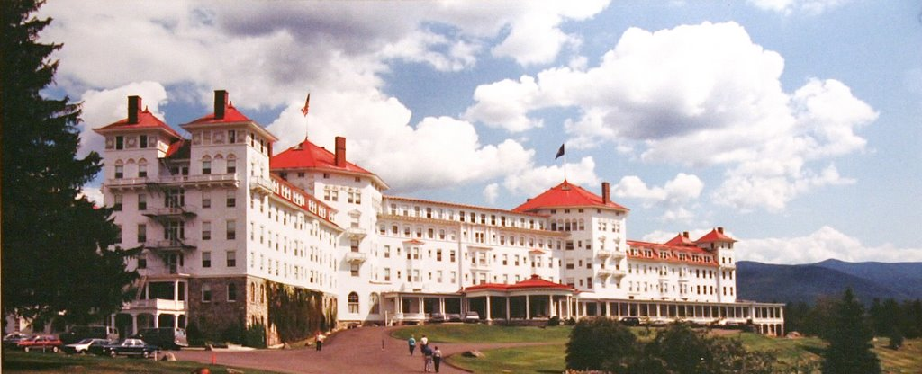
Origin of Today’s International Trade System: BRETTON WOODS CONFERENCE 1944
THE CORPORATE TRADE SYSTEM
44 representatives of the Allied Nations in World War II
met at Bretton Woods, N.H., in July 1944

Slide 3
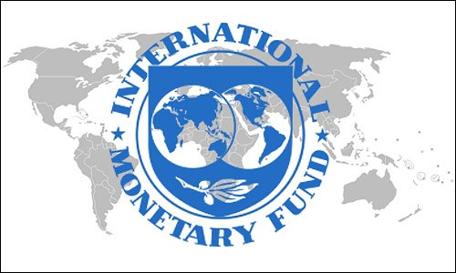
DEBT-MONEY & International Trade System
The American plan was accepted:
a country needing money, would be
given a loan (DEBT)
The IMF & World Bank were set up

Slide 4
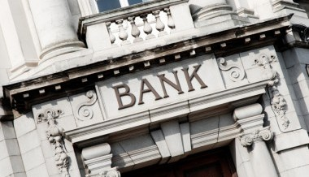
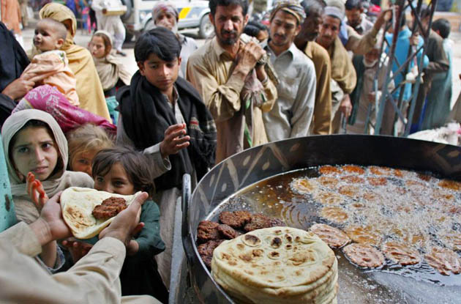
DEBT-MONEY & World Bank
1
Debt-money
is loaned to
poor nations
3
World Bank
sells bonds
Banks create
debt-money &
buy bonds
2
DEBT
Private Commercial Banks
in Rich Nations
Third World Nations

Slide 5
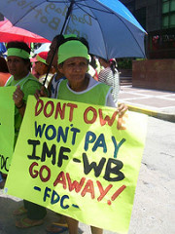
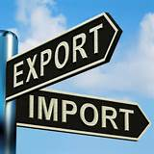
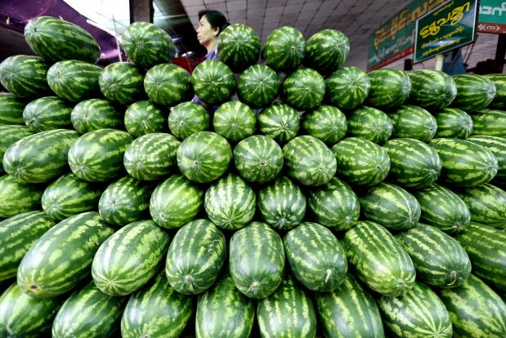
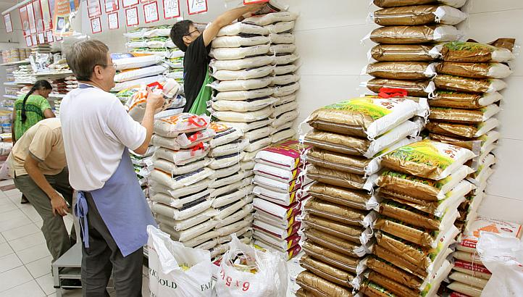
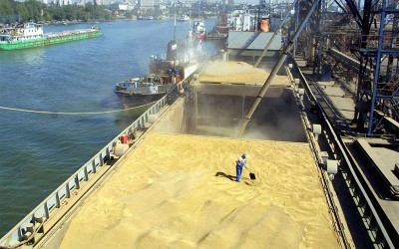
DEBT-MONEY & Third World Nations
To repay their international debts, poor nations must earn dollars.
They compete against other poor countries, all who export similar products, glut the market, and drive down prices
They compete against the wealthy nations, who strive to maximize exports and minimize imports, because they too have massive public and private debts
ALL NATIONS
ARE IN DEBT !!!!

Slide 6
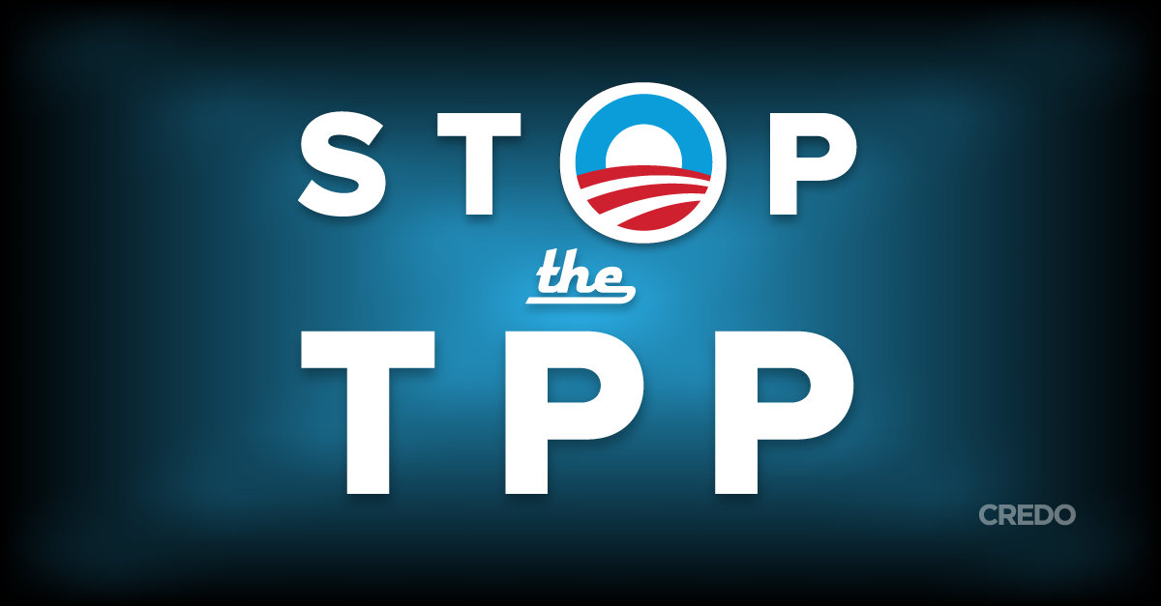
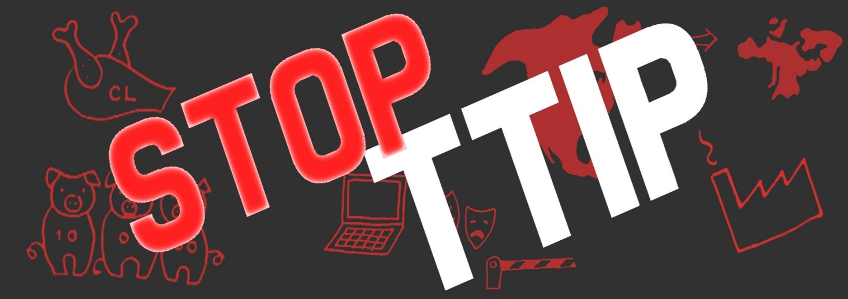
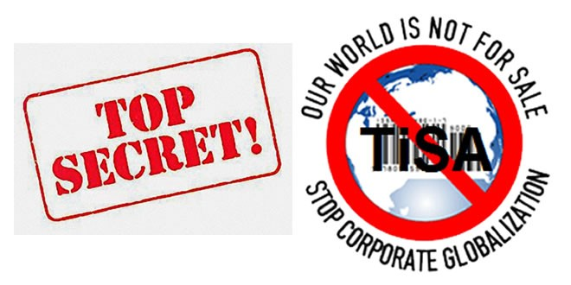
WHERE IS TPP? WHAT IS RCEP? TTIP?
TRANS PACIFIC PARTNERSHIP
Regional Comprehensive Economic Partnership
TRANSATLANTIC TRADE & INVESTMENT PARTNERSHIP
Trade in Services Agreement

Slide 7
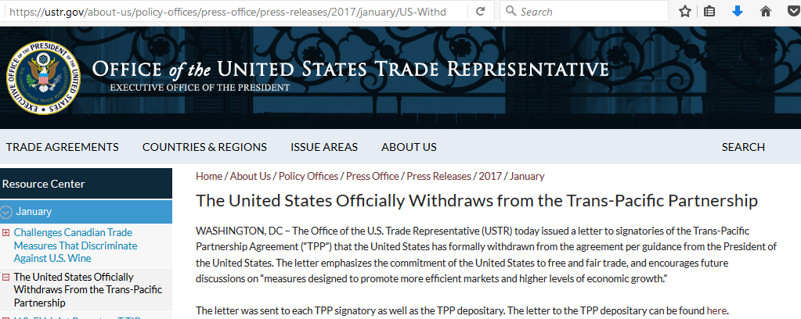
TTP IS SUPPOSEDLY DEAD

Slide 8
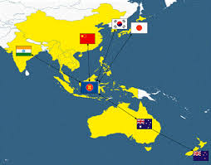
RCEP
RCEP is the
Regional Comprehensive Economic Partnership
16 MEMBER COUNTRIES
AFFECTS 50% OF THE WORLD’S POPULATION

Slide 9
RCEP
RCEP HAS TAKEN THE PLACE OF THE TPP,
WITHOUT THE U.S. –
CHINA IS THE LARGEST TRADE PARTNER

Slide 10
RCEP
RCEP is the
Regional Comprehensive Economic Partnership
DOCTORS WITHOUT BORDERS:
“RCEP is set to become on of the gravest
threats to affordable treatment for patients
worldwide… It will cause a reverse impact
on public health and access to medicine.”

Slide 11
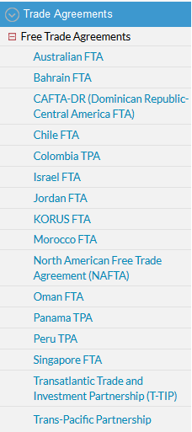
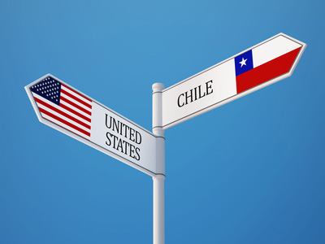
THE U.S. IS CURRENTLY A MEMBER OF
16 ACTIVE FREE TRADE AGREEMENTS
ALWAYS BENEFIT MULTINATIONAL CORPORATIONS
ALL CONTAIN ISDS, WHICH ATTACKS DEMOCRACY
NEGOTIATED BY CORPORATIONS IN SECRET
BEING
RENEGOTIATED
TPA – Trade Promotion Agreement
(includes free trade)
FTA – Free Trade Agreement

Slide 12
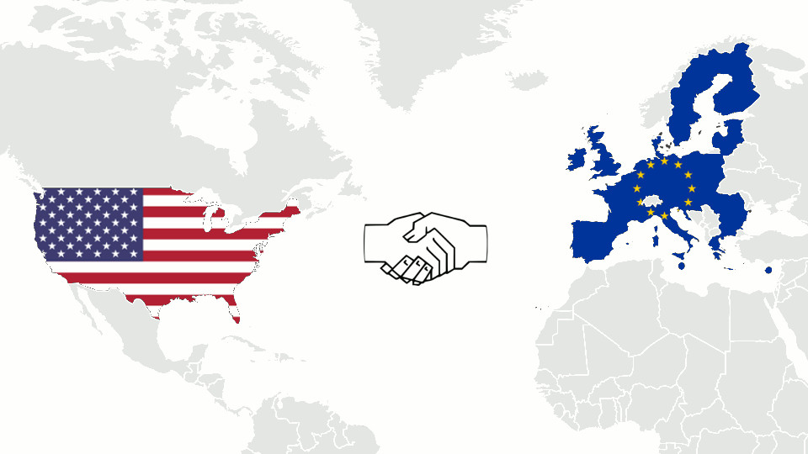
TTIP
The Transatlantic Trade & Investment Partnership is called a “Free Trade” Agreement, purportedly to regulate trade relations between the U.S. and the European Union.
This agreement covers more than
60% of global GDP.
Between July 2013 and October 2016,
15 Negotiating Rounds were held.

Slide 13
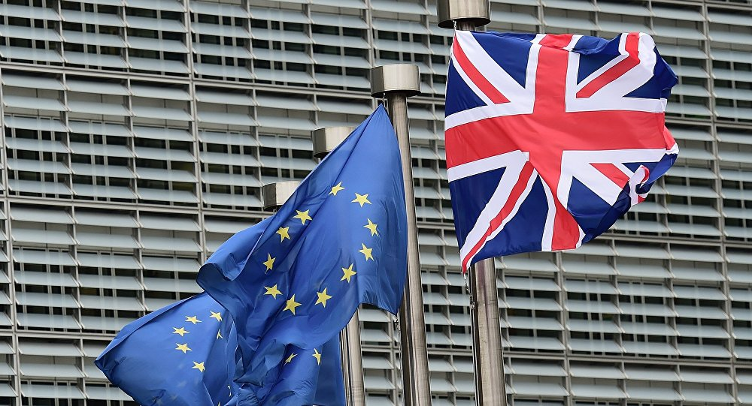
CURRENT STATUS OF TTIP
Sep 21, 2016
US officials have indicated that talks will be parked for now, warning Brussels
that the EU is a much less attractive proposition without the UK.
Chief US trade negotiator Dan Mullaney said: “Imagine if the United States said,
for instance, ‘Well, maybe TTIP will not apply to California’. “

Slide 14
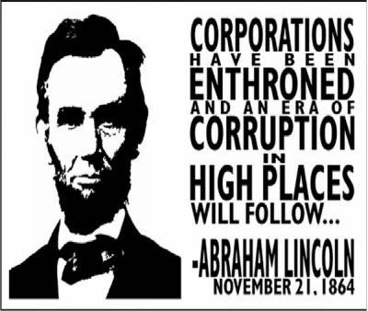
They say they are ‘trade agreements’, but they are WAY MORE!!!!
THERE ARE MANY CHAPTERS BUT VERY FEW OF THEM ARE ON TRADE…
IT IS AN AGREEMENT TO PROMOTE CORPORATE POWER…
SOME OF THE AREAS COVERED:
INTELLECTUAL PROPERTY (COPYRIGHT
AND PATENTS)
ENVIRONMENTAL POLICY
FINANCIAL SERVICES
PROCUREMENT
INVESTMENT – ‘ISDS’
INTERNET ACCESS
MEDICATIONS
LABOR RIGHTS
BANKING REGULATIONS
FARM POLICY/AGRICULTURE
NOTE: Public procurement: public authorities buying goods, works (e.g construction) or services from private companies. Example: buying computers for a police station.

Slide 15
HISTORY
BEFORE CONGRESS PASSED NAFTA (NORTH ATLANTIC FREE TRADE AGREEMENT) IN 1994, TRADE AGREEMENTS COVERED ONLY QUOTAS AND TARIFFS.
STARTING WITH NAFTA, THE SO-CALLED “FREE TRADE” AGREEMENTS HAVE EXPANDED THE AREAS COVERED – LIKE INTERNET ACCESS, INTELLECTUAL PROPERTY, ENVIRONMENT, ETC.
SINCE 1994, THERE HAVE BEEN MULTIPLE FREE TRADE AGREEMENTS… MOST HAVE INCLUDED A CLAUSE CALLED:
ISDS -- INVESTOR STATE DISPUTE SETTLEMENT.

Slide 16
ISDS
INVESTOR STATE DISPUTE SETTLEMENT CLAUSE
THIS CLAUSE ELEVATES CORPORATIONS TO THE STATUS OF A NATION…
IT ALLOWS FOREIGN CORPORATIONS TO SUE SOVEREIGN GOVERNMENTS…
AND WIN HUGE MONETARY AWARDS, BASED ON THE LOSS OF EXPECTED FUTURE PROFITS DUE TO DOMESTIC LAWS, SUCH AS LAWS PROTECTING THE ENVIRONMENT, WORKERS, HEALTH AND SAFETY…
ALL OF OUR PROTECTIVE LEGISLATION IS IN JEOPARDY.
THE NUMBER OF ISDS CASES HAS DRAMATICALLY INCREASED SINCE 1994.

Slide 17
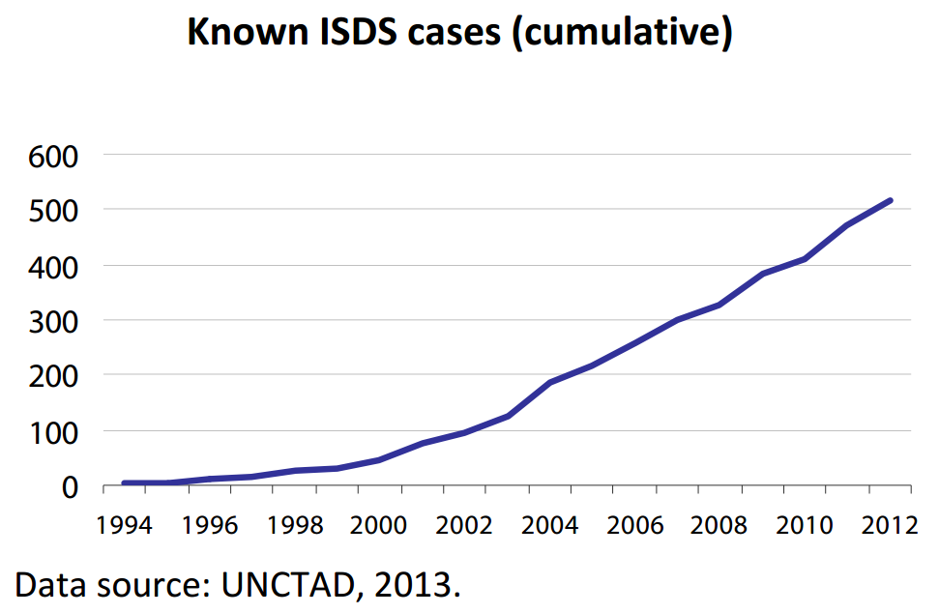
AS OF JUNE 1, 2017: THERE ARE 767 CASES ‘PENDING, CONCLUDED, AND UNKNOWN’.

Slide 18
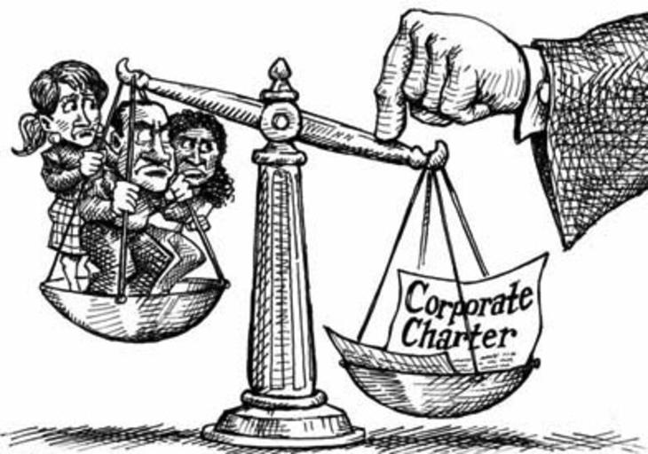
ISDS EXAMPLES
NATIONAL SOVEREIGNTY

Slide 19
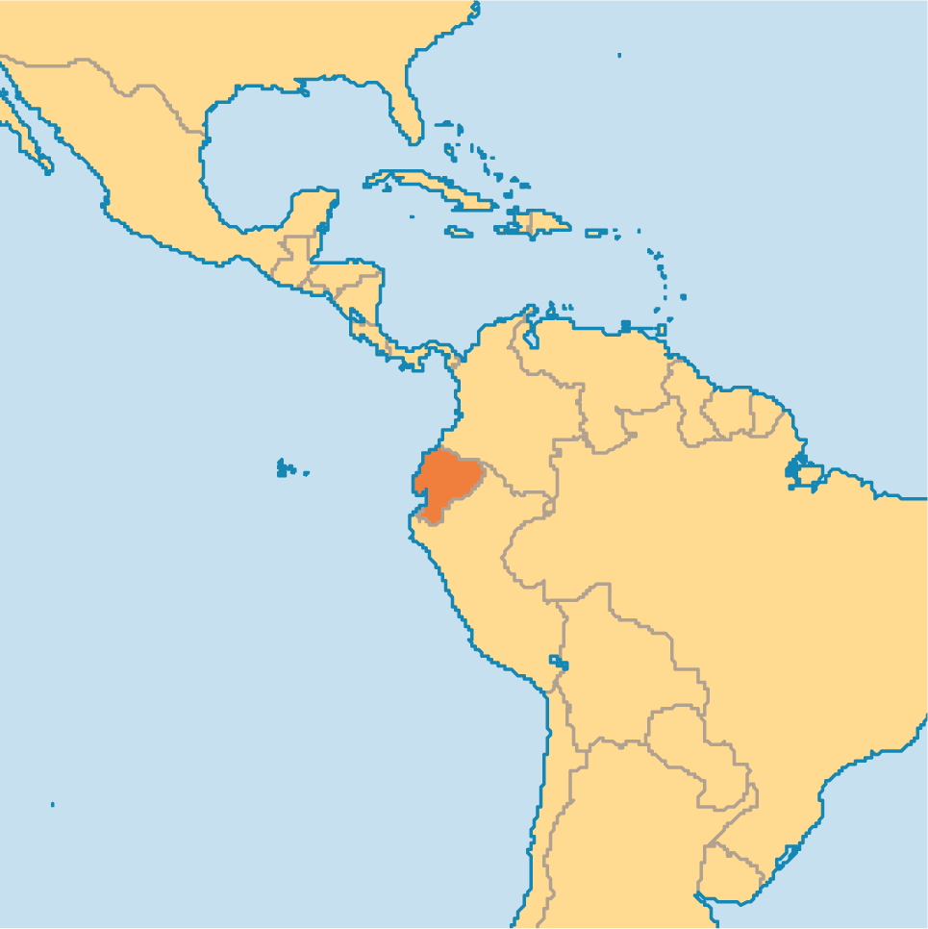
ISDS EXAMPLE #1:
THE HIGHEST REWARD SO FAR IS 3.2 BILLION $
GIVEN TO OCCIDENTAL OIL CO.
OCCIDENTAL SUED EQUADOR OVER EQUADOR’S TERMINATION OF AN OIL CONCESSION CONTRACT, EVEN THOUGH THE TERMINATION WAS APPARENTLY LEGAL.

Slide 20
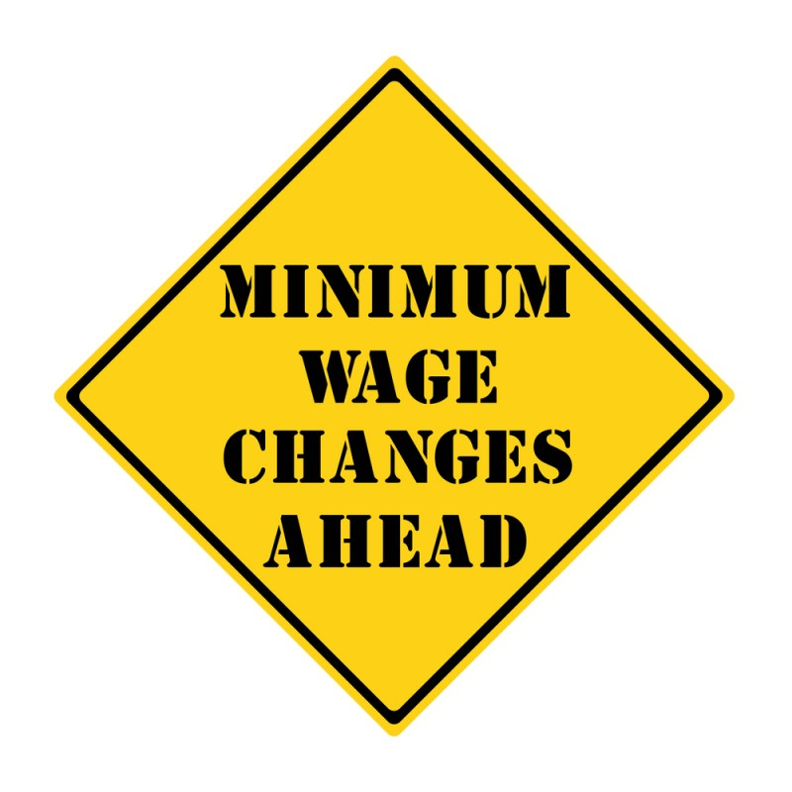
#4 ISDS EXAMPLE: MINIMUM WAGE
A FRENCH MULTI-NATIONAL, VEOLIA GROUP, IS SUING EGYPT, CONTESTING INCREASES IN EGYPT’S MINIMUM WAGE.

Slide 21
HOW DOES THE ISDS OPERATE?

Slide 22
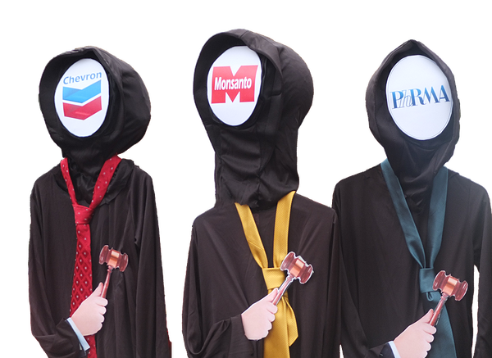
A PANEL OF THREE JUDGES
THE JUDGES ARE CORPORATE ATTORNEYS.
PROCEEDINGS ARE SECRET.
THERE IS NO APPEAL.
THE JUDGES ONLY CONSIDER THE LOSS OF “EXPECTED FUTURE PROFITS”,
BUT NOT THE RIGHT TO
A CLEAN ENVIRONMENT,
FAIR LABOR STANDARDS,
HEALTH AND SAFETY OF POPULATION,
GENERAL WELFARE

Slide 23
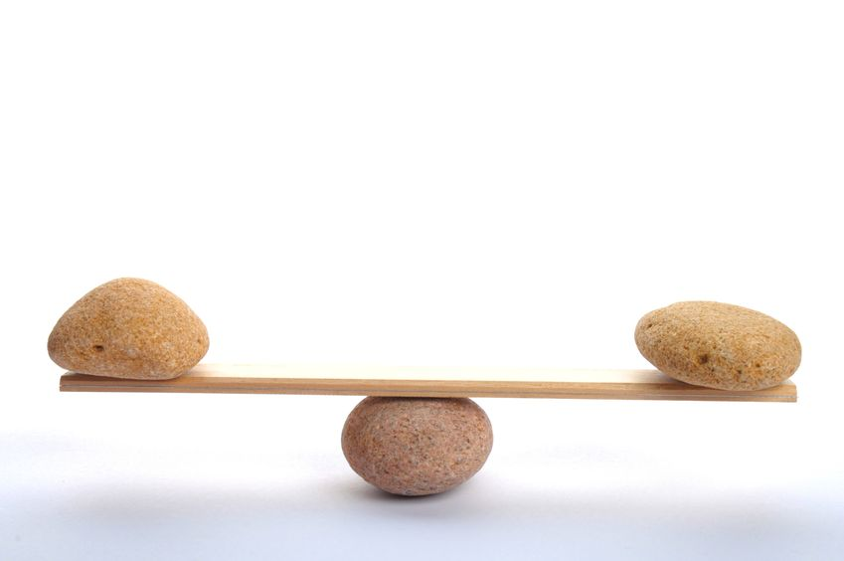
EQUITABLE TRADE
NOT CORPORATE TRADE

Slide 24
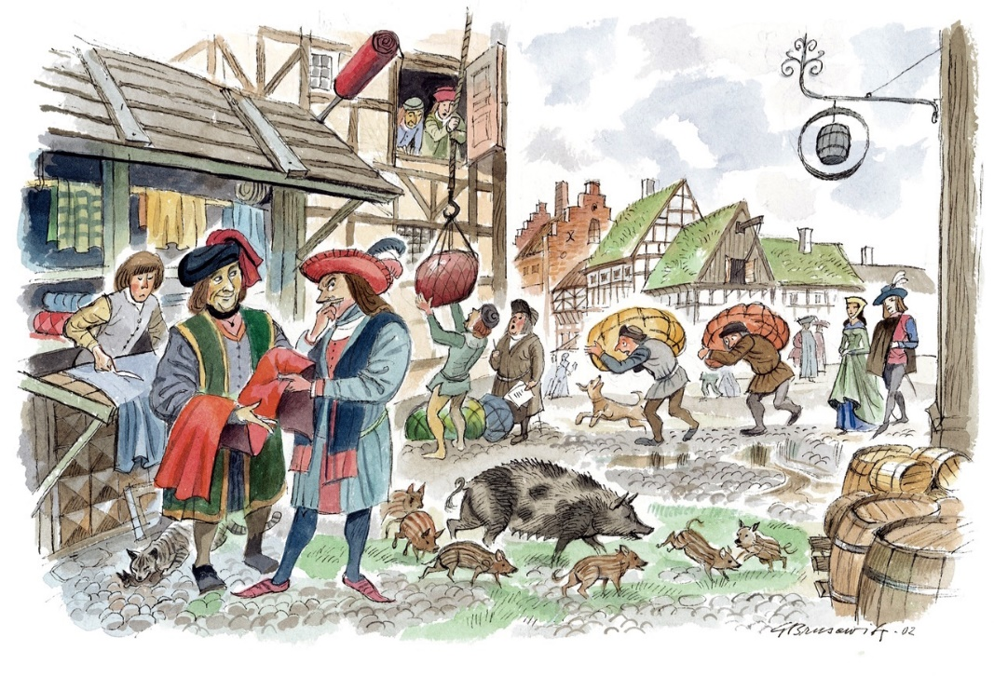
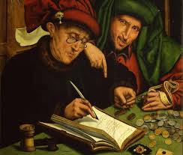
ORIGIN OF BANKING
TODAY’S BANKING DEVELOPED FROM TRADE
TRADE HAS TWO PARTS:
THE GOODS & THE MONEY
GOODS
MONEY

Slide 25
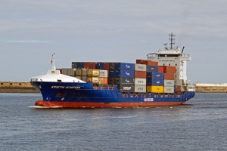
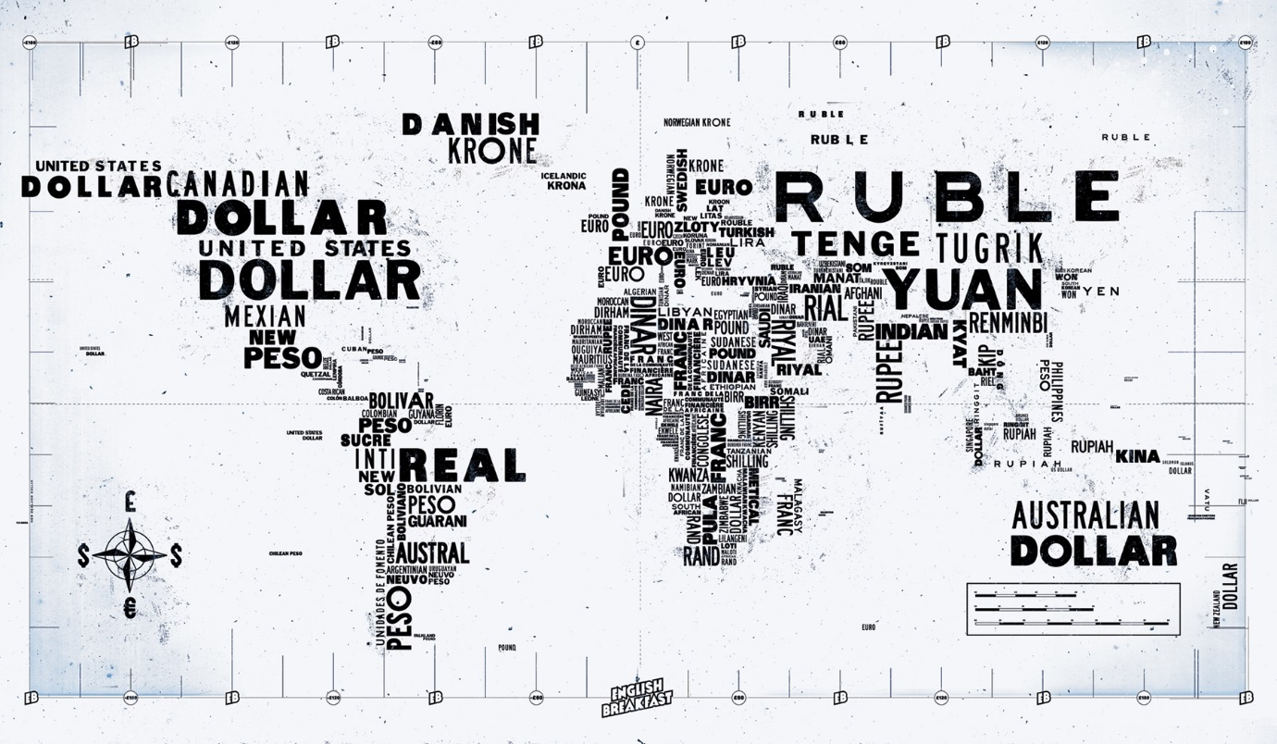
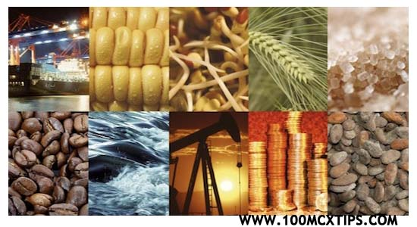
ORIGIN OF BANKING
TODAY’S BANKING DEVELOPED FROM TRADE
CLEARLY, MONEY AND GOODS ARE NOT THE SAME THING.
GOODS ARE WEALTH.
MONEY IS NOT WEALTH.

Slide 26
ORIGIN OF BANKING
TODAY’S BANKING DEVELOPED FROM TRADE
Three parts of the trading system -- production, transfer, and consumption of goods -- were concrete and clearly visible to the ordinary citizen.
BUT… the operations of banking and finance were concealed, scattered, and abstract so that they appeared to many to be difficult.
Such is true to the current day.
GOODS
MONEY

Slide 27
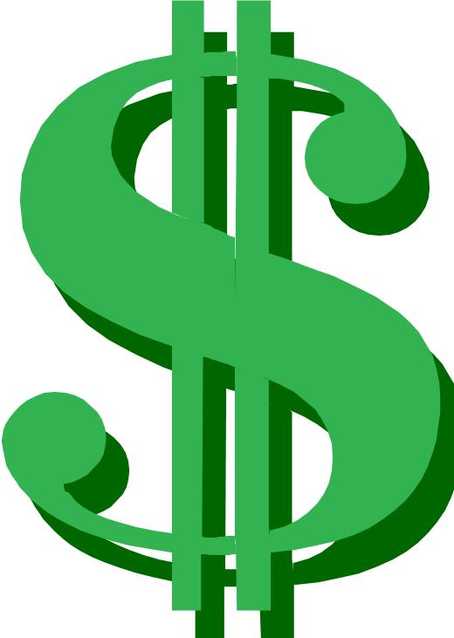
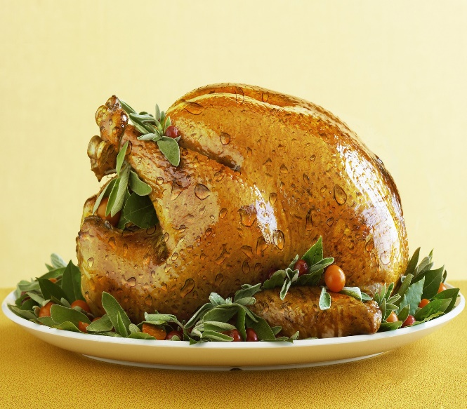
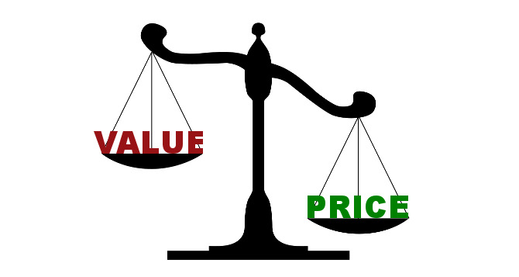
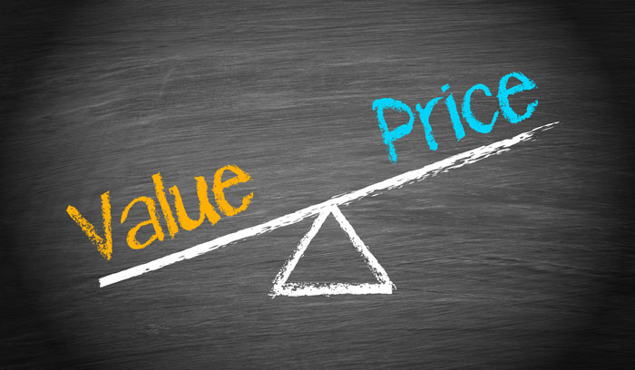
ORIGIN OF BANKING
TODAY’S BANKING DEVELOPED FROM TRADE
GOODS AND MONEY ARE RELATED -- THEY MOVE IN OPPOSITE DIRECTIONS
When the price of goods goes DOWN….
the value of money goes UP.
When the price of goods goes UP….
the value of money goes DOWN.
PRICE
VALUE
VALUE
VALUE
PRICE

Slide 28
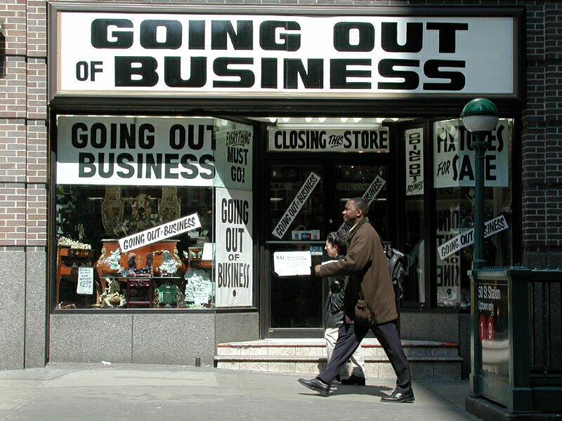
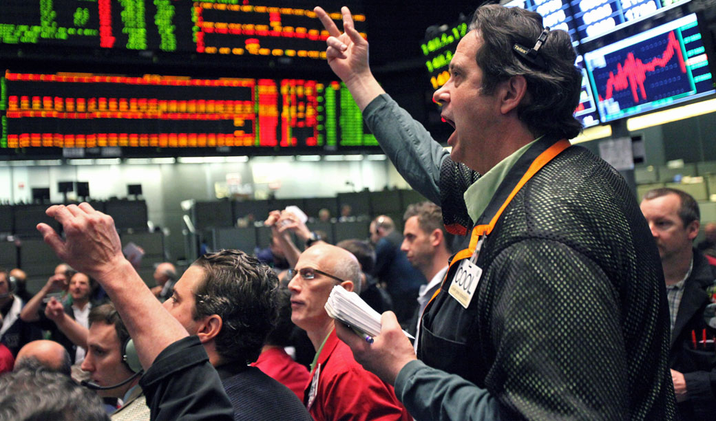
ORIGIN OF BANKING
TODAY’S BANKING DEVELOPED FROM TRADE
INTERNATIONAL BANKERS MANIPULATE THE PRICE –
BY MANIPULATING THE SUPPLY OF MONEY
Bankers cause deflation, by ‘calling in their loans’, which takes bankmoney out of circulation.
Bankruptcy for the producers. Unemployment for labor.
Profits for the bankers.
Money becomes more valuable.
Bankers cause inflation, by ‘creating too many loans’, which adds bankmoney into circulation. Money becomes less valuable.
Profits for the bankers: more loans drive up prices of things; asset bubbles are created – stocks, land; foreclosures on real assets when the ‘bubble’ bursts.

Slide 29
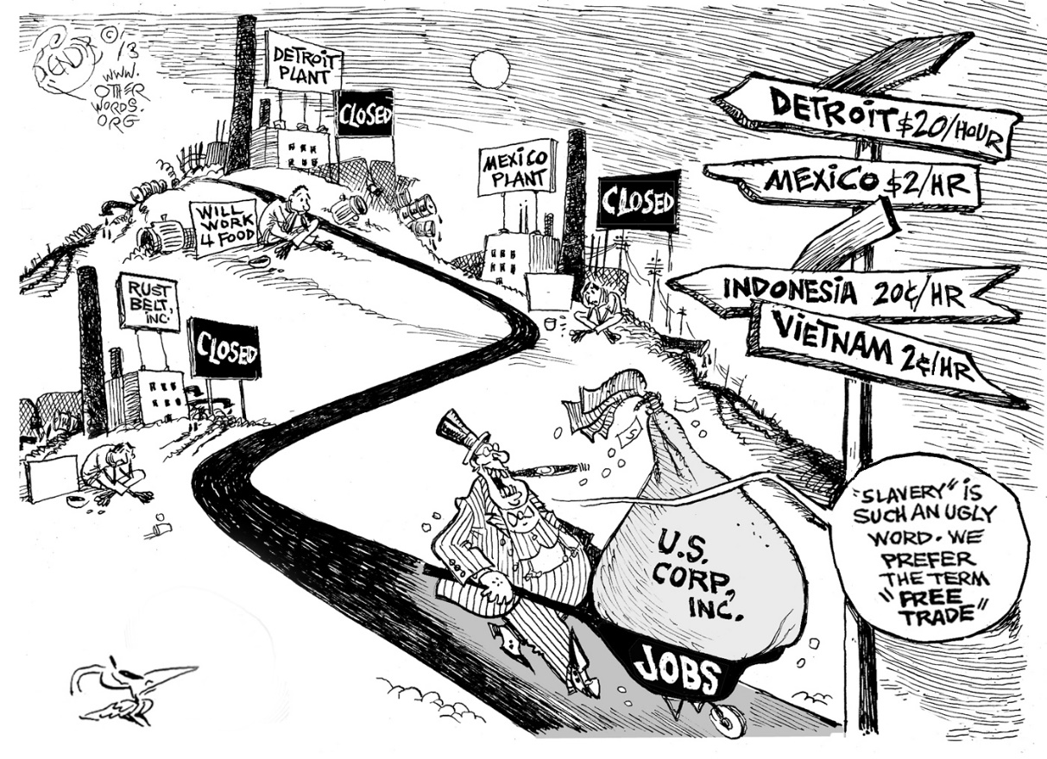
Today’s Situation SLAVE TRADE
Multinational corporations rig trade to their profit at the expense of third world nations, calling it “free” trade.

Slide 30
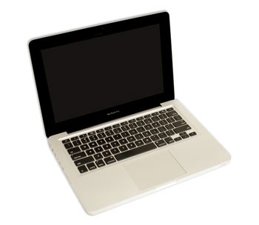
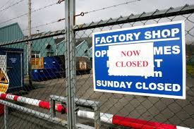
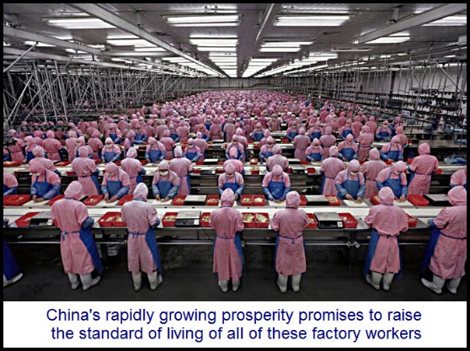
‘FREE’ TRADE IMPORTER:
But, look, how much cheaper for me
to buy from the Chinese!
U.S. IMPORTER
$5
$10
CLOSED
CLOSED AMERICAN FACTORY
& UNEMPLOYMENT
CHINESE-MADE COMPUTER
& SLAVE LABOR

Slide 31
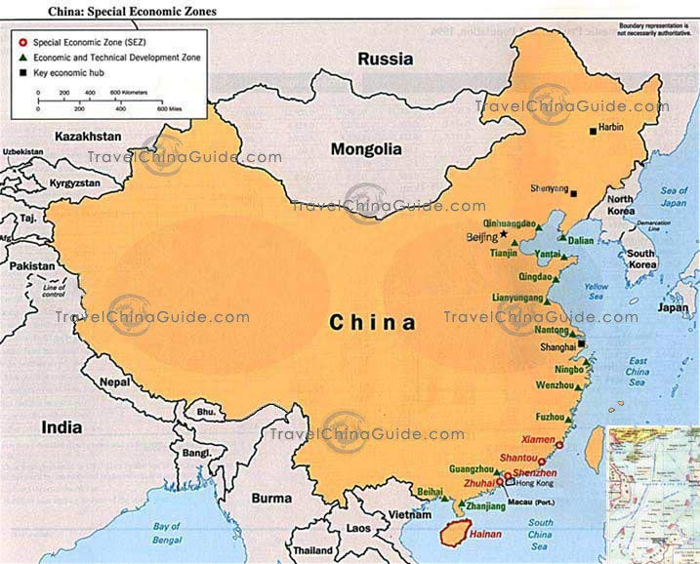
‘FREE’ TRADE IMPORTER:
But, look, how much cheaper for me
to buy from the Chinese!
U.S. IMPORTER
-$10
-$5
$10 OF INCOME WAS NOT MADE IN U.S.
$5 LEAVES THE U.S.
CHINA
- $15 OF U.S. MONEY WAS LOST TO OUR ECONOMY

Slide 32
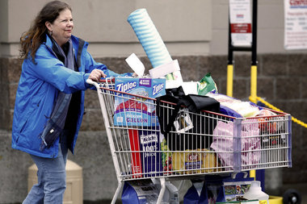
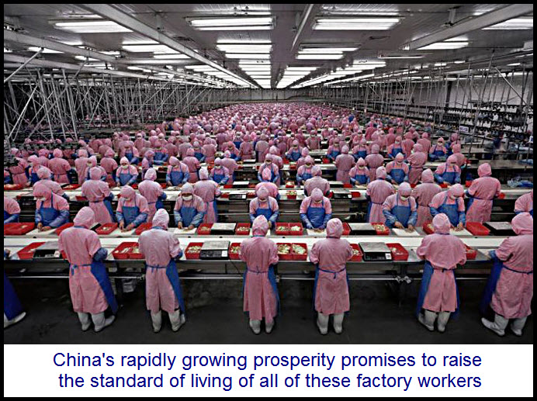
PSYCHOLOGY OF ‘FREE’ TRADE
I’m unemployed and I’m in debt …so thank goodness for cheap prices!
$5
U.S. CONSUMER
CHINESE-MADE COMPUTER
& SLAVE LABOR

Slide 33
WHAT IS EQUITABLE TRADE?
BASED ON RESPECT FOR OURSELVES AND OUR TRADING PARTNERS

Slide 34
WHAT IS EQUITABLE TRADE?
ENCOURAGES DOMESTIC PRODUCTION

Slide 35
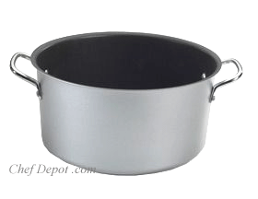
HOW?
$5
IMPORT-EXPORT
TARIFF FUND

Slide 36
HOW?
U.S. IMPORTER PAY $ INTO FUND: TO BUY FOREIGN GOODS (AT AMERICAN PRICES)
FOREIGN IMPORTER TAKE $ FROM FUND: TO BUY AMERICAN GOODS (AT AMERICAN PRICES)
$5
IMPORT-EXPORT
TARIFF FUND
IF U.S. IMPORTER BUYS A FOREIGN GOOD,
TARIFF FUND ENCOURAGES FOREIGN IMPORTER TO BUY U.S. GOOD

Slide 37
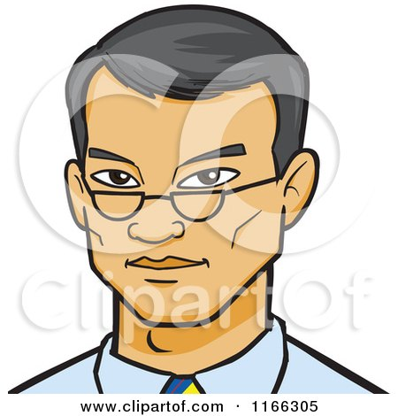
TARIFF FUND
U.S. IMPORTER --
PAYS MONEY INTO FUND
$5
U.S. IMPORTER
$5
CHINESE COMPUTER
IMPORT-EXPORT
TARIFF FUND
$5
AMERICAN COMPUTER
FOREIGN IMPORTER –
USES MONEY FROM FUND
CHINESE IMPORTER

Slide 38
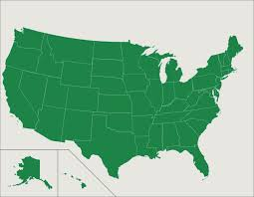
EQUITABLE TRADE
‘FREE’ TRADE IMPORTER:
NOW THAT THE CHINESE PRICE IS THE SAME AS THE U.S. PRICE ….
I AM GOING TO BUY FROM MY PRODUCERS
U.S. IMPORTER
+$10
$5
IMPORT-EXPORT
TARIFF FUND
CHINA
$5
$10 IS MADE IN U.S.
$10 OF U.S. MONEY WAS GAINED BY OUR ECONOMY

Slide 39
EQUITABLE TRADE
‘FREE’ TRADE IMPORTER:
SINCE THERE IS MONEY IN THE TARIFF FUND, I CAN USE IT TO REDUCE MY COST FOR THAT
AMERICAN GOOD. I WILL BUY FROM THE U.S.
TAILOR IN U.S.
GETS MONEY
CHINESE IMPORTER
$5
+$10
$5
CHINA
IMPORT-EXPORT
TARIFF FUND
$5
$10 IS MADE IN U.S.
$10 OF U.S. MONEY WAS GAINED BY OUR ECONOMY

Slide 40
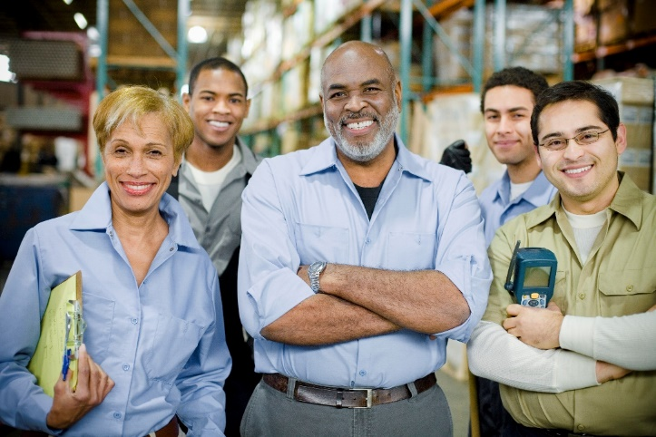
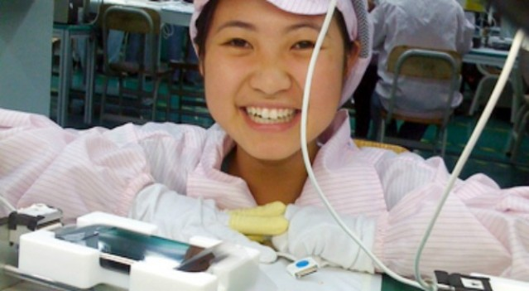
WHAT IS EQUITABLE TRADE?
HAPPY AMERICAN WORKERS
HAPPY CHINESE WORKERS

