Slide 1
PUBLIC SOVEREIGN MONEY versus PRIVATE CREDIT

Slide 2
ORIGIN OF BANKING:
Private Banknotes & Bank Deposits

Slide 3
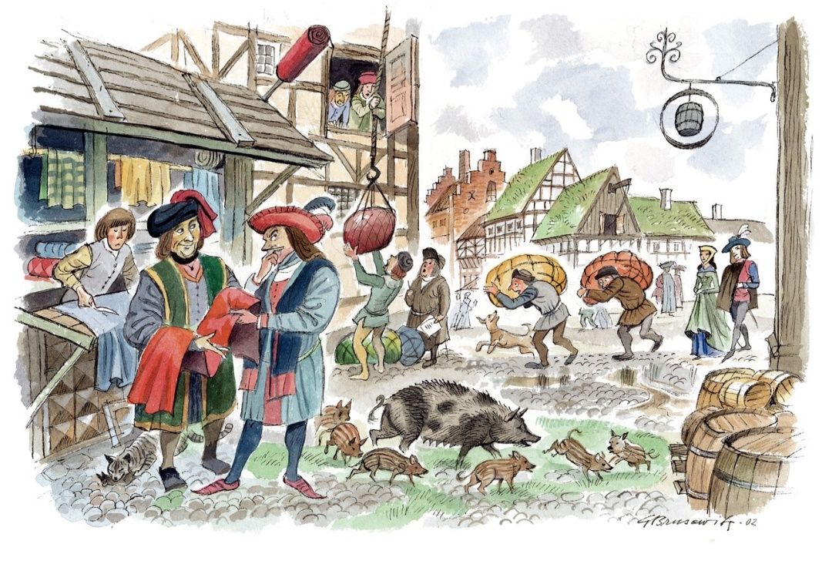
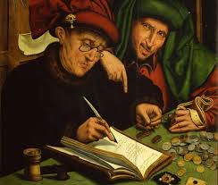
ORIGIN OF BANKING
TODAY’S BANKING DEVELOPED FROM TRADE
Over time, some merchants shifted attention from the GOODS to the MONEY side of the exchange.
Three parts of the trading system -- production, transfer, and consumption of goods -- were concrete and clearly visible to the ordinary citizen.
BUT… the operations of banking and finance were concealed, scattered, and abstract so that they appeared to many to be difficult. Such is true to the current day.
GOODS
MONEY

Slide 4

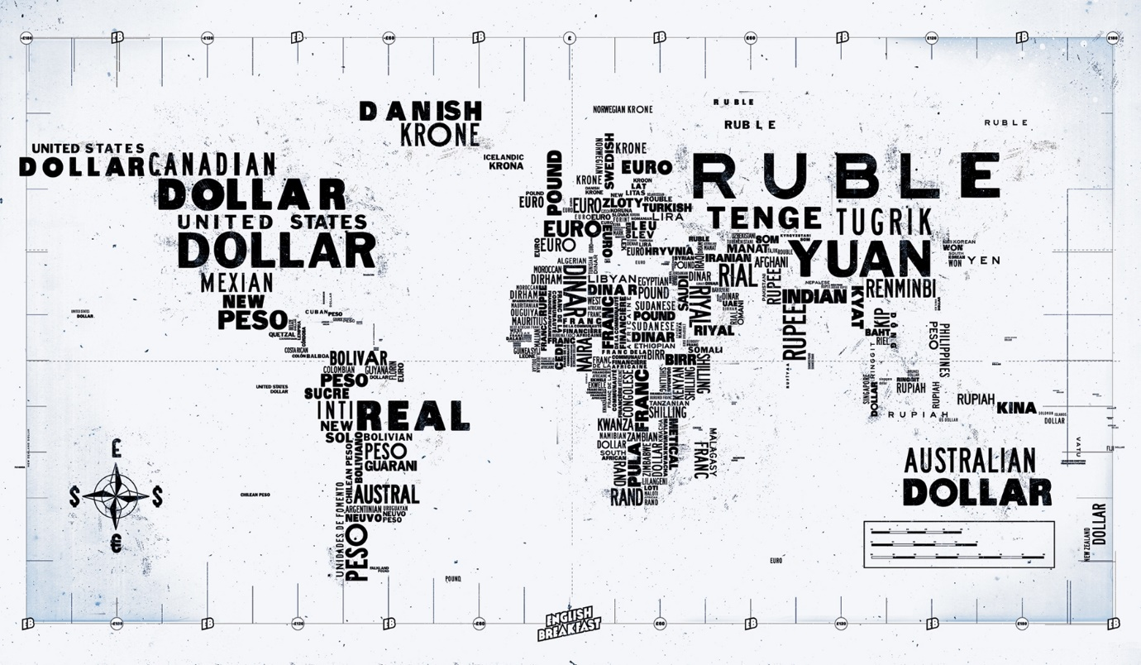

ORIGIN OF BANKING
TODAY’S BANKING DEVELOPED FROM TRADE
CLEARLY, MONEY AND GOODS ARE NOT THE SAME THING.
GOODS ARE WEALTH.
MONEY IS NOT WEALTH.
IT IS A CLAIM ON WEALTH.

Slide 5
ORIGIN OF BANKING
TODAY’S BANKING DEVELOPED FROM TRADE
GOODS AND MONEY ARE RELATED
The value of GOODS, expressed in money,
is called PRICE.
The value of MONEY, expressed in goods, is called VALUE.
PRICE
VALUE

Slide 6






ORIGIN OF BANKING
TODAY’S BANKING DEVELOPED FROM TRADE
GOODS AND MONEY ARE RELATED -- THEY MOVE IN OPPOSITE DIRECTIONS
When the price of goods goes DOWN….
the value of money goes UP.
When the price of goods goes UP….
the value of money goes DOWN.
PRICE
VALUE
VALUE
VALUE
PRICE

Slide 7
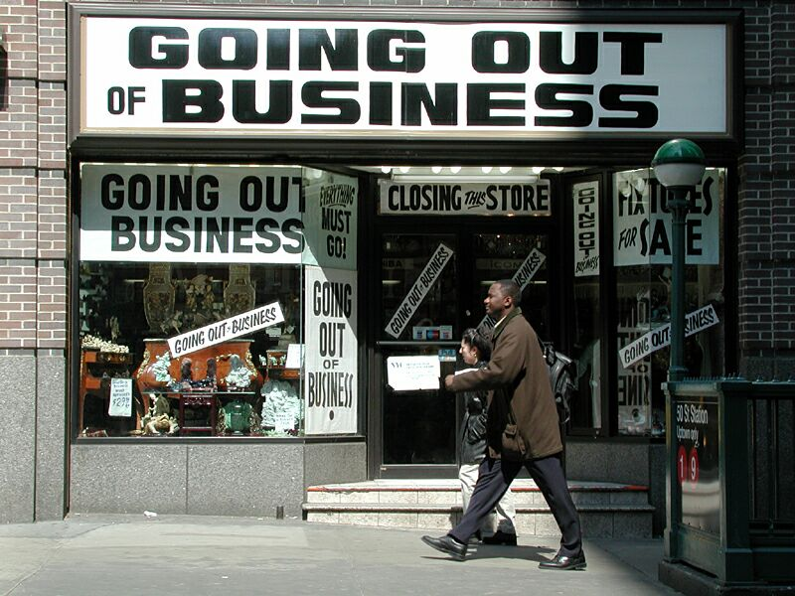

ORIGIN OF BANKING
TODAY’S BANKING DEVELOPED FROM TRADE
INTERNATIONAL BANKERS MANIPULATE THE PRICE –
BY MANIPULATING THE SUPPLY OF MONEY
Bankers cause deflation, by ‘calling in their loans’, which takes bankmoney out of circulation. Prices go down.
Bankruptcy for the producers. Unemployment for labor.
Profits for the bankers.
Bankers cause inflation, by ‘creating too many loans’, which adds bankmoney into circulation. Prices go up.
Shaky prosperity (asset bubbles) for the producers and laborers.
Profits for the bankers: more loans as the bubble inflates; foreclosures when the ‘bubble’ bursts.

Slide 8
BIRTH OF ‘BANK CREDIT’
aka Private Bank Money

Slide 9
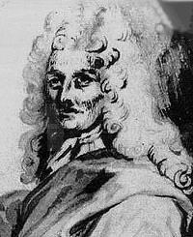
BIRTH OF ‘BANK CREDIT’, aka Private Bank Money
ENGLAND DEVELOPS THE SECRET OF CREDIT
The founding of the private Bank of England by William Paterson and his friends in 1694 is one of the great dates in world history…
The private Bank of England got a charter from the Parliament, which granted the PRIVILEGE to issue private banknotes as loans to the public (earning interest), and these private banknotes would be accepted by the government for taxes and fees.
This meant the private bank was creating what people ‘used as money’ but it was always created out of loans to the public … always with interest.
The power of creating the money supply was given away by the government.
William Paterson (1658 - 1719) did say:
“The Bank hath benefit of interest on all moneys
which it creates out of nothing.”

Slide 10
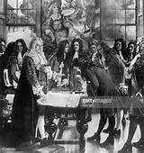
BIRTH OF ‘BANK CREDIT’, aka Private Bank Money
The bank hid what they were doing from the public and government.
They told them money was gold and silver,
but they were creating their banknotes and bank deposits – all from loans.
William Paterson on the creation of the Bank of England:
“All this while, the very name of a bank or corporation was avoided, though the notion of both was intended… “

Slide 11
ORIGIN OF THE FED:
THE U.S. BANK OF (shush! CREDIT) ISSUE

Slide 12
Parallels to Establishing the Bank of England
“The historical parallels between the establishment of the Federal Reserve System in 1913 and the Bank of England in 1694 are striking:”
Stephen Zarlenga, LOST SCIENCE OF MONEY, p. 525

Slide 13
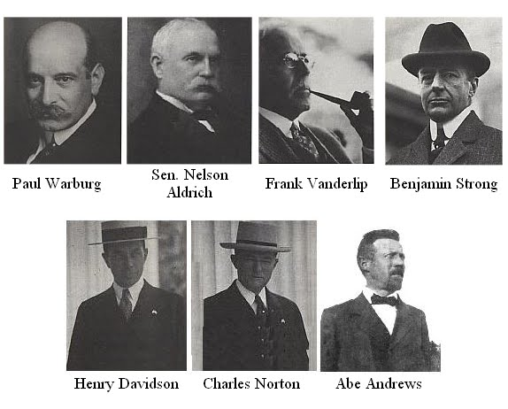
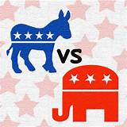
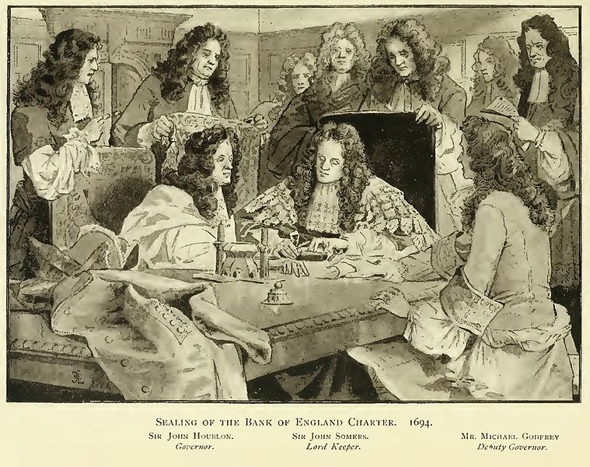

Parallels to Establishing the Bank of England
1
SECRECY SURROUNDING ITS CREATION
TONNAGE ACT (BANK OF ENGLAND)
FEDERAL RESERVE ACT
“All the while the very name of a bank or corporation was avoided..” William Paterson, founder
Secretly written at Jekyll Island
Failed as a Republican bill and subsequently disguised as a Democratic Party bill
Was a rider to a bill
Bankers pretended to oppose their own bill.

Slide 14
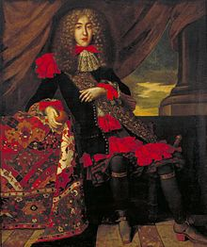
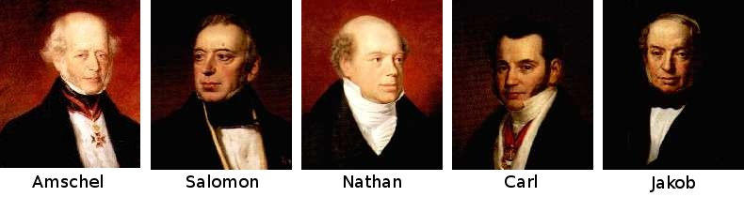
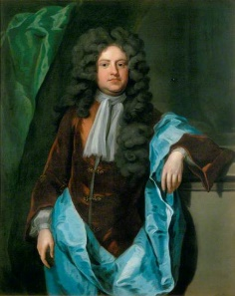
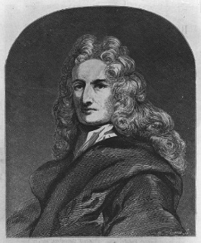
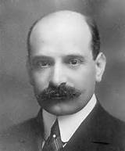
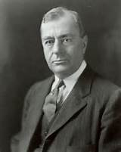
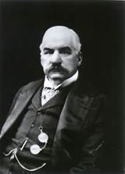

Parallels to Establishing the Bank of England
2
LINKS TO FOREIGN SUPPORTERS
BANK OF ENGLAND
FEDERAL RESERVE ACT
Dutch and Jewish financiers financed
William of Orange’s invasion of England, 1688
Paul and Felix Warburg, Kuhn Loeb partners, were from
the Warburg banking family of Hamburg, Germany, who represented the Rothschild interest
Dutch financier Franciso Suasso
lent two million guilders
THE ‘LOCALS’
THE ‘LOCALS’
Charles Montagu
1st Earl of Halifax
MICHAEL GODFREY
Sir William Paterson
PAUL WARBURG
BENJAMIN STRONG
J.P. MORGAN

Slide 15
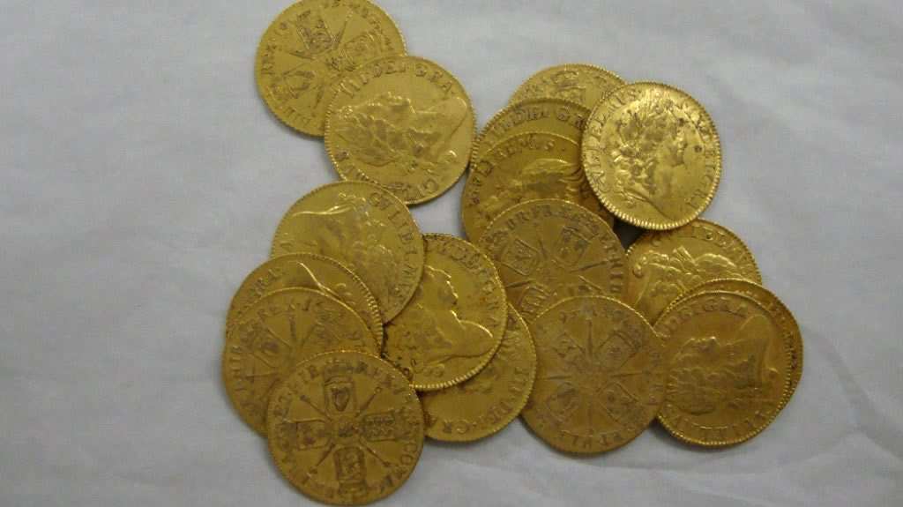
Parallels to Establishing the Bank of England
3
ITS COMPLEXITY KEPT PEOPLE FROM UNDERSTANDING THE TRUE SOURCE OF ITS POWER –
THE MONEY CREATION PROCESS
BANK OF ENGLAND
FEDERAL RESERVE ACT
Nowhere in the Federal Reserve Act was there a
description of the creation of money by private banks.
“An Act To provide for the establishment of Federal
reserve banks, to furnish an elastic currency*, to afford
means of rediscounting* commercial paper,
to establish a more effective supervision of banking
in the United States, and for other purposes.”
The bank owners obscured the true nature of money –
while creating abstract money, they put forward a back-
ward commodity concept of money as gold and silver.
‘elastic currency’ and ‘rediscounting’ means
‘creating money out of nothing’

Slide 16
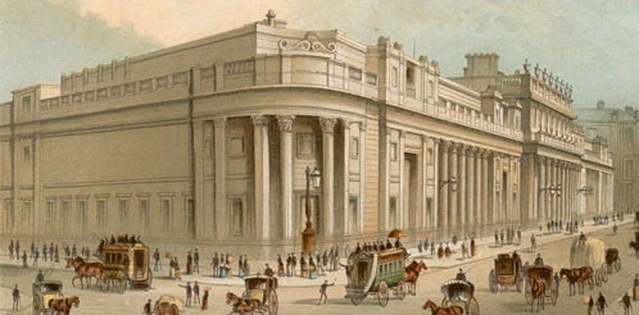
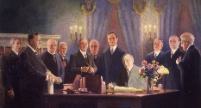
arallels to Establishing the Bank of England
4
PRIVATELY OWNED,
BUT MADE TO APPEAR PUBLIC
BANK OF ENGLAND
FEDERAL RESERVE ACT
“All this while, the very name of a bank or corporation was avoided, though the notion of both was intended… “ William Paterson
“The Nation magazine was the only public organ, so far as
I can find out, which pointed out that the issue of the
money of the U.S. was being turned over to a body of
men who were neither elected nor answerable to
elections.” Mullins

Slide 17

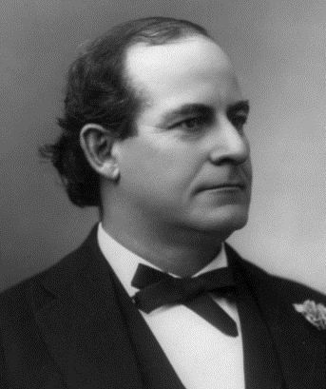
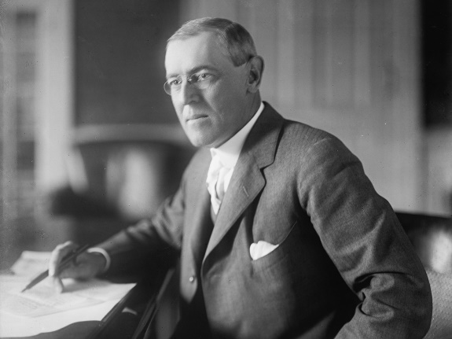
Parallels to Establishing the Bank of England
5
SOME EARLY SUPPORTERS
ENDED UP CONDEMNING
BANK OF ENGLAND
FEDERAL RESERVE ACT
William Paterson became so disaffected that he
published a book condemning the Bank’s
buildup of the national debt.
William Jennings Bryan and Woodrow Wilson
both regretted their role in getting the
Federal Reserve bill passed.
Secretary of State
1913
U.S. President
1913

Slide 18
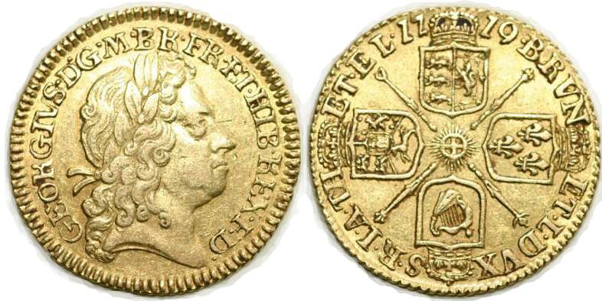
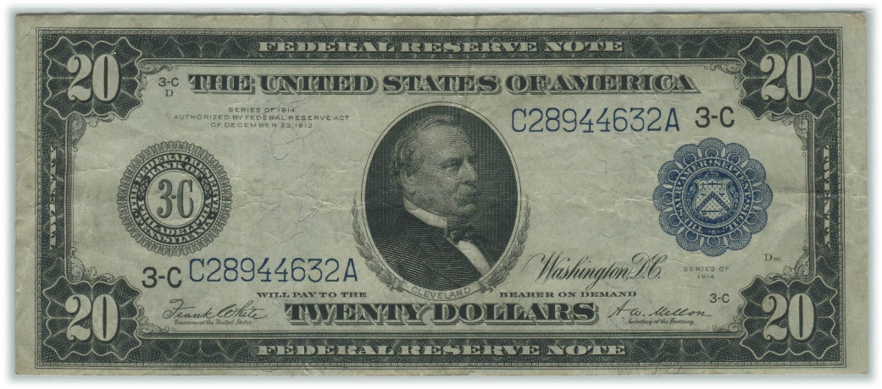
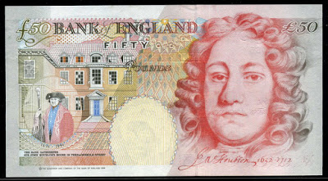
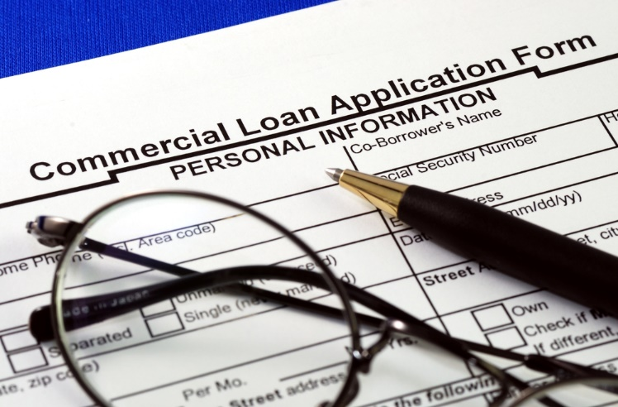
Parallels to Establishing the Bank of England
6
PURPORTED TO BE BACKED BY GOLD
BANK OF ENGLAND
FEDERAL RESERVE ACT
Federal Reserve Notes began 100% gold-backed but in
1917 that was reduced to 40%.
Deposits creating from loans began with only 14% gold
backing.
Two years after its commencement, the bank failed
to redeem its private paper currency in gold.

Slide 19
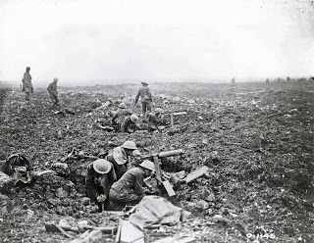
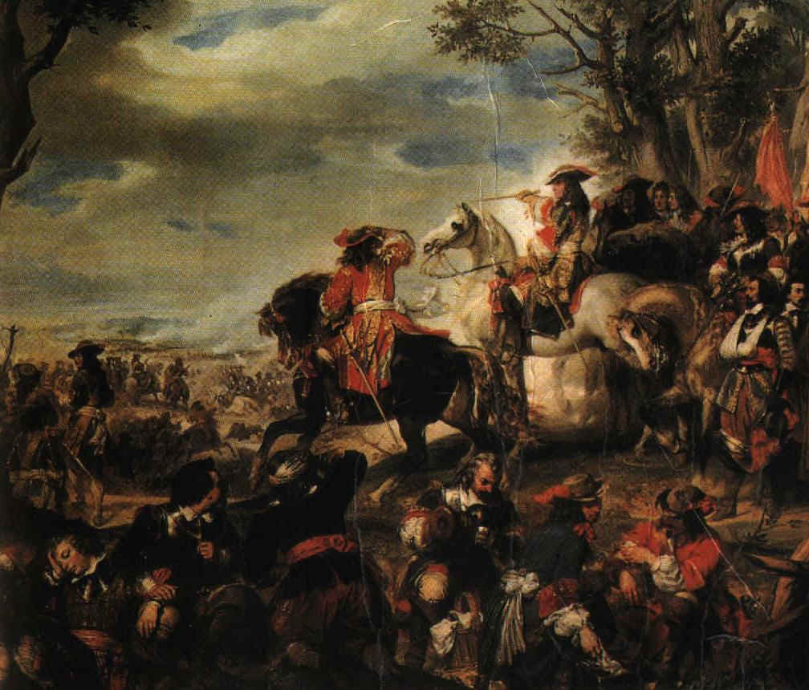
Parallels to Establishing the Bank of England
7
BOTH ENGLAND AND AMERICA PUSHED INTO EARLY WARS
BANK OF ENGLAND
FEDERAL RESERVE ACT
Nine Years’ War (1688-1697)
(England/Scotland, Germany, Netherlands, Savoy, Spain, and Sweden v France)
Nine Years’ War (1688-1697)
(England/Scotland, Germany, Netherlands, Savoy,
Spain, and Sweden versus France)
WORLD WAR I
April 1917 – November 1918

Slide 20
WHO CREATES OUR MONEY SUPPLY?

Slide 21

WHO CREATES OUR MONEY SUPPLY?
Most people believe that modern banking consists of taking IN deposits
and loaning them OUT at a higher rate of interest.
But modern banking consists of creating credit in the borrower’s account (“a bank loan”). In other words, the bank creates “BANKMONEY” and puts it in the borrower’s account.
When the borrower pays off the principal of the loan,
the bankmoney disappears or is ‘extinguished’ from the
books of the bank.
The bank keeps the interest from the borrower.

Slide 22
The power to create and destroy money is an awesome power:
How the Fed Was Used to Fund World War I

Slide 23
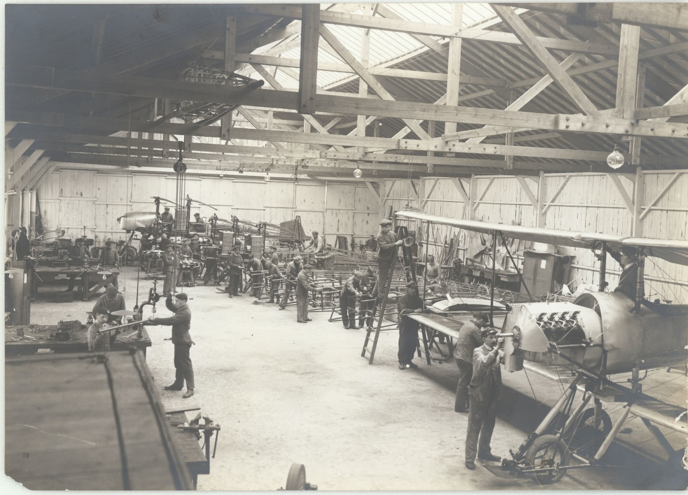
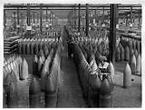
How the Fed Was Used to Fund World War I
COULD THE U.S. HAVE ENTERED THE WAR WITHOUT THE HELP
OF ITS CENTRAL BANK, THE FEDERAL RESERVE INSTITUTION?

Slide 24
How the Fed Was Used to Fund World War I
By 1916, the private investment bank of J.P. Morgan had organized loans
to Britain and France for a staggering 1.2 billion dollars of war munitions
By the 1917 entrance into war by U.S., 5 billion dollars of war supplies and weapons have been exported from the country by Morgan syndicate

Slide 25
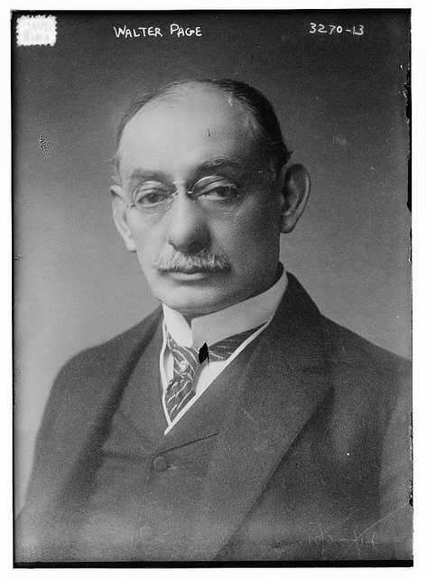
How the Fed Was Used to Fund World War I
March 5, 1917 - confidential dispatch from Walter Hines Page,
US Ambassador to London, to Wilson:
“I think that the pressure of this approaching crisis has gone beyond the
ability of the Morgan Financial Agency….If we should go to war with
Germany, the greatest help we could give the Allies would be such a credit…
Unless we go to war with Germany our Government, of course, cannot make
such a direct grant of credit……
He added that the alternative to war was domestic collapse of the US….
Walter Hines Page (1855 – 1918)
American journalist, publisher, diplomat
U.S. ambassador to U.K. during World War I

Slide 26
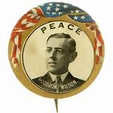
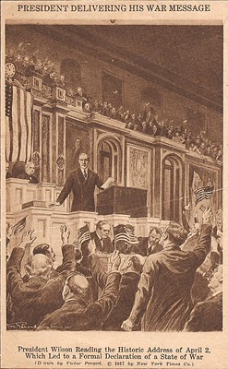
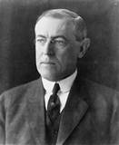
How the Fed Was Used to Fund World War I
April 1917: President Wilson, The Peace President,
asks for a declaration of war against Germany

Slide 27

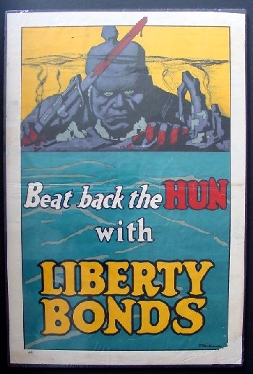
How the Fed Was Used to Fund World War I
The 1913 Federal Reserve Law allowed member banks to create bankmoney as loans to
commercial businesses shortterm.
BUT THE COUNTRY COULD NOT PAY FOR WORLD WAR 1 IN THIS WAY.
So… the Law was amended…
Member banks were allowed to create bankmoney and buy Liberty bonds
at government-debt auctions

Slide 28

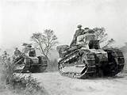
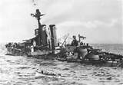
How the Fed Was Used to Fund World War I
April 1917 to the Armistice of 11/11/1918:
U.S. government lent the European Allied Powers the stupendous sum of 9.4 billion dollars.
All this money went to American industries, most tied to Morgan, Kuhn-Loeb, and Rockefeller, to pay for war supplies for allies.

Slide 29
The power to create and destroy money is an awesome power:
How the Fed Caused a Depression

Slide 30
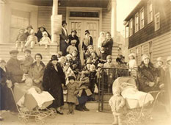
The Fed and the Depression of 1920-21
The history of the Federal Reserve System proves that it double-crossed the farmers of America at a secret meeting on May 18, 1920…. precipitated the Agricultural Depression of 1920-21.”
Eustace Mullins, A Study of the Federal Reserve, 1952, p. 30
The recession of 1920–21 was characterized by extreme.
The drop in wholesale prices was even more severe, falling by 36.8%, the most severe drop since the American Revolutionary War.

Slide 31
The Fed and the Depression of 1920-21
THE NEXT SERIES OF SLIDES COME FROM THE CONGRESSIONAL RECORD, REPORTING ON THE SECRET MEETING OF THE FEDERAL RESERVE BOARD, WHICH BROUGHT ON THE DEPRESSION OF 1920 ➔

Slide 32
The Fed and the Depression of 1920-21

Slide 33
The Fed and the Depression of 1920-21

Slide 34
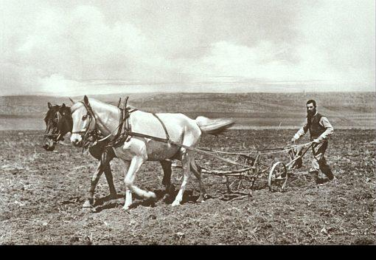
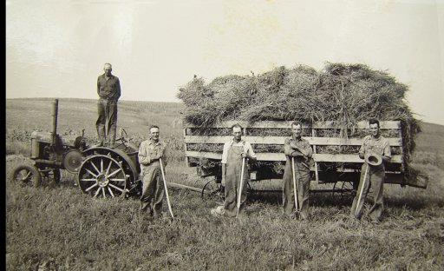
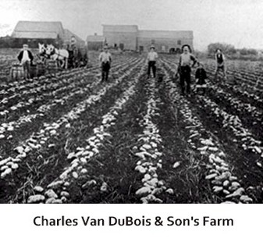
The Fed and the Depression of 1920-21
____|___________________________________|________________________________________________________|_______
Sept 1919 May 1920 Sept 1921
Bankers increased money supply by 8.63% Bankers reduced money supply by -16.79% to -8.16%
Prices rise by 15.8% Deep recession. Index of farm prices fell from 244 to 136.
Price of wheat fell from $3/bushel to $1.60/bushel
Farmers take out loans from bank. Farmers pay loan or foreclosed on.
Bankers engineered this recession.

Slide 35
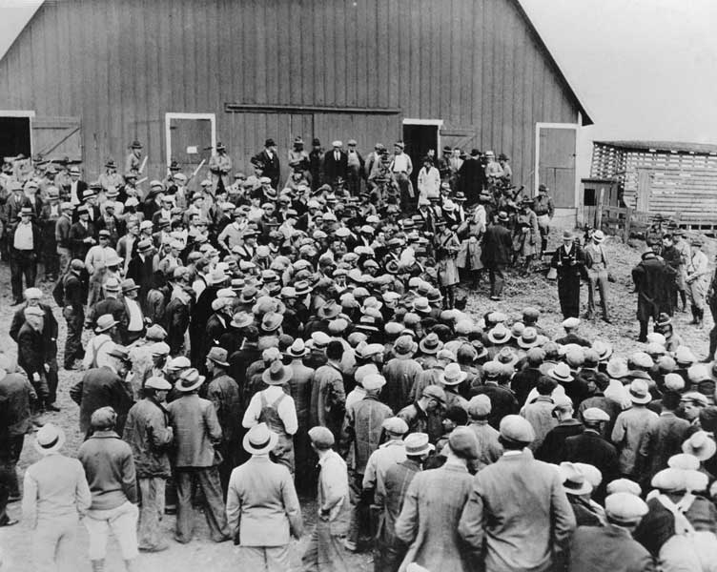
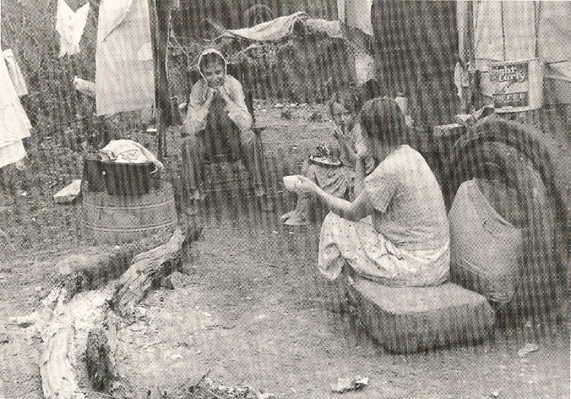
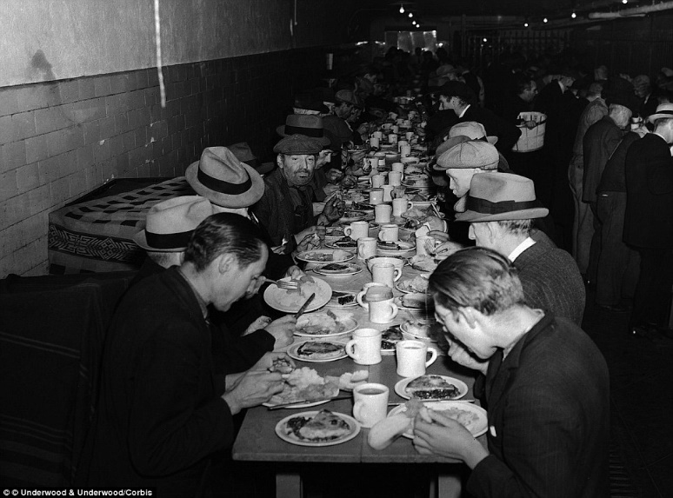
The Fed and the Depression of 1920-21
Many farms were overwhelmed by the postwar collapse of the agricultural commodities market.

Slide 36
A Positive Note

Slide 37
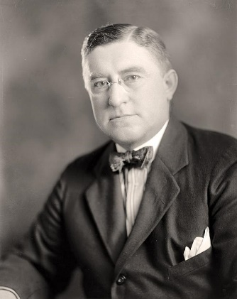
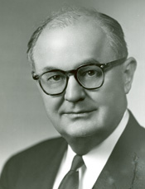
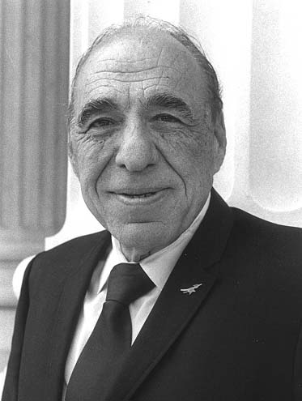
A Positive Note
Democratic Chairmen of the House Banking Committee
have regularly put forward legislation to nationalize or abolish the Federal Reserve System.
“Mr. Chairman, we have in this Country one of the most corrupt institutions the world has ever known. I refer to the Federal Reserve Board and the Federal Reserve Banks, hereinafter called the Fed.”
Louis McFadden
Congressman, 1923 to 1935
“In the US today, we have in effect two governments. We have the duly constituted government, then we have an independent, uncontrolled and uncoordinated government in the Federal Reserve, operating the money powers which are reserved to congress by the Constitution.”
Wright Patman
Congressman, 1929 to 1976
Congressman/Chairman Gonzales introduced legislation to rescind the Federal Reserve Act.
Henry González
Congressman, 1961 to 1999

Slide 38
TODAY’S BANKING SYSTEM

Slide 39


TODAY’S BANKING SYSTEM
Today the Federal Reserve System has evolved into the most powerful system in the world. The owners of this system are the private commercial banks which own all the shares in the 12 Federal Reserve Banks.

Slide 40
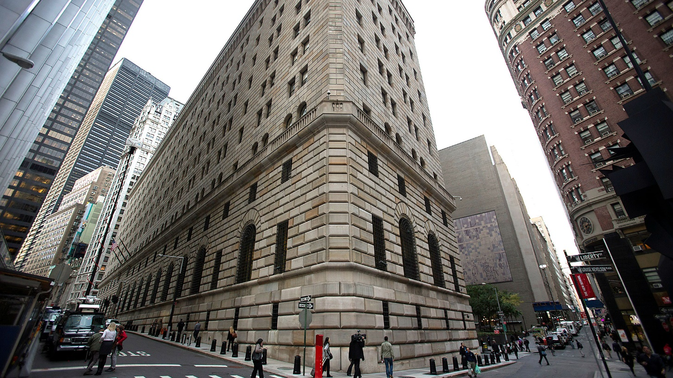
TODAY’S BANKING SYSTEM
The most powerful and center of power is the New York Federal Reserve Bank in NYC.
At least 50% of the shares of the NY Fed are owned by J.P.Morgan Chase, 23% by Citibank.
NY FED

Slide 41
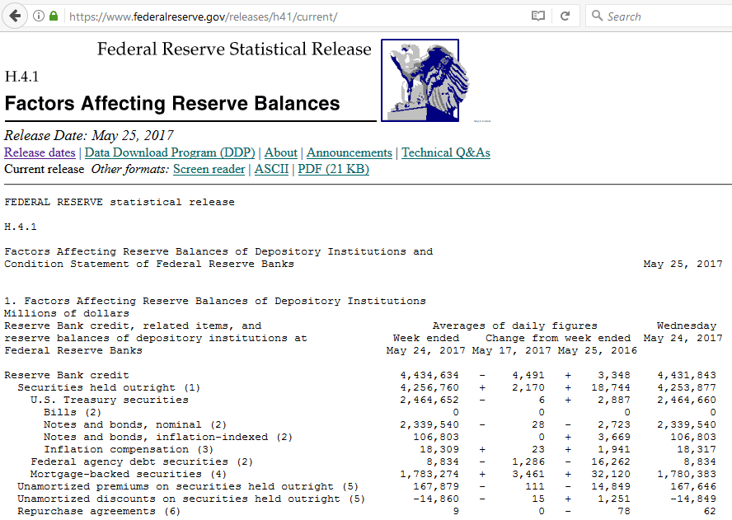
TODAY’S BANKING SYSTEM
Anyone can view the balance sheet of the 12 Federal Reserve Banks on the internet.
THE OWNERS OF THE FED BANKS
OWN 4.3 TRILLION OF SECURITIES

Slide 42

TODAY’S BANKING SYSTEM
The Two Separate Systems of the FED
12 RESERVE BANKS
OWNER
COMMERCIAL BANKS
BANK
MONEY
RESERVES
PUBLIC
RESERVES NEVER LEAVE
THE 12 RESERVE BANKS.
RESERVE ARE CENTRAL BANK MONEY,
CREATED BY THE 12 FED BANKS.
RESERVES CIRCULATE AMONG THE OWNER
COMMERCIAL BANKS.
BANKMONEY CIRCULATES AMONG PEOPLE, BUSINESSES, AND GOVERNMENTS

Slide 43
TODAY’S BANKING SYSTEM
The owner commercial banks decide how much bankmoney to create FIRST. Then the reserve bank follows SECOND with reserves.
12 RESERVE BANKS
OWNER
COMMERCIAL BANKS
RESERVES
BANK
MONEY
PUBLIC
BANKMONEY

Slide 44
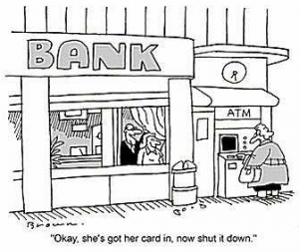
TODAY’S BANKING SYSTEM
REMEMBER:
Throughout history there have always been tyrants….
but they have ALWAYS failed.

Slide 45
THE END

