Slide 1
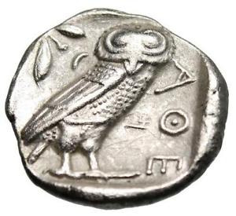
PUBLIC MONEY HAS A LONG SUPPRESSED HISTORY
RESIST THE MONEY POWER: 5,000 Years of Struggle
LEFT FORUM SUNDAY June 4th Session 5
10:00am - 11:50am Room: 1.113
ANN WEBRE

Slide 2
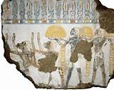
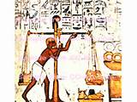
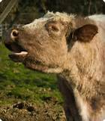
HOW DID GOLD BECOME MONEY?
THE TEMPLES WOULD CONTROL THE GOLD
They created a demand for it by accepting it for their ‘services’.
They controlled the supply, by accumulation and building consecration.
1 COW
130 grains troy GOLD BY WEIGHT

Slide 3
2 COINAGE – science of money advances

