Slide 1
SOLUTIONS TO DEBT-DRIVEN FORCED TRADE
Don Butterfield

Slide 2
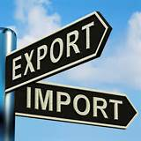
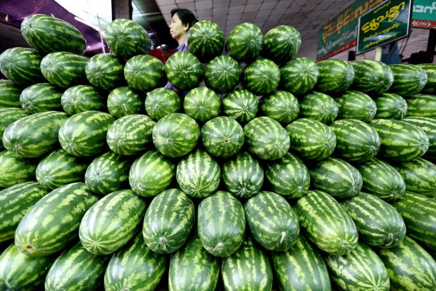
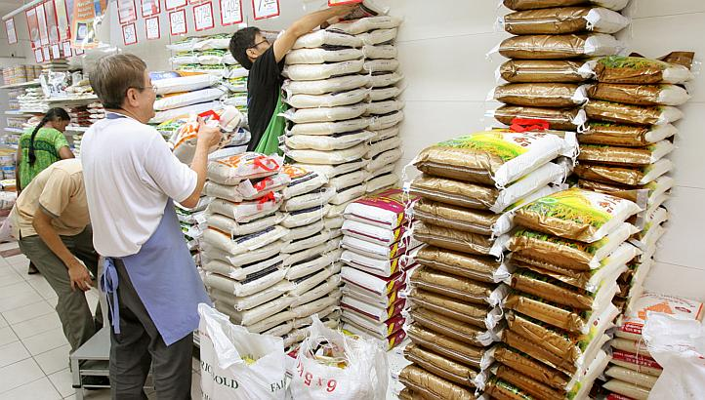
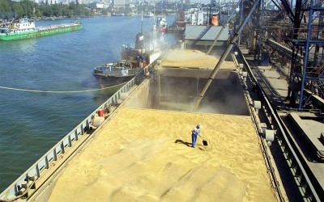
THE DEBT-MONEY SYSTEM DRIVES
RIGGED TRADE WORLD WIDE
To repay their international debts, poor nations must earn dollars by exporting.
They compete against other poor countries, all who export similar products, glut the market, and drive down prices. Low prices make it impossible to repay loans.
They compete against wealthy nations, who strive to maximize exports, because they too have massive public and private debts
ALL NATIONS
ARE IN DEBT !!!!

Slide 3
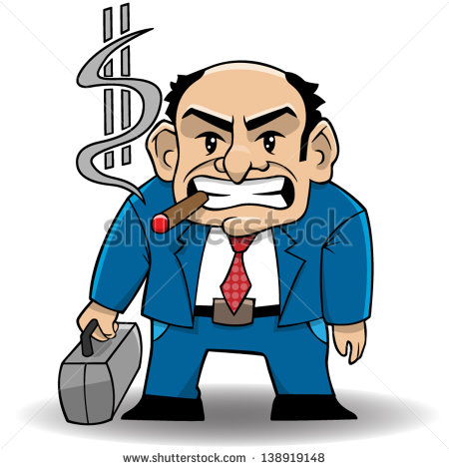
THE DEBT-MONEY SYSTEM DRIVES
RIGGED TRADE WORLD WIDE
Poor nations are not earning enough money to repay their loans, and so the private banks seize the assets – land, minerals, buildings, and food – of the poor nations.
“YUM, YUM”
says the
international
banker

Slide 4
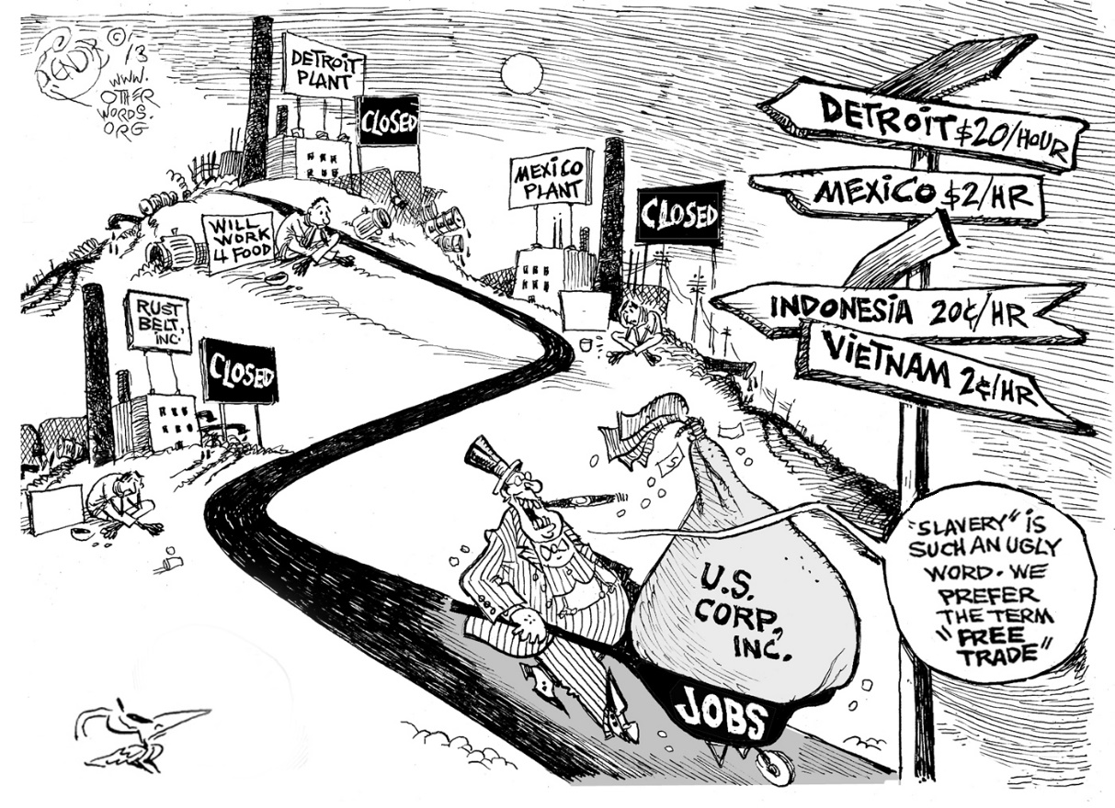
Today’s Situation None of the necessary conditions for free trade, to produce mutual benefits, apply anywhere in today’s world
Instead, all nations try to pursue an imbalance of trade.
Multinational corps. rig trade to their profit at the expense of third world nations, calling it “free” trade.
This Free Trade sham has been accepted and promoted by powerful financial and legal world agencies: World Bank, IMF, WTO, the UN, governments of the strongest nations etc.

Slide 5
Vision Statement
We must organize a debt-free system to function efficiently for mutual benefit to all countries involved.

Slide 6
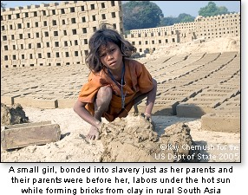
Objective
Remove the pressure of ubiquitous debt distorting all our activities.
A small girl, sold into slavery to pay debts, labors under the hot sun forming bricks in South Asia.

Slide 7
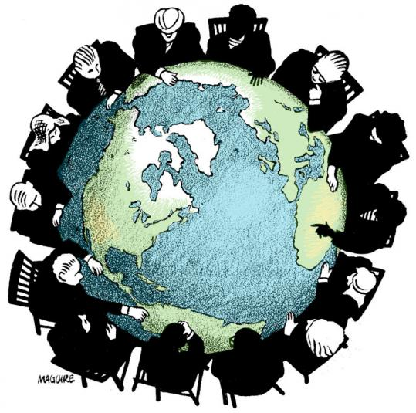
Strategies for a fairer ‘free’ trade….
Find a solution to developing nations and our own debt.
Find a solution to aggressive exporting.
End illegitimate debts of developing nations.
Let each nation set priorities for and monitor its economy.
Set a code of conduct to curb multinationals aggressive actions.

Slide 8
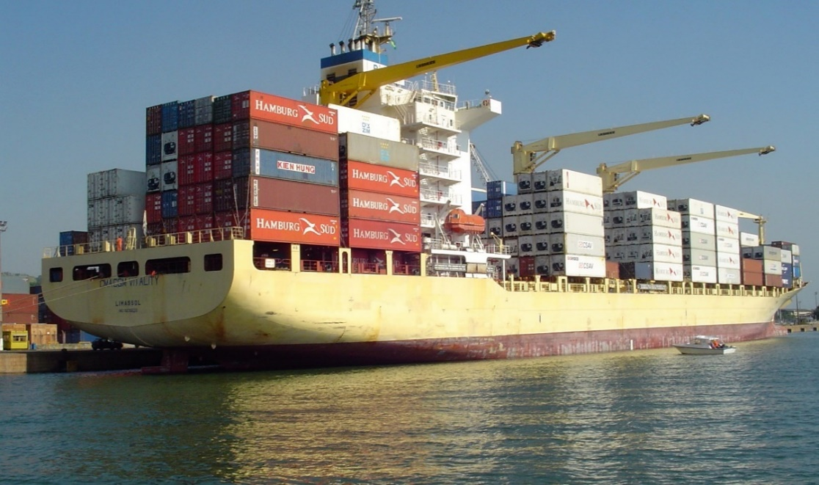
RECOMMENDATIONS
Pass the NEED Act in Congress to reform the U.S. money system.
Prevent the TPP and TTIP from ever being enacted and eliminate
agreements that contain detestable ISDS tribunals.
Create trade that respects the internal economy and price structure of every nation.
Amend the constitution to establish that human beings, not
corporations, are persons entitled to constitutional rights.

Slide 9
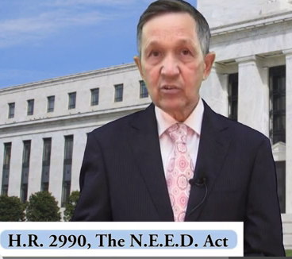
THE SOLUTION: DEBT-FREE MONEY
THE GOVERNMENT BUYS ALL THE SHARES OF THE 12 FEDERAL RESERVE BANKS FROM THE MEMBER COMMERCIAL BANKS.
THE COMMERCIAL BANKS REMAIN PRIVATELY OWNED,
AND LEND ONLY DEPOSITED MONEY.
CONGRESS SPENDS THIS DEBT-FREE GOVERNMENT MONEY ON PHYSICAL INFRASTRUCTURE, EDUCATION, HEALTH CARE - CREATING JOBS.
THE DEBT-FREE MONEY IS SPENT AT ALL LEVELS OF GOVERNMENT – FEDERAL, STATE, & MUNICIPAL
DENNIS KUCINICH
THE NEED ACT 2011-2012

Slide 10
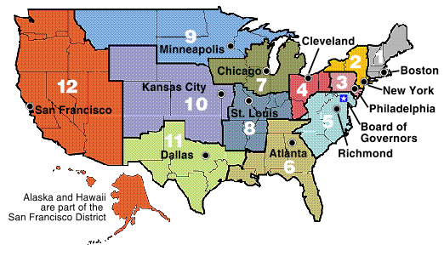
#1: FED RESERVE BANKS and their payment systems will be owned by the Government
Federal government buys all the shares of the 12 Federal Reserve Banks from member commercial banks. Their current functions will be performed by the Bureau of the Federal Reserve in the Treasury Department.

Slide 11
#2 TAKES AWAY POWER TO CREATE MONEY FROM
PRIVATE BANKS
Change accounting rules to only allow banks
to lend existing deposits.

Slide 12
#3 SPEND DEBT-FREE MONEY FOR THE
BENEFIT OF ALL CITIZENS
Congress spends to CREATE JOBS and REAL WEALTH
for all people in the country, not the few.
Build infrastructure -- trains, dams, bridges, levees
Education
Health Care

Slide 13
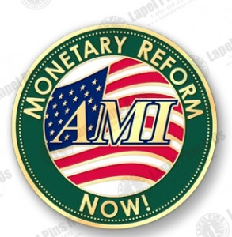
USA
American Monetary Institute, USA,
www.monetary.org
Helped Congressman Kucinich draft the NEED ACT

Slide 14
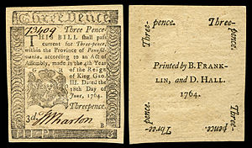
The history of the United States is a history of debt-free U.S. money.
COLONIAL SCRIPT
DEBT-FREE MONEY ISSUED BY
THE LEGISLATURE OF THE COLONY
OF PENNSYLVANIA
June, 1764
Every one of the thirteen colonies
issued debt-free/interest-free
money from their legislature.

Slide 15
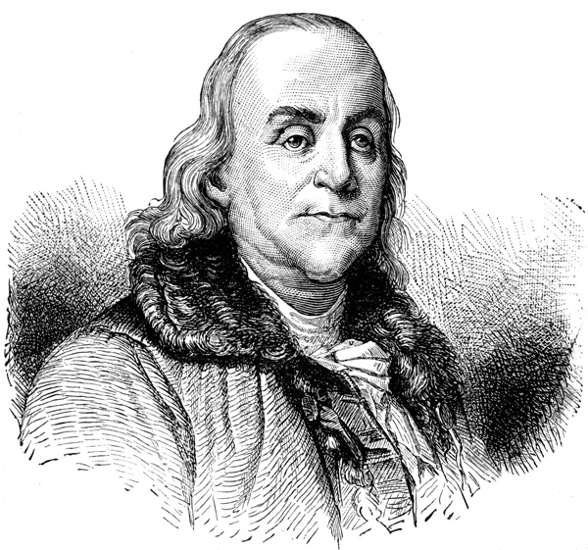
COLONIAL SCRIPT
COLONIAL SCRIPT
Every one of the thirteen colonies
issued debt-free/interest-free
money from their legislature.
“Experience, more prevalent than all the logic of the World,
has fully convinced us all, that paper money has been,
and is now of the greatest advantages to the country.”
Benjamin Franklin

Slide 16
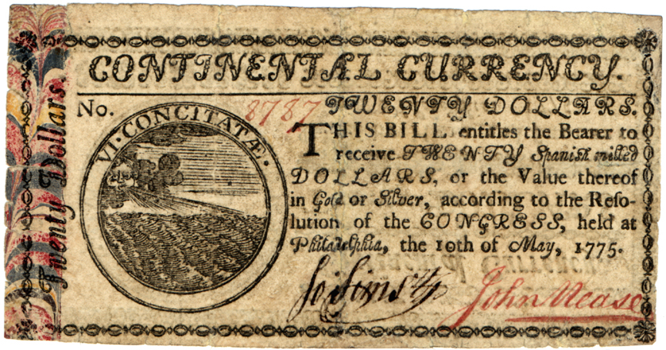
The history of the United States is a history of debt-free U.S. money.
CONTINENTAL CURRENCY
DEBT-FREE MONEY ISSUED BY
THE CONTINENTAL CONGRESS
FOR THE AMERICAN WAR
OF INDEPENDENCE, May 1775
The colonists issued about 200
million of these Continentals,
but the British counterfeited
another 200 million as a form
of economic warfare.

Slide 17
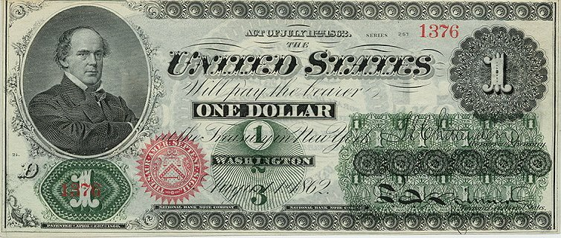
The history of the United States is a history of debt-free U.S. money.
GREENBACK CURRENCY
DEBT-FREE MONEY ISSUED BY THE U.S. CONGRESS DURING THE CIVIL WAR.
200 MILLION GREENBACKS WERE ISSUED BY THE NORTHERN CONGRESS AND THE GOVERNMENT SPENT THAT AMOUNT.

Slide 18
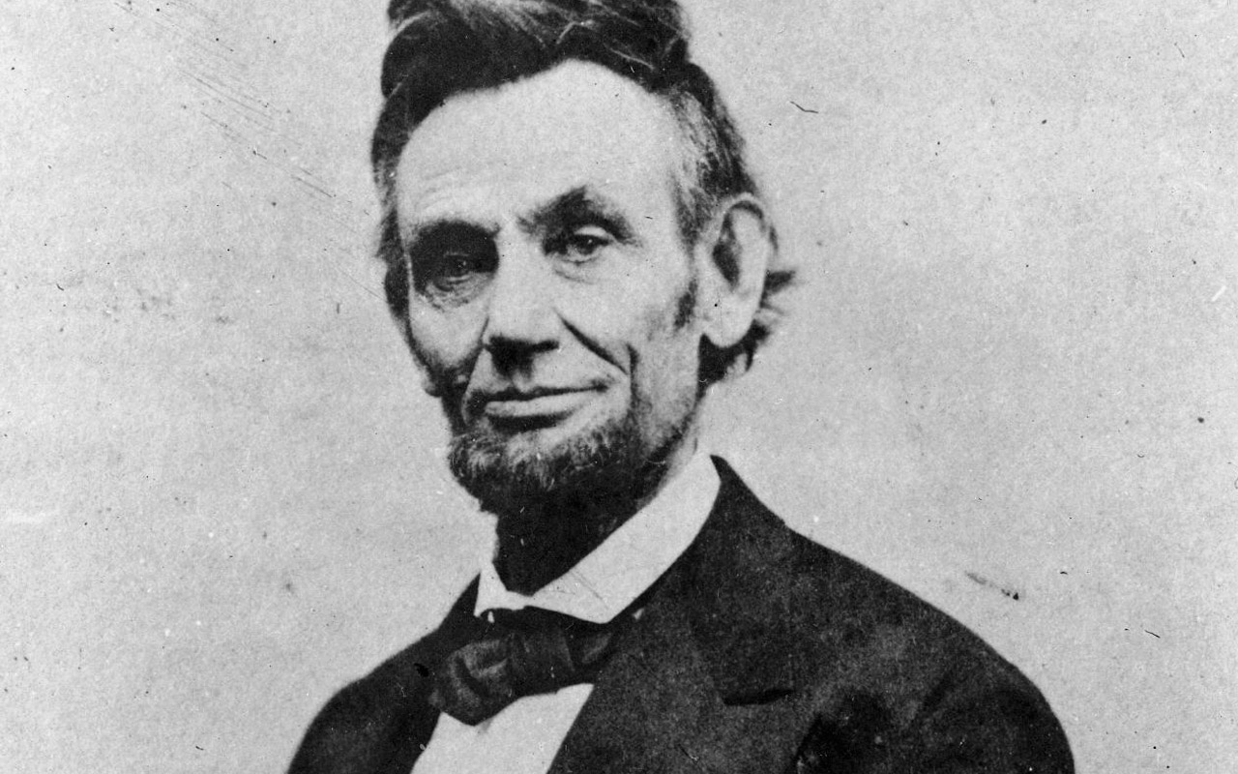
GREENBACK CURRENCY
ABRAHAM LINCOLN:
“The original issue of money should be maintained as the exclusive monopoly of national government.
Money will cease to be the master and become the servant of humanity.”

Slide 19
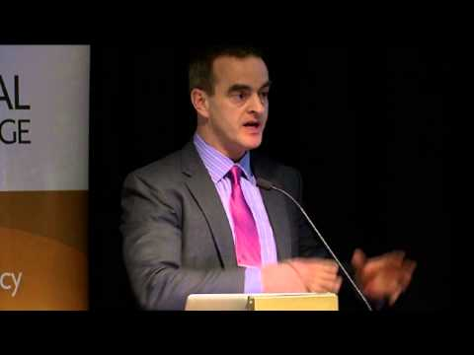
1930’s CHICAGO PLAN – REVISITED 2012 Another Plan to Stop Banks from Creating Money

Slide 20
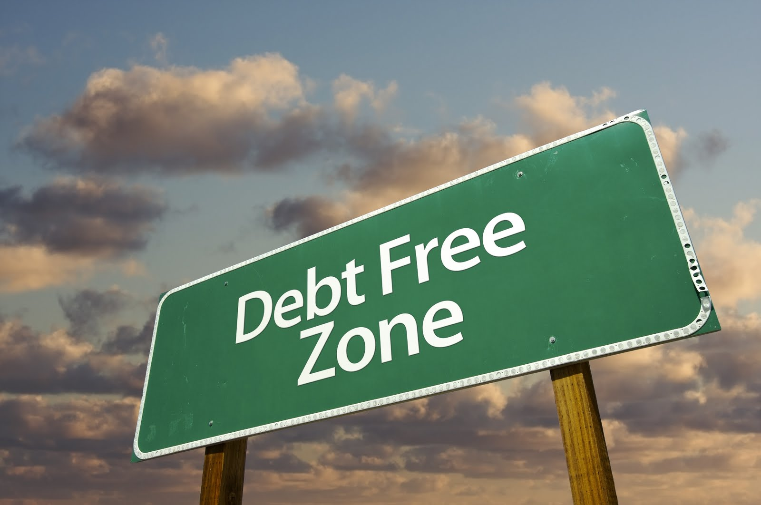
THE END

