Slide 1
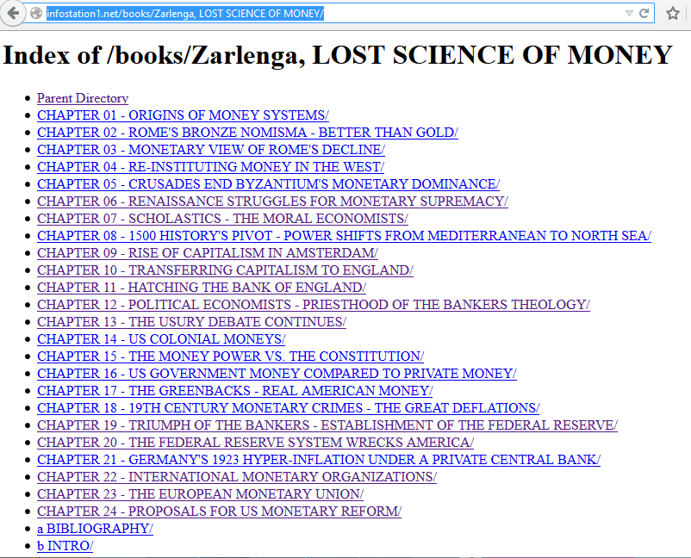
INFOSTATION1.NET/books/
Zarlenga, LOST SCIENCE OF MONEY

Slide 2
INFOSTATION1.NET/books/
Zarlenga, LOST SCIENCE OF MONEY
EACH CHAPTER CONTAINS:
POWERPOINT
RECORDED CLASS
SOURCES

Slide 3
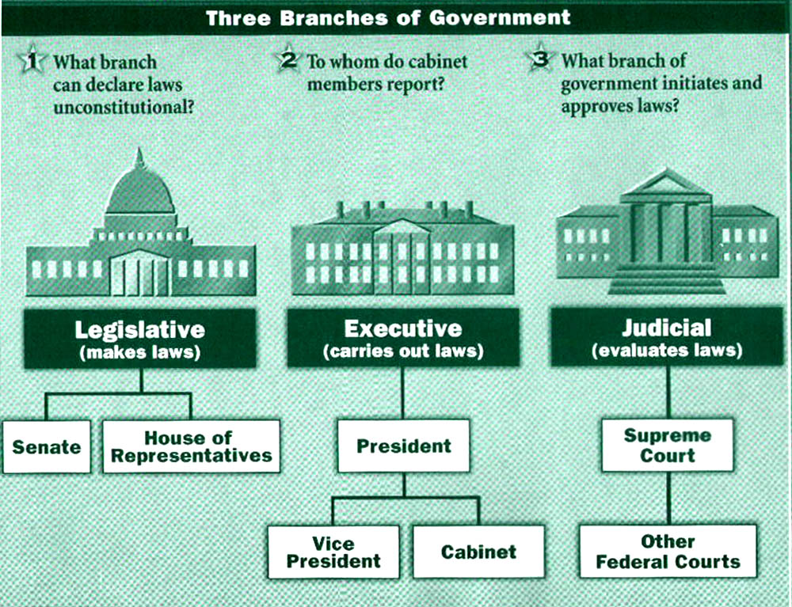
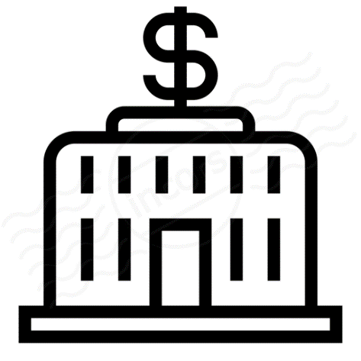
The Lost Science of Money
CHAPTER 24 – Part 1
PROPOSALS FOR U.S. MONETARY REFORM:
Toward a Fourth Branch of Government
Fourth Branch
Monetary
(creates money)
Monetary Authority

Slide 4
THEMES OF LOST SCIENCE OF MONEY BOOK
Primary importance of the money power (power to create money and regulate it)
Nature of money purposely kept secret and confused
How a society defines money determines who controls the society
Battle over control of money has raged for millennia: public vs private
The misuse of the monetary system causes tremendous misery and suffering for the ordinary people. Will & Martin, February 2014
Whenever the public has owned a significant fraction of the money power, great public benefit has ensued: Sparta, the Roman Republic, the American Colonies in the 18th century, GREENBACKS after the Civil War, Canada after the Great Depression, British experience after World War II. Martin, July 2014.

Slide 5
PARTS OF PRESENTATION
Introduction
Who Is Responsible?
Misdiagnosis of America’s Problems
Monetary Reform is Crucially Needed
Money’s Nature Must Dictate Monetary Reform
Distractions from Sovereign Money
The Gold Promoters
The “Free Banking” Ideologues
Local Currency (“Lets”) Advocates
The “All Money is Debt” Faction
Government’s Responsibility to Provide the Money
THE AMI STRATEGY: Reforming the Federal Reserve System
Reform #1: Nationalization of the Federal Reserve

Slide 6
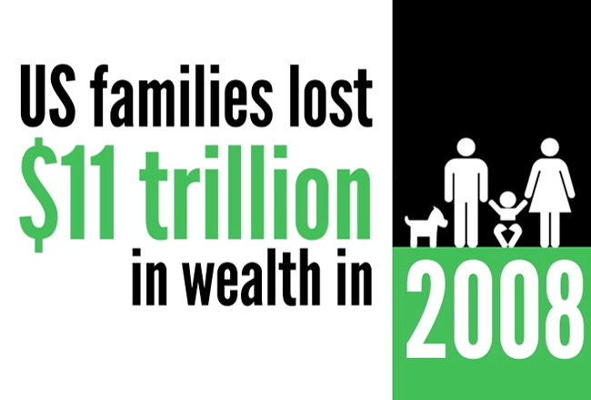
Who Is Responsible?
“Those in charge of the U.S. money system, and their predecessors, must bear a large part of the responsibility for this inequitable situation. They broke the banks in 1929-32 and would not re-establish the money supply except to make war. They proceeded to base the economy on the military industrial complex for five decades, amassing many thousands of thermonuclear weapons which could only be used if the Earth was being destroyed...
The banking disasters of Penn Central, Continental Illinois, Franklin National, and the B.C.C.I. among others, have kept U.S. banking fraud in the headlines over the years. The Savings and Loan scandals of the late 1980s and early 1990s were a direct result of their removal of government banking regulations, and finally cost the American taxpayers over $100 billion to bail them out.” Zarlenga, LSM, p. 653
And, more recently, the financial crisis of 2008-9…

Slide 7
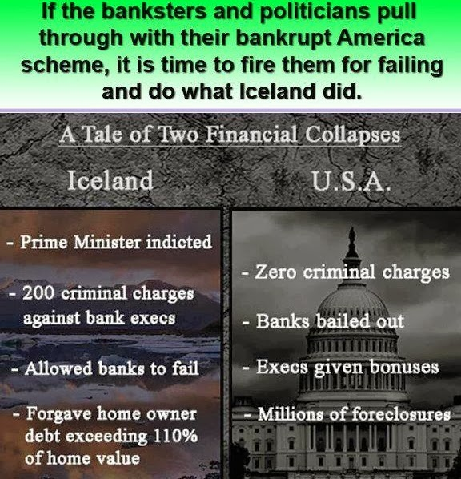
Who Is Responsible?
“It appears to be a pillar of the U.S. ‘justice’ system that the banking crime connected with these disasters must go essentially unpunished.” Zarlenga, LSM, p. 653

Slide 8
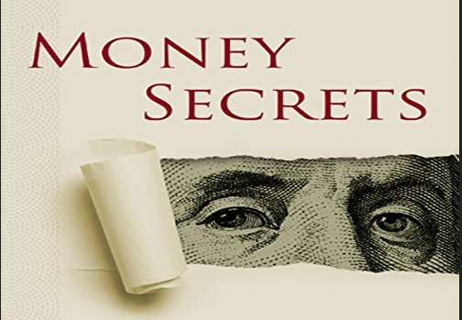
Misdiagnosis of America’s Problems
The nature of money is kept undefined and confused. Therefore, “the money system origin of so many of society’s serious problems” are “obscured”. Zarlenga, LSM, p. 653

Slide 9
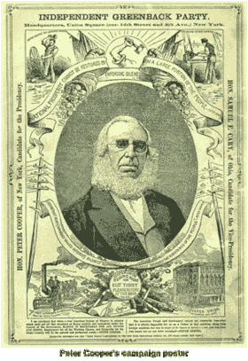
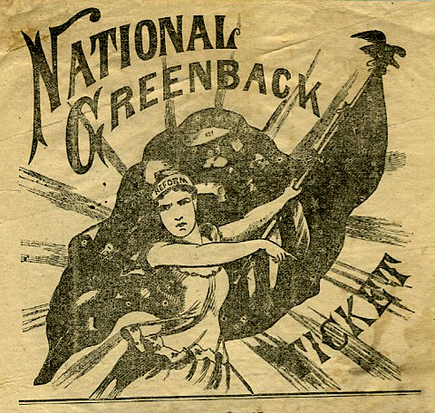
Misdiagnosis of America’s Problems
In the 19th century, the system of money was discussed in national politics. Huge national movements of third parties, like the Greenback-Labor Party, discussed the monetary system and made it the major issue.
PETER COOPERS CAMPAIGN POSTER

Slide 10
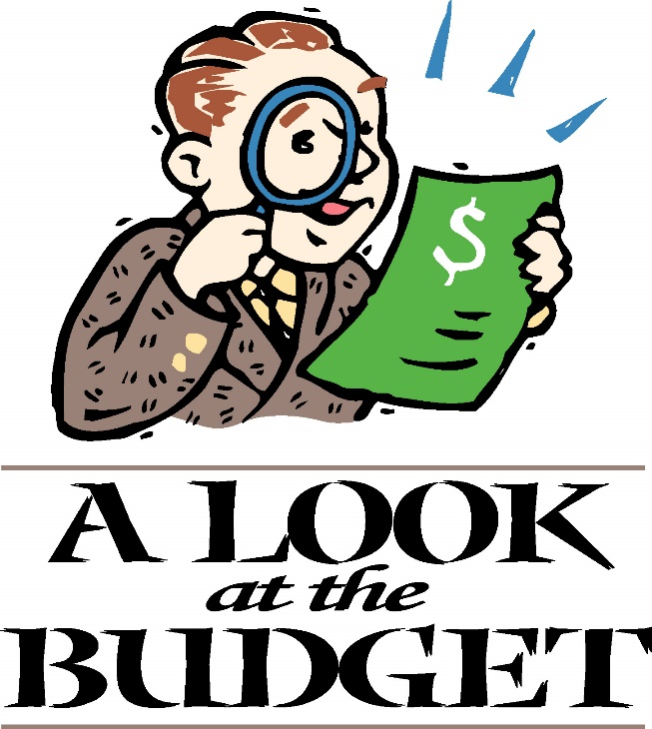
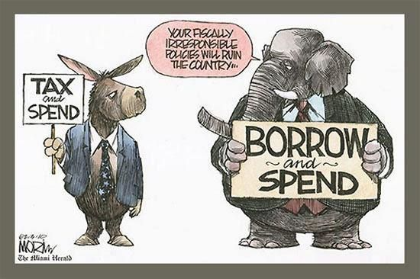
Misdiagnosis: Federal Budget and Debt
The American public is told the government must balance income and expenses, like a household. The government must either tax or borrow, if it needs more money.

Slide 11
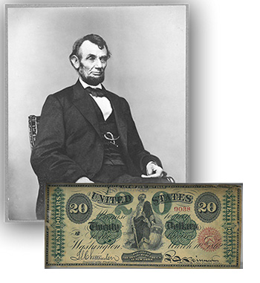
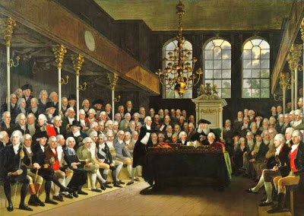
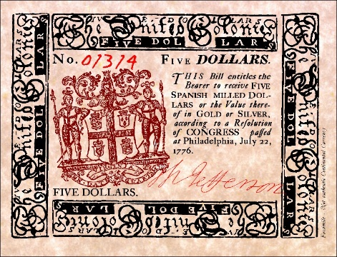
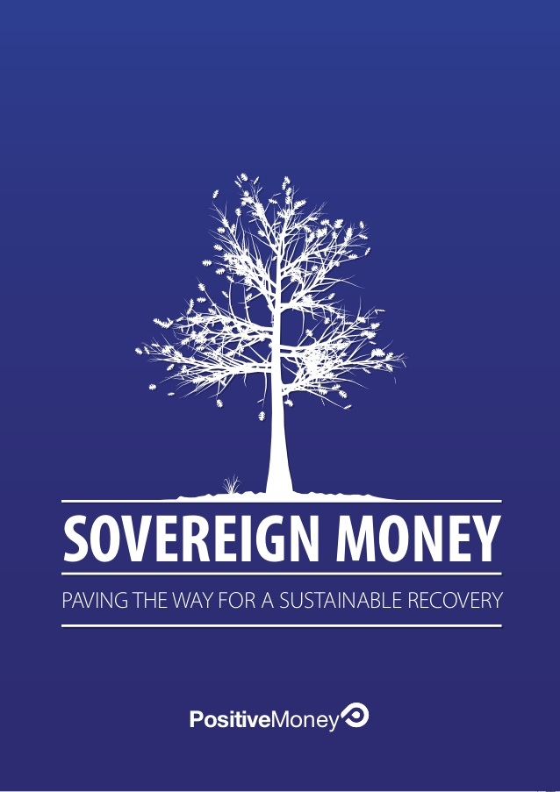
Misdiagnosis: Federal Budget and Debt
But the government is not a household! The government has the power and responsibility of issuing debt-free money for the public good. Creating it and spending it for public needs.
GOVERNMENT DEBT-FREE MONEY CREATION
In the U.S. colonies, all colonial legislatures
issued colonial paper currency. The colonies
thrived on this debt-free money. It was
called colonial script.
Lincoln funded the Civil War with
congressional-issued debt-free paper
money called Greenbacks, rather than
borrow at high interest from the big
banks.

Slide 12
Q & A
WILL’S CONCLUSION:
THE CONTROL OF MONEY -- WITHOUT CONTROL FROM THE PUBLIC -- LEADS TO
CORRUPTION … USURPATION … SLAVERY.

