Slide 1
PRIVATE POWER vs. PUBLIC RIGHTS
Why do Fracking and other Fossil Fuel Corporations
Have So Much Power?"

Slide 2
The Panel
Deirdre Aherne
Lifetime educator (retired) and full-time climate activist with 350NYC, the People’s Climate Movement NY (PCMNY) and WE ACT for Environmental Justice.
Susan Peters
A student of monetary history for the last 6 years, and has spoken publicly on the topic at colleges and civic groups. She has a degree in history and one in education, worked for 32 years on Wall Street as a systems analyst, and has been applying her expertise as a systems analyst to the money system. She is a member of the American Monetary Institute.
B Allen Barndt
B Allen Barndt has worked on Wall Street and the City of London in global banks and management consulting firms. For the last several years, he has been a qualitative researcher focusing on bringing alternative voices into the dialogue about money. The questions and concerns raised by marginalized and non-expert groups challenge the assumptions and terms of debate of the dominant narratives held by economics and financial scholars, officials, journalists, and business expert communities.

Slide 3
Overview
Goals
Explore historical roots of why large corporations in the energy industry have so much power to threaten our environment and our health
Understand how the money system empowers the owners of the fossil fuel economy
Uncover the hidden structures of the banking system that underpin the power of large corporations
Suggest some possible solutions to the underlying problems
Share some grass-roots actions that are challenging the power of the banking system to finance fossil fuel expansion and prevent alternative economies

Slide 4
PARTS OF PRESENTATION
HISTORY & MORE
MONEY BEHIND FOSSIL FUELS & MORE
SOLUTIONS

Slide 5
HISTORY & MORE

Slide 6
What do we mean by the Energy Industry?
Coal --- first coal mining in UK …. 1578 Queen Liz the 1^{st:}:
she issued a 99 year lease to her favorite money lender to surreptitiously lease out the coal mines and rule together the nation’s energy supply
at the same time, Queen Liz passed laws forbidding the use of wood from the forests, forcing people to buy coal
in the people’s mind, the operators of the coal mines were the bad guys, and this false consciousness was reinforced by royal ministers
Oil --- USA 1859; by 1870 John D. Rockefeller Sr. controls Standard Oil trust
Gas --- The world's first industrial extraction of natural gas started at Fredonia, NY in 1825
Fracking
Horizontal fracking: intensive use of chemicals and high-pressure water. Expanded use of ‘eminent domain’ to acquire land rights.
Nuclear Power --- Russia 1954. First commercial nuclear plant, UK in 1956

Slide 7
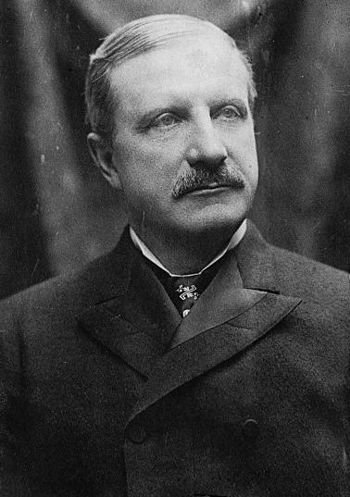
Why is the History Important?
Historically and to this day, the power of the energy industry is fueled by private commercial banks.
The historical relationship between the banking sector and the energy industry enables the growth of all fossil fuel industries.
Examples from history:
Coal - Queen Elizabeth and her money lender, Thomas Sutton, in 1578
Standard Oil – William Rockefeller, 1897, Director, National City Bank (Citibank)- oil, railroad, mining interests. Bank & Oil families intermarried.
WWll – Winston Churchill wanted oil from Persia and Mesopotamia (current day Iran and Iraq) to fuel the British Navy, to replace the coal-burning fleet;
British banks funded oil extraction in Iraq starting in 1890s and pushed to control the Ottoman region
British government created Anglo-Persian, later BP,
Other banking dynasties got into oil (i.e. Mellon, Harriman, Rothschild, etc.)
By 1928, the Middle East oil was shared between British, American, and French oil monopolies.
William Rockefeller

Slide 8
Extreme extractivism in action on land and sea. Why is this a problem for the planet? Keep it in the ground!

Slide 9
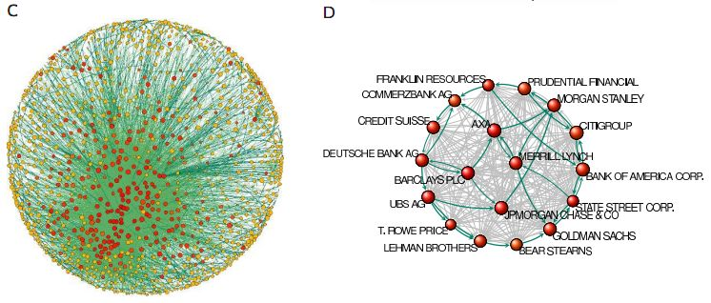
Graphic of Global Capitalist Network: Banks at the core
revealed--the-capitalist-network-that-runs-the-world.html

Slide 10
Is it any coincidence that banking licenses are central to the largest holdings dominating the world economy?
Is it any coincidence that banking licenses are central to the largest holdings dominating the world economy?
1300+ Transnational Corporations, with interlocking ownerships to thousands more, control 20% of the global economy
“They collectively own through their shares the majority of the world's large blue chip and manufacturing firms - the "real" economy - representing a further 60 per cent of global revenues.”
147 “super-entities” control even more
"In effect, less than 1 per cent of the companies were able to control 40 per cent of the entire network," says Glattfelder.
Most were financial institutions. The top 20 included Barclays Bank, JPMorgan Chase & Co, and The Goldman Sachs Group.
Source: http://www.newscientist.com/article/mg21228354.500-revealed--the-capitalist-network-that-runs-the-world.html

Slide 11
Who is financing the enormous production increases of the world’s dirtiest fossil fuel?
From 2005 to mid-2013, 89 commercial banks poured a total of 118 billion euro into the coal mining industry.
The lion’s share of finance – 71% - was, however, provided by only 20 banks.
Together, these banks financed enormous coal mine expansions around the world.”
Source: Finance GreenWatch http://financegreenwatch.org/?p=11028
The study “Banking on Coal,” answers this question.
Published by:
the German environmental NGO urgewald
the Polish Green Network
the international NGO network BankTrack &
the CEE Bankwatch Network.

Slide 12
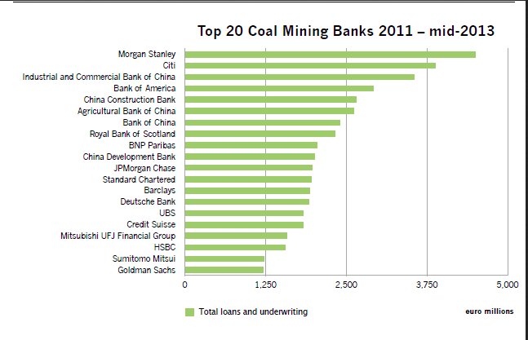
Who is financing the enormous production increases of the world’s dirtiest fossil fuel?

Slide 13
How do bank loans enable fossil fuels?
All corporations need bank credit to run their operations -- Fossil fuel corporations are no different
They actually use a small amount of shareholder money, as little as possible, and borrow the rest
They chase returns that beat the interest rate, this is a motive force for constant growth
Banks create money for them
A quick look at SEC filings of balance sheets reveals this dependency

Slide 14
How do bank loans enable fossil fuels: HALLIBURTON
Security and Exchange Act of 1934, FORM 10-K
HALLIBURTON COMPANY
Guarantee agreements. In the normal course of business, we have agreements with financial institutions under which approximately $1.9 billion of letters of credit, bank guarantees, or surety bonds were outstanding as of December 31, 2012, including $277 million of surety bonds related to Venezuela. p.33
The counterparties to our forward exchange contracts and interest rate swaps are global commercial and investment banks. p.47
U.S. $2,000,000,000 Five Year Revolving Credit Agreement among Halliburton, as Borrower, the Banks party thereto, and Citibank, N.A., as Agent (incorporated by reference to Exhibit 10.1 to Halliburton’s Form 8-K filed February 23, 2011, File No. 1-3492). p. 93
Underwriting Agreement, dated November 8, 2011, among Halliburton and Citigroup Global Markets Inc., Deutsche Bank Securities Inc., HSBC Securities (USA) Inc., RBS Securities Inc., Credit Suisse Securities (USA) LLC, Morgan Stanley & Co. LLC and the several other underwriters identified therein (incorporated by reference to Exhibit 1.1 to Halliburton’s Form 8-K filed November 14, 2011, File No. 1-3492). p.93

Slide 15
How do bank loans enable fossil fuels: PEABODY ENERGY
Security and Exchange Act of 1934, FORM 10-K
PEABODY ENERGY
Our available liquidity as of December 31, 2011 was $2.3 billion, which included cash and cash equivalents of $0.8 billion, $1.5 billion available for borrowing under the Revolver… p.51
The Macarthur Corporate Funding Facility has a $130.0 million Australian dollar sub-limit for bank guarantees, leaving an available capacity of $200.0 million Australian dollars at December 31, 2011. Letters of credit and cash-backed bank guarantees totaling $65.0 million Australian dollars were outstanding as of December 31, 2011. p.51
On October 28, 2011, the Company entered into the 2011 Term Loan Facility that provides for borrowings up to $1.0 billion. The Company borrowed $1.0 billion under the 2011 Term Loan Facility to finance, in part, the acquisition of Macarthur.
Indenture, dated as of March 19, 2004, between the Registrant and U.S. Bank National Association, as trustee (Incorporated by reference to Exhibit 4.12 of the Registrant's Quarterly Report on Form 10-Q for the quarter ended March 31, 2004).

Slide 16
WHAT ARE THE EFFECTS
OF THE DEBT-MONEY SYSTEM?

Slide 17
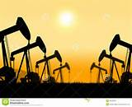
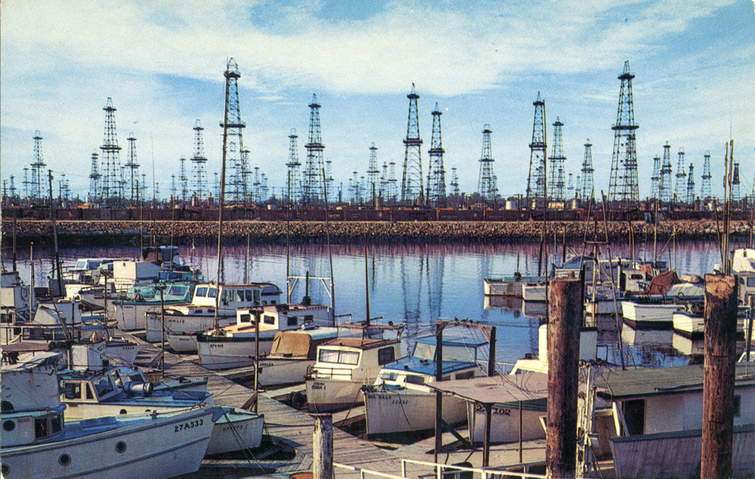
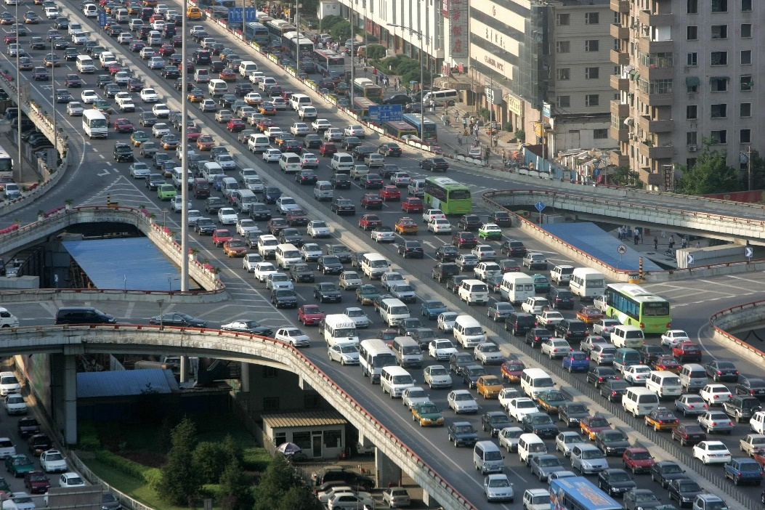
THIS IS THE ‘FIRST USE OF MONEY’ – MONEY CREATED BY BANKS OUT OF DEBT.
THEY LOAN TO BUSINESSES THEY CONTROL.
THEY OWN POWER PLANTS. THEY LEND TO POWER PLANTS.
OWNERS OF BANKS AND FOSSIL FUEL INDUSTRIES (ROCKEFELLER, HARRIMAN, DUPONT, MELLON, ETC. ) CHOOSE
OUR ENERGY CHOICES FOR US.
THEY PROMOTED OIL IN THE 20TH CENTURY. THEY ALSO BLOCKED FUEL CELLS, ELECTRIC CARS, LOCAL ENERGY (HOUSEHOLD WIND MILLS), ALTERNATIVES ENERGIES (WIND, HYDRO).
THEY TOOK AWAY PUBLIC TRANSPORTATION AND PUSHED THE HIGHWAY BILLS TO PROMOTE THEIR AUTOMOBILE.

Slide 18
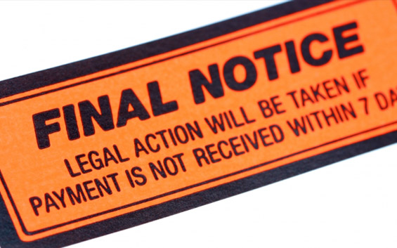
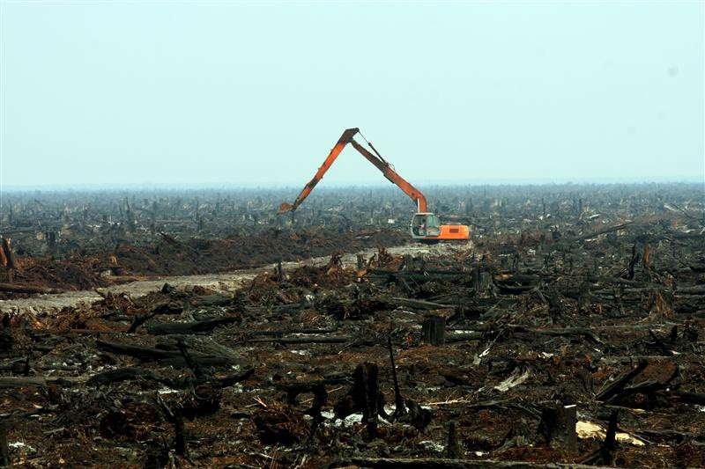
THIS IS THE ‘FIRST USE OF MONEY’ – MONEY CREATED BY BANKS OUT OF DEBT.
WHY DO I HAVE TO PAY YOU SO MUCH OUT OF MY INCOME… WHEN YOU CREATED IT OUT OF NOTHING….
NATURE IS BEING DESTROYED -- NATURE IS COLLATERIAL FOR FUTURE LOANS FROM BANKS. PEOPLE DESPERATE TO REPAY WILL DESTROY THE ENVIRONMENT.
INTEREST COMPOUNDS AND GROW EVEN WHEN WE SLEEP OR ARE SICK… WHAT DID THE BANK DO TO DESERVE THIS? AND THE OWNERS OF THE BANKS ESPECIALLY.
NIGERIAN RAIN FOREST

Slide 19
SINCE ALL MONEY IS DEBT….
THEREFORE, MONEY IS PULLED IN TWO DIRECTIONS
REPAY DEBTS
PAY FOR GOODS & SERVICES

Slide 20
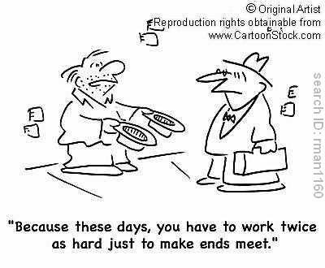
THEREFORE, THIS ‘DOUBLE DEMAND’ ON MONEY
CREATES A CHRONIC LACK OF PURCHASING POWER
CONSUMER: HAS LESS MONEY TO BUY GOODS & SERVICES
DISPOSABLE INCOME

Slide 21
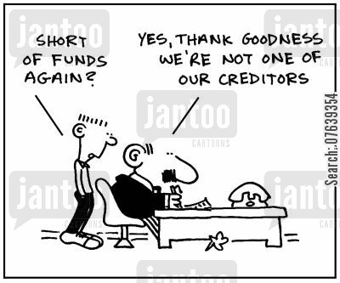
THEREFORE, THE CHRONIC LACK OF PURCHASING POWER
AFFECTS BUSINESSES TRYING TO SELL THEIR GOODS & SERVICES
BUSINESS: ADDS THE COST OF LOANS TO THE PRICE OF GOODS & SERVICES
PRICES

Slide 22
THEREFORE, THE DEBT-MONEY SYSTEM IS A DRIVING FORCE ---
FOR MORE DEBT…..
CONSUMERS:
MUST BORROW-TO-BUY
BUSINESS:
MUST BORROW TO INVEST
GOVERNMENT:
MUST BORROW TO GOVERN

Slide 23
‘MONEY’

Slide 24
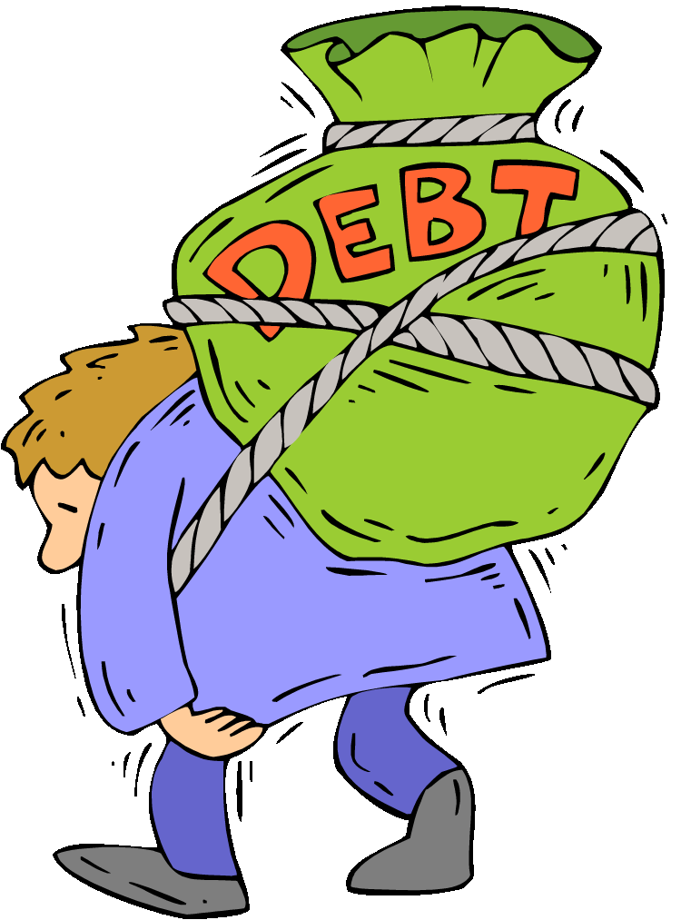
FOSSIL FUELS & OUR DEBT-BASED FINANCIAL SYSTEM
TO WHOM IS EVERYONE IN DEBT?

Slide 25
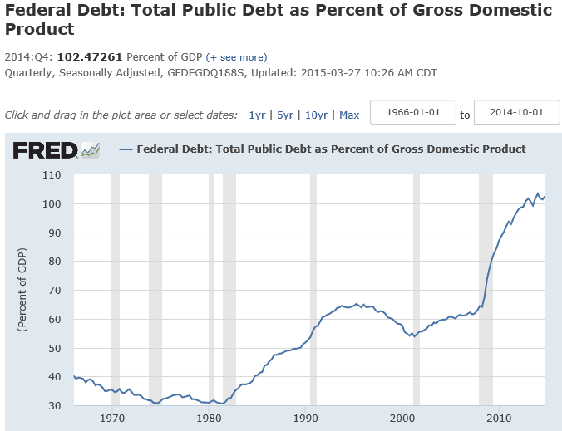
PUBLIC DEBT
U.S.A. is now up to
102% of GDP
WHAT CHANGED AROUND
1980 ???

Slide 26
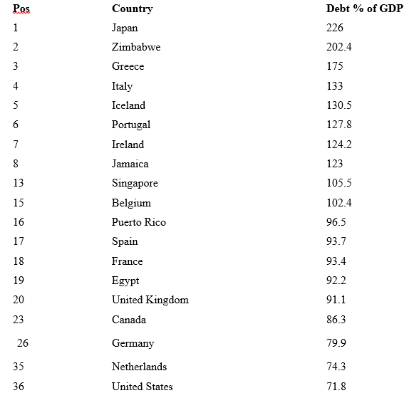
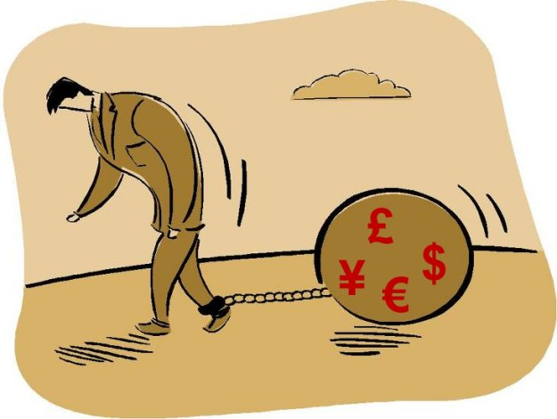
EVERY COUNTRY IN THE WORLD
SUFFERS FROM A MASSIVE,
CONSTANTLY INCREASING
NATIONAL DEBT
PUBLIC DEBT
as % of GDP,
as of 2010
⬅ TODAY, U.S. IS 102% OF GDP!

Slide 27
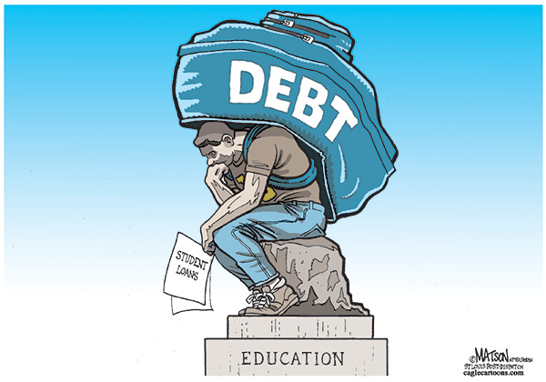
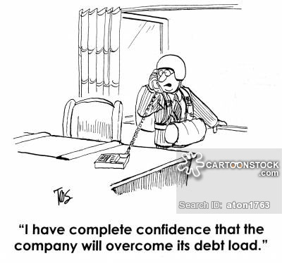
IN ADDITION TO MOUNTING NATIONAL DEBTS, THERE IS
ESCALATING
PRIVATE DEBT
STUDENTS
HOME
BORROWERS
BUSINESS
PEOPLE
CREDIT CARD USERS

Slide 28
IF SO MANY INDIVIDUALS, HOUSEHOLDS, STUDENTS, BUSINESSES AND NATIONS ARE IN DEBT,
WHO ARE THEY IN DEBT TO?
PUBLIC & PRIVATE DEBT

Slide 29
WHY? HOW?
WHO HAS THE WEALTH?
THE OWNERS OF THE PRIVATE BANKING SYSTEM ARE
FAR WEALTHIER THAN ANYONE ELSE…

Slide 30
WHAT THEY OWN

Slide 31
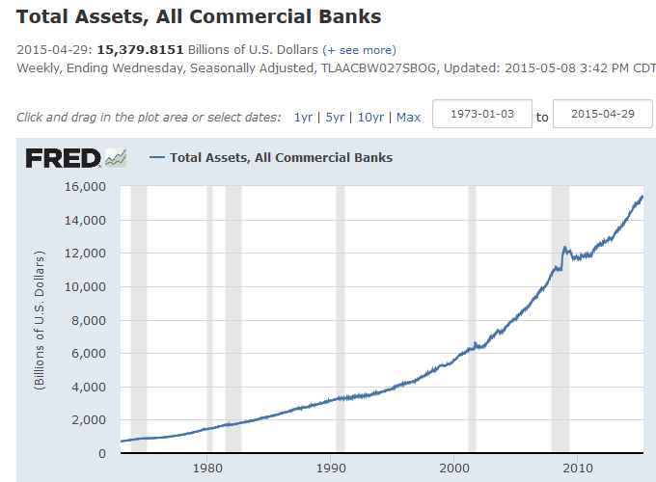
WHAT THEY OWN – 15.4 TRILLION
BANK’S ASSETS ARE:
CASH 2.8 T
LOANS 8.2 T
SECURITIES 3.0 T
OTHER 1.4 T
TOTAL 15.4 T

Slide 32
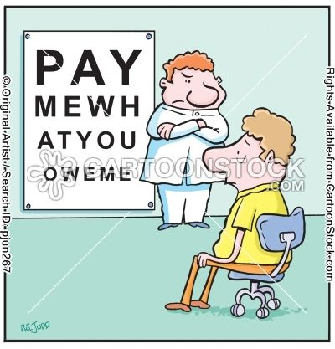
WHAT THEY OWE
O W E M E

Slide 33
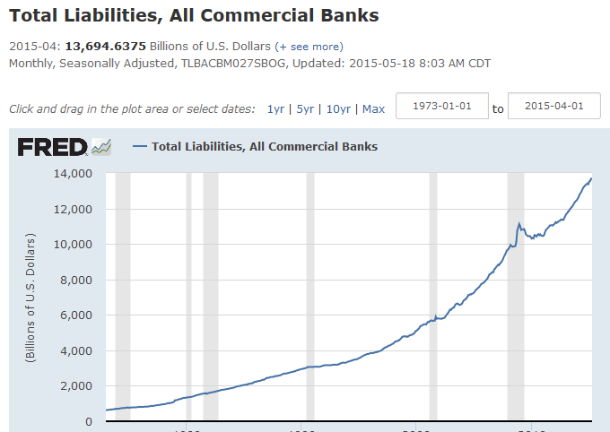
WHAT THEY OWE – 13.7 TRILLION
BANK’S LIABILITIES ARE:
DEPOSITS 10.7 T
BORROWINGS 1.7 T
OTHER .6 T
TOTAL 13.7 T

Slide 34
WHY ARE THE OWNERS OF THE PRIVATE BANKING SYSTEM SO WEALTHY?

Slide 35
LIES WE HAVE BEEN TAUGHT
AND ARE TOLD EVERY DAY

Slide 36
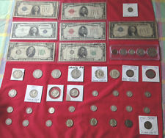
#1 LIE: Government creates our money.
TRUTH: Government only creates 3% of our money –
coins and paper notes.
ONLY 3% OF OUR MONEY SUPPLY!

Slide 37
#2 LIE: Banks lend money they have in the bank.
TRUTH: Banks create brand-new money when they make a loan & type accounting numbers in the borrower’s account.
97% OF OUR MONEY SUPPLY
ALL CHECKING ACCOUNT
MONEY STARTED AS A
PRIVATE BANK LOAN

Slide 38
LIE #3: Private commercial banks (like Bank of America)
are just like any other corporation.
TRUTH: A private bank corporation is a unique
and abnormal corporation.
If the banking corporations decide to give loans, our economy has life.
If they decide to stop making loans and call in loans, our economy dies.

Slide 39
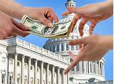
#4 LIE: The government decides who gets money.
TRUTH: Banking corporations decide who gets money
because they decide to whom to give loans [debt].
weapons manufacturers
stock speculators
Congressional lobbyists
agribusiness
fossil fuel companies
mortgagors
multi-national corporations

Slide 40
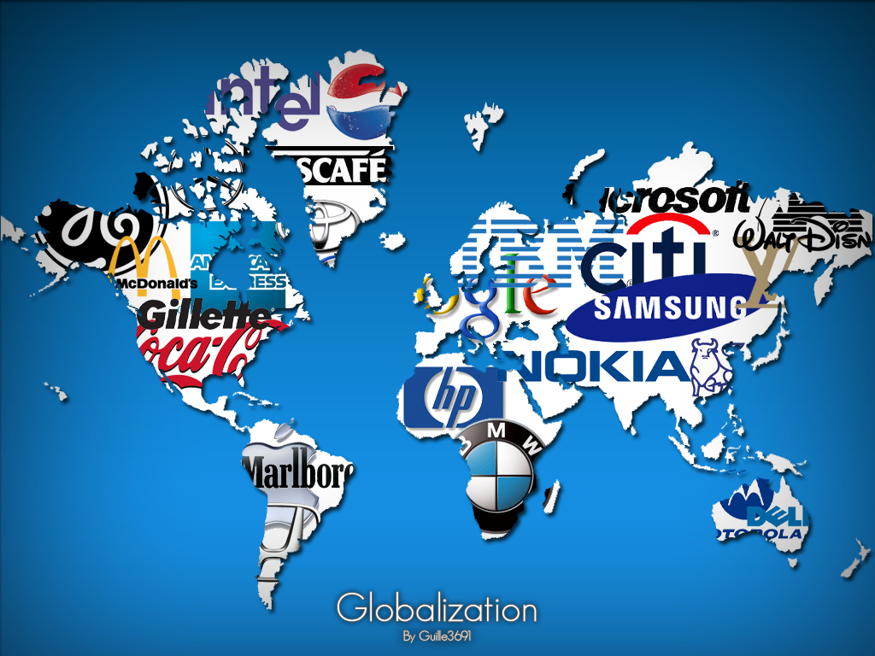
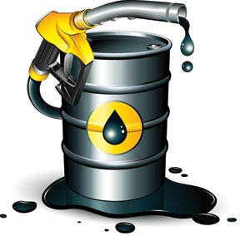
#5 LIE: The problem is multi-national corporations.
TRUTH: The problem is the
PRIVATE DEBT-MONEY banking system.
DEBT
DEBT
DEBT
DEBT
The OWNERS of the private debt-money system also OWN multi-national corporations, and FUEL them with their debt.

Slide 41
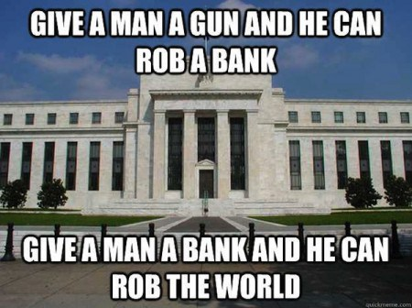
Where does the money for bank loans come from?
Banks create it out of thin air!
Money creation operations conformed by Bank of England, Money Creation in the Modern Economy, The Quarterly Bulletin, 1Q 2014, http://www.bankofengland.co.uk/publications/Pages/quarterlybulletin/2014/qb14q1.aspx
Various money creation theories debunked or validated by Richard A. Werner, Can banks individually create money out of nothing? − The theories and the empirical evidence, International Review of Financial Analysis, Volume 36, 2014

Slide 42
YOU ARE PROBABLY THINKING I AM NOT AN EXPERT
AND DON’T KNOW WHAT I AM TALKING ABOUT….
THAT WHAT I AM SAYING IS NONSENSE OR WORSE!
DON’T TAKE MY WORD FOR IT ====➔

Slide 43
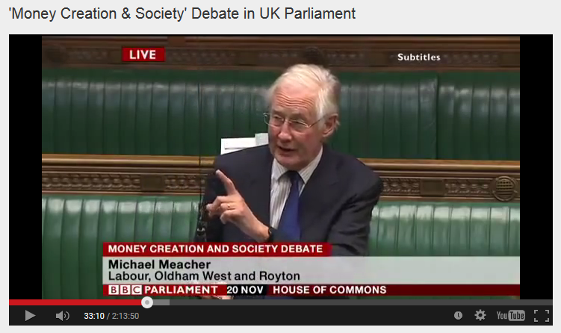
House of Commons, Nov. 20, 2014, Mr. Michael Meacher, MP:
“It is unfortunate… that it is so little understood by the public that money is created every time by the banks when they make loans.”
“And it is the banks – the banks – which determine how money is allocated across the economy.”

Slide 44
House of Commons, Nov. 20, 2014, Mr. Michael Meacher, MP:
“They [the banks] have been granted enormous privileges since they can create [money] simply by writing an accounting entry on a register and they decide who uses that [money] and for what purpose.”

Slide 45
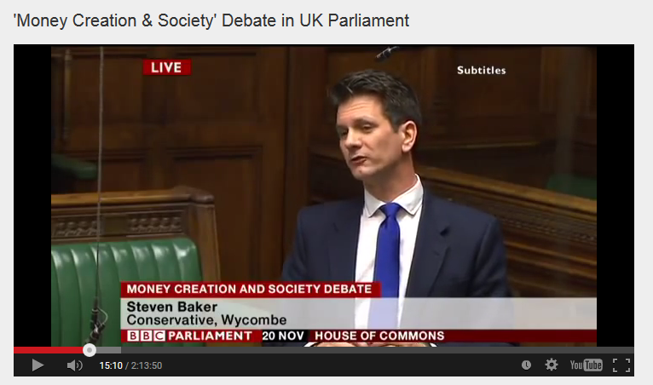
House of Commons, Nov. 20, 2014, Mr. Steven Baker, MP:
“Whenever a bank makes a loan it simultaneously makes a matching deposit in the borrower’s bank account, thereby creating new money.”

Slide 46
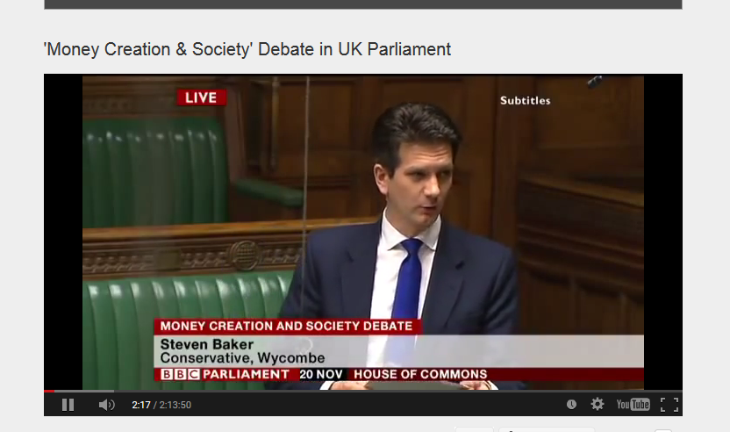
House of Commons, Nov. 20, 2014, Mr. Steven Baker, MP:
“The explanation is actually taken from the Bank of England article ‘Money Creation in the Modern Economy’. It seems to me rather hard to dismiss.”

Slide 47
SOLUTIONS

Slide 48
Why care about money creation?
Money creation is an enormous power in the hands of controlling-stake shareholders and their appointee boards of directors who create money for their own corporate use (fossil fuels, extraction, military industrial complex, real estate, FIRE sector speculation, media, etc.)
All the most powerful corporate family and investor groups also own banking licenses
All main economic theories ignore money creation and money power, focusing us on other factors, so it remains unseen and unchallenged

Slide 49
Banks Determine First Use of Money
Owners of Banks through their appointees to boards of directors decide the shape and direction of our economy by the industries they give credit to
Banks are at the nucleus of the most powerful global holdings groups
Their owners use their banking licenses to fund fossil fuels, extraction, and plantations that exploit low wage workers in countries without laws and human rights
Owners use their banking licenses to create money for the companies they own as credit
Owners, through their lawyers, PACs, and lobbyists, write the rules and craft the legislation

Slide 50
How can we begin to change this?
Money creation in the US is encoded in Article 1 Sections 8 & 10 of the US Constitution – this was the first place money creation was outsourced and privatized into merchant-bankers’ hands in our history
State banking acts, the national banking act, and the Federal Reserve Act contain the rest of the details that got us to where we are today
These laws must become targets for change by progressive movements
We must also begin to create alternatives and replace these laws

Slide 51
What are alternatives?
Alternative money forms exist with radically different social outcomes
Some proposals: Icelandic Sovereign Money Proposal 2015, NEED Act Proposal 2011, Chicago Plan 1930s; Public Banking Act proposals in numerous US states; Alternative Currency Act, AB 129, California
Constitutional Court case in Canada, FEDERAL COURT OF CANADA BETWEEN: COMMITTEE FOR MONETARY AND ECONOMIC REFORM ("COMER"), WILLIAM KREHM, and ANN EMMETT, Plaintiffs - and - HER MAJESTY THE QUEEN, THE MINISTER OF FINANCE, THE MINISTER OF NATIONAL REVENUE, THE B ANK OF CANADA, THE ATTORNEY GENERAL OF CANADA, Defendants; Rocco Galati, Esq, Plaintiffs’ Counsel
Local money/complementary currency programs (EU 20+ Germany, 50+ France, etc.)
Mutual credit networks expanding all over the world

Slide 52
What are alternatives?
 | Bank Credit/Debt Money | Public Banking | Sovereign Money | Local Complementary Currencies | Mutual Credit, Local Exchange Trading Systems, Time-banking
Unit | $, £, ¥, €, etc. | $ (North Dakota), RMB, R$, € (regional/community) | Channel Islands, Icelandic Proposal, NEED ACT (US), Positive Money (UK) | Various, Sol-Violette, Le Palmas, Cheimgauer, Bristol £, Totnes £, Ithaca Hour, Credito, 100+ EU pilots | Various, Swiss WIR, Bay Bucks (SF, CA), etc.
How issued | Private banking system, debt-money | NFP Publicly-owned bank, debt-money | Monetary Authority, debt-free money | Participants volunteer in closed-circuit, debt-free participant-created money | Members create credit between themselves, participant-created ‘real’ credit (non-debt)
BANK CREDIT
‘DEBT-MONEY’
SOVEREIGN MONEY
DEBT-FREE MONEY
LOCAL CURRENCIES
DEBT-FREE MONEY
PERSONAL CREDIT
Sources:
Doug Rushkoff, Life, Inc.
Bernard Lietaer, Rethinking Money
Thomas Greco, The End of Money and the Future of Civilization
Troost/Hersel: How a socialization of the German banking system might look like, Rosa Luxemburg Stiftung
***MONEY IS ISSUED AND CIRCULATES***
+++CREDIT APPEARS AND DISAPPEARS+++

Slide 53
Why should we care now?
Progressive movements talk about a lot of goals to make a better world.
But, we never talk about how money is created, how 1st use impacts us, and how to change it
We need to make money reform/alternative money an important part of our work for change
The important part now is to recognize this Achilles Heel for fossil fuels, begin to educate ourselves about alternatives, and find money reform movements to support

Slide 54
How Activists are Fighting Back
DIVESTMENT MOVEMENT
PUTTING PRESSURE ON BANKS NOT TO INVEST IN NEW FOSSIL FUEL INFRASTRUCTURE
EDUCATING PEOPLE ABOUT THE DEBT-MONEY SYSTEM
ORGANIZING A NATIONAL MOVEMENT FOR GREENBACK DEBT-FREE MONEY ISSUED BY GOVERNMENT
BUILDING LOCAL COMPLEMENTARY AND MUTUAL CREDIT ALTERNATIVES TO FILL THE VOID WHEN THE NEXT CRISIS MEANS BANKS STOP LENDING TO PEOPLE CREATING NEW SUFFERING

Slide 55
WE DO NOT HAVE TO LIVE WITH THIS MONEY SYSTEM!
TAKE BACK OUR GOVERNMENT…
TAKE BACK OUR MONEY SYSTEM…
FOR A MORE PEACEFUL WORLD

