Slide 1
PANEL: The Secret Pillars of Capitalism - Land Control and Debt-Money: Two Systems That Enslave Us and How We Can Change Them SUNDAY, JUNE 1 10:00am - 11:50am (Room 9.68)
PART 4: BANK DEBT AND HUDSON YARDS
LAND-MONEY STUDY GROUP

Slide 2
MONEY IS ...
#1
UNIQUE

Slide 3
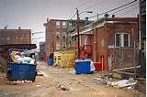
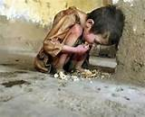
MONEY IS UNIQUE – IT HAS THE POWER OF LIFE AND DEATH Without money, people die.

Slide 4
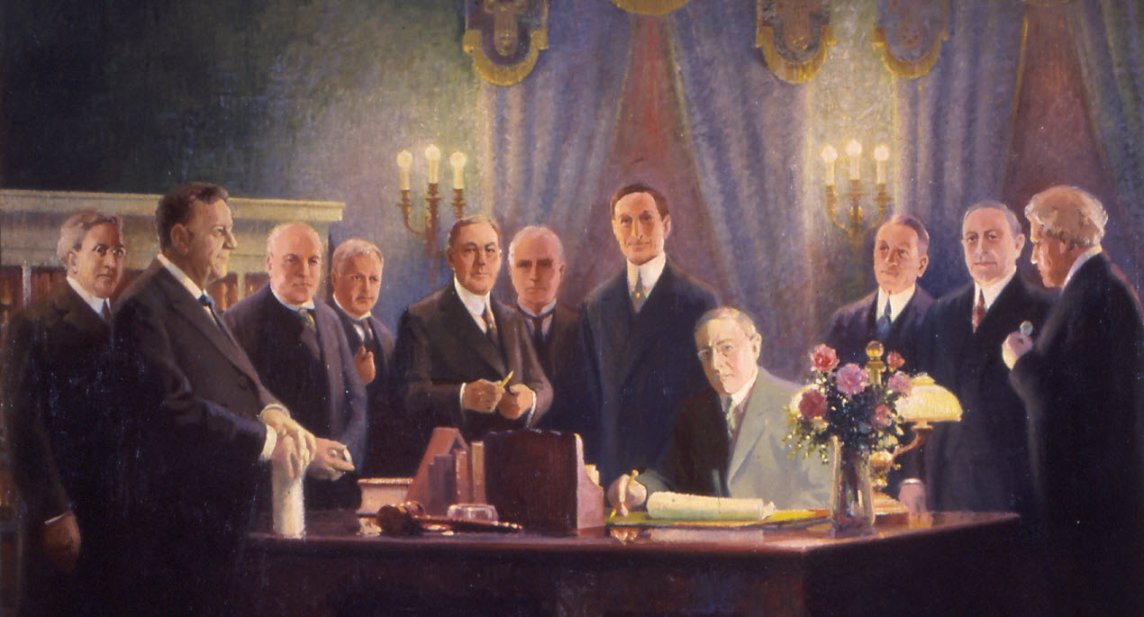
MONEY IS UNIQUE
A HUMAN INVENTION, EXISTING IN THE LAW

Slide 5
#2
THE NATURE OF MONEY IS PURPOSELY KEPT SECRET AND CONFUSED.
WHY ?

Slide 6
BECAUSE OUR MONEY HAS BEEN …
PRIVATIZED

Slide 7
PRIVATE COMMERCIAL BANKS –
Do not lend your deposits to borrowers
NO
DEPOSITS
(savings)
LOANS
(investment)

Slide 8
IT IS THE EXACT OPPOSITE !!!

Slide 9
A borrower signs a loan contract,
and the BANK CREATES A DEPOSIT
in the borrower’s account
LOANS
CREATE
DEPOSITS

Slide 10
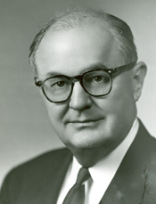
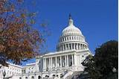
Wright Patman, TX Democrat,
Chair, US House Committee on Banking and Currency (1965-75):
“Although banks no longer have the right to issue bank notes,
they can create money in the form of bank deposits
when they lend money … or buy securities …”

Slide 11
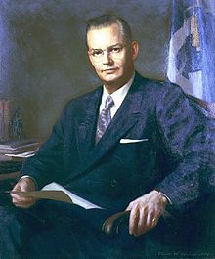
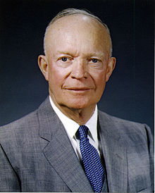
Who knew about this private takeover of our money? How do I know it is true?
Robert B. Anderson, Secretary of the Treasury under President Eisenhower:
"When a bank makes a loan it simply adds to the borrowers’ deposit account in the bank by the amount of the loan. The money is not taken from anyone else's deposit … It's new money, created by the bank for the use of the borrower.“

Slide 12
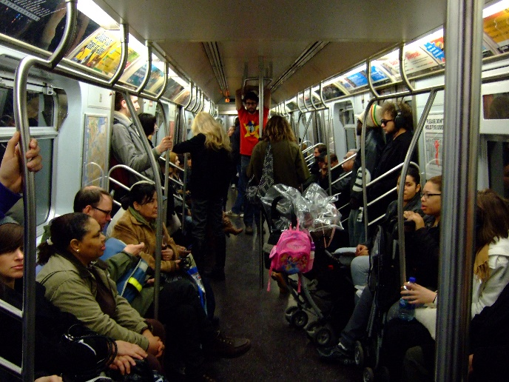
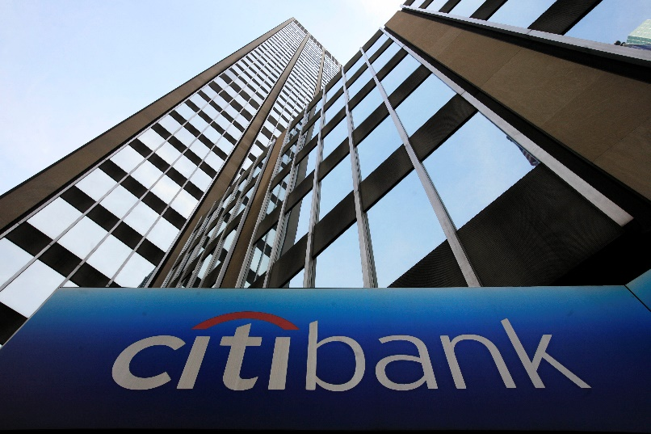
THE PRIVATE BANK MAKES UP THE DEBT-MONEY LOAN OUT OF ‘THIN AIR’. THE WORKING-CLASS BORROWER MUST REPAY PRINCIPAL AND INTEREST WITH HARD WORK.
WHAT WORK DID THE BANK DO TO CREATE THIS CONTRACTUAL DEBT?
CREATING LOANS FROM
‘THIN AIR’
‘THIN AIR’
PRINCIPAL
WORK
INTEREST
WORK
PROFIT
NYC SUBWAY RIDERS ON WAY
TO WORK

Slide 13
WHY ARE WE NOT TAUGHT THIS ? ? ? ?
WHY ?
CONCENTRATION OF WEALTH
Less than 1% of the population now claims ownership of almost 50% of the wealth.

Slide 14
THE SYSTEM CONCENTRATES WEALTH
The private banks get interest on all of our money
HOUSEHOLDS:
MORTGAGE LOANS,
STUDENT LOANS,
CAR LOANS, ETC.
SMALL
BUSINESS
LOANS
INTEREST
INTEREST
PRIVATE
BANKS
INTEREST
INTEREST
GOVERNMENTS LOANS:
FEDERAL,
STATE, LOCAL
CORPORATE
LOANS

Slide 15
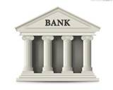
THE SYSTEM CONCENTRATES WEALTH
PRINCIPAL
BORROWER’S CHECKING ACCOUNT
___DEBIT___________CREDIT____
|
| $40,000
| LOAN PRINCIPAL
REPAY PRINCIPAL
THE BANKS NEVER
CREATE THE MONEY
FOR THE INTEREST
HOW CAN THE BORROWERS OF ALL THESE LOANS REPAY WITH THE INTEREST ????
THEY CAN’T !!!!!
WHAT IS MISSING?

Slide 16
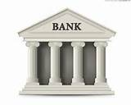
THE SYSTEM CONCENTRATES WEALTH
There will always be people who cannot pay off their debts.
The banks get the collateral.

Slide 17
THE SYSTEM CONCENTRATES POWER
Historically, the first goal of the owners of the money system is to buy the government.
LOBBYISTS
GIVE LOANS &
CONTRIBUTIONS TO
PRIVATE COMMERCIAL BANKS:
GOLDMAN, CITI, MORGAN CHASE, BOA, ETC.
PACS
ELECTIONS

Slide 18
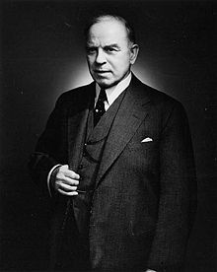
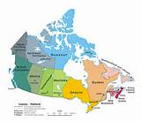
THE SYSTEM CONCENTRATES WEALTH
William Lyon Mackenzie King, 10th Prime Minister of Canada 1935-48:
"Until the control of the issue of … (MONEY) … is restored to government and recognized as its most sacred responsibility, all talk of the sovereignty of parliament and of democracy is idle and futile....”

Slide 19
THE SYSTEM DECIDES WHAT KIND OF SOCIETY WE WILL HAVE
The power of money creation funds the Financial – Military – Industrial Empire
HEDGE FUNDS, ASSET MANAGERS
PRIVATE COMMERCIAL BANKS:
GOLDMAN, CITI, MORGAN CHASE, BOA, ETC.
STOCKS, BONDS, DERIVATIVES
LOANS & INVESTMENT
UNIVERSITIES FOR
MILITARY RESEARCH
WEAPONS

Slide 20
The nature of the Money System must not be known.
MEDIA CORPORATIONS
to confuse the public
PRIVATE COMMERCIAL BANKS:
GOLDMAN, CITI, MORGAN CHASE, BOA, ETC.
GIVE LOANS AND INVESTMENTS TO….
HISTORY DEPARTMENTS
to erase
monetary history
ECONOMICS DEPARTMENTS
to erase the nature of money

Slide 21
WHY ARE WE NOT TAUGHT THIS ? ? ? ?
WHY ?
CONCENTRATION OF WEALTH

