Slide 1
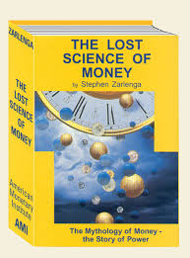
“Over time, whoever controls the money system, controls the nation.” Stephen Zarlenga (1941 – 2017)
With the publication of his book,
THE LOST SCIENCE OF MONEY, in 2002,
Stephen Zarlenga began a reform movement.
Thank you, Stephen!
Stephen brilliantly defined “usury” as
“the structural misuse of society’s money system”.

Slide 2
Hi! I’m going to talk about two things:
PART 1 THE SYSTEM PART 2 ITS CONSEQUENCES

Slide 3
Meet the system!
Private banks create the money we need…

Slide 4
Private banks create our money! Not our government?
I don’t believe it… It’s too hard to believe…
You don’t have to believe me. Here… listen to others ➔ ➔ ➔ ➔
Notes:
4

Slide 5
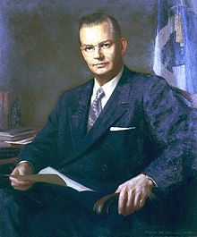
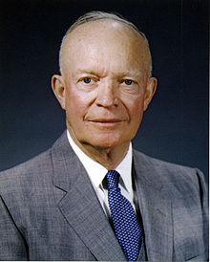
Robert B. Anderson, Secretary of the Treasury under President Eisenhower:
"When a bank makes a loan it simply adds to the borrower’s deposit account in the bank by the amount of the loan.
The money is not taken from anyone else's deposit…
It's new money, created by the bank for the use of the borrower.“
Robert B. Anderson
Secretary of the Treasury, 1957-1961
President Dwight D. Eisenhower
1953-1961

Slide 6
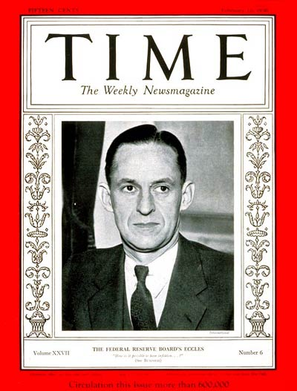
“That is what our money system is. If there were no debts in our money system, there wouldn’t be any money.”
Mariner S. Eccles
Chairman, Federal Reserve
under President Franklin D. Roosevelt
Notes:
6

Slide 7
Let’s look at the money system.
How does it work?

Slide 8
#1
When someone borrows from a bank, the money put into their checking account is created by the bank.
(The money supply grows.)
When the borrower repays the bank, the MONEY DISAPPEARS.
(The money supply shrinks.)
What! This can't be! We all need that money! It mustn’t go away!
Notes:
8

Slide 9
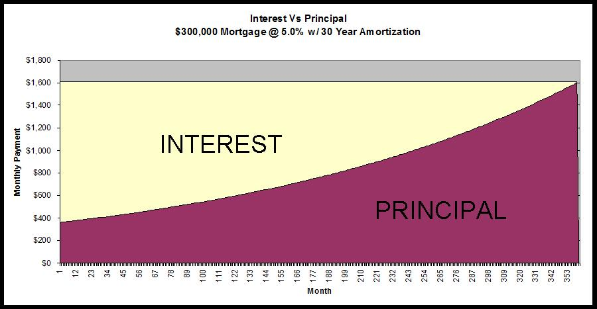
#2
Of course, we know that every borrower must pay interest.
What many don’t realize is that banks NEVER CREATE THE MONEY FOR THE INTEREST. Only for the principal of the loan.
Oh, my goodness.
This is getting really confusing.
Why not create the interest?
NEVER CREATED➔
Notes:
9

Slide 10
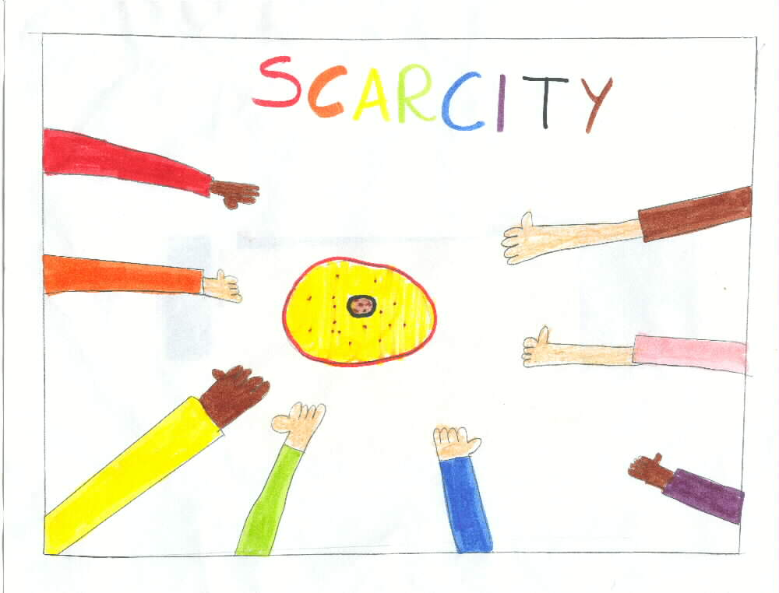
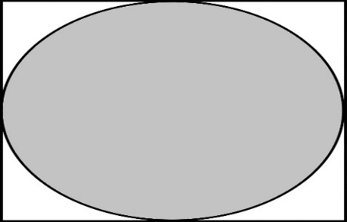
Since the money for interest is never created, money is always SCARCE.
Where will I get the money to pay the interest !!!
PRINCIPAL ONLY
LOOK HERE ➔ ➔
Notes:
10

Slide 11
With more loans!!!
CREDIT CARD DEBT
CAR LOAN DEBT
STUDENT DEBT
HOME MORTGAGE DEBT
Notes:
11

Slide 12
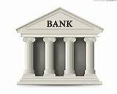
Or the bank gets the wealth -- ah -- excuse, me –
I meant ‘collateral.’
DEBT SLAVE
Notes:
12

Slide 13
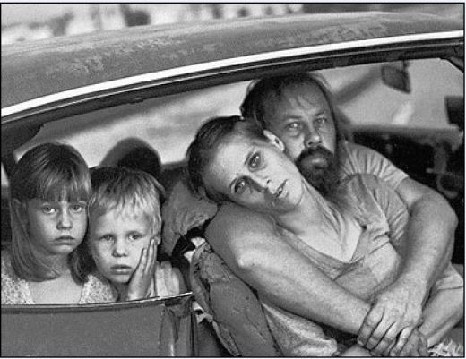
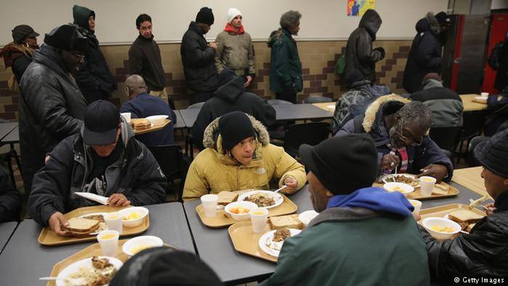
The SYSTEM DEMANDS that more loans be created, or else there will be defaults, foreclosures, bankruptcies, and unemployment…
All the while the banks and the top 1% become richer….
Remember 2008?
Notes:
13

Slide 14
The banking system decides… …who gets the money, …and how much.
Umm. I don’t like the sound
of this….

Slide 15
THIS SYSTEM CAN BE CHANGED!
Remember that!
THE NEED ACT

