Slide 1
Private Bank Debt-Money & Its Impacts on Humans
Where does money come from?
What gives corporations their power?

Slide 2
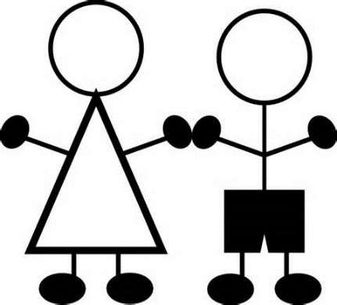
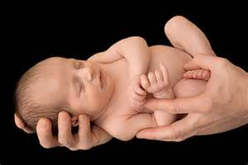
Where does our money come from?
Well, I earn mine from my job.
No, no. What I mean is, who creates the dollars? Where do the dollars get born?

Slide 3
Oh, that’s easy. Everybody knows our government creates the money.
The government spends too much,
my taxes are way too high,
and it’s all the government’s fault!
Uum…that’s interesting but doesn’t make sense.
What do you mean, doesn’t make sense?

Slide 4
Think of this.
If our government is the creator of our money,
why is our government 19 trillion dollars in debt?
Ah…. ah…. well….
I never thought about this!

Slide 5
LOOK ME STRAIGHT IN THE EYE….
Okay…..
REPEAT AFTER ME….
Okay…..

Slide 6
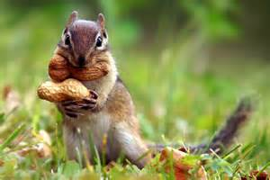
Our money is created by PRIVATE, COMMERCIAL BANKS…
…our money is created … by PRIVATE, COMMERCIAL BANKS ???
…whenever they create a loan or buy a stock or bond.
…whenever they create a loan …. or buy a stock or bond?
Ah….not quite sure what this means …

Slide 7
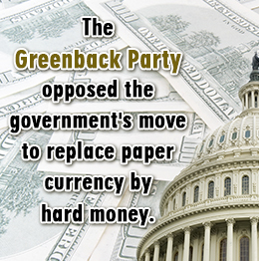
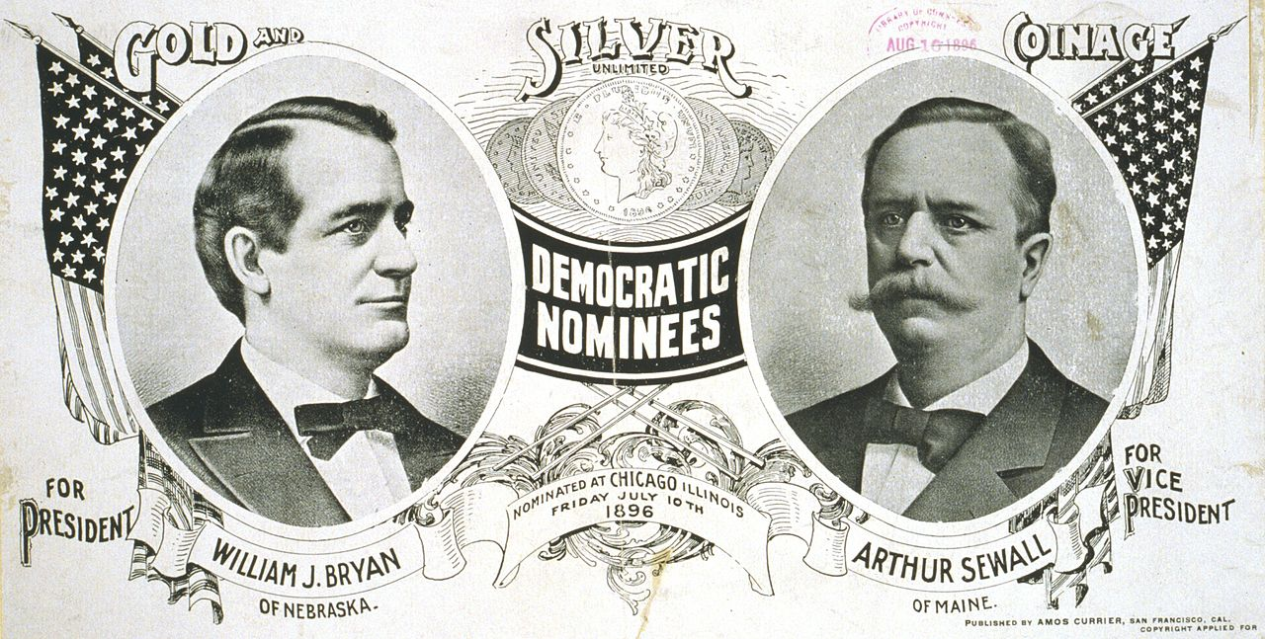
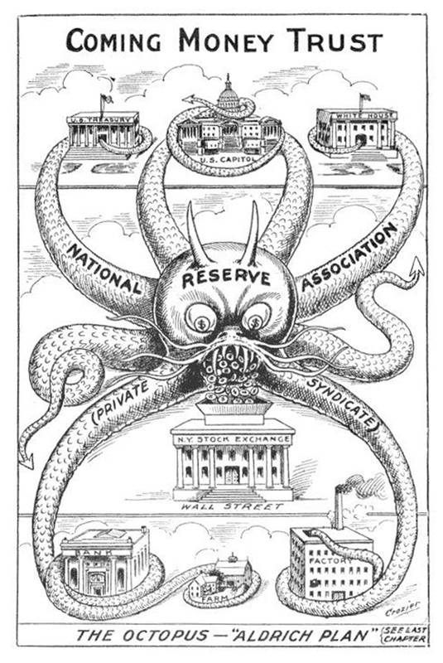
The History of Money Creation has been suppressed…
By whom?
When?
Where?
Since 1930’s, the discussion of who creates our money has disappeared from public discourse

Slide 8
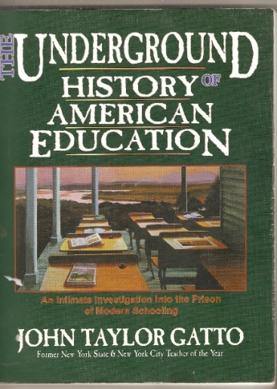
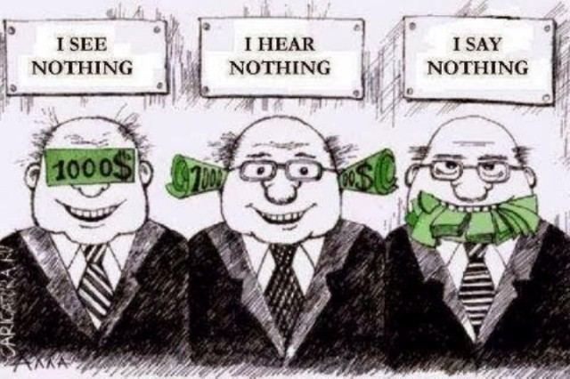
WHOEVER CONTROLS THE MONEY, CONTROLS THE SOCIETY…
EDUCATION GOVERNMENT PRESS

Slide 9
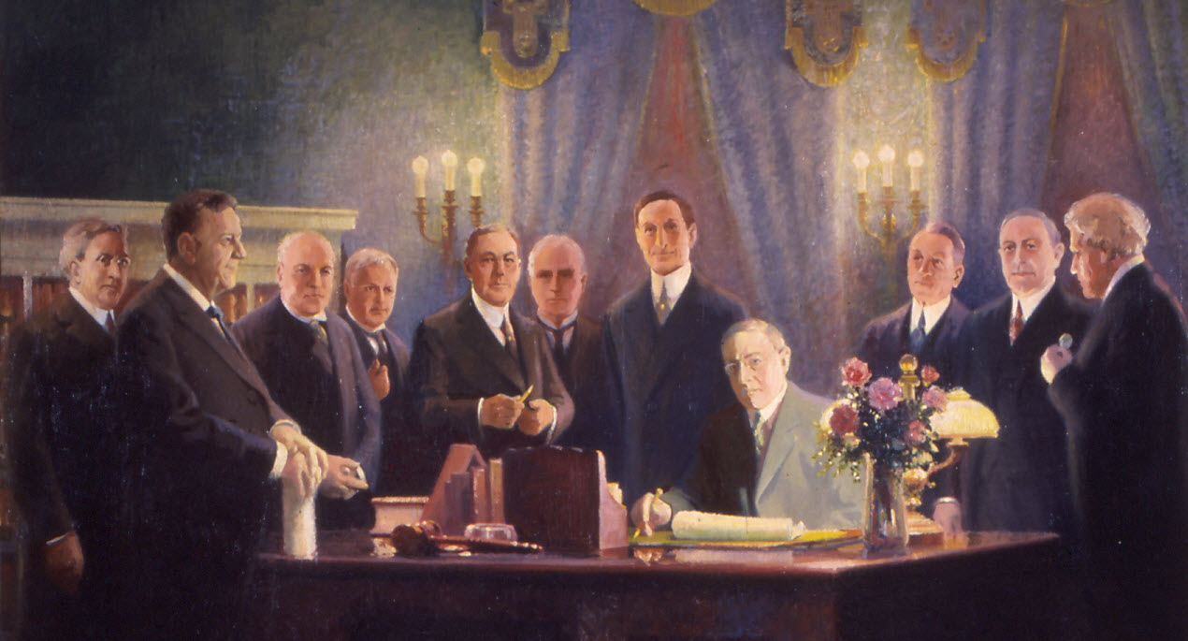
In 1913 the Federal Reserve Bill created a private central bank system.
The member commercial banks were legally allowed to create money ‘out of thin air’.
But I thought banks ‘lend’ money. Supposedly, the money is in the bank, and we pay them interest for the use of it!
President Wilson signing Federal Reserve Bill.

Slide 10
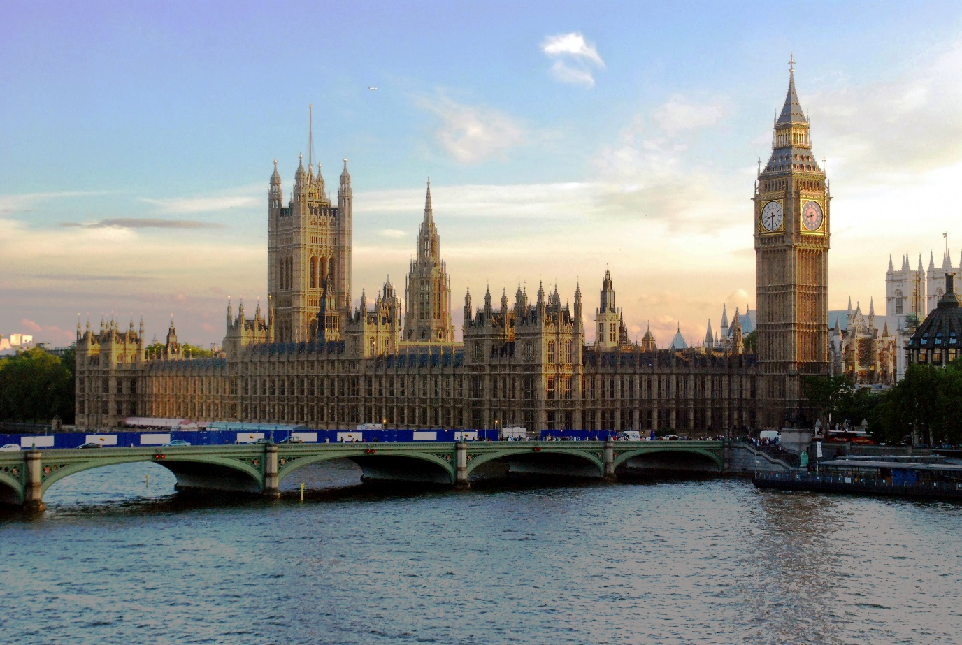
I don’t believe it… It’s too hard to believe.
You don’t have to believe me. Here… listen to a member of Parliament.

Slide 11
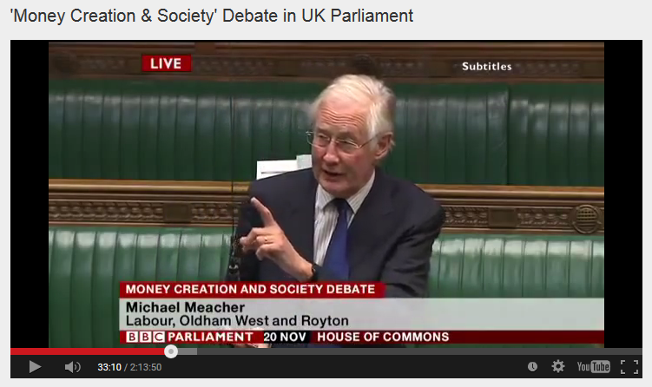
House of Commons, Nov. 20, 2014, Mr. Michael Meacher, MP:
“It is unfortunate… that it is so little understood by the public that money is created every time by the banks when they make loans.”
“And it is the banks – the banks – which determine how money is allocated across the economy.”

Slide 12
How does this hidden system work?

Slide 13
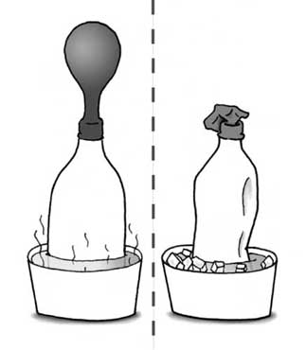
#1:
When a private commercial bank makes a loan, it CREATES MONEY.
The money supply GROWS.
When the loan is repaid, the MONEY DISAPPEARS.
The money supply SHRINKS.
What! This can't be!
Whoever heard of such a thing!
MONEY SUPPLY
GROWS & DISAPPEARS
(‘BUSINESS CYCLE’)
BANKS MAKE
LOANS
BANKS STOP
MAKING LOANS

Slide 14
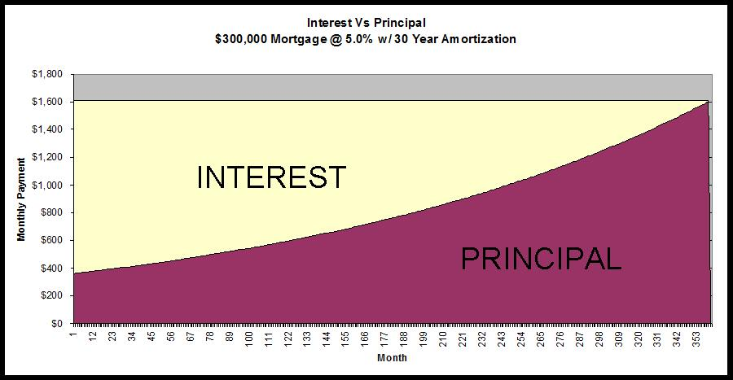
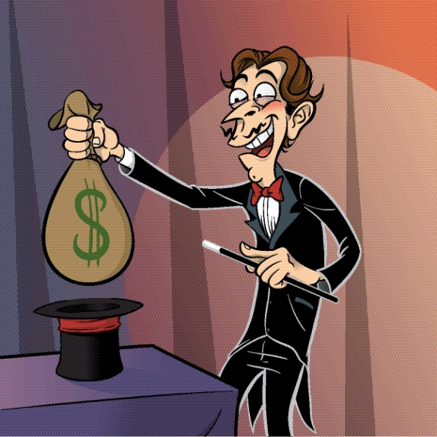
#2:
Of course, we know that every borrower must pay interest.
What is not known, is that banks NEVER CREATE THE MONEY FOR THE INTEREST. Only for the principal of the loan.
NEVER CREATED➔
Oh, my goodness.
This is getting really confusing. Why not create the INTEREST?

Slide 15
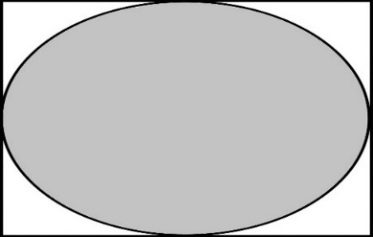
Since the money for interest is never created, money is always SCARCE. There is never enough money TO REPAY ALL THE LOANS AND INTEREST.....
That doesn’t
seem fair to me…
In fact…that’s a
******* CRIME!
NO INTEREST
PRINCIPAL ONLY

Slide 16
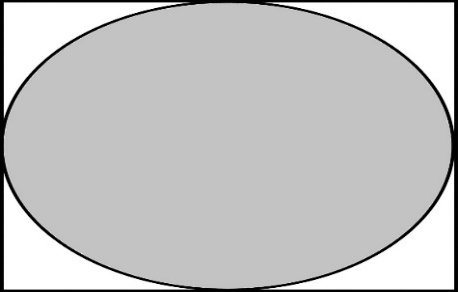
Day by day, loans are always being repaid, so the money supply is always shrinking. So, someone always must go into debt…to create money.
WHAT !!!!
Who made this system?
We are all slaves
to this system!
NO INTEREST
PRINCIPAL ONLY

Slide 17
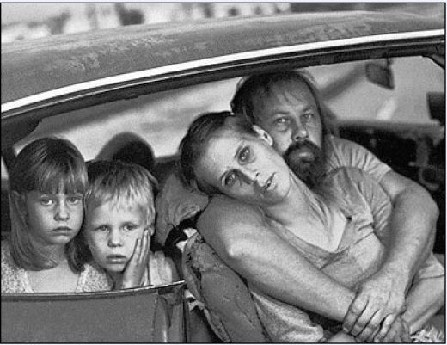
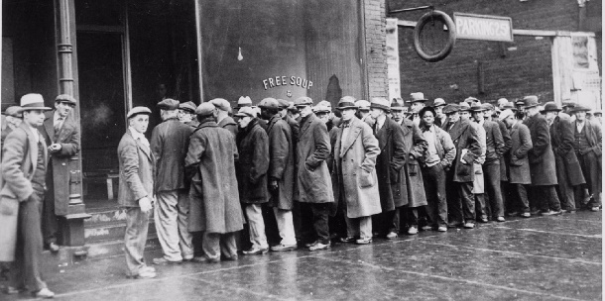
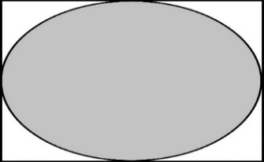
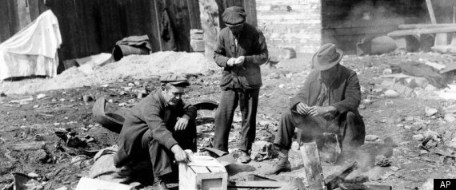
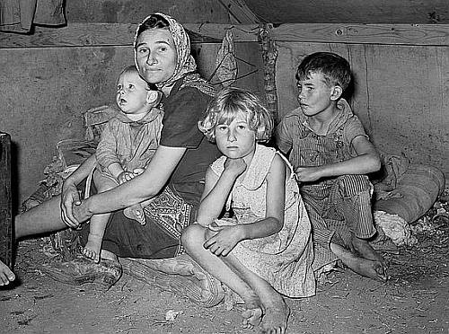
Thus, the system DEMANDS THAT MORE LOANS BE CREATED, else the money supply will shrink and there will be defaults, foreclosures, bankruptcies, unemployment, recessions, depressions, complete economic collapse.
DAMN! We are screwed!
NO INTEREST
PRINCIPAL ONLY

Slide 18
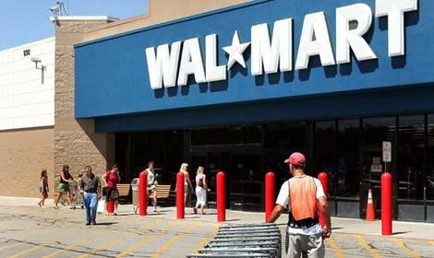
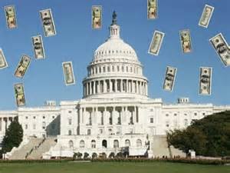
#3:
The banks decide the nature of our society,
because they decide who gets loans (debt-money).
FOSSIL FUELS
WAR & WEAPONS
AGRIBUSINESS
LOBBYISTS
SPECULATORS
FREE TRADERS
DEPARTMENT STORES &
GROCERY STORES

Slide 19
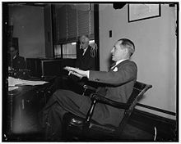
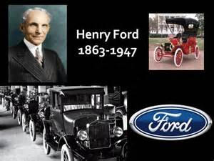
Mariner S. Eccles
Chairman, Federal Reserve
under President Franklin D. Roosevelt:
“That is what our money system is.
If there were no debts in our money system,
there wouldn’t be any money.”
Henry Ford:
“It is well enough that people of the nation do not understand our banking and monetary system, for if they did,
I believe there would be a revolution before tomorrow morning.”
You can say that again!

Slide 20
Wait one minute.
Does this twisted system have anything to do with the massive power of corporations?

Slide 21
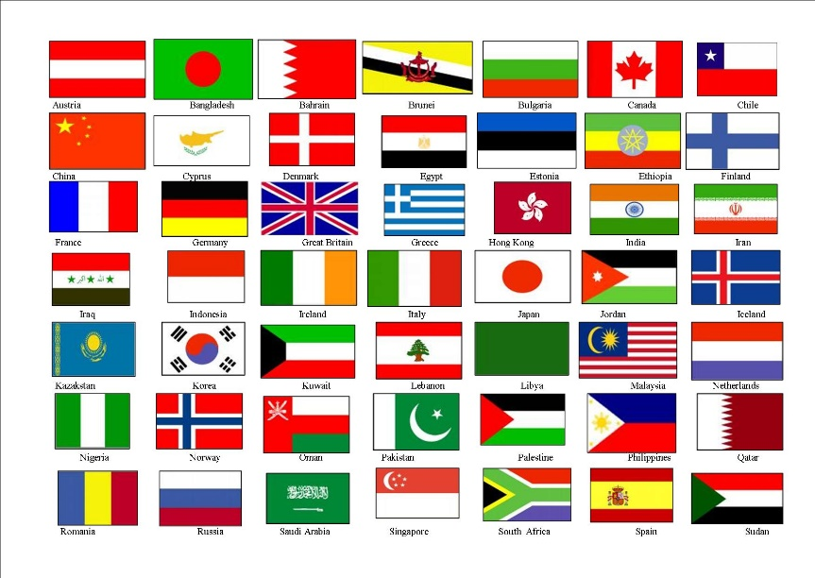
The PRIVATE BANK DEBT-MONEY system has spread to every country.

Slide 22
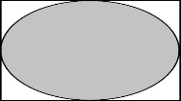
In each country, the DEBT-MONEY system causes:
#1
PRINCIPAL
SCARCE MONEY
#2
LACK OF PURCHASING POWER
#3
WAGE DEPENDENCY

Slide 23
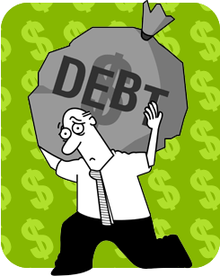
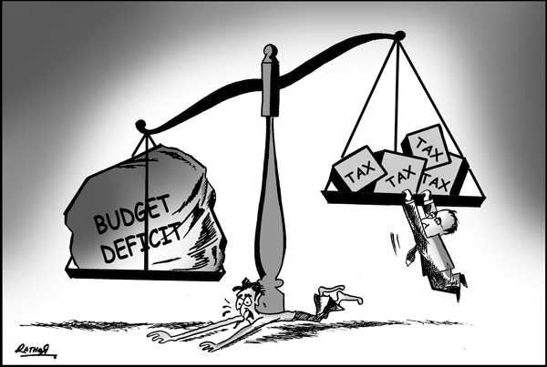
#1
SCARCE MONEY:
Money is constantly disappearing as the debt is paid down.
All are forced to borrow to have a money supply.
Consumers borrow
to buy
Industry borrows
to invest
Government borrows
to pay expenses

Slide 24
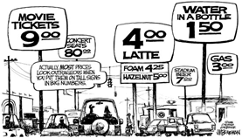
#2
LACK OF CONSUMER PURCHASING POWER
Business debt elevates prices.
Consumer debt reduces spending money (reduces purchasing power).
RESULT: business cannot sell all its products and services.
I can’t afford it!

Slide 25
#3
WAGE DEPENDENCY
A person with a 25 year mortgage, confronted with goods priced out
of his reach, and taxed to the eyeballs, will do anything to keep his job
and will do any job.
I have to keep my job!
Else I will be homeless and hungry!

Slide 26
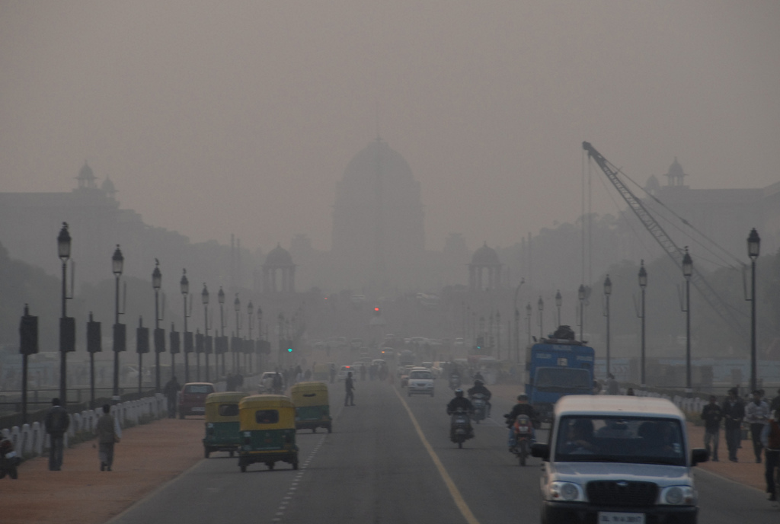
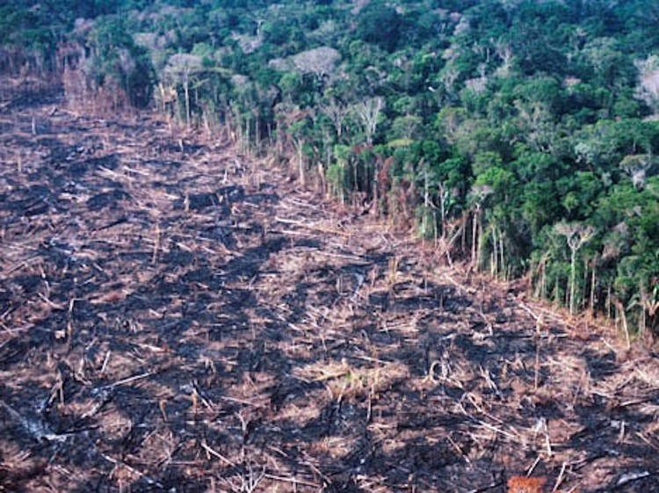
THE RESULT in every country:
BUSINESS IS FORCED TO EXPORT to sell all their goods.
ECONOMIC GROWTH IS FORCED to pay debts and give everyone a job.
INDIA AND OZONE POLLUTION
CORPORATE DESTRUCTION OF RAIN FOREST

Slide 27
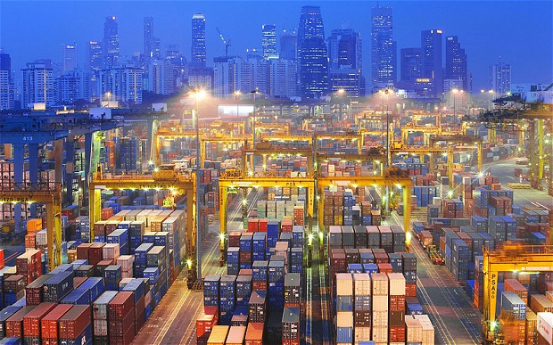
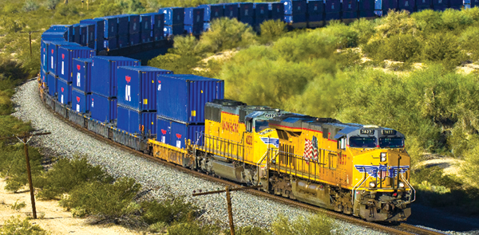
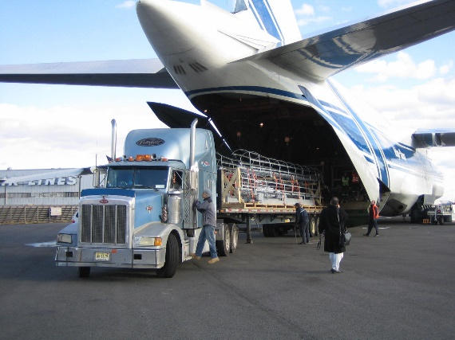
That makes no sense! The same goods are
being sent back and forth across the world?
Yes.

Slide 28
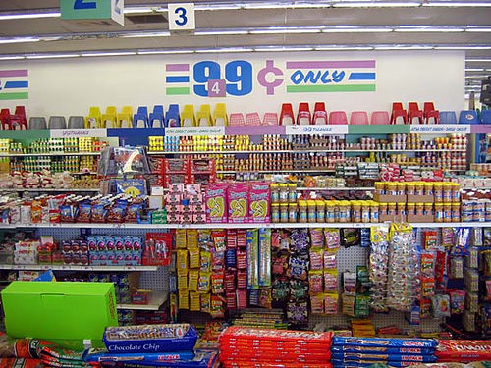
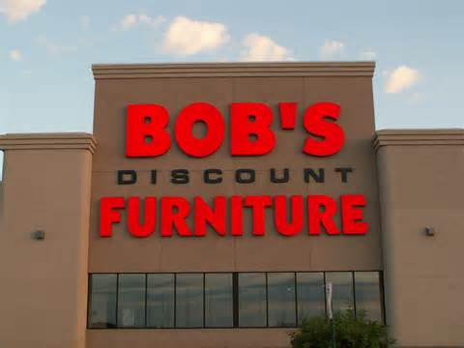
Because of their low disposable income,
consumers are FORCED TO BUY cheap, shoddy goods.
Advantage is given to low priced goods.
“If I had money, I would eat local,
organic foods. I just can’t afford it.”
“If I had money, I could afford really
well made furniture, but ….”

Slide 29
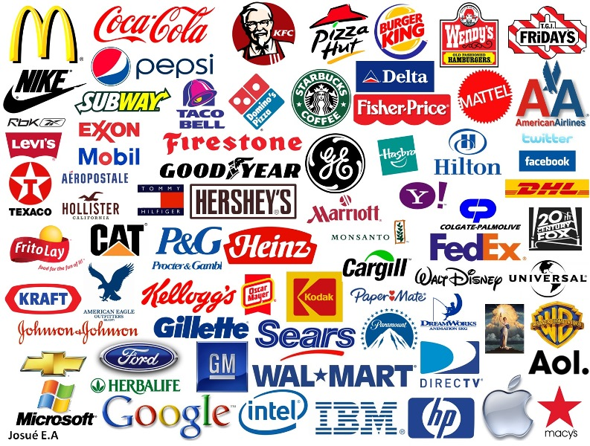
So, DEBT-MONEY grants unfair advantage to MULTINATIONALS,
who can mass produce cheap goods,
bulk transport them, use large wholesale & retail networks,
be granted large loans from Wall Street banks…
What? This system
fuels Multinationals?
Yes.

Slide 30
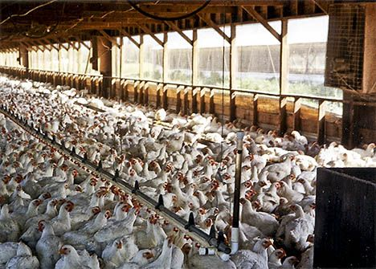
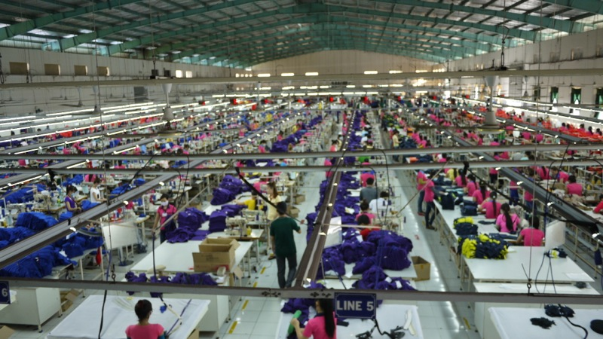
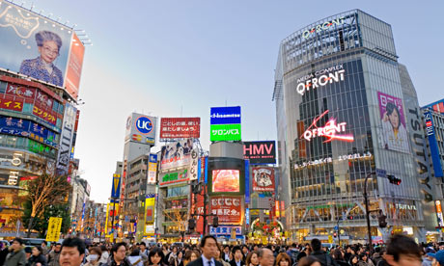
Because of their size, multinationals succeed in the fierce business competition created by DEBT-MONEY
This deadly competition forces multinationals
on a ceaseless search for new products, services,
and cheap labor. The goods have short lifespans and declining quality, but they keep people employed.
Is that why there are so many different types of the same products? Why products are constantly changing? Why we are bombarded in all directions with propaganda called advertising to manipulate us into buying, buying, buying?
Yes.

Slide 31
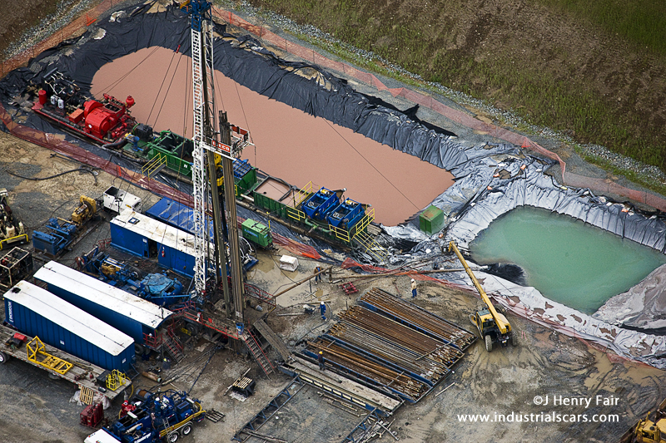
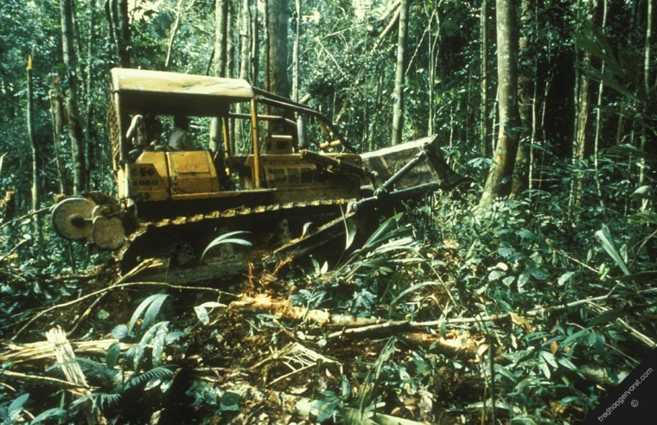
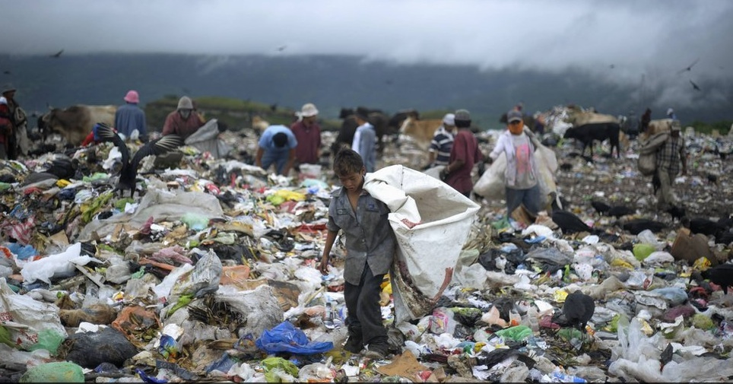
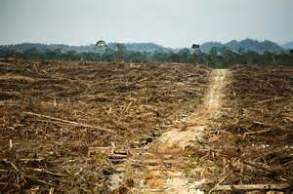
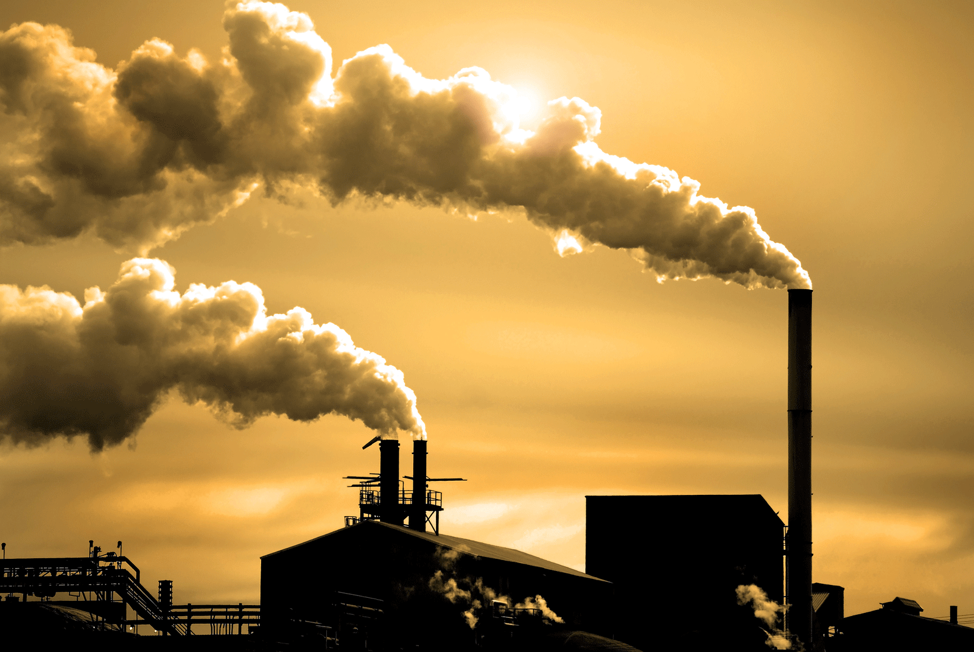
DEBT-MONEY’s forced growth wastes natural resources and human beings:
The multinationals' cheap products end up in landfills, are produced again & again,
each time wasting the earth’s resources, destroying the environment and people.

Slide 32
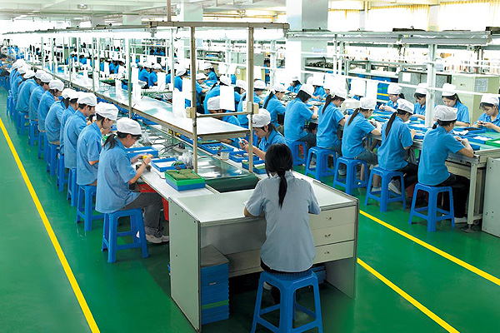
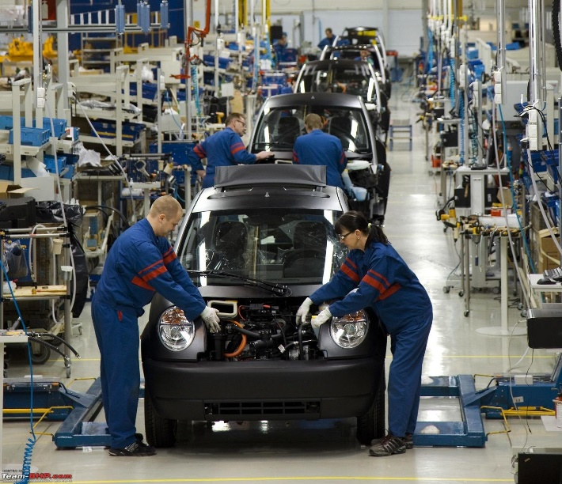
Creating cheap goods over and over again offers continuous employment,
AS THE ENVIRONMENT IS DESTROYED.
If people’s houses were secure and their incomes adequate,
they would welcome a reduction in the need to work the long
hours currently demanded.

Slide 33
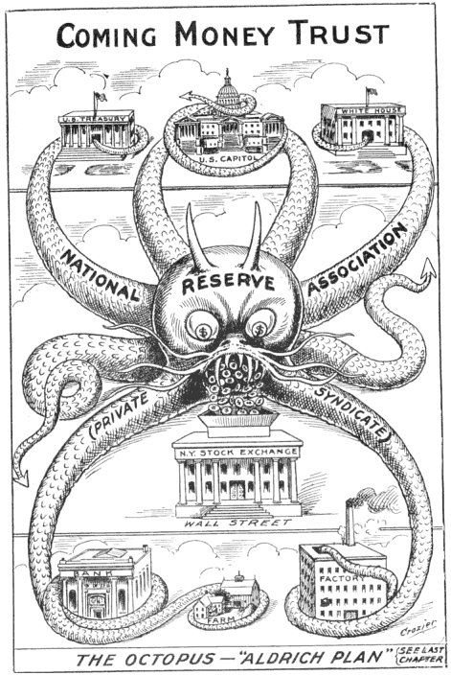
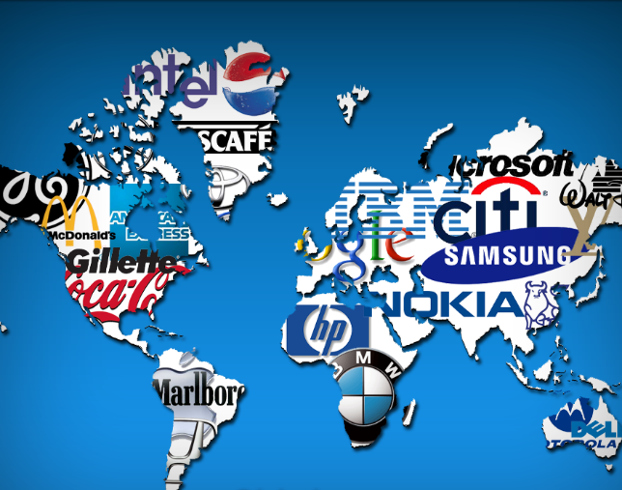
Multinationals are the ultimate creations of debt-money!

Slide 34
WAIT !!!!
What can we do ?????
The Green Party has a solution:
GREENING THE DOLLAR MONETARY REFORM PLANK
Approved by the Platform Committee on July 11th, 2008 in Chicago.

Slide 35
GREENING THE DOLLAR MONETARY REFORM PLANK
The U.S. Government buys all the shares of the 12 regional Federal Reserve Banks.
Take from the private banks the privilege to create new money;
leave them the function of lending already existing money with interest.
All new money is created by the U.S. Government -- DEBT-FREE, INTEREST-FREE --
as population and commerce grows. The U.S. Government creates and spends on infrastructure,
including the “human infrastructure” of Education and Health Care.

Slide 36
Greens for Monetary Reform Website
greensformonetaryreform.org
DEFINES THE PROBLEM
DESCRIBES THE SOLUTION
DESCRIBES THE TRANSITION
FROM THE PROBLEM
TO THE SOLUTION
What is the difference between
BANK DEBT-MONEY & PUBLIC SOVEREIGN MONEY?
And more!

Slide 37
THE END
The easiest way to escape from the problem
is to solve it.

