Slide 1
2020 AMI CONFERENCE
Independent Parity Group
Inspired by NORM,
National Organization for Raw Materials
normeconomics.org

Slide 2
NATIONAL ORGANIZATION FOR RAW MATERIALS normeconomics.org
FARM PARITY =
AN ECONOMY THAT WORKS FOR EVERYONE

Slide 3
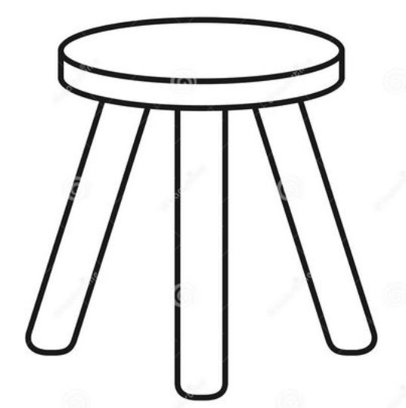
THREE LEGS OF A PROSPEROUS NATIONAL ECONOMY
1
3
2
PARITY PRICES
FOR RAW MATERIAL PRODUCERS
to produce adequate national income
PARITY TARIFFS
to protect American purchasing power
PARITY WAGES FOR LABOR
to distribute wealth
A FLOOR OF HONEST SOVEREIGN MONEY

Slide 4
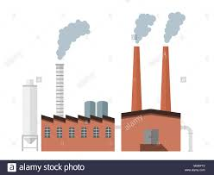
All wealth comes from the earth…
“Cut off from the earth….our industries would stop, our works crumble,
and we ourselves starve.”
Leon Maclaren, “The Function of Economics”, 1952

Slide 5
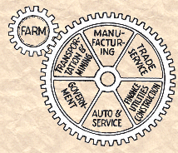
All wealth comes from the earth…
and operates according to the natural law of economics
NORM (National Organization for Raw Materials) has historical proof, based on government statistical records:
If raw materials production is priced in balance with the costs
of labor and capital (parity prices), prosperity is possible.
With parity prices, agriculture’s gross income turns over 7 times through the economy, guaranteeing an adequate national income, without debt.

Slide 6
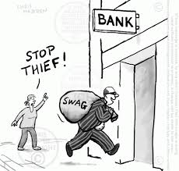
THERE ARE TWO ECONOMIES
THE REAL ECONOMY
where we all live and work
to produce wealth and earn income
THE FINANCIAL ECONOMY
that converts wealth into debt,
to bring in perennial unearned income
“Unlike wealth, which is subject to the laws of thermodynamics,
debts do not rot with old age and are not consumed in the process of living.
On the contrary, they grow at so much per cent per annum, by the well-known
mathematical laws of simple and compound interest.”
Frederick Soddy
Wealth, Virtual Wealth and Debt, 1926

Slide 7
Both AMI and NORM want a just world and therefore fight the money power.
Both want to get sovereign U.S. money into the hands of our citizens.
Congress creates and distributes new sovereign
U.S. money for raw materials parity prices,
infrastructure, education, health care.
Teach the truth about money and credit.
Parity prices distribute sovereign U.S. money as earned income to producers, laborers, owners.
Teach the truth about economics.

Slide 8
NATIONAL ORGANIZATION FOR RAW MATERIALS normeconomics.org
“If the price of raw materials, at the first point of sale, is in balance with the costs of labor and capital in the rest of the economy, you cannot have a depression.”
Randy Cook, President, NORM in Intro to Prosperity Is Within Our Grasp, 2018
Farmer
Today U.S. farmers are forced to sell
commodities to the international market,
taking the price offered by international traders.
The price in one year could be $2/bushel,
but the next year $1/bushel, etc. But the farmers’ costs do not go down with the international price.
Secretary
How would you like your yearly salary to vary
according to the international market?
Miss Smith, you’ve worked for us this year and we will be paying you $20,000. I know we paid you $30,000 last year, but the international market price for secretaries has gone down.

Slide 9
NATIONAL ORGANIZATION FOR RAW MATERIALS normeconomics.org
WHAT IS EQUITABLE TRADE?

Slide 10
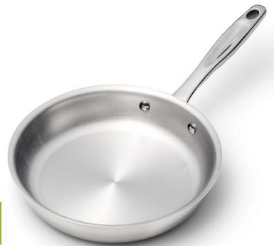
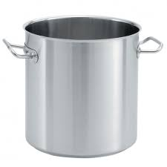
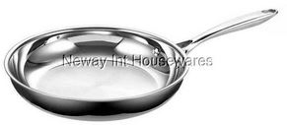
An Equitable Trade Fund
protects U.S. purchasing power
promotes trade between countries
1
2
When a U.S. importer buys a Chinese pan,
he pays the U.S. price for the pan:
$49 to Chinese exporter + $50 to fund =
$99 U.S. equivalent price
www.360cookware.com
8 ½ inch stainless steel fry pan
$ 99.00 USD
$49
$50
$99.00 U.S. equivalent price
www.newayusa.com
8 inch stainless steel fry pan
$49.99 USD
U.S. importer
EQUITABLE TRADE FUND
owned by all U.S. & Chinese
importers/exporters

Slide 11
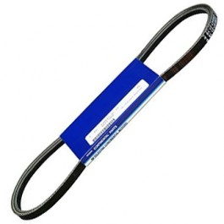
An Equitable Trade Fund
protects U.S. purchasing power
promotes trade between countries
1
2
When the CHINESE importer buys U.S.-made
airplane alternator belt, he pays the U.S. price for the belt:
$85 to U.S. exporter + $15 from fund = $100 U.S. price
airplane alternator belt
$85.00 USD
$85
$15
$100.00 U.S. price
EQUITABLE TRADE FUND
owned by all U.S. & Chinese
importers/exporters
Chinese importer
airplane alternator belt
$ 100.00 USD

Slide 12
An Equitable Trade Fund
Promotes trade between countries
$49
8 inch stainless steel fry pan
$50
$99.00 U.S. equivalent price
$49.99 USD
U.S. importer
EQUITABLE TRADE FUND
$15
$85
$100.00 U.S. price
Chinese importer
airplane alternator belt
$ 100.00 USD

Slide 13
NATIONAL ORGANIZATION FOR RAW MATERIALS normeconomics.org
THE TRADE TURN EXPLAINED

Slide 14
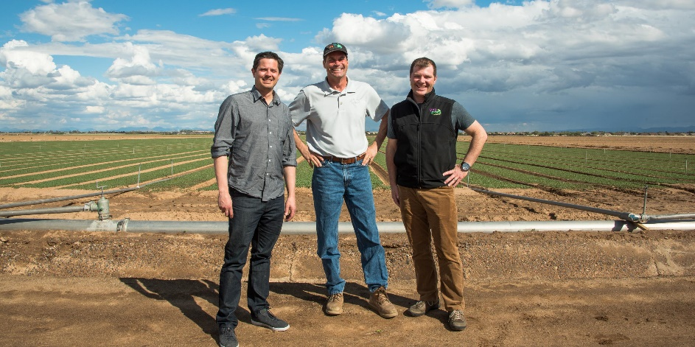
Agriculture must be considered the foundation of the economy of the United States:
it is the nation’s largest industry
(after finance)
it creates the biggest share of
raw material input of new wealth in any accounting period

Slide 15
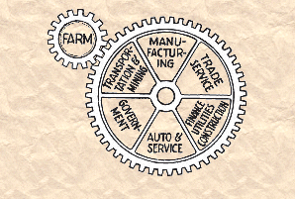
A PARITY PRICE FOR RAW MATERIALS
PARITY PRICES keep agriculture in balance with the costs of labor and capital in the rest of the economy.
Parity ensures that EARNED INCOME will be DISTRIBUTED throughout the economy as widely and as fairly as possible.

Slide 16
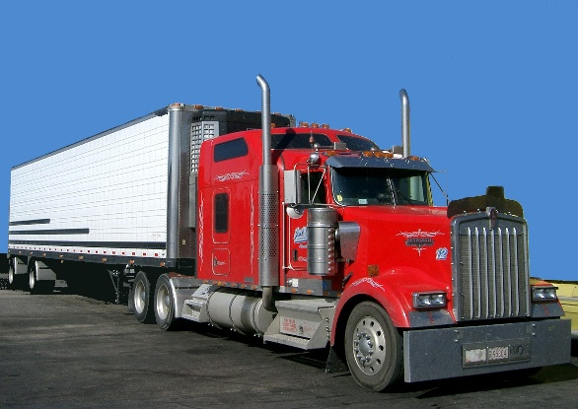
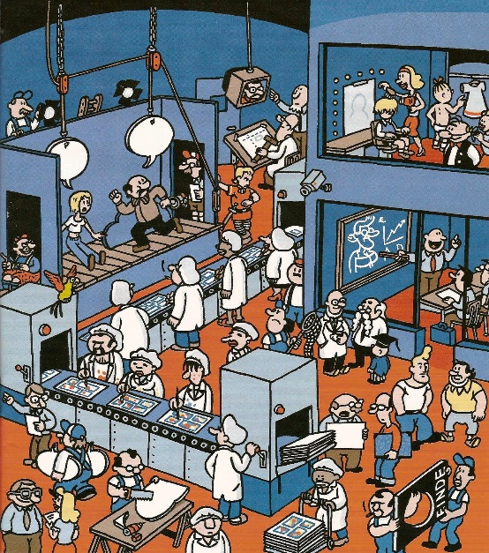
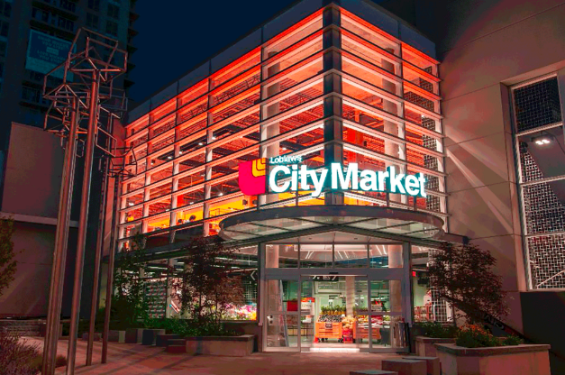
Gross farm income generates earned national income.
If earned national income is too low to avoid deficits (debts),
ag prices are below parity.

Slide 17
With parity, gross farm income will multiply as it is spent through the domestic economy at least 7 times.

Slide 18
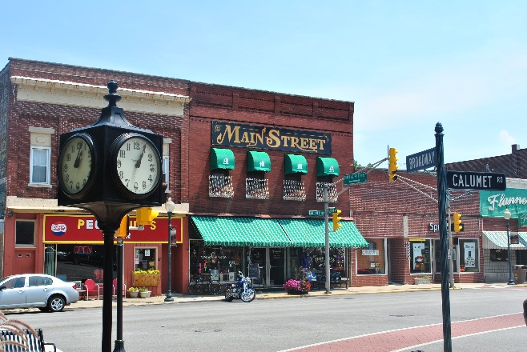
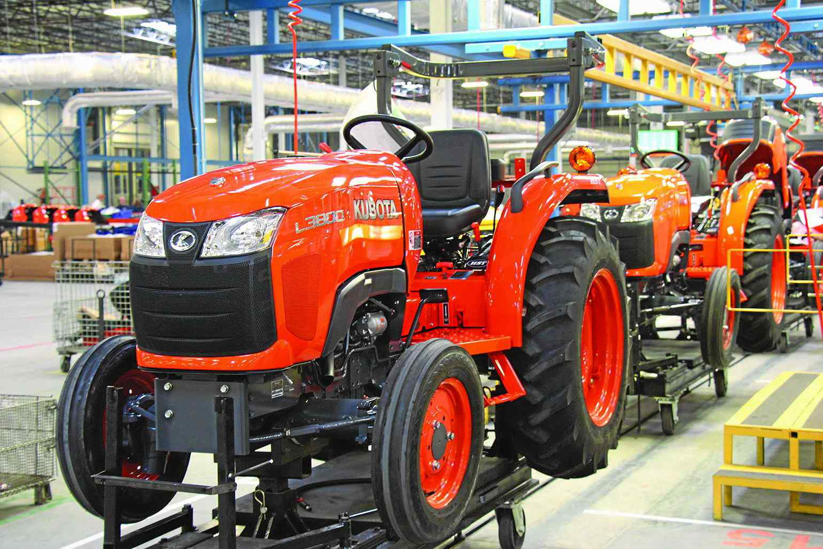
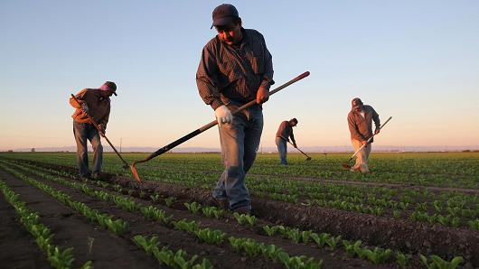
With parity, earned income will be fairly distributed to owners and workers throughout our private enterprise economy = PROSPERITY. With no debt creation!
PARITY PRICES
BUY FROM RURAL STORES
PURCHASE TRACTORS & MORE
PAY WORKERS GOOD WAGES

