Slide 1
MIS-REPRESENTATIONS OF MONEY IN OUR COUNTRY TODAY
WHY?

Slide 2
# I

Slide 3
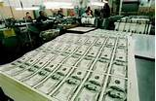
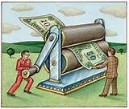
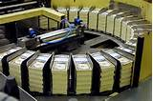
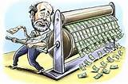
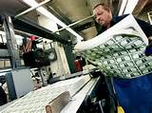
#I All money is created by our government. How often do you see the image of our government’s printing presses?

Slide 4
#I. All money is created by our government. How often do you see the expression ‘printing’ money by the government?
The budget plan released Tuesday starts by laying out a grim scenario for America’s fiscal future: “Unless we change course, we will have a debt crisis,” it says. “Pressed for cash, the government will take the easy way out: It will crank up the printing presses.” The Washington Post blog.
Just how much money is the U.S. government printing to meet its debts? Steven Horwitz, professor at St. Lawrence University, and co-author of the Austrian blog, explains that the amount of money printed in the past few months since the October economic crisis, has been absolutely unprecedented in U.S. history.

Slide 5
#I. All money is created by our government. Is this true?
NO!

Slide 6
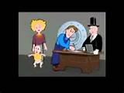
#I. 97% of all money is created by private commercial banks, when they make loans.
Truth

Slide 7
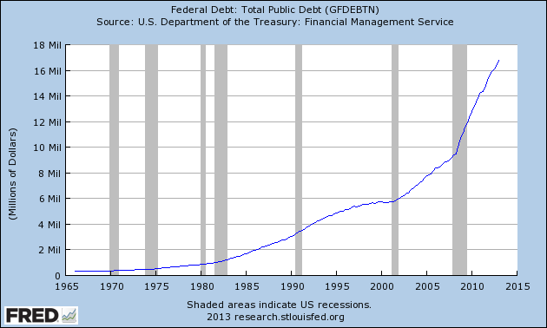
#I. The government makes only 3% of all money.
After tax receipts, the government borrows all other money needed to pay expenses.
The largest creditor are banks – both Federal Reserve Banks and their owners,
private commercial banks.
Truth
TOTAL NATIONAL DEBT = 16.8 TRILLION DOLLARS

Slide 8
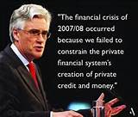
#I. 97% of all money is created by private commercial banks, when they make loans.
Truth
Lord Adair Turner, speaking as chair of the Financial Services Authority, 6th February, 2013

Slide 9
# 2

Slide 10
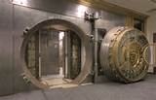
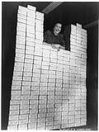
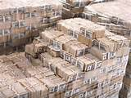
#2 The bank’s money is stored in the bank’s vaults as currency.

Slide 11
#2 The bank’s money is stored in the bank’s vaults as currency.
Is this true?
NO!

Slide 12
#2. The bank’s money is an accounting entry on the books of a private bank.
Truth
CYBER THIEF

Slide 13
# 3

Slide 14
#3 Depositors’ money is loaned to borrowers.
DEPOSITS
LOANS

Slide 15
#3. Depositors’ money is loaned to borrowers. Is this true?
NO!

Slide 16
#3. When a bank lends to a borrower, the bank creates electronic bank credit -- a deposit in the borrowers checking account.
LOANS
create
DEPOSITS
Truth

Slide 17
#3. When a bank lends to a borrower, the bank creates electronic bank credit in the borrowers checking account.
The bank credit functions as money. We pay our bills with checks, debit cards, auto-payments.
Truth

Slide 18
# 4

Slide 19
#4. We deposit money in the bank for safe-keeping.
DEPOSITS

Slide 20
#4. We deposit money in the bank for safe-keeping. Is this true?
NO!

Slide 21
#4. When we deposit money in the bank, we are loaning the money to the bank. We no longer own the money. We are the bank’s creditor.
Truth

Slide 22
# 5

Slide 23
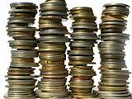
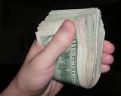
#5. All money consists of coins and cash.

Slide 24
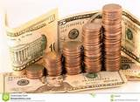
#5. All money consists of coins and cash. Is this true?
NO!

Slide 25
#5. Ninety seven percent of money is accounting entries on the books of the private banks.
Truth

Slide 26
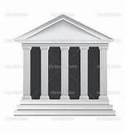
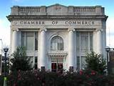
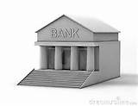
#6. Banking institutions are different from corporations.
=
NOT
DEUTSCHER BANK

Slide 27
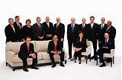
#6. Banking institutions are different from corporations. Is this true?
NO!
BANK OF AMERICA

Slide 28
#6. Private banks are corporations that are required to maximize profits.
Truth

Slide 29
WHY IS OUR MONEY IN THE CONTROL OF PRIVATE CORPORATIONS?

Slide 30
WHY ARE OUR SENATORS & REPRESENTATIVES NOT TEACHING US ABOUT OUR MONEY SYSTEM?

Slide 31
WHY ARE OUR HIGH SCHOOLS AND COLLEGES NOT TEACHING US ABOUT OUR MONEY?

Slide 32
WHAT CAN CITIZENS DO?

