Slide 1

OUR NEW MONETARY AUTHORITY
MONETARY AUTHORITY
Or … how much new money
does our economy need this year?

Slide 2

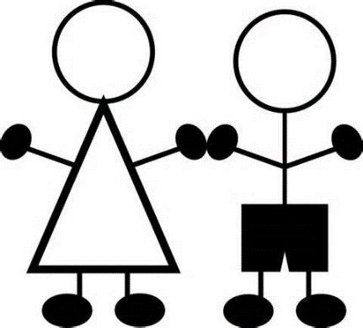
MONETARY AUTHORITY
Is the new Monetary Authority also part of the NEED Act?
Yes. You see, our nation grows from year to year in population.
That means the nation must have MORE FOOD, CLOTHING, HOMES.
This requires more money in our money supply.
But we don’t want inflation (too much money) or deflation
(too little money).

Slide 3


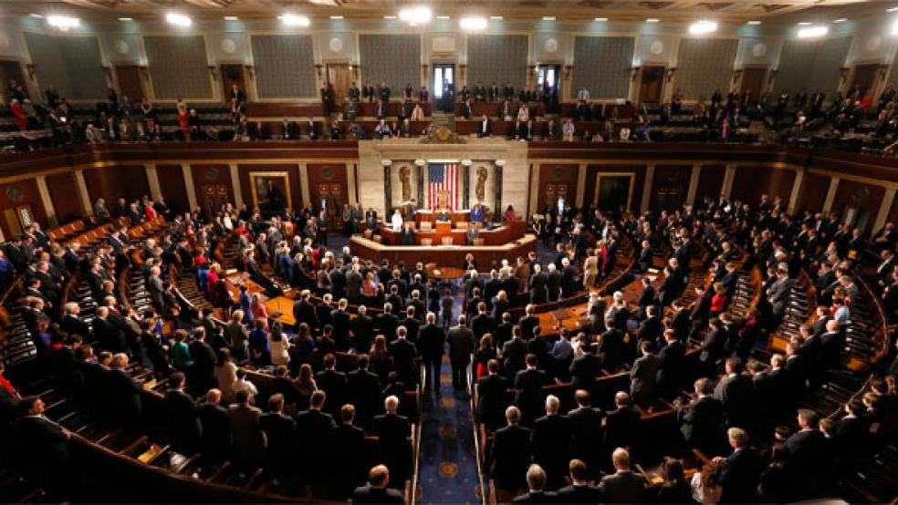
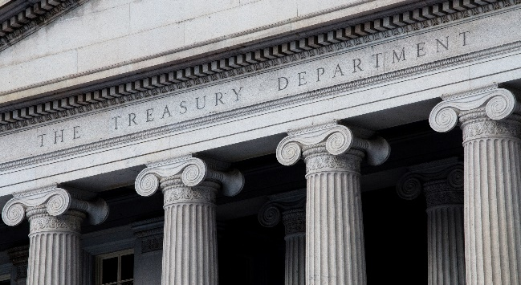
So how can the size of the money supply be controlled?
By the brand-new MONETARY AUTHORITY. In the Treasury Department in Washington, D.C.
The MONETARY AUTHORITY is part of the executive branch, and takes the place of the Federal Reserve Board which has been abolished.
The Monetary Authority establishes how much new money is created each year to allow goods and services to move freely in the economy.
Congress decides how much money will be spent and for what.
The Treasury Secretary pays out the money authorized by Congress. If there is no money left to pay in the government’s account, the Secretary will create money, BUT ONLY UP TO THE LIMITATION SET BY THE MONETARY AUTHORITY.
MONETARY AUTHORITY
U.S. CONGRESS
TREASURY

Slide 4
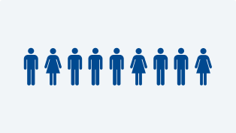


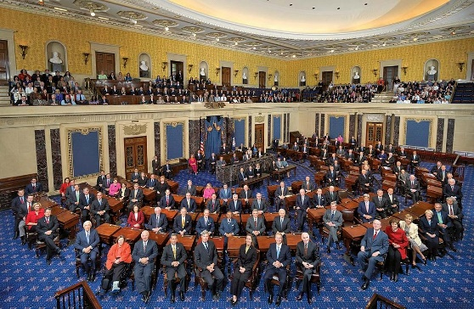
So how can the size of the money supply be controlled?
There will be 9 PUBLIC members, appointed by the President, with the consent of the Senate.
Each members serves for 6 years.
MONETARY AUTHORITY
Appointed by
OFFICE OF PRESIDENT
With advice & consent
of U.S. SENATE

Slide 5
MONETARY AUTHORITY
Hold on just one minute!!! How can I trust these 9 people?
How do I know they will be working for the welfare of all citizens,
not the plutocracy?
Will they feel independent and safe from money and power?
Let’s see what the NEED ACT says.....

Slide 6

MONETARY AUTHORITY
The NEED ACT says:
“The Secretary of the Treasury may not intervene in any matter
or proceeding before the Monetary Authority,
unless otherwise specifically provided by law.
The Secretary of the Treasury may not delay, prevent, or intervene in:
The Monetary Authority.
The Authority’s decision of the amounts of money to be created.
The most efficient method of disbursement consistent with the appropriations of Congress.
….That sounds good... but... this is really important....
How can the citizens trust this Monetary Authority?

Slide 7
….I really want to be sure these 9 people will be working for us, the citizens, the workers, the 99%
MONETARY AUTHORITY
How about this?
The NEED ACT says:
“Not more than 4 of the members of the Monetary
Authority may be members of the same political party.”
So, there have to be, at a minimum, 3 parties represented!
….Better...

Slide 8



MONETARY AUTHORITY
….Describe what these 9 people will be working on?
The NEED ACT sets the following targets:
“The Monetary Authority shall pursue a monetary policy ... that the supply of money in circulation should not become inflationary nor deflationary...
...promote effectively the goals of maximum employment, stable prices, and moderate long-term interest rates.”
JOBS
PRICE STABILITY
….Much better...

Slide 9



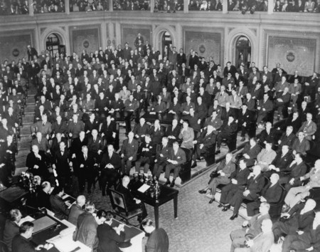
MONETARY AUTHORITY
Will the citizens know what is going on?
There will be public reports every quarter of the year.
Whenever the target set by the Monetary Authority differs by 0.5% from the actual money supply, the Secretary of the Treasury will report this to Congress every quarter of the year.
0.5% means a difference of $5,000 for every million dollars
in the money supply.
….Much better...

Slide 10
But the most important change in our money system is .....
..... given to us by the NEED ACT .....
..... allowing the Monetary Authority to
function for all the citizens.....
….yes? ....yes?

Slide 11


Think of this.
Democracy includes the absence of privilege to any group.
The NEED ACT removes the most powerful privilege of all – the privilege of banks to manufacture money by issuing loans!
….

Slide 12
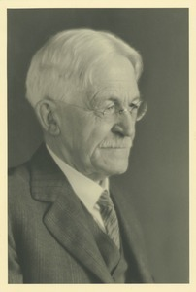
We will have U.S. Money -- issued by our government debt-free.
Our money supply will not be owed to bank corporations.
The money will be an asset to all the citizens of the U.S.
Here is a respected American.....
DAVIS RICH DEWEY, AMERICAN ECONOMIST AND STATISTICIAN
(1858 – 1942)
“The underlying idea in the greenback philosophy…is that the issue of currency is a function of government, a sovereign right which ought not to be delegated to corporations.”
Yes! Yes!

Slide 13
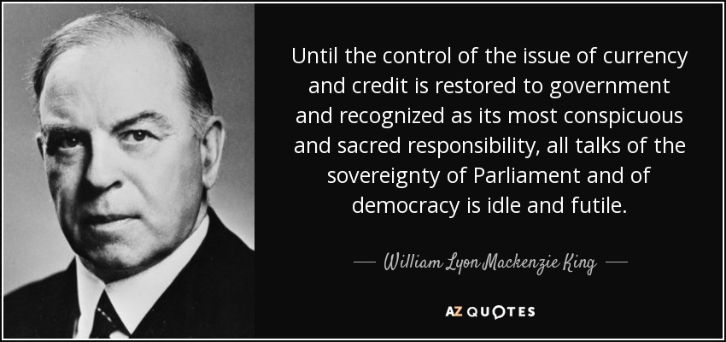

Here is a respected Canadian.....
WILLIAM LYON MACKENZIE KING, 10TH PRIME MINISTER OF CANADA (1935-1948)
….

Slide 14

The Monetary Authority will be protecting our common welfare!
MONETARY AUTHORITY

Slide 15
THE END

