Slide 1

TRANSITION: FROM BANKMONEY TO SOVEREIGN MONEY
Monetary Reform for the People
SAFE … EASY … ACHIEVABLE
SEAMLESS … OVERNIGHT …. NON-DISRUPTIVE
NOT SCARY … NOT RADICAL
Sue Peters
Member, Green Party U.S.
Member, American Monetary Institute
Member, GreensForMonetaryReform.org

Slide 2

WHO CREATES OUR MONEY SUPPLY?
Most people believe that banks take IN deposits
and loan them OUT at a higher rate of interest.
BUT banks create BANKMONEY (credit) in the borrower’s account (“a bank loan”).
When the borrower repays the loan principal, the BANKMONEY is ‘extinguished’ (“POUFF”!) from the books of the bank.
The bank keeps the interest from the borrower.
“POUFF……POUFF……POUFF….”

Slide 3
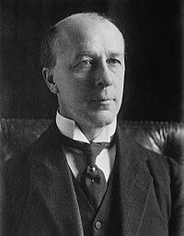

WHO CREATES OUR MONEY SUPPLY?
BANKING CORPORATIONS CREATE BANKMONEY
"Every loan, overdraft, or bank purchase creates a deposit…
every repayment of a loan, overdraft or bank sale destroys a deposit."
Right Honourable Reginald McKenna,
Former British Chancellor of the Exchequer (Treasury)
Chairman, Midland Bank, 1924.

Slide 4
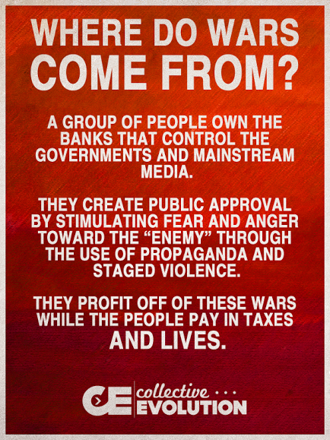
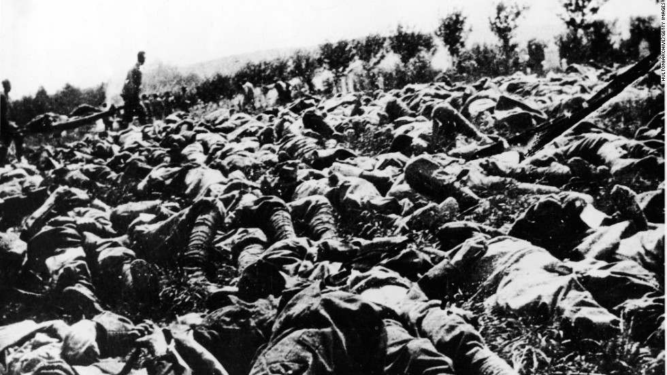
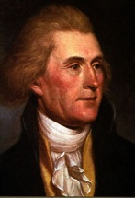
The power to create and destroy money is an awesome power:
WAR
“I believe that banking institutions are more dangerous to our liberties than standing armies.”
THOMAS
JEFFERSON
THE BODIES OF WW I

Slide 5
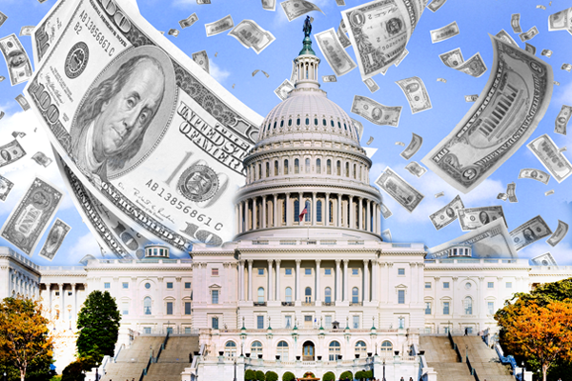
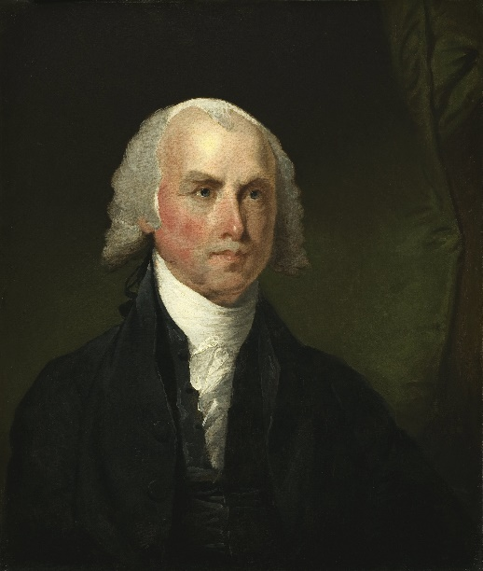
The power to create and destroy money is an awesome power:
BUY GOVERNMENT
“History records that the money changers have used every form of abuse, intrigue, deceit, and violent means possible to maintain their control over governments by controlling money and its issuance.”
James Madison

Slide 6

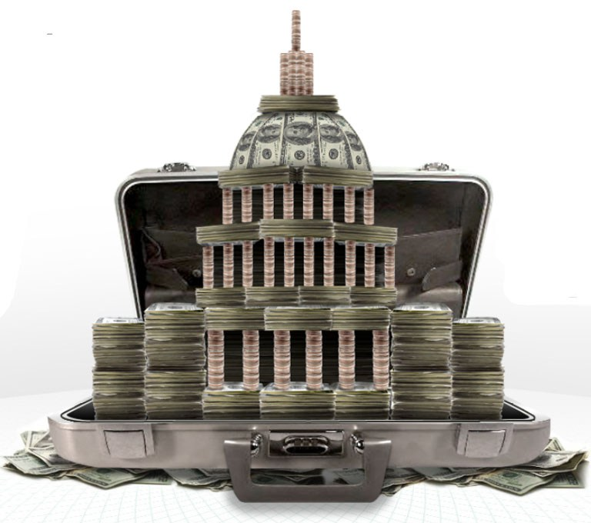
The power to create and destroy money is an awesome power:
BUY GOVERNMENT
“I am afraid the ordinary citizen will not like to be told that the banks can and do create money. And they who control the credit of the nation direct the policy of Governments and hold in the hollow of their hand the destiny of the people.”
Reginald McKenna, as Chairman of the Midland Bank, addressing stockholders in 1924.

Slide 7
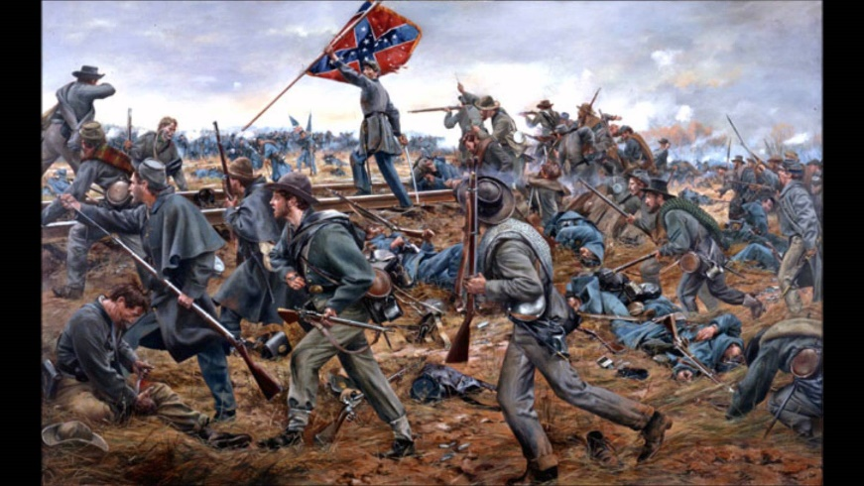
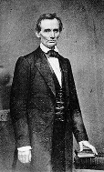

The power to create and destroy money is an awesome power:
EMPOWER CORPORATIONS
"I have two great enemies, the southern army in front of me and the financial institutions, in the rear. Of the two, the one in the rear is the greatest enemy.....
I see in the future a crisis approaching that unnerves me and causes me to tremble for the safety of my country. As a result of the war, corporations have been enthroned and an era of corruption in high places will follow, and the money power of the country will endeavor to prolong its reign by working upon the prejudices of the people until wealth is aggregated in a few hands and the Republic is destroyed.
ABRAHAM LINCOLN

Slide 8
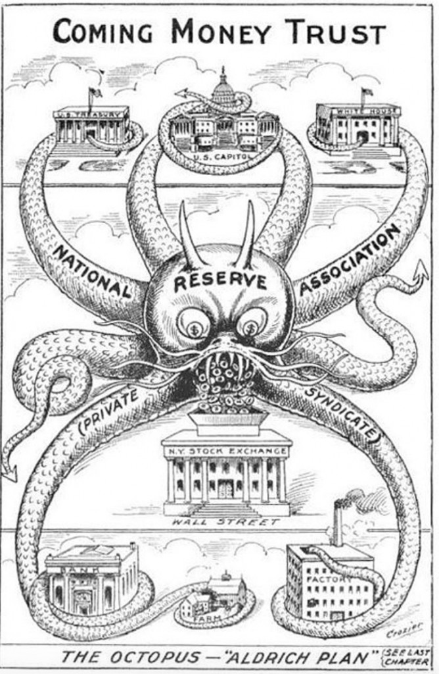

The power to create and destroy money is an awesome power:
CONTROL THE ECONOMY
“Slavery is likely to be abolished by the war power, and chattel slavery destroyed. This I and my European friends are in favor of, for slavery is but the owning of labor and carries with it the care of the laborer, while the European plan, led on by England, is capital control of labor by controlling wages.
THIS CAN BE DONE BY CONTROLLING THE MONEY.”
HAZARD CIRCULAR
1862
The circular (or private letter) was purported to have been brought to America by a Mr. Charles Hazzard, an agent of the capital and banking interests in London, WHO DISTRIBUTED IT
TO CAPITALISTS AND BANKERS IN NEW YORK
AND NEW ENGLAND.

Slide 9
U.S. MONETARY REFORM – 1996 TO THE PRESENT

Slide 10
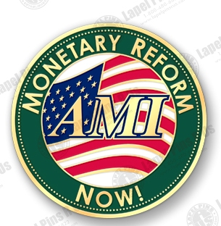
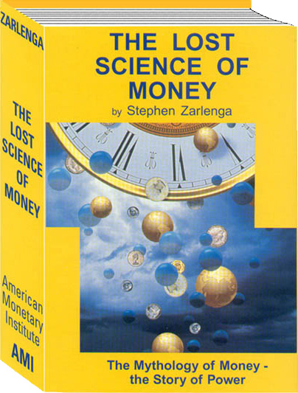
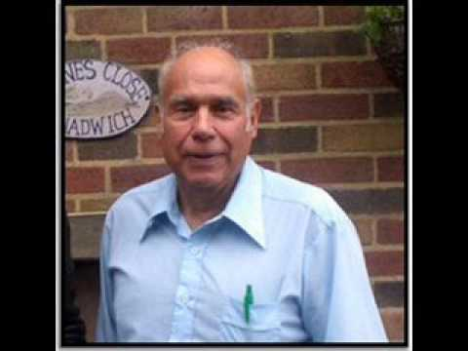
U.S. MONETARY REFORM – 1996 TO THE PRESENT
FOUNDED 1996
PUBLISHED 2002
1941 - 2017
With the founding of the American Monetary Institution (AMI) and the publication of his book, LOST SCIENCE OF MONEY, Stephen Zarlenga began the new American Monetary Reform Movement for sovereign money.

Slide 11
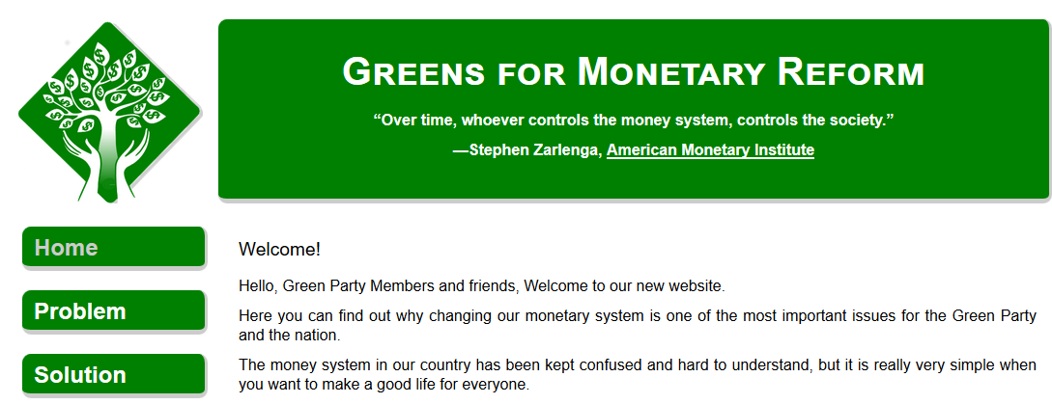
U.S. MONETARY REFORM – 1996 TO THE PRESENT
The Green Party U.S. recognized the significance for Stephen’s work and worked to finally get the basics of the Sovereign money reform into the national platform.
The Green Party explains this momentous reform at: GreensForMonetaryReform.org

Slide 12
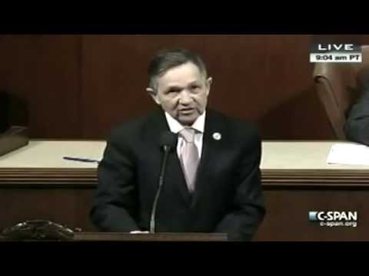
U.S. MONETARY REFORM – 1996 TO THE PRESENT
In 2010 and 2011, Representative Dennis Kucinich entered into Congress THE NEED ACT (HR2990).
This act was based on the work of the AMI and Stephen Zarlenga.
This act was totally for the PUBLIC GOOD, not for the banks.

Slide 13
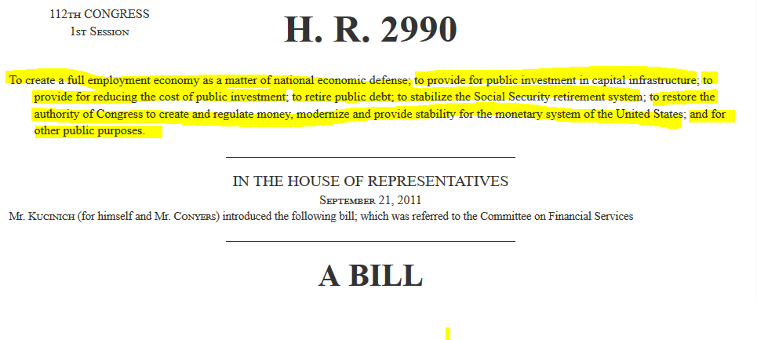
U.S. MONETARY REFORM – 1996 TO THE PRESENT
HR2990

Slide 14
MONETARY REFORM FOR THE PEOPLE
PRINCIPLES & PROCEDURES ALREADY IN PLACE
ALL THE PARTS ARE ALREADY THERE – READY TO GO!

Slide 15
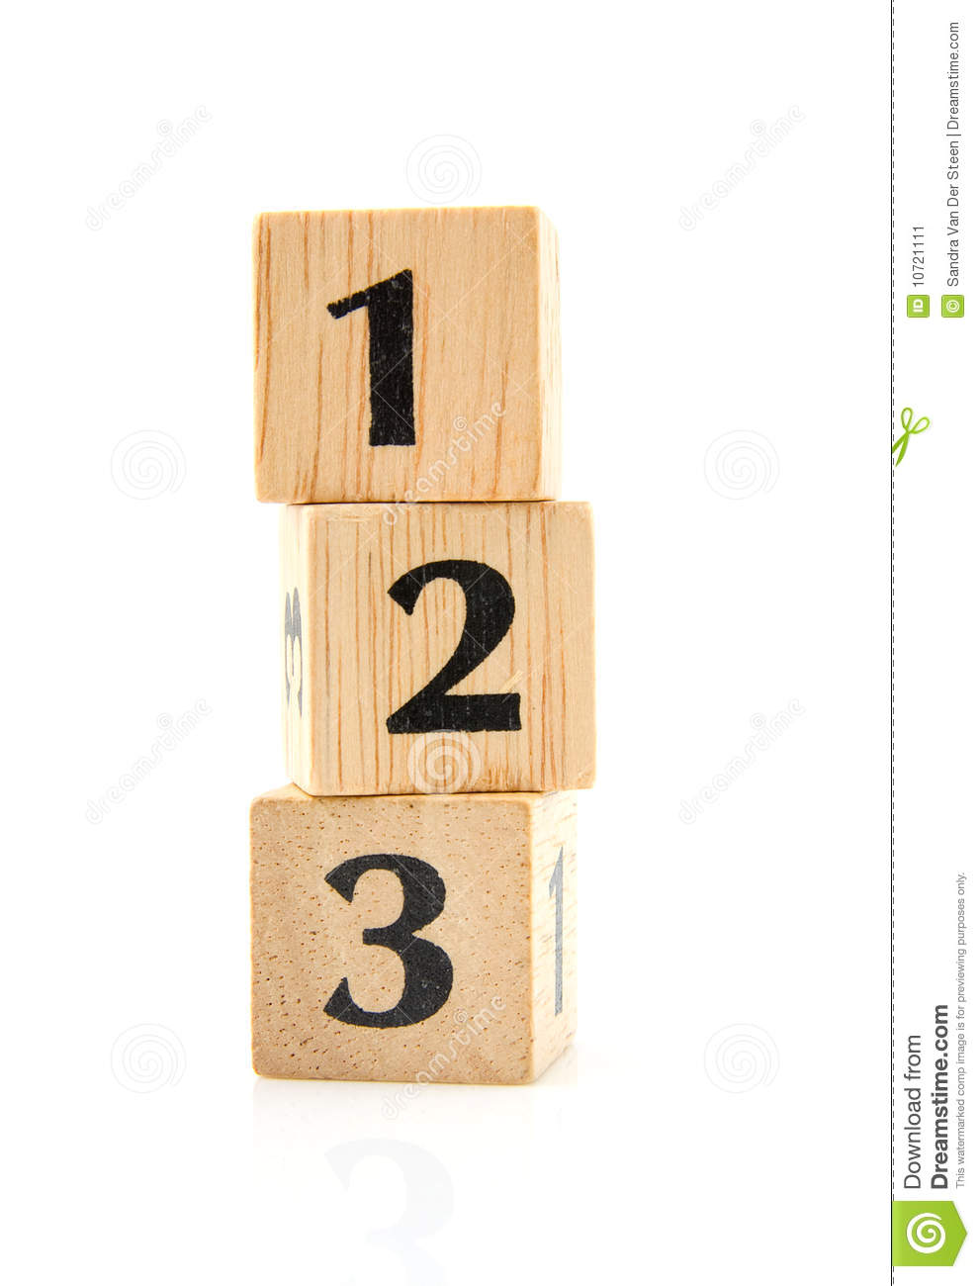
MONETARY REFORM FOR THE PEOPLE
THE NEED ACT has 3 parts.
All 3 parts must be enacted at the same time, for monetary reform to succeed.
All 3 parts must be in place together, or the Private Money Power will take
back control, as they have done over recorded history.
NATIONALIZE THE FEDERAL RESERVE BANKS
STOP BANKS CREATING WHAT WE USE AS MONEY
SPEND SOVEREIGN MONEY INTO ECONOMY

Slide 16


Slide 17

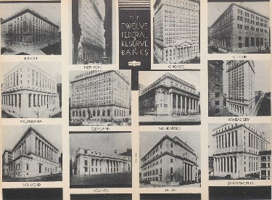
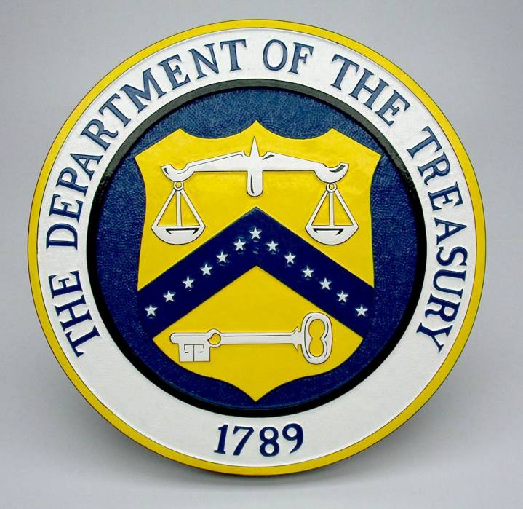
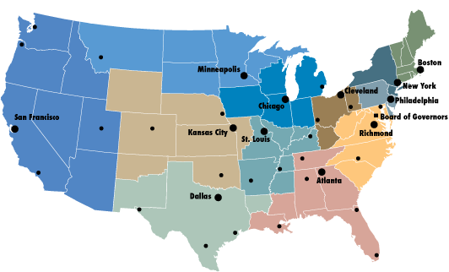
NATIONALIZE THE 12 FED BANKS
The 12 Federal Reserve Banks are made a Bureau and moved into the Treasury.

Slide 18
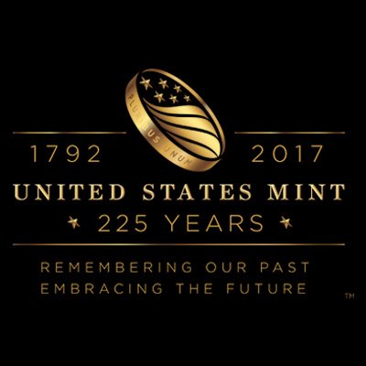
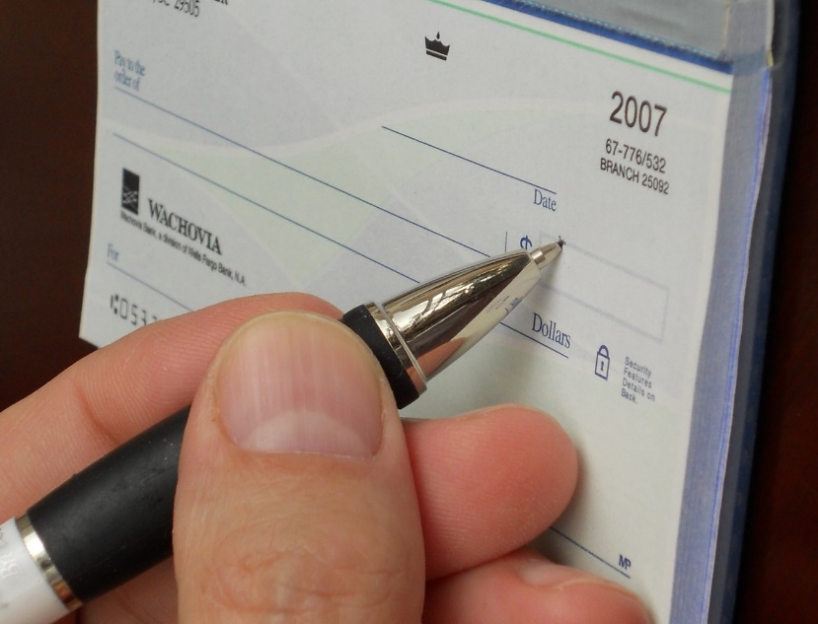
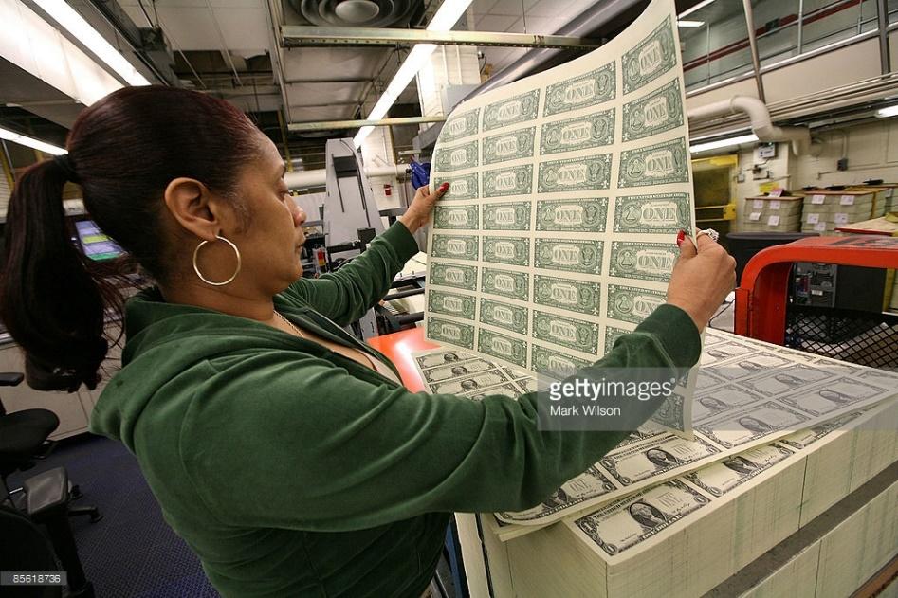
NATIONALIZE THE 12 FED BANKS
The Treasury will now contain all 3 forms of money.
COINS
PAPER NOTES
CHECKBOOK MONEY

Slide 19
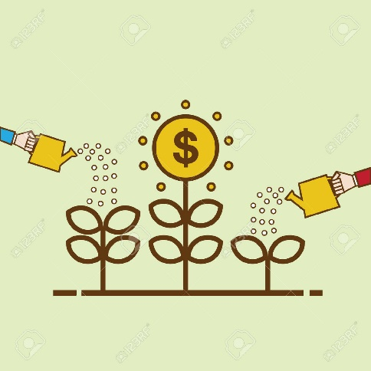
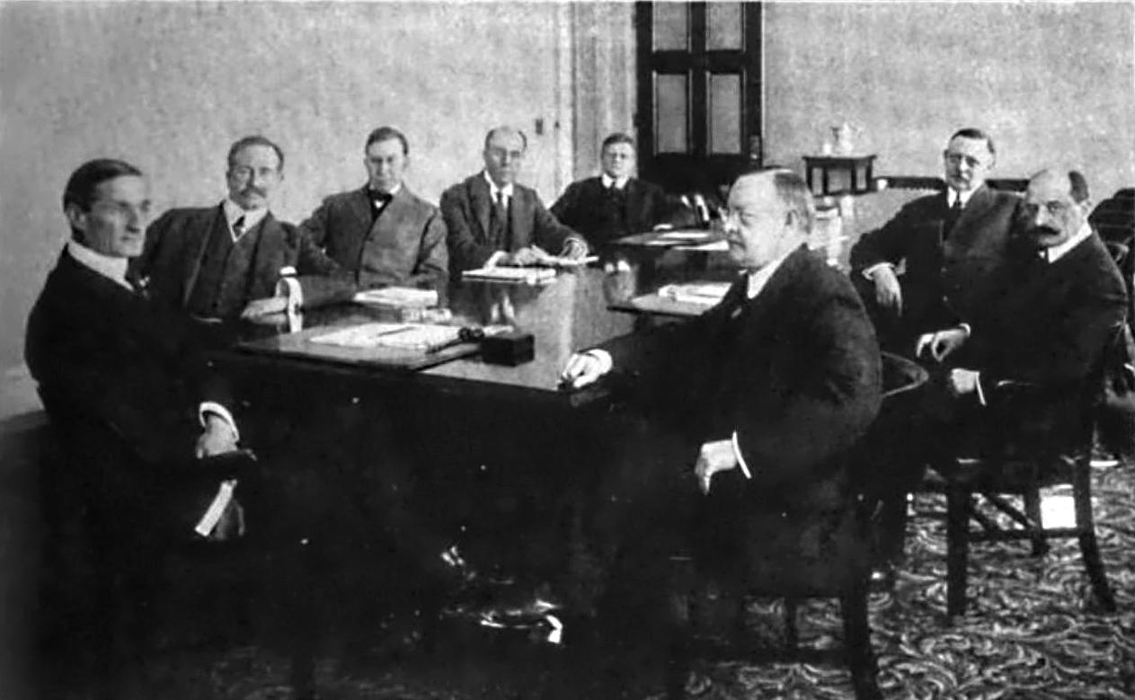
NATIONALIZE THE 12 FED BANKS
The Federal Reserve Board is abolished and replaced by an independent
Monetary Authority inside Treasury Department.
REPLACED BY….
FIRST FEDERAL RESERVE BOARD, 1914
NEW MONETARY AUTHORITY

Slide 20

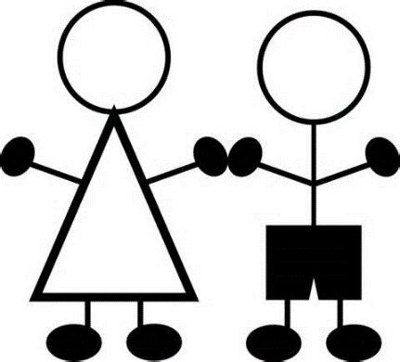
MONETARY AUTHORITY
Is the new Monetary Authority also part of the NEED Act?
Yes. You see, our nation grows from year to year in population.
That means the nation must have MORE FOOD, CLOTHING, HOMES.
This requires more money in our money supply.
But we don’t want inflation (too much money) or deflation
(too little money).

Slide 21
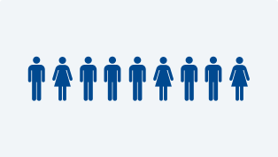



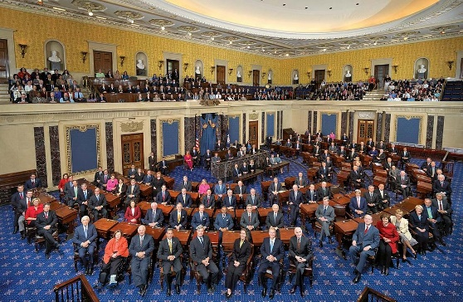
So how can the size of the money supply be controlled?
There will be 9 PUBLIC members, appointed by the President, with the consent of the Senate.
Each members serves for 6 years.
MONETARY AUTHORITY
Appointed by
OFFICE OF PRESIDENT
With advice & consent
of U.S. SENATE

Slide 22
MONETARY AUTHORITY
Hold on just one minute!!! How can I trust these 9 people?
How do I know they will be working for the welfare of all citizens,
not the plutocracy?
Will they feel independent and safe from money and power?
Let’s see what the NEED ACT says.....

Slide 23

MONETARY AUTHORITY
The NEED ACT says:
“The Secretary of the Treasury may not intervene in any matter
or proceeding before the Monetary Authority,
unless otherwise specifically provided by law.
The Secretary of the Treasury may not delay, prevent, or intervene in:
The Monetary Authority.
The Authority’s decision of the amounts of money to be created.
The most efficient method of disbursement consistent with the appropriations of Congress.
….That sounds good... but... this is really important....
How can the citizens trust this Monetary Authority?

Slide 24
….I really want to be sure these 9 people will be working for us, the citizens, the workers, the 99%
MONETARY AUTHORITY
How about this?
The NEED ACT says:
“Not more than 4 of the members of the Monetary
Authority may be members of the same political party.”
So, there have to be, at a minimum, 3 parties represented!
….Better...

Slide 25

STOP BANKS CREATING BANKMONEY

Slide 26

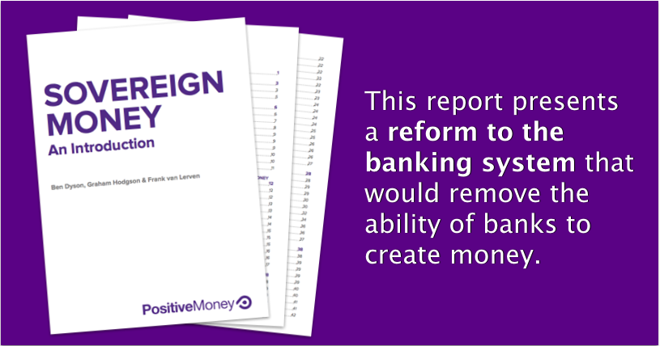
STOP BANKS CREATING BANKMONEY
All money in money supply becomes ‘sovereign money’.
Sovereign money does not disappear when a bank loan is paid off.

Slide 27

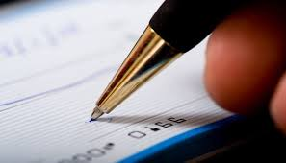
STOP BANKS CREATING BANKMONEY
THERE WOULD ONLY BE 2 TYPES OF ACCOUNTS IN A COMMERCIAL BANK:
CHECKING ACCOUNTS -- MONEY STAYS PROPERTY OF ACCOUNT HOLDER
INVESTMENT ACCOUNTS -- MONEY LOANED TO BANK TO INVEST
CHECKING ACCOUNT
“SAFEKEEPING”
INVESTMENT ACCOUNT
“UNSECURED LOAN TO BANK”

Slide 28

STOP BANKS CREATING BANKMONEY
A NEW REVOLVING FUND IN THE U.S. TREASURY
RECYCLES THE CURRENT MONEY SUPPLY (CREATED BY BANK LOANS)
BACK INTO THE ECONOMY
ALL LOANS CAN BE REPAID TO CREDITORS
REVOLVING FUND

Slide 29
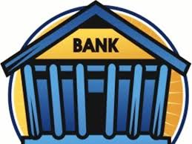
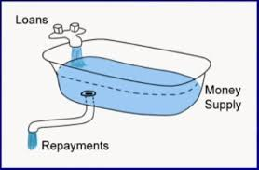
STABLE MONEY SUPPLY
Yes, yes, yes.... tell me, what is this Revolving Fund?
Okay, think about this: today, on this day of TRANSITION –
what is our money supply?
Create
Loans
You’re making me think, and ... and .... it’s FUN!
Unpaid Loans
Today, our money supply was created by commercial banks making loans.
So our money supply ... is ...
unpaid loans owed to banks!

Slide 30
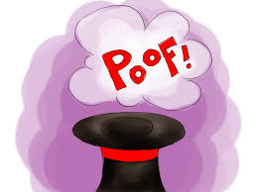
STABLE MONEY SUPPLY
Right! Yesterday, the day before TRANSITION,
if a borrower repaid his loan, the principal repayment would have been ‘extinguished’,
meaning money would disappear from the books of the bank.
And... now?

Slide 31
STABLE MONEY SUPPLY
Starting at TRANSITION, the commercial banks must make loans
from money they own, borrow, or get from investors.
And when these loans are repaid, the money doesn’t disappear! It gets returned
to the bank to lend out again.
They can’t create or destroy money by creating bank loans any more.
I’m sorry.
I have to SAY…..
➔ ➔ ➔

Slide 32






What a wonderful stupendous glorious relief !!!!

Slide 33
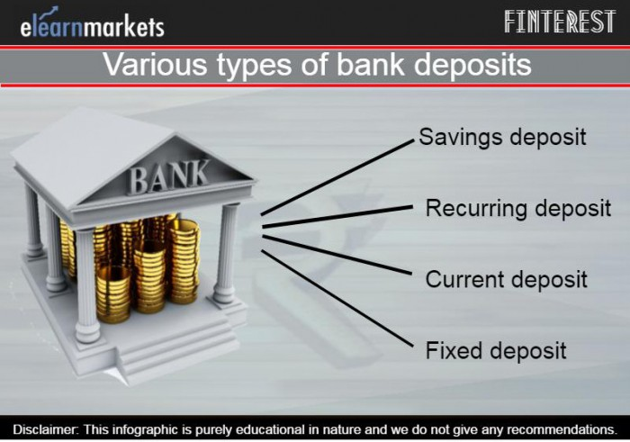

STABLE MONEY SUPPLY
Wait! Why do we need a Revolving Fund if the government will now create our money DEBT-FREE?
Good question. The Revolving Fund ensures we have a permanent, stable money supply at
TRANSITION and in the future.
Today’s pre-TRANSITION money supply is 12 Trillion Dollars! This money, created by bank loans, is found in all types of deposit accounts in banks:
savings ... checking ... time deposits ... etc.
This is the life blood of our economy. We all
need it ... and we need all of it.

Slide 34

STABLE MONEY SUPPLY
WHAT HAPPENS TO OUR MONEY SUPPLY?
The Revolving Fund makes sure our money supply stays STABLE!!!
BEFORE TRANSITION
AFTER TRANSITION
MONEY SUPPLY = BANK LOANS
MONEY SUPPLY: DEBT-FREE PUBLIC MONEY
DISAPPEARING WITH REPAYMENT
PERMANENTLY CIRCULATING

Slide 35


STABLE MONEY SUPPLY
The 12-trillion pre-TRANSITION money supply must
not ‘disappear’ when the bank loans are repaid,
or we will have deflation.
The 12-trillion pre-TRANSITION money supply must not be kept by the banks, when the bank loans are repaid, or they will be wealthy beyond compare!
So, what do we do?

Slide 36





STABLE MONEY SUPPLY
At TRANSITION, the banks will legally owe the Treasury’s Revolving Fund 12 trillion dollars – the pre-TRANSITION bank loans. Repayments of these loans must be passed to the Revolving Fund to be SPENT or LOANED into the money supply.
pre-TRANSITION
pre-TRANSITION
PRINCIPAL PAYMENTS
PRINCIPAL PAYMENTS
BORROWER
REVOLVING FUND
Ah!
STABLE MONEY SUPPLY

Slide 37


STABLE MONEY SUPPLY
Over time, WE RECYCLE the 12-trillion pre-TRANSITION bank loans back into the money supply, so the economy remains stable.
The bank gets its interest, the borrower pays off debt, and the economy has a stable money supply. All debts are payable!
ECONOMY
DEBT-FREE
MONEY SUPPLY
3
BORROWERS
REPAY LOANS
FUND SPENDS BACK
1
2
PRINCIPAL REPAYMENTS
REVOLVING FUND
BANKS KEEP INTEREST

Slide 38
#1 Loans to Banks
So, how will the Treasury recycle the funds?
Well, first, the Treasury can lend the funds to banks, if the bank needs money to make a loan. The Treasury will charge less interest than the bank charges its customer.
This will ensure the banks will always have enough money to lend into our economy!
ECONOMY WITH
MONEY SUPPLY
REVOLVING FUND
BANKS
ECONOMY
LOANED TO BANKS
LOANED TO
CUSTOMERS
MONEY
SUPPLY

Slide 39


#2 Lender of Last Resort
Also, if there is a national emergency, the Treasurer, advised by the Monetary Authority and authorized by Congress, shall draw out from the fund up to 80% of the Revolving Fund.
REVOLVING FUND
ECONOMY
80%
MONEY SUPPLY
SPEND

Slide 40
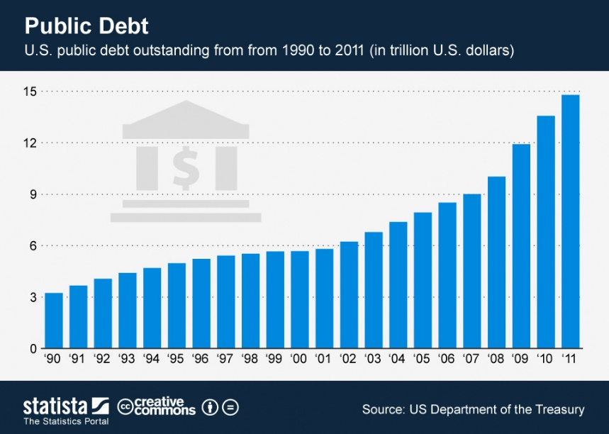


#4 Pay Down Public Debt
Also….. the Treasurer can use the Revolving Fund to pay off our public debt.
Our country could be debt-free.
No public debt? Debt-free?
Impossible! You’re nuts!

Slide 41



#4 Pay Down Public Debt
No, no! Listen! It’s hard to believe but it’s true!
As Treasury bonds, notes, bills come into the Treasury to be repaid to the borrowers, the Treasurer will use funds from the Revolving Fund to pay them off.

Slide 42

#4 Pay Down Public Debt
Listen! We can leave our children
with a debt-free government!

Slide 43

#4 Pay Down Public Debt
Listen! Our taxes will go DOWN, not up.
We will no longer have to pay interest on our national debt, cause there will be no national debt.

Slide 44

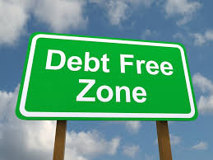

THE REVOLVING FUND – Take a Bow!
Incredible!
Wow!
Wow!
Wow!
You said it!
Wow!
Wow!
Wow!

Slide 45


Slide 46


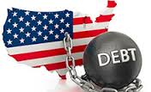
SPEND SOVEREIGN MONEY INTO THE ECONOMY
WHAT CAN WE DO, WHEN THE GOVERNMENT CREATES THE MONEY WE NEED?
Taxes can be reduced
Government borrowing can be reduced

Slide 47
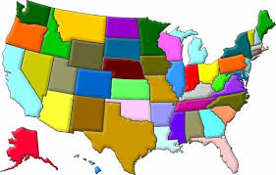
SPEND SOVEREIGN MONEY INTO THE ECONOMY
WHAT CAN WE DO, WHEN THE GOVERNMENT CREATES THE MONEY WE NEED?
25% of all new sovereign money is given as a grant to the states
the states decide how to use this money

Slide 48
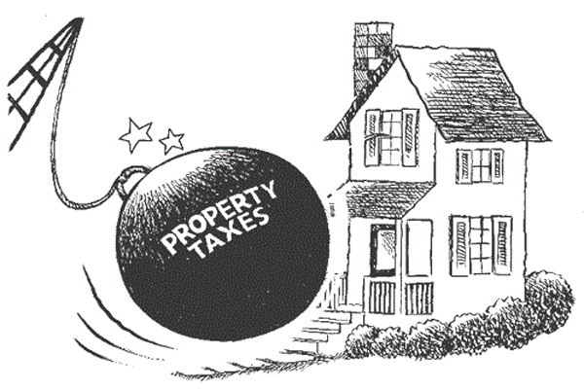

SPEND SOVEREIGN MONEY INTO THE ECONOMY
WHAT CAN WE DO, WHEN THE GOVERNMENT CREATES THE MONEY WE NEED?
interest-free lending to state, county, and local governments
state and local taxes can be reduced

Slide 49


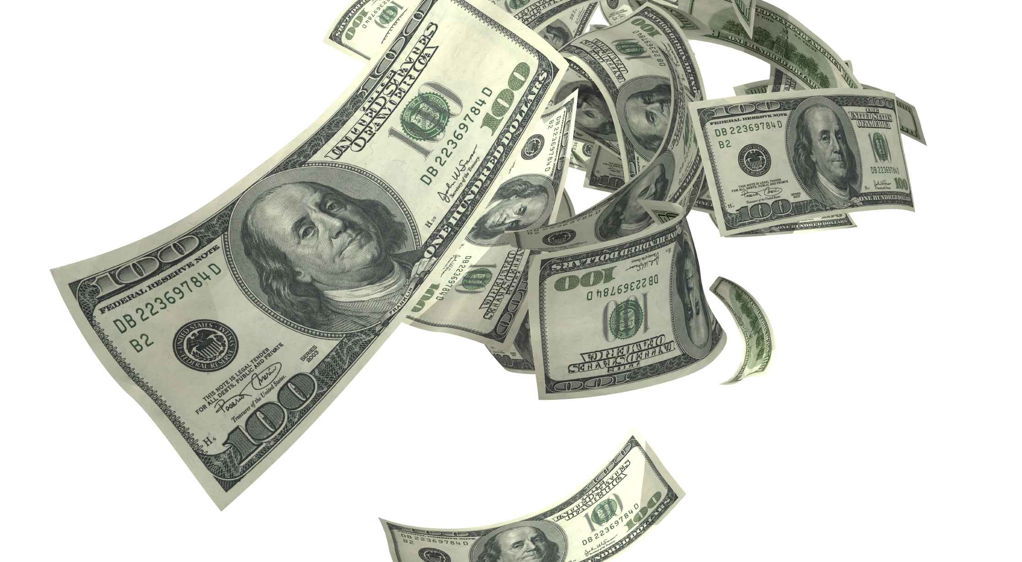
SPEND SOVEREIGN MONEY INTO THE ECONOMY
WHAT CAN WE DO, WHEN THE GOVERNMENT CREATES THE MONEY WE NEED?
THERE IS MORE DISPOSABLE INCOME FOR EVERYONE

Slide 50
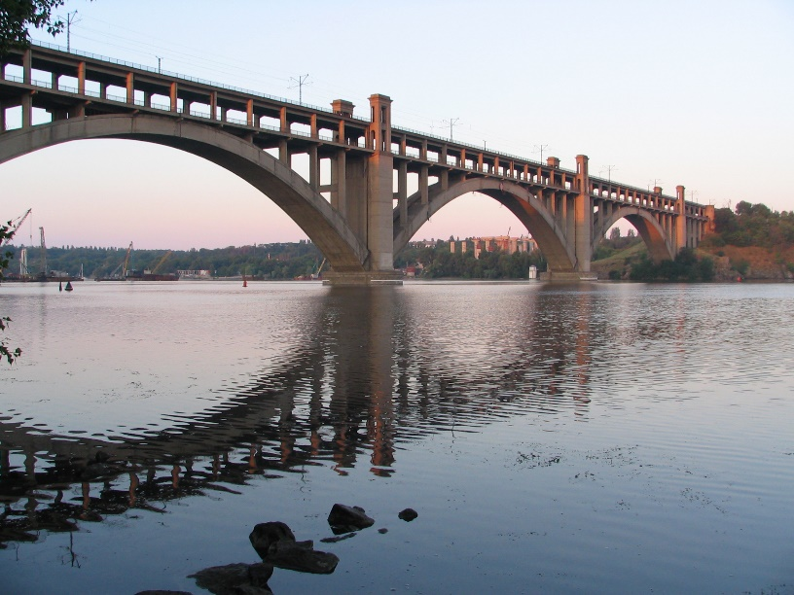
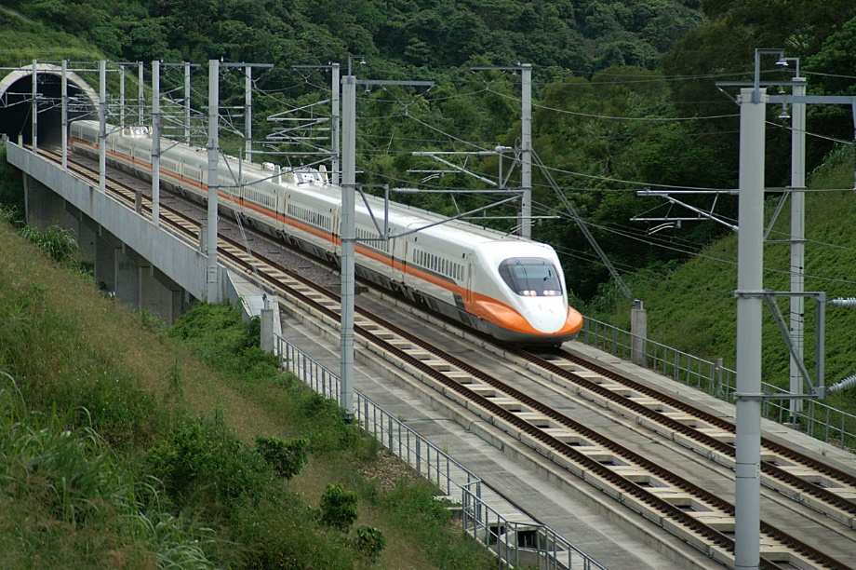
SPEND SOVEREIGN MONEY INTO THE ECONOMY
WHAT CAN WE DO, WHEN THE GOVERNMENT CREATES THE MONEY WE NEED?
SPEND MONEY ON REPAIR OF PHYSICAL INFRASTRUCTURE

Slide 51

SPEND SOVEREIGN MONEY INTO THE ECONOMY
WHAT CAN WE DO, WHEN THE GOVERNMENT CREATES THE MONEY WE NEED?
SPEND MONEY ON EDUCATION

Slide 52
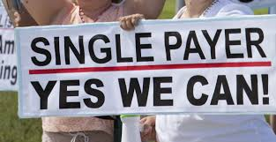

SPEND SOVEREIGN MONEY INTO THE ECONOMY
WHAT CAN WE DO, WHEN THE GOVERNMENT CREATES THE MONEY WE NEED?
SPEND MONEY FOR SINGLE-PAYER HEALTHCARE

Slide 53
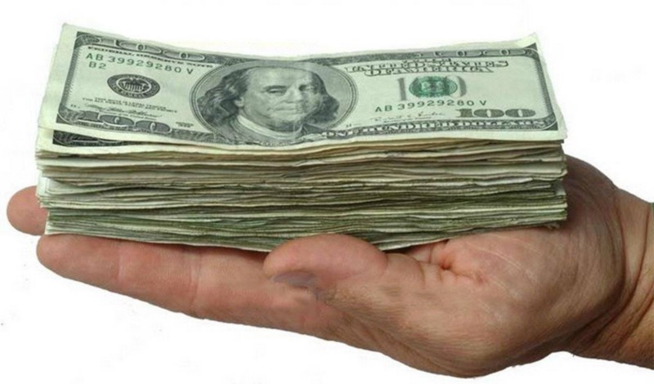
SPEND SOVEREIGN MONEY INTO THE ECONOMY
WHAT CAN WE DO, WHEN THE GOVERNMENT CREATES THE MONEY WE NEED?
GIVE A ONE-TIME CITIZEN’S DIVIDEND OF $10,000 TO EVERY PERSON
TO JUMP START THE ECONOMY
PEOPLE DECIDE WHAT TO DO WITH IT
THEY CAN BEGIN PAYING DOWN THEIR DEBTS

Slide 54


SPEND SOVEREIGN MONEY INTO THE ECONOMY
WHAT CAN WE DO, WHEN THE GOVERNMENT CREATES THE MONEY WE NEED?
FULL EMPLOYMENT IS POSSIBLE!

Slide 55
SOVEREIGN MONEY PROMOTES THE GENERAL WELFARE

Slide 56


