Slide 1
Money
Money Creation
This is rightfully a public matter.

Slide 2
Public money
2

Slide 3
I. What is money?
II. Public vs. private control of money issuance
3

Slide 4
I. What is money?
4

Slide 5
90% or more of our money is account money
10% or less of our money is coins and bills
5

Slide 6
Account money is nothing new
Ancient Mesopotamia, 3500 BC, clay tablets with Cuneiform records of debts “payable to the bearer.”
“Some of the very first written documents that have come down to us are Mesopotamian tablets recording credits
and debits” – Graeber, Debt: The First 5,000 Years
6

Slide 7
Some examples of money
Account balances Cattle
Cowry shells Leather money
Beads Tool money
Clay tablets recording debt payable to the bearer Sacks of grain
Metals by weight
Shekel Coins
Bills of exchange
Assignable promissory notes (goldsmiths) Tally sticks
Tobacco Beaver skins Banknotes Paper money
New account money created as loans
New account money created debt-free by government
7

Slide 8
Money has taken many forms.
What makes them all be money, i.e.
What is the nature of money?

Slide 9
According to economists… different forms of money all function as a
Medium of exchange
Unit of measure Store of value

Slide 10
Why do people accept money in return for their labor and goods?

Slide 11
Is a society's money system a public matter?

Slide 12
Review so far
•
Money is whatever functions as medium of exchange for a community or society

Slide 13
We can classify forms of money into these types:
COMMODITY (valued by market) |  | FIAT (valued by law)
 |  | Credit | Debt-free
15

Slide 14
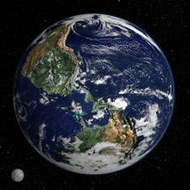
The Commons
Earth or Nature
(ground, water, air, frequencies, ...)
Cultural heritage
(money, language, art, knowledge, customs, ...)
Money
(shared medium of exchange)

Slide 15
II. Public vs private control of money issuance
18

Slide 16
US MONETARY HISTORY
PUBLIC MONEY
Colonial scrip Continentals
US Mint (coinage)
US Notes/Greenbacks (1862-1971)
PRIVATE MONEY
Commodity monies
Bank credit money has dominated
Central banks
•
•
•
•
•
•
•
–
–
First Bank of the US
Second Bank of the US
Federal Reserve System
–
19

Slide 17
Public Money: Colonial currencies
20

Slide 18
Public Money: Continental currency
21

Slide 19
Public Money: Legal Tender Acts (1862-3)
US Notes/Greenbacks 1862 - 1971
23

Slide 20
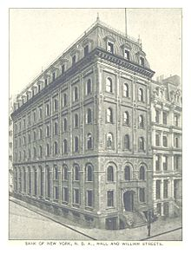
PRIVATE MONEY Hamiltonians wanted "Credit Money“ for Control & Power
Hamilton got a bank charter from New York City in 1784.
This was the first ever American private commercial bank in the nation, with the legal power to CREATE bankmoney (‘bank credit’).
22

Slide 21
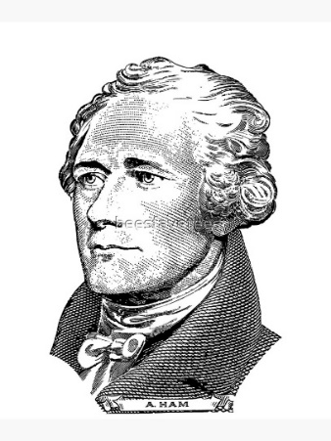
PRIVATE MONEY Hamiltonians wanted "Credit Money“ for Control & Power
In 1789, Hamilton became the country’s first Secretary of the Treasury. On December 14, 1790, Secretary of the Treasury Alexander Hamilton submitted to Congress the Second Report on the Public Credit, which described the private system
Hamilton introduced and we have today:
“Every loan, which a Bank makes is, in its first shape,
a credit given to the borrower on its books,
the amount of which it stands ready to pay….
But, in a great number of cases, no actual payment is made in either.
The Borrower frequently, by a check or order, transfers his credit
to some other person, to whom he has a payment to make…
22

Slide 22
The problem
The money creation power has never been taken away from the banks.
24

Slide 23
Article I, Section 8
of the United States Constitution
The Congress shall have power
Clause 1:
Clause 2:
Clause 5:
To lay and collect Taxes To borrow Money
To coin Money, regulate the
●
●
●
Value thereof
25

Slide 24
“The mistake … lies in fearing money and trusting debt.”
– Professor Henry Simons
26

Slide 25
An unjust privilege
As long as banks create money that didn't exist before the loan,
we have a recipe for transfer of money from the many to the few.
26

Slide 26
Frederick Soddy
1877-1956, English chemist
In four books written from 1921 to 1934, Soddy carried on a "campaign for a radical restructuring of global monetary relationships", offering a perspective on economics rooted in physics … Soddy wrote that financial debts grew exponentially at compound interest but the real economy was based on exhaustible stocks of fossil fuels. Energy obtained from the fossil fuels could not be used again. This criticism of economic growth is echoed by his intellectual heirs in the now emergent field of ecological economics.
http://archive.org/stream/roleofmoney032861mbp#page/n11/mode/2up Soddy, The Role of Money (1934)
28

Slide 27
Frederick Soddy
The Role of Money (1934)
PREFACE
The “money-power” … to create and destroy money by adding and withdrawing figures in bank ledgers, without the slightest concern for the interests of the community ...
To allow it [monetary system] to become a source of revenue to private issuers is to create, first, a secret and illicit arm of the
government and, last, a rival power strong enough ultimately to overthrow all other forms of government.
29

Slide 28
What type we accept as our money has far-reaching consequences
Medium of exchange
Shall money be
•
•
•
some valuable commodity?
(intrinsic value)
credit?
publicly issued, debt-free?
(abstract)
(abstract)
Who shall control our money system?
30

Slide 29
Public money
Separation of
money issuance (public) from
money lending (private)
31

