Slide 1
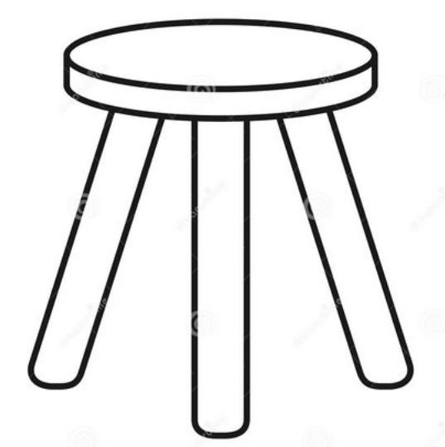
THREE LEGS OF A PROSPEROUS NATIONAL ECONOMY
1
3
2
PARITY PRICES
FOR RAW MATERIAL PRODUCERS
to produce adequate national income
PARITY TARIFFS
to protect national purchasing power
PARITY WAGES FOR LABOR
to distribute wealth
A FLOOR OF HONEST SOVEREIGN MONEY

