Slide 1
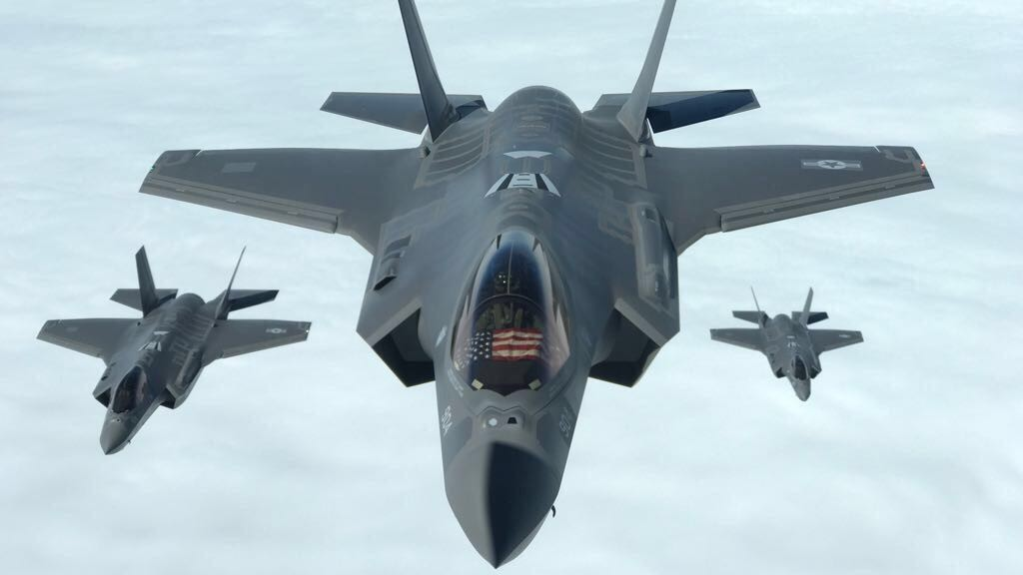
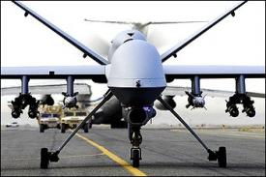
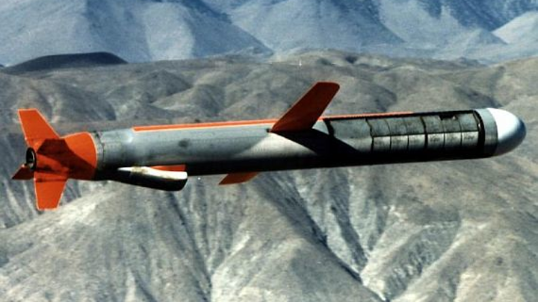
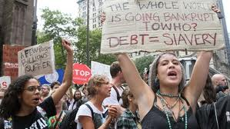
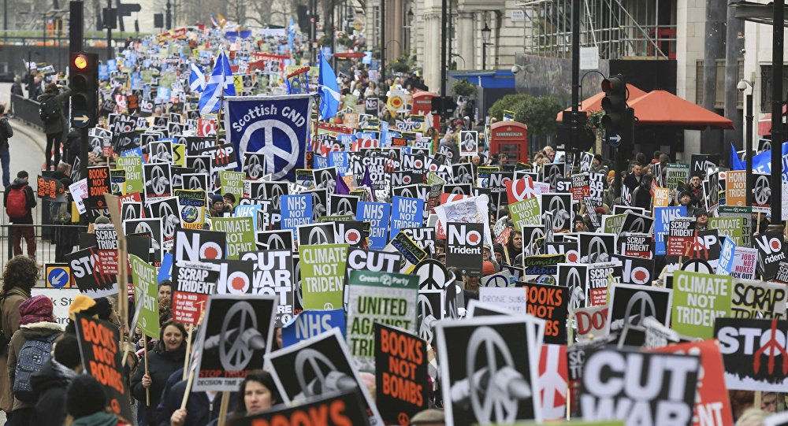
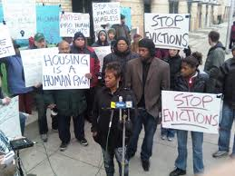
Defying Empire,
Defending Democracy,
& Powering Up with RCV
Notes:
F35
Tomahawk cruise
Reaper drone
Battleships/aircraft carrier?

Slide 2
The critical role of
Greens
Defying Empire,
Defending Democracy,
&
Powering up with RCV
Notes:
In particular, we’re going to talk about the critical role of Greens and allies in each of these important arenas where we are leading the charge, and still the ones we’ve been waiting for. So no pressure, but if you don’t like the way things are going, we have a critical role to play in reclaiming our future.
I want to ground this discussion in the framework of empire, the elephant in the room.
Empire is not compatible with Democracy.

Slide 3
Empire doubling down
War abroad
War at home
Failed states
Mass migration
Worse terrorist threats
Environmental, social & economic destruction,
Global instability
Breaks our budget,
Drains social resources,
Militarizes society – schools, prisons, police, entertainment
Degrades democracy
Notes:
So empire doubling down – the latest bipartisan 733 B military authorization, 60% discretionary budget – resurgent cold war, regime change threats to Ven, Iran, Cuba?
This has consequences abroad & at home where it’s breaking our budget….

Slide 4
Empire doubling down
War abroad
War at home
Failed states
Mass migration
Worse terrorist threats
Environmental, social & economic destruction,
Global instability
Breaks our budget,
Drains social resources,
Militarizes society – schools, prisons, police, entertainment
Degrades democracy

Slide 5
Foundations of Democracy
Under Assault
Election integrity – money, media, voter suppression, debate exclusion, hackable voting machines, ballot access exclusion
Civil liberties – press freedom (persecution of press, censorship), protest, privacy, political dissent
Human rights – racism, xenophobia, anti-Moslem, anti-semitism, anti-lgbt, misogeny; deportations, detentions, family separations
McCarthyism / Russiagate – warmongering, censorship, political repression, propaganda
Notes:
I want to connect the dots here and clarify how pervasive this assault on democracy is.

Slide 6
Resistance of Greens & Allies
Empire doubling down
GPAX
BAP
BAR
Popular Resistance
Code Pink
Embassy protectors
VFP, Global Network, UNAC
X
War abroad
War at home
Failed states
Mass migration
Worse terrorist threats
Environmental, social & economic destruction,
Global instability
Breaks our budget,
Drains social resources,
Militarizes society – schools, prisons, police, entertainment
Degrades democracy

Slide 7
Greens & Allies
Defending Democracy
Election integrity – money, media, voter suppression, debate exclusion, hackable voting machines, ballot access exclusion
Civil liberties – press freedom, protest, privacy, political dissent
Human rights – racism, xenophobia, anti-Moslem, anti-semitism, anti-lgbt, misogyny; deportations, detentions, family separations
McCarthyism/Russiagate – warmongering, censorship, political repression

Slide 8
Recount Update
Elections we can trust, that are accurate, secure & just, & free from the scourge of Jim Crow
>10,000 volunteers, >161,000 donors, $7 M dollars
MI WI, PA - high risk: vulnerable voting machines, narrow margins; election results conflicted with exit & pre-election polls
Recount was blocked: political & bureaucratic hurdles, financial extortion.
Revealed: out-of-date laws, prohibitive procedures, politicized courts, machine failure and vulnerability, flagrant racial inequities.
Notes:
WI estimate of recount cost was 1.1M. Only days later that was revised to $3.5M.

Slide 9
MI Recount
>70,000 ballots - no vote for president. = 7X margin
Difference = 0.2%, red flag for error/tampering.
Recount stopped by state court, opposition led by GOP.
Ruled we did not have “standing”,
Serious problems call results into question.
In Detroit alone, 87 voting machines broke, due to the city’s decade-old voting machines,
U.S. Civil Rights Commission 2000: voters of color at much greater risk of having votes misread or tossed out.
Revealed bizarre rules that make precincts ineligible for recount if discrepancies between their vote count & number of voters in poll books.
in f/u, new VMs purchased for entire state.
Notes:
stopped by the courts, where opposition was led by GOP operatives, who filed several lawsuits to block the recount.
state court ruled that Stein did not have “standing”, claiming she was not a proper party to seek a recount under Michigan law because she did not come close enough to winning the election. This ruling was unfortunate because recounts should not be undertaken based on who calls for them. They should be conducted because they’re needed - as indicated by irregularities and tight margins. In the future, statistical audits should be used to verify election results, and point to any discrepancies that show when a recount is needed. Ultimately, it’s the voters - and our democracy - who benefit from having recounts, and elections we can believe in.
Despite the short duration, serious problems quickly surfaced that called the accuracy of results into question
The recount also brought to light bizarre rules that make precincts ineligible for recounting if they have discrepancies between their vote count and the number of voters listed in their poll books. That means that the areas most in need of investigation are legally prevented from getting it.

Slide 10
WI Recount
Recount conducted through entire state.
Not all counties recounted by hand.
Repeated efforts to obstruct
FEC complaint by WI Republican Party;
Frivolous suit filed by a Trump super PAC
$2.4 M increase in recount cost.
Worked for over a year to set up state-wide exam of “source code” software
Never before examined following election for evidence of tampering or errors
Notes:
ballots are simply reinserted into the same machines that produced the first count, providing no meaningful cross check on the potentially flawed machines.
Election officials in Milwaukee County, the largest and the most socioeconomically, racially and ethnically diverse county in the state, declined a hand recount. This was unfortunate given the findings in Michigan that showed voting machines are most likely to malfunction in under-resourced communities of color. Absent a hand recount, there is no way to know whether the vote count in Milwaukee County was likewise compromised.
A new, unique Wisconsin law allows us the right to examine this software. The examination, conducted by computer voting experts, would check for evidence of human error, intentional interference or tampering by anyone - whether foreign powers, criminal networks, domestic partisans, or corporations that control the voting software.

Slide 11
PA Recount
80% voters forced to use paperless VMs
Recount procedures were draconian, complex, impossible to fulfill
Required at least 3 affidavits in each of >9,000 precincts->27,000 voters
No deadline dates or locations provided for filing.
Recount was stopped by bureaucracy, legal maneuvering & politicized court decisions.
Cases continued in state & federal court.
Notes:
Paperless machines = “black boxes” w no simple or reliable way to verify the accuracy of the vote count..
3 voters per precinct (9000 precincts)

Slide 12
Litigation Victories
for Election Integrity
MICHIGAN
2016 - State & federal courts ruled to stop recount. Appeal ended in state court, ruled no“standing”.
2017 - MI replaces all voting machines
WISCONSIN
WIN - 2017 After ~1 year, WI Election Commissn agreed we have right to examine 2016 VM & software, including “source code”.
Counts & tallies votes, never thoroughly examined.
Law never before used.
WIN – WEC decision upheld in state district court, after voting machine corps attempted to reverse the WEC decision or at least to enforce a gag rule.
.
Notes:
Following numerous motions to delay or dismiss
Nov, 2018, PA settlement raises the bar for the nation,

Slide 13
Recount Litigation
Victories for Election Integrity
WISCONSIN CON’T
PENDING - Voting machine corps appeal state district court decision. May go to WI Supreme Ct.
PENNSYLVANIA
WIN –2018 Defeated VM corporations’ motion to dismiss case in federal court.
WIN – 2018 Settlement that eliminates paperless voting machines, requires paper ballots, insures best practice audits, & gives us representation on that audit committee.
NATIONAL
March 2018 Congressional spending bill allocated $380 M for election security to be distributed among the 50 states.
Notes:
Following numerous motions to delay or dismiss
Nov, 2018, PA settlement raises the bar for the nation,

Slide 14
Many Reforms Needed
For Elections We Can Trust
Rapid transition to paper ballots.
Cybersecurity best practices, audits, recounts.
Treaty to end election interference by any nation (US is leading perpetrator, nonviolent & violent.)
End voter suppression, Right to Vote
Break stranglehold $$: public financing, free air time.
RCV: Expand voter choice, end fear-based elections
Inclusive debates
Protect rights of free speech & political opposition, end McCarthyism/Russiagate repression
Privacy protections - end micro-targeting, military-style psyops.
Notes:
12 states use paperless electronic machines
¼ of voters??
Cybersecurity best practices, post-election audits, recounts as needed
End voter suppression. Constitutional right to vote.
International treaty to end interference by any nation in other nations’ elections. (US is leading perpetrator, nonviolent & violent.)
Protect rts of free speech, political op from repression under the guise of protecting us from fake news & foreign propaganda
Break stranglehold of big money: public financing for political campaigns, free air time for ballot-qualified candidates,
Expand voter choice, end fear-based elections through Ranked Choice Voting, which liberates voters to vote for what they want, instead of against what they dislike.
Inclusive debates to inform voters about greater range of choices that they are clamoring for
Protect rights of free speech and political opposition from McCrthyism/Russiagate repression under the guise of protecting us from fake news & foreign propaganda
Inclusive debates to inform voters about choices they’re clamoring for
Protect rights of free speech & political opposition from McCarthyism/Russiagate repression under the guise of protecting us from fake news & foreign propaganda
Prop or not
Fb purges
Algorhythms for fb, googlesearches -> burried leftists, anti-war, social movements

Slide 15
Examples of Major Election Interference
DNC rigging the 2016 Democratic primary
Billions of dollars in free airtime for corporate candidates, especially Trump - “damn good” for network profits
Voter suppression - voter ID laws, Interstate Crosscheck, felon disenfranchisement
Cambridge Analytica – 100s (1000s?) data points on 50M fb users, targeted with psyops & propaganda.
Notes:
Interference by political operatives not ok either.
suppression schemes -voter ID laws, Interstate Crosscheck, felon disenfranchisement that systematically deny millions of Americans their constitutional right to vote.

Slide 16
NOT
Examples of Major Election Interference
Notes:
The IRA’s most shared pre-election Facebook post - a cartoon of a gun-wielding Yosemite Sam.

Slide 17
NOT
Examples of Major Election Interference
Notes:
Most popular instagram post

Slide 18
NOT
Examples of Major Election Interference
Russian social-media activity was mostly unrelated to the 2016 election (11%);
microscopic reach - 126 M on FB
1 out of 23,000 pieces of content.
$46,000 IRA FB budget = 0.05% of the $81 million spent on FB ads by Clinton+Trump campaigns.
$4,700 on Google platforms in 2016
vs $6B free air time for Trump (“damn good for CBS”)
Lack of relevant targeting, timing
From: New Studies Show Pundits Are Wrong About Russian Social-Media Involvement in US Politics 2018.12.28, Nation By Aaron Maté

Slide 19
Ranked Choice Voting
Ends spoiler myth, spoiler panic, voter blaming & shaming
Enables debate & dialogue that democracy depends on

