Slide 1
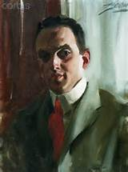
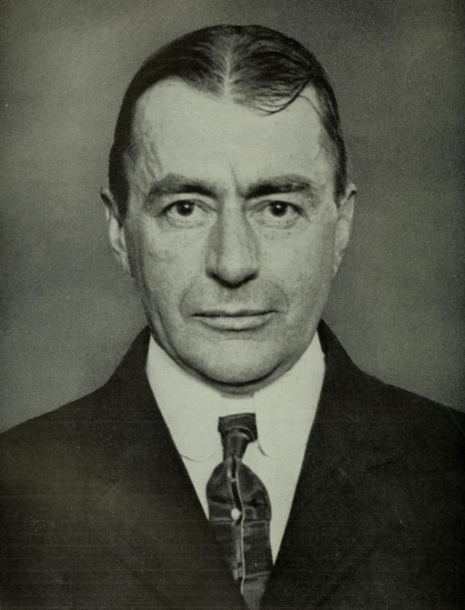
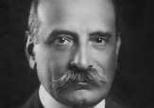
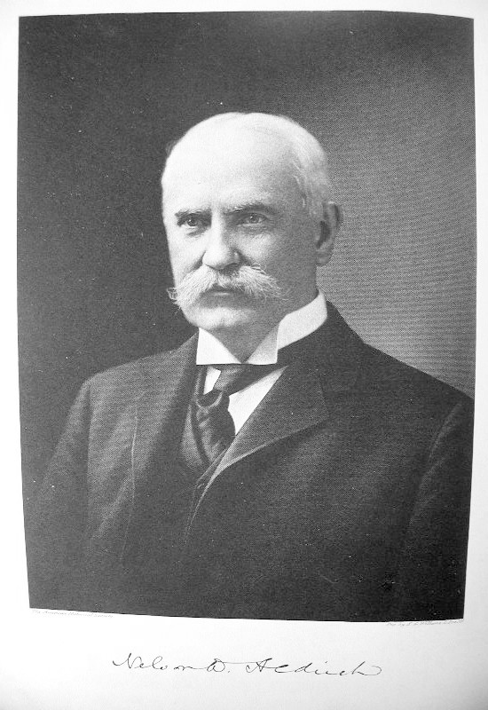
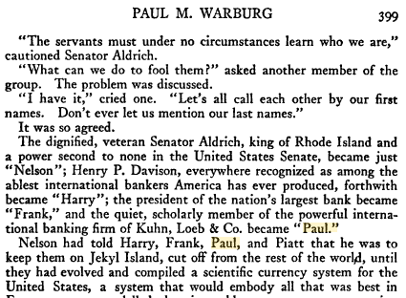
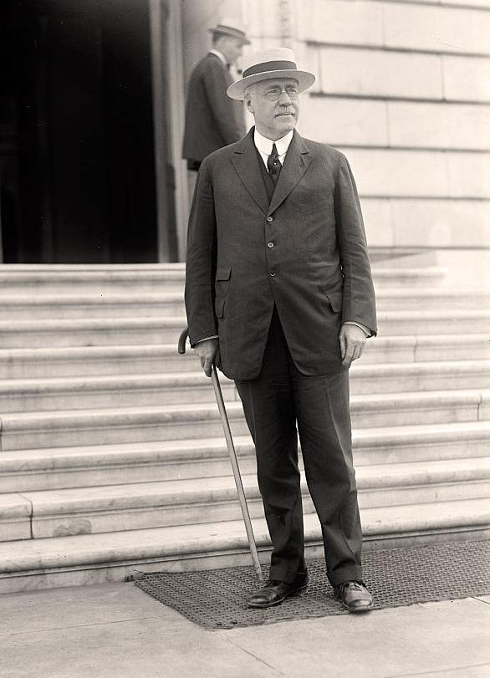
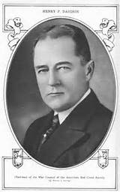
The Lost Science of Money
CHAPTER 19 – Part 2
TRIUMPH OF THE BANKERS:
ESTABLISHMENT OF THE FEDERAL RESERVE SYSTEM
PIATT
ANDREWS
BENJAMIN
STRONG
PAUL
WARBURG
NELSON
ALDRICH
FRANK
VANDERLIP
HARRY
DAVISON
Bertie Charles Forbes
Men who are Making America
pub. 1916-1917
THE ‘FIRST NAME CLUB’ from Jekyll Island Meeting, Nov, 1910

Slide 2
THEMES OF LOST SCIENCE OF MONEY BOOK
Primary importance of the money power (power to create money and regulate it)
Nature of money purposely kept secret and confused
How a society defines money determines who controls the society
Battle over control of money has raged for millennia: public vs private
The misuse of the monetary system causes tremendous misery and suffering for the ordinary people. Will Decker & Martin Dunn, February 2014
Whenever the public has owned a significant fraction of the money power, great public benefit has ensued: Sparta, the Roman Republic, the American Colonies in the 18th century, GREENBACKS after the Civil War, Canada after the Great Depression, British experience after World War II. Martin Dunn, July 2014.

Slide 3
PARTS OF PRESENTATION
Carroll Quigley: Fed Established by Stealth – But Is It a Conspiracy?
The Work of Ezra Pound and Eustace Mullins
Author? Author? The Bankers Pretend to Oppose Their Own Bill
Parallels to Establishing the Bank of England
The Age Old Techniques of Monetary Domination
“Safeguards” in the Federal Reserve Act
A. Mitchell Innes “Leads” the Way
The Fed is a Fractional Reserve Banking System
The Income Tax Also Created in 1913
How the Fed Was Used to Fund World War I
The Fed and the Depression of 1920-21
A Positive Note
Summary

Slide 4
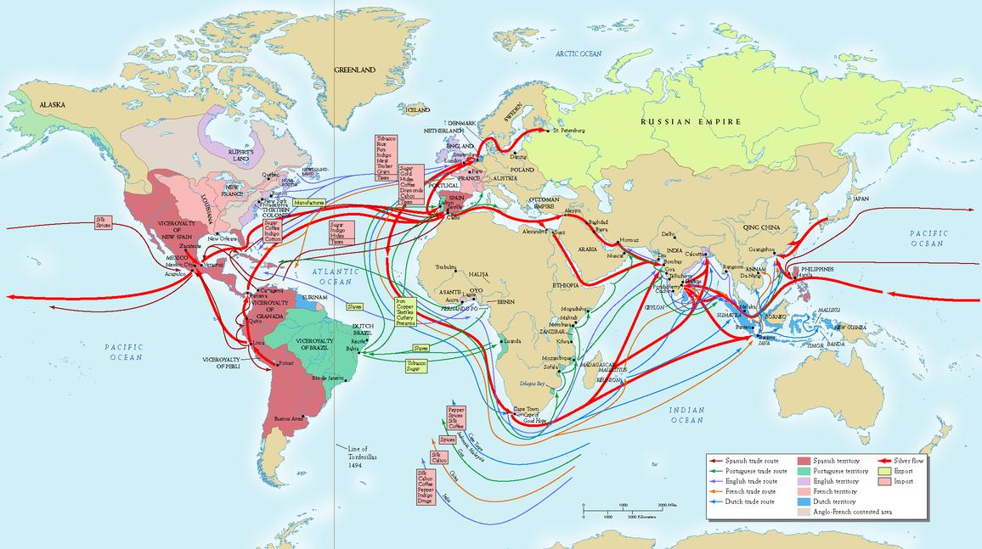
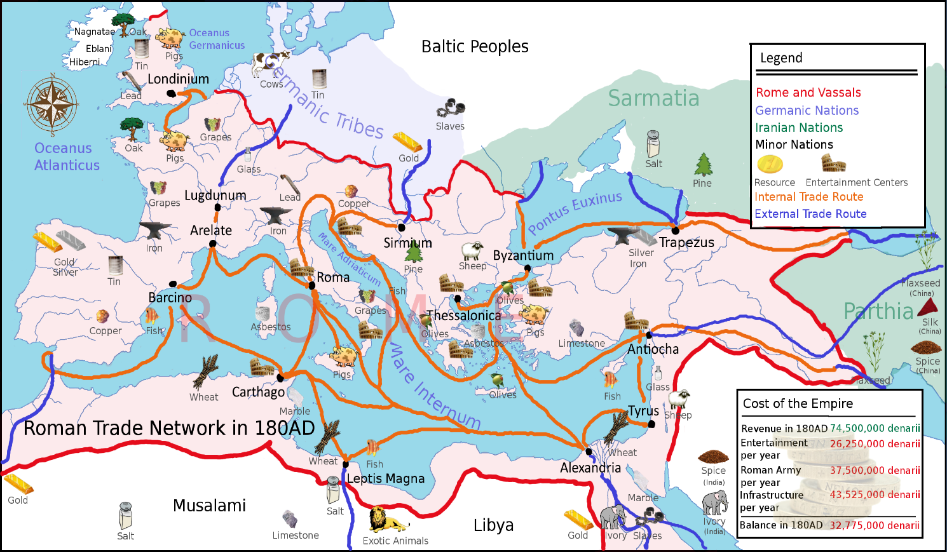
1. Carroll Quigley:
Fed Established by Stealth – But Is It a Conspiracy?
Carroll Quigley wrote TRAGEDY & HOPE: A HISTORY OF THE WORLD IN OUR TIME, pub. 1966. Here are some observations of the author:
With the re-introduction of money into Europe in the 11th century, profit was sought “by moving goods from one place to another. In this effort, goods went from places where they were less valuable to places where they were more valuable, while money, doing the same thing, moved in the opposite direction… Thus the value of goods was expressed in money, and the value of money was expressed in goods…
… goods were more valuable where prices were high and money was more valuable where prices were low.” Quigley, pp. 43-44

Slide 5
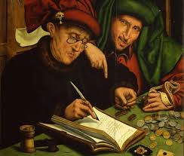
1. Carroll Quigley:
Fed Established by Stealth – But Is It a Conspiracy?
Carroll Quigley wrote TRAGEDY & HOPE: A HISTORY OF THE WORLD IN OUR TIME, pub. 1966. Here are some observations of the author on the history of the monetary system:
“In the course of time, however, some merchants began to shift their attention from the goods aspect of commercial interchange to the other, monetary, side of the exchange...
... three parts of the system, concerned with the production, transfer, and consumption of goods, were concrete and clearly visible so that almost anyone could grasp them simply by examining them, while the operations of banking and finance were concealed, scattered, and abstract so that they appeared to many to be difficult.
To add to this, bankers themselves did everything they could to make their activities more secret and more esoteric. Their activities were reflected in mysterious marks in ledgers which were never opened to the curious outsider.”
Quigley, pp. 45-46

Slide 6
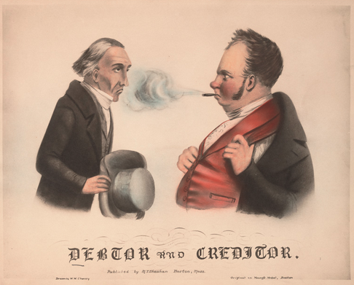
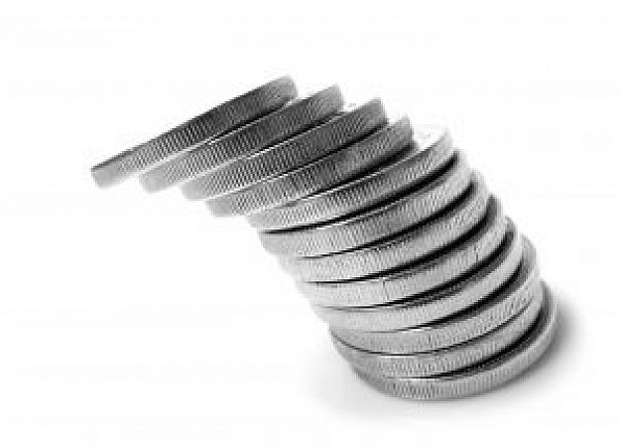
1. Carroll Quigley:
Fed Established by Stealth – But Is It a Conspiracy?
Carroll Quigley wrote TRAGEDY & HOPE: A HISTORY OF THE WORLD IN OUR TIME, pub. 1966. Here are some observations of the author on the history of the monetary system :
“Rising prices benefit debtors and injure creditors, while falling prices do the opposite.
A debtor, called upon to pay a debt at a time when prices are higher than when he contracted the debt, must yield up less goods and services…
A creditor, such as a bank, which has lent money… on one price level, gets back the same amount of money – but a smaller quantity of goods and services – when repayment comes at a higher price level… “
Debtors like rising prices. Their debt is easier to pay.
Creditors (bankers) like falling prices. Their money is worth more.
Quigley, p. 44

Slide 7
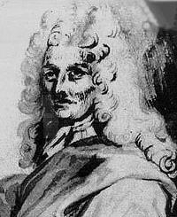
1. Carroll Quigley:
Fed Established by Stealth – But Is It a Conspiracy?
Carroll Quigley wrote TRAGEDY & HOPE: A HISTORY OF THE WORLD IN OUR TIME, pub. 1966. Here are some observations of the author on the history of the monetary system :
“Credit had been known to the Italians and Netherlanders… Nevertheless, the founding of the Bank of England by William Paterson and his friends in 1694 is one of the great dates in world history…
… creation of paper claims [bank notes] greater than the reserves [money] available means that bankers were creating money out of nothing.
The same thing could be done.. by deposit banks… ‘created deposits’ or loans could also be covered adequately by retaining reserves [money] to only a fraction of their value.
… bankers usually refused to express their actions, either note issuing or deposit lending, in these terms… ” Quigley, pp. 48-49
William Paterson (1658 - 1719) did say:
“The Bank hath benefit of interest on all moneys
which it creates out of nothing.”

Slide 8
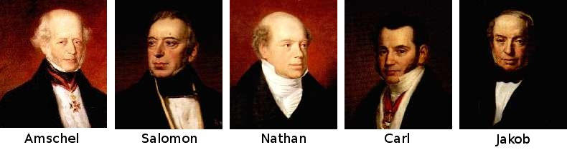
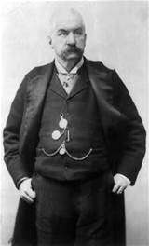
1. Carroll Quigley:
Fed Established by Stealth – But Is It a Conspiracy?
Carroll Quigley wrote TRAGEDY & HOPE: A HISTORY OF THE WORLD IN OUR TIME, pub. 1966. Here are some observations of the author on the history of the monetary system :
“Financial Capitalism, 1850-1931: This third stage of capitalism [an economic system motivated by the pursuit of profits within a price system] is of such overwhelming significance in the history of the twentieth century… subterranean and even occult…. The center of that system was in London, with major offshoots in New York and Paris… “
One of the reasons the center was London had to do with “the skill in financial manipulation, especially on the international scene, which the small group of merchant bankers of London had acquired…”
International bankers “… aspired to establish dynasties of international bankers… Baring, Lazard, Erlanger, Warburg, Schroder, Seligman, the Speyers, Mirabaud, Mallet, Fould, and above all Rothschild and Morgan.
THE 5 ROTHSCHILD BROTHERS
J.P. MORGAN
FRANKFORT
VIENNA
LONDON
NAPLES
PARIS

Slide 9
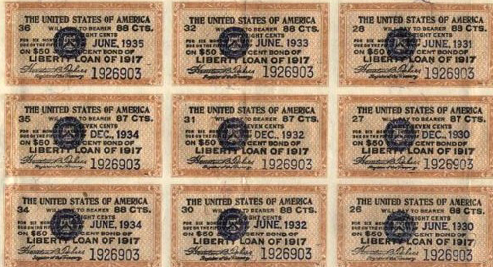
1. Carroll Quigley:
Fed Established by Stealth – But Is It a Conspiracy?
Carroll Quigley wrote TRAGEDY & HOPE: A HISTORY OF THE WORLD IN OUR TIME, pub. 1966. Here are some observations of the author on the history of the monetary system :
The international bankers were different than the ordinary bankers:
1. they were international
they were close to governments and particularly concerned with questions of government debts
their interests were almost exclusively in bonds and very rarely in goods
they were, accordingly, fanatical devotees of deflation and of the gold standard
they were almost equally devoted to secrecy and the secret use of financial influence in political life
      (paraphrased from Quigley, p. 52)

Slide 10
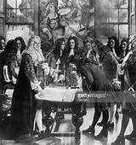
1. Carroll Quigley:
Fed Established by Stealth – But Is It a Conspiracy?
Carroll Quigley wrote TRAGEDY & HOPE: A HISTORY OF THE WORLD IN OUR TIME, pub. 1966. Here are some observations of the author on the history of the monetary system :
For Carroll Quigley, the FED was established by stealth
for that was the nature of international bankers and banking.
Secrecy and deception and obfuscation to the public
was its history.
William Paterson on the creation of the Bank of England:
“All this while, the very name of a bank or corporation was avoided, though the notion of both was intended… “

Slide 11
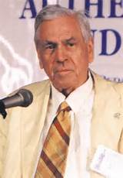
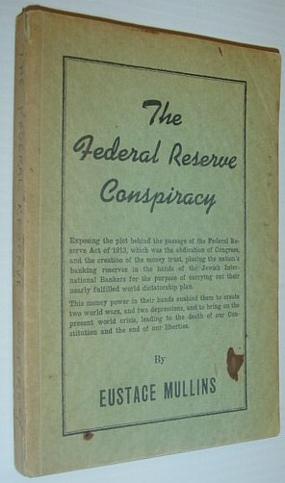
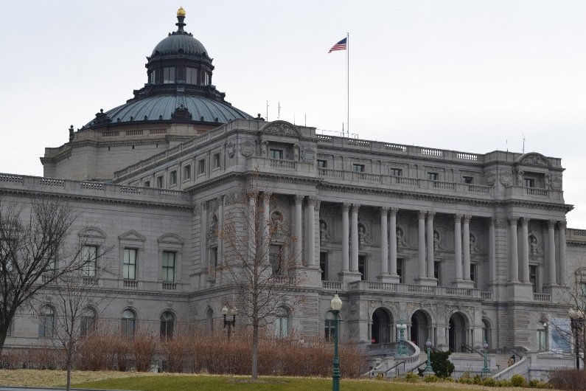
The Work of Ezra Pound and Eustace Mullins
“Mullins had studied under Ezra Pound… Pound understood the abstract nature of money, and the importance of that concept to society. One of the requirements he set for his students was that they read all of the available writings of Alexander Del Mar.” Stephen Zarlenga, LSM, p. 522
“Mullins’ book, The Federal Reserve Conspiracy, was published in 1952… Through Mullins’ work, many behind the scenes activities of highly placed financiers came to light.” Stephen Zarlenga, LSM, p. 522
Eustace Mullins
(1923 – 2010)
For 2 years, Mullins researched four hours a day at the Library of Congress. “This research is substantiated by citations and documentation from hundreds of newspapers, periodicals and books…”
Mullins, The Secrets of the Federal Reserve, Foreword

Slide 12
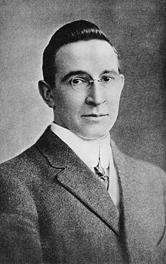
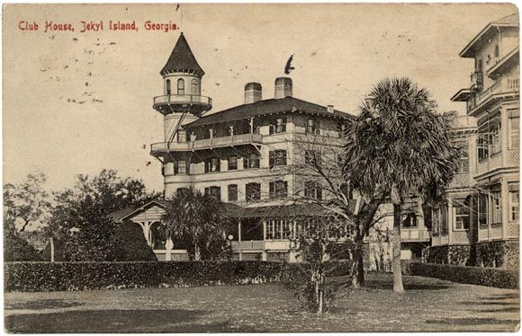
The Work of Ezra Pound and Eustace Mullins
The meeting of Wall Street bankers to write what would be the Federal Reserve bill was kept secret. The bankers understood that the country did not want a banking system ruled by Wall Street.
“Picture a party of the nation’s greatest bankers stealing out of New York on a private railroad car
under cover of darkness, stealthily hieing hundreds of miles South… I am giving to the world,
for the first time, the real story of how the famous Aldrich currency report, the foundation of our
new currency system, was written… the real birth of the present Federal Reserve System, the
plan done on Jekyll Island… Warburg… more than any one man has made the system possible
as a working reality.” B.C. Forbes, CURRENT OPINION, Dec 1916
Forbes revelation did not get much response. First, it was two years after the bill was passed;
secondly, it was dismissed as preposterous. In a book published in 1930, a biographer of Aldrich calls it “a mere yarn”.
Nathaniel Stephenson, Nelson W. Aldrich, A Leader in American Politics, pub. 1930
B.C. Forbes (1880 – 1954)
founder of Forbes Magazine
in 1917

Slide 13
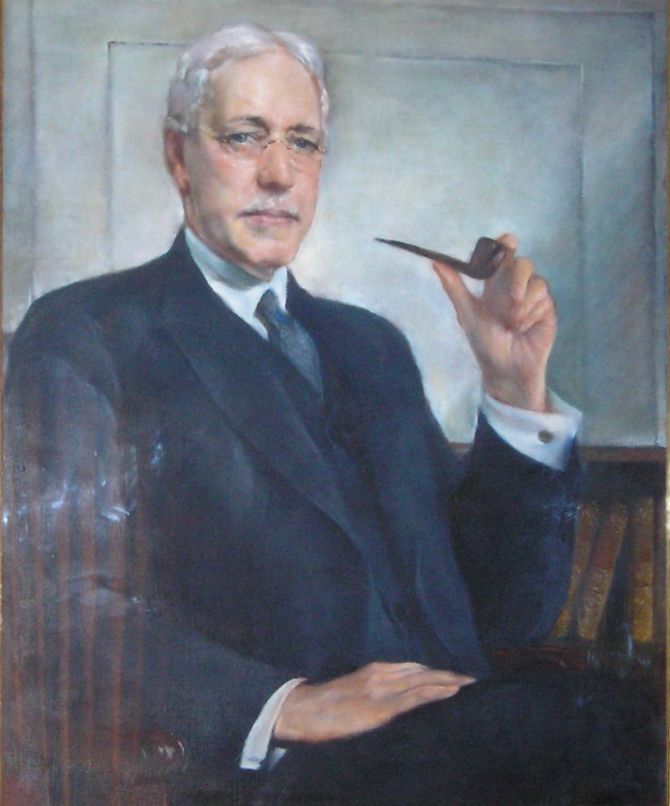
The Work of Ezra Pound and Eustace Mullins
However, as the men of the First Name Club wrote their memoirs, the facts came out.
Frank Vanderlip (‘Frank’) wrote in the Saturday Evening Post, Feb 9, 1935:
“Despite my views about the value to society of greater publicity for the affairs of corporations, there was an occasion near the close of 1910, when I was as secretive, indeed, as furtive, as any conspirator… I do not feel it is any exaggeration to speak of our secret expedition to Jekyl Island as the occasion of the actual conception of what eventually became the Federal Reserve System.”
The National City Bank of New York, 1909
Directors
James Stillman (Chairman) Stephen S. Palmer
Francis M. Bacon George W. Perkins
Cleveland H. Dodge James H. Post
Charles S. Fairchild M. Taylor Pyne
Henry C. Frick William Rockefeller
Joseph P. Grace Jacob H. Schiff
Edward H. Harriman Samuel Sloan
Cyrus H. McCormick William Douglas Sloane
Edwin S. Marston Henry A.C. Taylor
John W. Sterling Moses Taylor
P.A. Valentine Frank A. Vanderlip (President)
Frank A. Vanderlip, Sr.
(1864 – 1937)

Slide 14
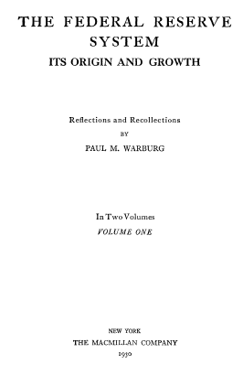

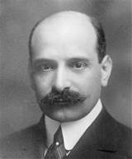

The Work of Ezra Pound and Eustace Mullins
However, as the men of the First Name Club wrote their memoirs, the facts came out.
Paul Warburg, the true architect of the Federal Reserve bill, wrote in 1930 in volume 1 of his book, The Federal Reserve System, Its Origin and Growth:

Slide 15
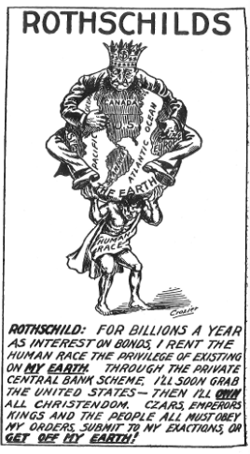
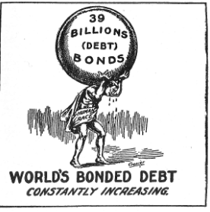
The Work of Ezra Pound and Eustace Mullins
“The main problem, as Paul Warburg informed his colleagues, was to avoid the name ‘Central Bank’. For that reason, he had decided upon the designation of ‘Federal Reserve System’. This would deceive the people into thinking it was not a central bank.
However, the Jekyll Island plan would be a central bank plan… it would be owned by private individuals who would profit from ownership of shares. As a bank of issue, it would control the nation’s money and credit.
Few people outside the banking world would realize that the existing concentration of the nation’s money and credit structure in New York made the proposal of a regional reserve system a delusion.” Mullins, Secrets of the Federal Reserve, p. 5
From Alfred Owen Crozier,
U.S. Money Vs. Corporation Currency,
“Aldrich Plan.”, pub. 1912

Slide 16
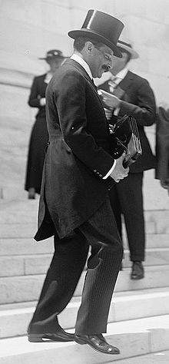
The Work of Ezra Pound and Eustace Mullins
PAUL MORITZ WARBURG
Warburg, the Monetary Reformer
Paul Warburg came to this country in 1902, as a German immigrant. His family banking firm of M.M. Warburg Company, of Hamburg and Amsterdam, was the chief German representative of the great European banking family, the Rothschilds.
He became a partner in the Kuhn, Loeb Company, New York, at a salary of five hundred thousand dollars a year. He earned this salary by travelling the country speaking to banking associations about the need for a “reformed monetary system”.
Warburg, Governor, First Federal Reserve Board, 1914-1918
Paul Warburg was not only part of the secret Jekyl Island group that secretly wrote the Federal Reserve law. He later was appointed to its first board of governors from 1914 until 1918, but
resigned in 1918. The German Warburg bank was funding the Kaiser’s war, and Max Warburg (Paul’s brother) was head of the German secret police.
“According to The New York Times, Paul Warburg’s letter of resignation stated that some objection had been made because he had a brother in the Swiss Secret Service. The New York Times has never corrected this blatant falsehood, perhaps because Kuhn, Loeb Company owned a controlling interest in its stock.” Mullins, The Secrets of the Federal Reserve, p. 88

Slide 17

The Work of Ezra Pound and Eustace Mullins
PAUL MORITZ WARBURG
Warburg, Member, Federal Advisory Council 1918-1927
“Congressman Carter Glass declared… on the floor of the House that the interests of the public would be protected by an advisory council of bankers... it has functioned for seventy years in almost complete anonymity, its members and their business associations, unnoticed and unknown by the public…
The selection of the regional members… from the list of bankers who worked most closely with the ‘big five’ banks of New York, and who were their principal correspondent banks, proves that the much-touted ‘regional safeguarding of the public interest’ … was from its very inception a deliberate deception.
J.P. Morgan [Jr.] obligingly gave up his seat on the Federal Advisory Council, and for the next ten years, Paul Warburg continued to represent the Federal Reserve district of New York on the Council.”
Mullins, Secrets of the Federal Reserve, pp. 40-45

Slide 18
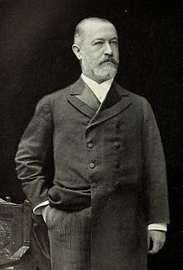
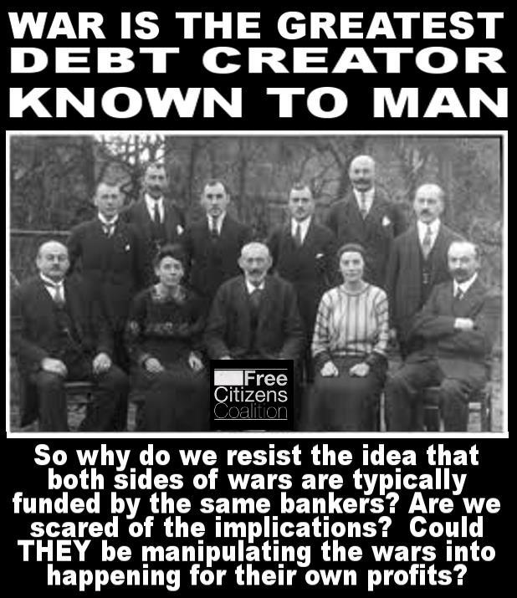
The Work of Ezra Pound and Eustace Mullins
KUHN, LOEB AND COMPANY
JACOB SCHIFF, Head, KUHN, LOEB & Co.,
PRIVATE NEW YORK INVESTMENT
BANK ALLIED WITH MORGAN, whose
daughter married Felix Warburg, brother
of Paul Warburg. Paul married the daughter
of the other KUHN, LOEB owner, Solomon Loeb –
SCHIFF HAD TWO BROTHERS IN
GERMANY DURING THE WAR
WHO ALSO WERE ACTIVE
AS BANKERS TO THE GERMAN
GOVERNMENT.
Schiff served as a director of
Equitable Life Assurance Society,
National City Bank of New York,
Central Trust Co.,
Western Union Telegraph Co.,
Union Pacific Railroad,
Bond & Mortgage Guarantee Co.,
and Wells Fargo & Co.

Slide 19
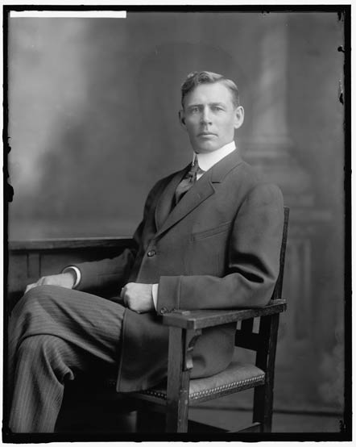
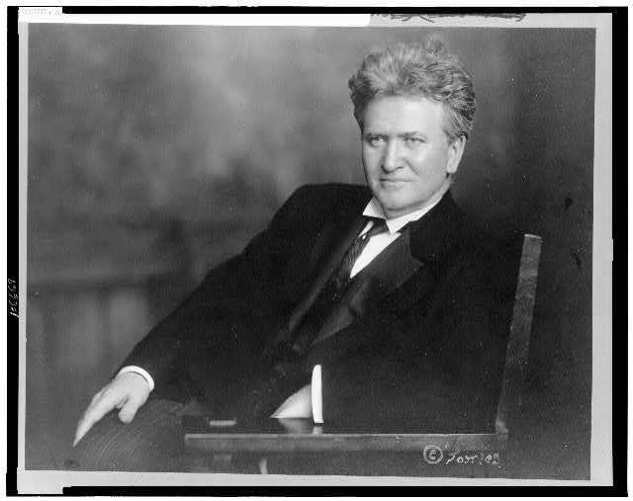
The Work of Ezra Pound and Eustace Mullins
“The speeches of Senator LaFollette and Congressman Lindbergh became rallying points of opposition to the Aldrich Plan in 1912. They also aroused popular feeling against the Money Trust. Congressman Lindbergh said, on December 15, 1911,
‘The government prosecutes other trusts, but supports the money trust. I have been waiting patiently for several years for an opportunity to expose the false money standard, and to show that the greatest of all favoritism is that extended by the government to the money trust.’
Senator LaFollette publicly charged that a money trust of fifty men controlled the United States. George F. Baker, partner of J.P. Morgan, on being queried by reporters as to the truth of the charge, replied that it was absolutely in error. He said that he knew from personal knowledge that not more than eight men ran this country.“
Mullins, The Secrets of the Federal Reserve, p. 16
Charles Lindbergh Sr.
(1859 – 1924)
Robert M. "Fighting Bob" La Follette, Sr.
(1855 – 1925)

Slide 20
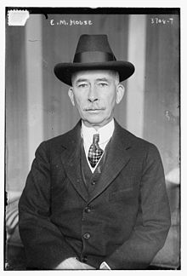
The Work of Ezra Pound and Eustace Mullins
“Professors like Wilson… were easy prey for Europe’s and America’s banking operators.” Stephen Zarlenga, LSM, p. 521
“Woodrow Wilson’s unofficial messenger and confidante during the entire time of his reign was Colonel House, who was sent to him with the cordial recommendations of Paul Warburg. Colonel House functioned as Wilson’s private emissary to Europe for several years, keeping up the cordial relations between Felix and Paul Warburg of Kuhn, Loeb Co., New York, and the rest of the family in M.M. Warburg Co. of Amsterdam and Hamburg, including the brother who was head of the German secret service.”
Mullins, A Study of the Federal Reserve, p. 53
Colonel House writes in his diary, March 1917, as President Wilson decides about declaring war: “The President asked whether I thought he should ask Congress to declare war, or whether he should say that a state of war exists and ask them for the necessary means to carry it on. I advised the latter. I was afraid of an acrimonious debate if he puts it up to Congress to declare war.”
Edward Mandell House
(1858 – 1938)

Slide 21
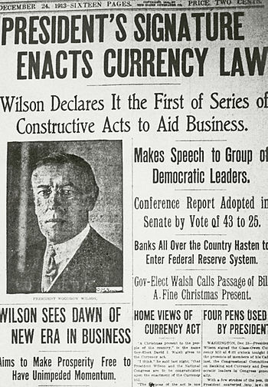
The Work of Ezra Pound
and Eustace Mullins
“The dictatorial nature of Woodrow Wilson always manifested itself whenever there was public criticism of his actions, and he was angered by the unfavorable comments on Warburg and Jones. In attempting to defend his appointment of these men, Wilson made one of the most ridiculous statements ever spoken by a President of the United States.
He told reporters that:
“THE MAJORITY OF THE MEN CONNECTED WITH WHAT WE HAVE COME TO CALL ‘BIG BUSINESS’ ARE HONEST, INCORRUPTIBLE, AND PATRIOTIC.”
Mullins, Secrets of the Federal Reserve, p. 46

Slide 22
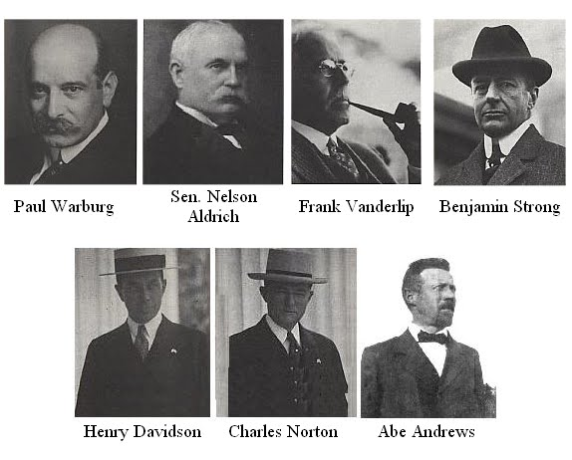
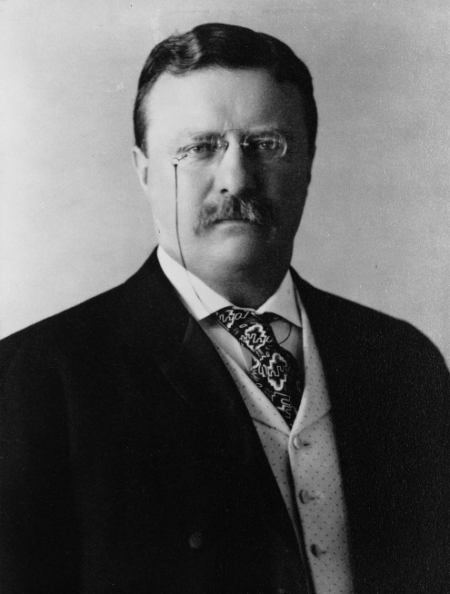
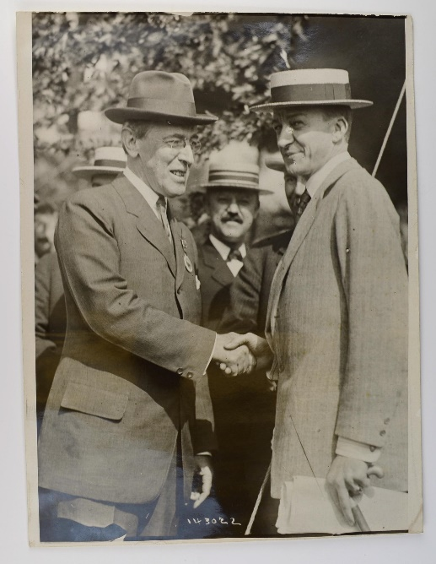
3. Author? Author? The Bankers Pretend to Oppose Their Own Bill
The Jekyll Island meeting devised the ‘Aldrich National Reserve Association’. Paul Warburg objected to the bill having the ‘Aldrich’ name since Aldrich was associated with Wall Street. Indeed, the bill failed to pass with Teddy Roosevelt, a Republican president.
“With the return of the Jekyl Island group to New York, the financiers now sponsored a nationwide propaganda movement to sell the people on “The Aldrich Plan.” All national banks were forced to contribute to a slush fund of five million dollars, and the great universities were used as strongholds of propaganda, abetted by the university presidents and the professors of economics.
Woodrow Wilson, President of Princeton University, was the first prominent educator to speak in favor of the Aldrich Plan…
During the Panic of 1907, Wilson had declared that: ‘All this trouble could be averted if we appointed a committee of six or seven public-spirited men like J.P. Morgan to handle the affairs of our country.”
Mullins, Secrets of the Federal Reserve, pp. 13-14
Jekyll Island Club
THEODORE ROOSEVELT
President 1901 – 1909
WOODROW WILSON
President 1913 – 1921

Slide 23
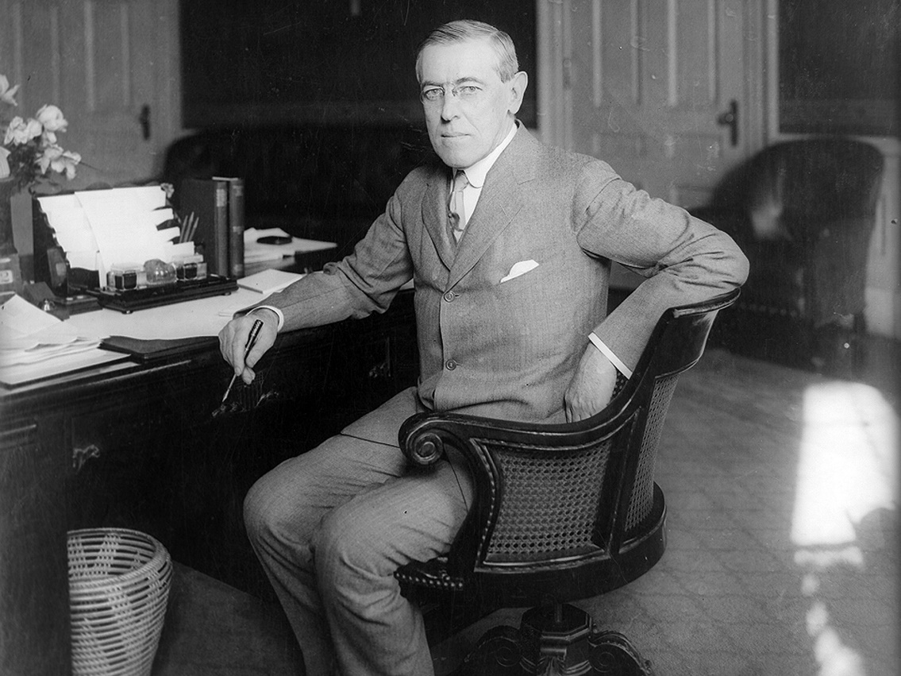
3. Author? Author? The Bankers Pretend to Oppose Their Own Bill
“Professors like Wilson… without real knowledge of the business or trading world but with over-inflated egos and a religious attachment to the inaccurate theories of Adam Smith, were easy prey for Europe’s and America’s banking operators.” Stephen Zarlenga, LSM, p. 521
“Wilson was elected President of the United States in 1912 on a
monetary reform platform. He promised the people of this country
that he would give them a money and credit law which would be
free of Wall Street influence…
His campaign for the Presidency had been entirely financed by
Cleveland H. Dodge, of Kuhn, Loeb’s National City Bank, Jacob Schiff,
senior partner in Kuhn, Loeb Co., Henry Morgenthau, Sr., Bernard
Baruch, and Samuel Untermyer.
Woodrow Wilson appeared before the people during his campaign with
monetary reform bill … officially sponsored by the Democratic Party.”
Eustace Mullins, A Study of the Federal Reserve, pub. 1952, p. 26
President Woodrow Wilson, 1856 – 1924
(in office 1913 – 1921)

Slide 24
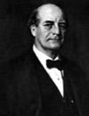
3. Author? Author? The Bankers Pretend to Oppose Their Own Bill
The Democratic bill has been ascribed to various authors. “Later observers concluded that the two banking plans [the Aldrich
Bill and the Federal Reserve Bill] were virtually the same.” Stephen Zarlenga, LSM, p. 524
“… some newspapers were unkind enough to point out its close kinship to the discredited Aldrich Plan.”
Eustace Mullins, A Study of the Federal Reserve, p. 26
The Democratic Owen-Glass Act (aka Federal Reserve Bill) claimed the following:
To liberate the farmer from his yearly need to mortgage his property to get credit.
(At a secret meeting on May 18, 1920 the Federal Reserve raised the rate to 7% and
precipitated the Agricultural Depression of 1920-21.)
To stabilize the monetary unit and give the dollar a consistent purchasing power.
(This item was stricken out of the bill. Mullins quotes Senator Owen in his book:
“I was unable to keep this mandatory provision in the bill because of the secret
hostilities developed against it, the origin of which at that time I did not fully understand.”
To release the country from the domination of a few Wall Street Bankers. The system
would divide the country into eight or twelve reserve bank districts.
(This ignored the fact that New York was the nation’s money market.)
To get the bill passed through Congress, William Jennings Bryan acted as Democratic whip.
“He later wrote that: ‘In my long political career, the one thing I genuinely regret is my part
in getting the banking and currency legislation enacted into law.’ ” Mullins, p. 29
Williams Jennings Bryan
Secretary of State 1913-1915

Slide 25
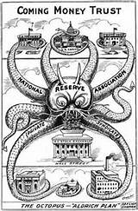
3. Author? Author? The Bankers Pretend to Oppose Their Own Bill
Colonel Elisha Ely Garrison, friend of both Theodore Roosevelt and Woodrow Wilson, says Professor Scott of Wisconsin University and himself revised the Aldrich-Warburg Plan [Monetary Commission’s plan] and created a revision that became the Federal Reserve Law. “It is this bill which I handed to [Representative] Glass across the dinner table that very evening, March 3, 1913, and which Glass has recently had the audacity to call a copy of the bill written by [Professor Henry Parker] Willis and himself.” Garrison, Roosevelt, Wilson and the Federal Reserve Law, p. 246
Garrison wrote his plan differed from the Aldrich plan in the following 9 ways:
Provides no recognition of speculative activities.
Makes small bank absolutely independent of big bank.
Machinery of system absolutely under government control.
Ownership of institution not confined to banks.
Provides for world conferences between committees of economists as to
influences of banking upon prices.
Free access of smallest bank to the Re-discount and Reserve Institution.
Central reserve of gold.
The Central Institution will support original production through exclusive
re-discount of commercial acceptances of current transactions.
The institution will never operate to the advantage of the powerful
financially [the ‘Money Trust’] against the weak.

Slide 26
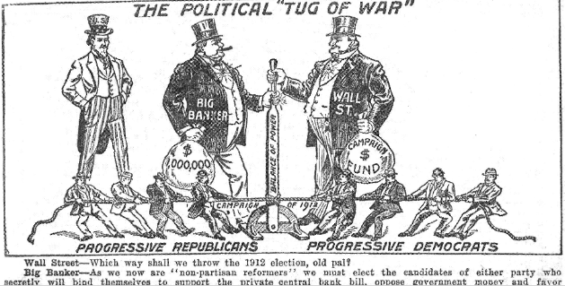
3. Author? Author? The Bankers Pretend to Oppose Their Own Bill
“To still further confuse the American people and to blind them to the real purpose of the Federal Reserve Act, the chief proponents of the Aldrich Plan, Senator Nelson Aldrich and Frank Vanderlip, set up an enthusiastic hue and cry against the bill. They gave interviews to reporters and politicians, anywhere they could find an audience…
Senator Robert L. Owen… pointed out that Vanderlip… was objecting to just those provisions in the Reserve Plan which he had fought for in the Aldrich Plan.”
Eustace Mullins, A Study of the Federal Reserve, pp. 29, 30
From Alfred Owen Crozier,
U.S. Money Vs. Corporation Currency,
“Aldrich Plan.”, pub. 1912

Slide 27
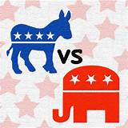
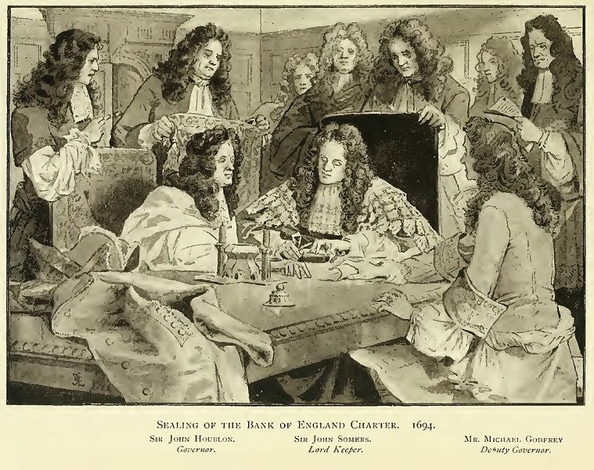

Parallels to Establishing the Bank of England
“The historical parallels between the establishment of the Federal Reserve System in 1913 and the Bank of England in 1694 are striking:” Stephen Zarlenga, LSM, p. 525
1
SECRECY SURROUNDING ITS CREATION
TONNAGE ACT (BANK OF ENGLAND)
FEDERAL RESERVE ACT
“All the while the very name of a bank or corporation was avoided..” William Paterson, founder
Secretly written at Jekyll Island
Failed as a Republican bill and subsequently disguised as a Democratic Party bill
Was a rider to a bill
Bankers pretended to oppose their own bill.

Slide 28
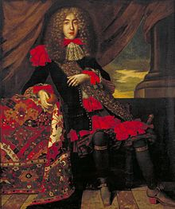
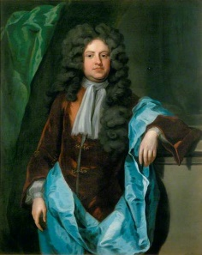
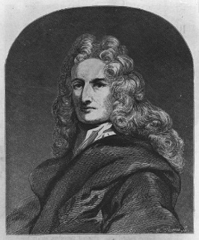

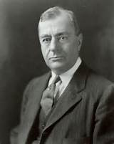
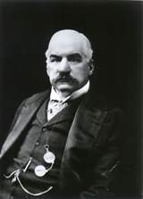

Parallels to Establishing the Bank of England
“The historical parallels between the establishment of the Federal Reserve System in 1913 and the Bank of England in 1694 are striking:” Stephen Zarlenga, LSM, p. 525
2
LINKS TO FOREIGN SUPPORTERS
BANK OF ENGLAND
FEDERAL RESERVE ACT
Dutch and Jewish financiers financed
William of Orange’s invasion of England, 1688
Paul and Felix Warburg, Kuhn Loeb partners, were from
the Warburg banking family of Hamburg, Germany, who represented the Rothschild interest
Dutch financier Franciso Suasso
lent two million guilders
THE ‘LOCALS’
THE ‘LOCALS’
Charles Montagu
1st Earl of Halifax
MICHAEL GODFREY
Sir William Paterson
PAUL WARBURG
BENJAMIN STRONG
J.P. MORGAN

Slide 29
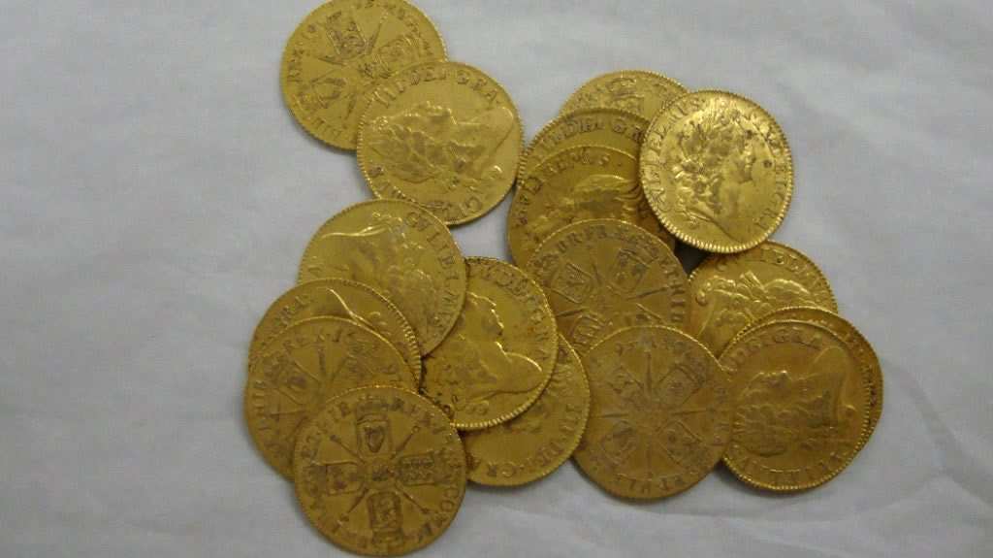
Parallels to Establishing the Bank of England
“The historical parallels between the establishment of the Federal Reserve System in 1913 and the Bank of England in 1694 are striking:” Stephen Zarlenga, LSM, p. 525
3
ITS COMPLEXITY KEPT PEOPLE FROM UNDERSTANDING THE TRUE SOURCE OF ITS POWER –
THE MONEY CREATION PROCESS
BANK OF ENGLAND
FEDERAL RESERVE ACT
Nowhere in the Federal Reserve Act was there a
description of the creation of money by private banks.
“An Act To provide for the establishment of Federal
reserve banks, to furnish an elastic currency*, to afford
means of rediscounting* commercial paper,
to establish a more effective supervision of banking
in the United States, and for other purposes.”
The bank owners obscured the true nature of money –
while creating abstract money, they put forward a back-
ward commodity concept of money as gold and silver.
‘elastic currency’ and ‘rediscounting’ means
‘creating money out of nothing’

Slide 30
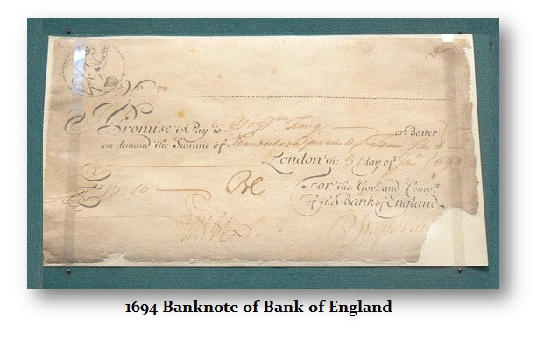
Parallels to Establishing the Bank of England
“The historical parallels between the establishment of the Federal Reserve System in 1913 and the Bank of England in 1694 are striking:” Stephen Zarlenga, LSM, p. 525
3
ITS COMPLEXITY KEPT PEOPLE FROM UNDERSTANDING THE TRUE SOURCE OF ITS POWER –
THE MONEY CREATION PROCESS
BANK OF ENGLAND
FEDERAL RESERVE ACT
Nowhere in the Federal Reserve Act was there a
description of the creation of money by private banks
“Sec. 14. Open-Market Operations.
Any Federal reserve bank may, under rules and regulations prescribed by the Federal Reserve Board, purchase and sell in the open market*, at home or abroad, either from or to domestic or foreign banks, firms, corporations, or individuals...”
BANK OF ENGLAND’S PRIVATE BANK NOTE,
‘redeemable in gold or silver’
The bank created abstract paper money for private power and profit of a small group.
* ’purchase … in the open market’ means ‘creating
money out of nothing’

Slide 31
Parallels to Establishing the Bank of England
“The historical parallels between the establishment of the Federal Reserve System in 1913 and the Bank of England in 1694 are striking:” Stephen Zarlenga, LSM, p. 525
3
ITS COMPLEXITY KEPT PEOPLE FROM UNDERSTANDING THE TRUE SOURCE OF ITS POWER –
THE MONEY CREATION PROCESS
BANK OF ENGLAND
FEDERAL RESERVE ACT
Marriner Eccles (Chairman of the Fed) questioned
by Thomas E. Dewey’s congressional committee, June 1933:
Eccles: “I mean the Federal reserve, when it carries out an
open market operation, that is, if it purchases government
securities in the open market, it puts new money into the
hands of the banks which creates idle deposits.”
Dewey: “There are no excess reserves to use for this purpose?
…What are you going to buy them with? You are going to
create credit?”
Eccles: “That is all we have ever done. That is the way the
Federal Reserve System creates money. It is a bank of issue.”
“Just as the people had been trained through the ages
to think of money as precious metal, and precious metal
as money, so they could be trained to think of paper
money as representing… their gold, or their silver! ”
David Astle, Essay 2, Babylonian Woe
1844 – law gave the Bank a monopoly on the printing
of new bank notes. The Act exempted demand deposits
from the legal requirement of a 100-percent reserve
which it did demand for the issuance of paper money.
The deposits were created when the Bank made loans
as accounting entries.

Slide 32


Parallels to Establishing the Bank of England
“The historical parallels between the establishment of the Federal Reserve System in 1913 and the Bank of England in 1694 are striking:” Stephen Zarlenga, LSM, p. 525
4
PRIVATELY OWNED,
BUT MADE TO APPEAR PUBLIC
BANK OF ENGLAND
FEDERAL RESERVE ACT
“All this while, the very name of a bank or corporation was avoided, though the notion of both was intended… “ William Paterson
“The Nation magazine was the only public organ, so far as
I can find out, which pointed out that the issue of the
money of the U.S. was being turned over to a body of
men who were neither elected nor answerable to
elections.” Mullins

Slide 33


Parallels to Establishing the Bank of England
“The historical parallels between the establishment of the Federal Reserve System in 1913 and the Bank of England in 1694 are striking:” Stephen Zarlenga, LSM, p. 525
5
SOME EARLY SUPPORTERS
ENDED UP CONDEMNING
BANK OF ENGLAND
FEDERAL RESERVE ACT
William Jennings Bryan and Woodrow Wilson both regretted
their role in getting the Federal Reserve bill passed.
Professor H. Parker Willis was the first Secretary of the
Federal Reserve Board, serving between 1914 and 1918.
He thought he had written the Federal Reserve Act:
William Paterson became so disaffected that he
published a book condemning the Bank’s
buildup of the national debt.
“What could be expected from a group of men such as composed the board… solely interested in standing from under when there was any danger of friction… while eager only to ‘stand in’ with the ‘big men’ whom they know as the
masters of American finance and banking.” H. Parker Willis

Slide 34





Parallels to Establishing the Bank of England
“The historical parallels between the establishment of the Federal Reserve System in 1913 and the Bank of England in 1694 are striking:” Stephen Zarlenga, LSM, p. 525
6
PURPORTED TO BE BACKED BY GOLD
BANK OF ENGLAND
FEDERAL RESERVE ACT
Federal Reserve Notes began 100% gold-backed but in
1917 that was reduced to 40%.
Deposits creating from loans began with only 14% gold
backing.
Two years after its commencement, the bank failed
to redeem its private paper currency in gold.

Slide 35


Parallels to Establishing the Bank of England
“The historical parallels between the establishment of the Federal Reserve System in 1913 and the Bank of England in 1694 are striking:” Stephen Zarlenga, LSM, p. 525
7
BOTH ENGLAND AND AMERICA PUSHED INTO EARLY WARS
BANK OF ENGLAND
FEDERAL RESERVE ACT
Nine Years’ War (1688-1697)
(England/Scotland, Germany, Netherlands, Savoy, Spain, and Sweden v France)
Nine Years’ War (1688-1697)
(England/Scotland, Germany, Netherlands, Savoy,
Spain, and Sweden versus France)
WORLD WAR I
April 1917 – November 1918

Slide 36


The Age Old Techniques of Monetary Domination
“The Federal Reserve System employed the standard false monetary concepts used for centuries to make domination possible.
As early as 1735 … the philosopher Bishop Berkeley had warned about them … :
      Money’s nature is a commodity.
      Money must be gold.
      Bankers were the source of money in a society, rather than the society itself
      Bankers could somehow be trusted to control the money system”
      Stephen Zarlenga, LSM, p. 528

Slide 37


“Safeguards” in the Federal Reserve Act
“… there were substantial restrictions in the Federal Reserve Act which appeared to block arbitrary abuses by bankers.” Stephen Zarlenga, LSM, p. 529
All printed Federal Reserve Notes were to be 100% backed by gold
The “real bills doctrine”: all commercial loans created as a deposit in a bank
were to be backed 100% by commercial output from new production, plus an
additional 14% by gold
The Governors of the Board in Washington were appointed by the President
Both the Secretary of the Treasury and the Comptroller of the Currency
were members of the Board
“What we don’t get
now, we can get later
by administrative methods.”
Paul Warburg

Slide 38


“Safeguards” in the Federal Reserve Act
Benjamin Strong was to become President of the all-powerful Federal Reserve Bank of New York from 1914 to his early death in 1928. Strong wrote to Paul Warburg on November 1, 1913:
“I can reluctantly force myself to admit the
necessity of compromise… but as to the
obligation of the U.S. Government being
gratuitously added to these circulating notes…. (no)
This is a provisional return to the heresies of
Greenbackism and fiat money.”
Strong’s Oct. 17, 1913 letter to
Col. Millard Hunsiker, as quoted by
Lester V. Chandler,
Benjamin Strong, Central Banker,
Washington: Brookings, 1958, p. 17

Slide 39


“Safeguards” in the Federal Reserve Act
FEDERAL ADVISORY COUNCIL, 1914
FEDERAL ADVISORY COUNCIL, 1914
Established under provisions of the Federal Reserve Act, to provide advice to the Board of Governors. Consists of one representative for each Federal Reserve Bank, elected annually by the bank's board of directors. Held first meeting December 1914.
FEDERAL RESERVE BOARD, 1914
OPEN MARKET INVESTMENT COMMITTEE, 1923
In 1923 the Open Market Investment Committee
was established, with Strong as chair, to determine
open-market operations for the System. The Fed then
began to use open-market operations proactively.
Standing: Paul M. Warburg, John Skelton Williams (Comptroller of the
Currency), W.P.G. Harding, Adolph C. Miller
Seated: Charles S. Hamlin (Governor), *William G. McAdoo (Chairman,
Sec of Treasury, Wilson’s son-in-law), Frederic A. Delano

Slide 40


Alfred Mitchell-Innes “Leads” the Way
“Thus the Federal Reserve System appeared to be based on gold as money, but the Fed had the potential to substitute bank credit for money. Just around the time of its inception, two articles appeared… They had the effect of preparing the mindset of those bankers who actually believed in a gold based money system, for the new ‘reality.’ “ Stephen Zarlenga, LSM, p. 530
From Wikipedia:
“Educated privately, he [Innes] entered the British Diplomatic Service in 1890 … was Counselor at the British Embassy in Washington, D.C. from 1908 to 1913.
While in Washington, he wrote two articles on money and credit for The Banking Law Journal. The first, 'What is Money?', received an approving review from John Maynard Keynes, which led to the publication of the second, 'Credit Theory of Money'.
Long forgotten and rediscovered decades later, the articles have been praised as "the best pair of articles on the nature of money written in the twentieth century". **
**Credit and State Theories of Money: The Contributions of A. Mitchell Innes by L. Randall Wray, pub. 2004
Washington D.C. residence of Innes
during the creation of the Federal Reserve Bill.

Slide 41

Mitchell Innes “Leads” the Way
INNES DEFINES DEBT-FREE MONEY OUT OF EXISTENCE !
WHAT IS MONEY?
By A. MITCHELL INNES
From The Banking Law Journal, May 1913.
“Adam Smith's position depends on the truth of the proposition that if the baker or the brewer wants meat from the butcher, but has (the latter being sufficiently provided with bread and beer) nothing to offer in exchange, no exchange can be made between them… But is it true? Assuming the baker and the brewer to be honest men... the butcher could take from them an acknowledgment that they had bought from him so much meat, and all we have to assume is that the community would recognize the obligation of the baker and the brewer to redeem these acknowledgments… we at once have a good and sufficient currency.
There is absolutely no reason for assuming the existence of so clumsy a device as a medium of exchange… In other words, the present theory is based on the antiquity of the law of debt.
Money, then, is credit and nothing but credit. A's money is B's debt to him, and when B pays his debt, A's money disappears. This is the whole theory of money.”

Slide 42

Mitchell Innes “Leads” the Way
INNES DEFINES MONEY OUT OF EXISTENCE !!!!
(THEN, WHAT WAS THE AMERICAN BILL OF CREDIT? CONTINENTAL? GREENBACK?)
The Credit Theory of Money
By A. Mitchell Innes
From The Banking Law Journal, Vol. 31 (1914), Dec./Jan., Pages 151-168.
“… of all the false ideas current on the subject of money none is more harmful than that which attributes to the government the special function of monopolizing the issues of money.
There is no such thing as a medium of exchange.
Credit and credit alone is money.
A banker is one who centralises the debts of mankind and cancels them against one another. Banks are the clearing houses of commerce.
Money in one form or another is, in fact, issued by banks, merchants, etc.”

Slide 43


Mitchell Innes “Leads” the Way
INNES DEFINES MONEY OUT OF EXISTENCE !!!!
(THEN, WHAT WAS THE AMERICAN BILL OF CREDIT? CONTINENTAL? GREENBACK?)
“… Innes had to ignore the historical examples of government money, especially the American examples such as the Greenbacks and the colonial currencies… In effect Innes attempted to define money out of existence. He was yet another English expert befuddling American minds.
This is the general direction 20th century establishment economists followed: they made inappropriate and false distinctions between ‘high powered money’ (actually money) and ‘lower powered money’ (actually credit). Instead of… clarifying the crucial distinctions between money and credit, they confused and obfuscated the concepts.” Zarlenga, LSM, p. 530

Slide 44

The Fed is a Fractional Reserve Banking System
Most people believe that modern banking consists of taking in deposits
and loaning them out at a higher rate of interest.
But modern banking consists of creating credit in the borrower’s account (“a bank loan”) based on the bank’s reserve money at its Federal Reserve Bank, which is one-tenth of the bank’s loans. In other words, the bank creates ‘money/credit’ out of nothing!
Bankers still pretend to pay out cash for the created credits
in the customer’s account.

Slide 45

The Fed is a Fractional Reserve Banking System
Fractional reserve systems are unstable because depositors can get scared and withdraw cash from the bank, which can close the bank, because it
doesn’t have that much cash (real money). It has been creating credit (fake money) in a bank account.
Crowd at New York's American
Union Bank during a bank run
early in the Great Depression.
The Bank went out of business
on June 30, 1931

Slide 46

The Fed is a Fractional Reserve Banking System
“The Federal Deposit Insurance Corporation (FDIC, enacted in 1935) guarantees the bank accounts. People know
that the FDIC could not really handle a system-wide collapse, but they trust and assume that the U.S. Government
will. Thus it is GOVERNMENT [emphasis added] credit that keeps the banks open in America.”
Stephen Zarlenga, LSM, p. 531
CURRENT FDIC INSURANCE:
Beginning January 1, 2013, all of a depositor’s accounts at an insured depository institution, including all noninterest-bearing transaction accounts, will be insured by the FDIC up to the standard maximum deposit insurance amount ($250,000).

Slide 47




The Fed is a Fractional Reserve Banking System
The 12 Federal Reserve Banks turn over 90% of their net profit to the government, from the
interest earned on money (‘reserves’) creation…
But the owners of the 12 Federal Reserve Banks – the commercial banks – keep all of the interest
earned on the money they create out of thin air – the public’s money (checking accounts).
In addition, by not renewing loans they can cause an economic depression.
The power to create and destroy money is an awesome power.

Slide 48
The Income Tax Also Created in 1913
The 16th amendment to the U.S. Constitution, adopted on February 3, 1913, established the income tax we know today. Until 1913, customs duties (tax on importation of goods into the country) and excise taxes (tax on sale or production of a good within the country) were the primary sources of federal revenue.
The Income Tax was raised to help pay for World War I.
History of income tax rates adjusted for inflation (1913-2010)
 | Number of | First Bracket | Top Bracket
Year | Brackets | Rate | Rate | Income | Adj. 2014 | Comment
1913 | 7 | 1% | 7% | $500,000 | $11.86M | First permanent income tax
1917 | 21 | 2% | 67% | $2,000,000 | $36.68M | World War I financing
1925 | 23 | 1.5% | 25% | $100,000 | $1.34M | Post war reductions

Slide 49


10. How the Fed Was Used to Fund World War I
COULD THE U.S. HAVE ENTERED THE WAR WITHOUT THE HELP
OF ITS CENTRAL BANK, THE FEDERAL RESERVE INSTITUTION?

Slide 50
10. How the Fed Was Used to Fund World War I
By 1916, the private investment bank of J.P. Morgan had organized loans
to Britain and France for a staggering 1.2 billion dollars of war munitions
By the 1917 entrance into war by U.S., 5 billion dollars of war supplies and weapons have been exported from the country by Morgan syndicate

Slide 51

10. How the Fed Was Used to Fund World War I
March 5, 1917 - confidential dispatch from Walter Hines Page,
US Ambassador to London, to Wilson:
“I think that the pressure of this approaching crisis has gone beyond the
ability of the Morgan Financial Agency….If we should go to war with
Germany, the greatest help we could give the Allies would be such a credit…
Unless we go to war with Germany our Government, of course, cannot make
such a direct grant of credit……
He added that the alternative to war was domestic collapse of the US….
Walter Hines Page (1855 – 1918)
American journalist, publisher, diplomat
U.S. ambassador to U.K. during World War I

Slide 52



10. How the Fed Was Used to Fund World War I
April 1917: President Wilson, The Peace President,
asks for a declaration of war against Germany

Slide 53

10. How the Fed Was Used to Fund World War I
The original Section 16 of the Federal Reserve Act required that all circulating notes issued by the central bank (created out of thin air) be backed 100% by real bills plus 40% by gold reserves.
Member commercial banks could borrow cash (Fed Reserve Notes) from the Fed, but only by submitting "real bills"
(commercial loans) as collateral.
The member banks were allowed to create money from thin air by making loans to commercial businesses. These bills were short-term debt instruments created by commercial businesses. The loans were backed by business inventories (the "real" in real bills).
By lending cash to member banks on real bills as collateral (‘discounting’), the Fed could increase the money supply. The ‘lent cash’ were Federal Reserve Notes created out of thin air by the Federal Reserve Bank.
BUT THE COUNTRY COULD NOT FUND
WORLD WAR I ONLY THRU THE CREATION
OF FEDERAL RESERVE NOTES BASED ON
‘COMMERCIAL LOANS’ AND GOLD.

Slide 54



10. How the Fed Was Used to Fund World War I
The Federal Reserve Law was amended to dramatically increase the
Fed’s ability to issue notes.
1916 - Section 13.8 change: to allow the Fed for the first time to make loans to member
banks (create money out of nothing) with government debt serving as collateral. But their quantity was limited by the commercial loan collateral requirement.
April 1917: Wilson and Congress declare war.
June 1917 – Section 16 change: to allow the Fed Reserve Note to be backed with only
60% commercial loans and 40% gold.
1917 - Section 13.8 change: ‘unreal’ loans (government debt) were now permitted to satisfy the 60% requirement of ‘real’ loans (commercial debt).
The Fed now faced no constraints creating Fed Reserve notes (out of nothing) and loaning them to its member banks with their collateral of government debt.

Slide 55


10. How the Fed Was Used to Fund World War I
The immediate result of these changes was a massive increase of Fed loans to member banks secured by government debt, i.e., a massive increase of Federal Reserve notes created out of nothing.
Member banks could buy 3.5% Liberty bonds at government-debt auctions (creating credit money out of nothing) and then submit the bonds to the Fed as collateral for loans at the preferential rate of 3% (the Fed creating Federal Reserve notes out of nothing).
By 1919, Fed loans to its members, collateralized by government debt, grew to almost 100% of all ‘discounts’ made.
No longer need the Treasury depend on the wherewithal of private individuals and banks … they could depend on their central bank.

Slide 56



10. How the Fed Was Used to Fund World War I
April 1917 to the Armistice of 11/11/1918:
U.S. government lent the European Allied Powers the stupendous sum of 9.4 billion dollars.
All this money went to American industries, most tied to Morgan, Kuhn-Loeb, and Rockefeller, to pay for war supplies for allies.

Slide 57

11. The Fed and the Depression of 1920-21
“… the biggest lie was that it [Federal Reserve System] would end money panics and business depressions. We were to have no more bank failures, no more farms seized by mortgage holders, no more factories closing down or unemployment…
The history of the Federal Reserve System proves that it double-crossed the farmers of America at a secret meeting on May 18, 1920, when it raised the rate to 7% on agricultural paper and precipitated the Agricultural Depression of 1920-21.”
Eustace Mullins, A Study of the Federal Reserve, 1952, p. 30
The recession of 1920–21 was characterized by extreme deflation—the largest one-year percentage decline in around 140 years of data. The Department of Commerce estimates 18% deflation... The drop in wholesale prices was even more severe, falling by 36.8%, the most severe drop since the American Revolutionary War.

Slide 58
11. The Fed and the Depression of 1920-21
THE NEXT SERIES OF SLIDES COME FROM THE CONGRESSIONAL RECORD, REPORTING ON THE SECRET MEETING OF THE FEDERAL RESERVE BOARD, WHICH BROUGHT ON THE DEPRESSION OF 1920 ➔

Slide 59
11. The Fed and the Depression of 1920-21

Slide 60
11. The Fed and the Depression of 1920-21

Slide 61
11. The Fed and the Depression of 1920-21

Slide 62

11. The Fed and the Depression of 1920-21
From Alfred Owen Crozier,
U.S. Money Vs. Corporation Currency,
“Aldrich Plan.”, pub. 1912

Slide 63



11. The Fed and the Depression of 1920-21
____|___________________________________|________________________________________________________|_______
Sept 1919 May 1920 Sept 1921
Bankers increased money supply by 8.63% Bankers reduced money supply by -16.79% to -8.16%
Prices rise by 15.8% Deep recession. Index of farm prices fell from 244 to 136.
Money loses value. Money gains value.
Bank loans repaid with money worth less. Bank loans repaid with money worth more or farm foreclosed on.
Bankers did not like this. Bankers engineered this recession.
Price of wheat fell from $3/bushel to $1.60/bushel

Slide 64




11. The Fed and the Depression of 1920-21
“In the 1920s John Skelton Williams was the Comptroller of the Currency and an ex-officio member of the Fed Board. In 1923 he wrote as follows of events in 1920: ‘When I realized the dangers of the drastic deflation which they were bringing about, I urged and implored them [bankers and their representatives] to put on the brakes before it should be too late.” William Hixson, What’s the Difference Between Bankers and Counterfeiters?, pub. 2005, p. 192
Heavily mortgaged during World War I, in expectation of continued high prices, many farms were overwhelmed by the postwar collapse of the agricultural commodities market.
John Skelton Williams
(1865 - 1926)
Controller of Currency
(1914-1921)

Slide 65

12. A Positive Note
Democratic Chairmen of the House Banking Committee have regularly put forward legislation to nationalize or abolish the Federal Reserve System.
1933: Congressman Louis T. McFadden of Pennsylvania, Chairman for more than 10 years, moved the House to impeach the Federal Reserve Board.
“Mr. Chairman, we have in this Country one of the most corrupt institutions the world has ever known. I refer to the Federal Reserve Board and the Federal Reserve Banks, hereinafter called the Fed. The Fed has cheated
the Government of these United States and the people of the United States out of enough money to pay the Nation's debt.”
Louis Thomas McFadden
(1876 – 1936)
Congressman from 1923 to 1935

Slide 66

12. A Positive Note
Democratic Chairmen of the House Banking Committee have regularly put forward legislation to nationalize or abolish the Federal Reserve System.
1938: Congressman Wright Patman introduced a bill to nationalize the Fed.
He represented Texas from 1929 to 1976.
Patman summarized his long experience with Wall Street Banking in his 50 page report, A Primer on Banking published by the U.S. Government Printing Office in 1964”
“In the US today, we have in effect two governments. We have the duly constituted government, then we have an independent, uncontrolled and uncoordinated government in the Federal Reserve, operating the money powers which are reserved to congress by the Constitution.”
John William Wright Patman
(1893 – 1976)
Congressman from 1929 to 1976

Slide 67

12. A Positive Note
Democratic Chairmen of the House Banking Committee have regularly put forward legislation to nationalize or abolish the Federal Reserve System.
1980-90’s: Congressman/Chairman Gonzales introduced legislation to rescind the Federal Reserve Act.
Henry Barbosa González
(1916 – 2000)
Congressman from 1961 to 1999
The book Deception and Abuse at the Fed, by Robert Auerbach, recounts major instances of Fed mismanagement and abuse of power that were exposed by Rep. Gonzalez, including:
Blocking Congress and the public from holding powerful Fed officials accountable by falsely declaring—for 17 years—it had no transcripts of its meetings;
Stonewalling Congressional investigations and misleading the Washington Post about the $6,300 found on the Watergate burglars.
Rep. Gonzalez believed the FED should not be allowed to operate with the secrecy and independence in which it shrouded itself.

Slide 68
13. Summary
The populist parties arose after the Democrats were neutralized by European bankers in 1868.
This splintered the national majority in favor of Greenback money.
The Aldrich-Vreeland Act was used to stabilize the banking system successfully, but the artificially induced panic
of 1907 provided the excuse for establishing the Federal Reserve System.
Aldrich’s National Monetary Commission never defined money.
The bankers opposed their own bill to get it passed.

Slide 69
Q & A
WILL DECKER’S CONCLUSION:
THE CONTROL OF MONEY -- WITHOUT CONTROL FROM THE PUBLIC -- LEADS TO
CORRUPTION … USURPATION … SLAVERY.

