Slide 1
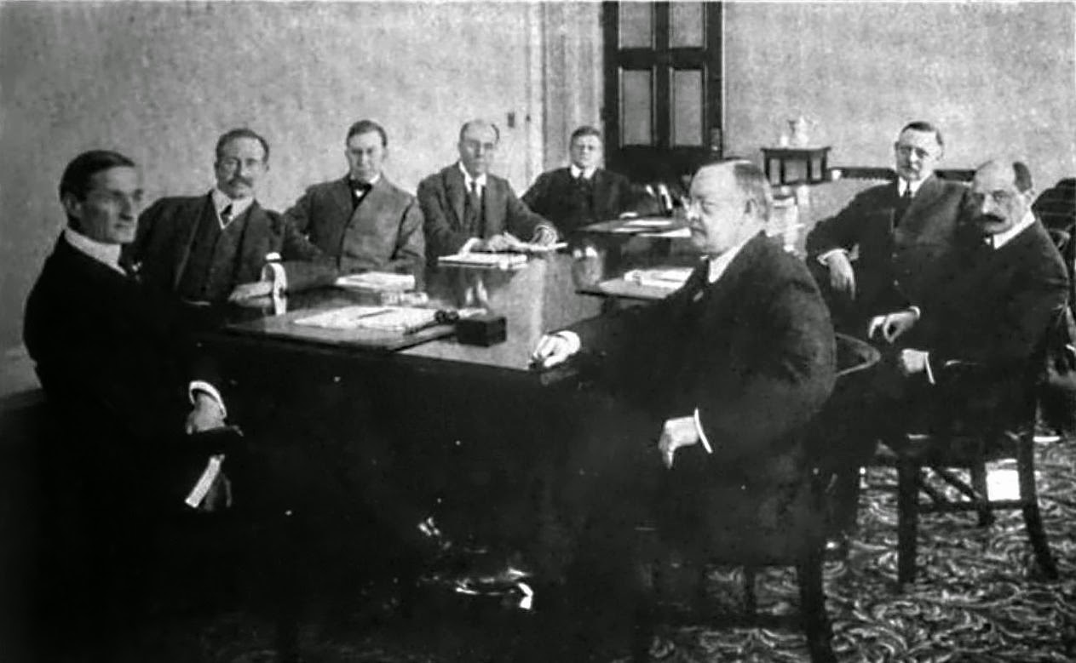
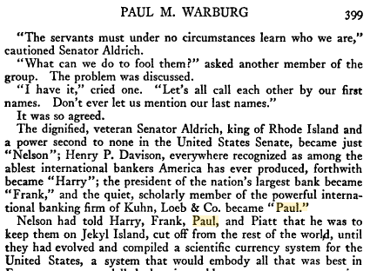
The Lost Science of Money
CHAPTER 19 – Part 1
TRIUMPH OF THE BANKERS:
ESTABLISHMENT OF THE FEDERAL RESERVE SYSTEM
1917 FEDERAL RESERVE BOARD
Bertie Charles Forbes
Men who are Making America
pub. 1916-1917

Slide 2
THEMES OF LOST SCIENCE OF MONEY BOOK
Primary importance of the money power (power to create money and regulate it)
Nature of money purposely kept secret and confused
How a society defines money determines who controls the society
Battle over control of money has raged for millennia: public vs private
The misuse of the monetary system causes tremendous misery and suffering for the ordinary people. Will Decker & Martin Dunn, February 2014
Whenever the public has owned a significant fraction of the money power, great public benefit has ensued: Sparta, the Roman Republic, the American Colonies in the 18th century, GREENBACKS after the Civil War, Canada after the Great Depression, British experience after World War II. Martin Dunn, July 2014.

Slide 3
PARTS OF PRESENTATION
Introduction
Populism – Bagged by the Bankers
Belmont “Factor” Splits the Democrats
Highlight of the Greenback Movement
1896 William Jennings Bryan Campaign: “Cross of Gold” Speech
Decentralization Reduces Some Problems
The Growing Competition
Gold and Technology Discoveries Bring Relief
Currency Act of 1900
Treasury Secretary Shaw’s Innovative Solutions
The Postal Savings System
Bankers Thwart Societal Solutions: Panic of 1907
Government Comes to the Rescue – Again
The Aldrich-Vreeland System

Slide 4
INTRODUCTION

Slide 5
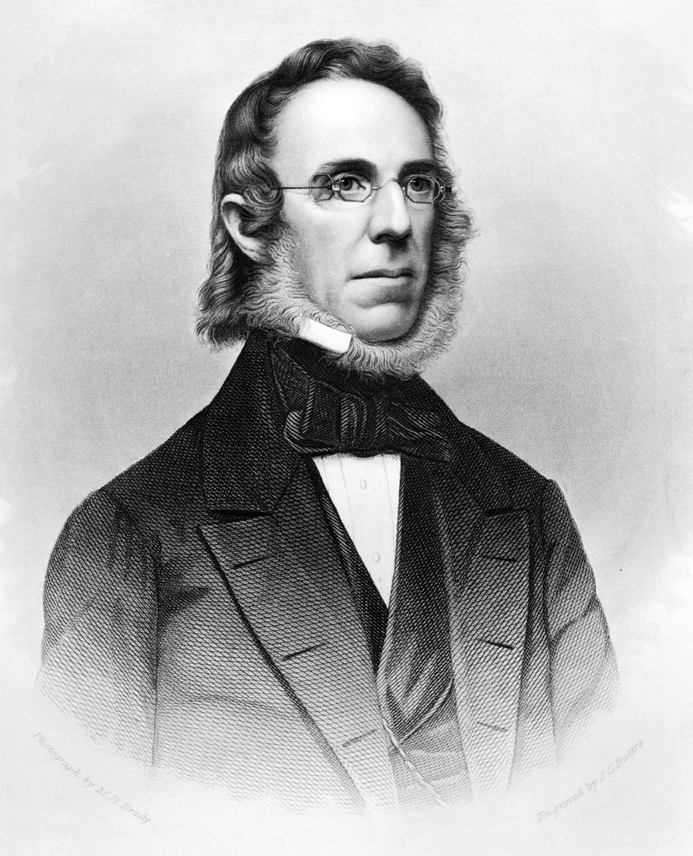
1. INTRODUCTION
“The bankers will favor a course of special legislation to increase their power… They will never cease to ask for more, …so long as there is more that can be wrung from the toiling masses of the American People.”
Peter Cooper to Ulysses Grant June, 1877
PETER COOPER
1791 – 1883

Slide 6
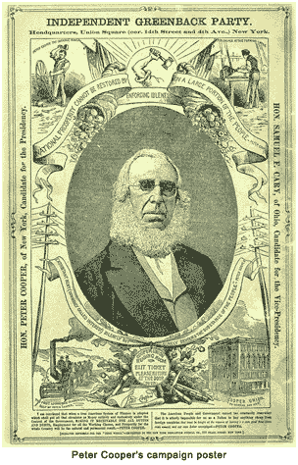
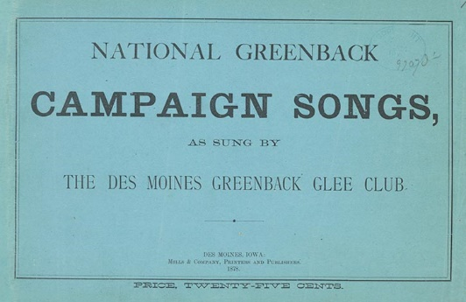
1. INTRODUCTION
GREENBACK BATTLES OF THE 1860s AND 1870s WERE THE “REAL THING”
“For the first and only time in our history, the primary secular problem of American society was being accurately attacked: the private control of the money system and the special privileges that elements of society – the bankers – had usurped for their personal benefit at society’s expense.”
Stephen Zarlenga, LSM, p. 507

Slide 7
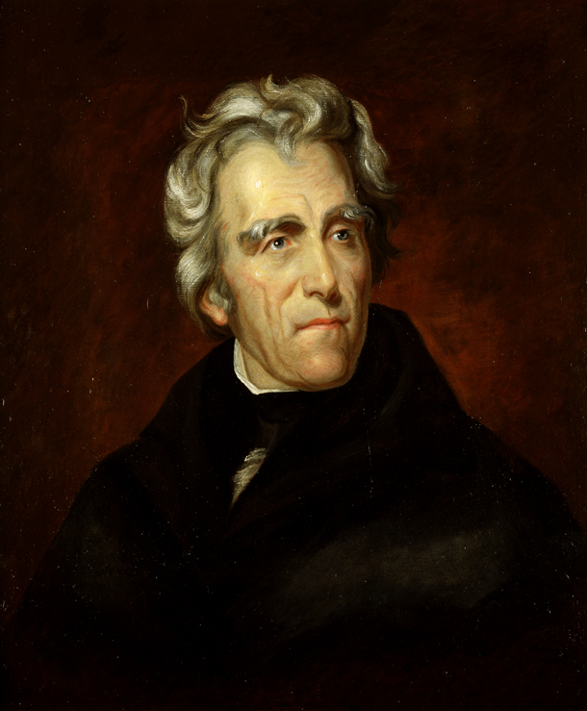
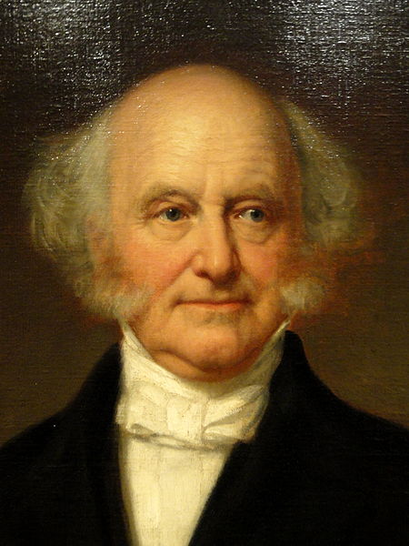
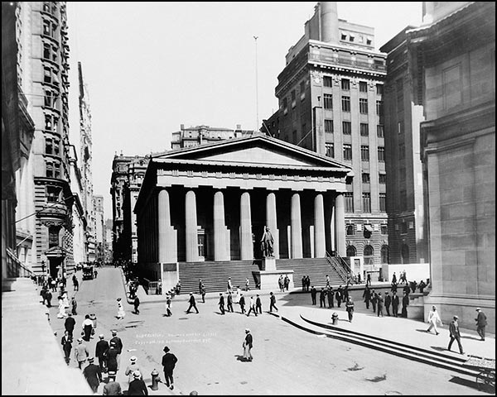
1. INTRODUCTION
GREENBACK BATTLES OF THE 1860s AND 1870s WERE THE “REAL THING”
“The programs of Jackson and Van Buren had much more popular support but lacked an accurate solution, and erroneously instituted a system more dependent on metal.”
Stephen Zarlenga, LSM, p. 507

Slide 8
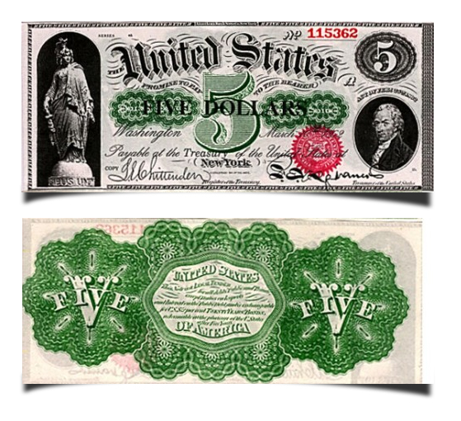
1. INTRODUCTION
GREENBACK BATTLES OF THE 1860s AND 1870s WERE THE “REAL THING”
“… the Greenbacks were (and still are)… a method of creating money without interest costs or debt, and without alienating the control of the money system from the government of the people…
… with the establishment of the Federal Reserve System in 1913, serious discussions of who should control the nation’s money system became almost impossible to carry on in the American mainstream.”
Stephen Zarlenga, LSM, pp. 507-508

Slide 9
2. Populism – Bagged by the Bankers
Populism’s diversity weakened it … “Populists didn’t always share common goals and could be divided and discouraged.”
Stephen Zarlenga, LSM, p. 508
“… as average people they were always in need of money and their political activities reduced their meager resources.”
Stephen Zarlenga, LSM, p. 508
“Populists didn’t fully recognize the deviousness of their opponents.”
Stephen Zarlenga, LSM, p. 508
AND TODAY?

Slide 10
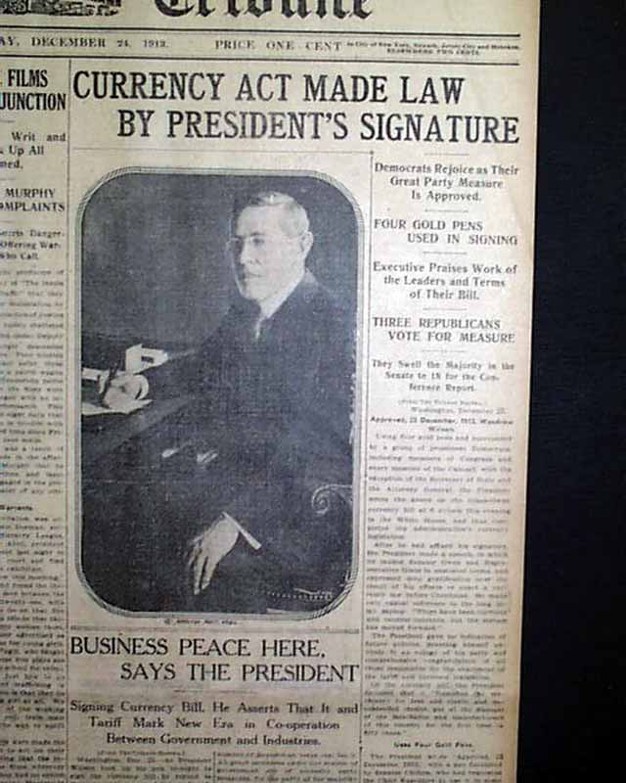
2. Populism – Bagged by the Bankers
BANKERS WERE MORE CLOSLY KNIT WITH A NARROWLY DEFINED OBJECTIVE.
MOST IMPORTANTLY –
the bankers’ treachery was self-financing…
the laws they brokered thru government gave them money and power…
the money gave them
control of the media
Banking families had centuries of recorded experience in European court intrigue...
they knew how to manipulate behind the scenes
Stephen Zarlenga, LSM, p. 508
1917 FEDERAL RESERVE BOARD

Slide 11
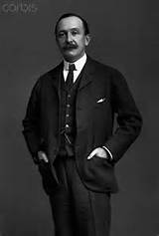
3. Belmont “Factor” Splits the Democrats
“The presence of August Belmont, Baron Rothschild’s American agent, in the top echelons of the Democratic party would be enough to keep the Democrats from becoming the local focal point for the popular forces on the crucial Greenback issue – the control of the nation’s money system.” Stephen Zarlenga, LSM, p. 508
Democratic Party Platform of 1868 July 4, 1868
Fifth. One currency for the government and the people, the laborer and the office-holder, the pensioner and the soldier, the producer and the bond-holder.
AUGUST BELMONT,
ROTHSCHILD AGENT,
NEUTRALIZES
DEMOCRATIC PARTY

Slide 12
4. Highlight of the Greenback Movement
Greenback and Populist Parties Form in Reaction
National Labor Union/ Reform Party 1866-1874
Greenback Party 1876 - 1884
Farmers’ Alliance/Populist Party 1877 – 1896
Coxey’s Army March 1893

Slide 13
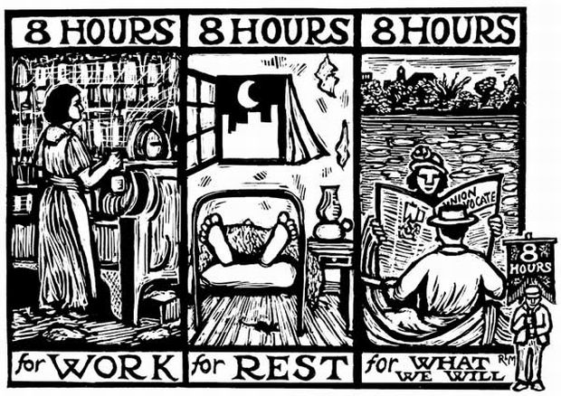
4. Highlight of the Greenback Movement
National Labor Union/Reform Party 1866-1872
All the organizers of the NLU considered the currency question the most important of all. One of its major organizers, William H. Sylvis, said:
“If it were possible to make all the trade unions in the country see the importance of this movement, and appreciate the fact that if we can succeed in establishing our monetary system as the law of the land it would so change the whole face of society as to do away with the necessity for trade unions entirely … “
… justice, reason and sound policy demand ... legal-tender Treasury notes as the exclusive currency of the nation.”
Terence V. Powderly, Thirty Years of Labor 1859-1889, p. 45

Slide 14
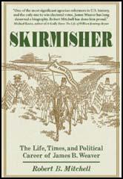
4. Highlight of the Greenback Movement
Greenback Party 1876 - 1884
Three propositions which have been the foundation of all greenback platforms:
1. that the currency of all national and state banks and corporations should be withdrawn;
2. that the only currency should be a paper one, issued by the government, "based on the faith and resources of the nation“
3. that coin should only be paid for interest on the present national debt, and for that portion of the principal for which coin had been specifically promised

Slide 15
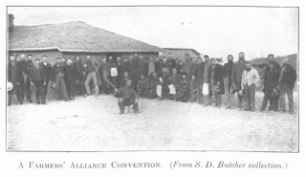
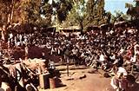
Farmers’ Alliance/Populist Party 1877 - 1896
4. Highlight of the Greenback Movement
ITS BUILDING BLOCKS WERE:
1. INDIVIDUAL SELF-RESPECT: members educating each other (lecturer system)
2. COLLECTIVE SELF-CONFIDENCE: the world’s first large-scale working class cooperative
3. CREATION OF A MOVEMENT CULTURE: new political language
4. MASS ORGANIZATIONAL EDUCATION IN FINANCIAL SYSTEM AND FARMING:
at its height, the movement had 40,000 lecturers and hundreds of newspapers
Notes:
The organic nofa farmers need to understand the struggle with the money system like the alliance.
Its demise kept the 2 party system.

Slide 16
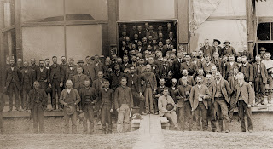
Farmers’ Alliance/Populist Party 1877 - 1896
4. Highlight of the Greenback Movement
PEOPLE’S PARTY AT COLUMBUS, NEBRASKA
Notes:
The organic nofa farmers need to understand the struggle with the money system like the alliance.
Its demise kept the 2 party system.

Slide 17
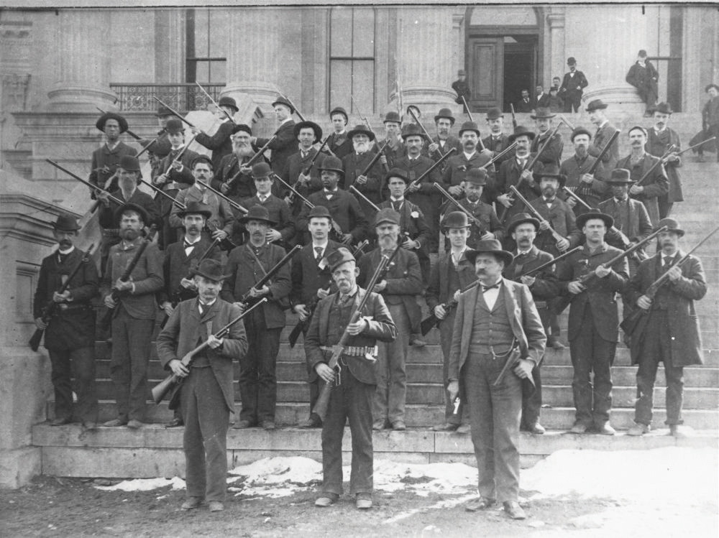
Farmers’ Alliance/Populist Party 1877 - 1896
4. Highlight of the Greenback Movement
A photo showing armed men who enforced the declaration of a Republican victory in Kansas. A number of Populist leaders had seized control of the statehouse but the doors were broken and these deputized men regained control..

Slide 18
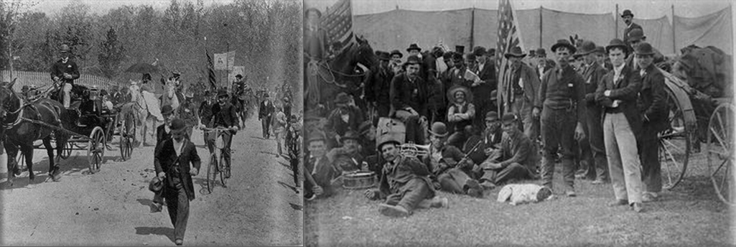
Coxey’s Army March 1893
4. Highlight of the Greenback Movement
THE PANIC OF 1893 CAUSED GREAT UNEMPLOYMENT, HUNGER, SUFFERING
Coxey’s Army demanded that the government issue $500,000,000 in Greenbacks…
to be paid out for public improvements and loaned to citizens at 2% interest…
Notes:
The organic nofa farmers need to understand the struggle with the money system like the alliance.
Its demise kept the 2 party system.

Slide 19
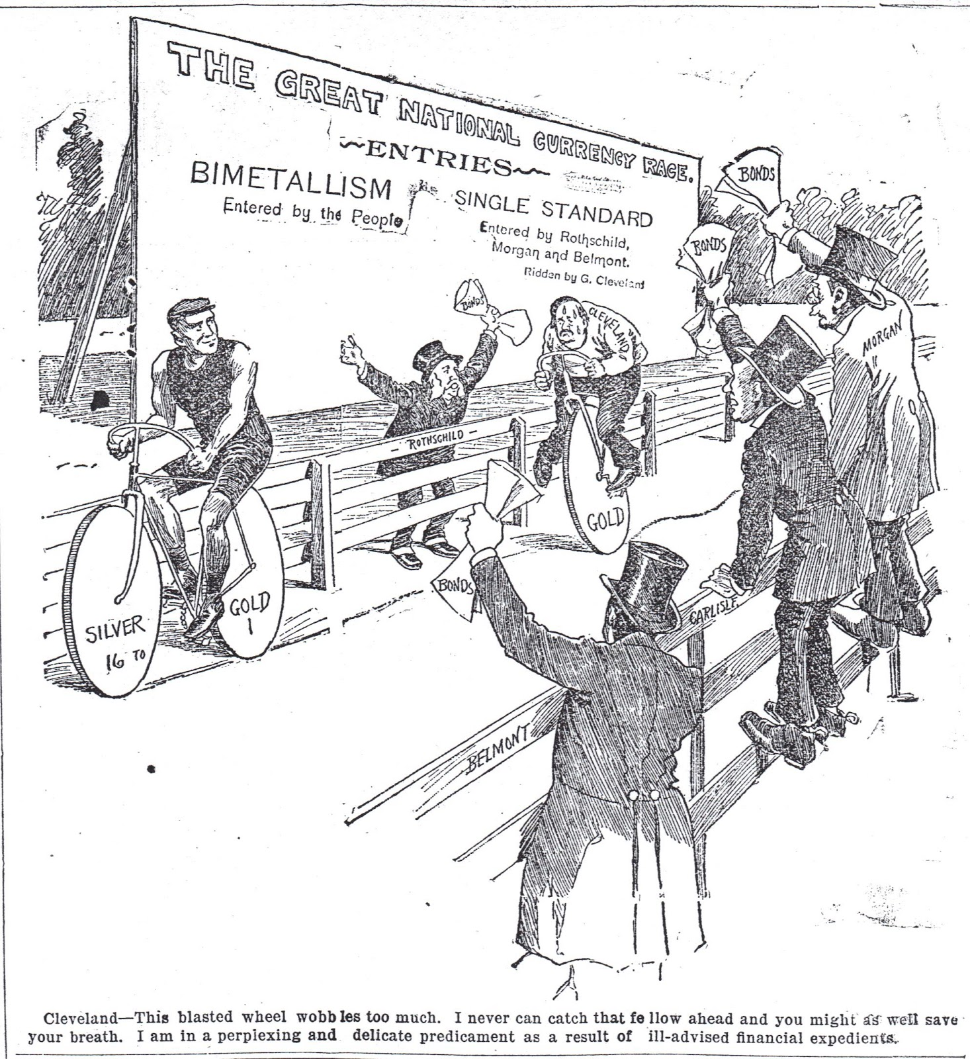
1896 William Jennings Bryan Campaign:
“Cross of Gold” Speech
POPULISTS CONCENTRATED ON THE ISSUE OF
SILVER COINAGE…
The political cartoon …shows rich men in top hats, holding government bonds as they cheer for President Cleveland, who is struggling to compete on a unicycle representing the single metal gold standard.
The common man, on a 2-wheeled bicycle representing bimetallism, stays in the lead.
Internet ‘blobjects by timman’, posted by Lynda Beck Fenwick, Tuesday, July 16, 2013
CLEVELAND was President for two non-consecutive terms:
1885-1889 and 1893-1897.

Slide 20
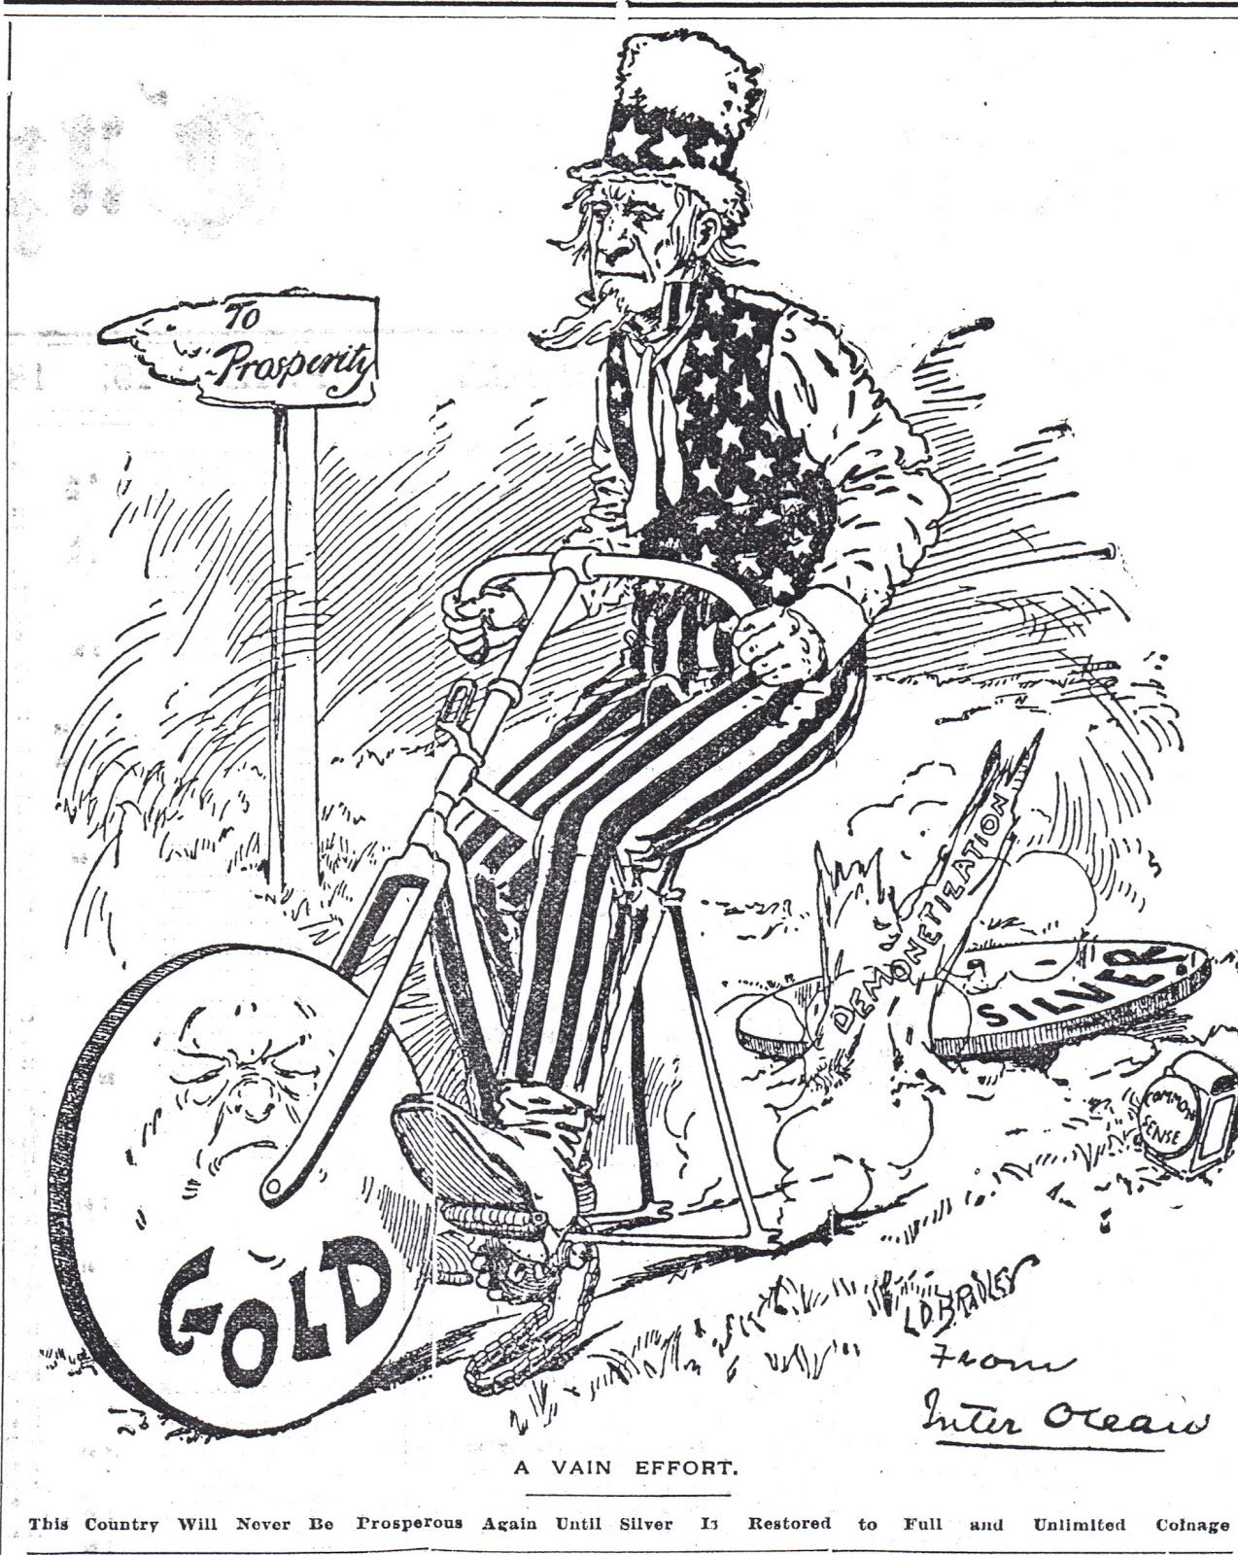
1896 William Jennings Bryan Campaign:
“Cross of Gold” Speech
POPULISTS CONCENTRATED ON THE ISSUE OF
SILVER COINAGE…
The political cartoon … uses a one-wheeled bicycle, showing how impossible it is for Uncle Sam to make any progress toward prosperity when the rear wheel, labeled "silver" has been removed.
Internet ‘blobjects by timman’, posted by Lynda Beck Fenwick, Tuesday, July 16, 2013

Slide 21
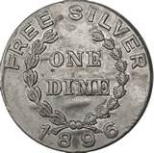
1896 William Jennings Bryan Campaign:
“Cross of Gold” Speech
The People’s Party leadership ultimately decided to merge with the Democratic Party in the Presidential elections of 1892 and 1896. This was called ‘fusion’.
The plank of ‘Free Silver’ became the rallying cry, but the revolutionary goal to put the power to issue money back into the hands of the public was lost.
Notes:
The organic nofa farmers need to understand the struggle with the money system like the alliance.
Its demise kept the 2 party system.

Slide 22
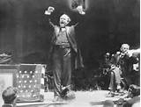
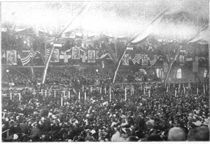
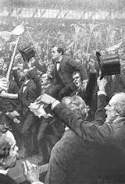
1896 William Jennings Bryan Campaign:
“Cross of Gold” Speech
William Jennings Bryan had gone into the Democratic Party’s convention in 1896 relatively unknown. He was not from the Populist Party.
His “Cross of Gold” speech, however, gave him the party nomination and made him a national figure.
“Having behind us the producing masses of this nation and the world, supported by the commercial interests, the laboring interests and the toilers everywhere, we will answer their demand for a gold standard by saying to them: You shall not press down upon the brow of labor this crown of thorns, you shall not crucify mankind upon a cross of gold..”
TO LISTEN TO A RECORDING OF BRYANT RECITING HIS SPEECH, copy and paste into your web browser:
https://soundcloud.com/retrocampaigns/william-jennings-bryans-cross

Slide 23
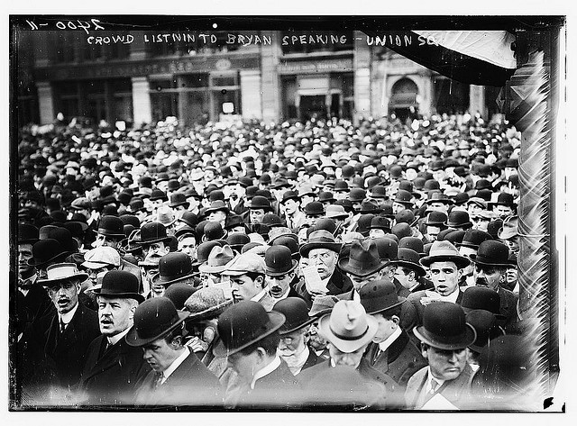
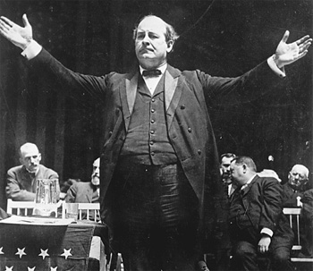
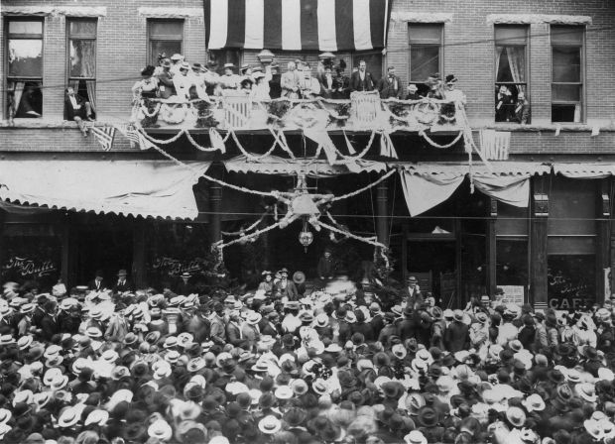
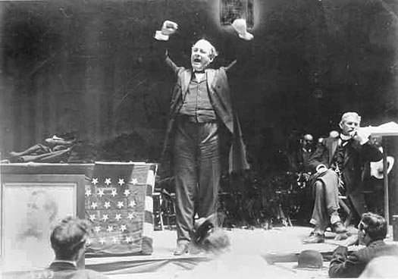
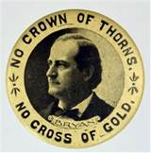
1896 William Jennings Bryan Campaign:
“Cross of Gold” Speech
“In two weeks Bryan, the great orator, visted two-thirds of all the states giving 400 speeches. Nothing like it had been seen before. The campaign became known as the “Honest Money Campaign.” Stephen Zarlenga, LSM, p. 511
Crowd listening to Bryan speaking at Union Square, NY
“But in reality the campaign offered the American people a choice between two systems, either of which could be controlled by the bankers.” Stephen Zarlenga, LSM, pp. 511-512

Slide 24
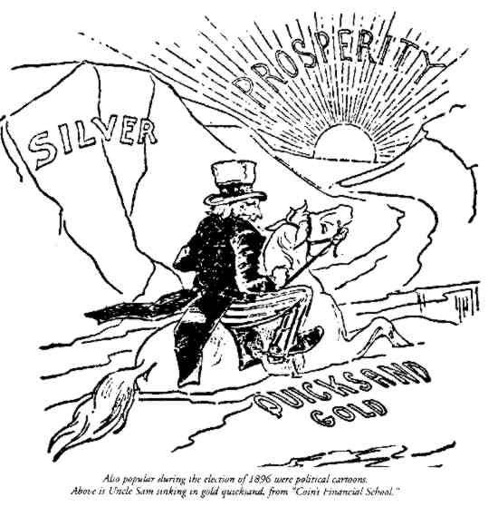
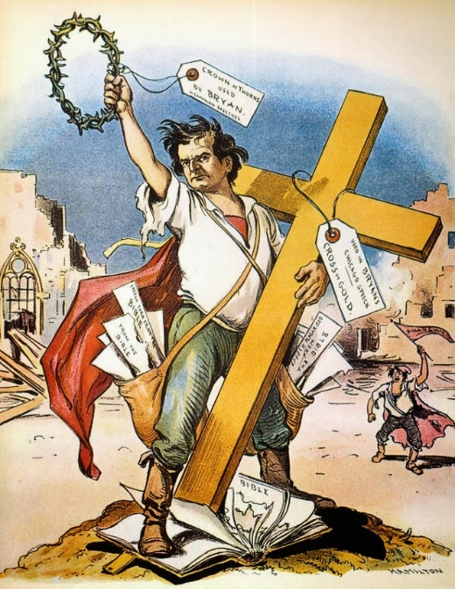
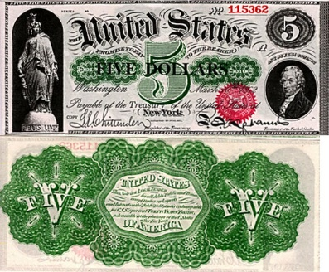
1896 William Jennings Bryan Campaign:
“Cross of Gold” Speech
“… remember that the nation had before it the successful example of a superior money system: the Greenbacks. Thus Bryan’s Democratic campaign was a major retrogression from the positions of the Greenback parties.” Stephen Zarlenga, LSM, p. 512

Slide 25
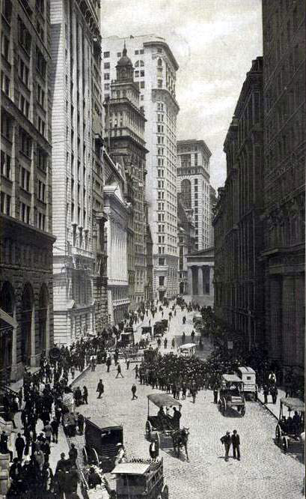
6. Decentralization Reduces Some Problems
SOME OF THE PROBLEMS FACED BY POPULISTS WERE IMPROVING:
Industrial production was becoming more decentralized
In 1890 no more than ten industrial stock issues were quoted regularly in the financial journals.
By 1893 the number increased to about thirty, and by 1897 to over two hundred.
Gabriel Kolko, The Triumph of Conservatism, p. 19
The trend is altogether clear: the manufacturing sector of the economy after the period of numerous mergers in 1897-1901 was growing increasingly competitive.
Gabriel Kolko, The Triumph of Conservatism, p. 54
BROAD STREET –
NY STOCK EXCHANGE
1904

Slide 26
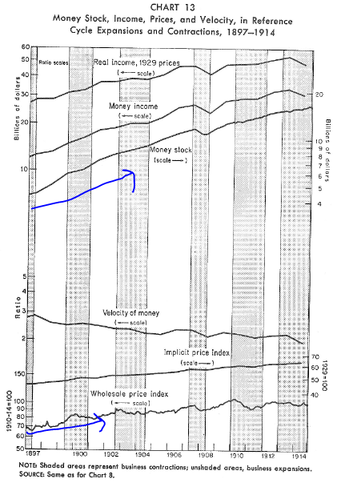
6. Decentralization Reduces Some Problems
SOME OF THE PROBLEMS FACED BY POPULISTS WERE IMPROVING:
The final years of the century saw a dramatic reversal of economic conditions.
Prices in the U.S. rose between 40 and 50 per cent from 1897 to 1914.
“The stock of money… bounded upward at an extraordinary rate: a cumulative increase of nearly 80 per cent in five years [1897-1902].”
Milton Friedman and Anna Schwartz,
A Monetary History of the United States, 1867-1960, p. 138

Slide 27
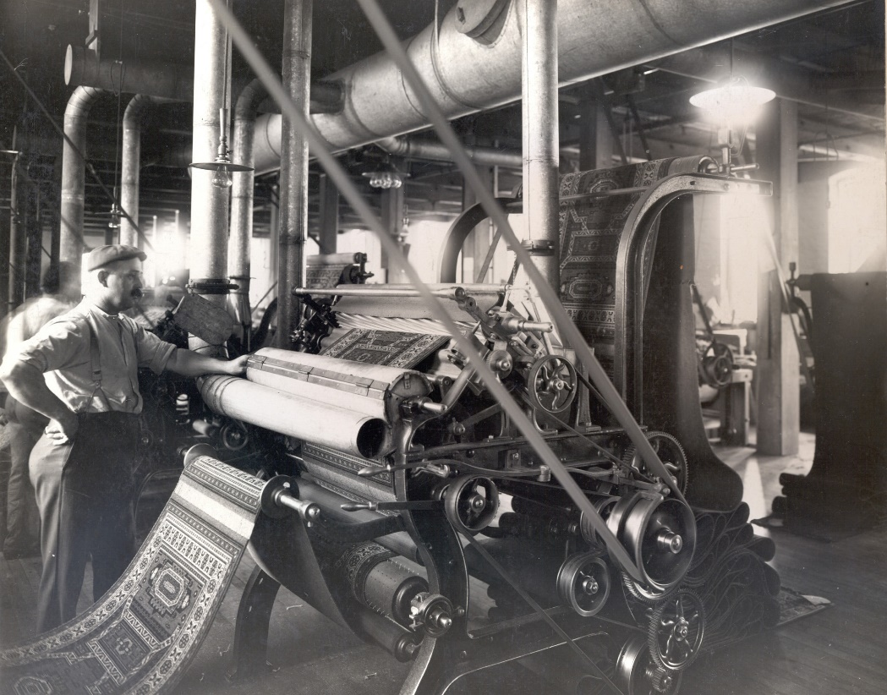
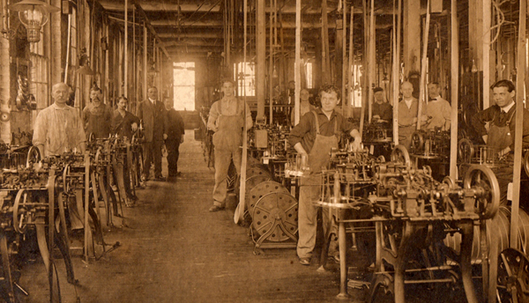
6. Decentralization Reduces Some Problems
SOME OF THE PROBLEMS FACED BY POPULISTS WERE IMPROVING:
Much of the manufacturing was potentially independent of the banks
New manufacturing funds were generated internally from profits, not from borrowing:
“During 1899-1904, the intense merger period, a large part of corporate finance came from external sources. For the entire period of 1900-1910, however, 70.4 per cent of the new funds in manufacturing came from internal sources, and this led to a general independence from outside financial power…
The ability of industrial corporations to finance their own growth meant a corresponding decrease in the power of finance capital, which in tum allowed competition to arise and new firms to develop quite freely of finance capital.
…a diminution of the power of the older investment and banking houses.”
Gabriel Kolko, The Triumph of Conservatism, p. 145

Slide 28
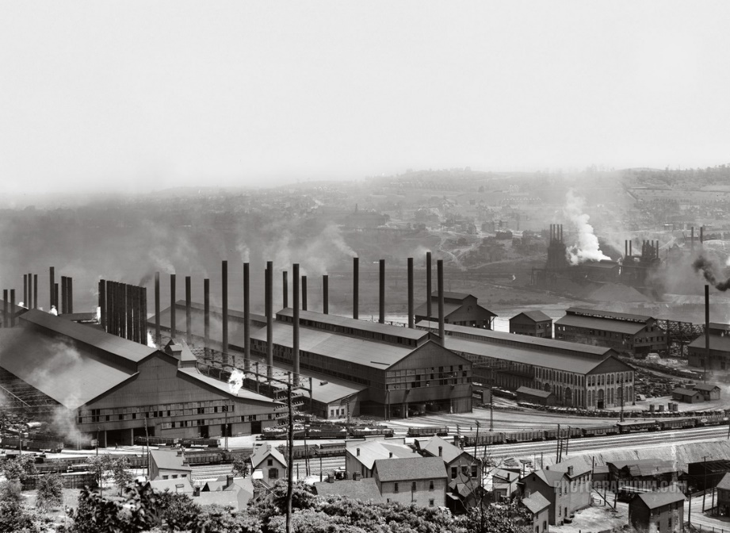
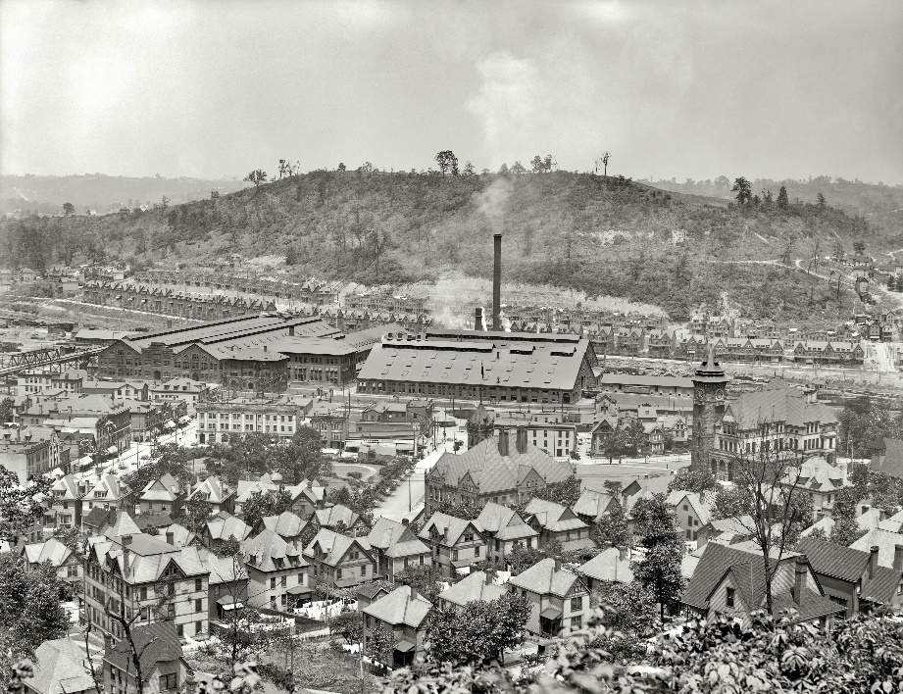
6. Decentralization Reduces Some Problems
SOME OF THE PROBLEMS FACED BY POPULISTS WERE IMPROVING:
New mergers and trusts were unable to compete with new industries
The mergers were mainly a way to sell watered down stock:
“A government study in 1900 of 183 industrial combinations shows that stocks and bonds valued at $3,085,000,000 were issued for plants with a total capital worth of $1,459,000,000.
The Department of Labor, in the same year, claimed that a substantial group of combinations they studied issued stocks valued at twice the cost of reproducing active plants.
Arthur S. Dewing, in a study of fourteen mergers, found that the average overcapitalization was well in excess of 50 per cent of the assets.”
Gabriel Kolko, The Triumph of Conservatism, p. 22
“The new mergers … were unable to stem the tide of competitive growth. Quite the contrary! They were more likely than not unable to compete successfully or hold on to their share of the market, and this fact became one of utmost political importance.”
Gabriel Kolko, The Triumph of Conservatism, p. 27
1901 U.S. STEEL
MERGER

Slide 29
7. THE GROWING COMPETITION (FOR THE N.Y. BANKERS)
The N.Y. Bankers abhor competition for themselves –
though they say competition is a hallmark of the capitalist system –
and they pay professors to teach this

Slide 30
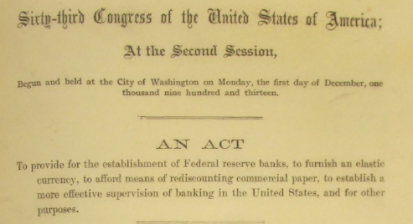
7. THE GROWING COMPETITION (FOR THE N.Y. BANKERS)
Then they corrupt governments into legislating special privileges for them…
NATIONAL BANKING ACT, 1863
FEDERAL RESERVE LAW, 1913

Slide 31
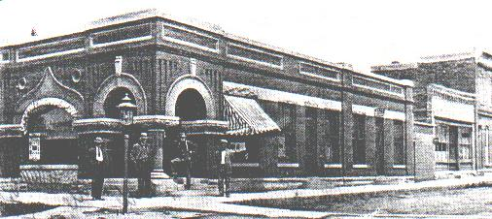
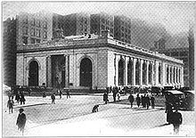
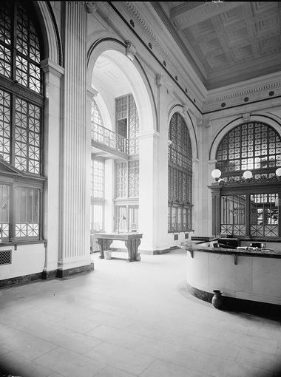
7. THE GROWING COMPETITION (FOR THE N.Y. BANKERS)
“Yet competition and decentralization was even increasing in the field of banking at the turn of the century. By 1892 state chartered banks surpassed nationally chartered banks in importance.” Stephen Zarlenga, LSM, p. 514
“Throughout the 1870's and much of the 1880's, by far the largest number of banks were national banks, with their financial standards determined in Washington.
By 1896, however, non-national state banks, savings banks, and private banks accounted for 61 per cent of the total number of banks, and by 1913, 71 per cent of the banks.
The capital and resources of these non-national banks were small in the immediate post-Civil War period, but in 1896 constituted 54 per cent of total banking resources, and in 1913, 57 per cent.”
Gabriel Kolko, The Triumph of Conservatism, p. 140
State Bank of Early, Iowa,
erected about 1900.
State Savings Bank, Detroit, Michigan, 1900

Slide 32
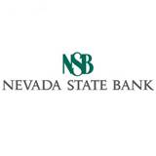
7. THE GROWING COMPETITION (FOR THE N.Y. BANKERS)
“In 1908 national bank notes represented only 20% of the total circulating currency. The number of banks grew from 10,000 in 1900 to 25,000 in 1914.” Stephen Zarlenga, LSM, p. 532

Slide 33
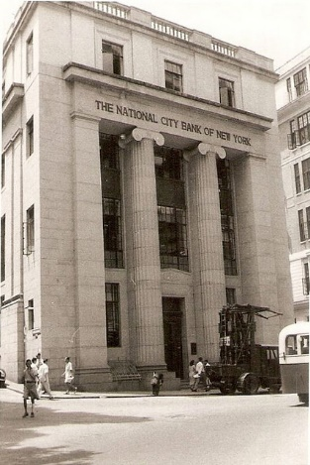
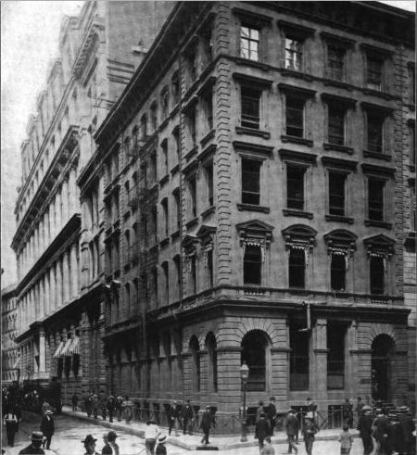
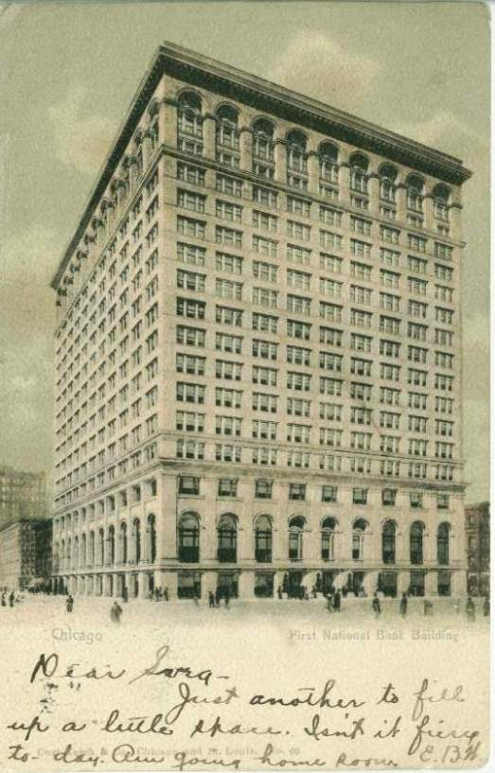
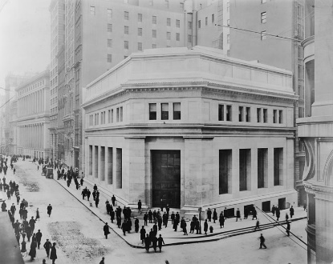
7. THE GROWING COMPETITION (FOR THE N.Y. BANKERS)
However, the New York banks controlled about one-half the total deposits… in 1912 there were only 12 banks capable of making loans over $1 million to any one firm, due to the National Bank Law limiting loans to any one borrower to 10% of the bank’s capital. Gabriel Kolko, The Triumph of Conservatism, p. 145
Guaranty Trust Co Building
J.P. Morgan Co.
National City Bank
of New York
Continental & Commercial
National Bank, Chicago
Chase National Bank
Corner of Pine and Nassau, NYC

Slide 34
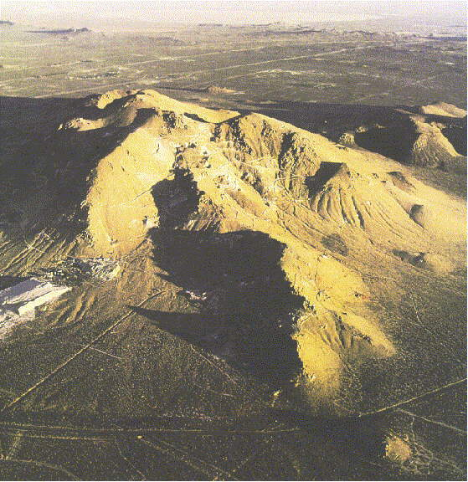
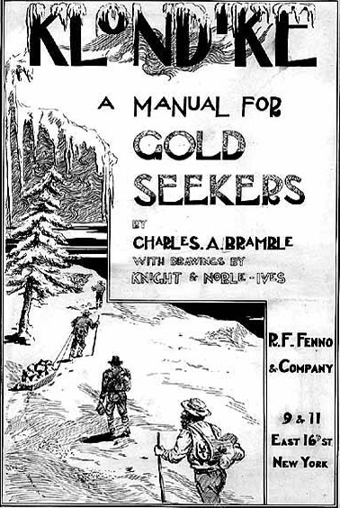
Gold and Technology Discoveries Bring Relief
“Toward the end of the 19th century, the worldwide need for more money in the existing mixed system of metals, bank created paper and credits, and government created money was alleviated by [two} fortunate developments.”
Stephen Zarlenga, LSM, p. 514
Major gold discoveries!
South Africa
Alaska
Australia
Invention of
Cyanide leaching process which
extracts a lot more gold
from crushed rock

Slide 35
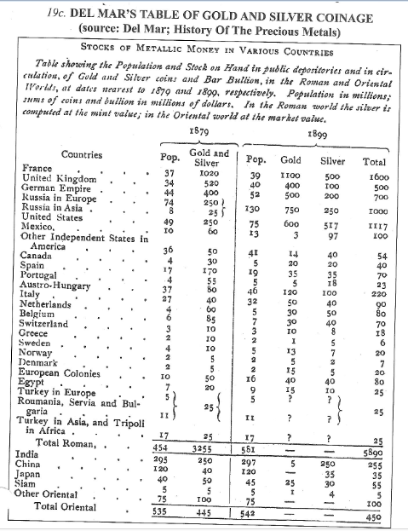
Gold and Technology Discoveries Bring Relief
Alexander Del Mar estimated gold and silver coinage in many countries and concluded that the world’s total gold and silver coinage grew:
1879 1899
$3.7 billion $6.34 billion

Slide 36
Currency Act of 1900
The Gold Standard Act of 1900 established gold as the only standard for redeeming paper money, stopping bimetallism which had allowed silver in exchange for gold. The Treasury was required to maintain a minimum of $150 million in gold reserves and the price of gold was set at $20.67 per ounce.
Since the Coinage Act of 1873, debt holders could demand reimbursement in whatever metal was preferred--usually gold. This was a de facto gold standard. The Act made a de jure gold standard.
There were no deflationary effects of this act because the production of gold had more than doubled from 1890 to 1898.

Slide 37
Currency Act of 1900
Gold enthusiasts point to this period as an example of the gold standard working well. But they ignore the following:
this was an unusual time when the supply of gold increased faster than the population
the supply of gold was augmented by paper notes and deposits issued by banks and government

Slide 38
10. Treasury Secretary Shaw’s Innovative Solutions
Shaw faced a banking system that was inflexible and unstable:
The system could not respond to changing business needs or seasonal requirements for money. Nationally chartered banks were allowed to create only about $800 million in currency.
There was no lender of last resort when the banks got into trouble.
The system was susceptible to booms and busts.
Leslie M. Shaw
(1848 – 1932)
Treasury Secretary
(1902-1907)

Slide 39
10. Treasury Secretary Shaw’s Innovative Solutions
The growing tendency on the part of the Treasury to intervene frequently and regularly in the money market.
“The central-banking activities of the Treasury were being converted from emergency measures to a fairly regular and predictable operating function.
Treasury intervention reached its peak after Leslie M. Shaw was appointed Secretary of the Treasury in 1902. He was a vigorous and explicit advocate of using Treasury powers to control the money market and had great confidence in the Treasury’s ability to do so.”
Friedman and Schwartz, A Monetary History of the United States, 1867-1960, p. 149
WALL STREET
1900
U.S. TREASURY
1900

Slide 40
10. Treasury Secretary Shaw’s Innovative Solutions
The growing tendency on the part of the Treasury to intervene frequently and regularly in the money market.
“Shaw initiated a program to avert banking panics by depositing government funds or bonds into banks when money was tight. Then, to calm down boom periods, he would withdraw them.”
Stephen Zarlenga, LSM, p 516
In addition, to add money to the society, the Secretary would pay interest on outstanding bonds ahead of the payment date. He would buy government bonds (debt) at high premiums, such as including all interest to date of purchase. Friedman & Schwartz, p. 151
WALL STREET, 1900
U.S. TREASURY, 1900
DEPOSIT
GOVT CURRENCY/BONDS
DURING PANICS
WITHDRAW
GOVT CURRENCY/BONDS
DURING BOOMS

Slide 41
10. Treasury Secretary Shaw’s Innovative Solutions
The growing tendency on the part of the Treasury to intervene frequently and regularly in the money market.
“Early in Apr. 1906, New York reserves were deficient, and the Secretary increased government deposits at national banks that pledged to import an equivalent amount of gold. The sum deposited was to be regarded as a temporary loan, to be returned to the Treasury as soon as the gold arrived. One bank was allowed to count the gold in transit as part of its reserves. “
Annual Report on the Finances, 1906, as quoted in Friedman & Schwartz, A Monetary History of the United States, 1867-1960, p. 155
WALL STREET, 1900
U.S. TREASURY, 1900
DEPOSIT
GOVT CURRENCY/BONDS
WITHDRAW
GOVT CURRENCY/BONDS

Slide 42
10. Treasury Secretary Shaw’s Innovative Solutions
The growing tendency on the part of the Treasury to intervene frequently and regularly in the money market.
“If the Secretary of the Treasury were given $100 million to be deposited with the banks or withdrawn as he might deem expedient, and if in addition he were clothed with authority over the reserves of the several banks, with power to contract the national bank circulation at pleasure, in my judgment no panic, as distinguished from industrial stagnation could threaten the U.S. or Europe that he could not avert…”
Annual Report on the Finances, Leslie Shaw, Secretary, 1906, as quoted in Friedman & Schwartz,
A Monetary History of the United States, 1867-1960, p. 149-150
WALL STREET, 1900
2
1
U.S. TREASURY, 1900
DEPOSIT
GOVT CURRENCY/BONDS
issued
3
4
WITHDRAW
GOVT CURRENCY/BONDS
redeemed

Slide 43
The Postal Savings System
January 1911
The U.S. Postal Savings System offered savings accounts, operating as a deposit bank and making no loans.
Like the theoretical operation of the Bank of Amsterdam.
POST OFFICE DEPOSITORY WINDOW

Slide 44
The Postal Savings System
% of Nation’s Savings
Year
4% 1919
2% 1929
13% 1933
20% 1947
2% 1960

Slide 45
Bankers Thwart Societal Solutions: Panic of 1907
“The hidden source of the panic of 1907 was the Bank of England’s instruction in September 1906 to British banks not to negotiate American finance bills but to have them all paid in gold as they matured. There was also a crisis situation in banking in Amsterdam and Hamburg.” Stephen Zarlenga, LSM, p. 517; Friedman & Schwartz, A Monetary History of the United States, 1867-1960, p. 156
OUT OF CIRCULATION
BILL OF EXCHANGE
“The panic is also a modern demonstration of the danger to public safety posed by a gold money standard, which foreign interests can manipulate at will and easily enough withdraw from circulation.” Stephen Zarlenga, LSM, p. 518

Slide 46
Bankers Thwart Societal Solutions: Panic of 1907
The Panic of 1907 was a manufactured, unnecessary panic.
It was an unusual panic because it was exclusively banking.
“The six large banks (in NY) acting in
concert could have sustained the local
situation… and could have supplied
the demands of outside banks.”
Oliver M. Sprague, History of Crises Under
the National Banking System, pub. 1968
“The banks refused to honor their deposits –
to pay out cash to their depositors;
however, all of their other financial
operations continued normally.”
Zarlenga, p. 517

Slide 47
Bankers Thwart Societal Solutions: Panic of 1907
THE BANKERS’ PANIC –
The stock market dropped 46%!

Slide 48
Government Comes to the Rescue – Again
“In November 1907, the Treasury issued $150 million of bonds and certificates and allowed the banks to use them as additional reserves, and the crisis was overcome… The gold standard ideologues ignore this necessary governmental intervention to save the system…” Stephen Zarlenga, LSM, p. 518
“The Treasury was called upon, in the latter part of October, 1907, to render assistance in the financial panic which, starting in New York City, gradually extended over the entire country... the amount of public deposits with banks reached $236,548,321.08 November 30, 1907, and on December 27, 1907, the maximum of $259,994,271.77 was attained, after which it was decreased to $256,920,154.70 by the close of the month…
In the month of January, 1908, there was a freer circulation of money than had prevailed for the previous three months. Large amounts were returned to the money centers, and some of the depositaries therein voluntarily returned to the Treasury a part of their holdings of public deposits.. “ Annual Report, pp. 12-13

Slide 49
The Aldrich-Vreeland System
The Aldrich–Vreeland Act or “Emergency Currency Act” was passed in response to the Panic of 1907. The Act empowered the Controller of the Currency to authorize some banks to issue new emergency banknotes, in addition to creating a National Monetary Commission.
Senator Aldrich was known to be the most powerful Senator and the representative of the bankers. He was chairman of the critical Senate Finance Committee and his daughter had married John D. Rockefeller, Jr.
Edward B. Vreeland
(1856 – 1936)
U.S. Rep. from New York
(1899 - 1913)
Nelson W. Aldrich
(1841 – 1915)
U.S. Senator from R.I.
(1881 – 1911)

Slide 50
The Aldrich-Vreeland System
The National Monetary Commission, populated by Senators and Representatives, was to study banking systems and propose legislation to reform the U.S. system. Aldrich was appointed chairman and Vreeland its vice-chairman. The 16-man Commission, at a cost of $300,000, visited Europe for two years to study the central banking systems.
“Aldrich’s monetary commission issued 24 large volumes, but according to Del Mar nowhere in these publications was the nature of money defined.” Stephen Zarlenga, LSM, p. 519
The Commission is given credit for writing the Federal Reserve Bill but we now know this was written by private bankers meeting in secret.
published 24 volumes and
summarized the defects of the
existing banking system
The Commission spent $300,000,
and never defined money.
NATURE OF MONEY?
“Europe has the
right idea! A central bank!”

Slide 51
The Aldrich-Vreeland System
The Aldrich–Vreeland Act was “perhaps the only example in U.S. history where the bankers wanted to increase the monetary powers of government officials… It appears to have been a part of the longer term plan to establish a privately owned central bank… For the Aldrich-Vreeland act was only for a limited period – it was scheduled to go out of existence in just six years, in 1914… Aldrich-Vreeland worked well, but the plan was to substitute the Federal Reserve System in its place.” Stephen Zarlenga, LSM, pp. 518-519
The act provided for the issuance of emergency currency
by groups of banks, as soon as depositors began runs on the banks.
The banks used the backing of bank-owned commercial paper and
approved state and local government bonds. After the emergency
was over, the currency would be withdrawn by the banks because
the government taxed it.

Slide 52
The Aldrich-Vreeland System
The Act was used only once. The occasion was the outbreak of World War I, when fears of financial crisis were enlarged by the closing of the New York Stock exchange.
“As soon as depositors began runs on banks, the emergency currency provided for the Aldrich-Vreeland Act was put into circulation. By the end of November, nearly $400 million had been issued and about a third of that total redeemed. The maximum amount outstanding on any one date was $364 million, which was nearly one-quarter of the total amount of currency in the hands of the public before the out-break of war… The availability of the emergency issue probably prevented a monetary panic and the restriction of payments by the banking system.”
Friedman and Schwartz, A Monetary History of the United States, 1867-1960, p. 172

Slide 53
The Aldrich-Vreeland System
“To judge by that one episode, the Aldrich-Vreeland Act provided an effective device for solving a threatened inter-convertibility crisis… The episode strengthens our own view, based primarily on other considerations, that it would have been equally effective on the occasion of the next threat of an inter-convertibility crisis which arose in late 1930…”
Friedman and Schwartz, A Monetary History of the United States, 1867-1960, p. 172
Depositors Congregate Outside Closed Banks, 1930-31

Slide 54
HOW THE GOLD STANDARD WORKS
JP Morgan helped out the government
In 1895, at the depths of the Panic of 1893, the Federal Treasury was nearly out of gold. President Grover Cleveland accepted Morgan's offer to join with the Rothschilds and supply the U.S. Treasury with 3.5 million ounces of gold to restore the treasury surplus in exchange for a 30-year bond issue. The episode saved the Treasury.

Slide 55
Q & A
WILL DECKER’S CONCLUSION:
THE CONTROL OF MONEY -- WITHOUT CONTROL FROM THE PUBLIC -- LEADS TO
CORRUPTION … USURPATION … SLAVERY.

