Slide 1
2-1 to 2-21-2018 TRIP TO EUROPE FOR MONETARY REFORM
Week 3: Iceland
Wed 2-14 to Wed 2-21
AMI:
Sue Peters, Jamie Walton

Slide 2
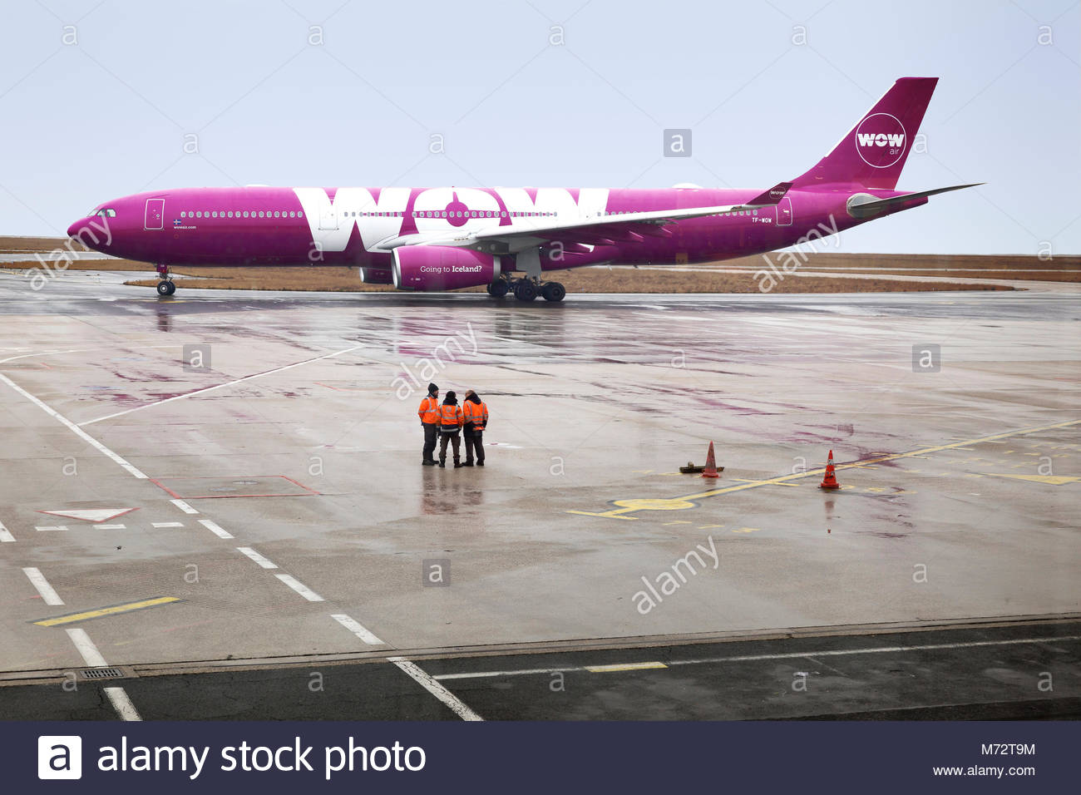
TO ICELAND
… FROM AMSTERDAM, NETHERLANDS
Tuesday
Wed 2-14-2018

Slide 3
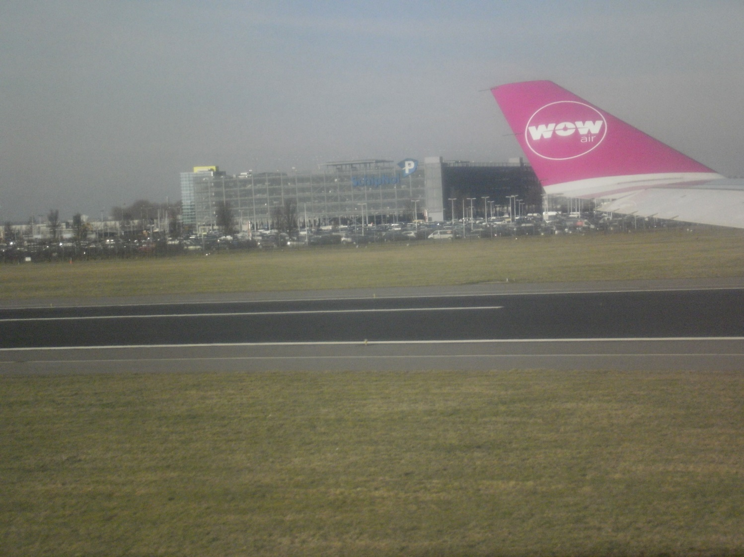
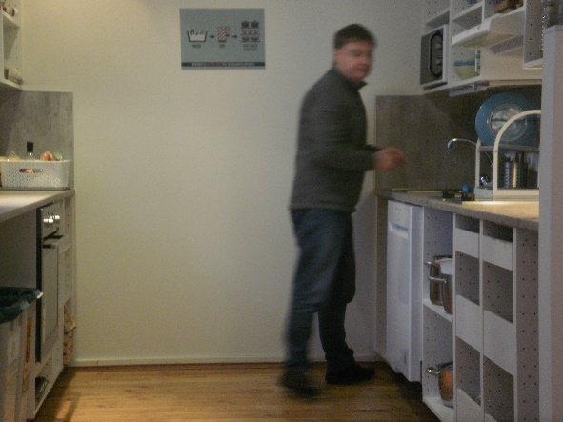
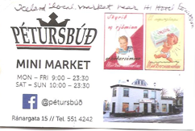
Iceland – Tuesday 2-14-2018
Jamie and I left Amsterdam for Iceland on
Wed Feb 14. We flew WOW Airlines. The plane
was late taking off but so were we. So everything
worked out.
WOW offers flights from Europe or the USA
to Iceland for very little money. However,
once the tourists get to Iceland, they find out
it is very expensive.
I was told by a traveler in my Zurich hostel
that we should bring food and drink with
us on our WOW flight to Iceland! So,
Jamie and I bought along cheese, wine, and spirits.
We found an inexpensive and friendly
local grocery store around our Iceland hostel
where we bought food and prepared it
in the hostel’s open kitchen.

Slide 4
Iceland – Tuesday 2-14-2018
I took this picture on takeoff from the
Amsterdam Schiphol Airport.
Is that chemtrails? I was surprised.

Slide 5
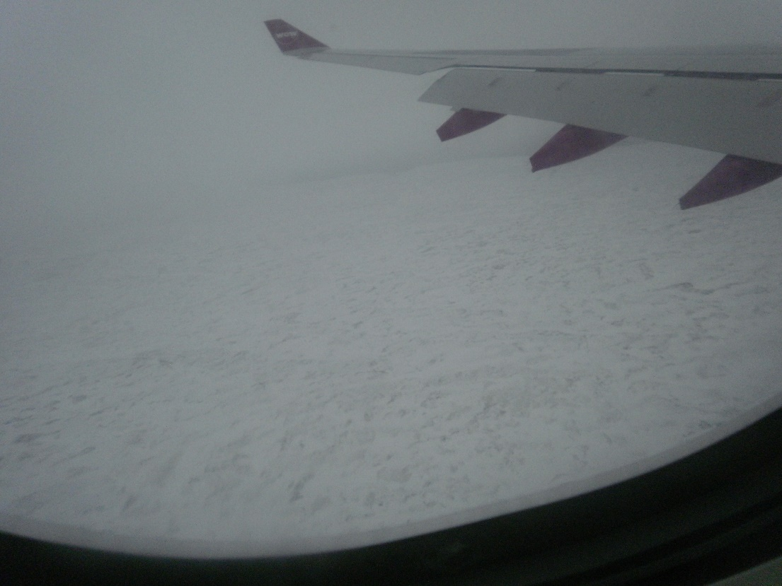
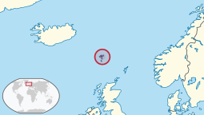
Iceland – Tuesday 2-14-2018
The first land I sighted turned out to be the
Faroe Islands. These islands are in the Atlantic
Ocean between Scotland and Iceland.
According to some articles, the Faroe Islands
offered to loan money to Iceland during its
financial crisis.
Iceland
Faroe Islands

Slide 6
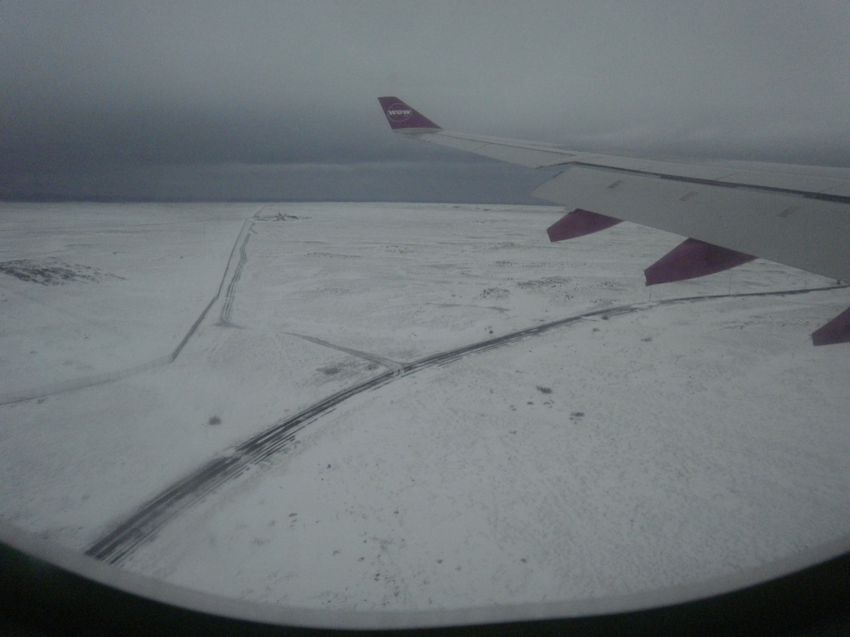
Iceland – Tuesday 2-14-2018
Here is the first view of Iceland we got from our WOW plane.
There had been a blizzard the day before.

Slide 7
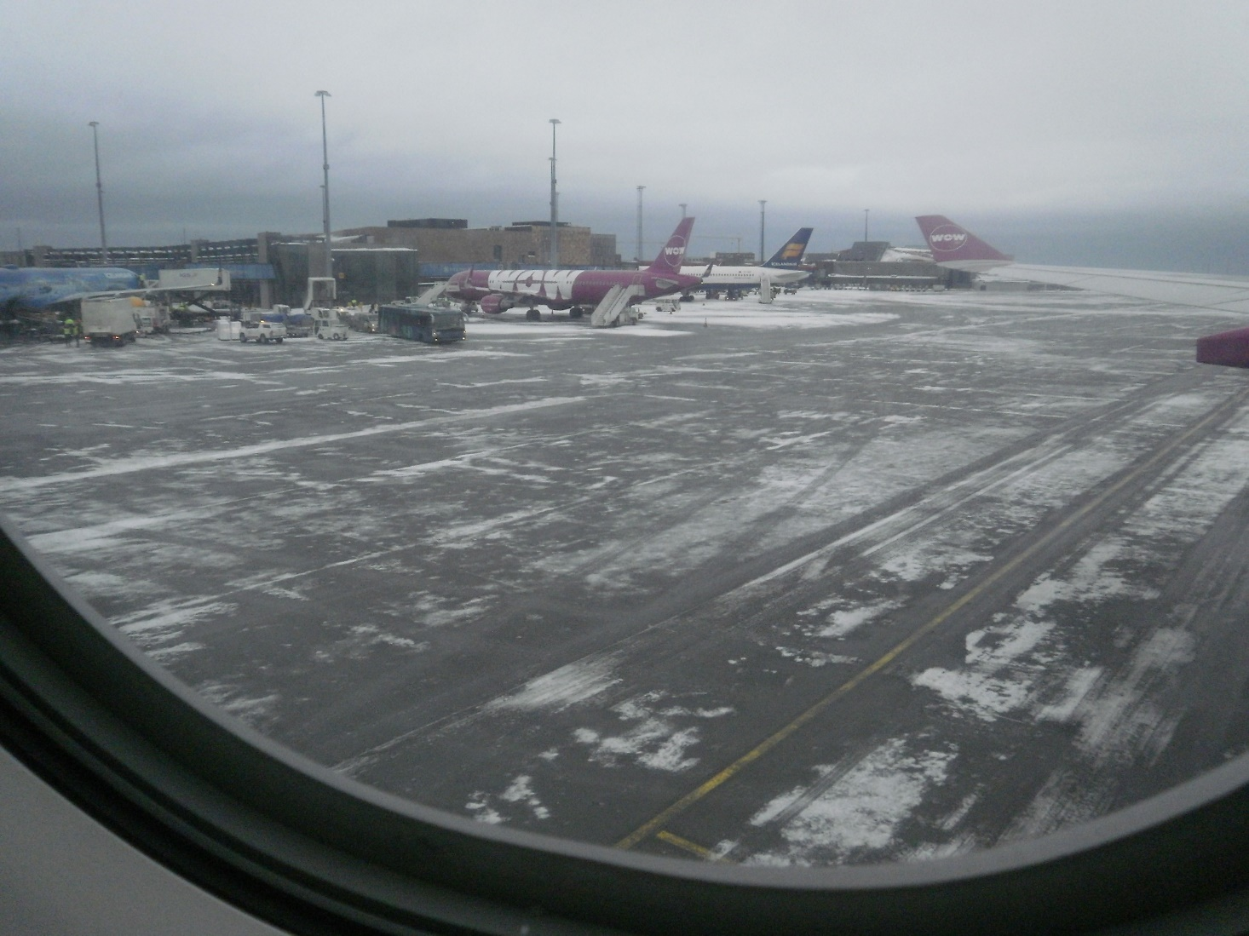
Iceland – Tuesday 2-14-2018
Here we are having landed in the airport on Iceland.

Slide 8
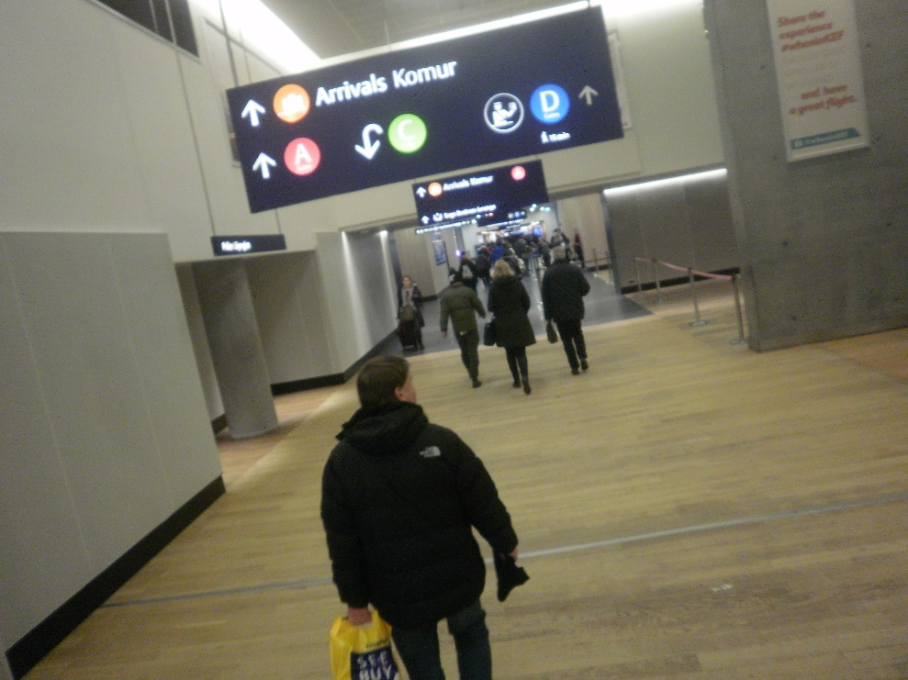
Iceland – Tuesday 2-14-2018
In the airport, we passed this
sign.

Slide 9
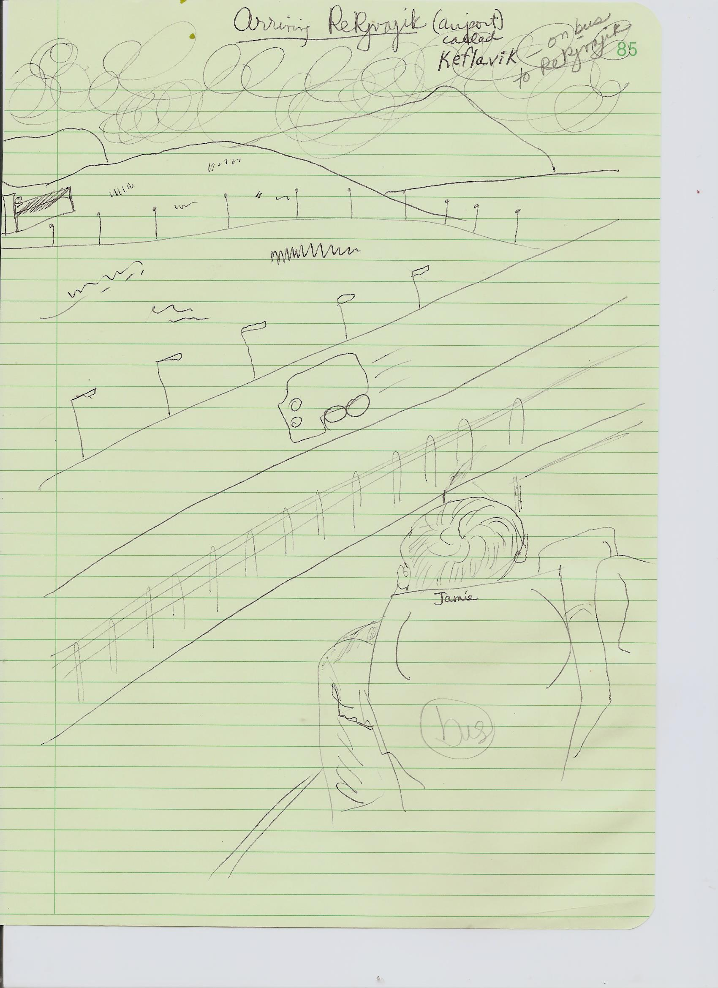
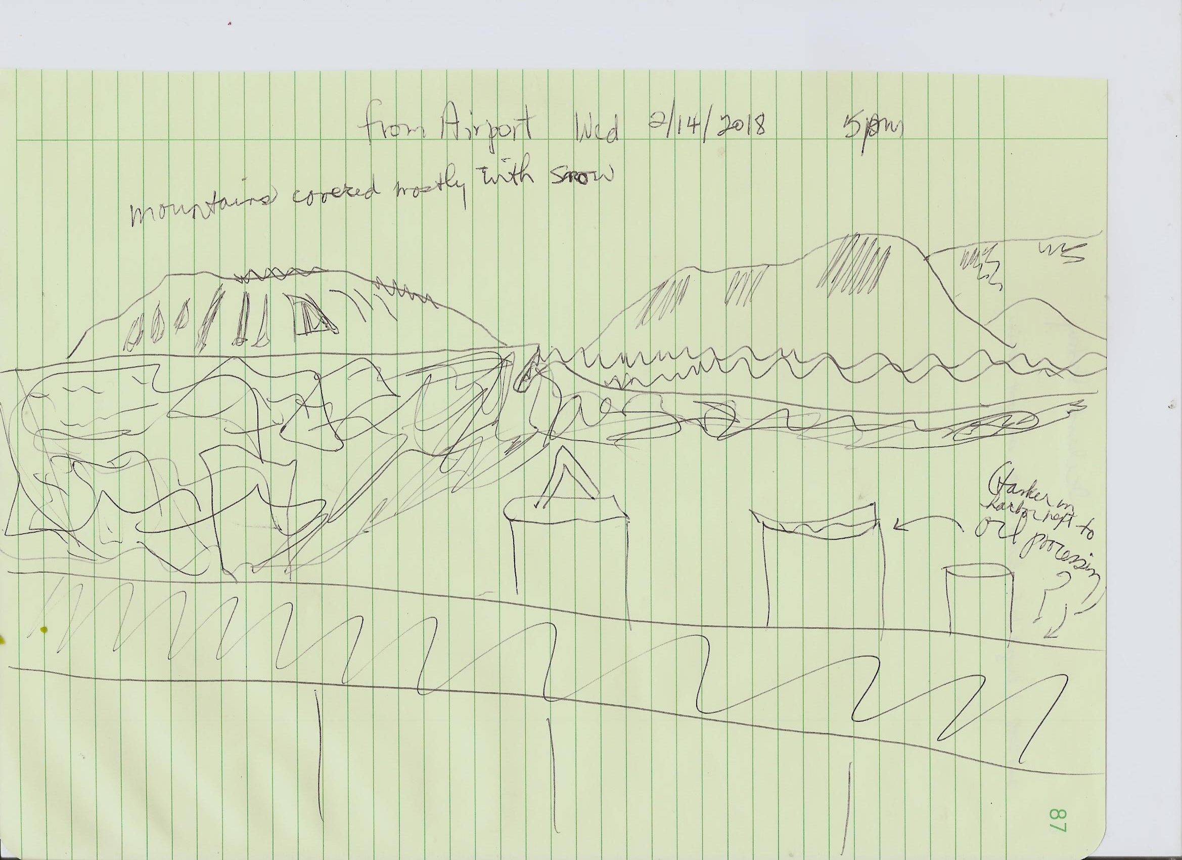
Iceland
LEAVING AIRPORT OF KEFLAVIK
2-14-2018 5pm
FROM AIRPORT TO REYKJAVIK
….mountains covered mostly with snow….
JAMIE

Slide 10
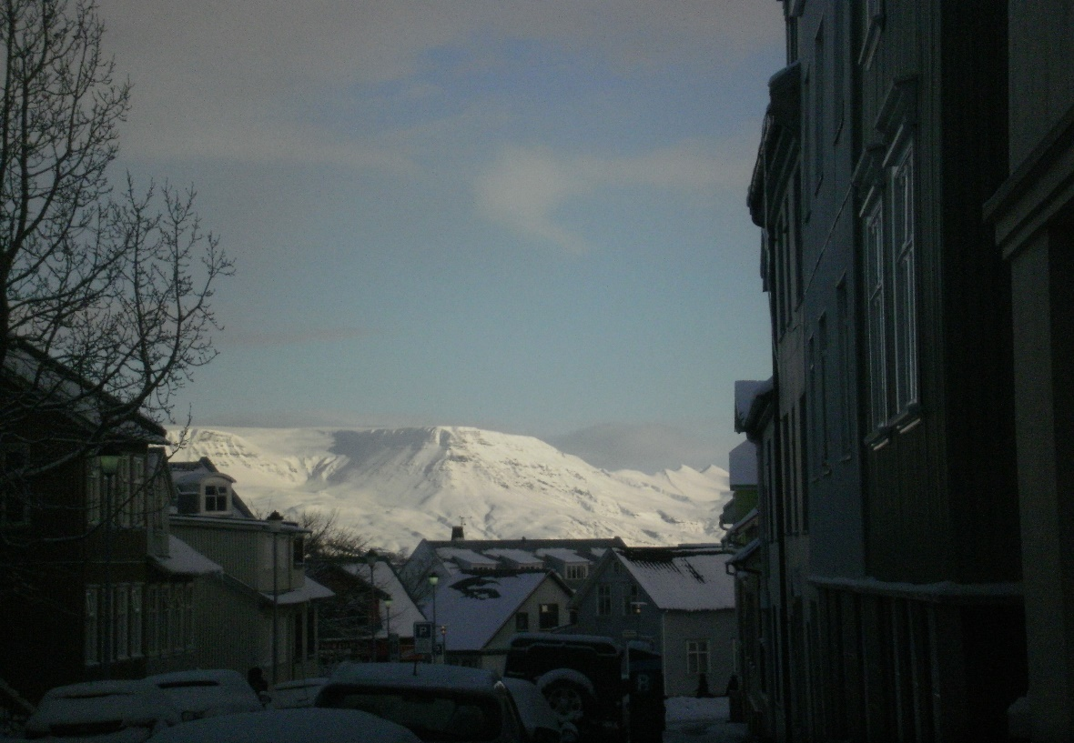
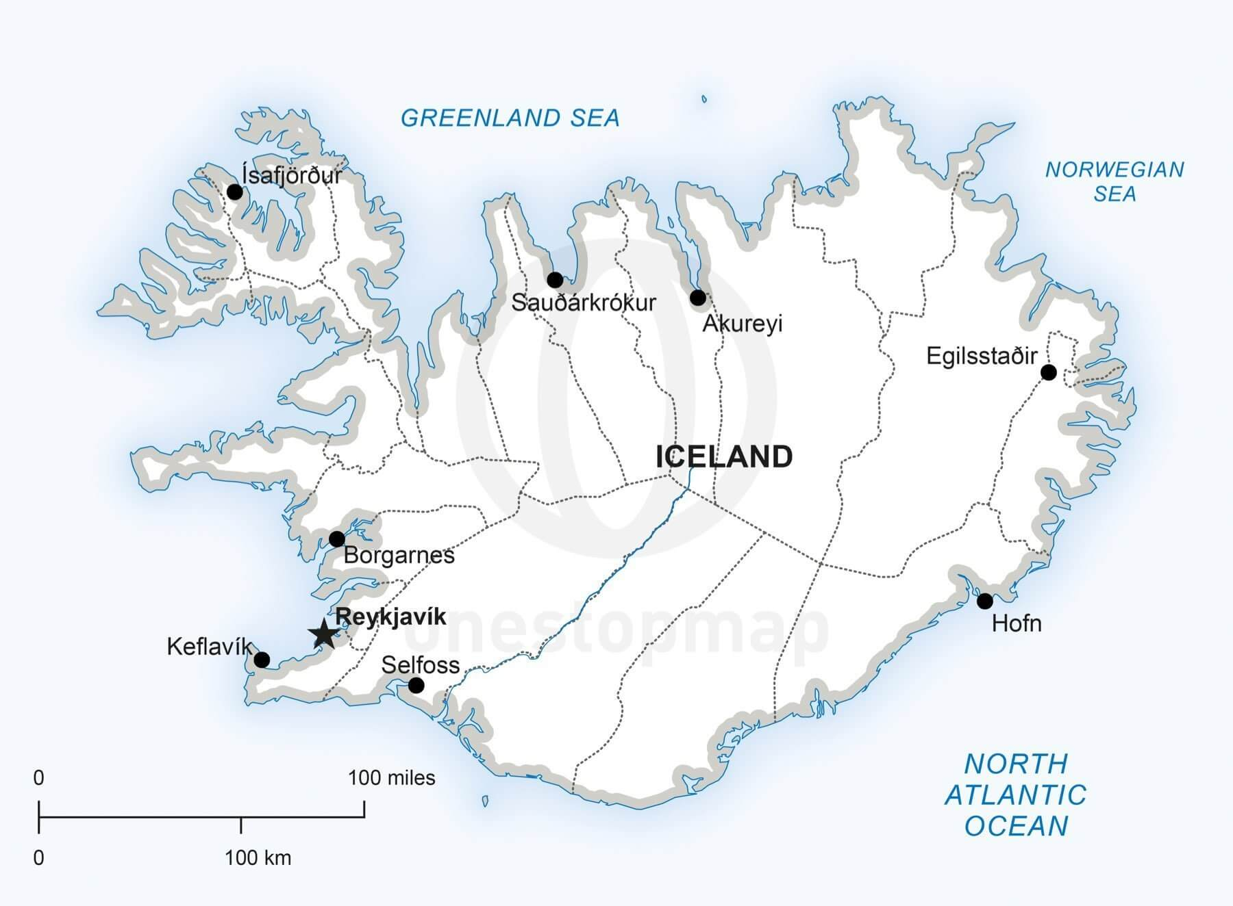
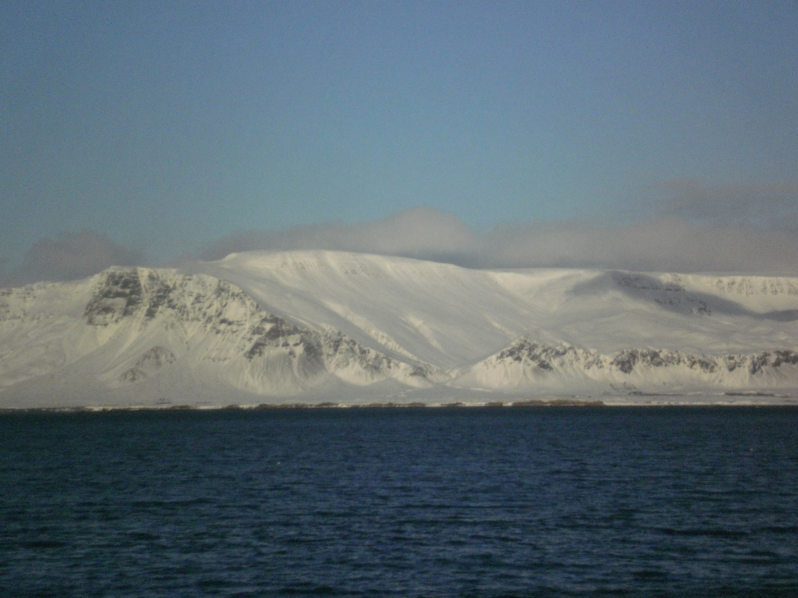
THURSDAY
2-15-2018
This is the capital Reykjavik. Two-thirds of the Icelandic people live in this sprawling
city. There are only 330,000 Icelandic citizens.
REYKJAVIK

Slide 11
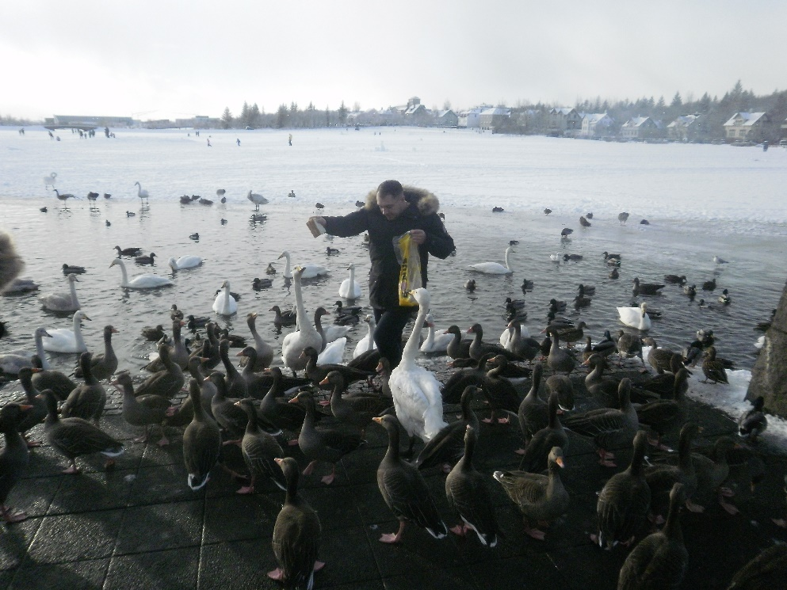
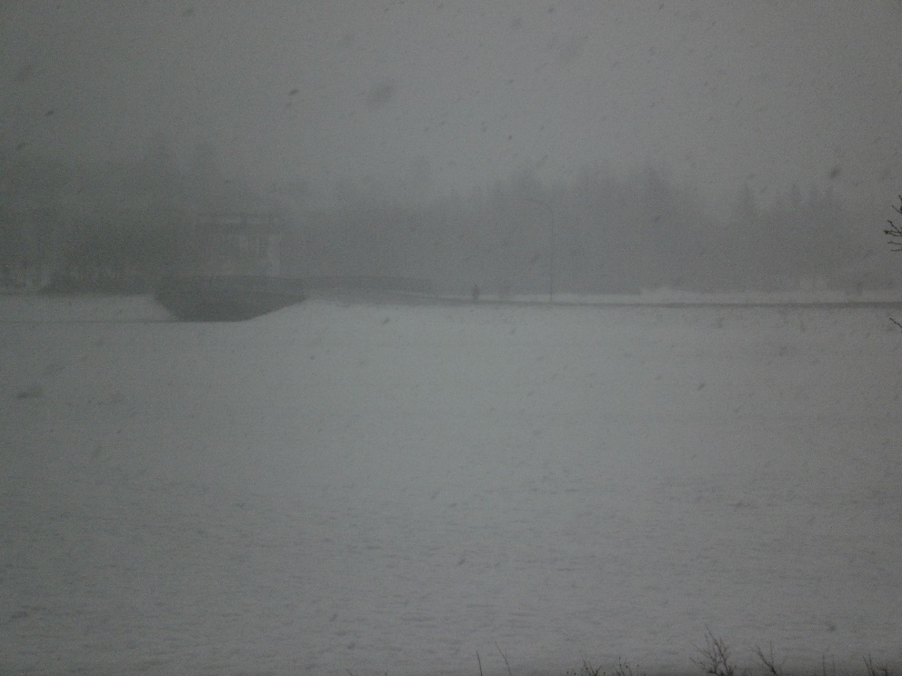
Iceland – Thurs 2-15
The next day, Thursday, it was snowing, off and on.
Iceland’s weather changes every hour …. literally.

Slide 12
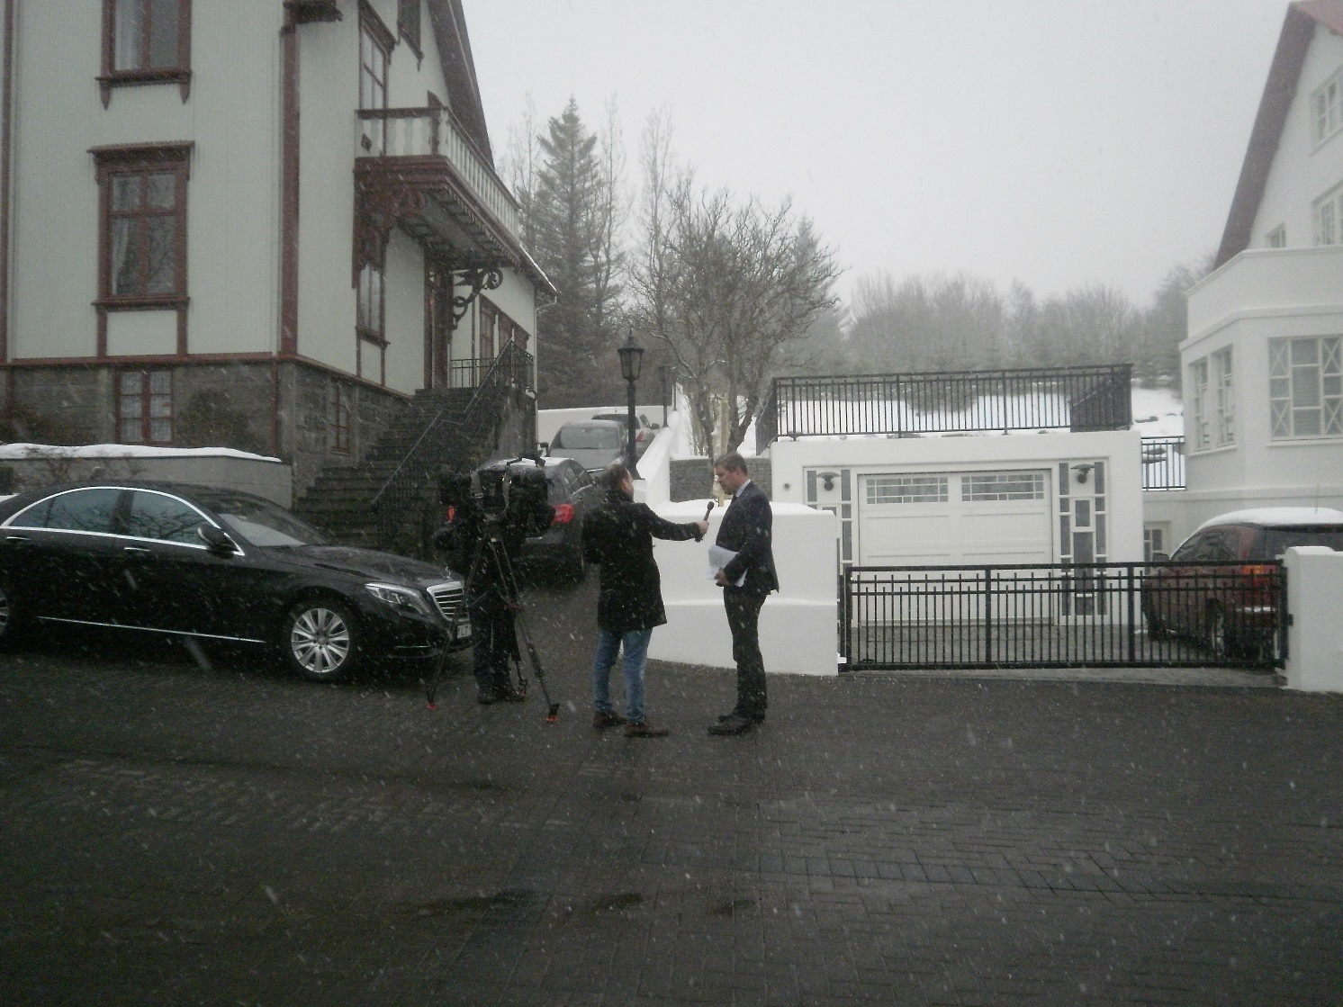
Iceland
While I was walking near the huge pond in downtown Reykjavik, I was attracted to a large house along the pond, with 3 photographers with equipment waiting on the sidewalk in the cold, and about 12 black cars parked in front. What was this about? Should I ask? Everything was black and dark in the cars.
I knocked on the window of one of the cars. I asked, “what are all the cars and the photographers?” The answer from the driver with an earphone in his ear, “They are waiting for the Icelandic government to come.”
Oh!

Slide 13
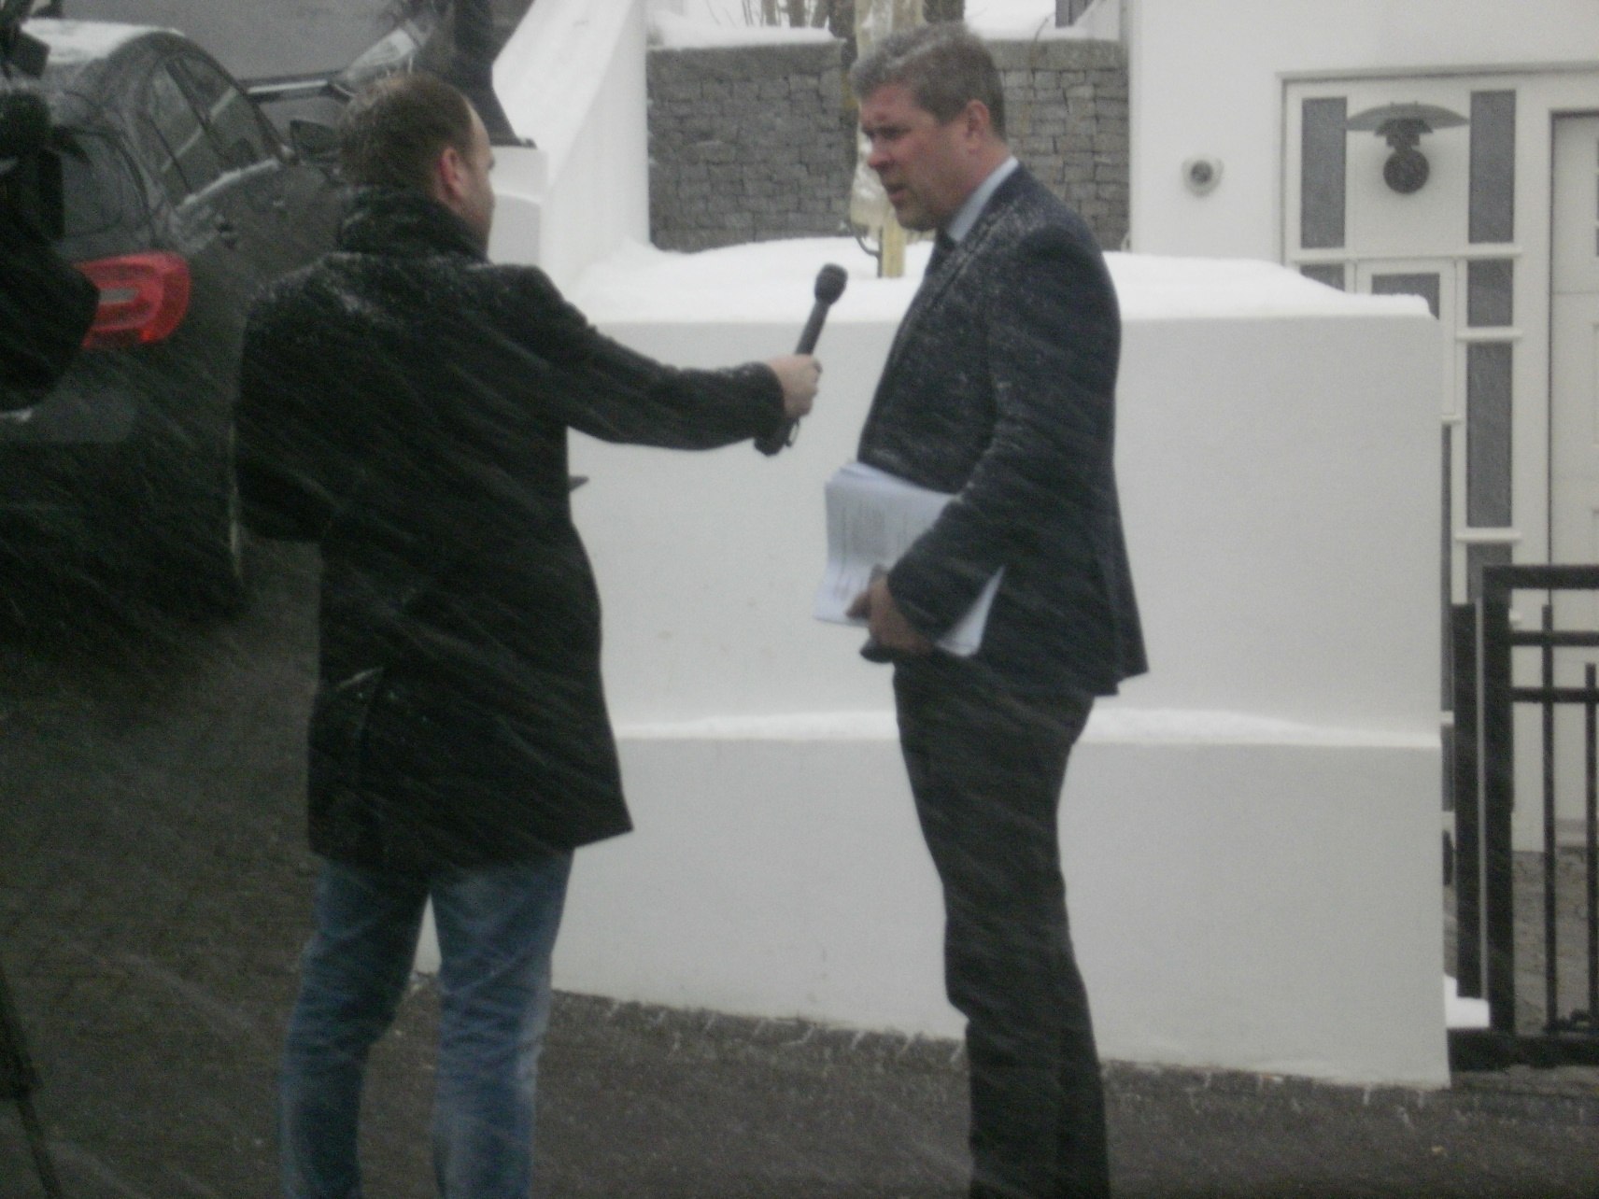
Iceland – Thurs 2-15
I waited but no ‘government’ came.
Then I met an Icelandic woman Sikka.
She told me that the Parliament is only a few
blocks away and the politicians use this
building for meetings.
She also told me that Jamie and I should try the
public pools in Rejkjavik which are heated by
geothermal energy and are outdoors!
I looked over at the government building and
saw the scene you see here to the right. “Sikka,
who is that?” “Oh, that is our Finance Minister.
And he’s not dressed for the weather!”
So I went over to take his picture, feeling that
I wouldn’t be able to get near anybody like
this in the U.S. Nobody said anything to me
when I went up close and shot my picture.

Slide 14
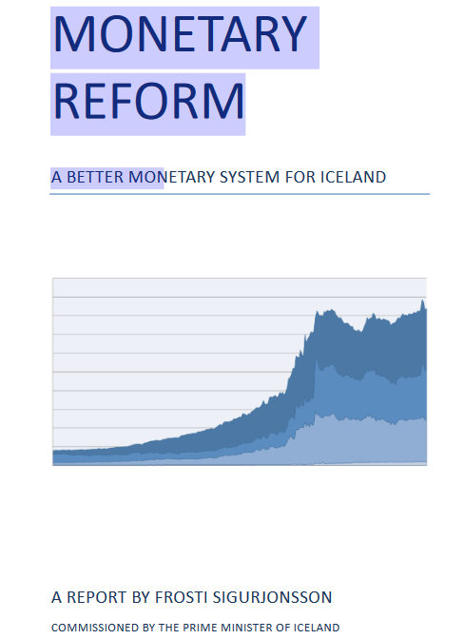
Iceland – Thurs 2-15 - Evening
That night, Jamie and I were going to meet with a group of monetary
reformers from Iceland. One of the reformers would be Frosti Sigurjonsson,
the gentleman who had written the groundbreaking report
‘A Better Monetary System for Iceland’. The report recommends
sovereign money, like the NEED Act of the AMI.
Jamie and I spent a couple of hours in the afternoon reviewing the NEED Act,
especially the part on the Transition and Revolving Fund. In the NEED Act,
the Revolving Fund would be used to make loans to private banks, as well as
interest free loans to state and local municipalities. An independent
Monetary Authority would decide how much new money could be created.
Frosti’s Revolving Fund was called the Conversion Liability Fund. His
Monetary Authority was called the Money Creation Committee.
A REPORT BY FROSTI SIGURIONSSON

Slide 15
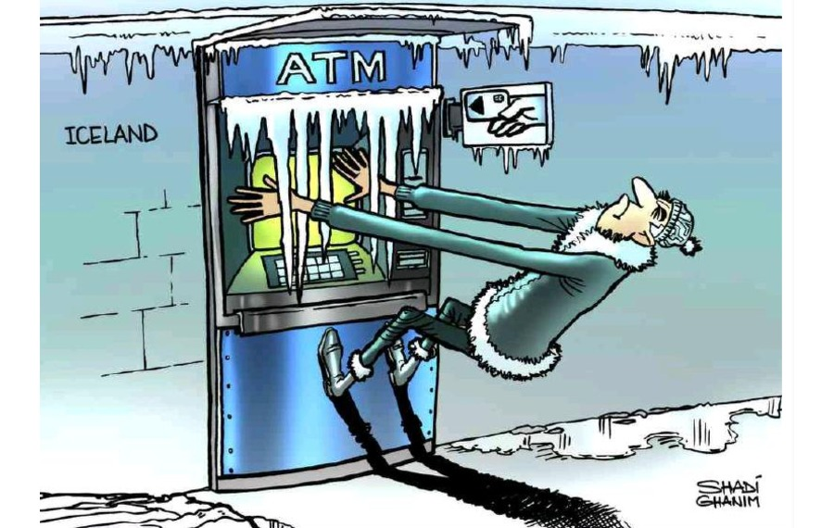
Iceland
I studied the 2008 financial crisis in Iceland.
I discovered that Iceland was a good historic
example of how a banking system works
and how it creates crises.

Slide 16
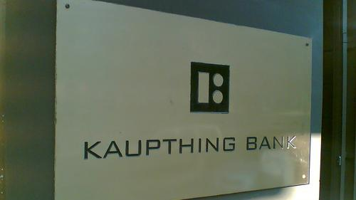
Iceland
Relative to the size of its economy, Iceland's 2008 systemic banking collapse was the largest experienced by any country in economic history. Between 1994 and 2008, the banks had increased the money supply 19x!
In 2006, the international magazine The Banker compiled a list of the largest banks in the world. Here is how the 3 large Icelandic banks rated!
Kaupthing bank -- number 211
Landsbanki -- number 236
Glitnir -- number 300

Slide 17
Iceland
Private banks can increase the money supply stupendously by working in tandem, so reserves did not have to be increased to the same extent!
“First, to the extent that payments are made between customers of the same bank, no extra reserves will be required. ..
“Second, if banks grow their lending at similar rates, and flows of deposits between banks are fairly balanced, then banks can increase their lending considerably while requiring very little additional reserves…”

Slide 18
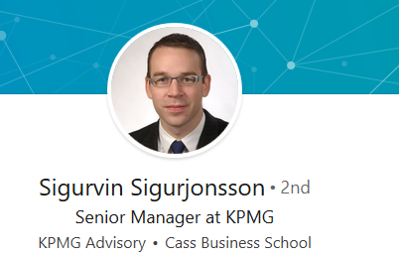
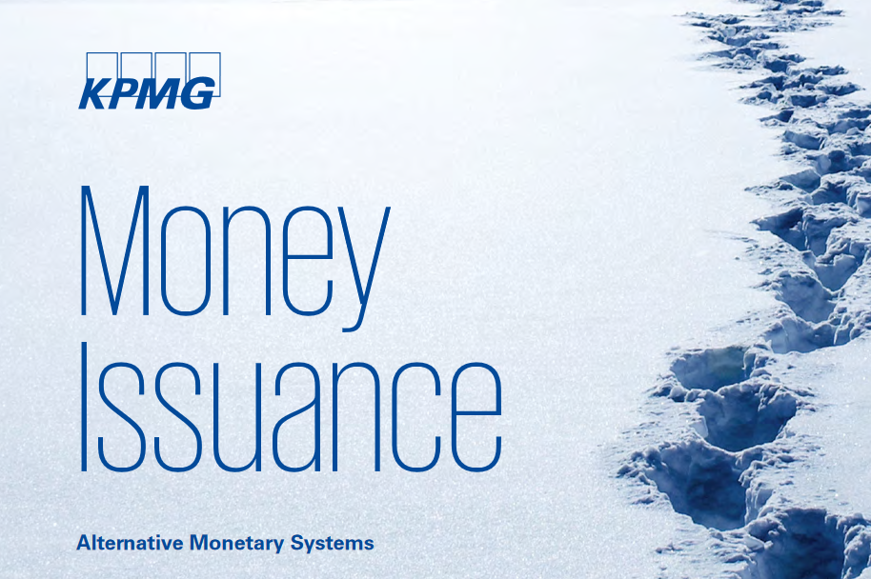
Iceland

Slide 19
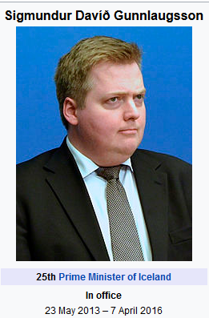
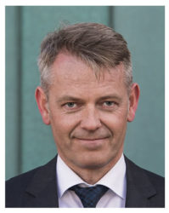
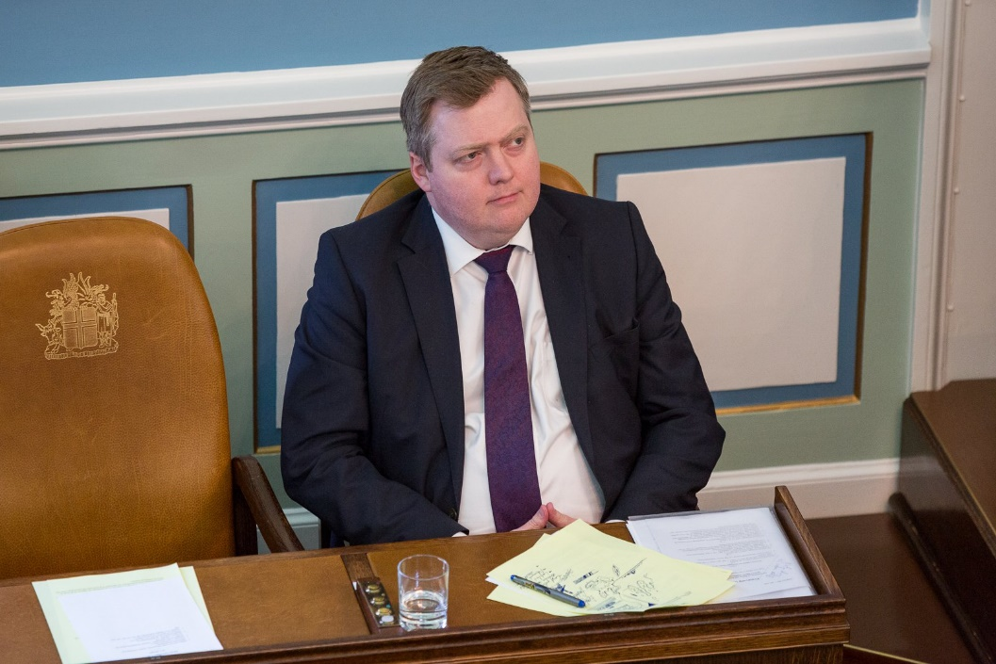
Iceland – Thurs 2-15
Reform of the Icelandic monetary system
In spring 2015 Frosti Sigurjónsson was commissioned by the former Icelandic Prime Minister Sigmundur Davíð Gunnlaugsson, to find out why the financial crisis of 2008-2011 hit Iceland particularly hard. In his study^{[2]} Frosti concludes that the main problem lies in the creation of money on the deposit money banks.^{[3]} Frosti advocates monetary control by the state. This corresponds to the objectives pursued and the Association for Monetary modernization of the Swiss Hansruedi Weber.^{[4]}

Slide 20
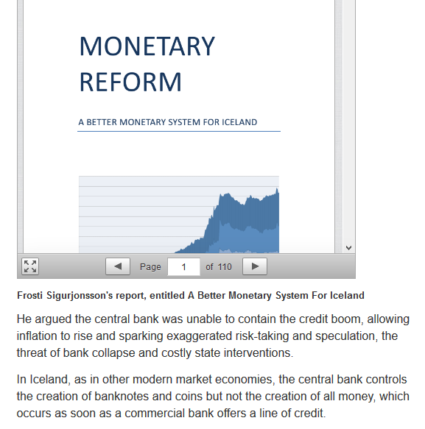
Iceland
The report had been requested by the Prime Minister, while Frosti was a
member of the Icelandic Parliament.

Slide 21
Iceland

Slide 22
Iceland
Frosti Sigurjonsson MP, author of the report, said: “Iceland, being a sovereign state with an independent currency, is free to abandon the present unstable fractional reserves system and implement a better monetary system. Such an initiative must however rest on further study of the alternatives and a widespread consensus on the urgency for reform.”

Slide 23
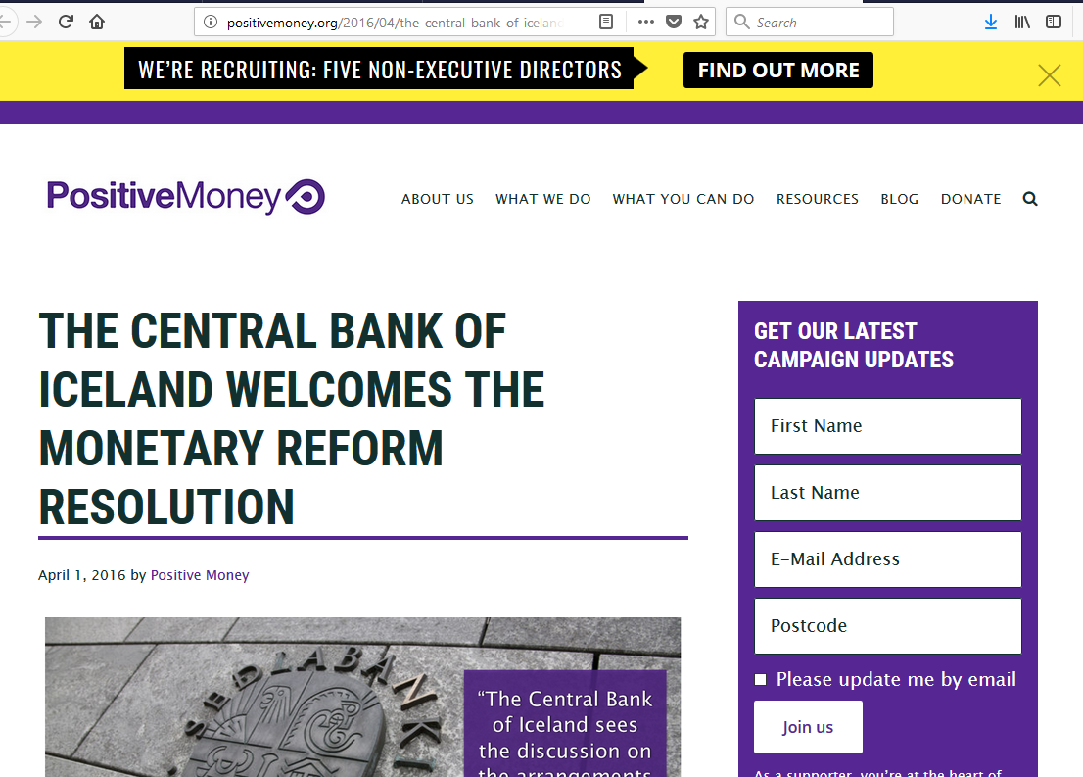
Iceland

Slide 24
Iceland
positivemoney.org
“Concerns exist that if governments are allowed to create money directly, they will get carried away and create excessive amounts of money to pay for vote-winning projects. Under the democratic Sovereign Money System, however, the government is not allowed to create money directly. The decision to create new money would be made by a money creation committee, independent of government, on the basis of what is appropriate for the economy as a whole. The committee will not have the power to decide who benefits from its money creation or what new money will be used for. The allocation of new money will be decided democratically by parliament. In the current system however, commercial banks are allowed to both create money and decide what new money is used for. Also, banks are currently incentivized to create money based on what is best for their bottom line, but not on what is appropriate for the economy as a whole.” — A better monetary system for Iceland

Slide 25
Iceland
from Iceland MR
Preface
“Of all the many ways of organising banking, the worst is the one we have today. ... Change is, I believe, inevitable. The question is only whether we can think our way through to a better outcome before the next generation is damaged by a future and bigger crisis. This crisis has already left a legacy of debt to the next generation. We
must not leave them the legacy of a fragile banking system too.” Lord Mervyn King, Governor of the Bank of England 2003-2013
1
This report, commissioned by the Prime Minister of Iceland, presents
the results of a study into the money creation mechanism in Iceland and the potential for its improvement. For more than half a century, Iceland has suffered from serious monetary problems including inflation, hyperinflation, devaluations,
an asset bubble and ultimately the collapse of its banking sector in
2008. Other countries have faced similar problems . Since 1970, bank
crisis have occurred 147 times in 114 countries 2 causing serious
reductions in output and increases in debt.
Despite its frequent failures, the banking system has remained essentially unchanged and homogenous around the world. Various reform proposals have been put forward, many of them promising, but none have been implemented.
A necessary step toward monetary reform is to increase awareness of the drawbacks and risks of the present system and why reform is needed. This report will hopefully serve as a useful source of information for the coming debate on the money creation process in Iceland and how it could be reformed to serve society better in the
future.
Reykjavík, March 20th 2015
Frosti Sigurjónsson

Slide 26
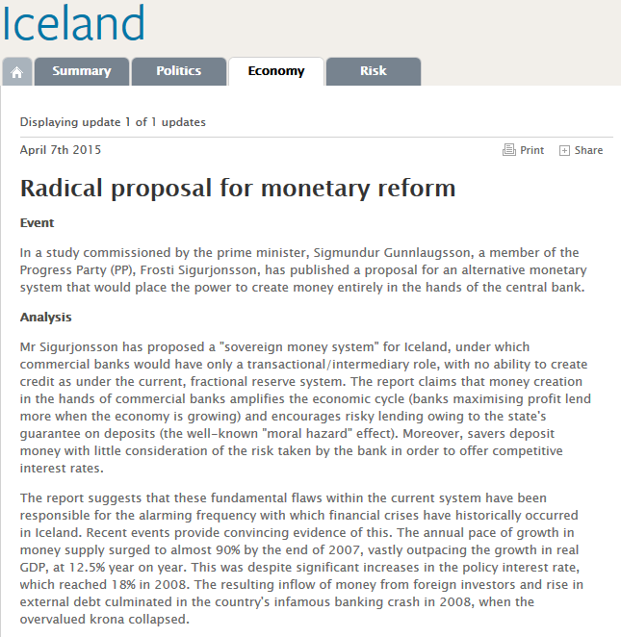
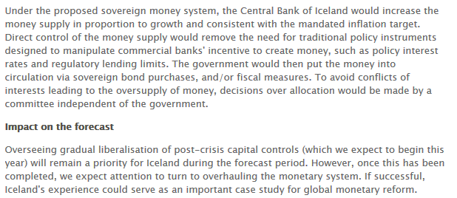
Iceland

Slide 27
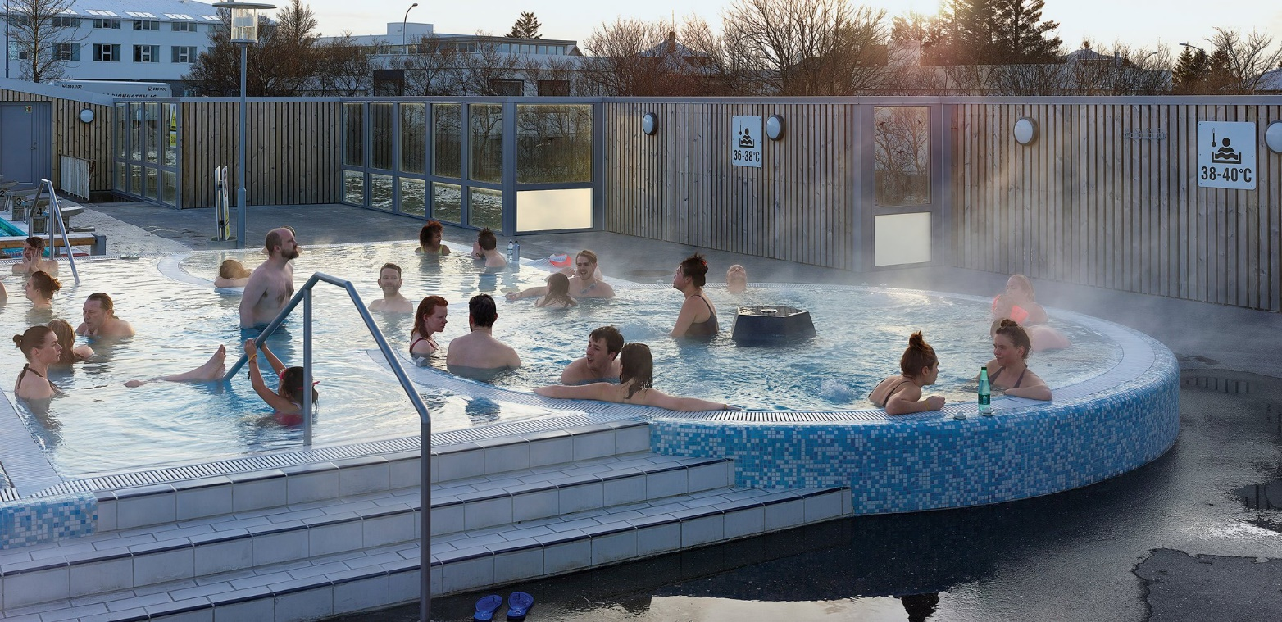
Iceland

Slide 28
Iceland
The prime minister of Iceland Sigmundur David Sigmundsson, said: “I am very pleased to receive this new report on monetary reform. The findings will be an important contribution to the upcoming discussion, here and elsewhere, on money creation and monetary policy.”

Slide 29
Iceland
“Fundamental reform of the monetary system must be considered.” says head of Iceland Parliament’s Committee for Economic Affairs
Frosti Sigurjonsson, Member of the Parliament of Iceland and Chairman of the Committee for Economic Affairs and Trade, today published a report outlining the need for a fundamental reform of Iceland’s monetary system.
The report, commissioned by the Prime Minister, considers the extent to which Iceland’s history of economic instability has been driven by the ability of banks to ‘create money’ in the process of lending.
The Icelandic economy has struggled with inflation and unstable exchange rates. Iceland also suffered one of the costliest banking crises in history.
The report describes how commercial banks in Iceland created far more money than was needed for economic growth. The Central Bank failed to bring the money supply under control using conventional means.
The report considers various reform proposals and concludes that the Sovereign Money proposal could provide a sound basis for effective reform in Iceland.

Slide 30
Iceland
The Financial Times writes:
“Having decided against scrapping its currency, the government in Reykjavik now mulls a complete ban on its banks creating krona when they issue new loans…In recent years Scandinavian central bankers have shown the same dauntless appetite for exploration that once saw Nordic ships fan out across the globe. In this spirit Reykjavik should give sovereign money a shot. Nations far bigger and meaner than Iceland have struggled to come to grips with financial excess through conventional means. As well as showing other countries a potential way forward, by bringing the axe down on fractional reserve banking the Icelanders might just regain some control over their economic destiny.”

Slide 31
Iceland
The City of Reykjavík, however, released a report on homelessness at the end of 2017. According to data from the report, there are over 360 homeless in Reykjavík, Iceland’s capital and largest city. Of this number, 68% were men, and 47% were between 21 and 40 years of age. The numbers include individuals living on the street, in shelters, in “precarious living situations,” as well as combinations of the above. Recently, Icelandic media has reported on a group of locals living permanently at the Reykjavík campsite and has raised awareness of the issue of homelessness. Many of these individuals have disabilities which impact their access to work and housing.

Slide 32
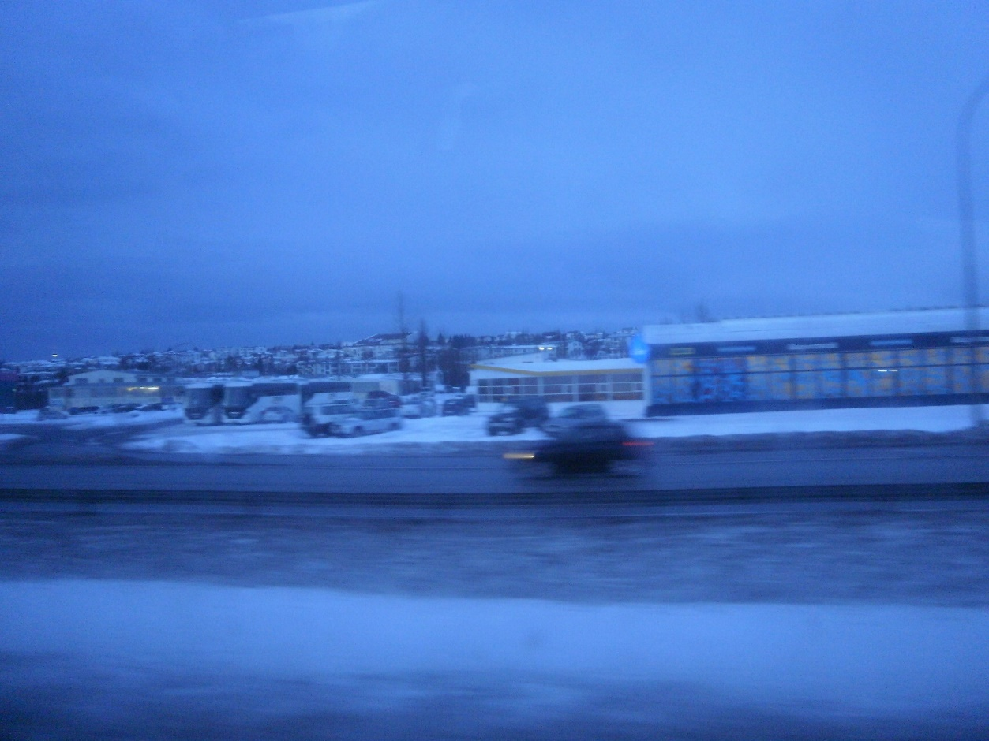
Iceland
https://arcticecon.wordpress.com/2012/02/15/aluminium-smelting-in-iceland-alcoa-rio-tinto-alcan-century-aluminum-corp/

Slide 33
Iceland
GM Rogers: Finding Fischer’s Fortune
19-Apr-2016 by Ian Rogers
The revelation that US former World Champion Bobby Fischer has been named in the Panama Papers is hardly a surprise – he had boasted that he hadn’t played tax since the 1970s – but the consequences of that discovery may turn out to be of interest to the Dutch and British governments.
In 2005, with Fischer unable to return to the US because of his sanctions-busting rematch against Boris Spassky in Yugoslavia during the Balkan war, Swiss bank UBS decided that they were no longer interested in holding Fischer’s millions.
Fischer had hidden his wealth with UBS for the previous 13 years, but UBS sent his cash and the liquidated value of his gold medals to the Icelandic bank Landsbanki. (Fischer had been earlier granted refuge in Iceland after being jailed in Japan and threatened with extradition to the US.)
Panamanian firm Mossack Fonseca, the legal firm whose leaked documents have shown that it regarded 95% of its clients as tax evaders, then worked with Landsbanki to set up a company in Panama, with suitably anonymous front men, to hold Fischer’s fortune.
Fischer died in 2008, the year Landsbanki collapsed in the financial crisis, leaving millions of savers in Britain and the Netherlands out of pocket.
The Icelandic government took over Landsbanki but resisted strong pressure from Holland and England to refund the lost money (which had been returned to savers by the two countries’ respective governments).
In 2013 a European court ruled that Iceland would not have to pay back any money, though if the receiver of Landsbanki found assets then England and Holland would be entitled to some.
This is where Fischer’s off-shore company becomes important.
It turns out that Mossack Fonseca dealt not with Landsbanki in Iceland but a secret off-shoot of the bank, Landsbanki Luxembourg SA.

Slide 34
Iceland

Slide 35
Iceland

Slide 36
Iceland

Slide 37
Iceland

Slide 38
Iceland

Slide 39
Iceland

Slide 40
Iceland
End
Week 3: Iceland

