Slide 1
2-1 to 2-21-2018 TRIP TO EUROPE FOR MONETARY REFORM
Week 2: Rome, Amsterdam
Thurs 2-8 to Wed 2-14
AMI:
Sue Peters, Bob Poteat, Jamie Walton

Slide 2
ARRIVING ROME
… FROM BOLOGNA, ITALY
Thurs. 2-8-2018

Slide 3
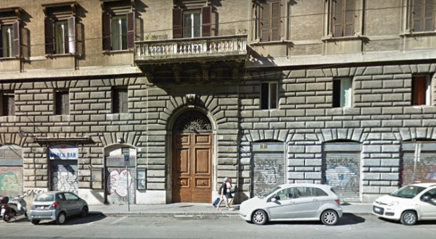
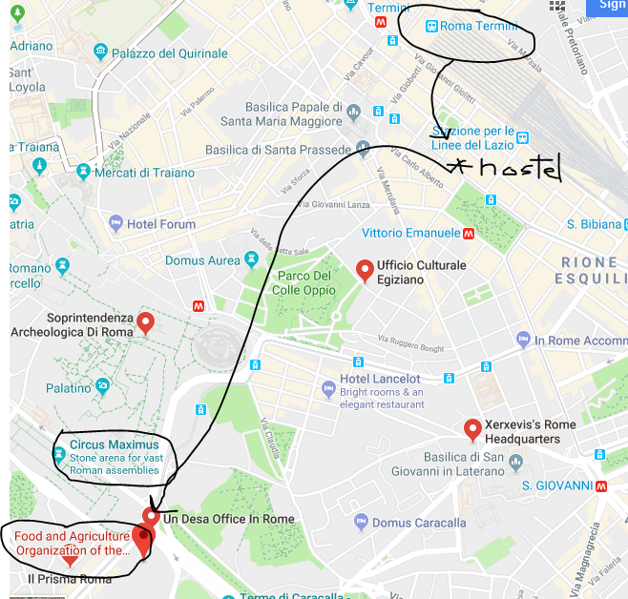
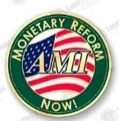
Rome, Italy
Napoleon Guest House
Via Napoleone 75
We arrived to the Rome Termini train station…
dropped our bags at our hostel run by two Philippino women…
and hopped on the underground metro to meet Michael Clark, who in 2012 joined the staff of U.S. Rep Dennis Kucinich to assist with the final drafting of the NEED Act.

Slide 4
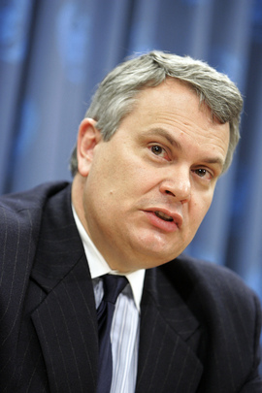
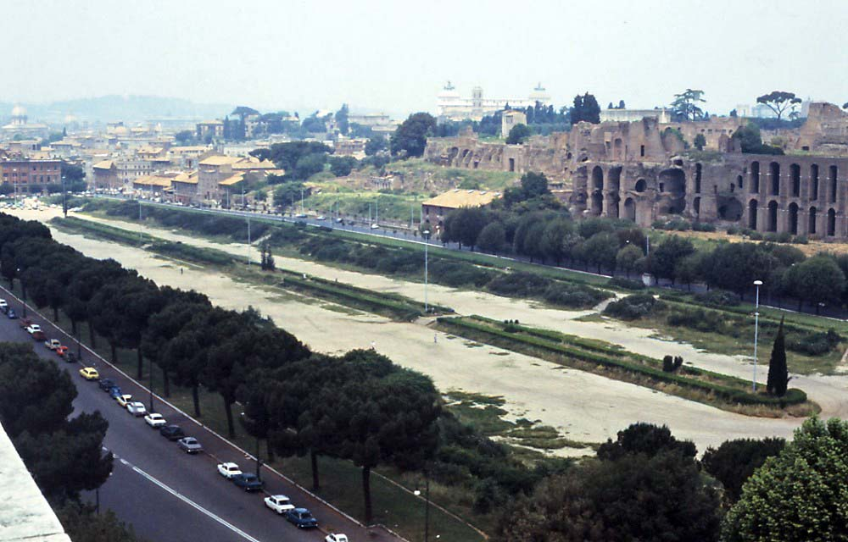
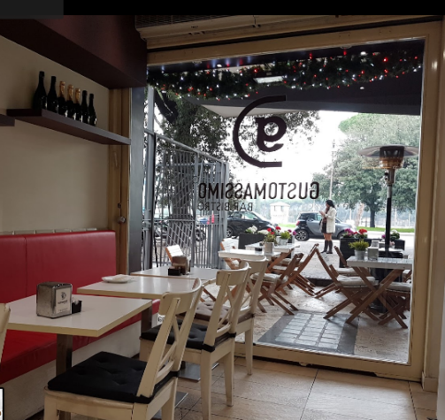
Rome, Italy
Michael works for the Food and Agriculture Org. of the UN. His office is
across from the Circus Maximus.
We ate delicious Italian food
waiting for Michael, looking
at the Circus Maximus
CIRCUS MAXIMUS

Slide 5
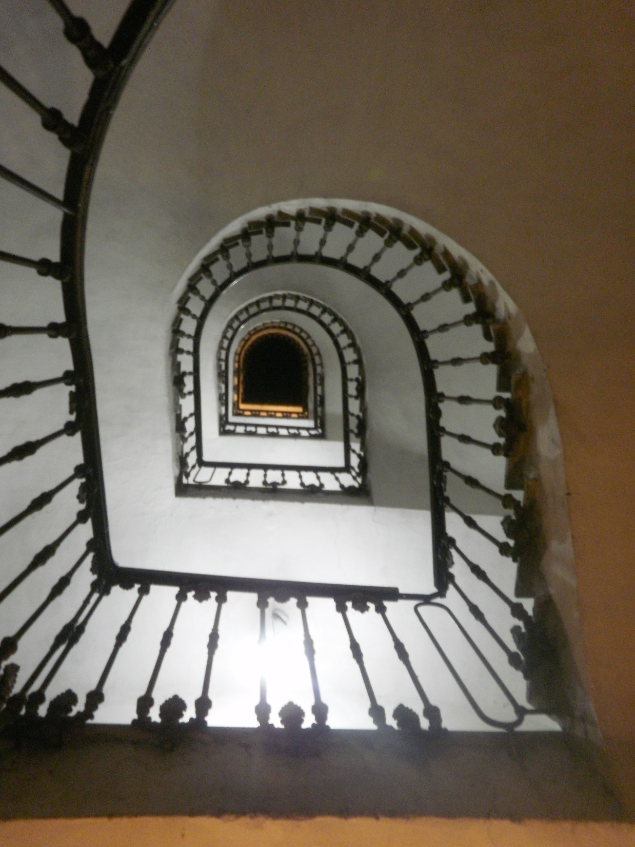
Rome, Italy
Michael took us on the tram to his apartment across
the Tiber to meet up with wife Dana and have dinner.
This is the stairwell of the old Italian apartment building
in which they live.
You have to walk up. The elevator doesn’t work.
Also, the mailboxes in the entrance aren’t working either!

Slide 6
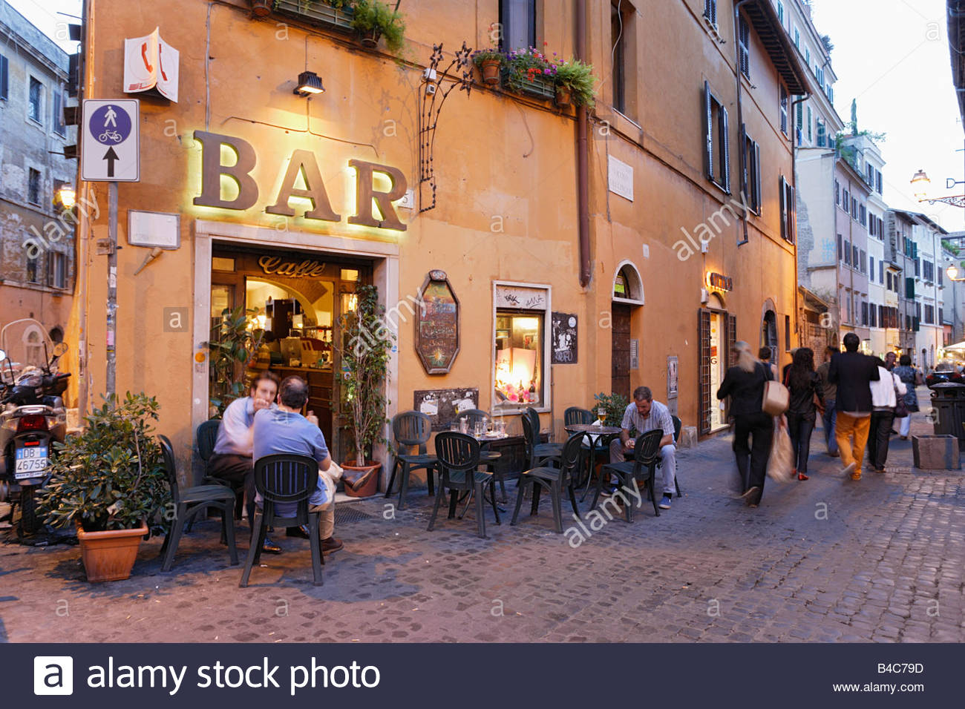
Rome, Italy
Then all of us –
Sue, Jamie, Bob, Michael, Dana –
went out for a local Italian
dinner of lots of meat and
drink!

Slide 7
Rome
Sightseeing
Fri. 2-9-2018

Slide 8
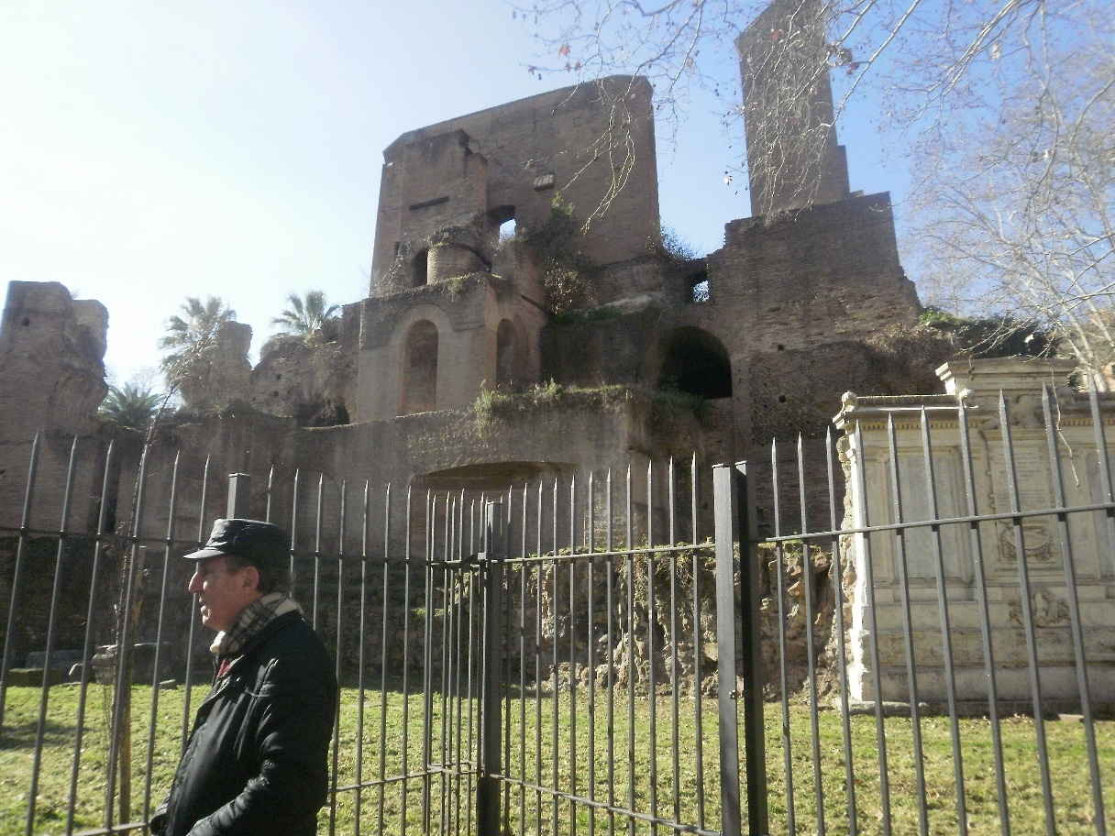
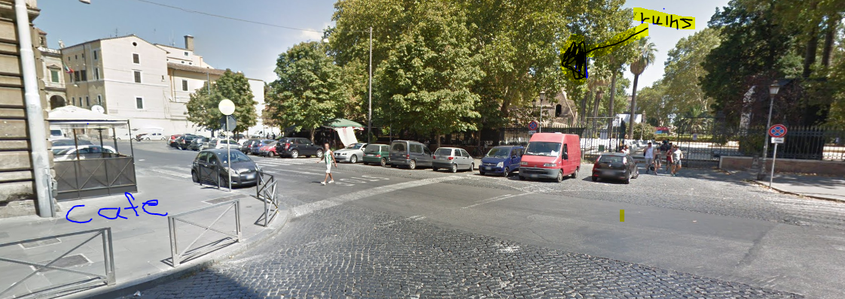
Rome, Italy
The next day, we switched rooms from the 4-person dorm, leaving the dorm to an older woman interrupted by our late night return! I hope she forgives us. The Phillipino hostess gave us our own room.
We found an outdoor café around the corner with delicious bacon and eggs and
a friendly waitress. Across the street was a public park and ancient ruins.
Our breakfast cafe
The ruins across the street

Slide 9
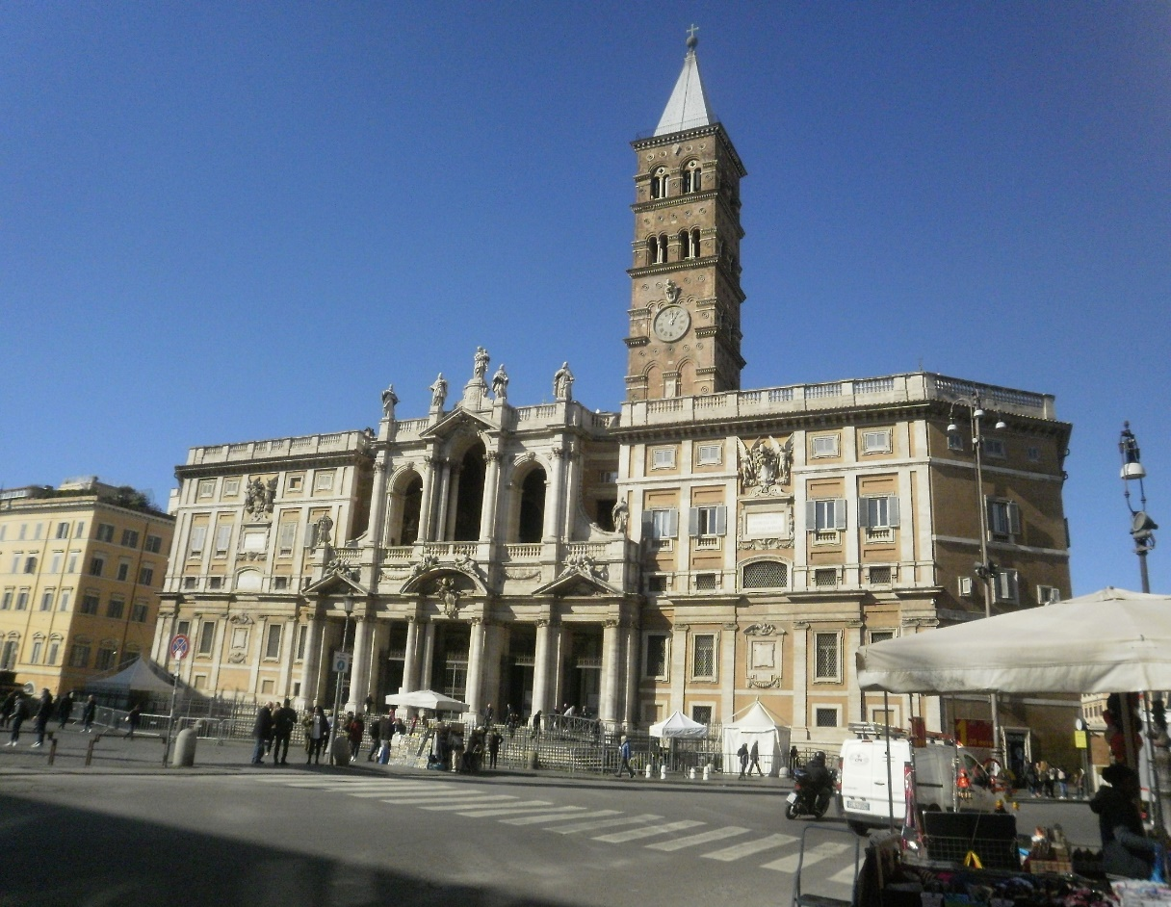
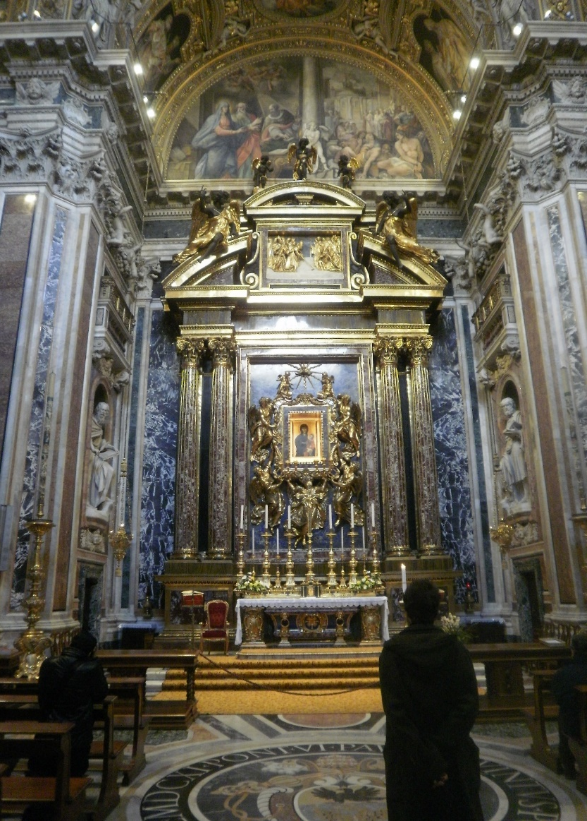
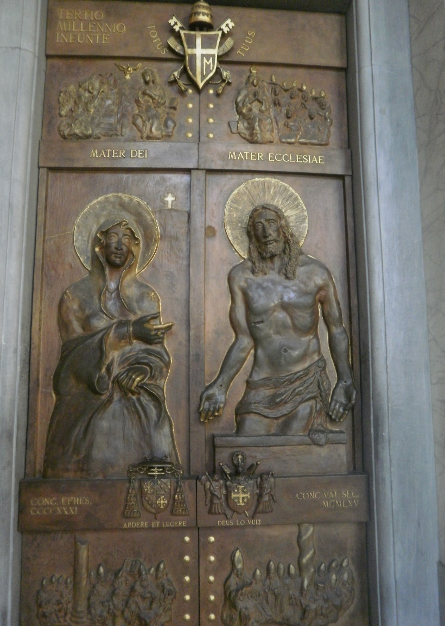
Rome, Italy
We did sightseeing around the neighborhood all morning and early afternoon.
Basilica di Santa Maria Maggiore,
the largest Marian (dedicated to
the Virgin Mary) church in Rome

Slide 10
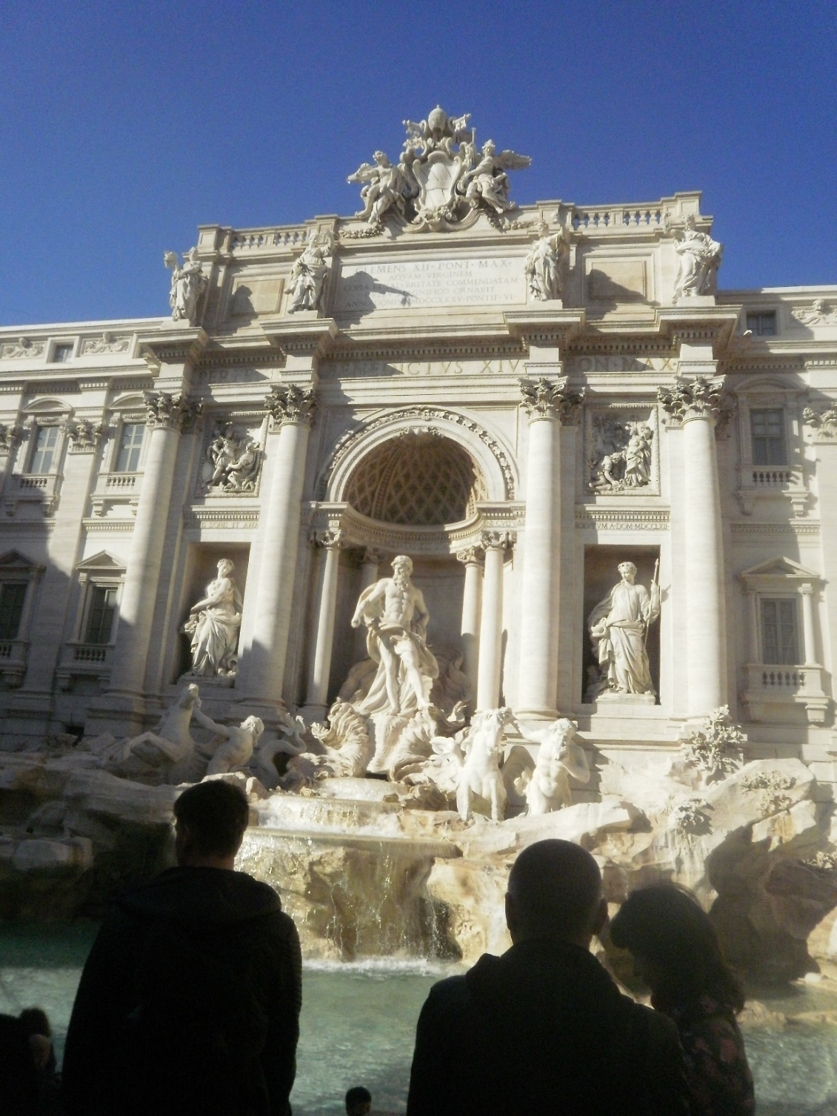
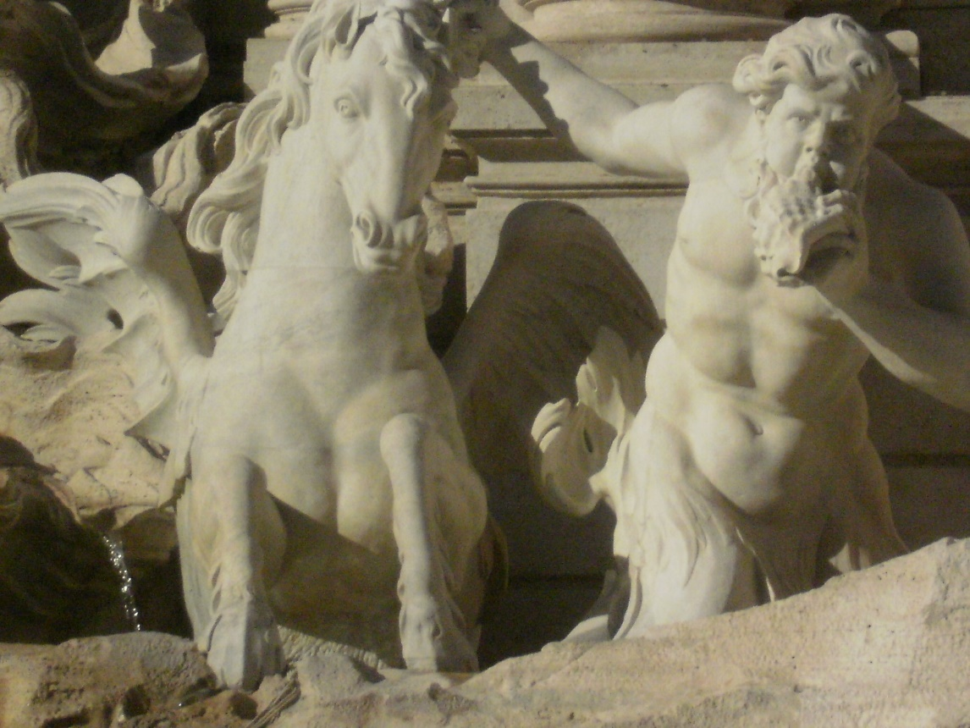
Rome, Italy
Like typical tourists, we walked to the
Trevi Fountain.

Slide 11
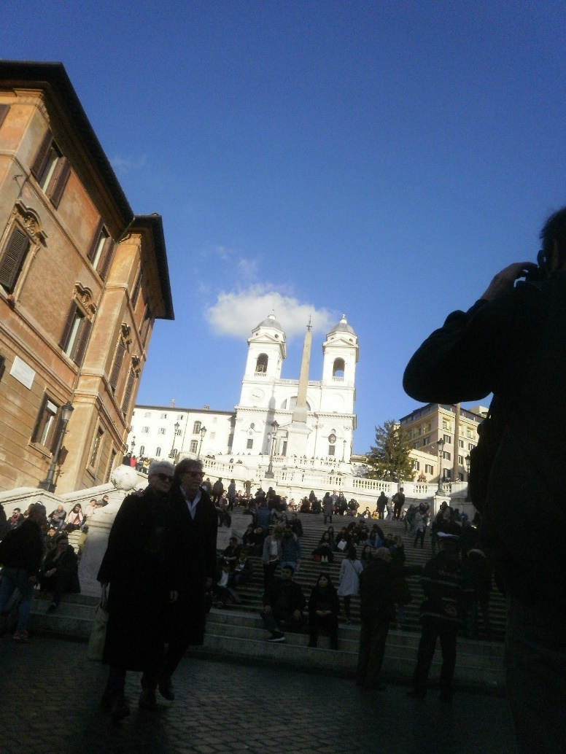
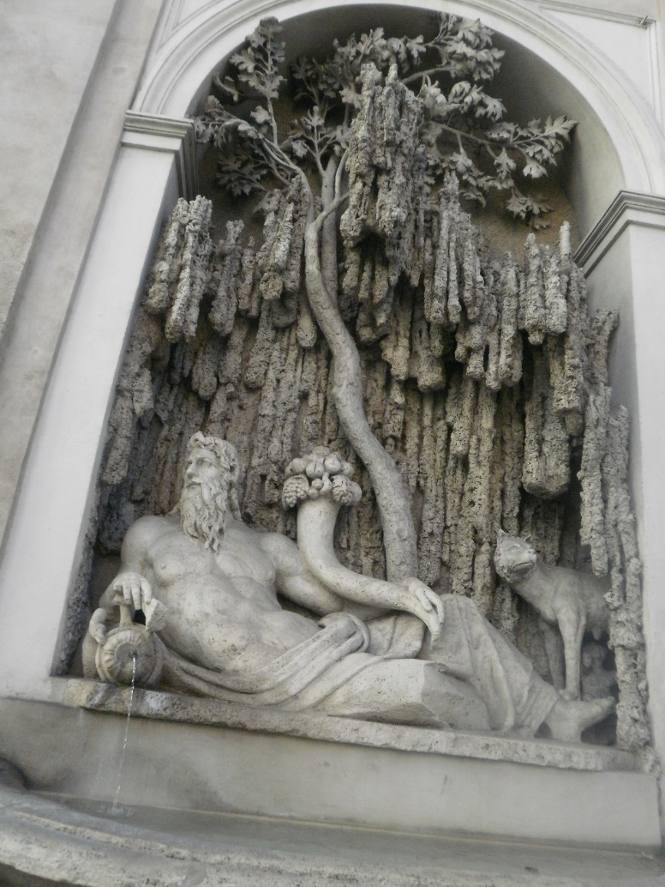
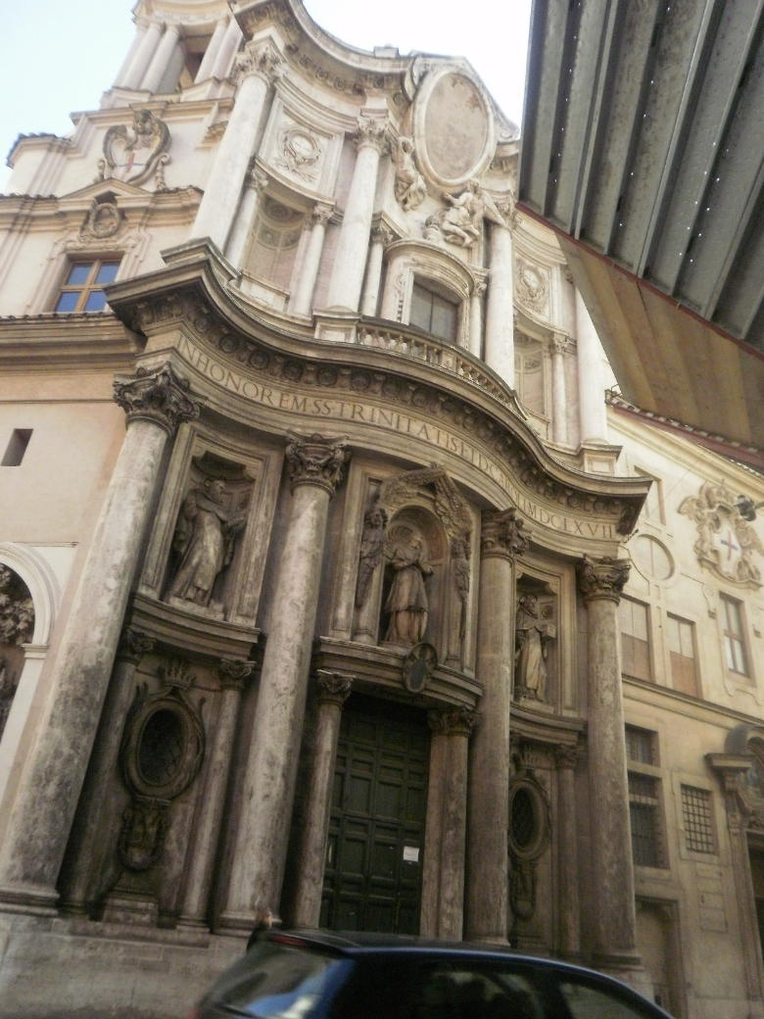
Rome, Italy
Wherever you walk, there is art…
art… art… and the Catholic Church.

Slide 12
Rome
Meeting with monetary reformer, Dominico
MONETA BENE COMUNE
Fri. 2-9-2018

Slide 13
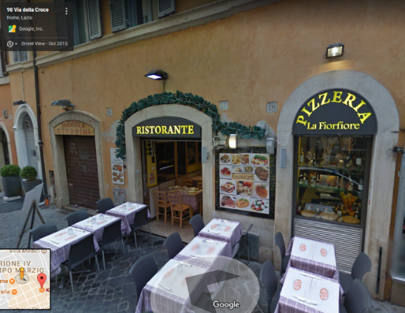
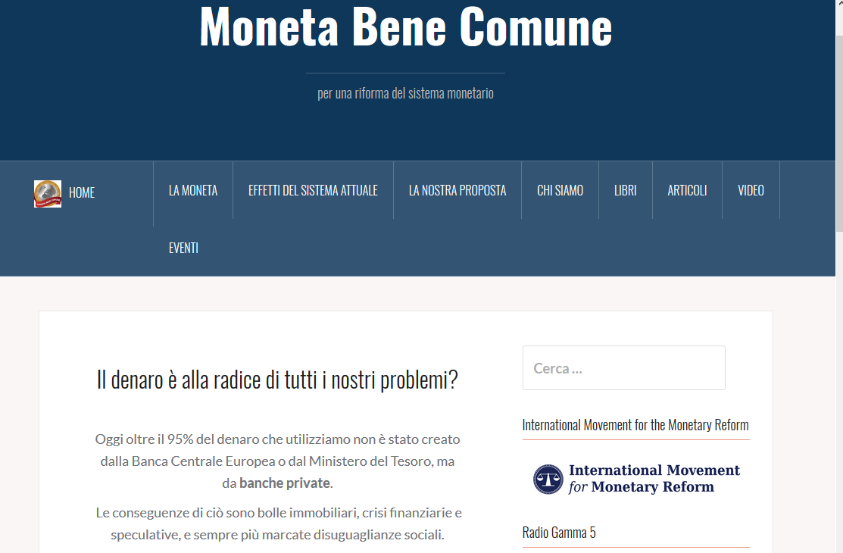
MONETA BENE COMUNE
We met Dominico at a Rome restaurant in the early afternoon. We ate, drank,
and listened to Dominico talk of monetary reform in Italy.
Like Giovanni and Fabio in Bologna, he talked of Professor Auriti, who brought a suit
against the private Bank of Italy in the 1990’s, and comedian/party leader Beppe Grillo,
who stopped talking about money creation by private banks after 1998.
He also mentioned the presence of Mosler and Barnard speaking publicly for MMT.
Dominico is a founder of the Italian money reform
group, Moneta Bene Comune. This group is part
of IMMR (International Movment for Monetary
Reform).

Slide 14
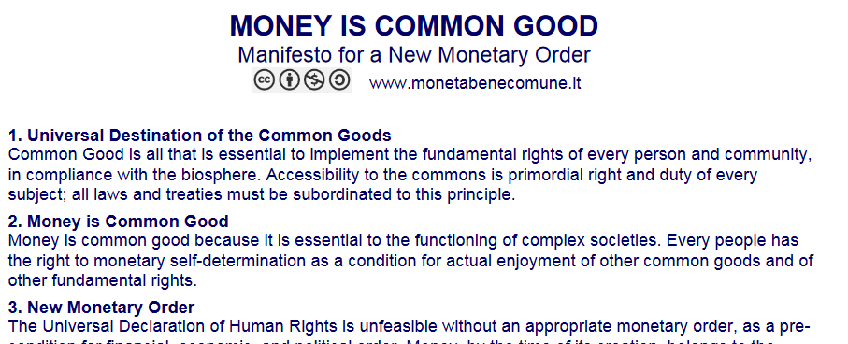
MONETA BENE COMUNE
Here is a description of what Moneta Bene Comune teaches:
For the full text:
http://www.monetabenecomune.it/wp-content/uploads/2016/04/MONEY-IS-COMMON-GOOD-2.pdf

Slide 15
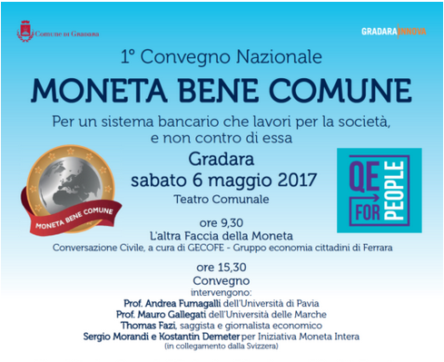
MONETA BENE COMUNE
Moneta Bene Comune hosts a 2-hour radio show each week, which reaches 10,000 listeners in the vicinity of Venice:
Moneta Bene Comune hosted an international conference in
Gradara last May, 2017. They are planning another one for
this May, 2018.
Would you like to attend?

Slide 16
MONETA BENE COMUNE
One of Dominico’s tutors was Guido Preparata, the author of
CONJURING HITLER: How Britain and America made the Third Reich
“So-called 'democracy' is a sham, the ballot a travesty… The tremendous sophistication, and the propagandists wall of artfully divulged misconceptions surrounding the banking system (we will return to this theme in Chapter 4), which is the chief instrument wherewith the hierarchs expropriate and control the wealth of their supporting community, is the limpid testimony of this essential transformation undergone by the feudal/oligarchic organization in the modem era. Conjuring Hitler, p. xvi

Slide 17
Leaving Rome for Amsterdam
Sat. 2-10-2018

Slide 18
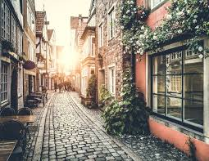
Leaving Rome for Amsterdam
We needed to decide whether to stay another day
in Rome or leave for Amsterdam.
Bob’s response was: “I don’t want to walk another
day on the uneven cobblestones of Rome. My legs
can’t take it.
That made lots of sense to all of us. Rome’s streets
are wonderfully old, but so uneven.

Slide 19
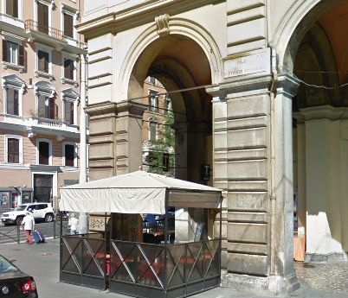
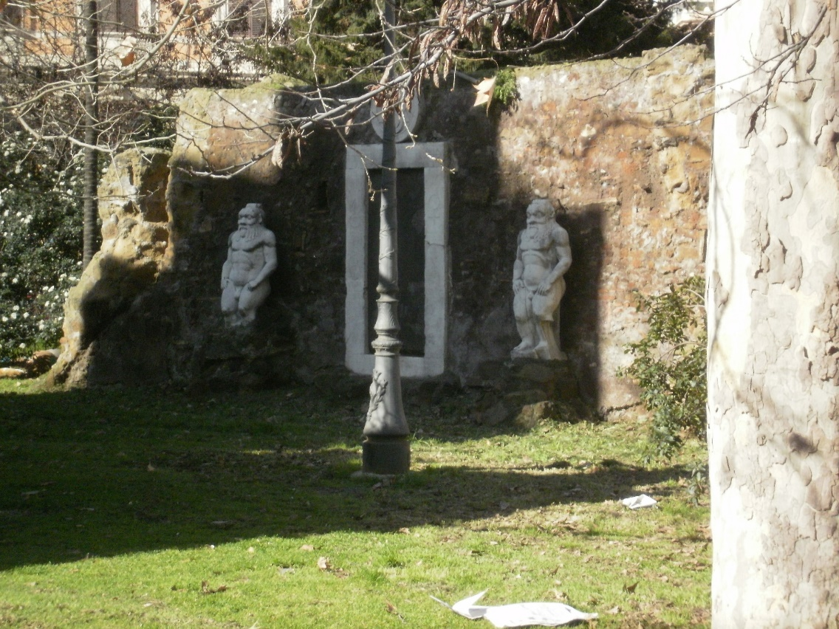
Leaving Rome for Amsterdam
The next morning, before we left Rome, I left Jamie and Bob at our breakfast café and walked across the street to investigate a ruin. A young man at our hostel had told me about this very unusual monument nearby – PORTA MAGICA – also known as the Alchemy Gate.
PORTA MAGICA is the only remainder of the villa of
Marque Palombara (1614-1680) who was a great expert
in the esoteric sciences and frequenter of the coterie
of Queen Christine of Sweden (1632-1654) who shared
his alchemy interest.
Palombara was also a member of the esoteric movement
of Rosicrucians.

Slide 20
Amsterdam
Sat. 2-10 to Wed. 2-14
4 days

Slide 21
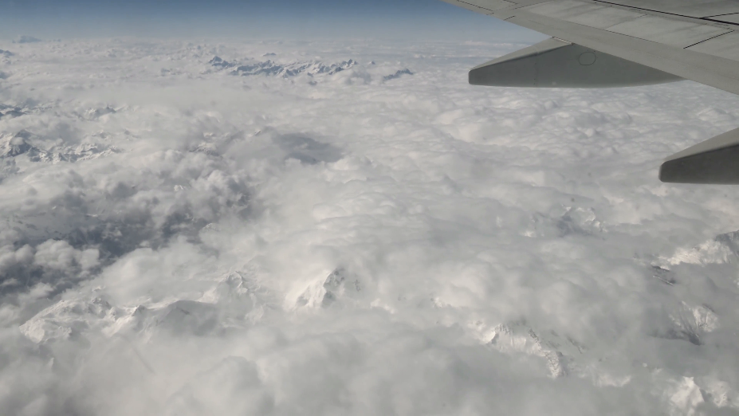
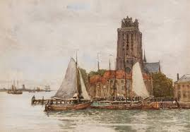
Amsterdam
At 4pm, on Sat., we flew from Rome Airport to Brussels, Belgium – we could see the Alps below!
Then we took a 7pm train from Brussels to Rotterdam,
changing quickly to another train to Amsterdam,
It was dark all the way! We arrived Amsterdam 9:37pm.
In Dordrecht, in the dark, I saw a huge cathedral on a very large river. Here is a painting of it by Robert Allen, the 19th century Scottish painter.

Slide 22
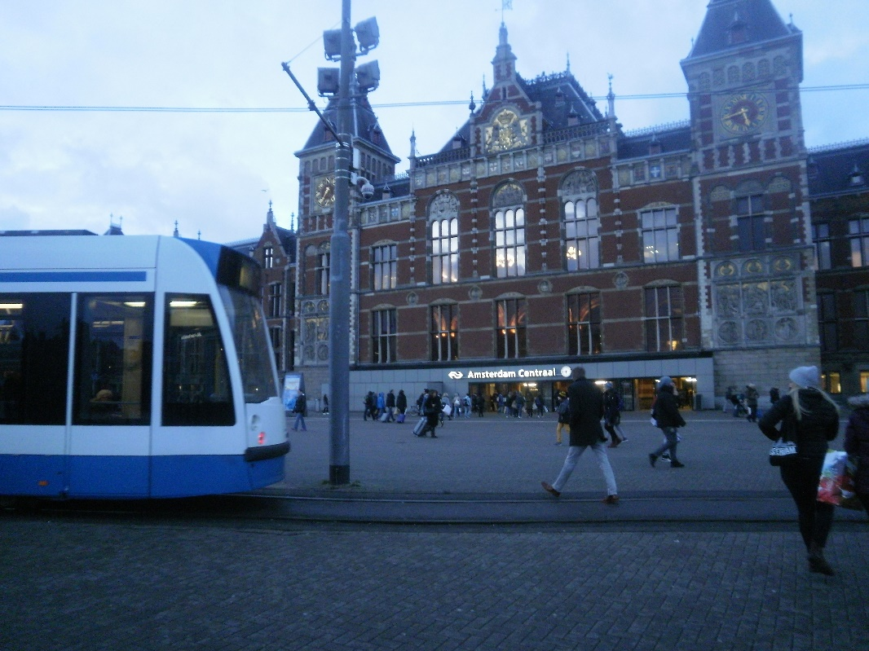
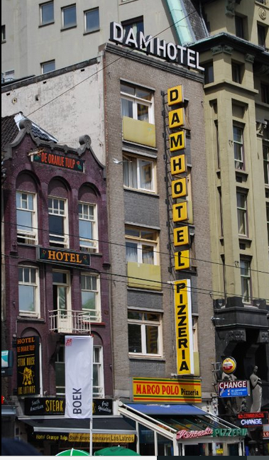
Amsterdam
DAM HOTEL &
MARCO POLO RESTAURANT
Our first hostel was the Dam Hotel,
very close to the train station.
We had to climb extremely steep
steps to get to the second floor,
where a tiny elevator took us up
one more flight!
We had dinner at the Marco Polo
restaurant below the hotel. So
delicious and lively.
We were very happy to arrive in downtown Amsterdam!
Train Terminal, Amsterdam
P.S. Thank you, Jamie, for carrying
my big bag up those steps!

Slide 23
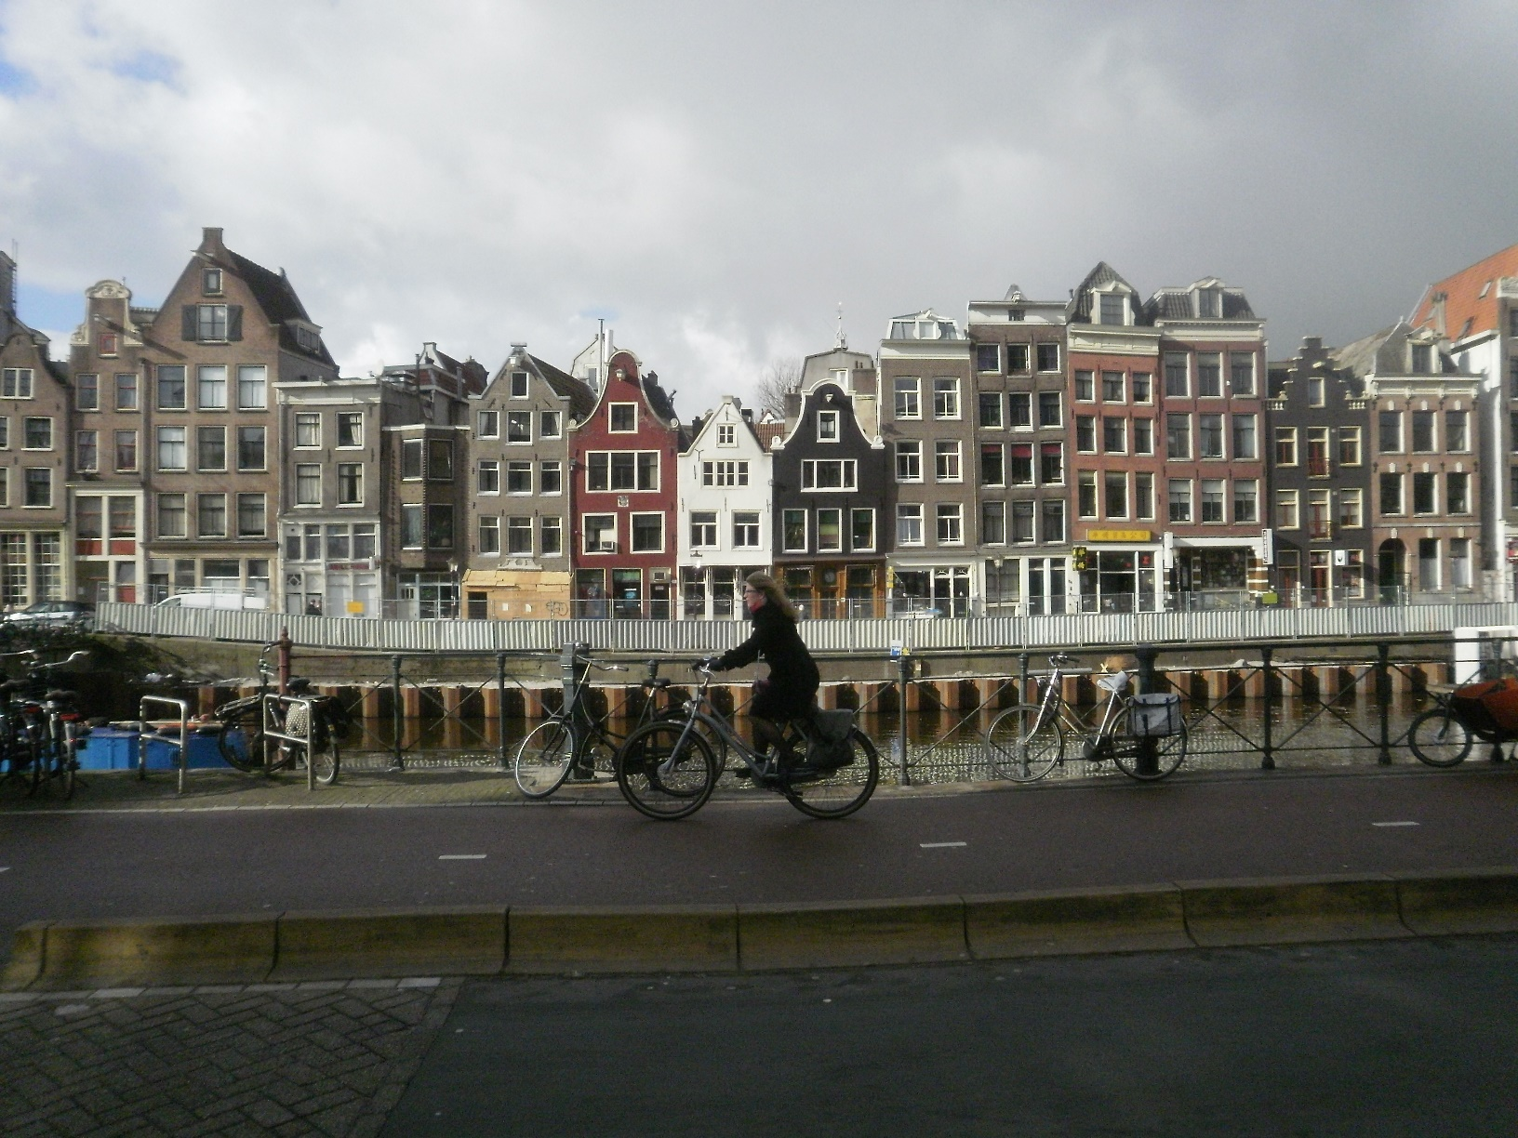
Amsterdam
Amsterdam is full of canals and tall, thin houses and people
riding their bicycles!
Each year thousands of bicycles are fished out of the canals!

Slide 24
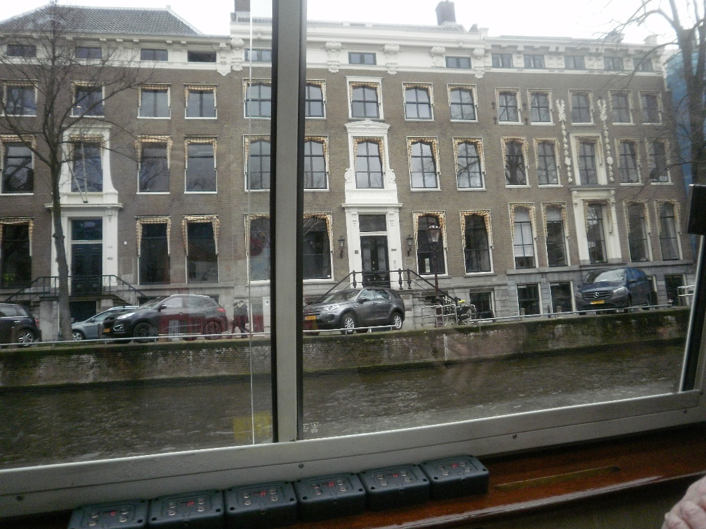
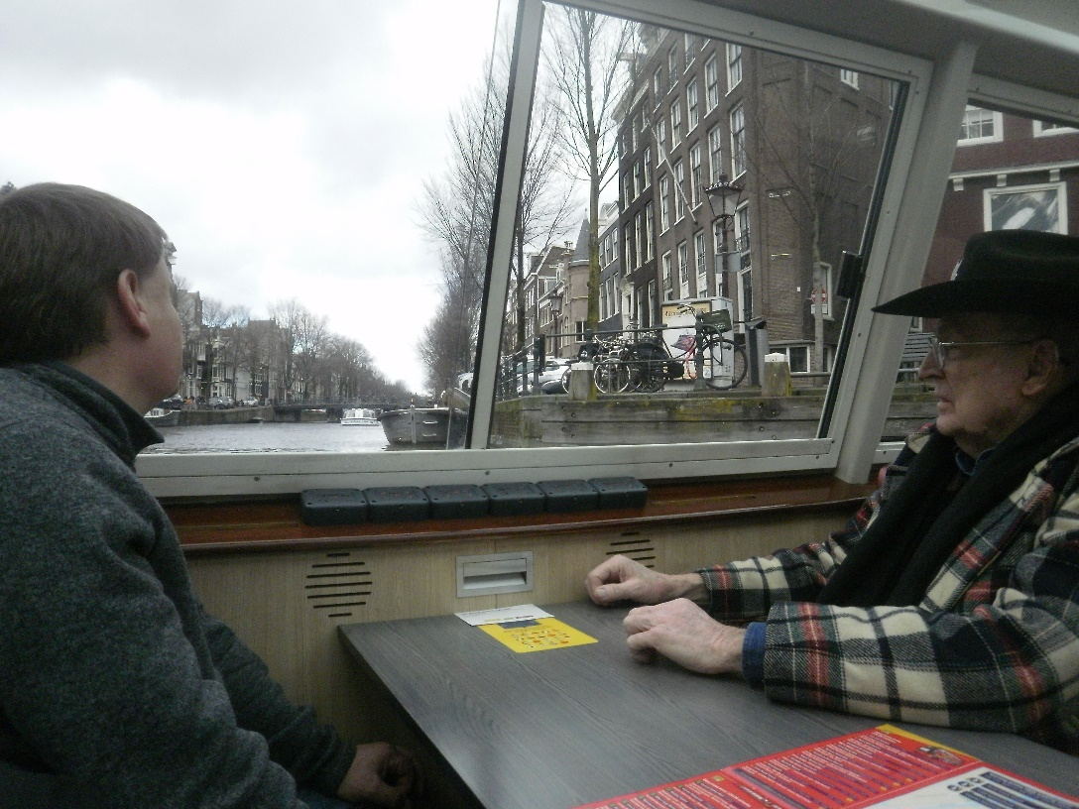
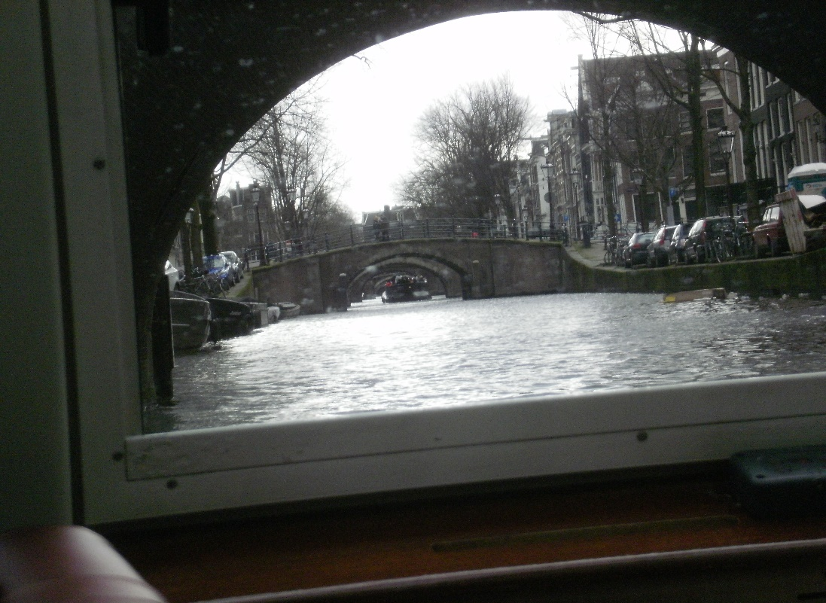
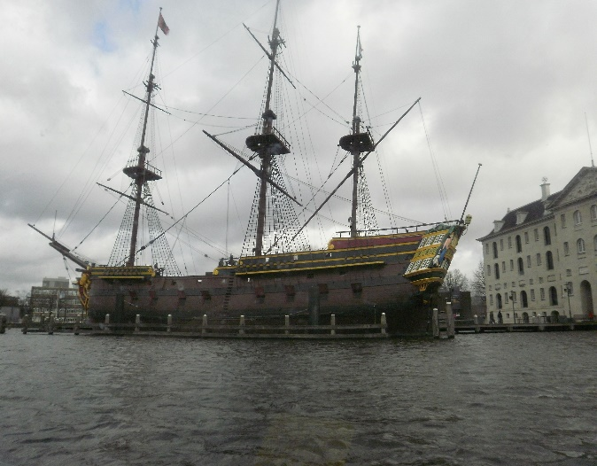
Amsterdam
The next day, Sunday, was Bob’s last day before flying back to the United States.
We went sightseeing all day.
First, a trip on a canal boat, with a funny comic captain.

Slide 25
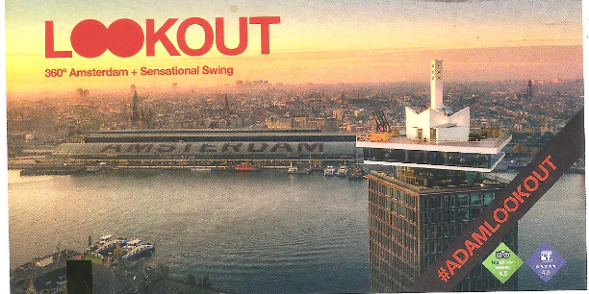
Amsterdam
The same day, Sunday, we took the free ferry across Amsterdam’s river IJ. -
Pronounce IJ like ‘ay‘ or ‘eye‘.
There is an observation tower on the other side of the river – it was fun.
RIVER IJ

Slide 26
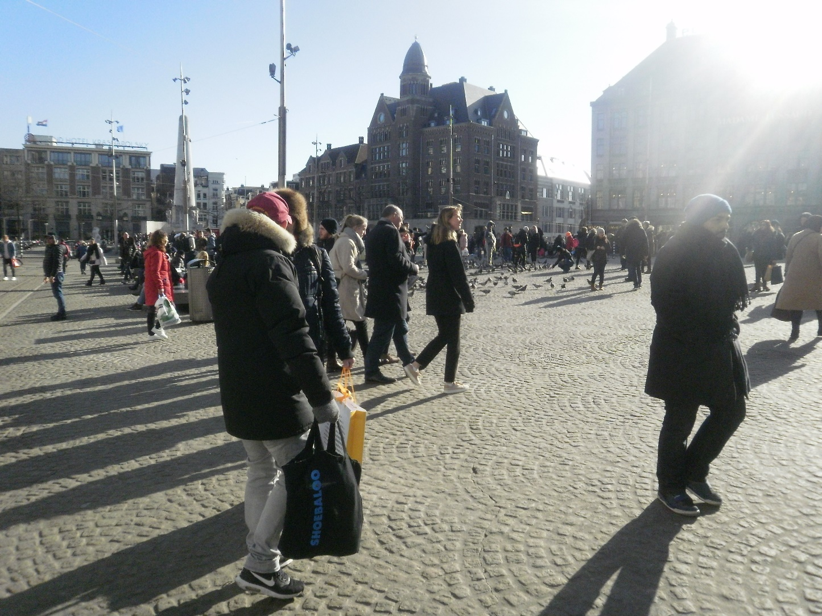
Amsterdam
Sunday night, Jamie and Sue went to the
nearby Dam Square to find a supermarket.
We got cheese, veggies, wine and spirits,
and returned back to our hostel to
celebrate with Bob our wonderful trip.
It was a farewell party for Bob, who was
flying the next morning back to the U.S.
It was fun! Thank you Bob and Jamie for
a wonderful trip.
DAM SQUARE

Slide 27
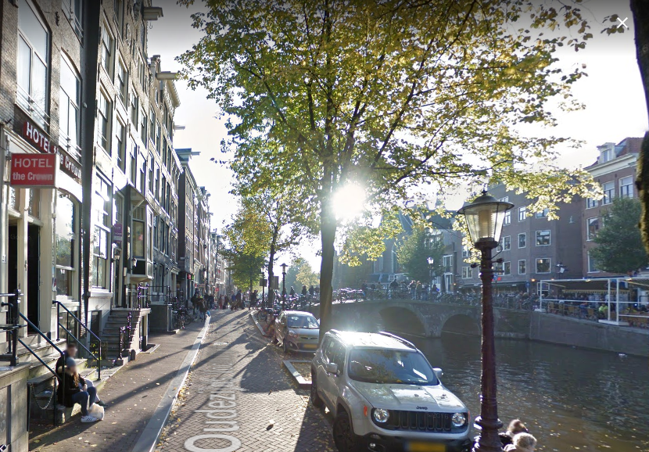
Amsterdam
Our room
Mon, Feb 12
Jamie and I continued our
Amsterdam vacation, by
moving to the Crown Hotel.
Our room was on the second
floor and looked out onto
the canal. It was a beautiful
view!
Monday night we went down
this block to find a bar/restaurant
with live ‘funk’ music. The 4
musicians were fantastic.
Thanks, Jamie, for sharing your
love of popular music.

Slide 28
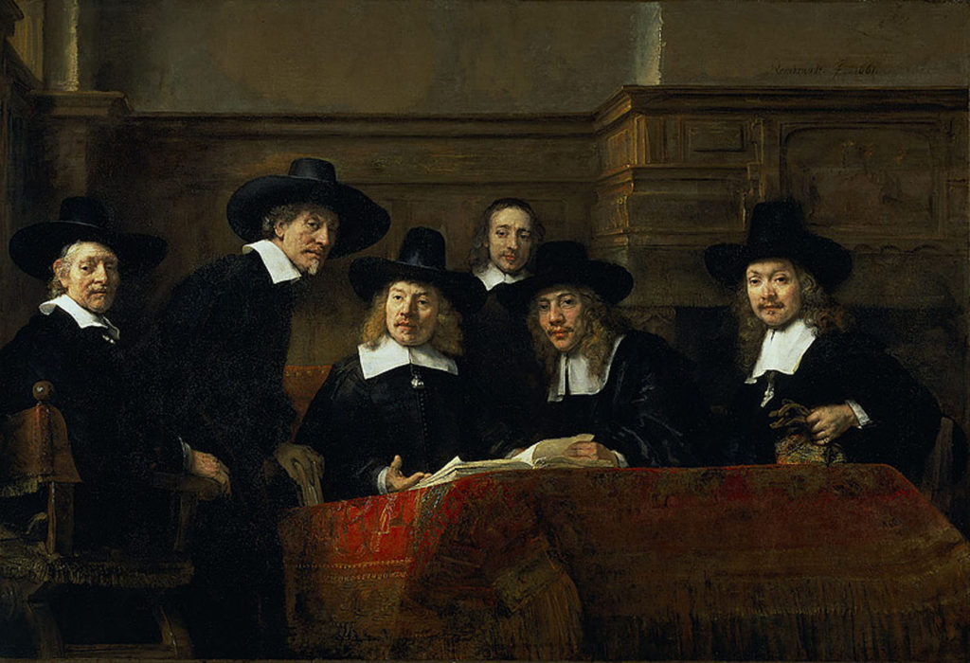
Amsterdam
Tues Feb 13
Jamie went to investigate some infrastructure in Amsterdam’s newer section, and I went to the Rijksmuseum, a Dutch national
museum.
I spent two hours in the ‘Gallery of Honour’ and found 24 artists
that were paid for their art by
the Dutch capitalists of the
17th century. Stephen Zarlenga
said about this period:
“Amsterdam… wrested control of the India trade from Portugal, developed Europe’s most powerful financial markets, and laid the exact foundations of modern capitalism.”
THE SYNDICS OF THE CLOTH GUILD, by Rembrandt

Slide 29
Amsterdam
Here are a few slides
from the LOST SCIENCE OF MONEY class
(http://infostation1.net/books/
Zarlenga, LOST SCIENCE OF MONEY)
(Needless to say, this history was
not found in the museum.)

Slide 30
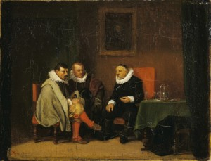
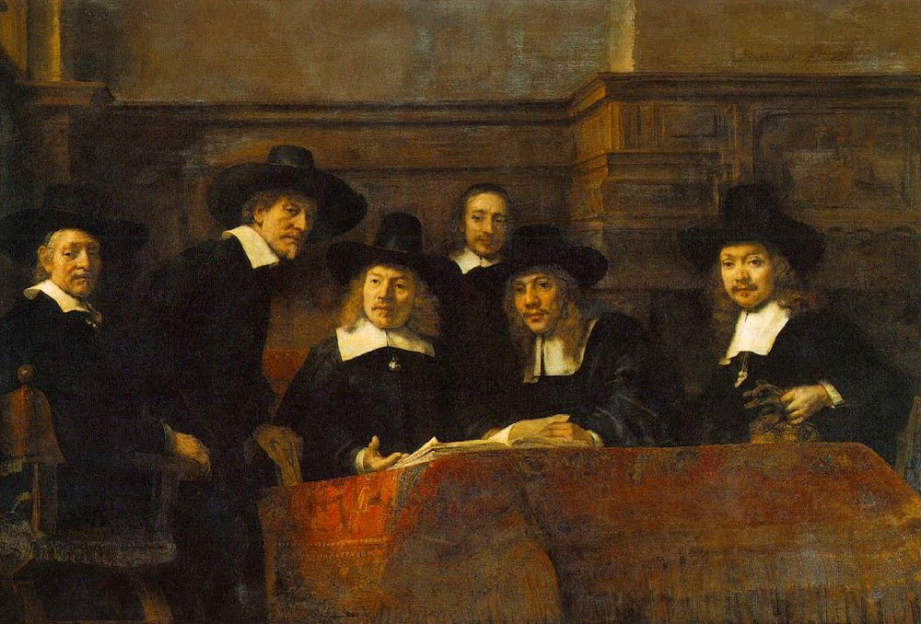
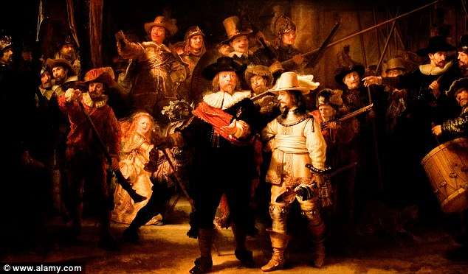
Nature of Capitalism http://infostation1.net/books
Alexander Del Mar, HISTORY OF MONETARY SYSTEMS, p. 330-331, published 1901
“The control of money,” says an eloquent writer on the subject, “is the ground upon which an international or cosmopolitan combination ‘finances’ the world and ‘farms’ humanity.“
“… the enrichment of a class, who know only how to scheme, to undermine and to appropriate the earnings of mankind…

Slide 31
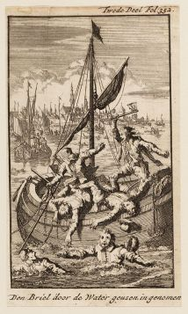
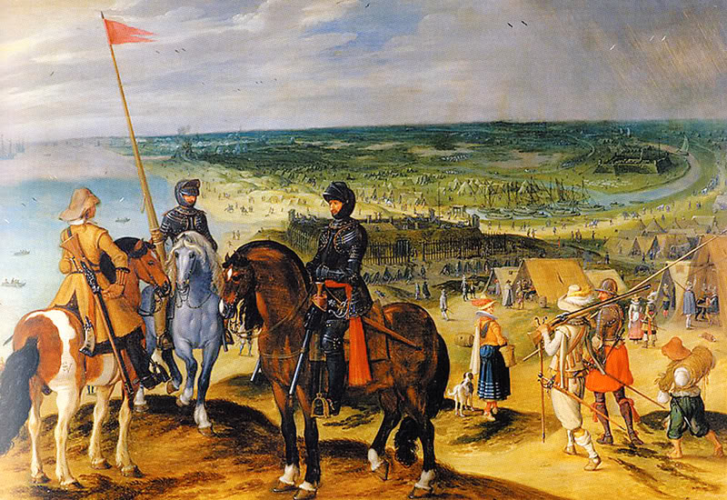
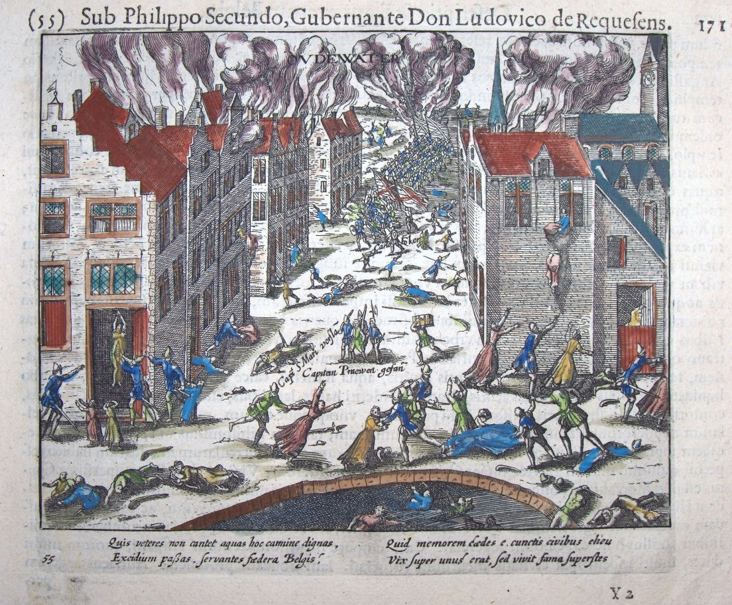
AMSTERDAM’S FINANCIAL SYSTEM (CAPITALISM) http://infostation1.net/books
TRADING WITH THE ENEMY:
NO CONSIDERATION OF PATRIOTISM OR NATIONALISM – THEY WERE INTERNATIONALIST
DURING WAR WITH SPAIN:
AMSTERDAM MERCHANTS TRADED WITH THE ENEMY
AMSTERDAM MERCHANTS INVESTED IN PRIVATEERS
WHICH PREYED ON DUTCH SHIPPING

Slide 32
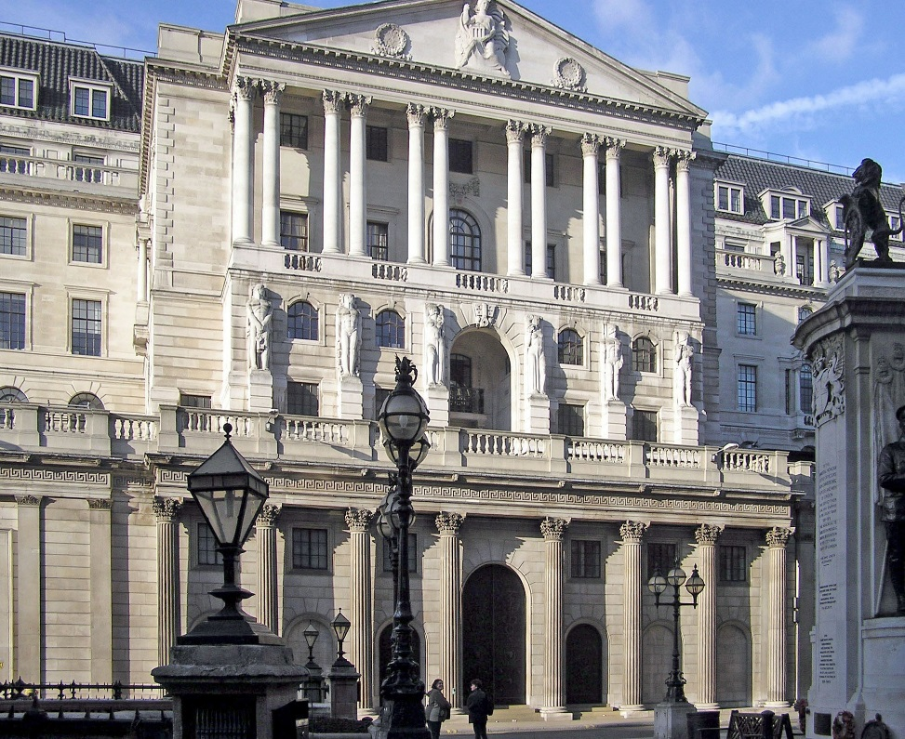
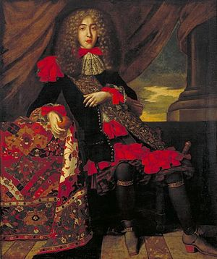
Holland financed England http://infostation1.net/books
THE BANK OF ENGLAND (1694) WAS FLOATED WITH DUTCH CAPITAL
DUTCH BANKERS WERE ITS LARGEST STOCKHOLDERS AND CUSTOMERS IN 1760
A SMALL BUT IMPORTANT GROUP OF Dutch traders and financiers, migrated to London:
Christian, Jew, Huguenot
via Holland
with international financial expertise
BANK OF ENGLAND
Francisco Lopes Suassos, 1657 –1710,
was a banker and financier of the Dutch
Republic..

Slide 33
Amsterdam
THE BOLS MUSEUM
&
MONETARY REFORM IDEAS

Slide 34
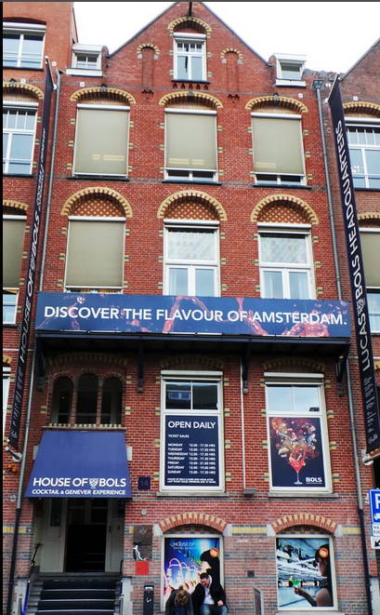
Amsterdam
A block away from the Rijksmuseum is the House of Bols,
a museum created by the Bols Company to explain the
history of their liqueurs. At the end of the self-tour, you
get the cocktail of your choice, made from Bols spirits, of course!
Now, I would not have thought to sightsee this particular venue,
but my osteopath back in New York had said he found it very
‘enlightening’ and made a point to encourage me to go. So Jamie
and I went.
And there was a surprise there for monetary reformers.

Slide 35
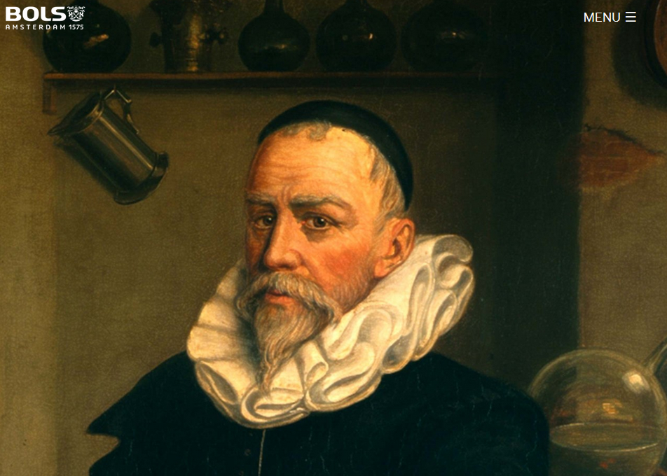
Amsterdam
MUSEUM HISTORY
LOST SCIENCE OF MONEY HISTORY
The grandson of the Bols founder, as a major shareholder in the Dutch East India Company, was not only shipping spices back from the East Indies, but also gold. The silver of Europe was shipped to the East for gold, since silver bought twice as much gold in the East, than in Europe.
The Bank of Amsterdam (supposedly only a deposit bank) was secretly creating money by loaning to the Dutch East India Company, as well as carrying on illegal trade in precious metals.

Slide 36
Amsterdam
End
Week 2: Rome, Amsterdam

