Slide 1
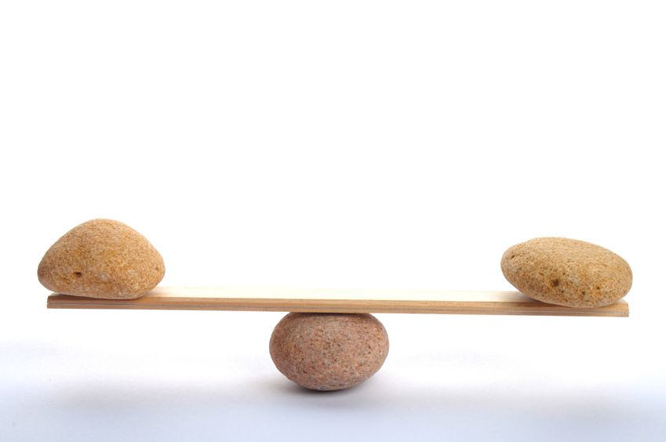
EQUITABLE TRADE
NOT CORPORATE TRADE

Slide 2
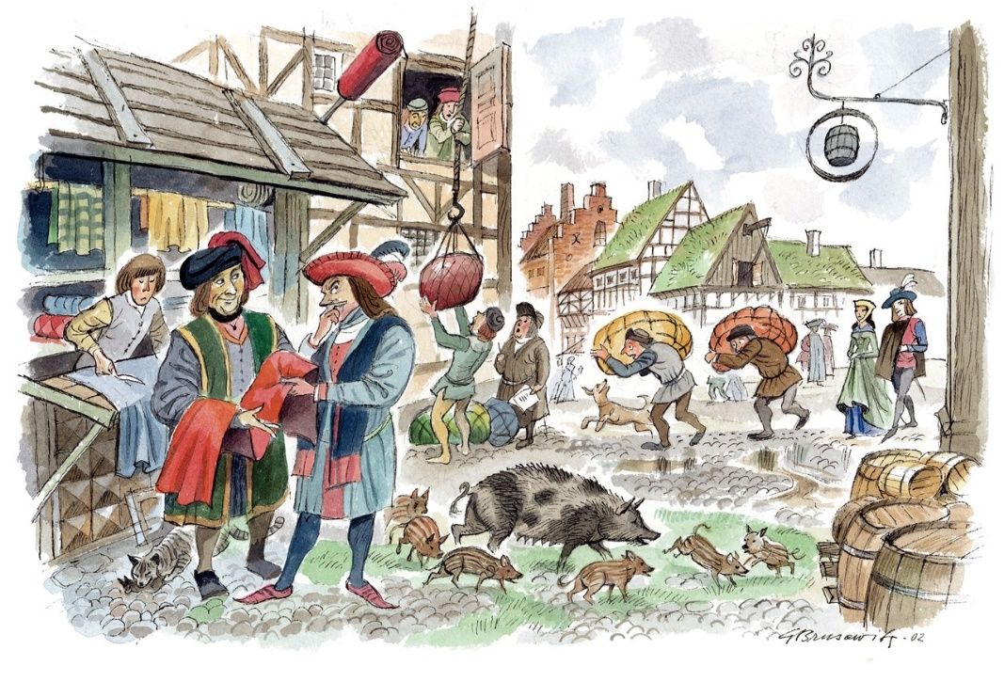
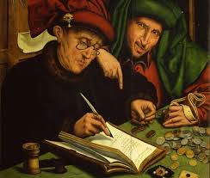
ORIGIN OF BANKING
TODAY’S BANKING DEVELOPED FROM TRADE
TRADE HAS TWO PARTS:
THE GOODS & THE MONEY
GOODS
MONEY

Slide 3
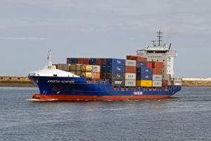
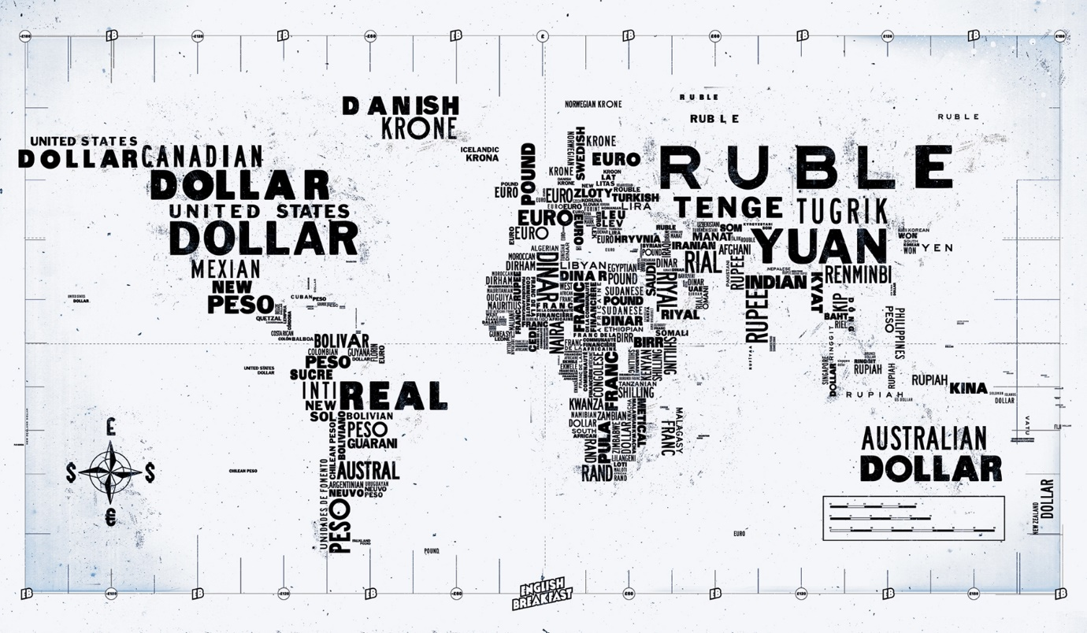

ORIGIN OF BANKING
TODAY’S BANKING DEVELOPED FROM TRADE
CLEARLY, MONEY AND GOODS ARE NOT THE SAME THING.
GOODS ARE WEALTH.
MONEY IS NOT WEALTH.

Slide 4
ORIGIN OF BANKING
TODAY’S BANKING DEVELOPED FROM TRADE
Three parts of the trading system -- production, transfer, and consumption of goods -- were concrete and clearly visible to the ordinary citizen.
BUT… the operations of banking and finance were concealed, scattered, and abstract so that they appeared to many to be difficult.
Such is true to the current day.
GOODS
MONEY

Slide 5
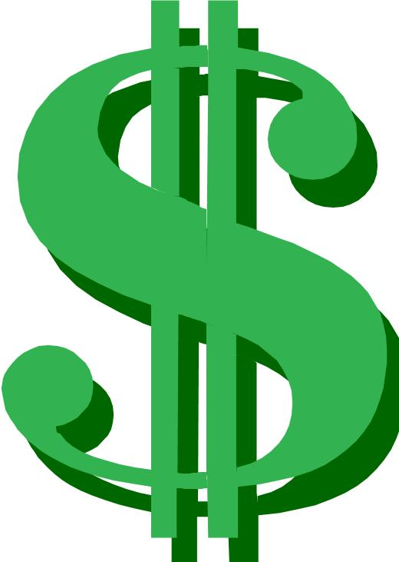
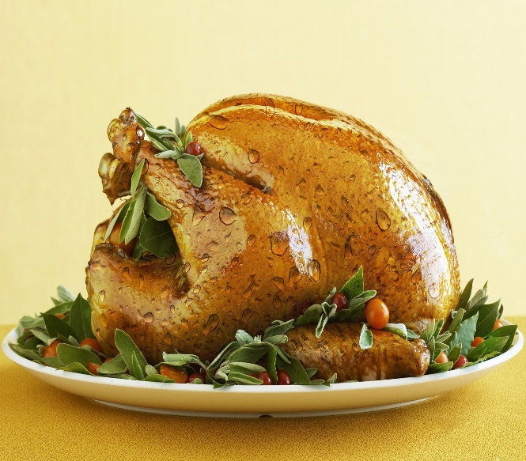
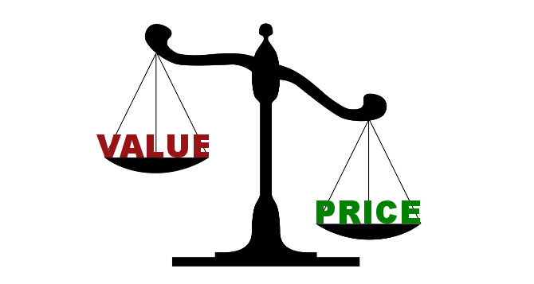
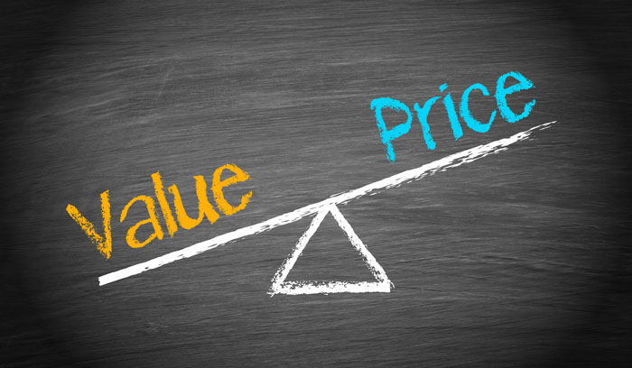


ORIGIN OF BANKING
TODAY’S BANKING DEVELOPED FROM TRADE
GOODS AND MONEY ARE RELATED -- THEY MOVE IN OPPOSITE DIRECTIONS
When the price of goods goes DOWN….
the value of money goes UP.
When the price of goods goes UP….
the value of money goes DOWN.
PRICE
VALUE
VALUE
VALUE
PRICE

Slide 6
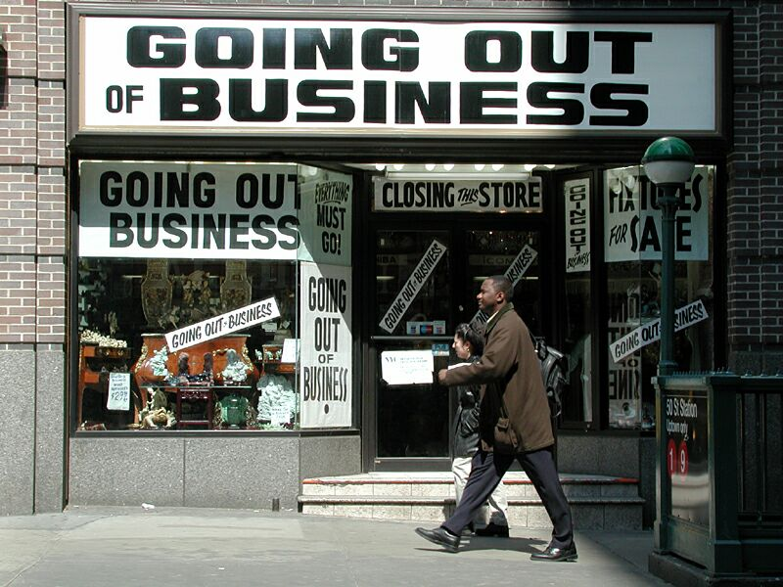
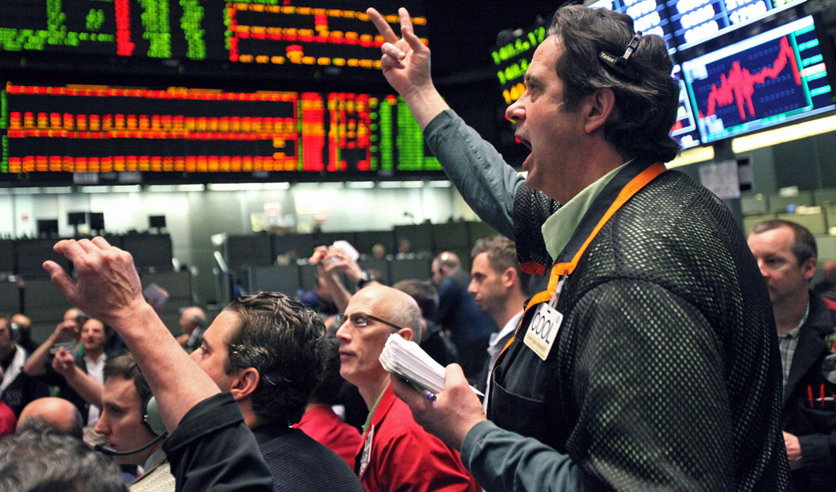
ORIGIN OF BANKING
TODAY’S BANKING DEVELOPED FROM TRADE
INTERNATIONAL BANKERS MANIPULATE THE PRICE –
BY MANIPULATING THE SUPPLY OF MONEY
Bankers cause deflation, by ‘calling in their loans’, which takes bankmoney out of circulation.
Bankruptcy for the producers. Unemployment for labor.
Profits for the bankers.
Bankers cause inflation, by ‘creating too many loans’, which adds bankmoney into circulation.
Profits for the bankers: more loans as the bubble inflates; foreclosures when the ‘bubble’ bursts.

Slide 7
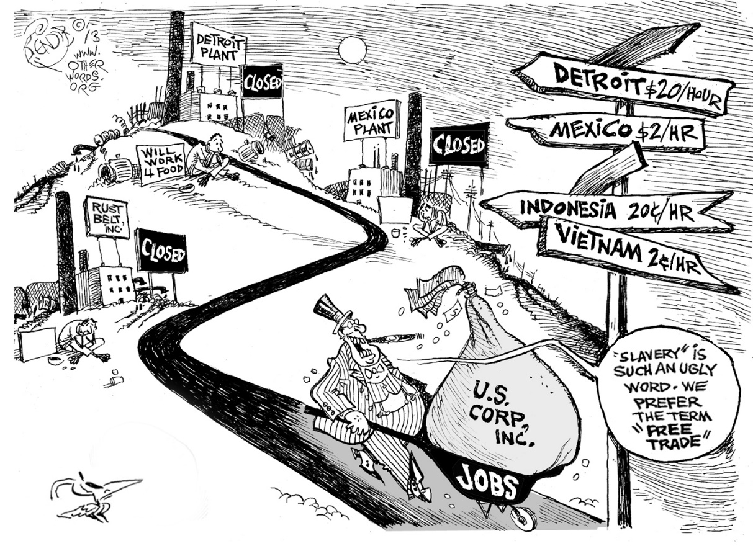
Today’s Situation
SLAVE TRADE
Multinational corps. rig trade to their profit at the expense of third world nations, calling it “free” trade.

Slide 8

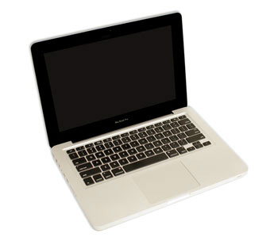
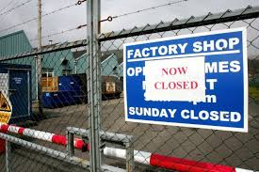
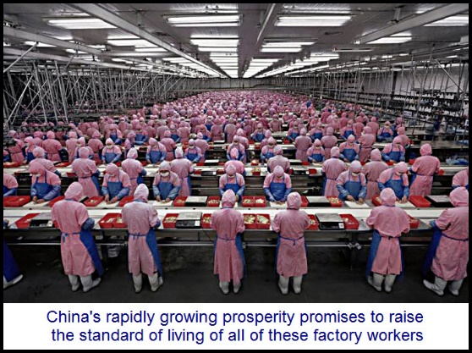
‘FREE’ TRADE IMPORTER:
But, look, how much cheaper for me
to buy from the Chinese!
U.S. IMPORTER
$5
$10
CLOSED
CLOSED AMERICAN FACTORY
& UNEMPLOYMENT
CHINESE-MADE COMPUTER
& SLAVE LABOR

Slide 9
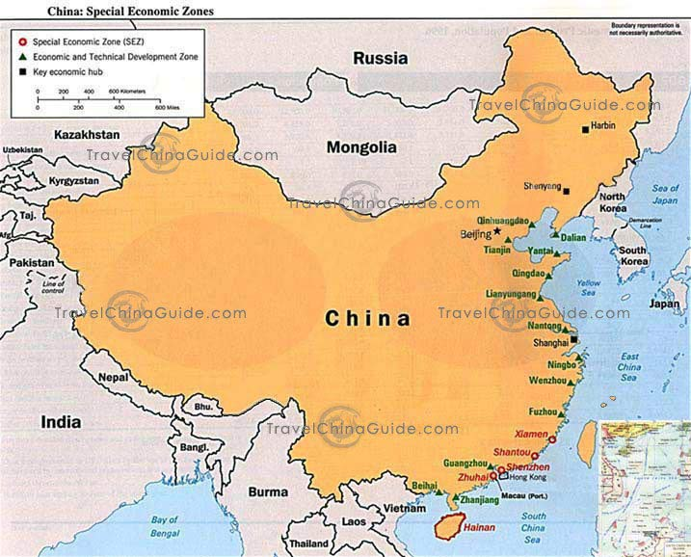
‘FREE’ TRADE IMPORTER:
But, look, how much cheaper for me
to buy from the Chinese!
U.S. IMPORTER
-$10
-$5
$10 OF INCOME WAS NOT MADE IN U.S.
$5 LEAVES THE U.S.
CHINA
- $15 OF U.S. MONEY WAS LOST TO OUR ECONOMY

Slide 10
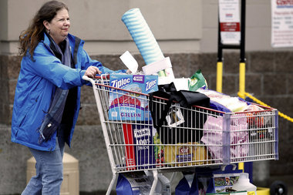
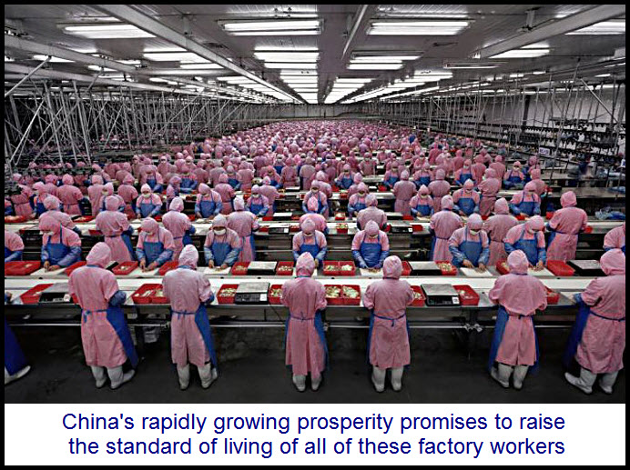
PSYCHOLOGY OF ‘FREE’ TRADE
I’m unemployed and I’m in debt …so thank goodness for cheap prices!
$5
U.S. CONSUMER
CHINESE-MADE COMPUTER
& SLAVE LABOR

Slide 11
WHAT IS EQUITABLE TRADE?
BASED ON RESPECT FOR OURSELVES AND OUR TRADING PARTNERS

Slide 12
WHAT IS EQUITABLE TRADE?
ENCOURAGES DOMESTIC PRODUCTION

Slide 13
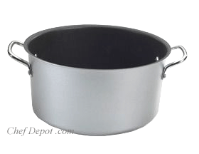
HOW?
$5
IMPORT-EXPORT
TARIFF FUND

Slide 14
HOW?
U.S. IMPORTER PAY $ INTO FUND: TO BUY FOREIGN GOODS (AT AMERICAN PRICES)
FOREIGN IMPORTER TAKE $ FROM FUND: TO BUY AMERICAN GOODS (AT AMERICAN PRICES)
$5
IMPORT-EXPORT
TARIFF FUND
IF U.S. IMPORTER BUYS A FOREIGN GOOD,
TARIFF FUND ENCOURAGES FOREIGN IMPORTER TO BUY U.S. GOOD

Slide 15


TARIFF FUND
U.S. IMPORTER --
PAYS MONEY INTO FUND
$5
U.S. IMPORTER
$5
CHINESE COMPUTER
IMPORT-EXPORT
TARIFF FUND
$5
AMERICAN COMPUTER
FOREIGN EXPORTER –
USES MONEY FROM FUND
CHINESE IMPORTER

Slide 16
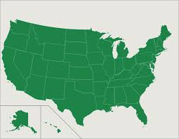
EQUITABLE TRADE
‘FREE’ TRADE IMPORTER:
NOW THAT THE CHINESE PRICE IS THE SAME AS THE U.S. PRICE ….
I AM GOING TO BUY FROM MY PRODUCERS
U.S. IMPORTER
+$10
$5
$5
IMPORT-EXPORT
TARIFF FUND
CHINA
$10 IS MADE IN U.S.
$10 OF U.S. MONEY WAS GAINED BY OUR ECONOMY

Slide 17
EQUITABLE TRADE
‘FREE’ TRADE IMPORTER:
SINCE THERE IS MONEY IN THE TARIFF FUND, I CAN USE IT TO REDUCE MY COST FOR THAT
AMERICAN GOOD. I WILL BUY FROM THE U.S.
TAILOR IN U.S.
GETS MONEY
CHINESE IMPORTER
$5
+$10
$5
CHINA
IMPORT-EXPORT
TARIFF FUND
$5
$10 IS MADE IN U.S.
$10 OF U.S. MONEY WAS GAINED BY OUR ECONOMY

Slide 18
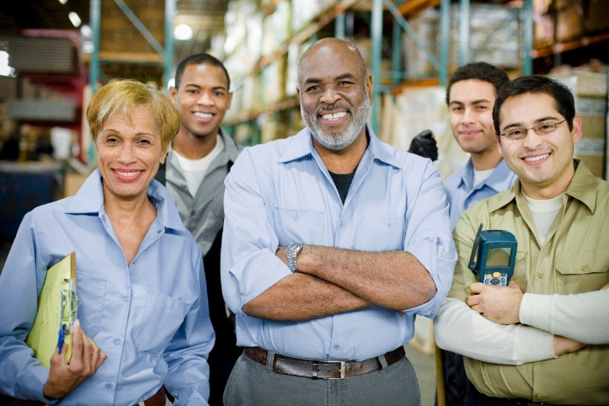
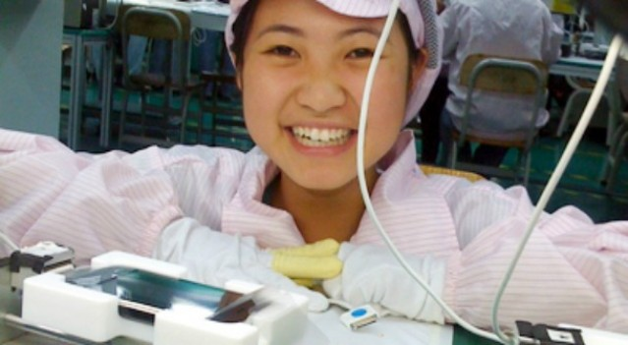

WHAT IS EQUITABLE TRADE?
HAPPY AMERICAN WORKERS
HAPPY CHINESE WORKERS

