Slide 1
The Power Elite’s 10 Strategies Opposing Monetary Reform
Greg Coleridge
American Monetary Institute
12th Annual Conference
October 1, 2016

Slide 2
To create change, one must develop…
A policy plan (laws, legislation, rules, regulations, platforms)
but also…
A strategic plan (strategy -- how to actualize, create, make real, bring to life)

Slide 3
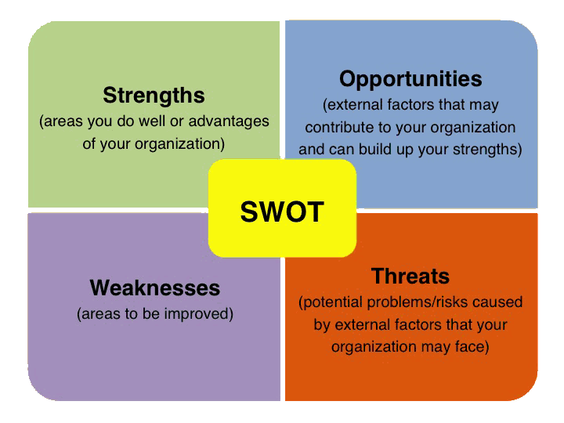
Many components to developing a strategic plan
Power analysis
SWOT:
Strengths,
Weaknesses,
Opportunities,
Threats

Slide 4
Threats to Real Monetary Reform
Individuals, organizations and conditions that are barriers to change
Individuals who and organizations that benefit from status quo
Concerning monetary issues: Financial institutions/leaders and those that do their bidding (politicians, academics, media, nonprofits heads at the top of the apex) = the Power Elite.

Slide 6
Power Elite’s 10 Strategies Opposing Monetary Reform
1. Ignore

Slide 7
Power Elite’s 10 Strategies Opposing Monetary Reform
Ignore
There is only one thing in life worse than being talked about, and that is not being talked about. - Oscar Wilde
To ignore is to deny its existence.
Facts are facts even if ignored.
A spark neglected makes a mighty fire. - Robert Herrick
Monetary Reform examples: media blackout on questions of debt, job creation, stimulating economy, repairing infrastructure, Fed problems.

Slide 8
Power Elite’s 10 Strategies Opposing Monetary Reform
Ignore
Demean

Slide 9
Power Elite’s 10 Strategies Opposing Monetary Reform
Demean
Criticize. Laugh at. Minimize. Smear.
Now a threat. Forced to be noticed – on public radar.
Monetary Reform examples: Unqualified. Anti-semitic. Goldbug. Conspiratorial. Part of cabal with crazy preppers. Radicals Kucinich/Conyers introduced it.

Slide 10
Power Elite’s 10 Strategies Opposing Monetary Reform
Ignore
Demean
Distort

Slide 11
Power Elite’s 10 Strategies Opposing Monetary Reform
Distort
Misrepresent. Claim something different that what you believe or promote.
Monetary Reform Examples: Only concerned about printing money out of thin air. Hyperinflation.
Opportunity to correct/truth telling.

Slide 12
Power Elite’s 10 Strategies Opposing Monetary Reform
Ignore
Demean
Distort
Distract

Slide 13
Power Elite’s 10 Strategies Opposing Monetary Reform
Distract
Focus on unimportant, minor, frivolous, tangential.
May be related or completely unrelated to issue (i.e. stuff, entertainment)
Monetary Reform examples: Helicopter money. Bank reform v. monetary reform. End the Fed.

Slide 14
Power Elite’s 10 Strategies Opposing Monetary Reform
Ignore
Demean
Distort
Distract
Coerce

Slide 15
Power Elite’s 10 Strategies Opposing Monetary Reform
Coerce
Use leverage:
cut funding
reduce access to information, groups, power-holders
pressure employers (i.e. media, colleges/ universities)
Monetary Reform examples: Pressure on profs from Fed/Banks, bank ads to media corpses.

Slide 16
Power Elite’s 10 Strategies Opposing Monetary Reform
Ignore 6. Coopt
Demean
Distort
Distract
Coerce

Slide 17
Power Elite’s 10 Strategies Opposing Monetary Reform
Coopt
Cherry pick message/frame (democratize/sovereign money) “Reform” when in fact “deform.”
Or plan (make central bank publicly accountable, ala BOE)
Or leaders/thinkers (promotions, jobs, money, status, access)

Slide 18
Power Elite’s 10 Strategies Opposing Monetary Reform
Ignore 6. Coopt
Demean 7. Conquer – divide &
Distort
Distract
Coerce

Slide 19
Power Elite’s 10 Strategies Opposing Monetary Reform
Conquer (Divide & Conquer)
Deliberate effort to split groups & individuals over real or artificial issues, personalities, turf.
Weakens solidarity, uses up energy and time, distracts away from external threat(s).
Monetary Reform examples: ?

Slide 20
Power Elite’s 10 Strategies Opposing Monetary Reform
Ignore 6. Coopt
Demean 7. Conquer – divide &
Distort 8. Outlaw
Distract
Coerce

Slide 21
Power Elite’s 10 Strategies Opposing Monetary Reform
Outlaw
Proposed reforms/alternatives/strategies are simply ruled illegal/unconstitutional.
General economic/financial examples from past/present: illegal holding of gold, abolish cash, illegal protests (zones), no secondary boycotts.

Slide 22
Power Elite’s 10 Strategies Opposing Monetary Reform
Ignore 6. Coopt
Demean 7. Conquer – divide &
Distort 8. Outlaw
Distract 9. Abuse
Coerce

Slide 23
Power Elite’s 10 Strategies Opposing Monetary Reform
Abuse
Physical violence: beat up, jail, torture, assassinate

Slide 24
Power Elite’s 10 Strategies Opposing Monetary Reform
Ignore 6. Coopt
Demean 7. Conquer – divide &
Distort 8. Outlaw
Distract 9. Abuse
Coerce 10. Neglect

Slide 25
Power Elite’s 10 Strategies Opposing Monetary Reform
Neglect
If and when serious problems explode and/or reform(s) succeed, last line of defense: refusal to or inadequately implement, monitor, fund program.
Financial examples: don’t prosecute banksters, inadequately fund regulatory agencies.

Slide 26
Power Elite’s 10 Strategies Opposing Monetary Reform
Ignore 6. Coopt
Demean 7. Conquer – divide &
Distort 8. Outlaw
Distract 9. Abuse
Coerce 10. Neglect

Slide 27
How to counter the Power Elite ?
Develop a strategic plan to create and maintain power
We must be just as committed to developed a strategic organizing plan for monetary change as we are to developing the policy plan for real monetary change.

Slide 28
Strategic Plan
3 Elements
1. Build mass movement
2. Create structures/institutions,
3. Develop/support local alternatives (programs, communities - not absolutely essential but extremely helpful).

Slide 29
Building Mass Movement
Goal – mass public support and active support
How? Civil resistance -- mass education, protest and persuasion, boycotts, resistance, disruption, escalation, create dramatic public tipping points that bring conflict to the surface.
Requirements – commitment to strategic planning, discipline (nonviolence), sacrifice

Slide 30
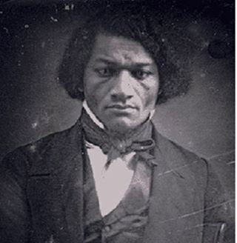
Frederick Douglas – on philosopy of reform
“The whole history of the progress of human liberty shows that… [i]f there is no struggle there is no progress. Those who profess to favor freedom and yet deprecate agitation are men who want crops without plowing up the ground; they want rain without thunder and lightning. They want the ocean without the awful roar of its many waters. This struggle may be a moral one, or it may be a physical one, and it may be both moral and physical, but it must be a struggle. Power concedes nothing without a demand. It never did and it never will.

Slide 31
“If you want to move the center, you have to pull from one end.”
- David Roberts, environmental journalist

Slide 32
Successful Civil Resistance Movements
U.S. Revolution Environmental protections
Abolishing slavery Ending Vietnam war
Populist reforms Occupy
Women’s rights Marriage equality
Labor rights Black Lives Matter
Civil Rights

Slide 33
Why is this essential?
System will face crisis…again…this time maybe fundamental.
Power Elites will lose credibility
A justice (economic and political) opening/vacuum will occur.
We must be prepared to move into that opening/fill that vacuum.

Slide 34
Why is this essential?
Plenty of ideas exist, but unless we’re in a position to control the levers of power, our plan won’t be implemented.
Rather – Power Elite will try to coerce, coopt, conquer (and divide), outlaw, abuse, neglect
Or the Power Elite will partially/totally collapse and is replaced by those who planned a mass civil resistance movement but who haven’t done the intellectual work of AMI/real monetary movement.

Slide 35
Why is this essential?
Either way, real monetary reformers will be (no pun intended) trumped.
Let us not only continue to work on strengthening our monetary policy plan, but also in earnest work on an strategic organizing plan.

Slide 36
Greg Coleridge
Director
Northeast Ohio American Friends Serivice Committee
gcoleridge@afsc.org
monetarycalendar@yahoo.com

