Slide 1
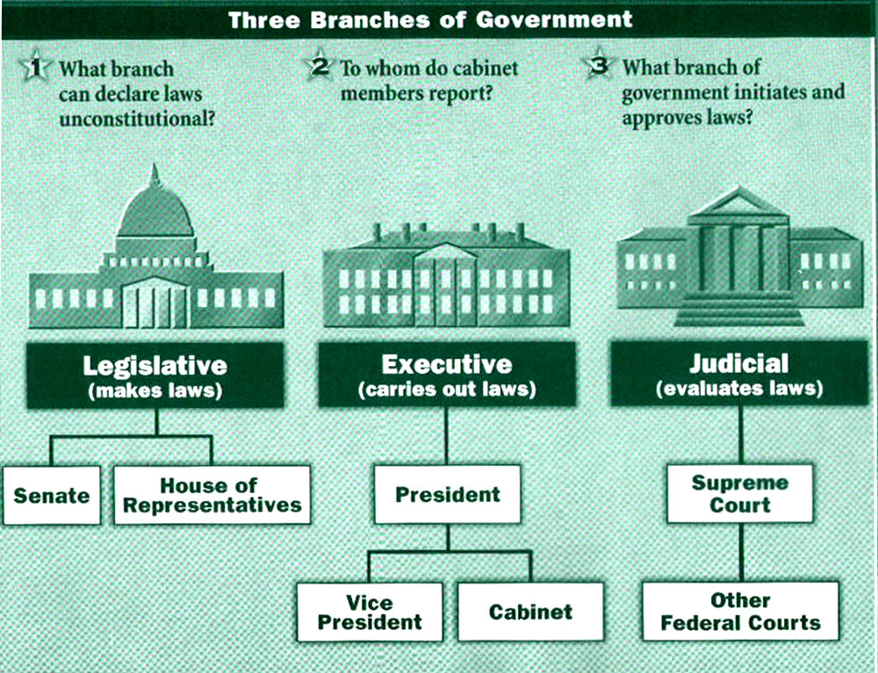

The Lost Science of Money
CHAPTER 24 – Part 1
PROPOSALS FOR U.S. MONETARY REFORM:
Toward a Fourth Branch of Government
Fourth Branch
Monetary
(creates money)
Monetary Authority

Slide 2
THEMES OF LOST SCIENCE OF MONEY BOOK
Primary importance of the money power (power to create money and regulate it)
Nature of money purposely kept secret and confused
How a society defines money determines who controls the society
Battle over control of money has raged for millennia: public vs private
The misuse of the monetary system causes tremendous misery and suffering for the ordinary people. Will & Martin, February 2014
Whenever the public has owned a significant fraction of the money power, great public benefit has ensued: Sparta, the Roman Republic, the American Colonies in the 18th century, GREENBACKS after the Civil War, Canada after the Great Depression, British experience after World War II. Martin, July 2014.

Slide 3
PARTS OF PRESENTATION
Introduction
Who Is Responsible?
Misdiagnosis of America’s Problems
Monetary Reform is Crucially Needed
Money’s Nature Must Dictate Monetary Reform
Distractions from Sovereign Money
  The Gold Promoters
  The “Free Banking” ideologues
  Local Currency (“Lets”) Advocates
  The “All Money is Debt” Faction
Governments Responsibility to Provide the Money
THE AMI STRATEGY: Reforming the Federal Reserve System
Reform #1: Nationalization of the Federal Reserve

Slide 4


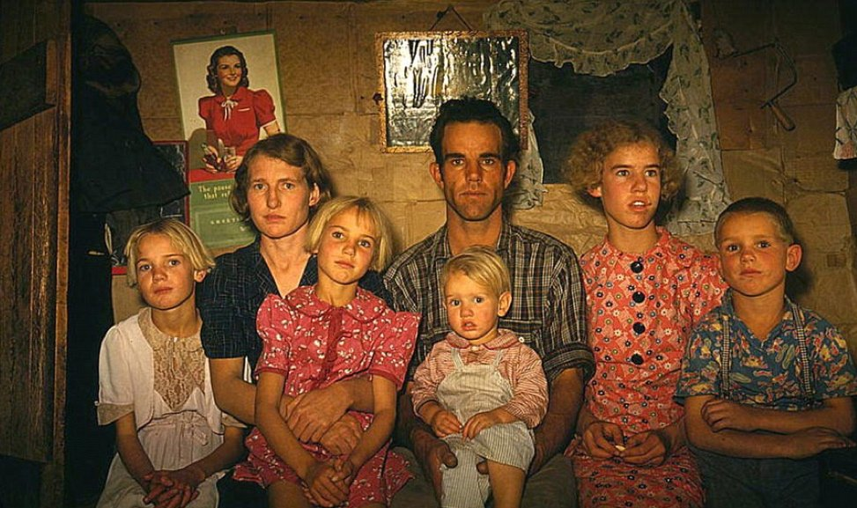
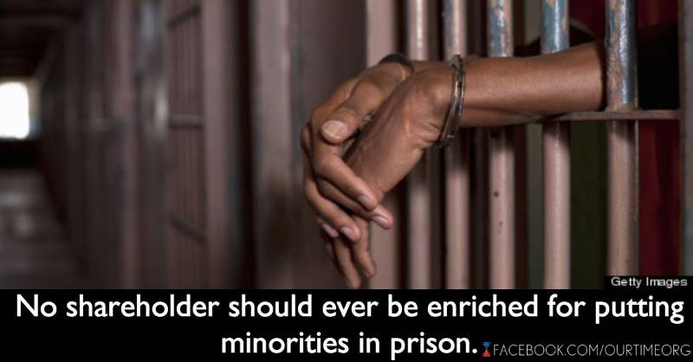
Introduction
The American monetary system is forcing
more and more Americans into poverty
Americans go further into credit card debt at ob-scene rates of interest, around 20%
Much of the crime arises from an inequitable
money system, rewarding the skill of financial
manipulation and not an honest day’s work
More working families slip into poverty
Drug and alcohol are used for escape
from a bleak existence
Growth of private prisons and
prison labor

Slide 5
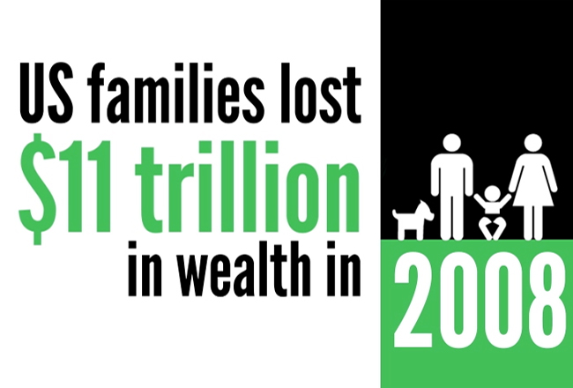
Who Is Responsible?
“Those in charge of the U.S. money system, and their predecessors, must bear a large part of the responsibility for this inequitable situation. They broke the banks in 1929-32 and would not re-establish the money supply except to make war. They proceeded to base the economy on the military industrial complex for five decades, amassing many thousands of thermonuclear weapons which could only be used if the Earth was being destroyed...
The banking disasters of Penn Central, Continental Illinois, Franklin National, and the B.C.C.I. among others, have kept U.S. banking fraud in the headlines over the years. The Savings and Loan scandals of the late 1980s and early 1990s were a direct result of their removal of government banking regulations, and finally cost the American taxpayers over $100 billion to bail them out.” Zarlenga, LSM, p. 653
And, more recently, the financial crisis of 2008-9…

Slide 6
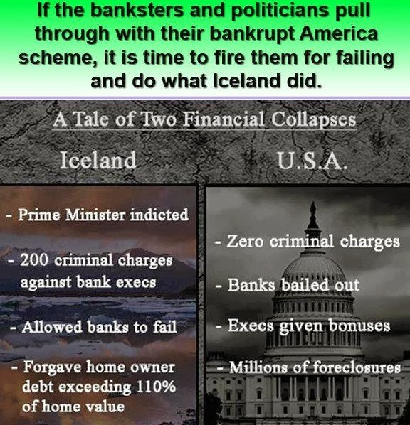
Who Is Responsible?
“It appears to be a pillar of the U.S. ‘justice’ system that the banking crime connected with these disasters must go essentially unpunished.” Zarlenga, LSM, p. 653

Slide 7

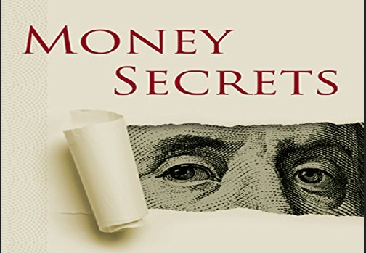
Misdiagnosis of America’s Problems
The nature of money is kept undefined and confused. Therefore, “the money system origin of so many of society’s serious problems” are “obscured”. Zarlenga, LSM, p. 653

Slide 8
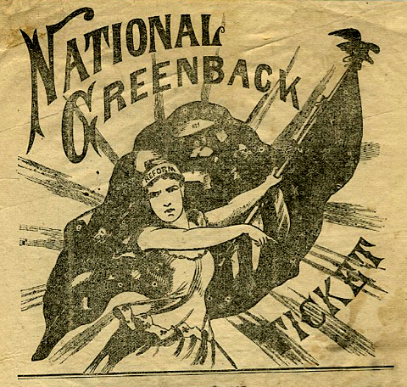
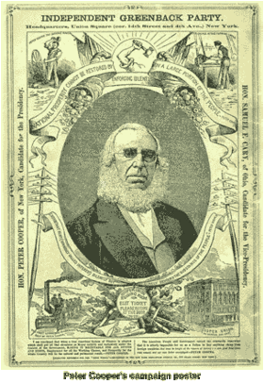
Misdiagnosis of America’s Problems
In the 19th century, the system of money was discussed in national politics. Huge national movements of third parties, like the Greenback-Labor Party, discussed the monetary system and made it the major issue.
PETER COOPERS CAMPAIGN POSTER

Slide 9
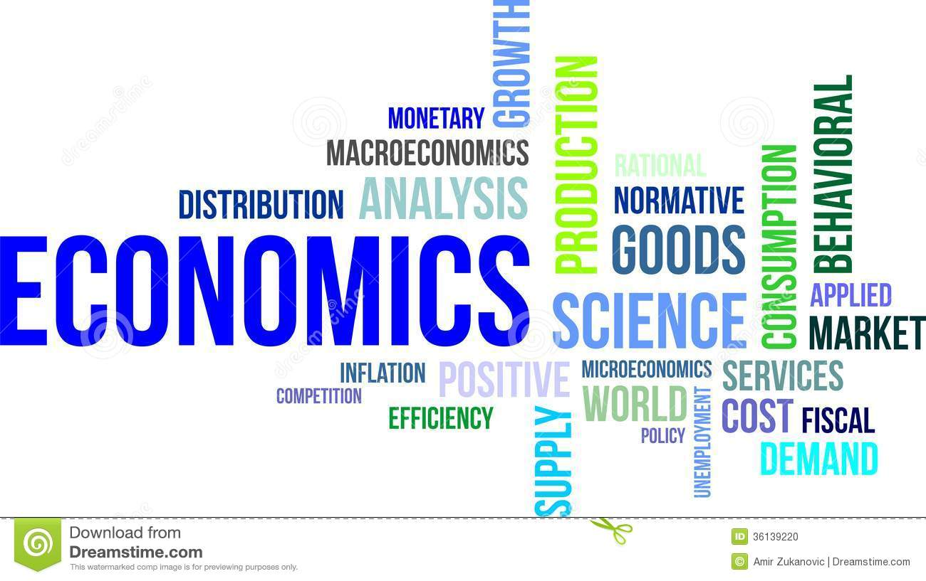
Misdiagnosis of America’s Problems
Today, if economists mention money, they discuss it simply as a veil over the real economy. This mis-education allows the private control of the money system to grow and grow.
ECONOMISTS DO NOT DISCUSS THE MONEY
CAN YOU FIND THE WORD ‘MONEY’ IN THEIR
LEXICON?
⬅ ⬅ ⬅

Slide 10
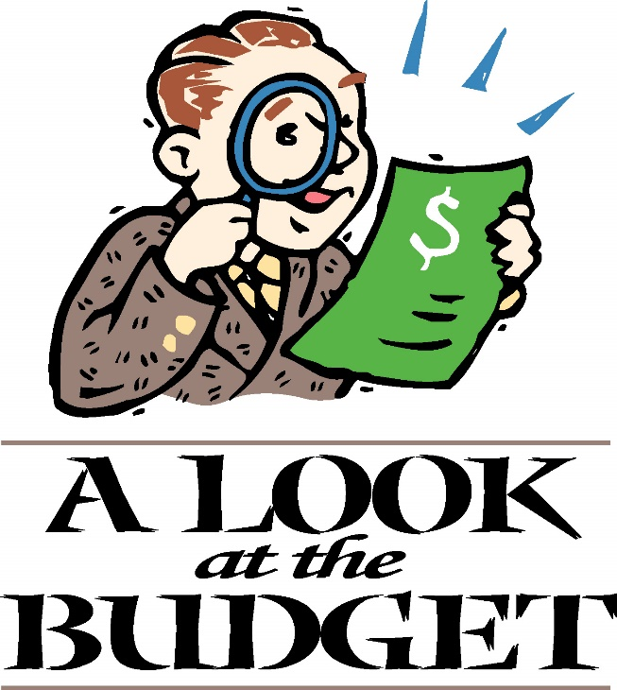
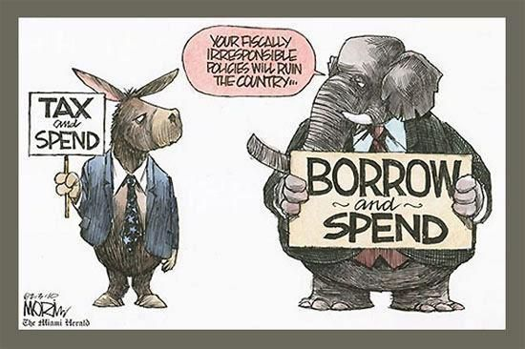

Misdiagnosis: Federal Budget and Debt
The American public is told the government must balance income and expenses, like a household. The government must either tax or borrow, if it needs more money.

Slide 11
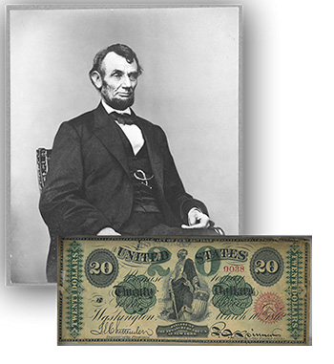
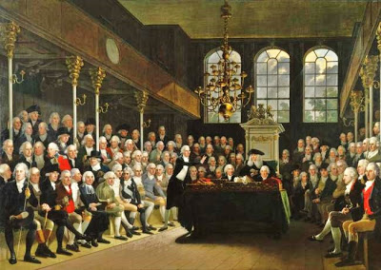
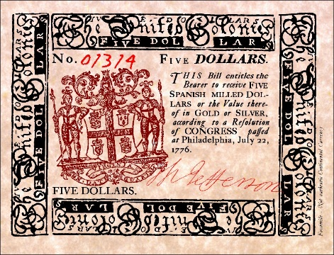
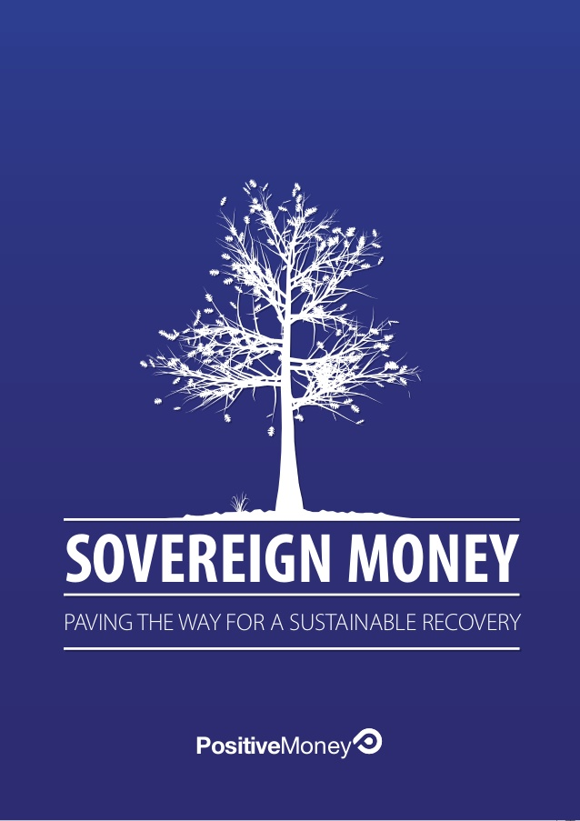
Misdiagnosis: Federal Budget and Debt
But the government is not a household! The government has the power and responsibility of issuing debt-free money for the public good. Creating it and spending it for public needs.
GOVERNMENT DEBT-FREE MONEY CREATION
In the U.S. colonies, all colonial legislatures
issued colonial paper currency. The colonies
thrived on this debt-free money. It was
called colonial script.
Lincoln funded the Civil War with
congressional-issued debt-free paper
money called Greenbacks, rather than
borrow at high interest from the big
banks.

Slide 12
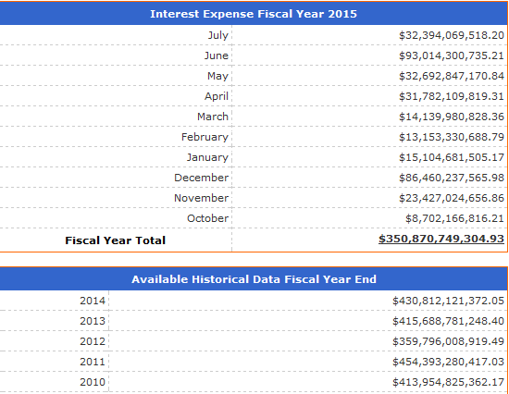
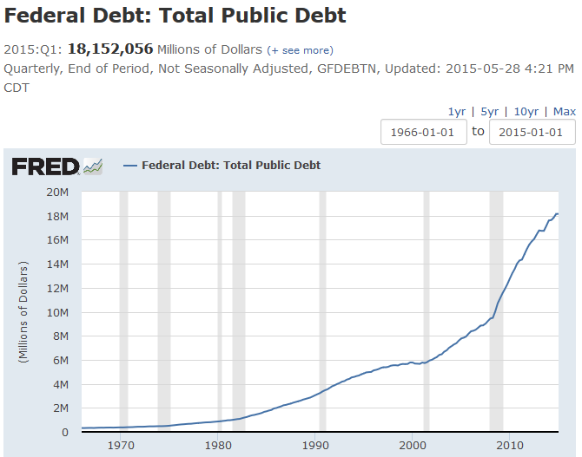
Misdiagnosis: Federal Budget and Debt
The current level of government debt cuts into the ability of our government to spend for the public good. The interest on the national debt soon will become the biggest item in the government’s budget.
But our government does not have to borrow money, because it has, according to the U.S. Constitution, the power to create money.
2015 = $18 TRILLION DOLLARS

Slide 13
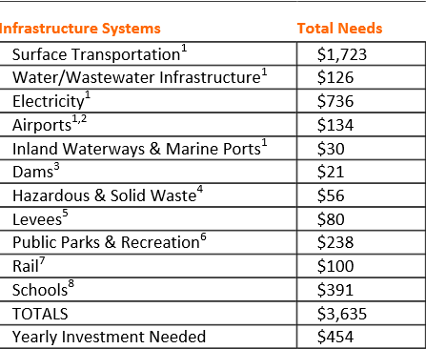
Misdiagnosis: Deterioration of the American Infrastructure System
“Again this results from not understanding that money should be created by government for such expenditures. Infra-structure spending is an excellent way to intro-duce new money into circulation, distributing it geographically, funding decent paying jobs and leaving valuable infra-structure for the citizens to use for many years.” Zarlenga, LSM, p. 654
IN BILLIONS $

Slide 14

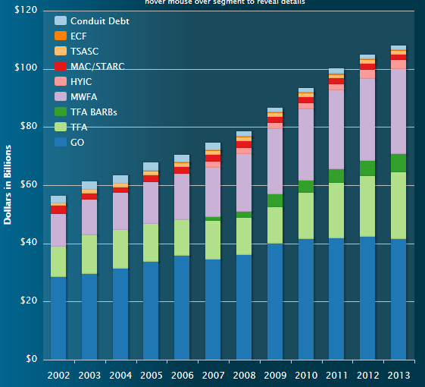
Misdiagnosis: Nullification of Local Government
“The monetary strangulation of government occurs at the Federal, state, and local levels. Small towns are forced into more debt in order to perform necessary functions. The interest costs on this debt approx-imately doubles the cost of all
equipment, construction, or services provided.” Zarlenga, LSM, p. 655

Slide 15
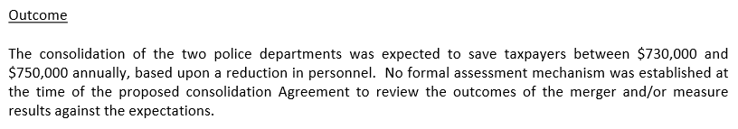
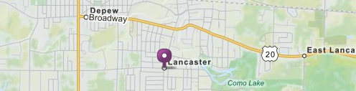
Misdiagnosis: Nullification of Local Government
“Local governments are being advised to merge activities with other localities to save money.” Zarlenga, LSM, p. 655

Slide 16


Misdiagnosis: Rescuing Social Security and Medicare/Medicaid
“Lack of money to pay for crucial programs is again not a fiscal (tax rates, government spending) but a monetary problem caused ultimately by the false idea that government must get money only by taxation or borrowing. The distribution of newly created government money through such programs is an excellent method of getting new money into circulation; it would be widely distributed by population and geography, in small amounts.” Zarlenga, LSM, p. 655
GOVERNMET DEBT-FREE MONEY CREATION
DON’T
IMPOVERISH
OUR SENIORS!

Slide 17


Misdiagnosis: A Broken Down Educational System
“The federal government could be supporting education much more if it were in control of the money system.” Zarlenga, LSM, p. 655
Schools are funded with local property taxes.
Retired people are forced to trade their homes
for the tax payments.

Slide 18

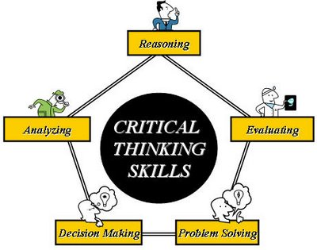
Misdiagnosis: A Broken Down Educational System
“Another larger problem of the schools is what’s being taught… What’s not being taught is how to think…
But a financial system based upon so many falsehoods requires a high degree of ignorance in the population or the system will be seen through and be overthrown.” Zarlenga, LSM, p. 655

Slide 19

Misdiagnosis: Teen-age Suicide and Murder
“… an important factor on the teenagers is the unbearable level of hypocrisy that our system now embodies. …the suicide rate among American teenagers has risen dramatically.” Zarlenga, LSM, p. 656
Suicides among young people continue to be a serious problem. Each year in the U.S., thousands of teenagers commit suicide.
Suicide is the third leading cause of death for 15-to-24-year-olds, and the sixth leading cause of death for 5-to-14-year-olds.
The American Academy of Child and Adolescent Psychiatry (AACAP)

Slide 20

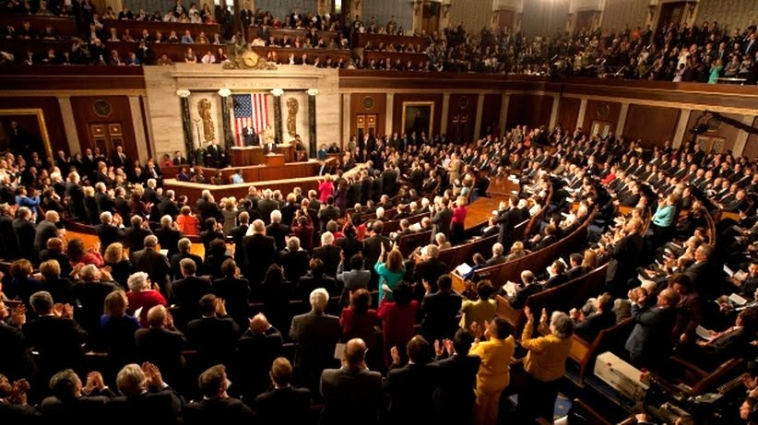
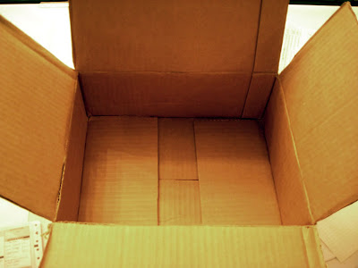
Misdiagnosis: Absence of a National Caretaker
“… the nation is controlled more from behind the scenes by financial institutions than by the citizens through elections… It can’t solve problems, which then develop into crises… an awareness slowly develops that there is ‘nobody home’ in Washington.” Zarlenga, LSM, p. 656

Slide 21
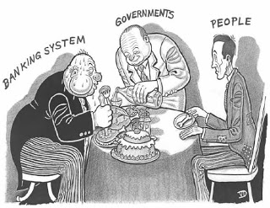
Monetary Reform is Crucially Needed
“It’s long overdue to admit that the money system is responsible for so many social crises.”
Zarlenga, LSM, p. 656

Slide 22
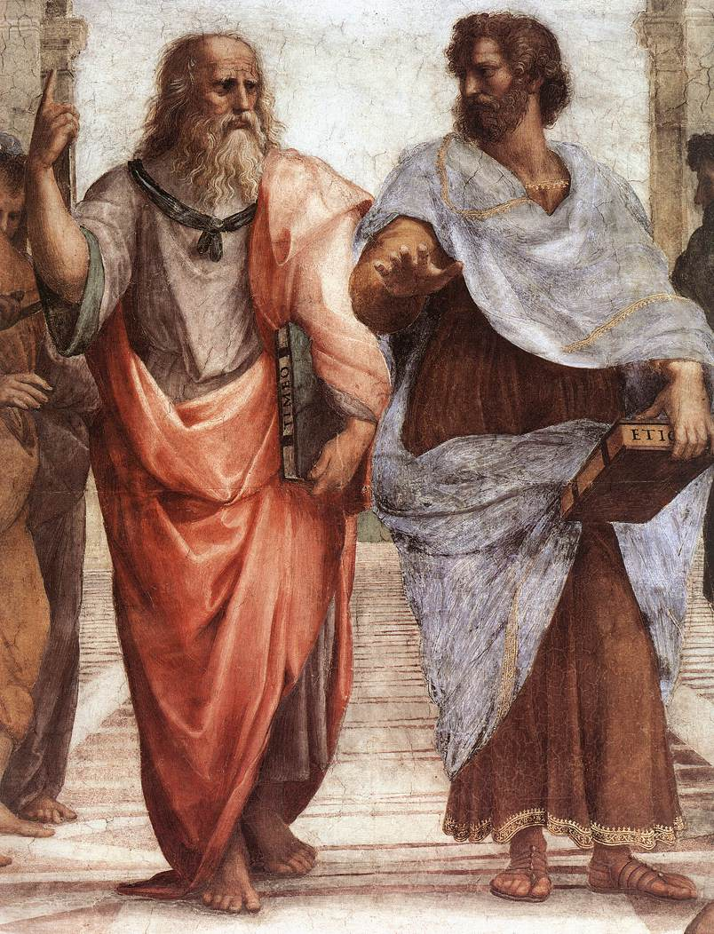
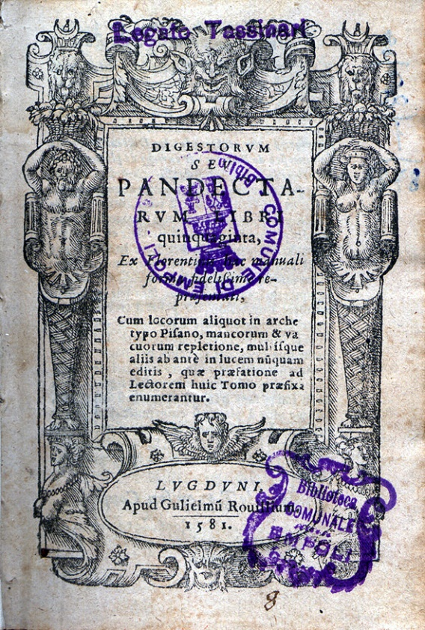
Moneys’ Nature Must Dictate Monetary Reform
WHAT MONEY IS...
Aristotle:
“Money exists not by nature but by law.”
Plato:
“a money token for purposes of exchange”
Julius Paulus, Roman Jurist:
“This device being officially promulgated, circulated and
maintained its purchasing power not so much from
its substance as from its quantity.”

Slide 23
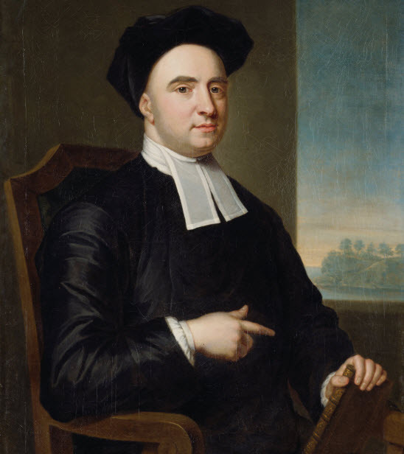
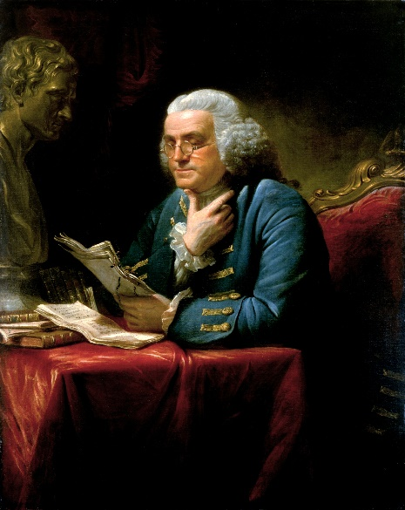
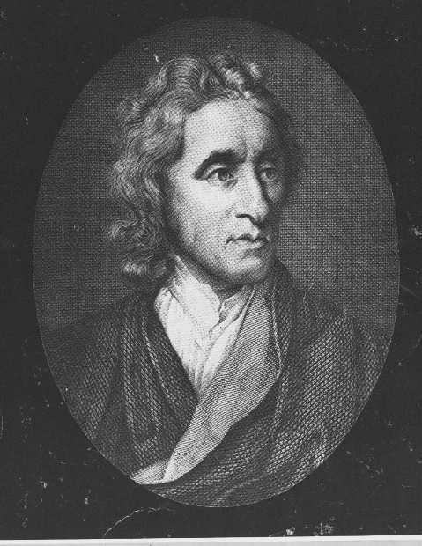
Moneys’ Nature Must Dictate Monetary Reform
WHAT MONEY IS...after a long darkness…
Bishop Berkeley:
“Whether the true idea of money as such,
be not altogether that of a ticket, or counter?”
Ben Franklin:
“To remedy such Inconveniences, and facilitate
Exchange, Men have invented MONEY, properly
called a Medium of Exchange, because through
or by its Means Labour is exchanged for Labour, or
one Commodity for another.”
John Locke, Essay on Money and Bullion:
“Observe well these rules: It is a very common mistake to say money is a commodity … Bullion is valued by its weight … money is valued by its stamp.”

Slide 24
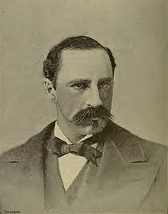
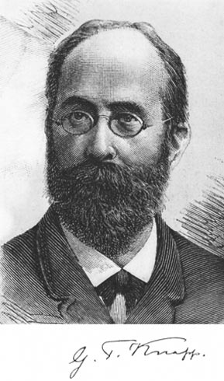
Moneys’ Nature Must Dictate Monetary Reform
WHAT MONEY IS...after a long darkness…
Alexander Del Mar, Money in Ancient Countries, p. 2:
“…what is commonly understood as money has always consisted,
tangibly, of a number of pieces of some material, marked by public
authority and named or understood in the laws or customs: that its
palpable characteristic was its mark of authority; its essential
characteristic, the possession of value, defined by law; and its
function, the legal power to pay debts and taxes and the
mechanical power to facilitate the exchange of other objects
possessing value.”
Georg F. Knapp, The State Theory of Money, p. 40:
“If we have already declared in the beginning that money is
a creation of law, this is not to be interpreted in the narrower
sense that it is a creation of jurisprudence, but in the larger
sense that it is a creation of the legislative activity of the State, a creation of legislative policy.”

Slide 25
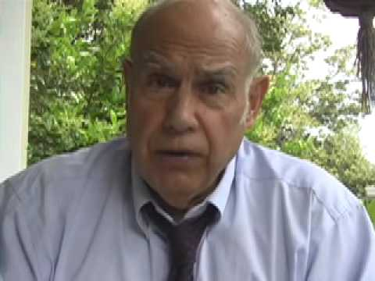
Moneys’ Nature Must Dictate Monetary Reform
WHAT MONEY IS...
Stephen Zarlenga, LSM, p. 657:
“Money’s essence is an abstract
social power embodied in law,
as an unconditional means of
payment.”
“This book has shown that it is historically self evident that the best money systems have been controlled
and monitored through law, by public authority. Leaving the money power in private hands has invited,
even assured, disastrous results. This is also consistent with the logic of money: since the money system
is a creature of law, it rightfully belongs within government, just as the law courts do.”
Zarlenga, LSM, p. 657

Slide 26
Moneys’ Nature Must Dictate Monetary Reform
“We have concluded that the nature of man and of society requires four, not three, branches of government.”
Zarlenga, LSM, p. 657
Fourth Branch
Monetary
(creates money)
Monetary Authority

Slide 27
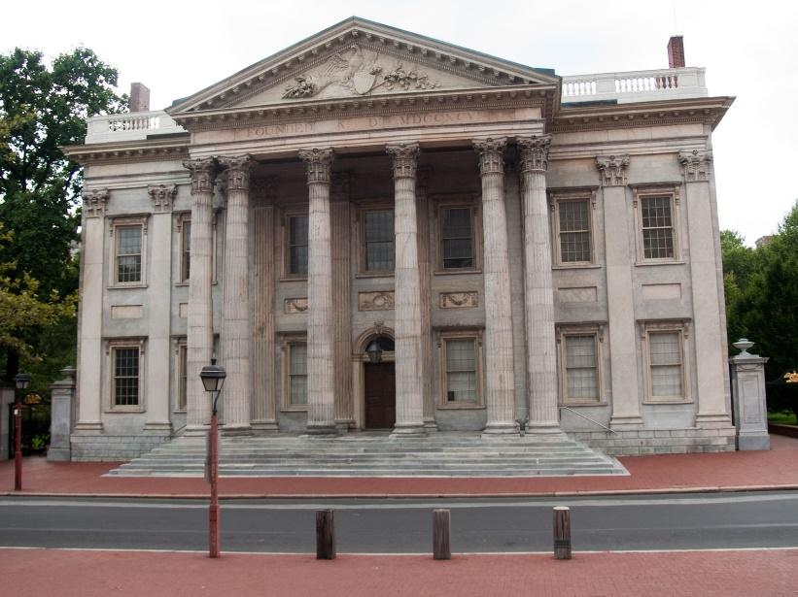

Distractions from Sovereign Money Reform: The Gold Promoters
“But history shows that over and again the so-called gold standard has been little more than a ruse and a way to concentrate special monetary privileges into the hands of a plutocracy.” Zarlenga, LSM, p. 658
A gold standard does not always stop inflation.
Indeed, a metallic-based money system is normally a
formular for deflation.
FIRST BANK OF THE UNITED STATES
Deflation hurts industry and labor, but
benefits creditors, who are repaid with more valuable money.

Slide 28
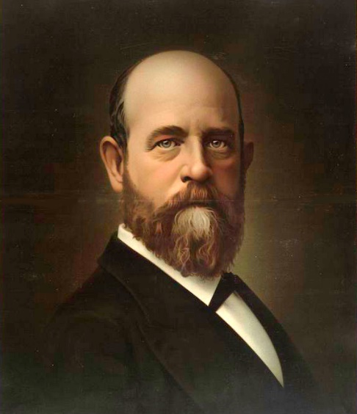
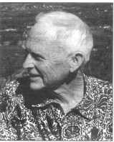
Distractions from Sovereign Money Reform: The Gold Promoters
“But history shows that over and again the so-called gold standard has been little more than a ruse and a way to concentrate special monetary privileges into the hands of a plutocracy.” Zarlenga, LSM, p. 658
Henry George (Social Problems, p. 168) derides metallic money:
“We are digging silver out of certain holes in the ground [called mines]
in Nevada and Colorado and poking it down other holes in the ground
[called vaults] in Washington, New York, and San Francisco.”
Robert de Fremery, Rights vs Privileges, pp. 54-55:
“The essence of a hard money is that its supply is fairly
stable and there are precise limits to it… And a purely
paper or ‘fiat’ money can be a hard money if we set
precise limits to its supply, or it can be a soft money if
we set no precise limits to its supply.”

Slide 29
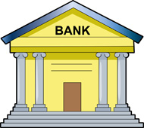
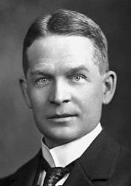
  Distractions from Sovereign Money: The “Free Banking” Ideologues
“Free Banking” is a system where bankers are allowed to create the money supply
in the form of their credits or notes. Bankers are allowed to issue unlimited
amounts of money, as long as customers are willing to accept it.
Professor Frederick Soddy (Money Versus Man, pp. 32, 45-6)
explained why this can’t be allowed:
“The issuer of money who first passes it into circulation cannot help getting something for
nothing, namely the exchange value of the money…
the value of everyone’s holdings of money is directly affected by every new issue or cancellation…
It reduces to a hypocritical sham all the enactments… to insure just weights and measure.”

Slide 30
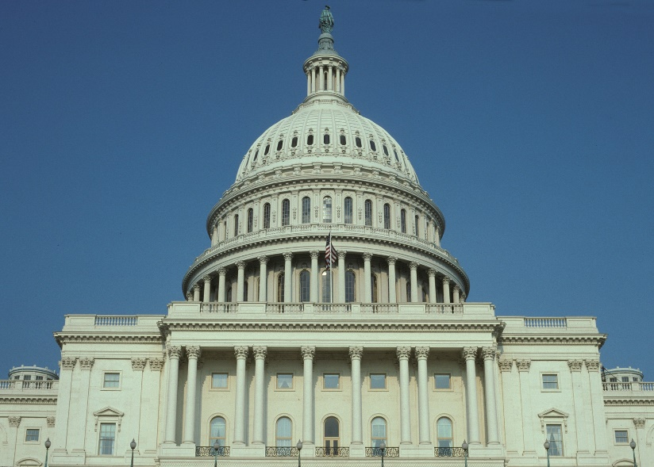
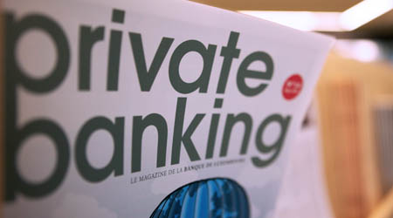
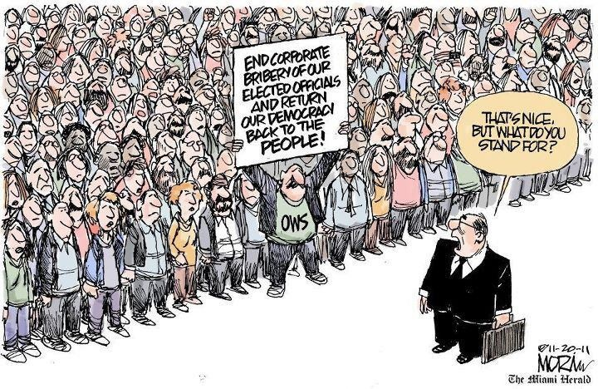

  Distractions from Sovereign Money: The “Free Banking” Ideologues
When the government issues the money,
it is a tax that benefits all members of the
society.
When the private banks issue the money, they enrich themselves, at the expense of everyone else. They use their privilege to control the government.

Slide 31

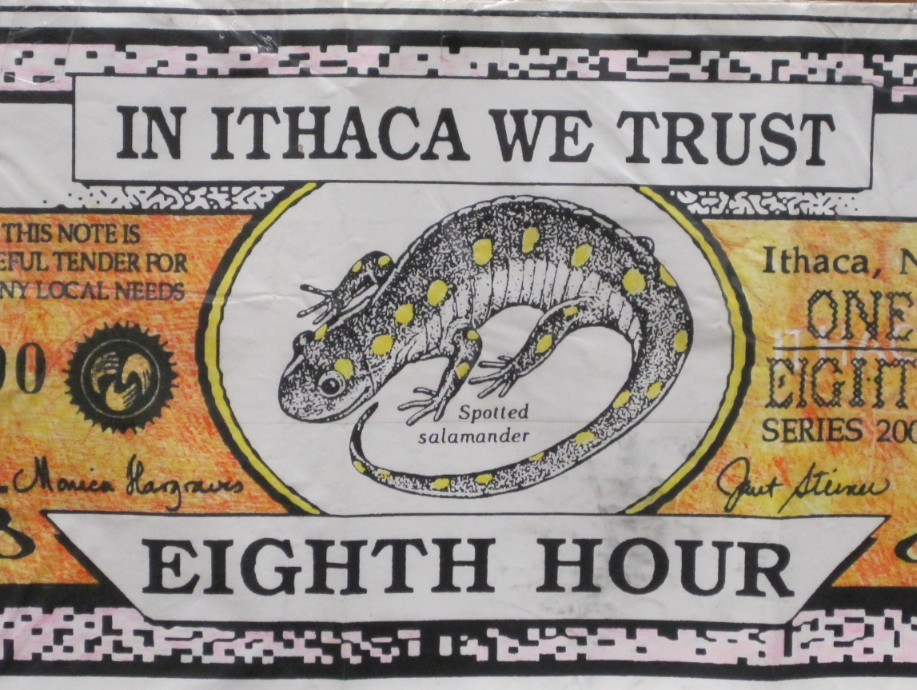
  Distractions from Sovereign Money:
  Local Currency (“Lets”) Advocates
Local currencies are also called LETS – Local Exchange Trading System. They use a local currency to exchange labor and commodities, outside the national currency.

Slide 32
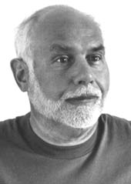
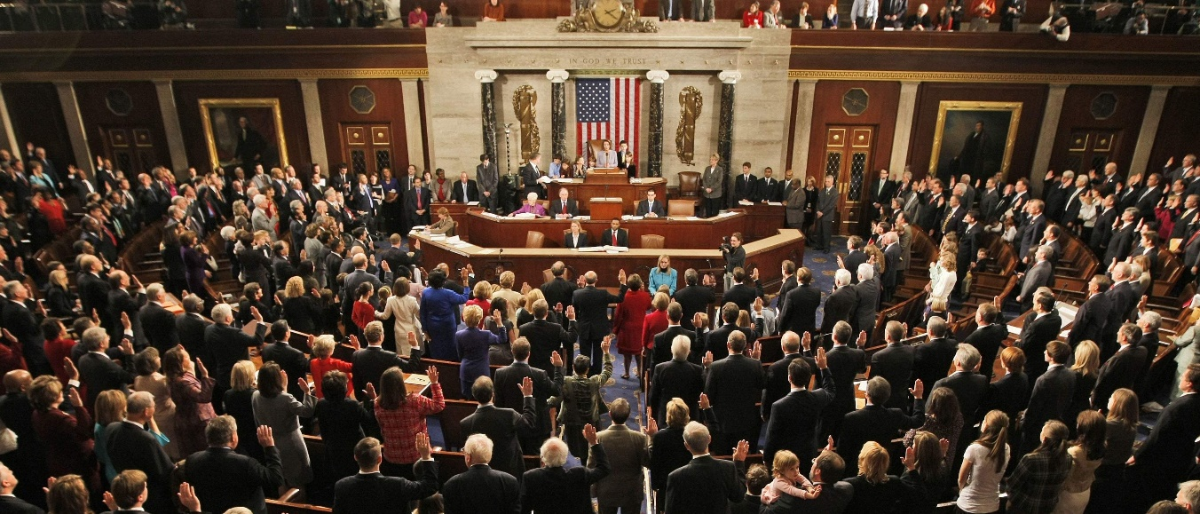
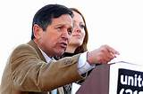
  Distractions from Sovereign Money:
  Local Currency (“Lets”) Advocates
“The problem is that while these local systems do no financial harm and can alleviate local cash shortages, they have been of very limited benefit…. These currencies will continue to be limited unless they can qualify as a true money form. That means taxes, at least local taxes, have to become payable in them.” Zarlenga, LSM, p. 660
“Furthermore, such local currencies do not stop the continued
mismanagement of the money system at the national level…
Ending that injustice should be our monetary priority.”
Zarlenga, LSM, p. 660
Dennis Kucinich
Stephen Zarlenga

Slide 33
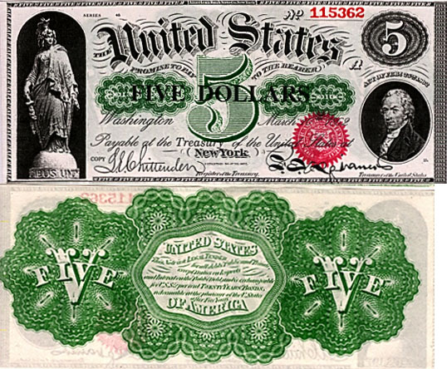
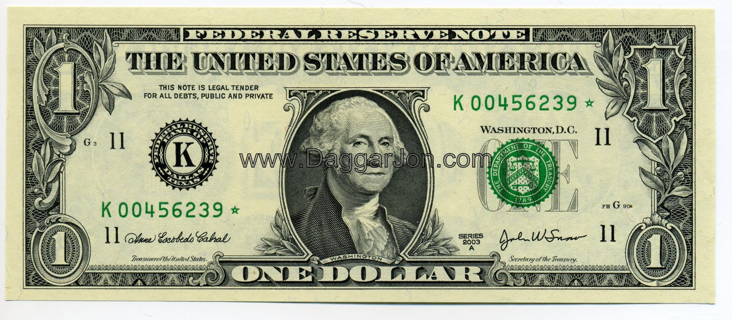
  Distractions from Sovereign Money:
  The “All Money Is Debt” Faction
“This group confuses the nature of money… They say that since most of the money in circulation is in the form of credits issued by banks (which are also debts to those being credited), that therefore the nature of money is that it is always debt.” Zarlenga, LSM, p. 661
GREENBACK DOLLAR
DEBT-FREE MONEY
GOVERNMENT ISSUED
FEDERAL RESERVE NOTE
DEBT-MONEY
BANK ISSUED
MONEY
CREDIT
“Credit can function imperfectly as money, when it has been (improperly) monetized
under the law. For example the legal treatment of the private Federal Reserve notes
as money by accepting them for taxes and making them a legal tender.” Zarlenga, LSM, p. 661

Slide 34
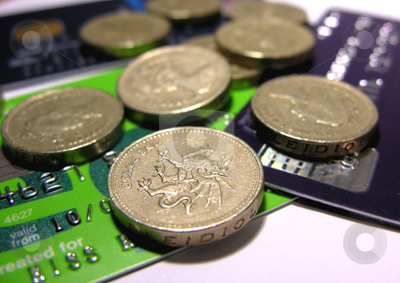
  Distractions from Sovereign Money:
  The “All Money Is Debt” Faction
“Those who argue that it [credit] is the only form of money, should realize that they are actually defining ‘money’ out of existence, and substituting ‘credit’ for it. Money and credit denote two different things. That’s one of the reasons we give them separate names.” Zarlenga, LSM, p. 661
MONEY
CREDIT

Slide 35

  Distractions from Sovereign Money:
  The “All Money Is Debt” Faction
“A society such as the U.S., depending on private bank credits in place of government-created money, is operating in moral quicksand. It has established a special privilege of power for those private parties issuing the credit – the bankers. As Professor Soddy and others have shown, this cannot help but do serious harm to the population as a whole.” Zarlenga, LSM, p. 661

Slide 36
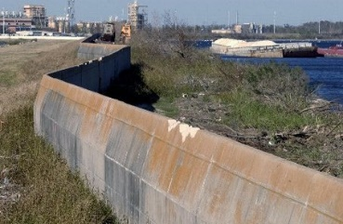



  Distractions from Sovereign Money:
  The “All Money Is Debt” Faction
“Properly constituted government money, except when spent on
warfare, tends to be used for … the broad interest of the citizens such
as bridge and road and water infrastructure; public health and
education [debt-free].” Zarlenga, LSM, 661
DEBT-FREE

Slide 37
  Distractions from Sovereign Money:
  The “All Money Is Debt” Faction
“Private credit tends to go for fast profit, defined in its least productive manner; for quickly getting back more than one gives, in terms of shuffling paper instruments.” Zarlenga, LSM, pp. 661-662
FINANCIAL SYSTEM: PAPER WEALTH

Slide 38
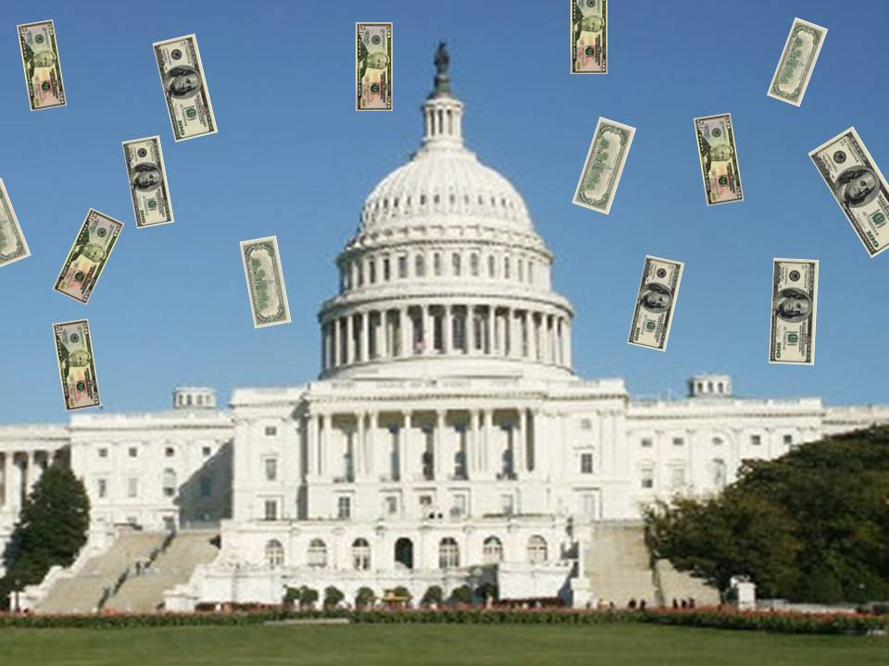
  Distractions from Sovereign Money:
  The “All Money Is Debt” Faction
“It’s a mystery why otherwise intelligent persons don’t see that such a privilege [bank credit] would necessarily fall into the hands of the already wealthy, unjustly enriching them, and further aggravating the obscene concentration of wealth in America.
Modern apologists also assert that bankers are generally of ‘high moral character.’ But why would moral people seek to gain an unfair advantage over their fellow citizens, through a little understood legal privilege, to engage in a process that necessarily robs from society….
If that [bank] credit has been improperly substituted for money, the bankers are more in control of the society than is the legislature, executive, and judiciary, not to mention the citizens.” Zarlenga, LSM, p. 661

Slide 39

Governments Responsibility to Provide the Money
“We regard the provision of the money mechanism to society by government as a major advance over any prior barter or credit arrangements.” Zarlenga, LSM, p. 663
Private credit, used as money, transfers wealth and power to the few, at the expense of the people of the nation. Usury on the national money supply passes labor and capital wealth every second of every day to the owners of the private banking system.
Private credit debt-money puts the government into debt.
Private credit debt-money puts the people and businesses of the nation into debt.
And, ultimately, because of the ability to create credit money and destroy credit money, through inflation and deflation, the owners of the banks transfer the true wealth of the nation to themselves. Today, the top 1% own 42% of the financial wealth.

Slide 40


Governments Responsibility to Provide the Money
“We regard the provision of the money mechanism to society by government as a major advance over any prior barter or credit arrangements.” Zarlenga, LSM, p. 663
Lincoln’s Greenback Dollar:
DEBT FREE MONEY ISSUED BY THE NATIONAL GOVERNMENT
Federal Reserve $5 Note:
DEBT MONEY ISSUED BY A PRIVATE BANKING SYSTEM
“We can understand why the bankers were so anxious to remove the Greenbacks from
circulation, where they provided a daily practical lesson in ‘monetary theory.’”
Zarlenga, LSM, p. 663

Slide 41

THE AMI STRATEGY:
Reforming the Federal Reserve System
“Fortunately there is a monetary reform that can reach our goal for the nation to control its own money system, and to end the monetary privileges that the financial classes have grabbed… Reform can begin, even without a complete and detailed blueprint of the ideal money system…” Zarlenga, LSM, p. 663
“Special care must be taken to avoid a program that leads to
deflation, as some past monetary reforms have.”
Zarlenga, LSM, p. 663

Slide 42


THE AMI STRATEGY:
Reforming the Federal Reserve System
“The American Monetary Institute’s strategy for monetary reform is to concentrate on three minimal reforms that place time on the side of justice… These minimal reforms should be agreeable to thoughtful, honest observers; but on these three points there should be no compromise.” Zarlenga, LSM, p. 663
REFORM #1: Nationalization of the Federal Reserve
REFORM #2: Ending Fractional Reserve Banking and Instituting the 100% Reserve Solution
REFORM #3: Institute Anti-Deflation Programs and Beware of Deflation

Slide 43



Reform #1: Nationalization of the Federal Reserve
The government, with political support, should nationalize the Federal Reserve System, by buying all the shares of the twelve Federal Reserve Banks from the private commercial banks who own them. This is not new. England did the same in 1946 and nationalized the Bank of England. And Canada did the same in 1938 when it bought all the private shares of the Bank of Canada.
NEXT TO BE NATIONALIZED?

Slide 44

Reform #1: Nationalization of the Federal Reserve
“Several past Chairmen of the House Banking Committee have introduced bills to do away with the private Federal Reserve System…” Zarlenga, LSM, p. 664
Wright Patman, chairman of the House Committee on Banking and Currency 1965-75, introduced bills to remove the Federal Reserve System.
“Now, I believe the system should be changed. The Constitution of the United States does not give the banks the power to create money. The Constitution says that Congress shall have the power to create money, but now, under our system, we will sell bonds to commercial banks and obtain credit from those banks… I believe the time will come when people will demand that this be changed. I believe the time will come in this country when they will actually blame you and me and everyone else connected with this Congress for sitting idly by and permitting such an idiotic system to continue. I make that statement after years of study.”
Wright Patman
(1893 – 1976)

Slide 45

Reform #1: Nationalization of the Federal Reserve
“Several past Chairmen of the House Banking Committee have introduced bills to do away with the private Federal Reserve System…” Zarlenga, LSM, p. 664
Henry Gonzales, Chairman of the House Banking and Currency Committee,
introduced legislation to repeal the Federal Reserve System almost every year.
The legislation was always defeated and the media remained silent.
Henry Gonzalez
1916 - 2000

Slide 46
Q & A
WILL’S CONCLUSION:
THE CONTROL OF MONEY -- WITHOUT CONTROL FROM THE PUBLIC -- LEADS TO
CORRUPTION … USURPATION … SLAVERY.

