Slide 1
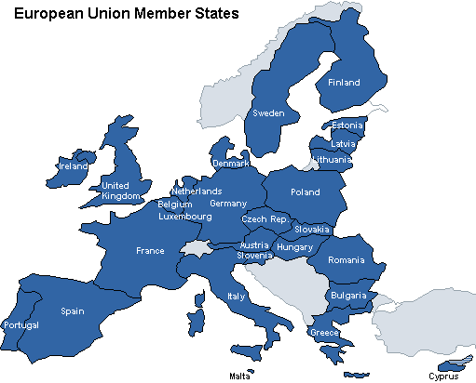
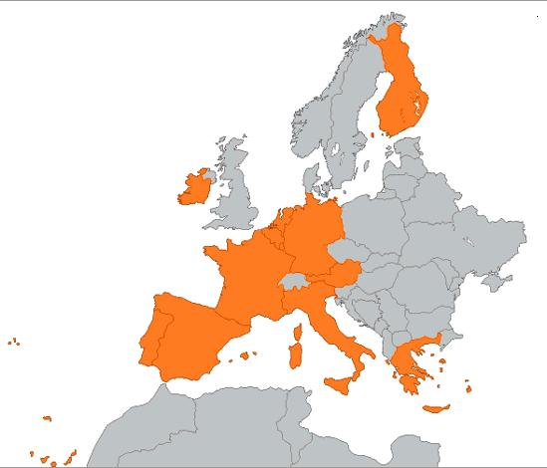
The Lost Science of Money
CHAPTER 23 – Part 2
The European Monetary Union
EU
EMU

Slide 2
THEMES OF LOST SCIENCE OF MONEY BOOK
Primary importance of the money power (power to create money and regulate it)
Nature of money purposely kept secret and confused
How a society defines money determines who controls the society
Battle over control of money has raged for millennia: public vs private
The misuse of the monetary system causes tremendous misery and suffering for the ordinary people. Will & Martin, February 2014
Whenever the public has owned a significant fraction of the money power, great public benefit has ensued: Sparta, the Roman Republic, the American Colonies in the 18th century, GREENBACKS after the Civil War, Canada after the Great Depression, British experience after World War II. Martin, July 2014.

Slide 3
PARTS OF PRESENTATION
The Fractional Reserve Problem
The 100% Reserve Solution
The ECB and creating reserves and new money
Regarding Great Britain: The Euro and the “Problem of Europe”
Accountability
Greece: Eurozone Sovereign Debt Crisis
Stated Goals & Comment
Political Influence Blocked & Comment
Likely Outcome
Conclusion
Conflict with Europe?
The Euro Results Thus Far

Slide 4
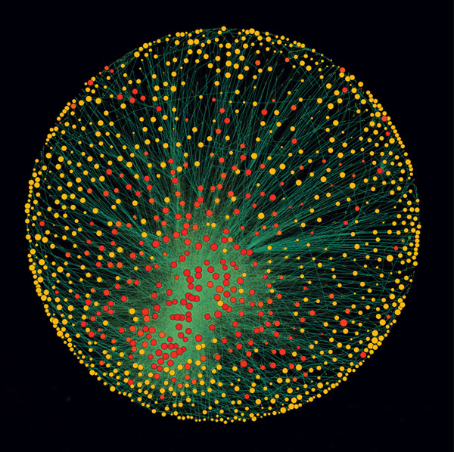
The Fractional Reserve Problem
The ECB allows banks to engage in fractional reserve banking.
This shifts power to the private banks to control economies.
The Top Fifty Corporate Owners
1. Barclays plc 2. Capital Group Companies Inc 3. FMR Corporation 4. AXA 5. State Street Corporation 6. JP Morgan Chase & Co 7. Legal & General Group plc 8. Vanguard Group Inc 9. UBS AG 10. Merrill Lynch & Co Inc 11. Wellington Management Co LLP 12. Deutsche Bank AG 13. Franklin Resources Inc 14. Credit Suisse Group 15. Walton Enterprises LLC (holding company for Wal-Mart heirs) 16. Bank of New York Mellon Corp 17. Natixis 18. Goldman Sachs Group Inc 19. T Rowe Price Group Inc 20. Legg Mason Inc
146 top players in the core of the world economy control 40% of the value of the Trans National Corporations…..
most are banking institutions.
http://journals.plos.org/plosone/article?id=10.1371/journal.pone.0025995

Slide 5
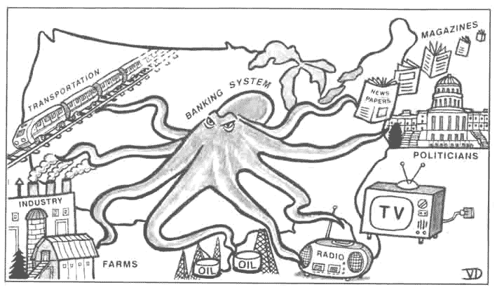
The Fractional Reserve Problem
The ECB allows banks to engage in fractional reserve banking.
Fractional Reserve Banking as a privilege to the private banks leads to the continuing concentration of wealth and power into the hands of the bankers.

Slide 6
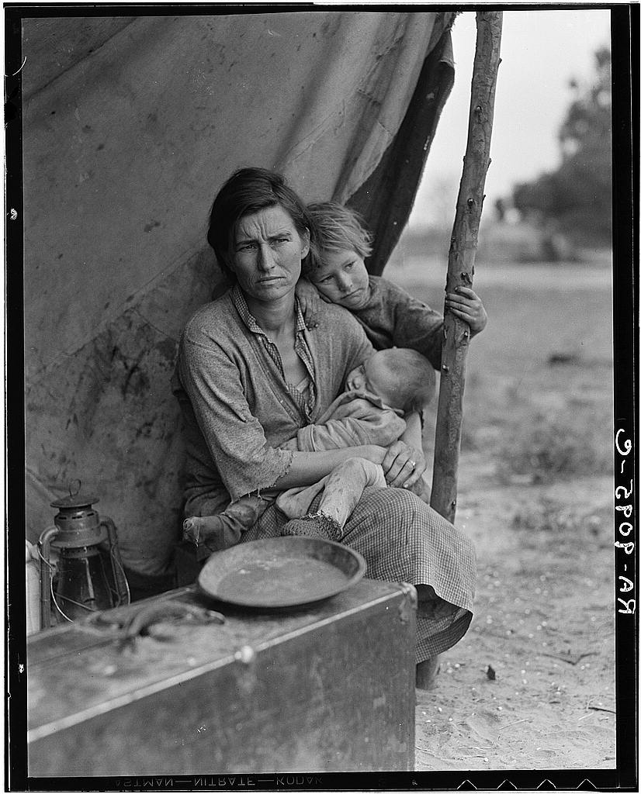
The Fractional Reserve Problem
The ECB allows banks to engage in fractional reserve banking.
Fractional Reserve Banking as a privilege to the private banks is a source of panics and crashes in money and banking markets.
THE GREAT DEPRESSION IN U.S.

Slide 7
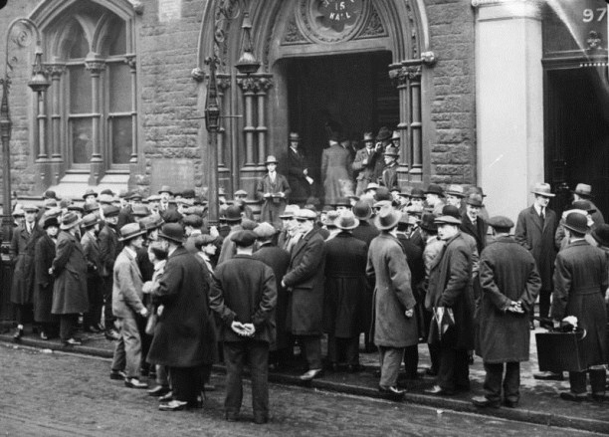
The Fractional Reserve Problem
The ECB allows banks to engage in fractional reserve banking.
Fractional Reserve Banking as a privilege to the private banks is a source of panics and crashes in money and banking markets.
THE GREAT DEPRESSION IN EUROPE

Slide 8
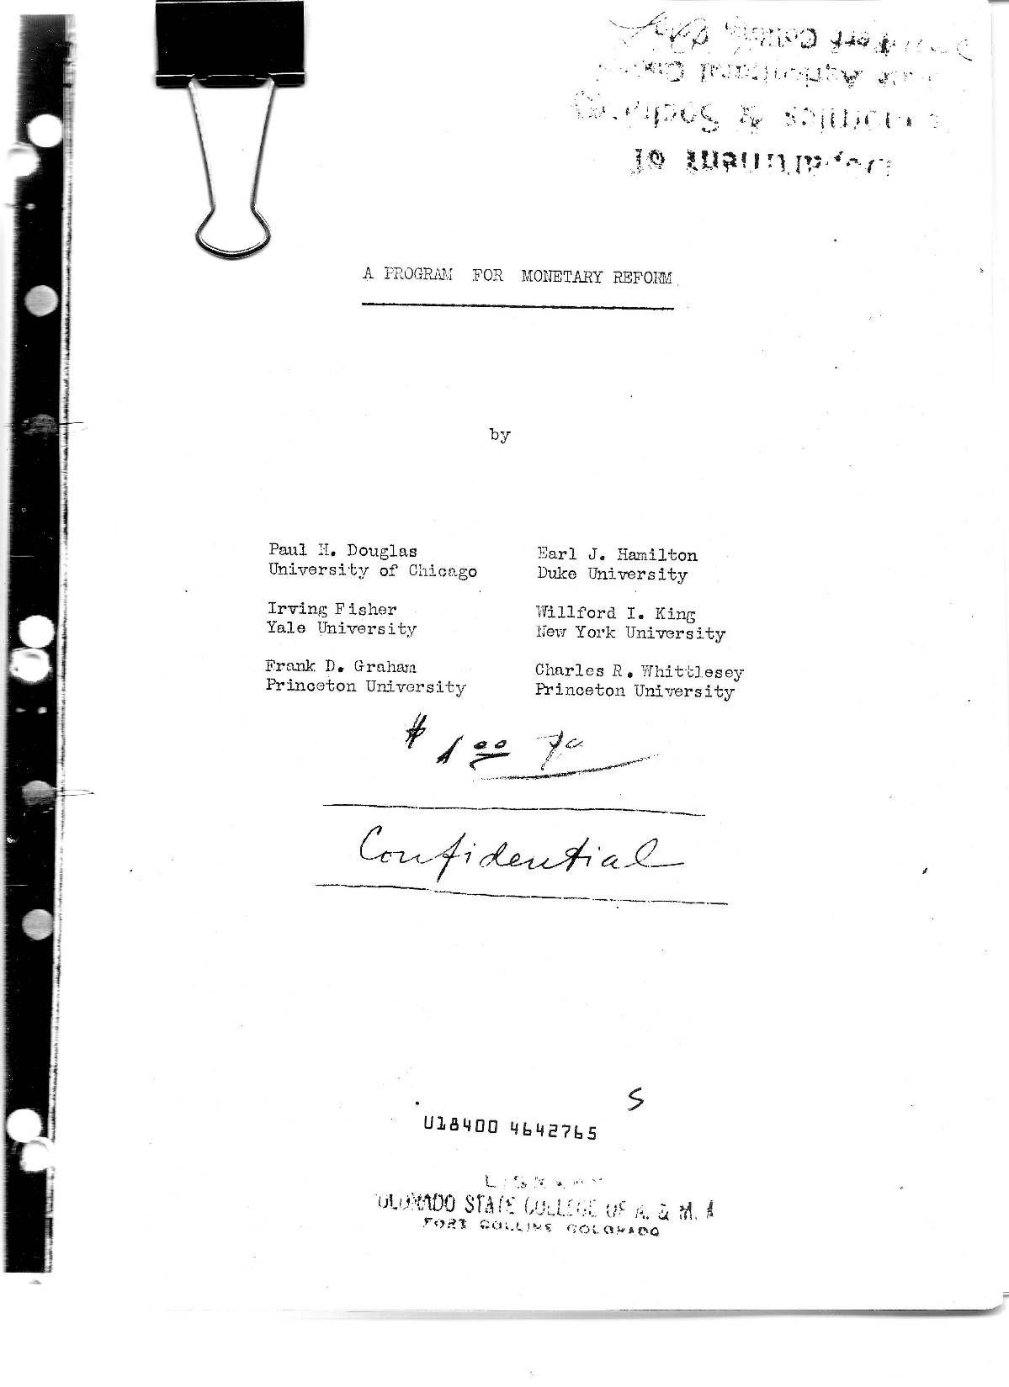
The 100% Reserve Solution
A PROGRAM FOR MONETARY REFORM
“One hundred percent reserves could be implemented.”
But … the European Bankers would prefer “fractional reserve banking under their old national systems, instead of 100% reserves in the European Community.” Zarlenga, LSM, p. 638

Slide 9
The 100% Reserve Solution
A PROGRAM FOR MONETARY REFORM
The following proposal was put forward by American economists in 1939 as an alternative to the private fractional reserve bank system:
“A PROGRAM FOR MONETARY REFORM”, 1939
by Paul H. Douglas Earl J. Hamilton
Irving Fisher Willford I. King
Frank D. Graham Charles R. Whittlesey
“… it is desirable that any bank or other agency holding deposits subject to check (demand deposits) be required to keep on hand a dollar of reserve for every dollar of such deposit, so that, in effect, deposits subject to check actually represent money held by the bank in trust for the depositor.”

Slide 10
The 100% Reserve Solution
“The Fractional Reserve System
(9) A chief loose screw in our present American money and banking
system is the requirement of only fractional reserves behind demand
deposits. Fractional reserves give our thousands of commercial banks
the power to increase or decrease the volume of our circulating medium
by increasing or decreasing bank loans and investments. The banks thus
exercise what has always, and justly, been considered a prerogative of
sovereign power. “ A Program for Monetary Reform, 1939, p. 19
“The 100% reserve system was the original system of deposit banking, but
the fractional reserve system was introduced by private Venetian bankers
not later than the middle of the Fourteenth century… But what thus began
as a breach of trust has now become the accepted and lawful practice.”
A Program for Monetary Reform, 1939, p. 19
“(13) The 100% reserve requirement would, in effect, completely
separate from banking the power to issue money. The two are now
disastrously interdependent. Banking would become wholly a business
of lending and investing pre-existing money.”
A Program for Monetary Reform, 1939, p. 29
A PROGRAM FOR MONETARY REFORM

Slide 11
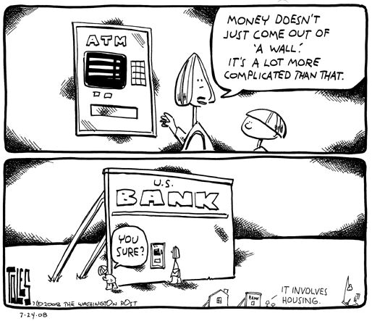
The ECB and creating reserves and new money
“It would negate much of the ultimate purpose of the ECB to rely on fractional reserve banking as its main method of creating money. The ECB needs the ability to do that independently and directly. It needs the ability to create reserves or simply money out of thin air, when it determines that is the best way to monetarily serve the Community.” Zarlenga, LSM, p. 638

Slide 12
The ECB and creating reserves and new money
“Yet there is not sufficient reference to the ECB’s power to create reserves – or its intended use in the ECB protocols… They are like temple priests bowing low to the ground in the presence of the holy of holies, afraid or forbidden to even to look directly at ‘the power’ .”
Zarlenga, LSM, p. 638
MAASTRICHT TREATY, aka Treaty on Economic Community
from Protocols creating ECB
*
*
ESCB – European System of Central Banks

Slide 13
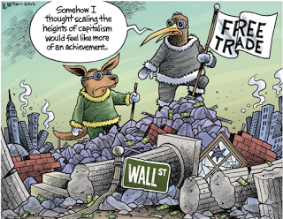
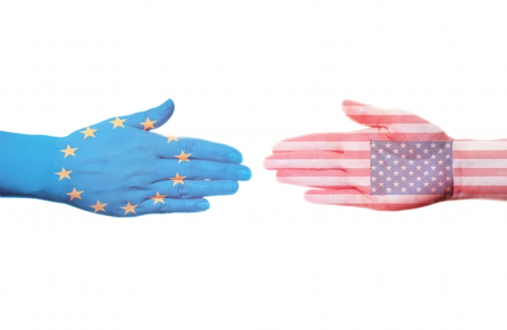
The ECB and creating reserves and new money
“Because the Bundesbank previously relied heavily on trade surpluses to obtain U.S. dollar monetary reserves, perhaps there is a hope of continuing to do this with the ECB… selling more than you buy creates friction with your trading partners. It is a mentality that treats the money system like a game of marbles...”
Zarlenga, LSM, pp. 638-639

Slide 14
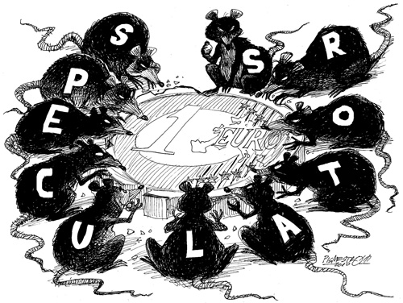
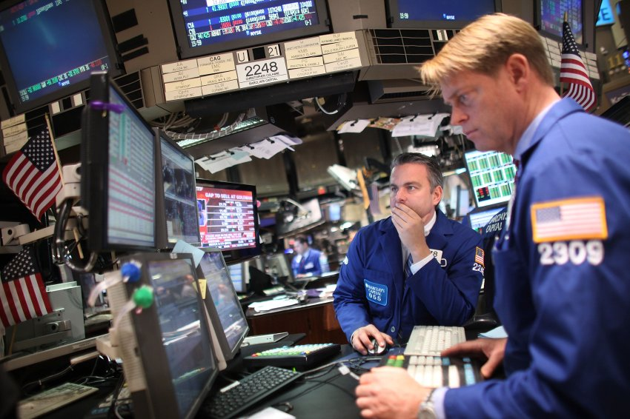
The ECB and creating reserves and new money
*
“… Europeans should remember that the ESCB contains the monetary power to help make the economy flourish, not merely to grow. It can be used when there is the will to do it…
They need to stop acting as facilitators for international currency speculation, which …
can only destroy.” Zarlenga, LSM, p. 639
*
ESCB – European System of Central Banks

Slide 15
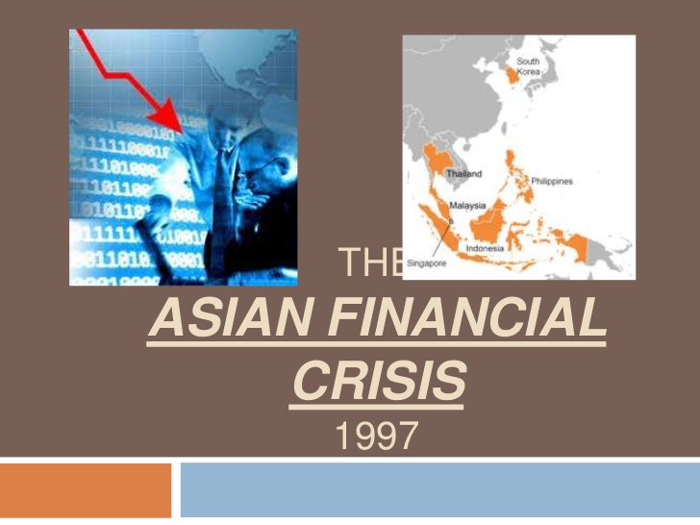
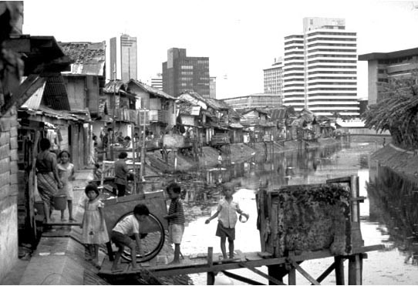
The ECB and creating reserves and new money
“… The recent monetary debacle of Southeast Asian countries in 1997-98 demonstrated the danger of basing one’s economy on a money system and monetary unit that someone else controls… Today [2002]… the Indonesian government is still in tatters… This experience highlights a system of unlimited free trade in currencies, and the resultant mobilization of billions of dollars that can be deployed with no advance notice, at the speed of light… Zarlenga, LSM, p. 640

Slide 16
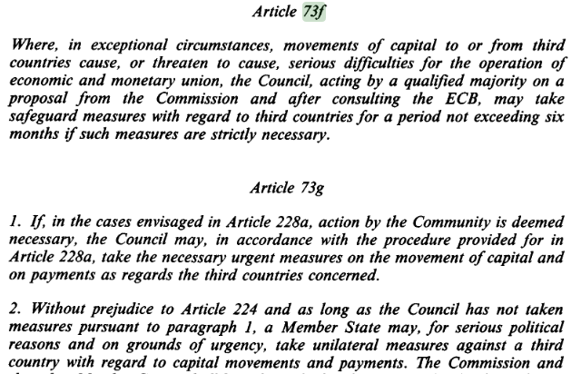
The ECB and creating reserves and new money
“The European Central Bank … can be strong enough to keep the monetary manipulators at bay. …combined with further measures such as denial of visas, and even arrest warrants against those in the corporate chain of command of offending organizations.” Zarlenga, LSM, p. 640
MAASTRICHT TREATY,
aka Treaty on European Union, 1993
In this treaty, non-monetary institutions were identified for the European Union:
European Parliament*
Council (Council of Ministers)* ^
European Commission* ^
Court of Justice of the EU
Court of Auditors of the EU
European Council
*legislative
^ executive

Slide 17
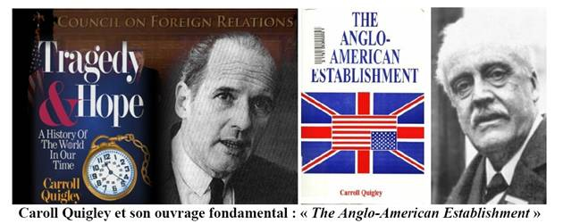
Regarding Great Britain:
The Euro and the “Problem of Europe”
“… integrating Britain into the European monetary system can help resolve a three centuries old problem that has plagued the world.” Zarlenga, LSM, p. 641
“The central problem of Europe remains today, as it has for a century, the problem of Germany. And today, as before, this problem cannot be solved without Britain. But such a solution requires that Britain accept the fact that it is… a European, and not a world, or even an Atlantic, Power. This the leaders of Britain and the American branch of the British Establishment have been unwilling to accept. As a consequence, Britain remains aloof from the Continent, committed to the ‘Atlantic Community’ …” Carroll Quigley, Tragedy and Hope, pub. 1966, p. 1282

Slide 18
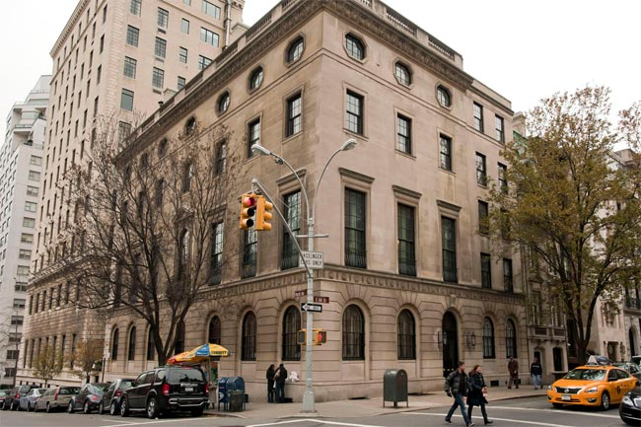
Regarding Great Britain:
The Euro and the “Problem of Europe”
“… integrating Britain into the European monetary system can help resolve a three centuries old problem that has plagued the world.” Zarlenga, LSM, p. 641
“The more moderate Round Table group… sought… above all to free Britain from Europe in order to build up an ‘Atlantic bloc’ of Great Britain, the British Dominions, and the United States. They prepared the way for this ‘Union’ through the Rhodes Scholarship organization… through the Round Table groups (which had been set up in the United States, India, and the British Dominions in 1910-1917), through the Chatham House organization, which set up Royal Institutes of International Affairs in all the dominions and a Council on Foreign Relations in New York…” Carroll Quigley, Tragedy and Hope, pub. 1966, p. 582
“Writing in 2009, the Secretary of the Rhodes Trust criticized the trend of Rhodes Scholars to pursue careers on Wall Street, noting that ‘more than twice as many [now] went into business in just one year than did in the entire 1970s,’ attributing it to "grotesque" wages offered by such occupations. Indeed, in the 1990s, at least a ‘half dozen’ Rhodes Scholars would serve as partners at Goldman Sachs, and since the 1980s, McKinsey & Company has had a dozen or more Rhodes Scholars…” Wikipedia
Council on Foreign Relations
New York, NY

Slide 19
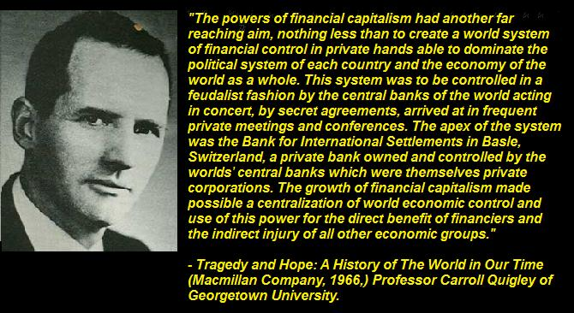
Regarding Great Britain:
The Euro and the “Problem of Europe”
In a public speech in April, 2015, Ann Emmett, President of the Canadian monetary reform group, COMER, said that the executive branch stopped giving interest and low-interest loans from the publicly-owned Bank of Canada after attending a meeting in 1974 at the BIS (Bank of International Settlements). COMER’s law suit would force the executive branch to again begin using the Bank of Canada to fund Canadian infrastructure projects, similar to the period 1938-1974. During this time, Canada got its free higher public education, national railroad system, public health care system, etc.
#1 Theme of LSM:
Primary importance of the money power

Slide 20
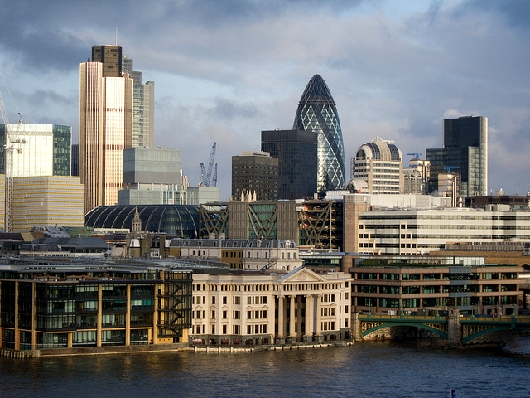
Regarding Great Britain:
The Euro and the “Problem of Europe”
From: B. B., monetary reformer Date: Jul 4, 2015 Subject: Greece To Consider Bank Closures And Capital Controls On Monday
They [Great Britain] dropped out of EMS [European Monetary System] back in about 1992. George Soros is blamed for taking them out when he shorted the pound with hot money.
The owners of the Corporation of the City of London never would have stood for giving up their currency so they could create debt bubbles.
City of London Corporation [British financial center] is unique in
the UK and has some unusual responsibilities for a local council,
such as being the police authority.

Slide 21
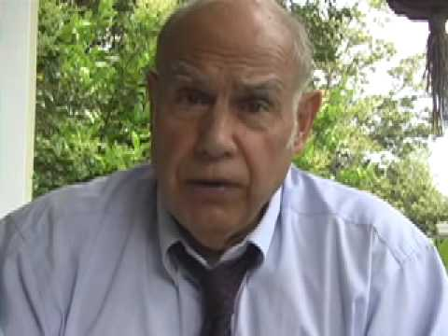
Accountability &
Institutionalize a Formal Review Process
MAASTRICHT TREATY, aka TREATY ON EUROPEAN UNION
“Presumably, not providing an adequate
money supply sufficient for industry and
commerce would be an omission.”
Stephen Zarlenga, LSM, p. 642

Slide 22
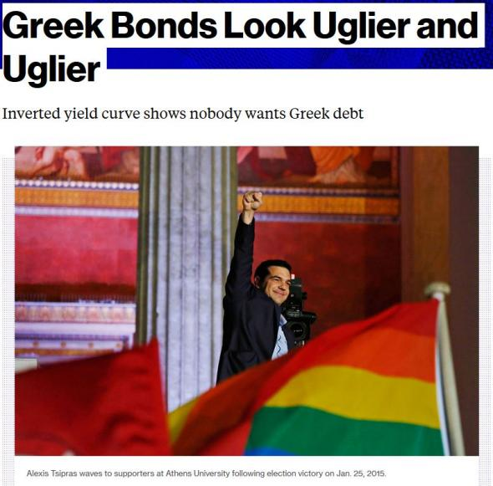
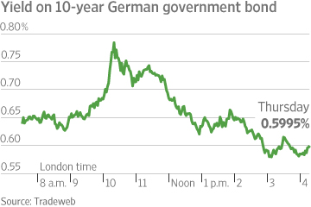
Accountability &
Institutionalize a Formal Review Process
Member nations of the Eurozone are responsible for their own budget: tax revenues coming in and government spending going out. When tax revenues do not cover government spending, individual countries need to sell their government bonds in the open market to raise money.

Slide 23
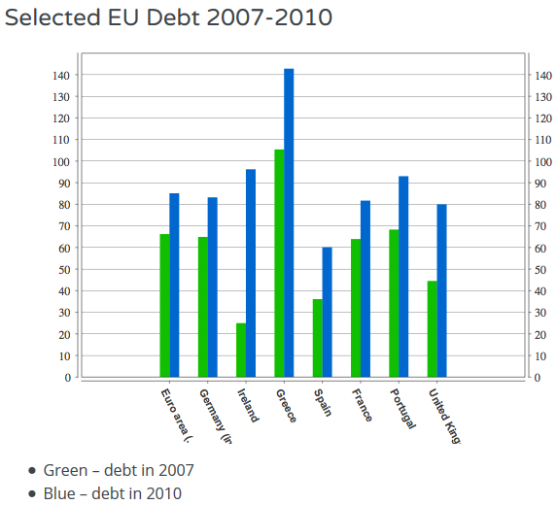
Accountability &
Institutionalize a Formal Review Process
THE 2010 SOVEREIGN DEBT CRISIS
Usually, when governments have difficulty selling their bonds, the Central bank of that country intervenes to buy government bonds with created reserves. But, the ECB made it very clear to markets it will not do this, so countries in the Eurozone have no lender of last resort.
While the ECB has supplied large amounts of liquidity [reserves] through both open market operations and lending to individual banks in 2008, it was hesitant to supply liquidity during the sovereign crisis of 2010.
The most useful guide to levels of manageable debt is the debt to GDP ratio. Therefore, a fall in GDP and rise in debt means this will rise rapidly.

Slide 24
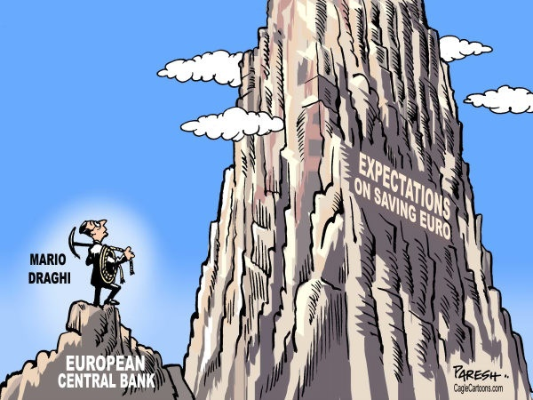
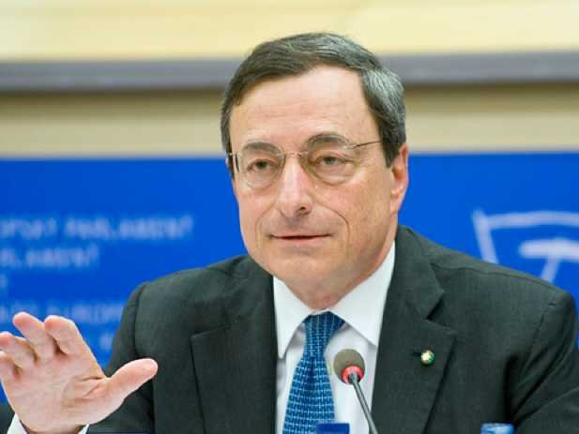
Accountability &
Institutionalize a Formal Review Process
2012 OMT: ECB’S GOVERNMENT BOND BUYING PROGRAM
The European Central Bank's Outright Monetary Transactions (OMT) or bond-buying program was announced by Mario Draghi, president of the ECB, in September 2012. The ECB has indicated that – through OMT – it is willing to purchase unlimited quantities of government debt, with maturities between one and three years.
The size of the program is unlimited, lending credence to Mr. Draghi’s remarks that he would do “whatever it takes” to save the euro. Mr Draghi stressed that any purchases under the OMT would be subject to "strict and effective" fiscal conditions, most likely to take the form of austerity measures and structural reforms. The prior bond-buying program, the Securities Markets Program [SMP] was both limited in its scope and unconditional. lexicon.ft.com
Usually, when it becomes difficult for a country to sell its government debt, the Central bank of that country intervenes to buy government bonds.
By creating OMT, the ECB has acknowledged that Eurozone governments need a lender of last resort.

Slide 25
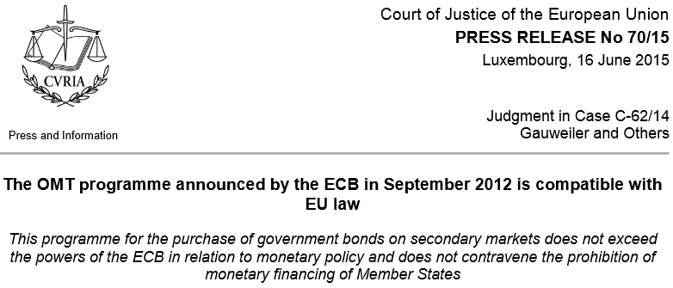
Accountability &
Institutionalize a Formal Review Process
JUNE 16, 2015
EUROPEAN COURT OF JUSTICE DECLARES OMT LEGAL
German plaintiffs took the OMT plan to court, arguing that the ECB overstepped its mandate and that it constituted monetary financing of governments, which is forbidden under EU law. The German Constitutional Court referred the case to the European Court of Justice, the EU’s top court.
OMT HAS NEVER BEEN USED

Slide 26
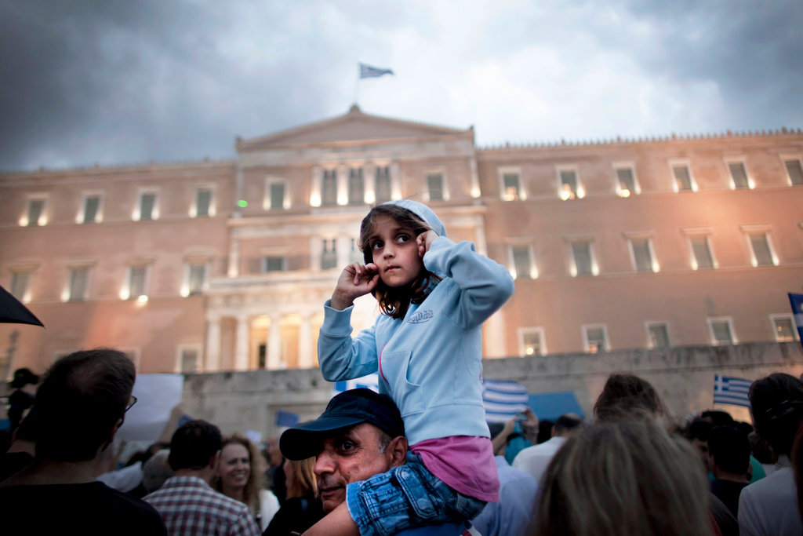
Greece: Eurozone Sovereign Debt Crisis
Who in the EMU is making these decisions?
Who in the EU?
By the spring of 2010, Greece was veering toward bankruptcy, which threatened to set off a new financial crisis.
To avert calamity, the so-called troika — the IMF, the ECB and the European Commission — issued the first of two international bailouts for Greece, which would eventually total more than 240 billion euros…
The bailouts came with conditions. Lenders imposed harsh austerity terms, requiring deep budget cuts and steep tax increases.

Slide 27
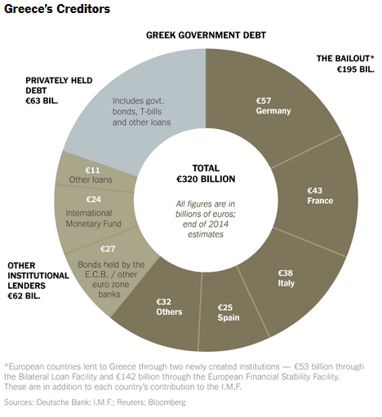
Greece: Eurozone Sovereign Debt Crisis
Almost two-thirds of Greece’s debt, about 200 billion euros, is owed to the eurozone bailout fund or other eurozone countries. Greece does not have to make any payments on that debt until 2023. The International Monetary Fund has proposed extending the grace period until mid-century.
In the short term, though, Greece has a problem making payments due on loans from the IMF and on bonds held by the ECB.
Those obligations amount to more than 24 billion euros through the middle of 2018, and it is unlikely that either institution would agree to long delays in repayment.
IMF
ECB
Are these debts debt-money?
And if so, what banks created them?

Slide 28
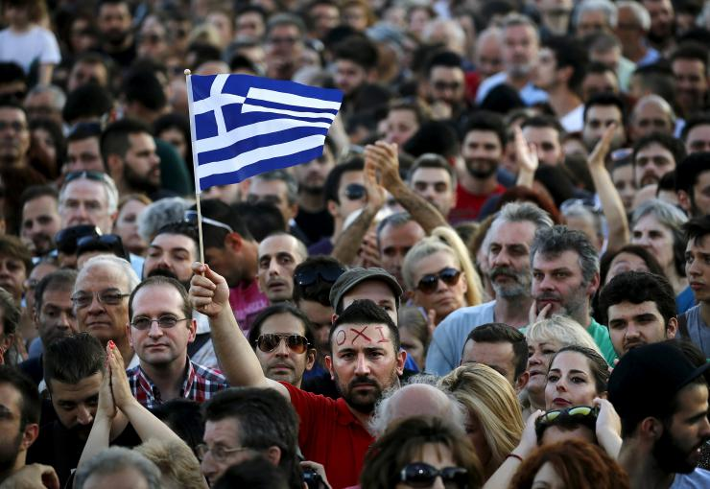
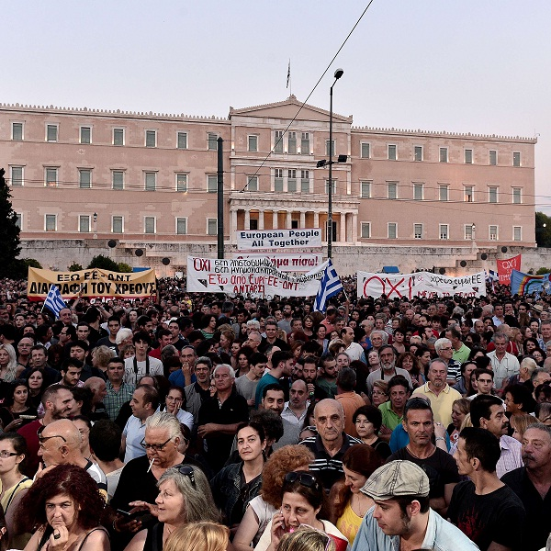
Greece: Eurozone Sovereign Debt Crisis
THE DEAL FOR GREECE
July 2015
A European Commission spokeswoman said a technical deal had been reached last night between parties including Greece, the IMF, the ECB, and the European Stability Mechanism.
In exchange for funding worth up to 86 billion euros ($94 billion), Greece has accepted reforms including significant pension adjustments, increases to value added taxes, an overhaul of its collective bargaining system, measures to liberalize its economy and tight limits on public spending.
It has also agreed to sequester 50 billion euros of public assets in a special privatization fund to act as collateral on the deal.

Slide 29
Greece: Eurozone Sovereign Debt Crisis
The ‘Greek Deal’
In the European Monetary Union, is the money system the
servant or the master?

Slide 30
Stated Goals & Comment
COMMENT: “Article 2 is the human face of the EMU. For it is not obvious (or even desirable) to all, that the money system must be held accountable to foster desirable results[!]
COMMENT: In Article 2 is embodied a ‘silent’ but important monetary principle: the correct vision that the money system must be managed to produce superior living results, not just to conform to dead theory.” Zarlenga, LSM, p. 643
Modified Maastricht Treaty, Principles, Article 2
“…to promote throughout the Community a harmonious and balanced development of economic activities, sustainable and non-inflationary growth respecting the environment, … , a high level of employment and of social protection, the raising of the standard of living and quality of life, and economic and social cohesion and solidarity among Member States.”
Modified Maastricht Treaty, Article 105
“…1. The primary objective of the ESCB shall be to maintain price stability. Without prejudice to the objective of price stability, the ESCB shall support the general economic policies in the Community with a view to contrIbuting to the achievement of the objectives of the Community as laid down in Article 2. “

Slide 31
Political Influence Blocked & Comment
Treaty of Maastricht Article 107
… neither the ECB, nor a national central bank, nor any member of their decision-making bodies shall seek or take instructions from Community institutions or bodies, from any government of a Member State or from any other body.
The Community institutions and bodies and the governments of the Member States undertake to respect this principle and not to seek to influence the members of the decision-making bodies of the ECB or of the national central banks in the performance of their tasks.
COMMENT: “Is the ECB prohibited from reciprocal influence attempts on the member states? Are the political implications, already embodied in the (banker promoted) economic and monetary theories that will guide the ECB, going to be honestly acknowledged for all to understand?” Zarlenga, LSM, p. 644

Slide 32
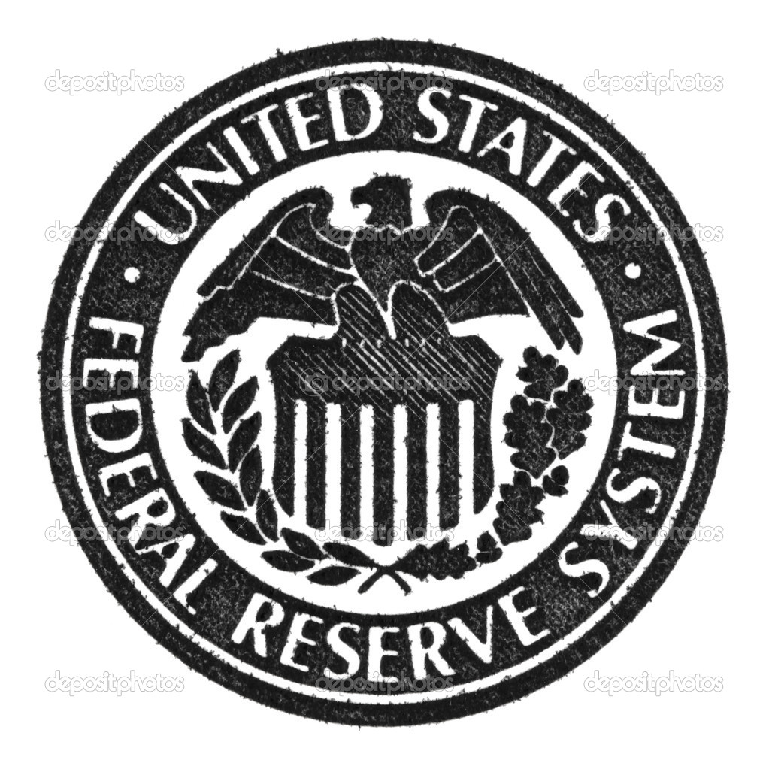
Likely Outcome
Stephen Zarlenga, LSM, p. 644:
“…the ECB appears superior to the Federal Reserve System. Consider for example the public ownership of it and its broad statement of social goals, which have no counterpart in the Federal Reserve.”

Slide 33
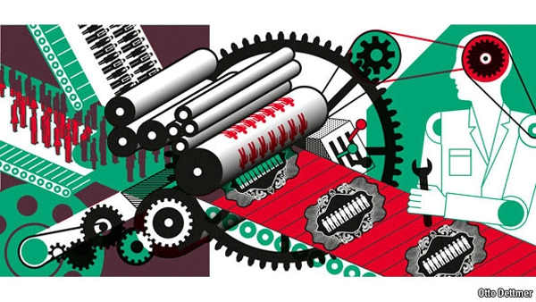
Likely Outcome
Stephen Zarlenga, LSM, p. 644 - warning:
“… the ECB does not stop an overly technocratic approach to running the money system… without enough thought and detailed written provision for the human, social and economic requirements.”
“The system is working. It’s so efficient!”
PRICE STABILITY

Slide 34
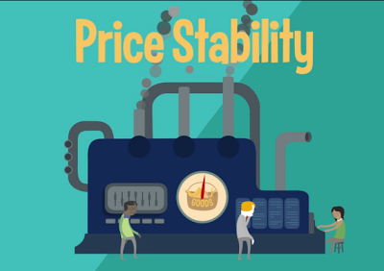
Likely Outcome
Stephen Zarlenga, LSM, p. 644 - warning:
“… ‘price stability’, if achieved through overly restricting the growth in the money supply, will favor wealthy bondholders at the expense of both industrialists and the less well off, increasing the gulf between rich and poor… based rather on one group controlling the money system, measuring and proclaiming the success of that system in terms specially designed to favor itself.”
T”The system is working! I’m getting rich!

Slide 35
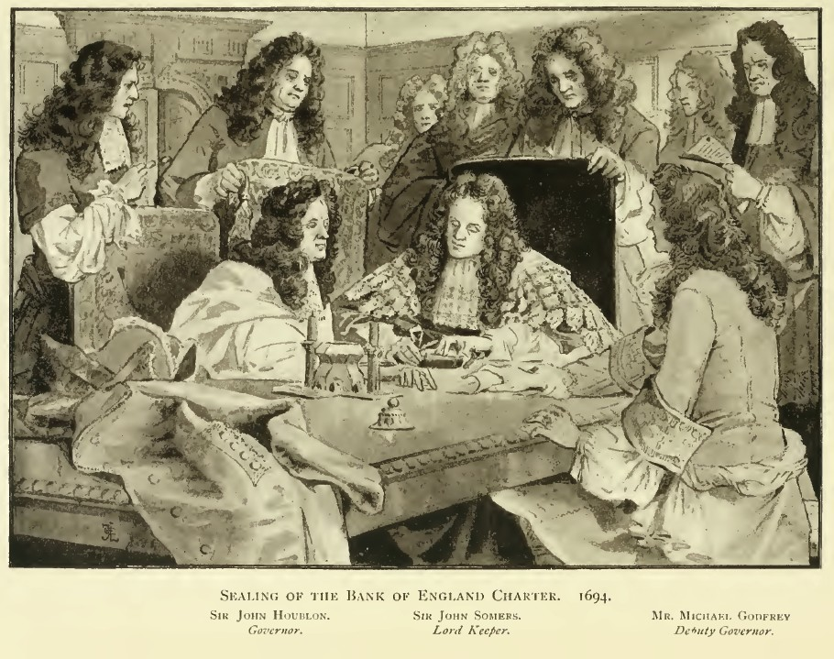
Conclusion
Zarlenga, LSM, p. 645:
“The European Community’s approach to monetary union – carefully deliberating the matter, publishing and then reworking its articles with informed input from many quarters and nationalities – is unique in the history of monetary reforms.”
Frank Vanderlip, President, National City Bank, 1909-1919:
“Despite my views about the value to society of greater publicity for the affairs of corporations, there was an occasion near the close of 1910, when I was as secretive, indeed, as furtive, as any conspirator… I do not feel it is any exaggeration to speak of our secret expedition to Jekyl Island as the occasion of the actual conception of what eventually became the Federal Reserve System.”
DECEPTION
Signing of the Bank of England charter.
“All this while, the very name of a bank or
corporation was avoided, though the notion
of both was intended…” William Patterson,
one of the founders.
DECEPTION

Slide 36
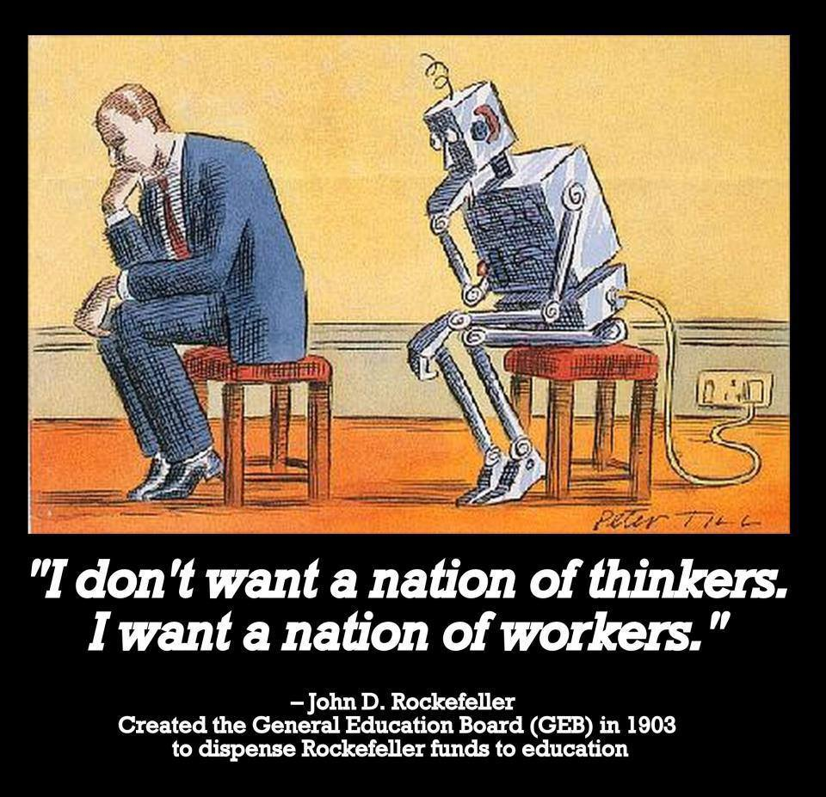
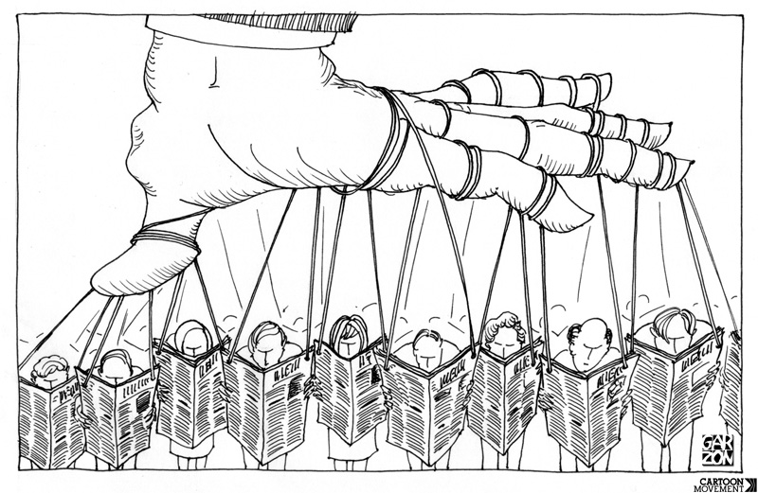
Conclusion
What do you think? Control over the education and national media by the money power can destroy democratic society. Evidence for this is the ignorance of the public of the history of money and the understanding of where money comes from and what money is.

Slide 37
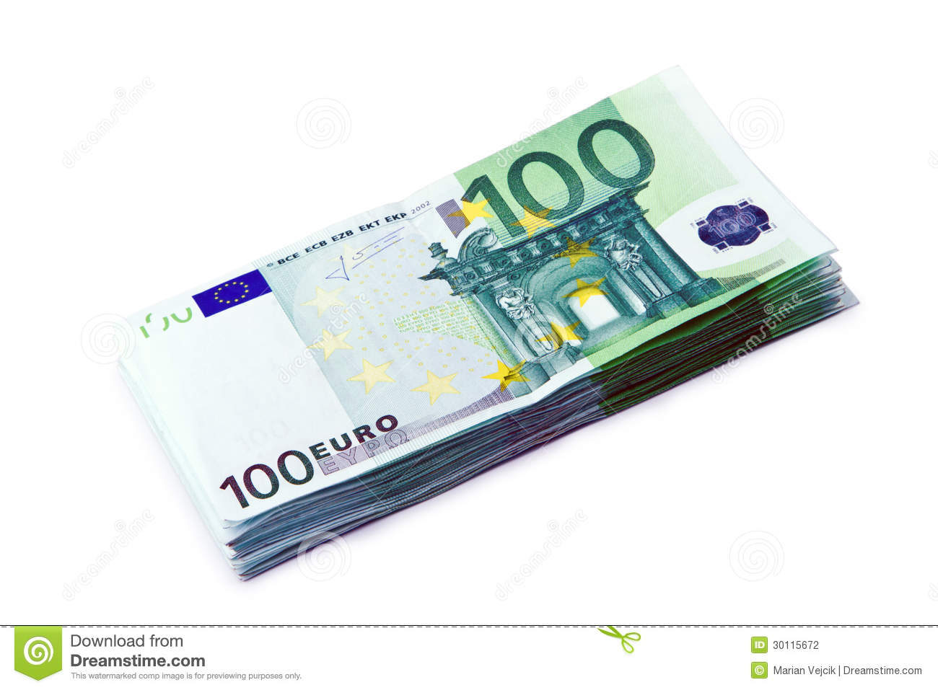
Conclusion
Zarlenga, LSM, p. 645:
“The potential obsession with price stability is one problem. The system must avoid ideological rigidity… These trouble signs can be substantially reduced by clarification of the fiat nature of money as a legal institution of the Community….. of the initial guidelines that the ECB will use in making increases in the money supply. These are not matters that should be left vague, or couched in overly concise technical jargon.”
WHAT IS MONEY? WHERE DOES IT COME FROM?

Slide 38
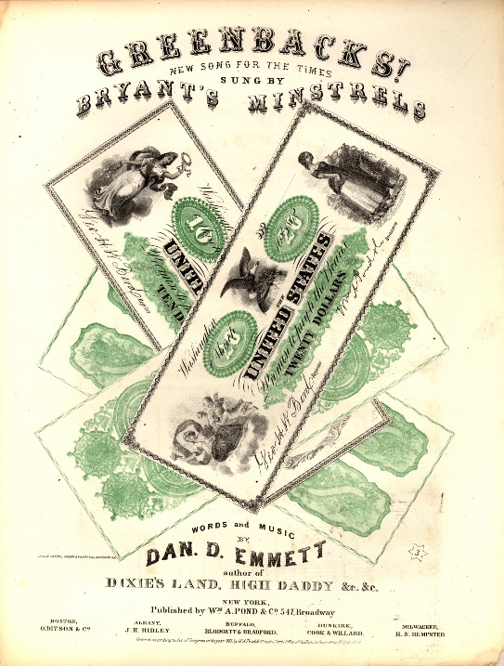
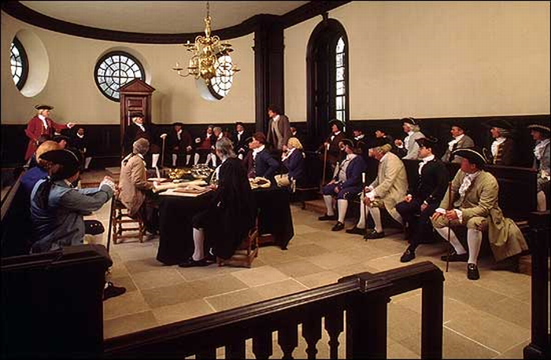
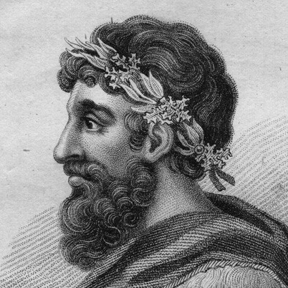
Conclusion
Zarlenga, LSM, p. 645:
“The attempt to disconnect the money system from politics reflects a distrust of the citizenry. …it must also be accountable, and it is through politics that the citizens express (indirectly) whether the money system is functioning well or not.
The raison d’etre [reason for being] of the money system is to serve the community, and history gives us little reason to place more trust in money systems controlled by elites, rather than by the citizens. If anything, the balance of monetary history indicates the opposite.”
Lycurgus of Sparta
instituted the first fiat
public money in 8th century
B.C. which lasted for
3 ½ centuries.
Lincoln’s Greenbacks were public
debt-free money that circulated
up to 1971.
American Colonial legislatures
issued debt-free money.

Slide 39
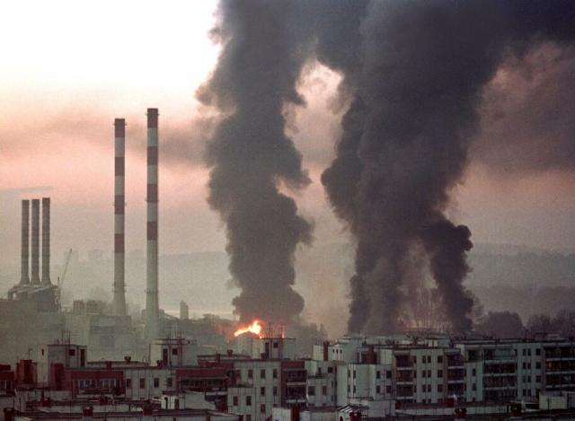
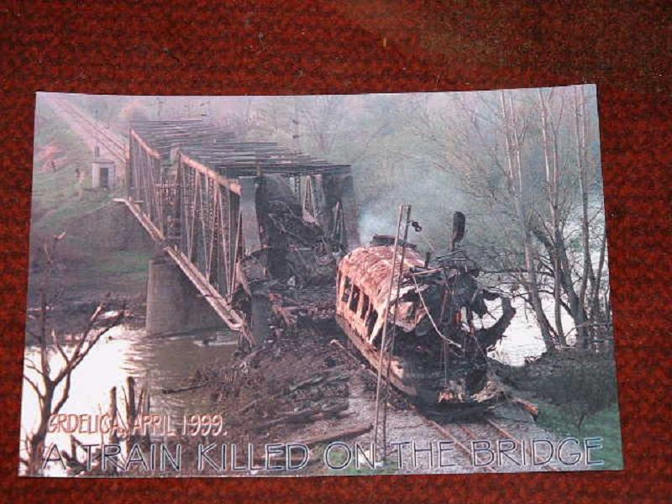
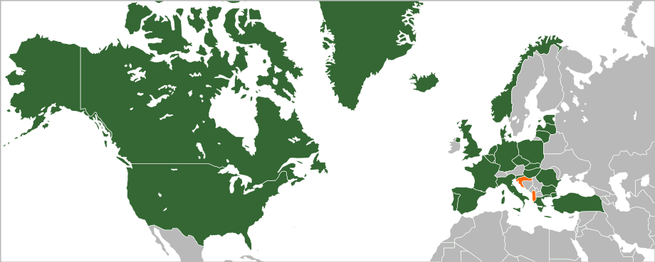
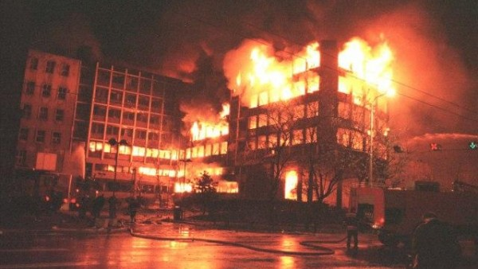
Conflict with Europe?
“Faced with European monetary independence, some really bad people may attempt a form of military domination instead. This possibility is raised, because NATO (North Atlantic Treaty Organization) appears to be emerging as a vehicle for such dominance… These elements could be characterized as an Anglo-American Establishment, comprising the worst elements from both countries.” Zarlenga, LSM, p. 648
NATO: The organization constitutes a system of collective defence whereby its member states agree to mutual
defense in response to an attack by any external party. Wikipedia
NATO’S 1999 WAR ON SERBIA
Is this collective defense?
NATO COUNTRIES

Slide 40
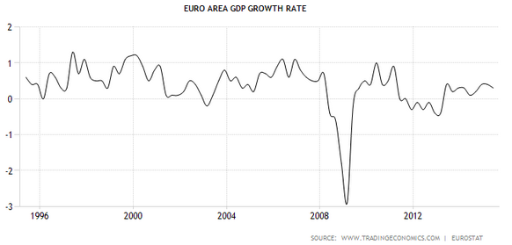
Euro Results Thus Far

Slide 41
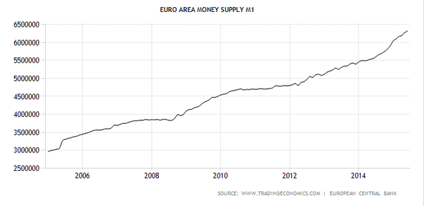
Euro Results Thus Far

Slide 42
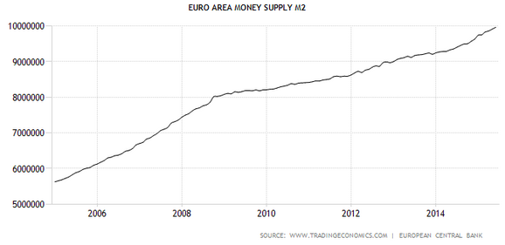
Euro Results Thus Far

Slide 43
Q & A
WILL’S CONCLUSION:
THE CONTROL OF MONEY -- WITHOUT CONTROL FROM THE PUBLIC -- LEADS TO
CORRUPTION … USURPATION … SLAVERY.

