Slide 1
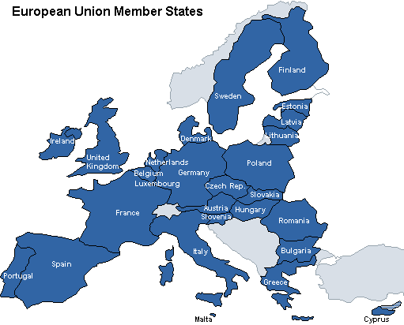
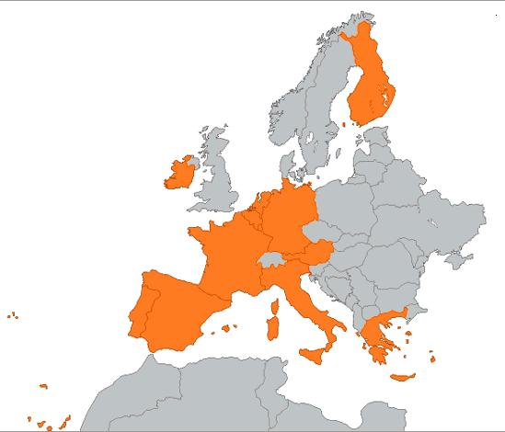
The Lost Science of Money
CHAPTER 23 – Part 1
The European Monetary Union
EU
EMU

Slide 2
THEMES OF LOST SCIENCE OF MONEY BOOK
Primary importance of the money power (power to create money and regulate it)
Nature of money purposely kept secret and confused
How a society defines money determines who controls the society
Battle over control of money has raged for millennia: public vs private
The misuse of the monetary system causes tremendous misery and suffering for the ordinary people. Will & Martin, February 2014
Whenever the public has owned a significant fraction of the money power, great public benefit has ensued: Sparta, the Roman Republic, the American Colonies in the 18th century, GREENBACKS after the Civil War, Canada after the Great Depression, British experience after World War II. Martin, July 2014.

Slide 3
PARTS OF PRESENTATION
The Formation of the European Union (EU)
European Monetary Union (EMU)
Treaty of Maastricht 1993
Stages towards the creation of EMU
The 3 decision making bodies of the ECB
The Owners
Reports and Scrutiny
Convergences: Fiscal Deficits; Government Debt; Price Stability; Exchange Rate Stability; Interest Rates
Money Creation Process
Policy Determination
Bank Notes
Monetizing Debt
Open Market and Credit Operations
Loan Creation Through Fractional serve Banking
Minimum Reserves
The Emergency Clause
Comments: Money Creation Powers of ECB

Slide 4
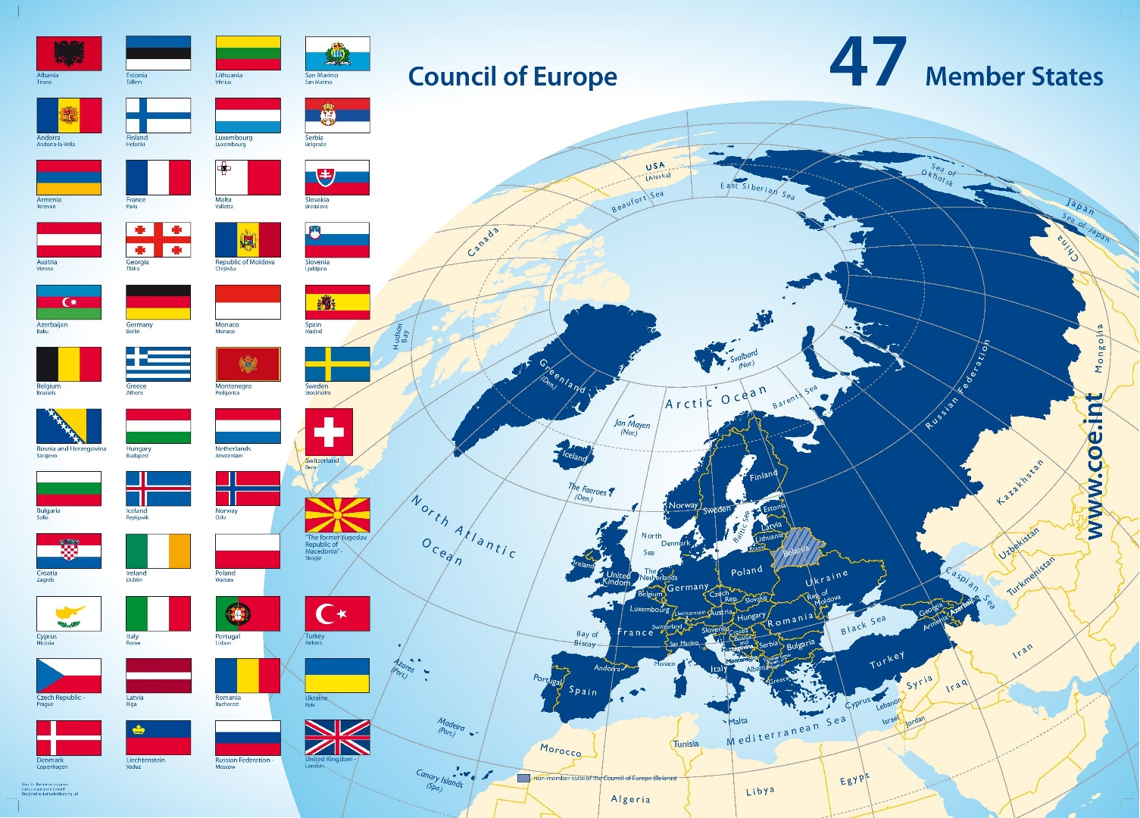
The Formation of the European Union (EU)
COUNCIL OF EUROPE, 1949
The historical roots of the European Union lie in the Second World War. Europeans are determined to prevent such killing and destruction ever happening again.
West European nations create the Council of Europe
founded in 1949
a regional intergovernmental organisation which promotes human rights, democracy, and the rule of law
cannot make binding laws.
best known body of the Council of Europe is the European Court of Human Rights, which enforces the European Convention on Human Rights
founded on 5 May 1949 by the Treaty of London: Belgium, Denmark, France, Ireland, Italy, Luxembourg, Netherlands, Norway Sweden, United Kingdom
today the Council includes most European states

Slide 5
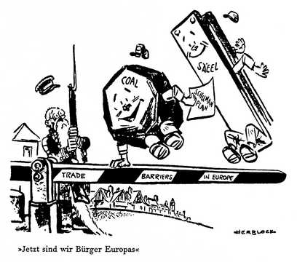
The Formation of the European Union (EU)
European Coal and Steel Community (ECSC) Treaty of Paris 1951-2002
the first international organisation to be based on the principles of supranationalism: a type of multinational political union where negotiated power is delegated to an authority by governments of member states
create a common market for coal and steel among its member states:
Belgium, France, West Germany, Italy, Netherlands, Luxembourg
run by four institutions:
(1) a High Authority composed of independent appointees
(2) a Common Assembly composed of national parliamentarians
(3) a Special Council composed of nation ministers
(4) a Court of Justice
A set of common rules was established to control cartels and to regulate mergers. The High Authority fixed prices and set production limits or quotas and was authorized to impose fines on business firms that infringed treaty rules.
From the 1960s one of the ECSC’s main tasks was to supervise its members’ reduction of their excess production of coal as that mineral was replaced by petroleum as an industrial fuel.

Slide 6
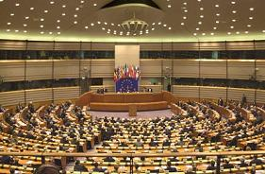
The Formation of the European Union (EU)
European Economic Community (EEC) Treaty of Rome 1957
A SINGLE MARKET – THE COMMON MARKET
its initial aim was to bring about economic integration, including a common market and customs union
known as the Common Market in the English-speaking world: 1962 - establishment of common price levels for agricultural products; 1968 - internal tariffs (tariffs on trade between member nations) were removed on certain products
6 founding members: Belgium, France, Italy, Luxembourg, Netherlands, West Germany
In 1993, a complete single market was achieved allowing for the free movement of goods, capital, services, and people within the EEC
incorporated and renamed as the European Community (EC) in 1993 by the Maastricht Treaty

Slide 7
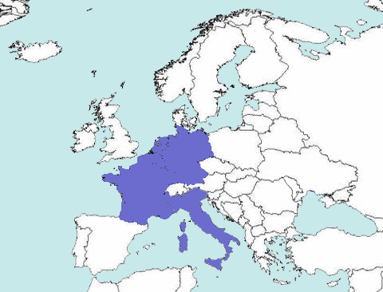
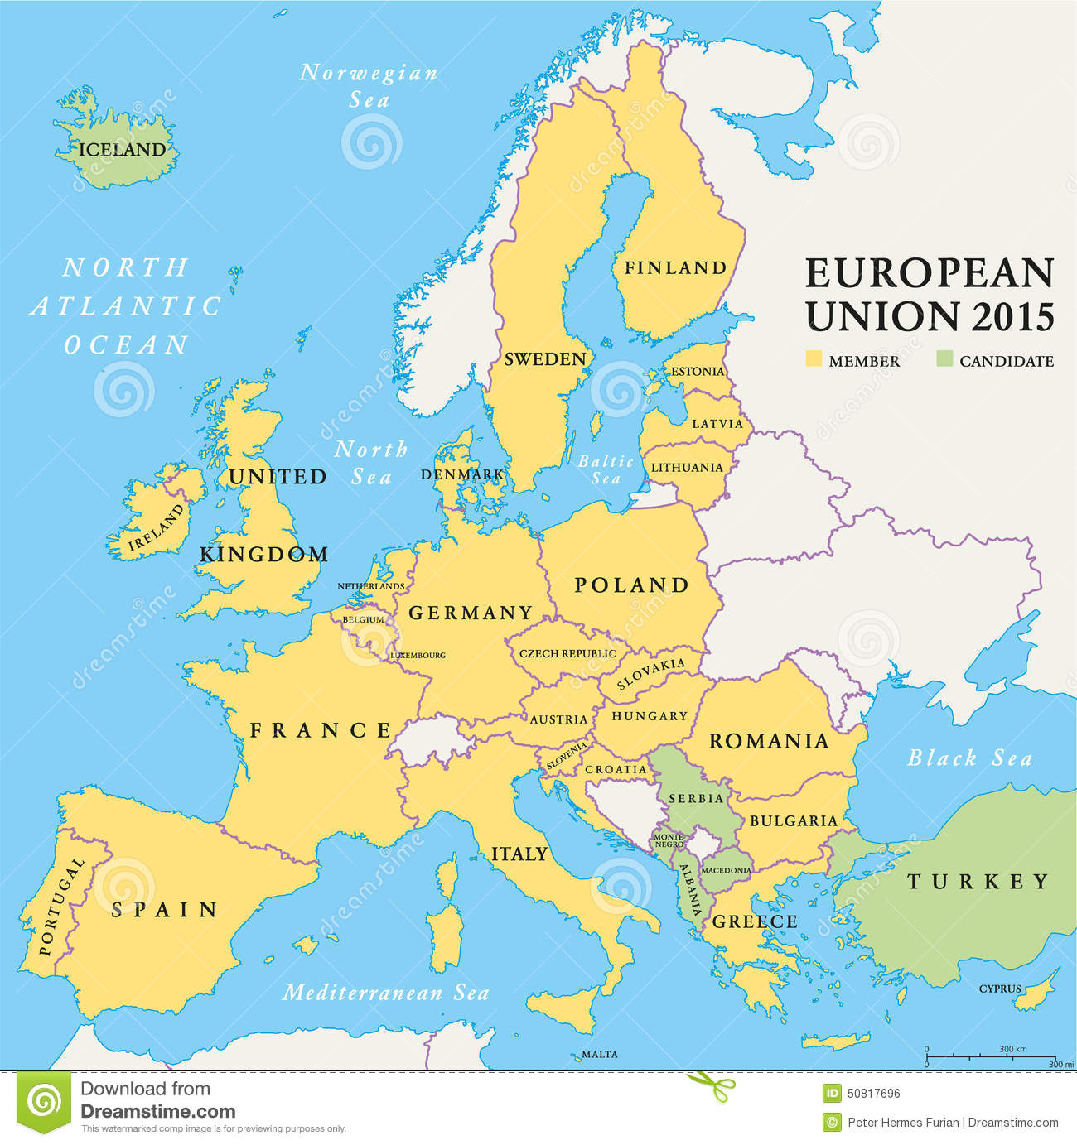
Formation of the European Union (EU)
European Economic Community (EEC)
Treaty of Rome 1957
1957
The six founding members were France, West Germany, Italy and the three Benelux countries: Belgium, the Netherlands and Luxembourg.
The first enlargement was in 1973, with the accession of Denmark, Ireland and the United Kingdom. Greece, Spain and Portugal joined in the 1980s.
The former East Germany became part of the EEC upon German reunification in 1990.
Upon the entry into force of the Maastricht Treaty in 1993, the EEC was renamed the European Community to reflect that it covered a wider range than economic policy. The EU has enlarged to include an additional sixteen countries by 2013.
2015

Slide 8
European Monetary Union - EMU
MAASTRICHT TREATY 1993: Est. European Union (EU) - Renamed EEC to European Community (EC)
BUT MORE IMPORTANTLY . . . . . .
Created the European Central Bank (ECB)
& the European Systems of Central Banks (ESCB)
Battle over control of money has raged for millennia:
public vs private
“…Europeans embark on the greatest monetary reform since Bretton Woods and the International Monetary Fund. This development is going to affect the lives and economies of all people, everywhere, far into the future.” Zarlenga, LSM, p. 629
EUROPEAN CENTRAL BANK (ECB)

Slide 9
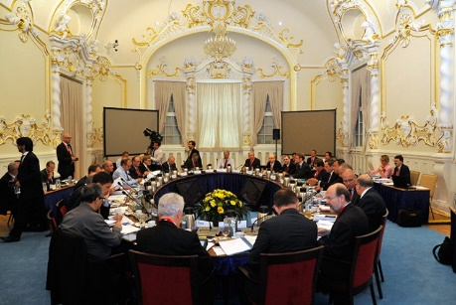
European Monetary Union - EMU
The Treaty of Maastricht was just the first step towards the European Monetary Union.
Other stages followed:
6/1/1998
12/31/1998
1/1/1999
1/1/2002
Single currency launched
Authority over monetary
policy transferred from
National Central Banks to
ECB Governing Council
ECB established
Euro formed
exchange rates
irrevocably fixed
New bank notes &
coins introduced

Slide 10
European Monetary Union - EMU
The ECB and the National Central Banks are independent of their governments
Treaty of Maastricht Article 107
… neither the ECB, nor a national central bank, nor any member of their decision-making bodies shall seek or take instructions from Community institutions or bodies, from any government of a Member State or from any other body.
The Community institutions and bodies and the governments of the Member States undertake to respect this principle and not to seek to influence the members of the decision-making bodies of the ECB or of the national central banks in the performance of their tasks.
Article 108
Each Member State shall ensure… that its national legislation including the statutes of its national central bank is compatible with this Treaty and the Statute of the ESCB.
WHO IS IN CONTROL?

Slide 11
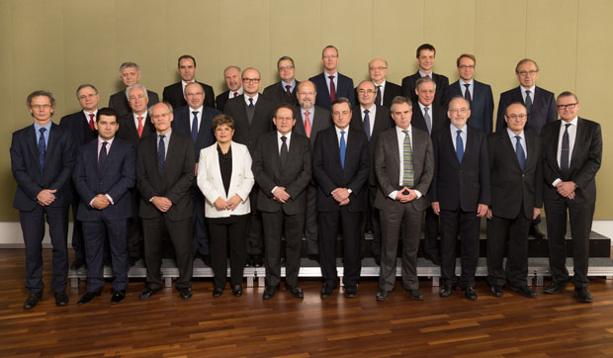
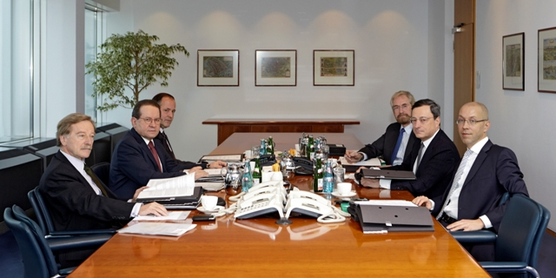
European Monetary Union - EMU
“The monetary power is primarily to be embodied in the European Central Bank (ECB), described in the Protocols of the treaty. Because it is set forth separately from the other institutions … and is being formed years after the others, there’s the impression that it is subsidiary to them. It is not.” Zarlenga, LSM, p. 630
The 3 decision making bodies of the ECB
ECB Executive Board: a President, a Vice President and at least 4 others, chosen from among persons of recognized standing and professional experience in monetary or banking matters. Appointed by EU heads of state. Recommended by EU Council, con-sulting EU Parliament and ECB Governing Council.
ECB Governing Council:
ECB Executive Board
and member national central bank governors
ECB General Council:
ECB Pres. and Vice Pres.,
and member national
central bank governors

Slide 12
European Monetary Union - EMU
ECB Governing Council
ECB General Council
ECB Executive Board
COMMENT 2002: The 3 decision making bodies of the ECB
“Real sovereignty and power are being ceded by the national central banks, and their respective nations, to the ECB... This centralization of monetary power can be good or very bad, depending on how wisely it is implemented… The danger is not well recognized: that the potential for catastrophic error is greater from one single power center than from twelve somewhat independent ones, closer to their constituencies. Consider Byzantium’s golden grip on Europe’s throat for 900 years.…
Restricting the management of the institution to people who have been indoctrinated into essentially the same economic theories is dangerous because… those theories themselves have been structured over time to serve particular interests.”
Zarlenga, LSM, pp. 631-632

Slide 13
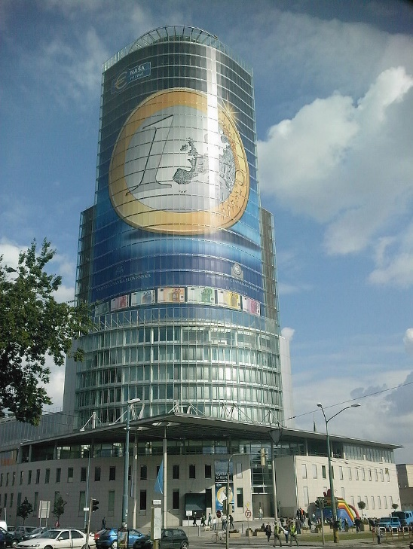
European Monetary Union - EMU
The Owners of the ECB: The National Central Banks.
ECB’s shareholders are the national central banks of the member states. They own the ECB’s capital of five billion euros. The initial capital allocation key was determined in 1998 on the basis of the states' population and GDP, but the key is adjustable. Shares in the ECB are not transferable and cannot be used as collateral.
The member national central banks provide the ECB with reserve assets. 15% of the contributions were made in gold, and the remaining 85% in US dollars and Japanese yen.
National Bank of Slovakia,
member since 2009
COMMENT 2002: Owners of the ECB
“By avoiding private ownership of the European Central Bank, the Community has wisely avoided creating an institution that is liable to take important monetary actions in the interest of its owners, rather than for the proper functioning of the money system. There is still the potential for those who manage the central bank to take actions that favor their former/future employers, their perceived class affiliations, or even their friends and associates. This is another reason for requiring diverse backgrounds among management.” Zarlenga, LSM, pp. 632-633

Slide 14
European Monetary Union - EMU
Reports and Scrutiny
(From the Protocol annexed to the Treaty establishing the European Community
https://www.ecb.europa.eu/ecb/pdf/orga/escbstatutes_en.pdf??23e3230a2693935abdf505f2c8d0aa9b)
A consolidated financial statement of the ESCB shall be published each week.
The accounts of the ECB and national central banks shall be audited by independent external auditors recommended by the Governing Council and approved by the Council. The auditors shall have full power to examine all books and accounts of the ECB and national central banks and obtain full information about their transactions.
[The ECB Governing Council] The proceedings of the meetings shall be confidential. The Governing Council may decide to make the outcome of its deliberations public.
Members of the governing bodies and the staff of the ECB and the national central banks shall be
required, even after their duties have ceased, not to disclose information of the kind covered by the obligation
of professional secrecy.

Slide 15
European Monetary Union - EMU
COMMENT 2002: Reports and Scrutiny
“Europeans would probably be surprised to learn that the U.S. Federal Reserve System has never been independently audited.
The secrecy to the grave requirement, on meetings and other matters, raises some concern. Certainly the ECB should not make it easy for speculators and others to thwart or unfairly benefit from its policies. But that can be done without giving the institution too much of an air of secrecy, which could lead to worse problems.”
Zarlenga, LSM, p. 633

Slide 16
European Monetary Union - EMU
In the steps towards monetary union,
member states had to bring key monetary measurements into CONVERGENCE
FISCAL DEFICITS must be equal or less than 3% of Gross Domestic Product (GDP)
GOVERNMENT DEBT must be equal or less than 60% of GDP
PRICE STABILITY (at an average annual rate) must not be more than 1 ½ % greater than three best
performing member states
EXCHANGE RATE STABILITY must stay within normal fluctuation margins of the Exchange Rate Mechanism, without severe tensions or unilateral devaluations for a minimum of 2 years
INTEREST RATES ON MEMBER’S LONG-TERM GOVERNMENT BONDS had to be within 2% of the three best
performing member states in terms of price stability
COMMENT 2002: CONVERGENCE
“The convergence requirements, especially on deficits, proved to be a real test of the ability of member states to confirm to some tight requirements, which even the economically strongest had great difficulty meeting…
The willingness of Germany to go to 12% unemployment in its effort to meet the pre-ordained requirements … represents a danger signal that ideology may be allowed to dominate the system, rather than requiring that the money system work effectively to improve life in the community.” Zarlenga, LSM, p. 634

Slide 17
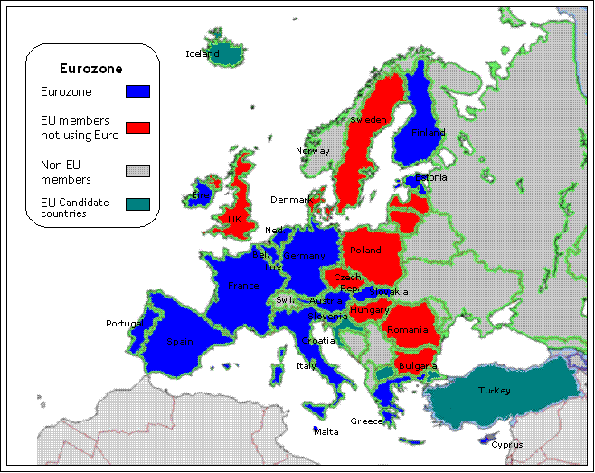
European Monetary Union - EMU
Eurozone, officially called the euro area, is a monetary union of 19 of the 28 European Union (EU) member states which have adopted the euro (€) as their common currency and sole legal tender. The other nine members of the European Union continue to use their own national currencies.

Slide 18
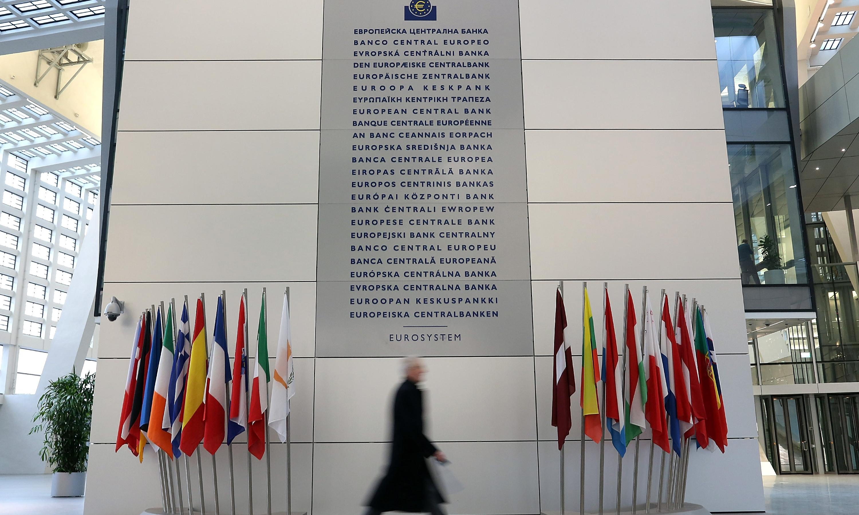
European Monetary Union – EMU
EUROSYSTEM OF CENTRAL BANKS
The Eurosystem consists of the ECB and the central banks of the member states that belong to the Eurozone, which apply the monetary policy decided by the ECB).
The Eurosystem is distinct from the European System of Central Banks (ESCB), which is the group of central banks that includes the ECB and the central banks of all European Union member states, including those of countries not included in the eurozone

Slide 19
MONEY CREATION PROCESS
“Usually the key feature of a monetary system is how new money is created and added to the system, or removed from circulation. This is of paramount importance because it is the main way the money system is controlled…
It is also important because in the process of defining how the money supply is created, it is normally necessary, and always desirable, to clearly state the exact definition of money in the system.” Zarlenga, LSM, p. 634
THE ECB TAKES EFFECTIVE CONTROL
OF THE SEVERAL METHODS OF
CREATING AND LIQUIDATING MONEY…

Slide 20
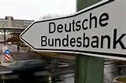
MONEY CREATION PROCESS:
a) Policy Determination
ECB Governing Council
formulates monetary policy
key interest rates
supply of reserves
etc.
ECB Executive Board
implements decisions of
ECB Governing Council
&
instructs National Central Banks
ECB will have power
to instruct National Central Banks
to carry out operations
National Central Banks
must follow guidelines and
instructions of ECB
ECB Governing Council
will take the necessary steps to ensure compliance

Slide 21
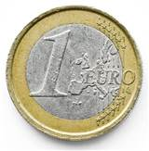
MONEY CREATION PROCESS:
Bank notes and minting of coins
ECB Governing Council
has the exclusive right
to authorize the issue of bank notes
Both the ECB and
National Central Banks
may issue these notes
The National Central Banks
will mint the coins
These bank notes
are the only
LEGAL TENDER

Slide 22
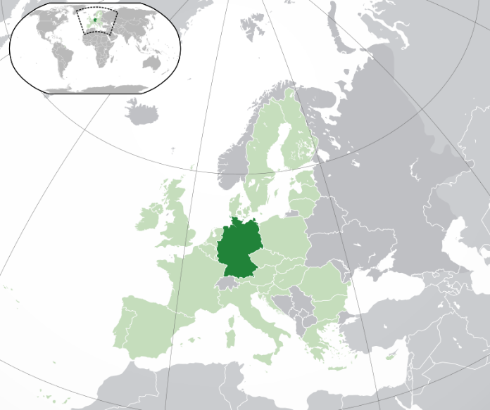
MONEY CREATION PROCESS:
Monetizing debt
ECB
The ECB and the National Central Banks are forbidden by Article 104 of the Maastricht Treaty to create debt-money, also known as credit:
ARTICLE 104
1. Overdraft facilities or any other type of credit facility with the ECB or with the central banks of the Member States (hereinafter referred to as ‘national central banks’) in favour of Community institutions or bodies, central governments, regional, local or other public authorities, other bodies governed by public law, or public undertakings of Member States shall be prohibited, as shall the purchase directly from them by the ECB or national central banks of debt instruments [government bonds].
The ECB and National
Central Banks of EMU
are forbidden to buy
government bonds
(debt) directly from
their governments.
Federal Republic
of Germany

Slide 23
MONEY CREATION PROCESS:
Open market and credit operations
NY Federal Reserve Bank
Primary Dealer List
(to buy U.S. Government Bonds
as part of Open Market Operations:
Treaty of Maastricht
Article 18
Open market and credit operations
18.1.
In order to achieve the objectives of the ESCB and to carry out its tasks, the ECB and the national central banks may:
operate in the financial markets by buying and selling outright (spot and forward) or under repurchase agreement and by lending or borrowing claims and marketable instruments, whether in Community or in non-Community currencies, as well as precious metals;
conduct credit operations with credit institutions and other market participants, with lending being based on adequate collateral.
18.2.
The ECB shall establish general principles for open market and credit operations carried out by itself or the national central banks…
Bank of Nova Scotia, New York Agency BMO Capital Markets Corp. BNP Paribas Securities Corp. Barclays Capital Inc. Cantor Fitzgerald & Co. Citigroup Global Markets Inc. Credit Suisse Securities (USA) LLC Daiwa Capital Markets America Inc. Deutsche Bank Securities Inc. Goldman, Sachs & Co. HSBC Securities (USA) Inc. Jefferies LLC J.P. Morgan Securities LLC Merrill Lynch, Pierce, Fenner & Smith Incorporated Mizuho Securities USA Inc. Morgan Stanley & Co. LLC Nomura Securities International, Inc. RBC Capital Markets, LLC RBS Securities Inc. SG Americas Securities, LLC TD Securities (USA) LLC UBS Securities LLC.

Slide 24
MONEY CREATION PROCESS:
Loan creation through fractional reserve banking
Treaty of Maastricht
Monetary policy
Article 105
The ESCB shall contribute to the smooth conduct of policies pursued by the competent authorities relating to the prudential supervision of credit institutions and the stability of the financial system.
Stephen Zarlenga, LSM, p. 636:
“Since the fall of Byzantium, commercial banks have created money by making loans –
by entering credits on their books.”

Slide 25
MONEY CREATION PROCESS:
Minimum reserves
Treaty of Maastricht Article 19
Minimum reserves
19.1
… the ECB may require credit institutions established in Member States to hold minimum reserves on accounts with the ECB and national central banks…
Regulations concerning… minimum reserves may be established by the Governing Council.
In cases of non-compliance the ECB shall be entitled to levy penalty interest and to impose other sanctions with comparable effect.
19.2
… the Council shall… define the basis for minimum reserves… as well as the appropriate sanctions in cases of non-compliance.

Slide 26
MONEY CREATION PROCESS:
Emergency Clause
Treaty of Maastricht Article 20
Other instruments of monetary control
The Governing Council may, by a majority of two thirds of the votes cast, decide upon the use of such other operational methods of monetary control as it sees fit…
The Council shall… define the scope of such methods if they impose obligations on third parties.
ECB GOVERNING COUNCIL
ECB GOVERNING COUNCIL

Slide 27
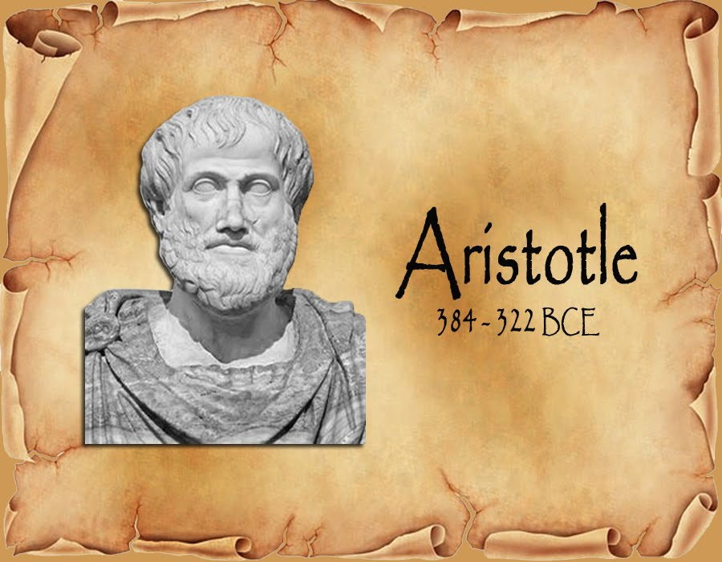
COMMENTS: MONEY CREATION POWERS OF ECB
“First, the ECB is about the creation, control, and liquidation of money. But there is no clear definition of money. Do they think it is unnecessary?...
One can infer a jumbled definition of this money, as ‘backed’ by, (but not redeemable for) various existing assets, commodities, government and other securities” Zarlenga, LSM, p. 637
“MONEY EXISTS NOT BY NATURE BUT BY LAW.”

Slide 28
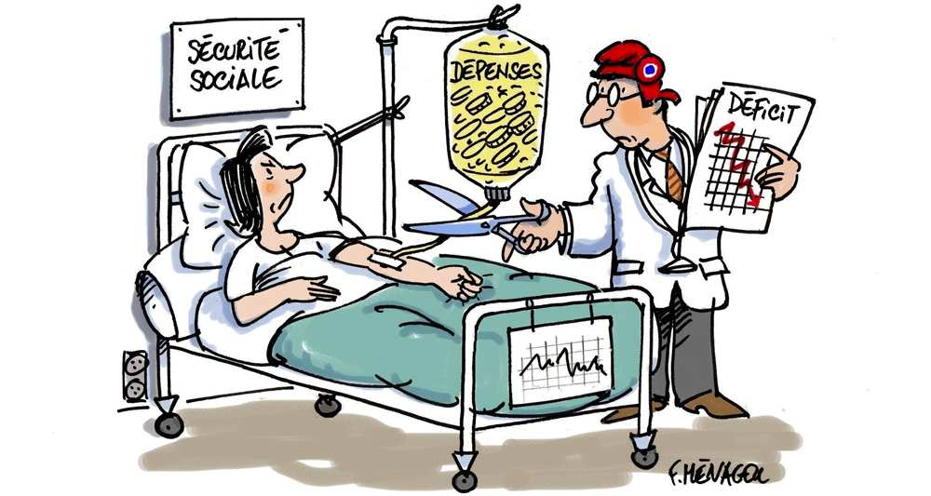
COMMENTS: MONEY CREATION POWERS OF ECB
“The second crucial item missing is a discussion of exactly how the ECB will create the new money needed as Europe’s population, industry and commerce grow. Which guidelines will be used?
Will money growth be geared to population growth? Adjusted upwards for growth in production and services? Be dependent on foreign trade balances? Left largely to the discretion of private bankers as in the U.S.?” Zarlenga, LSM, p. 637

Slide 29
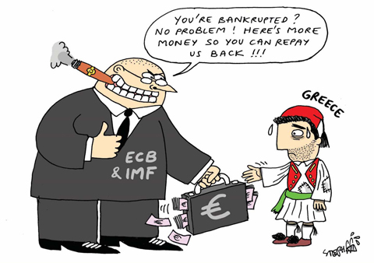
HOW AND WHY DID THIS HAPPEN?

Slide 30
Q & A
WILL’S CONCLUSION:
THE CONTROL OF MONEY -- WITHOUT CONTROL FROM THE PUBLIC -- LEADS TO
CORRUPTION … USURPATION … SLAVERY.

