Slide 1
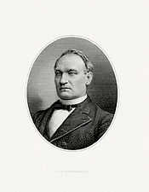
The Lost Science of Money
CHAPTER 18 – Part 2
19TH CENTURY MONETARY CRIMES – THE GREAT DE-MONETIZATIONS
“The conspiracy … formed here and in Europe to destroy … from
three-sevenths to one-half of the metallic money of the world,
is the most gigantic crime of this or any other age.”
John G. Carlisle, House of Representatives, February 21, 1878
John G. Carlisle (1834 – 1910)
Sec of Treasury 1893-1897

Slide 2
THEMES OF LOST SCIENCE OF MONEY BOOK
Primary importance of the money power (power to create money and regulate it)
Nature of money purposely kept secret and confused
How a society defines money determines who controls the society
Battle over control of money has raged for millennia: public vs private
The misuse of the monetary system causes tremendous misery and suffering for the ordinary people. Will Decker & Martin Dunn, February 2014
Whenever the public has owned a significant fraction of the money power, great public benefit has ensued: Sparta, the Roman Republic, the American Colonies in the 18th century, GREENBACKS after the Civil War, Canada after the Great Depression, British experience after World War II. Martin Dunn, July 2014.

Slide 3
PARTS OF PRESENTATION
INTERNATIONAL MONETARY INFLUENCES
Introduction
The Second Attack – Against the Greenback Bonds
2a) Bankers Sabotage the Democrats in 1868 Presidential Race 1868
2b) Credit Strengthening Act Signed by Grant 1869
The Third Attack – the “Secret” Demonetization of Silver 1873
3a) English Interference with the U.S. Mint Laws 1870-4
3b) The “Discovery” of the “Crime of 1873”
3c) The 1876 U.S. Monetary Commission Investigation 1876
NATIONAL MONETARY ISSUES
Third Parties Formed to Defend the Greenbacks
National Labor Union 1866-1874
Greenback Party 1876 - 1884
Farmers’ Alliance/People’s Party 1877 - 1896
The Silver Diversion
America Re-Monetizes Silver Against the World
The Worldwide Panic in the 1890’s
The U.S. Money Drought: 1860s – 1890s
The Greenback Legacy Continued
Summary

Slide 4
INTRODUCTION

Slide 5
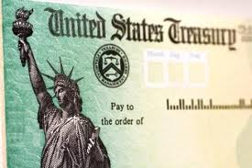
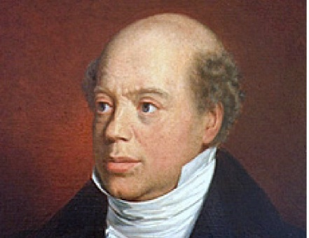
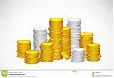
PART 1
INTRODUCTION: 5-20 BONDS
During the American Civil War, European financiers bought hundreds of millions of U.S. war bonds, paying for them in Greenbacks, bearing interest “in coin”. They were known as 5-20’s.
DEBT BOUGHT WITH GREENBACKS AND
BEARING INTEREST “IN COIN” AT CLOSE OF CIVIL WAR
Feb. 25, 1862.................................................................... ........do.................................................. 514,780,500.00
June 30,1864 .................................................................... ........do.................................................. 100,000,000.00
Mar. 3, 1865..................................................................... ........do.................................................. 44,479,100.00
Mar. 3,1864....................................................................... 5 per cent bonds.................................. 172,770,100.00
Mar. 3, 1863...................................................................... 6 per cent bonds.................................. 75,000,000.00
1
1
FOREIGN INVESTORS BUY BONDS with Greenbacks
1
1
FOREIGN INVESTORS EARN INTEREST ‘IN COIN’
2
1
3
1
3
IN FUTURE, US TREASURY REDEEMS BONDS
WITH LEGAL TENDER GREENBACKS
1

Slide 6
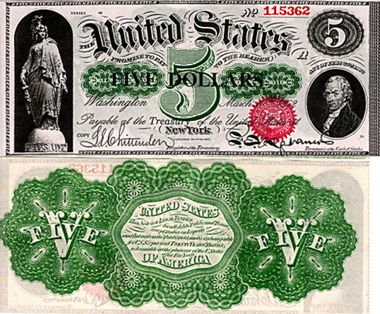
PART 1
INTRODUCTION: Redemption of 5-20 Bonds
During the American Civil War, the French Supreme Court promulgated a decision,
in accordance with the entire range of legal authority,
that contracts for money were equitably dischargeable in the current money of the day of payment.
FUTURE REDEMPTION WITH
LEGAL TENDER NOTES = GREENBACKS

Slide 7
PART 1
INTRODUCTION: Redemption of 5-20 Bonds
“… In this respect these bonds did not differ from all the other bonds issued since 1791, since none of them contained any provision as to the kind of money in which they should be paid; but, before the war, gold and silver coins were the only recognized legal-tender money, while after the war the existence of the legal-tender United States notes gave rise to discussion as to the power of the Government to liquidate all its debts in paper money..” U.S. Treasury Department, Information Respecting United States Bonds, Paper Currency and Coin, Production of Precious Metals, Etc., Revised July 1, 1915, p. 8 (below, p. 7)
FUTURE REDEMPTION WITH
LEGAL TENDER NOTES = GREENBACKS

Slide 8
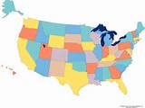
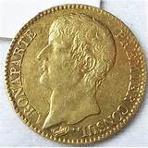
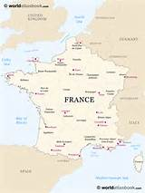
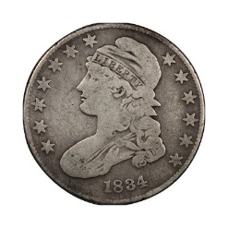
PART 1
INTRODUCTION: The Question of the Payment of Interest in “Coin”
“This decision [that contracts for money were dischargeable in the lawful money of the day] alarmed the European holders of
American bonds. ‘What might not those shrewd, those progressive Americans do with respect to the interest on these bonds, which was payable in ‘coins?’ Perhaps they would strike coins of debased gold, like the ancient Athenians…
“There was but one way to avert this financial calamity. This was to demonetize one of the precious metals, and fix the standard of the other…
“…the American government would never consent to that [demonetizing gold], because it would oblige them to pay in silver dollars, which… as influenced by our (the French mint) law, are worth 3 per cent more than gold ones. Therefore, let us endeavor to demonetize silver.”
Alexander Del Mar, A History of Monetary Crimes, p. 80
American silver worth 3% more
in Europe
15.5 silver:
1 gold
16 silver:
1 gold after 1834

Slide 9
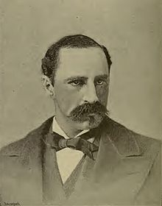
PART 1
INTRODUCTION: European Fundholding Syndicate Intrigues
“The [Latin] Monetary Union of 1865 was the beginning of that scheme of reckless avidity and dark intrigue which in the course of a few years destroyed one half of the metallic basis of money….
“Numerous conventions under its patronage were held in France, Belgium and Germany: its influence is plainly discernible in the treacherous defection of certain party leaders during the American presidential election of 1868; in the gratuitous [having no justification] ‘Credit-strengthening’ act of 1869… for the … alteration of our own Mint Code, namely, the alteration which demonetized silver and threw the commercial world into bankruptcy.” Alexander Del Mar, A History of Monetary Crimes, p. 81-82
Alexander Del Mar
(1836–1926),

Slide 10
THE SECOND ATTACK: AGAINST THE GREENBACK BONDS

Slide 11
PART 2
The Second Attack – Against the Greenback Bonds
The Union Congress issued government bonds to fund the Civil War, bought with Greenbacks. These bonds were to ‘mature’ (be repaid to creditors) in 20 years but were ‘callable’ by the government (repaid early if the government desired it) in 5 years. Therefore, they were called 5-20’s. Their interest was to be paid in ‘coin’ and principal in legal tender (Greenbacks).
The foregoing is a correct statement of the Public Debt, as appears from the Books and Treasurer's Returns in the Department, at the close
of business on the last day of August, 1869. WILLIAM A. R I C H A R D S O N , Acting Secretary of the Treasury

Slide 12
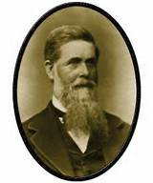
PART 2a
The Second Attack – Against the Greenback Bonds
Financiers began to call for repayment of principal of the 5-20’s in COIN – when they had been bought during the Civil War from the government in GREENBACKS, worth half the price of gold at the time.
Jay Cooke & Company was a U.S. bank that operated from 1861 to 1873. Headquartered in Philadelphia, PA, with branches in New York City and Washington D.C., the bank helped underwrite the Union Civil War effort. It was the first "wire" brokerage house, pioneering the use of telegraph messages to confirm securities transactions with clients.
Cooke & Company sold hundreds of millions of dollars in Union government bonds. Its reputation among investors around the world enabled the bank to sell these bonds when other brokerages could not.
Jay Cooke
(1821 – 1905)

Slide 13
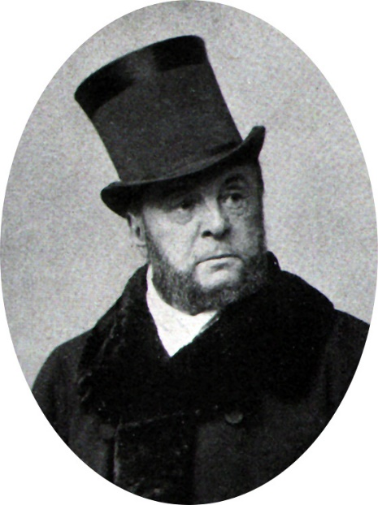
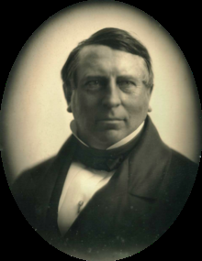
PART 2a
The Second Attack – Against the Greenback Bonds
August Belmont Sr. “was and had been for many years the agent for an European banking Syndicate. This Syndicate was the owner of a large amount in American War bonds and had acted as the agent and banker of numerous other European houses interested in the same bonds.” (5-20’s) Alexander Del Mar, A History of Monetary Crimes, p. 60
August Belmont Sr. “had been appointed Chairman of its /Democratic Party’s/ National Committee at a time when the fortunes and prospects of the party were very low and chiefly on account of the liberality with which he contributed to its beggared finances … On the 13th of March, 1868, Baron James Rothschild of Paris wrote to Mr. Belmont a letter which was exhibited by the latter to several gentlemen in New York. This letter had evidently been prepared for the purpose of being shown to leading members of the party, in order to influence their opinion on the bond question … concluded with warnings of ruin to those who might oppose the payment of the bonds in coin, or who might advocate their liquidation in greenbacks.” Alexander Del Mar, A History of Monetary Crimes, pp. 61-63
August Belmont, Sr. 1813-1890
“We’ve singled out Baron Rothschild for a reason: it is possible to trace the actions of his intermediary in America (his only primary agent here), August Belmont, in the Greenback political struggle. Belmont was a major factor in the Democratic Party of that day.” Stephen Zarlenga, LSM, p. 487
James Mayer de Rothschild 1792-1868

Slide 14
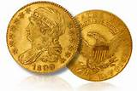
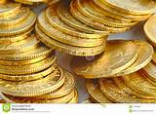
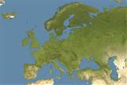
PART 2a
The Second Attack – Against the Greenback Bonds
“Payment in gold would give the English Baron James Rothchild, his clients, and other bankers, two undeserved benefits: first – the obvious 30% gain /in principal value/; second, the U.S. did not have the gold and would have to borrow it from the only possible source – Baron Rothschild and the other bankers, and their wealthy clients in Europe.
The U.S. would then have to pay them interest on that gold loan … the United States people would be financially raped in the process.” Stephen Zarlenga, LSM, p. 487
GOLD LOAN TO REPAY PRINCIPAL OF 5-20 BONDS
PRINCIPAL REPAID TO CREDITORS
INTEREST ON GOLD LOAN
(TO REPAY PRINCIPAL)

Slide 15
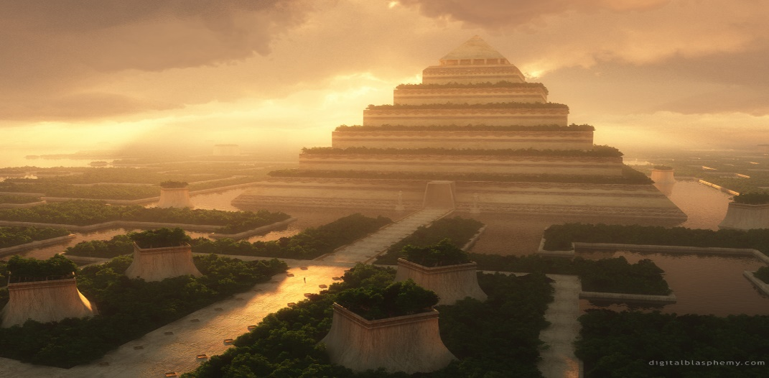
PART 2a
The Second Attack – Against the Greenback Bonds
“Since the physical gold would go from the bankers to the bankers, it’s clear that what was important to them about gold was not any ‘intrinsic’ qualities, but how they could use it to fleece American society … by paying them interest on their sterile gold holdings, which, like the ancient temple cults, they probably hoarded in useless oversupply.” Stephen Zarlenga, LSM, p. 487

Slide 16
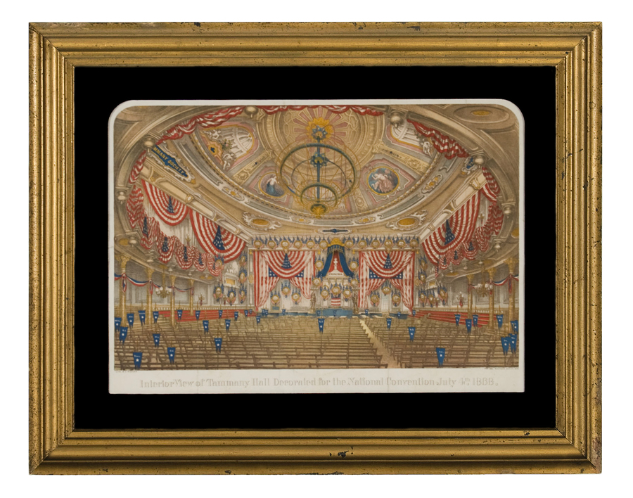
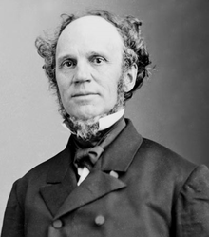
PART 2a
Bankers Sabotage the Democrats in the 1868 Presidential Race
“The Democratic Party platform opposed redeeming the bonds in coinage, while their candidate Seymour personally favored it. But the conspirators decided to take no chances and destroyed Seymour.” Stephen Zarlenga, LSM, pp. 487-488
“The Democratic national Convention met … to the complete
chagrin of the conspirators it passed the following resolution:
‘Where the obligations of the Government do not expressly state
upon their face, or the law under which they were issued does not
provide that they shall be paid in coin, they ought in right and in
justice, be paid in the lawful money of the United States.’ “
Alexander Del Mar, A History of Monetary Crimes, p. 62
Interior view of Tammany Hall,
for the Democratic National
Convention, July 4, 1868
HORATIO SEYMOUR
1810-1886

Slide 17
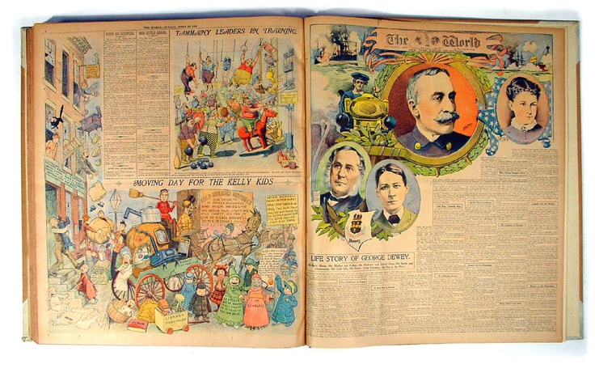
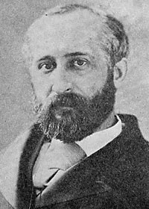
PART 2a
Bankers Sabotage the Democrats in the 1868 Presidential Race
The NY World was seen as the Democrats’ paper, specifically pledged from 1867 to support the Greenbacks.
“Mr. Manton Marble was not the sole or even the principal owner of the paper… Mr. Belmont was looked upon as the principal owner... Between Mr. Belmont and Mr. Marble the strongest ties of interest and friendship were known to exist.” Alexander Del Mar, A History of Monetary Crimes, p. 60
THE NEW YORK WORLD NEWSPAPER
was used to destroy the Democratic candidate.
Manton Marble
1834-1917

Slide 18
PART 2a
Bankers Sabotage the Democrats in the 1868 Presidential Race
“…within a fortnight of Election day … like a bolt shot from a summer sky, the New York World of Thursday, October 15, 1868, published a brief but portentous editorial article, in which, falsely and basely premising that success could not possibly await the /Democratic/ party with Horatio Seymour at its head, it treacherously and perfidiously advised that the name of this honored statesman should be withdrawn and some other substituted in its place for President of the United States.” Alexander Del Mar, A History of Monetary Crimes, p. 65
“Nothing could exceed the consternation produced by the World article of October 15, 1868. It was as though the general of a division had gone over to the enemy on the eve of an assured victory. The article was telegraphed all over the country … for no one supposed for a moment that Marble would have dared to publish such an article without authority from the chief representatives of the party in New York /Belmont, Tiden/”
Alexander Del Mar, A History of Monetary Crimes, p. 66
Manton Marble

Slide 19
PART 2a
Bankers Sabotage the Democrats in the 1868 Presidential Race
“Remember that the World had claimed to be and had been fully trusted as the organ and mouthpiece of the party; that it was believed to be owned and controlled by men presumed to be interested in the success of the party; that the prospects of the party had not for many years seemed so brilliant; that not a word from any quarter had been intimated against Mr. Seymour; that the Convention had been dissolved for over three months; that it could not be re-organized in less than one or two months; that no provision had been made to organize it again that year; that without it, no one had authority to change the Presidential Candidate or withdraw his name from the ticket; and that it was now within a fortnight of Election day.” Alexander Del Mar, A History of Monetary Crimes, p. 65
Alexander Del Mar (1836–1926)

Slide 20
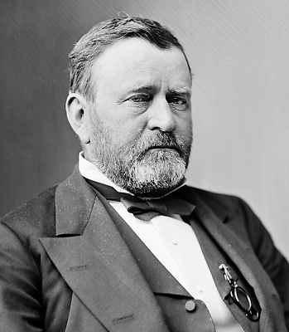
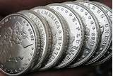
PART 2b
Credit Strengthening Act Signed 1869 – 5-20’s paid back in COIN
Belmont, Chairman of the National Democratic Party Committee, was unable to be contacted by party leaders and remained unavailable. Result: Democratic Party loses Presidency.
ELECTION OF NOVEMBER 1868
Republican Party
Grant 2,985,031 votes
Democratic Party
Seymour 2,647,830 votes
MARCH 18, 1869
President Grant’s first act was to sign the
Credit Strengthening Act
US BONDS WOULD BE REDEEMED IN COIN (NOT GREENBACKS)
&
GREENBACKS WOULD BE REDEMMED IN COIN
ULYSSES S. GRANT
1822-1885

Slide 21
THE THIRD ATTACK: THE “SECRET” DEMONETIZATION OF SILVER
“I don’t need a lawyer to tell me what I can’t do. I need a lawyer to tell me how to do what I can’t do.”
J.P. Morgan, U.S. Financier and possible agent for the Rothschild firm

Slide 22
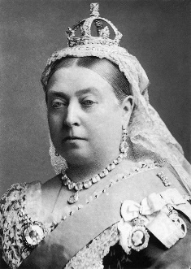
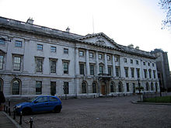
PART 3a: English Interference with the U.S. Mint Laws 1873-4
3. The Third Attack – The “Secret” Demonetization of Silver
Down to the year 1870 the Sovereign of Great Britain had the power by proclamation to reopen
the mints to the private and unlimited coinage of silver.
In 1870, however, a Mint bill was passed by both the House of Commons and the House of Lords with the professed purpose “to consolidate and amend the law relating to the coinage and Her Majesty’s mint…
no intention was disclosed of destroying or curtailing the royal prerogative of silver coinage…”
Alexander Del Mar, A History of Monetary Crimes, p. 66
QUEEN VICTORIA
Reign: 1837 - 1901
Royal Mint
around 1880

Slide 23
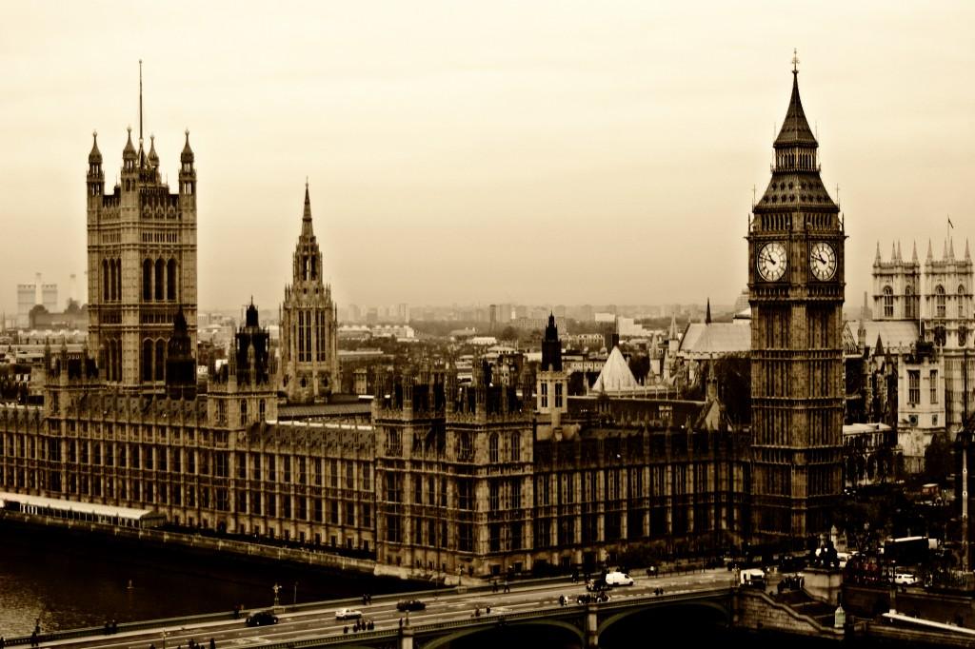
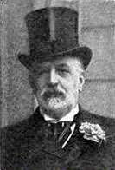
PART 3a: English Interference with the U.S. Mint Laws 1873-4
3. The Third Attack – The “Secret” Demonetization of Silver
Although the bill was repeatedly described as “not altering but perfecting the law…” “no innovation of any kind, no new principle was introduced in the bill…”
However, one clause had been dropped and another clause altered, which removed the power of the Sovereign from re-instituting the coining of silver at the Mint.
“Within a fortnight after its enactment in England, this Mint bill, which, it was alleged, contained ‘no innovations and no new principles,’ was in the hands of the Comptroller of the (paper) Currency at Washington, Mr. John Jay Knox, a young man and a new man, entirely ignorant of coinage… There it became the basis of a bill which purported, like its prototype, to be merely a codification of the existing laws relating to the coinage, but which, also like its prototype, really curtailed and destroyed the ancient prerogative of the State… ”
Alexander Del Mar, A History of Monetary Crimes, p. 85
British Parliament
A Rothschild Financier

Slide 24
PART 3a: English Interference with the U.S. Mint Laws 1873-4
3. The Third Attack – The “Secret” Demonetization of Silver
The U.S. Mint Act [February 12, 1873] failed to name the silver dollar as one of the “currently minted” U.S. silver coins, instead substituting the “trade dollar,“ a special silver coin minted for trade with China. Stephen Zarlenga, LSM, p. 495
This act discontinued the coinage of silver dollars.

Slide 25
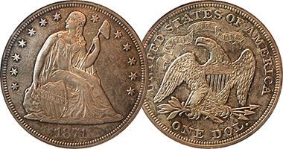
PART 3a: English Interference with the U.S. Mint Laws 1873-4
3. The Third Attack – The “Secret” Demonetization of Silver
The act of 1873 only discontinued its coinage; the provision of the Revised Statutes [June, 1874] took away its debt-paying power for sums beyond five dollars.
J. Laurence Laughlin, The History of Bimetallism in the United States [1885]
Act of June, 1814: "8 sect; 3586. The silver coins of the United States shall be a legal tender at their nominal value for any amount not exceeding five dollars in any one payment."
“But the $5 limit meant silver could be refused for any
commercial transactions. Gold or paper money would
have to be found for payment, and their value would be
enhanced.
The amounts of silver involved may not seem significant,
but it was important in the context of the requirement
to make Greenback bonds, and later the greenbacks
themselves, payable in ‘coinage,’ which would now mean
only gold coinage.” Stephen Zarlenga, LSM, p. 497
Liberty Silver Dollar 1872

Slide 26
PART 3b: The “Discovery” of the “Crime of 1873”
3. The Third Attack – The “Secret” Demonetization of Silver
“It [demonetization of silver dollar] was neither demanded by the
resolutions of public meetings or political conventions, nor asked for
in petitions from electors… While it was pending, the press of the
country was entirely unobservant or silent. After it passed, no notice
was taken of it for more than two years afterwards.
The most striking evidence, perhaps, of the public inattention to the
effect of the coinage act of 1873, is the fact that President Grant, who
signed it, had no knowledge of what it really accomplished in relation
to the demonetization of silver, and was still uninformed about it so
late as October 3, 1873, as is proved by his letter of that date to
Mr. Cowdrey. In this letter he wonders why silver is not brought to the
mints and coined into money!
The silver dollar was dropped purely and simply to enhance the value
of the gold dollar, and thus to double the debt of the American people.”
Alexander Del Mar, A History of Monetary Crimes, pp. 89-90

Slide 27
PART 3b: The “Discovery” of the “Crime of 1873”
3. The Third Attack – The “Secret” Demonetization of Silver
“… the very same men… who betrayed their party in 1868 and
who doubled the public indebtedness by promoting the act of March 18, 1869,
assisted to again double the debt, by promoting the surreptitious mint
codification act of February 12, 1873, and the further surreptitious act of
June, 1874.
… a sordid crime, hatched abroad and brought into this country by the
treacherous people who governed the utterances of the New York World.
Every one of the conspirators engaged in the commission of this crime
suddenly acquired riches.”
Alexander Del Mar, A History of Monetary Crimes, pp. 90-91
“Del Mar is referring to August Belmont, Manton Marble, and their
financial backer, Baron Rothschild.
Stephen Zarlenga, LSM, p. 498

Slide 28
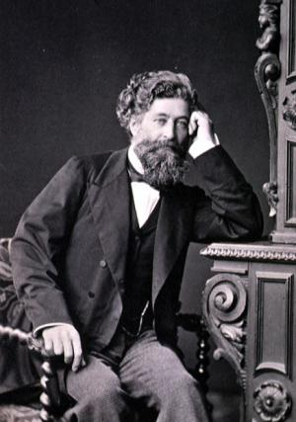
PART 3c: The 1876 U.S. Monetary Commission Investigation 1876
3. The Third Attack – The “Secret” Demonetization of Silver
Henri Cernuschi was a Parisian Jurist and banker and the inventor of the
term “bimetallism.”
“Parisian banker, Henri Cernuschi, the brilliant monetary thinker, was probably
responsible for helping Del Mar get off the false path of metallism, and
concentrate on the legal nature of money. Stephen Zarlenga, LSM, p. 496
Part of his testimony before the 1876 U.S. Monetary Commission:
“If it had been generally known that any such vital question as the
demonetization of silver was lurking in the bill it would have aroused
the most wide spreading discussion throughout the country… No
adequate or satisfactory reasons for the enactment of the laws of 1873-74
de-monetizing silver, have ever been given.”
as quoted by Stephen Zarlenga, LSM, p. 498
Henri Cernuschi (1821-1896)

Slide 29
PART 3c: The 1876 U.S. Monetary Commission Investigation 1876
3. The Third Attack – The “Secret” Demonetization of Silver
“August Belmont’s ‘testimony’ for the commission was a paltry one page letter
that bordered on contempt. He ignored the issue, saying that gold, being the
standard of value, cannot rise or fall… He told them to get better statistics from
someone else. He blamed the fall of silver to its being demonetized abroad…”
Stephen Zarlenga, LSM, p. 498
August Belmont, Sr. 1813-1890

Slide 30
4. Third Parties Formed to Defend the Greenbacks
Greenback and Populist Parties Form in Reaction
National Labor Union 1866-1874
Greenback Party 1876 - 1884
Farmers’ Alliance/Populist Party 1877 - 1896

Slide 31
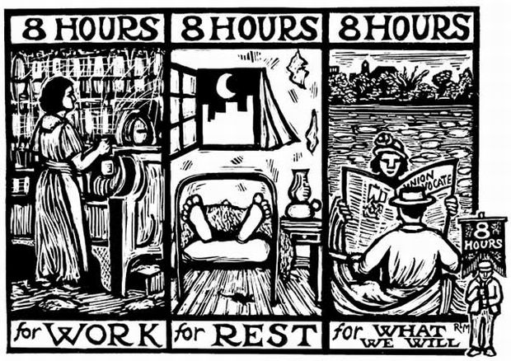
4. Third Parties Formed to Defend the Greenbacks
National Labor Union 1866-1874
The NLU is historically America’s first national labor union. It became known for its insistence on labor reforms through arbitration rather than strikes. It also urged for the creation of more national unions across the country.
In 1872, NLU became the National Labor Reform Party.

Slide 32
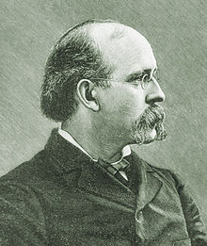
4. Third Parties Formed to Defend the Greenbacks
National Labor Union 1866-1872
“While the workingmen were enlisting in the service of their country, the bankers and owners of gold were working their way into Congress… and when the war ended they had control of Congress. A speaker on the floor of the House of Representatives said, after looking around him: ‘I see the representatives of eighty banks sitting as members of this House.’ “ Terence V. Powderly, Thirty Years of Labor 1859-1889, pub. 1890, p. 35
Terence V. Powderly
(1849–1924)

Slide 33
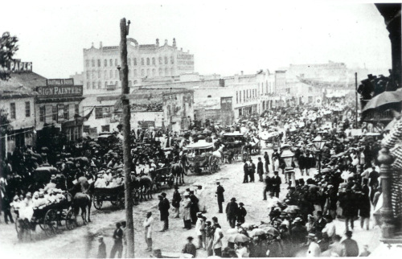
4. Third Parties Formed to Defend the Greenbacks
National Labor Union 1866-1872
“With the ending of the Civil War came the discharge, from the armies of the North and South, of upward of two millions of men who had been doing the work of destruction for four years… The summer of 1865 saw four millions of men standing where there was room for but two millions… they were through sheer necessity obliged to offer their services to employers for less than half what they were worth in order to maintain life and wherever they did find employment it was where others had been displaced.”
Terence V. Powderly, Thirty Years of Labor 1859-1889, p. 36-37
Soldiers Returning Home to Milwaukee
(photo from Milwaukee County
Historical Society)
From these conditions, the National Labor Union was organized.

Slide 34
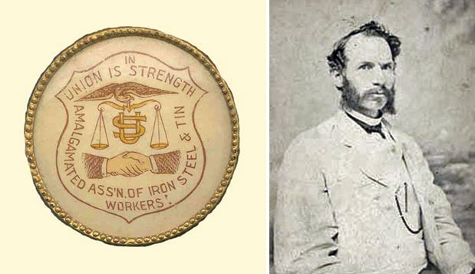
4. Third Parties Formed to Defend the Greenbacks
National Labor Union 1866-1872
The organizers of the NLU considered the currency question the most important of all. One of its major organizers, William H. Sylvis, said:
“If it were possible to make all the trade unions in the country see the importance of this movement, and appreciate the fact that if we can succeed in establishing our monetary system as the law of the land it would so change the whole face of society as to do away with the necessity for trade unions entirely … “
From the platform of the NLU:
“That money is the medium of distribution to non-producing capital and producing labor… that the power to make money and regulate its value is an essential attribute of sovereignty… That the law enacting the so-called national banking system is a delegation by Congress of the sovereign power to make money and regulate its power to a class of irresponsible banking associations, thereby giving to them the power to control the value of all the property in the nation… justice, reason and sound policy demand its immediate repeal, and the substitution of legal-tender Treasury notes as the exclusive currency of the nation.”
Terence V. Powderly, Thirty Years of Labor 1859-1889, p. 45
William H. Sylvis (1828–1869): founder of the Iron Molders’ International Union and NLU, one of the first American union federations attempting to unite workers of various crafts into a single national organization

Slide 35
4. Third Parties Formed to Defend the Greenbacks
National Labor Union 1866-1872
The NLU was neutralized by “the slanderer, the political demagogue, the self-seeking fellow-toiler, the jealous-minded and the paid emissary of wealth. They were many… THEY AT ONCE SET TO WORK TO CREATE DISSENSION AMONG THE MEMBERS BY HINTING THAT THE OFFICERS WERE ROBBING THEM; THAT THEY WERE BEING PETTED AND COURTED BY POLITICIANS; THAT THEY WERE SELLING OUT… Pliant tools in the ranks of labor aided them, and soon the power of the organization began to wane until it finally disbanded.” Terence V. Powderly, Thirty Years of Labor 1859-1889, pp. 45-55

Slide 36
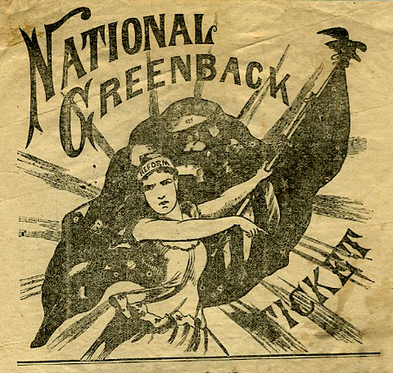
4. Third Parties Formed to Defend the Greenbacks
Greenback Party 1876 - 1884

Slide 37
4. Third Parties Formed to Defend the Greenbacks
Greenback Party 1876 - 1884
The passage of the resumption act of Jan. 14, 1875 revived the greenback feeling. A greenback convention at Indianapolis, Nov. 25, 1874, adjourned after indorsing by resolution the three propositions which have been the foundation of all greenback platforms since that time:
1, that the currency of all national and state banks and corporations should be withdrawn;
2, that the only currency should be a paper one, issued by the government, "based on the faith and resources of the nation," exchangeable on demand for bonds bearing interest at 3.65 per cent.;
3, that coin should only be paid for interest on the present national debt, and for that portion of the principal for which coin had been specifically promised

Slide 38
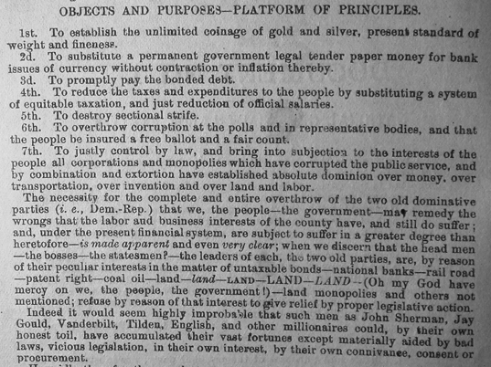
4. Third Parties Formed to Defend the Greenbacks
Greenback Party 1876 - 1884
A Greenback Document

Slide 39
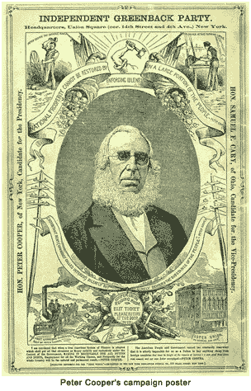
4. Third Parties Formed to Defend the Greenbacks
Greenback Party 1876 - 1884
Peter Cooper was the party's presidential candidate in 1876 but he won only 81,737 votes and was easily beaten by Rutherford Hayes (4,036,298) and Samuel Tilden (4,300,590). However, the party did send 15 representatives to Congress.
PETER COOPER’S CAMPAIGN POSTER

Slide 40
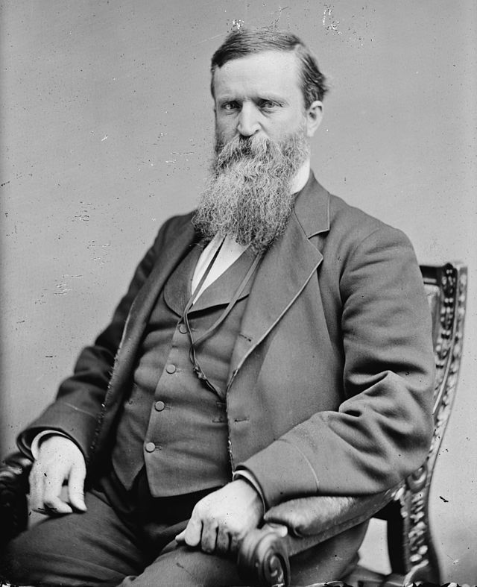
4. Third Parties Formed to Defend the Greenbacks
Greenback Party 1876 - 1884
In 1878 members of the Greenback Party joined with urban trade union groups to establish the Greenback Labor Party. James Weaver emerged as leader of the party and was its presidential candidate in 1880.
Weaver obtained 308,578 votes but was beaten by James Garfield (4,454,416) and Winfield S. Hancock (4,444,952). Most of Weaver's support came from the rural West but he was now one of the most important political figures in the United States.

Slide 41
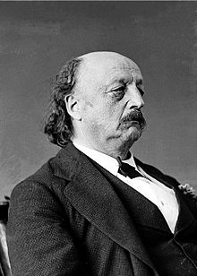
4. Third Parties Formed to Defend the Greenbacks
Greenback Party 1876 - 1884
In the 1884 Presidential Election, General Benjamin Butler was the Greenback Labor Party candidate. However, he only managed 175,096 votes (1.7% of overall vote).
The party convention of 1888 only drew 7 delegates and the party ceased to exist.
Benjamin Butler
(1818 – 1893)

Slide 42
Farmers’ Alliance & People’s Party 1877-1896
4. Third Parties Formed to Defend the Greenbacks
WHAT WAS THE FARMERS’ ALLIANCE?

Slide 43
Farmers’ Alliance & People’s Party 1877-1896
4. Third Parties Formed to Defend the Greenbacks
THE LAST DEMOCRATIC MASS MOVEMENT –
CAN WE HAVE ANOTHER?

Slide 44
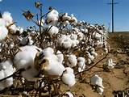
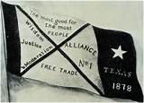
WHAT WAS THIS MOVEMENT?
4. Third Parties Formed to Defend the Greenbacks
Farmers’ Alliance & People’s Party 1877-1896
WESTERN PLAINS FARMERS & SOUTHERN FARMERS
JOINED TOGETHER TO FORM AN ORGANIZATION CALLED
NATIONAL FARMERS’ ALLIANCE AND INDUSTRIAL UNION

Slide 45
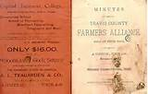
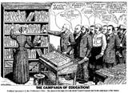
WHAT WAS ITS PURPOSE?
4. Third Parties Formed to Defend the Greenbacks
Farmers’ Alliance & People’s Party 1877-1896
“…more speedily educate ourselves” in preparation for the day “when all the balance of labor’s products become concentrated into the hands of a few, there to constitute a power that would enslave posterity”

Slide 46
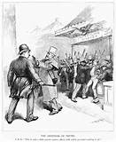
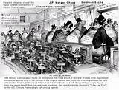
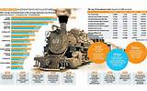
THE FARMERS’ ALLIANCE DENOUNCED: Credit Merchants Railroad monopolies Trusts Money Power Capitalists 2-price Credit System

Slide 47
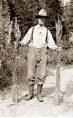
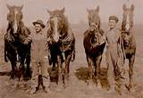
WHO CREATED THIS ORGANIZATION?
MEN AND WOMEN WITH POLITICAL SELF-RESPECT
AND SELF-POSSESSION

Slide 48
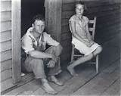
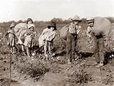
WHAT WAS THE CONDITION OF THE SOUTHERN FARMER?
SOUTHERN FARMERS WERE IN DEBT TO THE TOWN PLANTER/MERCHANT
THE CROP LIEN SYSTEM PREDOMINATED

Slide 49
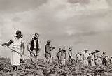
THE CROP LIEN SYSTEM
The ‘furnishing merchant, able to get most of their goods on consignment from competing Northern mercantile houses, bought supplies and “furnished” them on credit to farmers, taking a lien on the farmer’s crop for security. Farmers learned that the interest they were paying on everything they consumed limited their lives in a new and terrible way; the rates imposed were frequently well in excess of 100% annually, sometimes over 200%. At the heart of the process was a simple two-price system for all items – one price for cash customers and a second and higher price for credit customers. P. 22, THE POPULIST MOMENT, by Lawrence Goodwyn

Slide 50
THE CROP LIEN SYSTEM
“At ‘settlin’-up’ time, the farmer and the merchant would meet at the local cotton gin….at that moment, the farmer would learn what his cotton had brought…the merchant…then consulted his ledger for a final time. The accumulated debt for the year, he informed the farmer, exceeded the income received from the cotton crop. The “furnishing merchant” would then announce his intention to carry the farmer through the winter on a new account, the latter merely having to sign a note mortgaging to the merchant the next year’s crop….. Farmer, empty-handed, climbed in his wagon and drove home, knowing that for the second or fifth or fifteenth year he had not paid out. Lawrence Goodwyn, THE POPULIST MOMENT, p.21

Slide 51
WHAT WAS THE CONDITION OF THE WESTERN FARMER?
WESTERN FARMERS WERE IN DEBT
TO THE BANKS & MORTGAGE COMPANIES –
FOR HOMES AND PERSONAL PROPERTY
Notes:
The organic nofa farmers need to understand the struggle with the money system like the alliance.
Its demise kept the 2 party system.

Slide 52
WHAT WAS THE CONDITION OF THE WESTERN FARMER?
A farmer with only a few dollars in his pocket comes out here and takes a claim…..then he goes in debt for the farm for sufficient money to prove up and buy a horse or two….then he goes in debt for the necessary machinery to harvest his crop, and by the time his grain is ready to sell he is pretty well buried under a pile of debts. He takes his wheat to market, of course firmly believing that it is nothing less than No. 1 hard, but the elevator man’s eagle eye promptly discovers that it has been ‘frosted’ or is ‘damp’ and instead of getting 80 cents a bushel, as he expected, he is forced, from his necessities, to sell for what he can get. …the sun is now obscured by two or three blanket mortgages; and he sits down in his lonely cabin on the bleak prairies and imagines that he is being ground down by the despotic heel of monopoly. P. 82, THE POPULIST REVOLT, by John D. Hicks
Notes:
The organic nofa farmers need to understand the struggle with the money system like the alliance.
Its demise kept the 2 party system.

Slide 53
HOW DID THE ALLIANCE GROW?
ITS BUILDING BLOCKS WERE:
1. INDIVIDUAL SELF-RESPECT
2. COLLECTIVE SELF-CONFIDENCE
3. DEMOCRATIC SELF-DIRECTION
4. CREATION OF A MOVEMENT CULTURE
5. MASS ORGANIZATIONAL EDUCATION IN FINANCIAL SYSTEM AND FARMING
Notes:
The organic nofa farmers need to understand the struggle with the money system like the alliance.
Its demise kept the 2 party system.

Slide 54
HOW DID THE ALLIANCE GROW?
#1 ORGANIZATIONAL BASE: created an institution called the National Farmers Alliance and Industrial Union
#2 MASS RECRUITMENT: became the world’s first large-scale working class cooperative which attracted farmers in droves – attempted to pool products for market sale and transport.
#3 MASS EDUCATION: each sub-alliance in a town had its own lecturer, to educate about the financial system and farming. At its height, the movement had 40,000 lecturers! This education was supported by hundreds of Alliance newspapers initiated throughout the movement.
#4 POLITICS: turned to independent political action by creating its own institution, a third party called The People’s Party
Notes:
The organic nofa farmers need to understand the struggle with the money system like the alliance.
Its demise kept the 2 party system.

Slide 55
WHAT LESSONS DID THE ALLIANCE LEARN?
#1 immediate political action will not work – too many of the poor are tied to traditional modes of thinking
#2 personal self-respect must be instilled in membership – the movement had to support members educating each other (lecturer system)
#3 the cooperative idea spurred the organizational work
#4 the democratic instinct would be released with education and a new political language shared in mutually supportive groups
Notes:
The organic nofa farmers need to understand the struggle with the money system like the alliance.
Its demise kept the 2 party system.

Slide 56
WHY WAS THE ALLIANCE NOT SUCCESSFUL?
The People’s Party leadership ultimately decided to merge with the Democratic Party in the Presidential elections of 1892 and 1896. This was called ‘fusion’.
The Democrats incorporated some of the platform of the People’s Party, but were not for serious monetary reform. The plank of ‘Free Silver’ became the rallying cry, but the revolutionary goal to put the power to issue money back into the hands of the public was lost.
Notes:
The organic nofa farmers need to understand the struggle with the money system like the alliance.
Its demise kept the 2 party system.

Slide 57
5. The Silver Diversion
The “Crime of 1873” focused the public on silver versus gold money. Bimetallism versus one standard? A silver standard or a gold standard?
“Consider how the silver issue was used to derail the populists, and obscure the real monetary question of who should control the money system – private bankers or the government. Monetary control had been the main focus of the Greenback movement.” Stephen Zarlenga, LSM, p. 500

Slide 58
5. The Silver Diversion
“It is not out of the realm of possibility that the outrageous method of silver demonetization was a calculated move to enrage and disrupt and derail the movement. The ‘secret’ demonetization of silver was like the matador waving a red flag in front of a bull.” Stephen Zarlenga, LSM, p. 500

Slide 59
6. America Re-Monetizes Silver Against the World
Cernuschi had warned the Americans:
“In my opinion no country can coin silver alone… it is better to maintain
the paper-money (Greenbacks) than to issue a national currency of silver,
if the other nations do not use that metal as money.”
U.S. National Monetary Report, 1876
“… a highly ill-advised policy of re-monetizing silver against the World,
while the U.S. was already committed to redeem bonds and Greenbacks
in gold.” Stephen Zarlenga, LSM, p. 500
Henri Cernuschi (1821-1896)

Slide 60
6. America Re-Monetizes Silver Against the World
February 16, 1878 – THE BLAND-ALLISON SILVER REPURCHASE ACT – re-monetized silver. President Hayes’ veto of the bill was overridden.
The bill was not a free coinage of silver, but required the US Treasury to buy from 2 to 4 million dollars of silver per month FROM WESTERN MINES and coin into new silver dollars as legal tender. Over $378 million new silver dollars were coined – close to the number of Greenbacks outstanding.
SILVER DOLLAR, 1880

Slide 61
6. America Re-Monetizes Silver Against the World
July 14, 1890 – Sherman Silver Purchase Act. In addition to the silver required by the Bland-Allison Act of 1878, the US government was now required to purchase an additional 4.5 million ounces of silver bullion every month. The law required the Treasury to buy the silver with a special issue of Treasury (Coin) Notes that could be redeemed for either silver or gold.
“That was about 17 million more ounces per year than American mines could produce. Thus, the Sherman Act thereby allowed European financiers to exchange their abundant demonetized silver hoards for American gold at the fixed artificially advantageous price of the American 16 to 1 gold/silver ratio.” Stephen Zarlenga, LSM, p. 501
US Treasury buys
European silver with
Treasury ‘Coin’ Notes
Investors redeem Treasury
‘Coin’ Notes for gold
EUROPEAN
INVESTORS
US TREASURY
Treasury borrows gold to pay investors for Treasury Notes and interest on the gold loan!
US TREASURY, 1804

Slide 62
6. America Re-Monetizes Silver Against the World
6. America Re-Monetizes Silver Against the World
That plan backfired, as people (mostly investors) redeemed the new coin notes for gold dollars, thus depleting the government's gold reserves. After the Panic of 1893 broke, President Grover Cleveland oversaw the repeal of the act to prevent the depletion of the gold reserves
US TREASURY ‘COIN NOTE’, REDEEMABLE FOR GOLD OR SILVER
SILVER DOLLAR, 1880

Slide 63
6. America Re-Monetizes Silver Against the World
“ ‘The withdrawal of gold from the U.S. Treasury pursued an almost uninterrupted course from the moment of the enactment of the Sherman silver law until the outbreak of the (1893) panic,’ wrote Charles A. Conant. The net gold exportations were: 1891 - $68.1 million; 1892 – only $.5 million; 1893 - $87.5 million.”
Quote is from Charles A. Conant, A History of Modern Banks of Issue, pub. 1926
as quoted in Stephen Zarlenga, LSM, p. 501
“Sherman had to go back to his European syndicate for more gold loans, which came into and left the U.S. as through a revolving door. The passage of the act has always been blamed on American silver mining interests, but some of its main beneficiaries were European bankers..”
Stephen Zarlenga, LSM, p. 501

Slide 64
7. The Worldwide Panic in the 1890’s
The panic of '93 was the worst economic depression the United States had ever experienced at the time.
As a result of the panic, stock prices declined; 500 banks were closed; 15,000 businesses failed; and numerous farms ceased operation.
The unemployment rate in Pennsylvania hit 25%, in New York 35%, and in Michigan 43%. Soup kitchens were opened to help feed the destitute. Facing starvation, people did anything in exchange for food.
President Grover Cleveland convinced Congress to repeal the Sherman Silver Act, but the decline of the gold reserves stored in the US Treasury fell to a dangerously low level. This forced President Cleveland to borrow $65 million in gold from Wall-Street banker JP Morgan and the Rothschild banking family of England to support the gold standard.

Slide 65
8. The U.S. Money Drought: 1860s – 1890s
“The unusually slow rate of rise in the money
stock and the unusually large fraction of
declines from 1867 to 1879 are paralleled by
and connected with the unusual behavior of
prices… there is much direct evidence of a
rapid rise in output from 1867 to 1879…
population rose by more than 30 per cent…”
Friedman & Schwartz, A Monetary History
of the United States 1867-1960, pub. 1963,
pp. 32-34

Slide 66
8. The U.S. Money Drought: 1860s – 1890s
“…the Post-Civil War period in America (and abroad) was one of too scarce a money supply for a period of two-and-a-half to three decades. Population, railroads, mechanization and production were growing… Yet by many yardsticks, money was too scarce.
This money supply increase of only 17% over 12 years [1867-1879], or about 1.4% a year, during a period of high growth in population and in economic activity, must be considered deflationary.
This important example underscores the principle that it is not the absolute amount of money in existence that measures inflation or deflation, but the amount relative to population and economic activity, which the money must service.
The money supply must be compared to how much money there should be for optimal results. Nor is it accurately measured by price levels…”
Stephen Zarlenga, LSM, p. 503

Slide 67
9. The Greenback Legacy Continued
“The people were not fooled, so much as they were over-powered! Henry George, an important 19th century reformer, wrote:
‘It is not the business of government to direct the employment of labor and capital… On the other hand it is the business of government to issue money…
…the private interests of bankers have… compelled us to the use of a hybrid currency, of which a large part… is issued and made profitable to corporations… by leaving to them, even in part and under restrictions and guarantees, the issuance of money, the people of the United States suffer an annual loss of millions of dollars, and sensibly increase the influences which exert a corrupting effect upon their government.’ “
Henry George, Social Problems, pub. 1883, pp. 244-245, as quoted in Stephen Zarlenga, LSM, p. 504

Slide 68
10. Summary
Purposely executed 19th century deflations
Silver demonetizations
Bankers attack Greenbacks, supporters & their parties
Diversion of populists to silver question from main issue of societal control of the money system
Great importance by bankers to remove Greenbacks from the view of the world

Slide 69
THE MONEY POWER VS THE U.S. CONSTITUTION
STEPHEN ZARLENGA, LOST SCIENCE OF MONEY
THE GREENBACK
“…THEY WERE PROBABLY THE BEST MONEY
SYSTEM AMERICA HAS EVER HAD…
A MORE HONEST MONEY SYSTEM, CONTROLLED
BY GOVERNMENT, INSTEAD OF BANKS.”

Slide 70
Q & A
WILL DECKER’S CONCLUSION:
THE CONTROL OF MONEY -- WITHOUT CONTROL FROM THE PUBLIC -- LEADS TO
CORRUPTION … USURPATION … SLAVERY.

