Slide 1
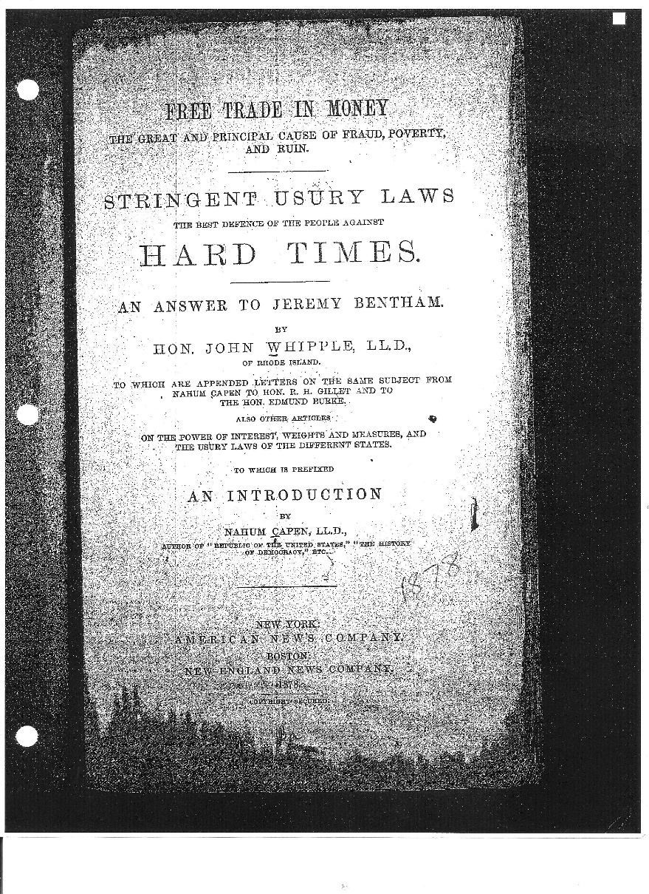
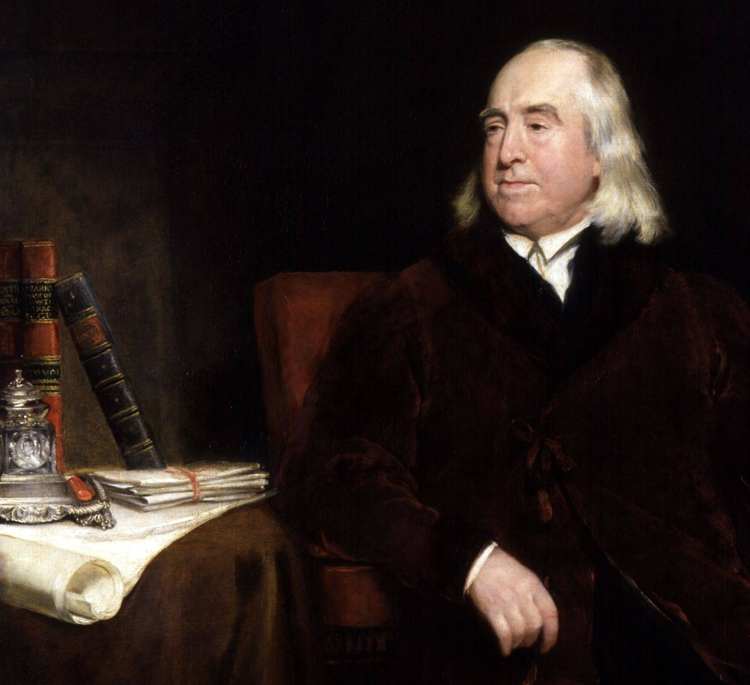
The Lost Science of Money
CHAPTER 13 – PART 1
THE USURY DEBATE CONTINUES
JEREMY BENTHAM, (1748 – 1832)
wrote IN DEFENSE OF USURY
STRINGENT USURY LAWS:
THE BEST DEFENSE OF THE
PEOPLE AGAINST HARD TIMES….
AN ANSWER TO JEREMY BENTHAM
1836
BY Hon. John Whipple, LL.D.
of Rhode Island

Slide 2
THEMES OF LOST SCIENCE OF MONEY BOOK
Primary importance of the money power (power to create money and regulate it)
Nature of money purposely kept secret and confused
How a society defines money determines who controls the society
Battle over control of money has raged for millennia: public vs private
The misuse of the monetary system causes tremendous misery and suffering for the ordinary working people. Will Decker & Martin Dunn, February 2014

Slide 3
PARTS OF PRESENTATION
Introduction by Stephen Zarlenga
Unidentified Usury
The “Thesis” of Capitalism
England in Trouble – The Visible Effects of Usury
Rogers and Aristotle to the Rescue
Christianity Joins in the “Rescue”
Usury in Trouble
Bentham’s Usury Rescue Squad
The “Anti-Jewish” Ploy
John Whipple’s Enlightened Attack on Usury

Slide 4
PART 1
Introduction by Stephen Zarlenga

Slide 5
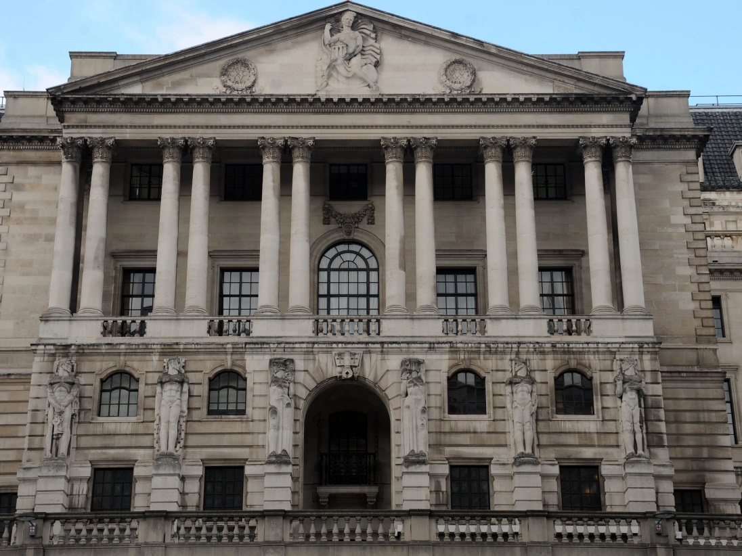
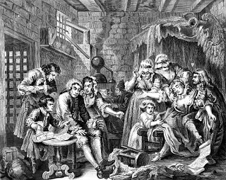
Introduction by Stephen Zarlenga
Stephen Zarlenga:
The banker’s power over society arose from the privilege to create and control the nation’s money supply for private profit instead of for the common good.
The banker’s power to restrict the circulation of money and cause deflation was seen in England after the 1810 Bullion Report.
BANK OF
ENGLAND
Debtor’s
Prison

Slide 6
Introduction by Stephen Zarlenga
The Bank of England’s operations signaled a recovery of the lost science of money.
To hold those privileges in a private institution, the definition of money and other key economic ideas had to be obscured with the promotion of the primitive commodity concept of money (Adam Smith’s Wealth of Nations).

Slide 7
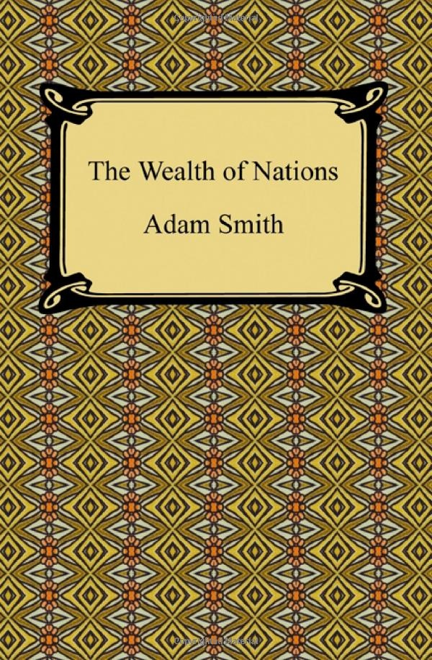
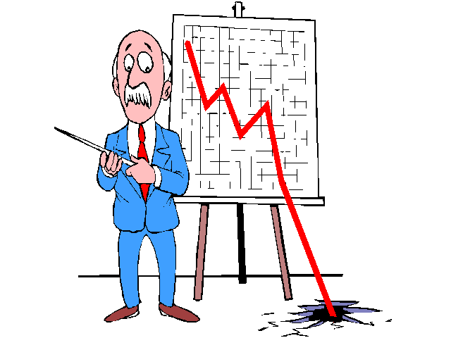
Introduction by Stephen Zarlenga
The educational establishment was compromised.
Over time an orthodox “thesis” of Capitalism was assembled and promoted.
Thus the Bank’s policy was to quickly re-bury the science of money.

Slide 8
PART 2
Unidentified Usury

Slide 9
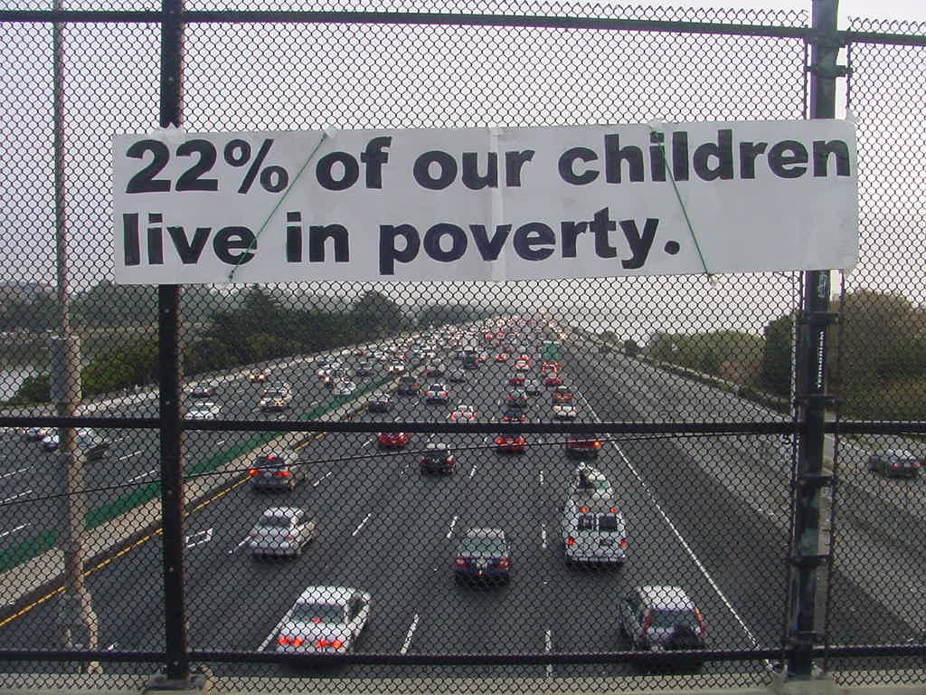
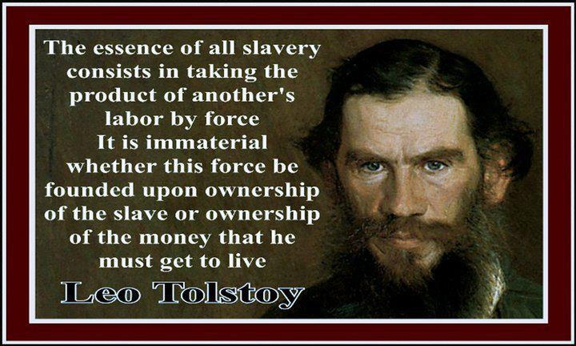
Unidentified Usury
The Bank of England’s manipulation of England’s money system is USURY – the taking of something for nothing through the structural misuse of the money mechanism. It is ‘MACRO USURY’ because it operates on the entire money system, affecting all exchanges and property and the labor markets. Society is brought into economic slavery.

Slide 10
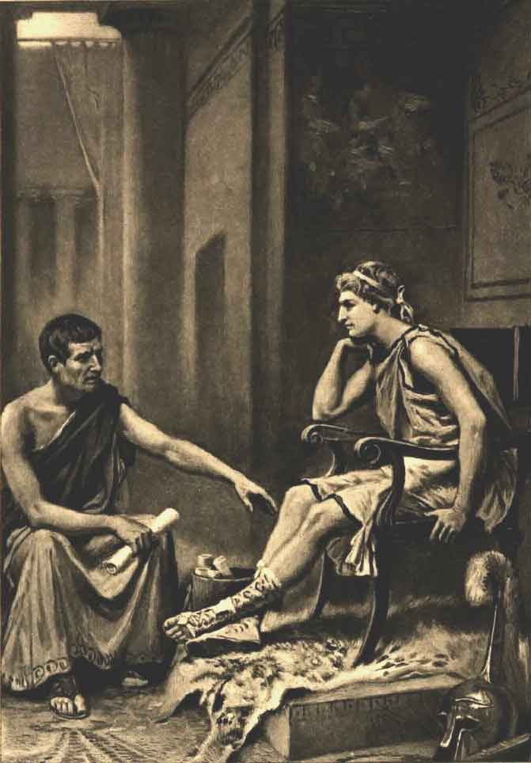
Unidentified Usury
It was not identified as USURY.
There was no Church, legal system, or tradition to oppose it.
The Protestants had been neutered on the problem of Usury.
From across the centuries, only Aristotle and the Scholastics warned of the problem.
Aristotle, Politics, Book One, Part X: usury is the lending of money at interest:
“The most hated sort, and with the greatest reason, is usury, which makes a gain out of money itself, and not from the natural object of it. For money was intended to be used in exchange, but not to increase at interest. And this term interest, which means the birth of money from money, is applied to the breeding of money because the offspring resembles the parent. Wherefore of all modes of getting wealth this is the most unnatural.“

Slide 11
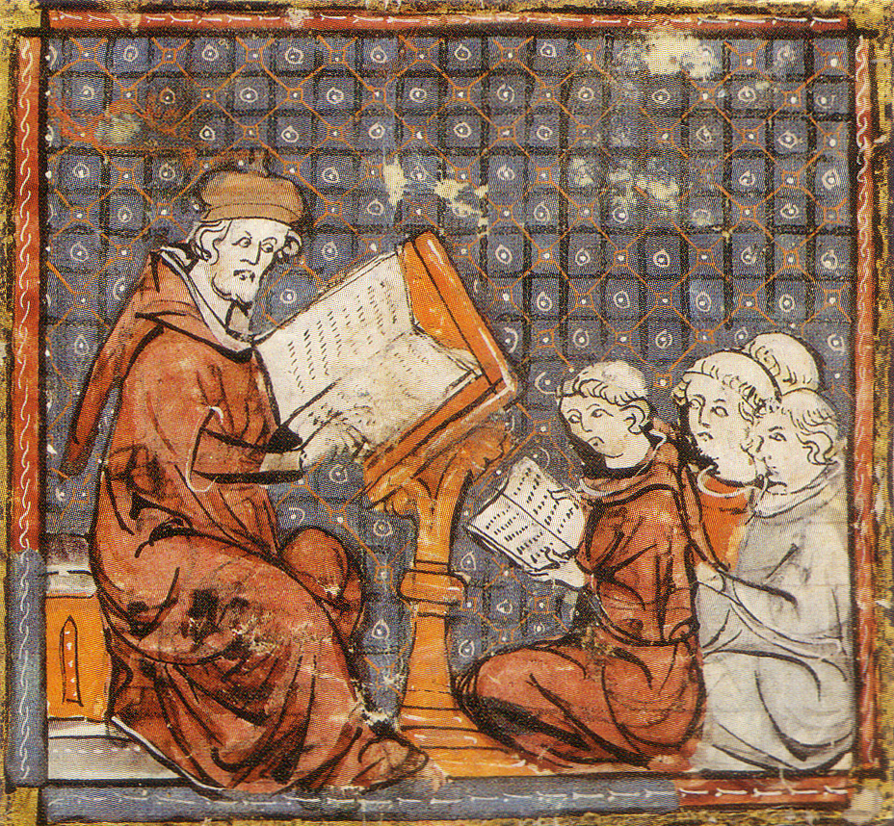
Unidentified Usury
“Money was admitted by the scholastics as a necessary evil. They confessed that money is useful as a medium of exchange, as a measure of value of things. And they accepted it only so far.
But if money becomes a source of income, if money will be used not for exchange purposes, but to produce a surplus of money, then it is a decided evil.
The production factors are land and labor both given by God. If money becomes a productive factor for itself then it tries to compete with God’s productive factors, and is therefore, undoubtedly, the work of the Devil.”
The Doctrine of Usury in the Middle Ages, By Simon Smith Kuznets

Slide 12
PART 3
The “Thesis” of Capitalism

Slide 13
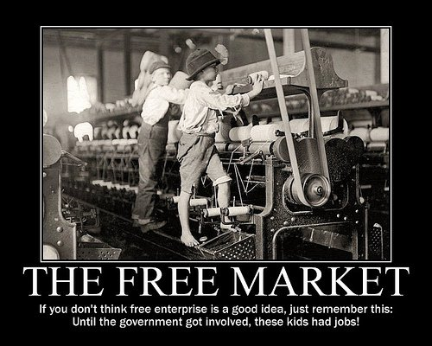
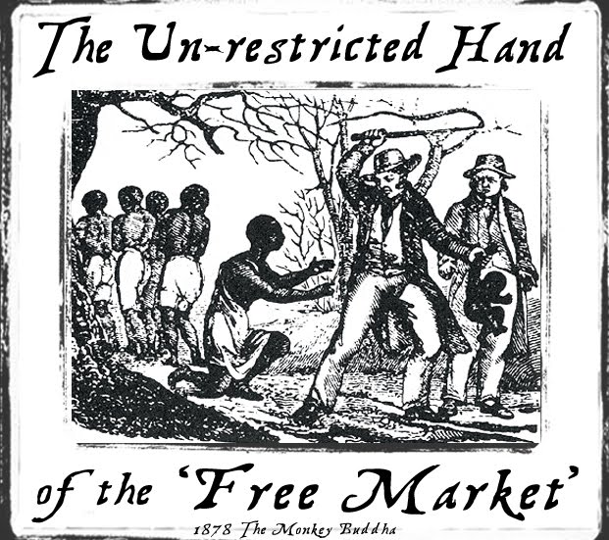
The “Thesis” of Capitalism
The ‘THESIS’ of Capitalism is found in Adam Smith’s Wealth of Nations, including his mis-definition of money and related errors and truths.
These theories were rationalizations and justifications for practices already in existence, and a power structure already in place.

Slide 14
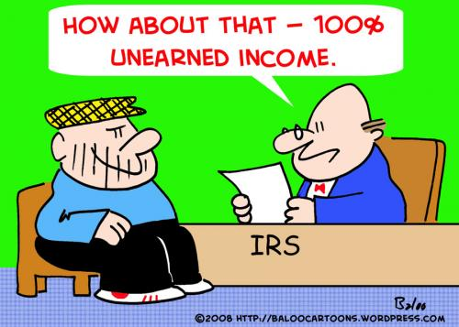
The “Thesis” of Capitalism
The economic sophistries of Capitalism were the source of unearned benefits, the reason for the existence of the ‘THESIS’.

Slide 15
PART 4
England in Trouble – The Visible Effects of Usury

Slide 16
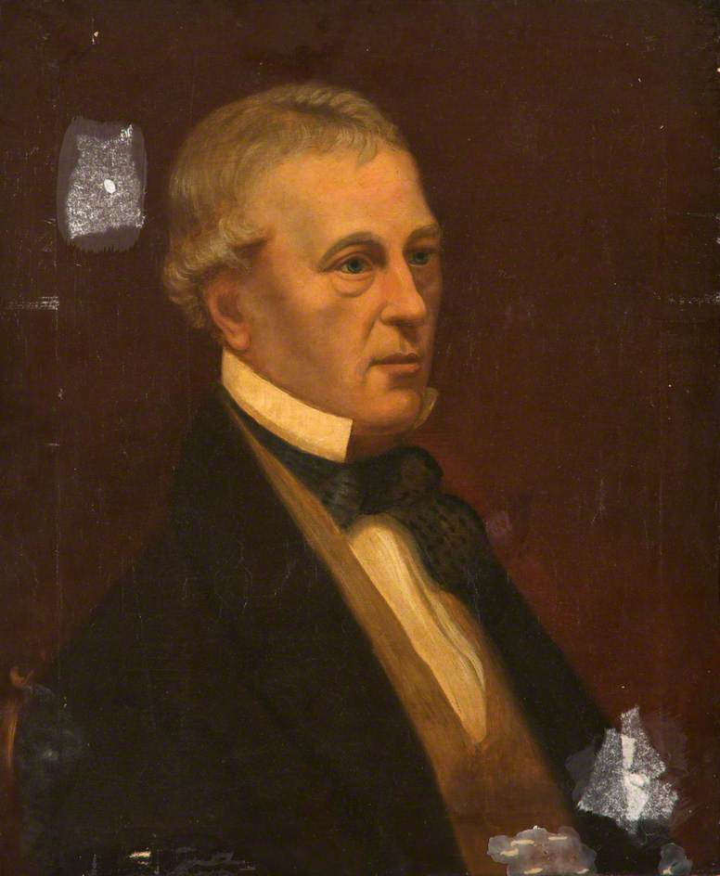
England in Trouble – The Visible Effects of Usury
Those willing to open their eyes could directly observe that Englishmen were being destroyed by these economic theories.
WILLIAM COBBETT, 1763-1835
“Experience, daily observation, minute and repeated personal inquiry and examination, have made me familiar with the state of the laboring poor, and sir, I challenge contradiction when I say, that a laboring man in England with a wife and only three children, though he and his family be economical, frugal, and industrious in the most extensive sense of those words, is not now able to procure himself by his labour a single meal of meat from one end of the year unto the other.” William Cobbett, 1806, quoted in Christopher Hollis, The Two Nations, p. 46.

Slide 17
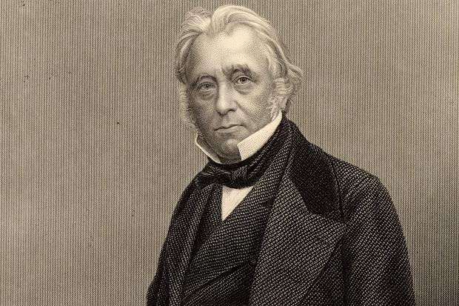
England in Trouble – The Visible Effects of Usury
Against these conclusions were thrown sweeping assertions to the contrary:
British historian and Whig politician, Thomas Babington Macaulay, wrote bold lies to promote the financially powerful, 1830:
“…unable to find any satisfactory record of any great nation, past or present, in which the working classes have been in a more comfortable situation than in England in the last thirty years.” Essay on Southey’s Colloquies, as quoted by Hollis.
Thomas Babington Macaulay
(1800–1859) - British historian
and Whig politician
From WIKIPEDIA:
“his books on British history were hailed as literary masterpieces” –
quoted in John MacKenzie, "A family empire,“
BBC History Magazine (Jan 2013)

Slide 18
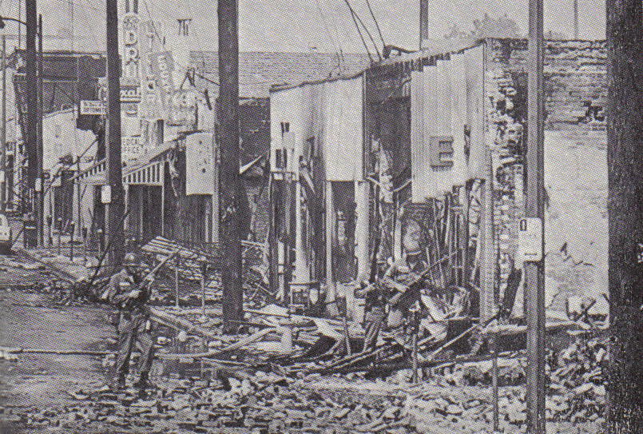
England in Trouble – The Visible Effects of Usury
“SUCH BOLD LIES EMANATING FROM AND PROMOTED BY THE FINANCIALLY POWERFUL IN POSITIONS OF INFLUENCE, COULD ONLY BE DECISIVELY REFUTED BY CAREFUL EMPIRICAL STUDIES……”
Stephen Zarlenga, LSM, p. 337
“The faults of that book /The Wealth of Nations/ ... in its unproved assumption that a society must necessarily consist
of a few capitalists and the propertyless proletariat …
To St. Thomas Aquinas property existed to promote the well-being of society, but to Adam Smith
society existed to defend the rights of the owners of property.” Christopher Hollis, Two Nations, p. 86
1965, urban US riots

Slide 19
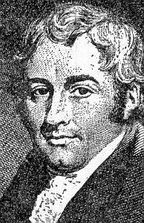
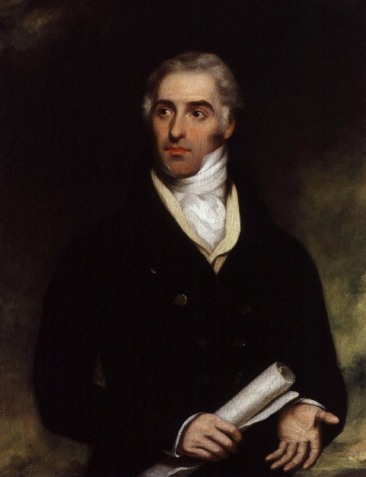
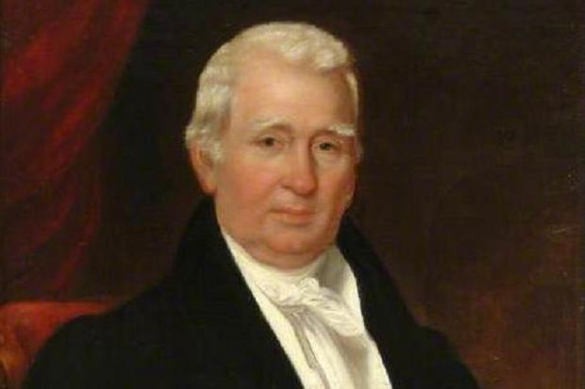
England in Trouble – The Visible Effects of Usury
“… in the dark age of the great betrayal, when the poor of England were lashed back to their unnecessary poverty, the strange handful of ill-assorted men who at all understood what had happened to England and who raised their voices in protest, were almost without exception people who by accident had escaped the influence of the educational system” Christopher Hollis, Two Nations, p. 87
John Lingard (1771-1851): born of humble parents;
educated outside of England; became a Catholic priest
and historian; Lord Macaulay did not like the History of England
written by John Lingard in the 1820's. He complained that Lingard's
"great fundamental rule of judging seems to be that the popular
opinion cannot possibly be correct." It would be fairer to say that
Lingard's fundamental rule of judging was that evidence matters
more than public opinion. And the evidence of history, as he so
often found and documented, ran against public opinion in England.
Thomas Michael Sadler (1780-1835):
from his fifteenth year he was
practically self-taught.
William Cobbett (1763-1835): Rural Rides; the
farmer’s son who went to no school and learned
history of the past only in middle age, after learning
the history of the present by personal experience and
observation.

Slide 20
PART 5
Rogers and Aristotle to the Rescue

Slide 21
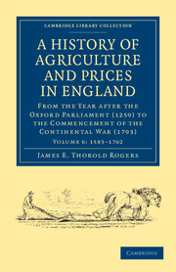
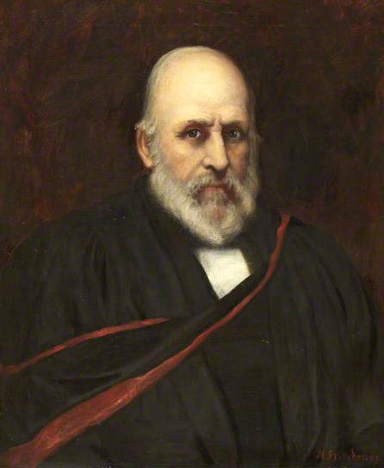
Rogers and Aristotle to the Rescue
WHAT WAS THE TRUTH?
A HISTORY OF AGRICULTURE AND PRICES IN ENGLAND (1259 – 1793)
by Thorold Rogers
“A clergyman Thorold Rogers (1823-1890) lived in Oxford (c. 1850) and made a living coaching in the classics and philosophy. In 1860, however, he began serious research into the wages and
prices ruling at the various dates in English history, and on the strength of this research
in 1862 he was elected Drummond Professor of Political Economy … The statistics which he
collected alone fill a thick volume, and there is no reason to suspect that the conclusions
at which he arrives are generalizations from insufficient data.” Hollis pp 42-43
Thorold Rogers (1823–1890)
7 vols: I, II (1866), III, IV (1882),
V, VI (1887), VII, PART I, VII, PART II (1902)

Slide 22
Rogers and Aristotle to the Rescue
THE TRUTH: Unnecessary Poverty
TRUTH: “Between Henry VII’s time and 1850 the population
of England multiplied by about five … the productivity of the
country had multiplied by about four by 1800 … and multiplied
by another four and a half between 1800 and 1850, making a
total of 18. As a result the poor ought to have been between
three or four times better-off. They were, however, considerably
worse off.” Hollis p. 46
Thorold Rogers (1823–1890)

Slide 23
Rogers and Aristotle to the Rescue
THE TRUTH: Unnecessary Poverty
TRUTH: “I contend that, from 1563 to 1824, a conspiracy, concocted by
the law and carried out by parties interested in its success, was entered into
to cheat the English workman of his wages, to tie him to the soil, to deprive
him of hope and to degrade him into irremediable poverty … ”
Thorold Rogers, Six Centuries of Work and Wages, 1903, p. 398
Thorold Rogers (1823–1890)

Slide 24
Rogers and Aristotle to the Rescue
THE TRUTH: Unnecessary Poverty
TRUTH: “The gentlemen of England, so far from being those
leaders of the nation towards a finer and a wider freedom which
the progressive history had represented them to be, were
revealed as in the heyday of their power the trickiest and most
rapacious class ever known among men.” Hollis p. 46
Thorold Rogers (1823–1890)

Slide 25
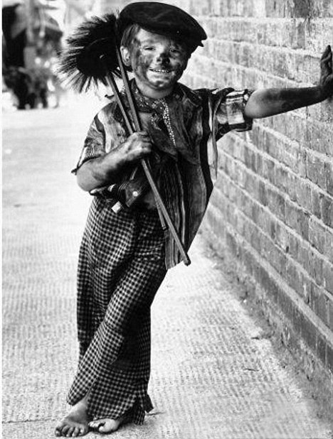
Rogers and Aristotle to the Rescue
THE TRUTH: Unnecessary Poverty
Hollis, Two Nations, pp. 85-86:
“Englishmen have been starving in the midst of plenty for four hundred years. A hundred years ago Cobbett found in his England ‘starving in the midst of abundance’ … A hundred years before Cobbett the very phrase … was on the lips of Bishop Berkeley. Two hundred years before Berkeley, Sir Thomas More was writing of the same phenomenon in his Utopia.
We must go back behind Sir Thomas More (1478-1535) to find an age where a man could not starve save when there was not enough food to feed him.“
Hollis, Two Nations, pp. 88:
“The important truth was that there was no difficulty at all in procuring a sufficiency of food for all …
The first business of a society, Aristotle tells us, is to see to it that its members can live. Therefore, the first business of its economic system is to produce a sufficiency of food and clothing, or of goods that can be exchanged for food and clothing … “

Slide 26
PART 6
Christianity Joins in the “Rescue”

Slide 27
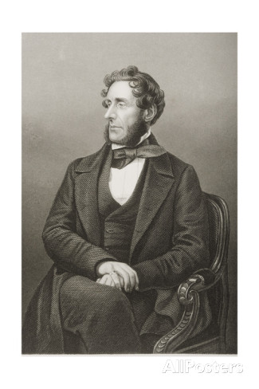
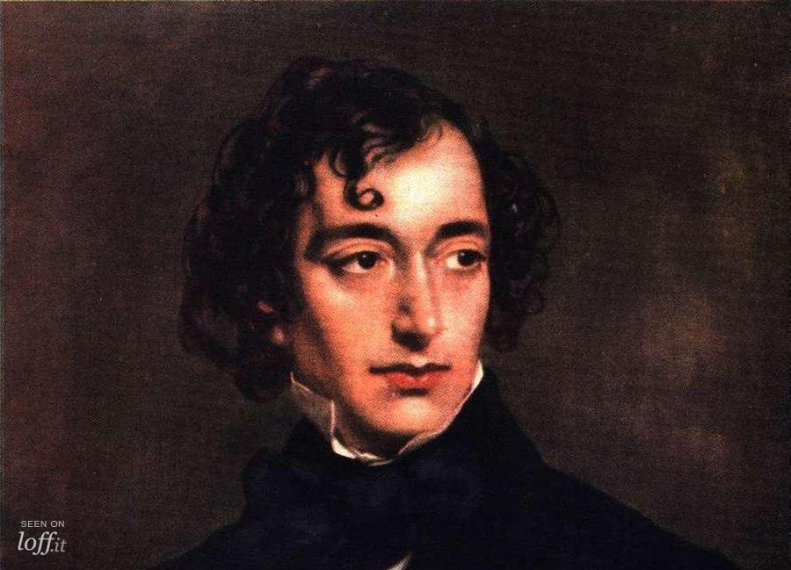
Christianity Joins in the “Rescue”
The first effective attacks on the system came not from economists but from the religious motives of three men:
Thomas Michael Sadler, a Methodist
Lord Shaftesbury (Ashley), an Evangelical
Disraeli, a Jew
Lord Shaftesbury (Ashley)
(1801–1885): Ashley grew up without any experience of parental love. He saw little of his parents, and when duty or necessity compelled them to take notice of him they were formal and frightening. He was saved by the housekeeper who gave him Christian love in the house.
Benjamin Disraeli (1804-1881): his father renounced Judaism when Benjamin was 12 years old and had his son baptized into the Church of England.
Thomas Michael Sadler (1780-1835): from his fifteenth year he was
practically self-taught.

Slide 28
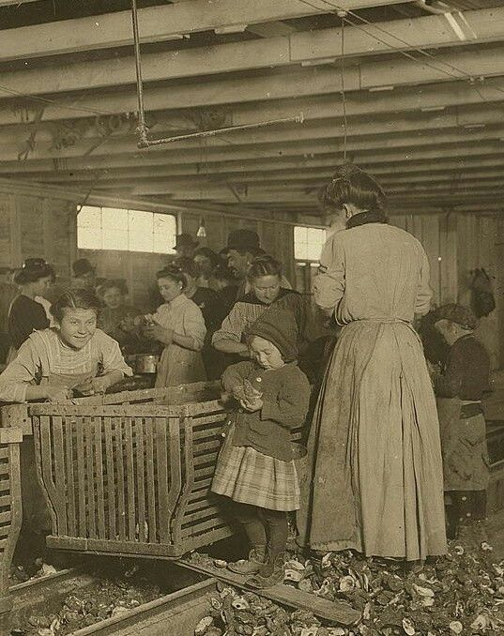
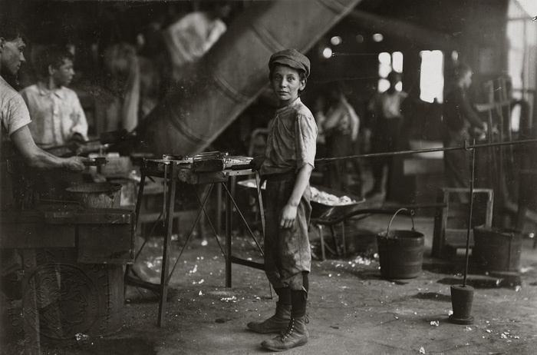
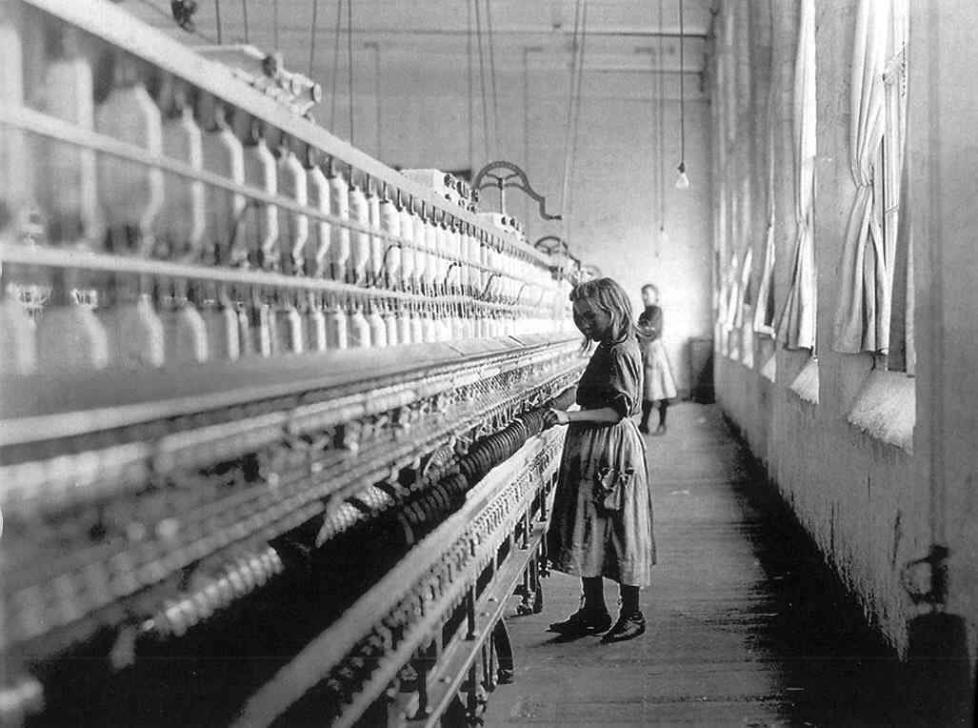
Christianity Joins in the “Rescue”
Sadler was the only member of Parliament, who challenged the whole philosophy of the economists and fought wholeheartedly the battle of the poor.
On 16 March 1832, Sadler attempted to introduce legislation in order to limit a child's work day (under the age of 18) to ten hours a day. He described in his own words the suffering that many children were facing in the factories but members of the Parliament still refused to pass the bill. This bill involved the following:
a ban on labor for children 9 years old and younger
a ten hour work day for people age nine to 18
time in the day included for meals
two hours of free time on Saturday
and a ban on working all night for children under the age of 21.
CHILD LABOR

Slide 29
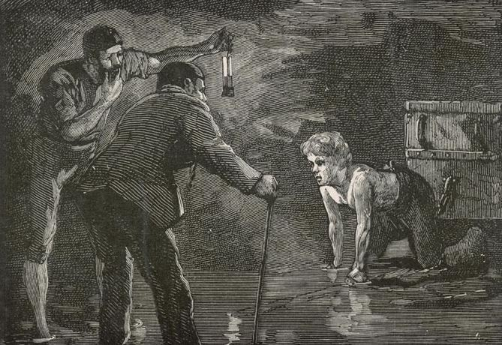
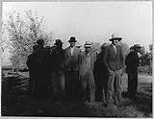
Christianity Joins in the “Rescue”
Lord Shaftesbury (Ashley) was leader of the Factory Reform Movement in the House of Commons and responsible in some way for the passage of nearly every labor reform bill from when he entered Parliament in 1826 until his resignation in 1847.
In March 1833, he introduced another Ten Hours Bill which failed to pass. He supported another Ten Hours Bill in 1836 which also failed to pass.
In March 1844 Ashley moved an amendment to a Factory Bill limiting the working hours of adolescents to ten hours. Finally, while Shaftesbury was out of Parliament, the 1847 Ten Hours Act (aka, Factory Act of 1847) finally passed Parliament, strongly supported by Shaftesbury.
He was described by the bill’s supporters in Lancashire:
"If there was one man in England more devoted to the interests of the factory people than another, it was Lord Ashley. They might always rely on him as a ready, steadfast and willing friend“. Wikipedia
“Where the old masters (old landed aristocracy) had robbed
the poor out of unashamed greed, the new masters (the
money power) robbed them on philosophical principle.”
Hollis, p 107

Slide 30
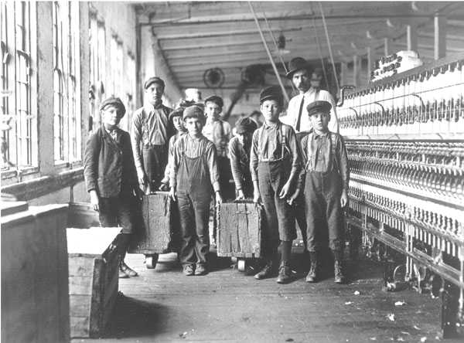
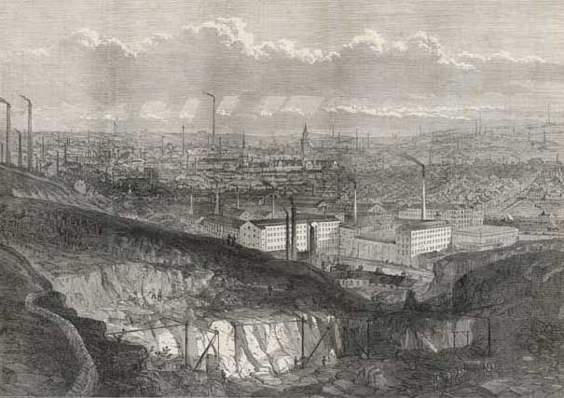
Christianity Joins in the “Rescue”
TEN HOURS ACT OF 1847 (FACTORY BILL)
The Ten Hours Act was made to ensure that women and children only worked up to 10 hours a day in factories. This would now make their maximum schedule 10 hours of work on each weekday, Saturdays 8 hours, and off Sundays. In total, this limited the work time per week to 58 hours.
The Ten Hours Act caused a lot of controversy and was finally passed after numerous attempts, in 1847. During the time before the Act was passed, Lord Ashley had resigned and Fielden was left to take sole responsibility. Being that he was a factory owner himself, Fielden worked his hardest to make sure that the Ten Hours Act was finally passed.
This Act was a major turning point for all factory workers ages 13-18 because it has now given them a solid work schedule. With the passing of these Acts child labors now had some better rights, but all of these changes did not automatically happen right away.
Then, from the mid 1800s to the very early 1900s, the 300-year decline in the English working man’s standard of living reversed.

Slide 31
BENJAMIN DISRAELI: In 1845 the new MP Benjamin Disraeli published a novel, SYBIL, OR THE TWO NATIONS. SYBIL traces the plight of the working classes of England. Disraeli was interested in dealing with the horrific conditions in which the majority of England's working classes lived.
Christianity Joins in the “Rescue”
Advertisement from the author, Benjamin Disraeli:
The general reader whose attention has not been specially drawn to the subject which these volumes aim to illustrate, the Condition of the People, might suspect that the Writer had been tempted to some exaggeration in the scenes which he has drawn and the impressions which he has wished to convey. He thinks it therefore due to himself to state that he believes there is not a trait in this work for which he has not the authority of his own observation, or the authentic evidence which has been received by Royal Commissions and Parliamentary Committees. But while he hopes he has alleged nothing which is not true, he has found the absolute necessity of suppressing much that is genuine. For so little do we know of the state of our own country that the air of improbability that the whole truth would inevitably throw over these pages, might deter many from their perusal.
Grosvenor-Gate, May Day, 1845.

Slide 32
In Chapter 3 of Sybil, Disraeli speaks of the trick history of textbooks and the degradation of the English people with the coming of William of Orange to the English shore.
Christianity Joins in the “Rescue”
TRICK HISTORY OF TEXTBOOKS, SYBIL, Chapter 3:
Generally speaking, all the great events have been distorted, most of the important causes concealed, some of the principal characters never appear, and all who figure are so misunderstood and misrepresented, that the result is a complete mystification …
THE GLORIOUS REVOLUTION, SYBIL, Chapter 3:
The prince came, and used our constitution for his purpose: he introduced into England the system of Dutch finance. The principle of that system was to mortgage industry in order to protect property: abstractedly, nothing can be conceived more unjust; its practice in England has been equally injurious.
In Holland, with a small population engaged in the same pursuits, in fact a nation of bankers, the system was adapted to the circumstances which had created it … But applied to a country in which the circumstances were entirely different; to a considerable and rapidly-increasing population; where there was a numerous peasantry, a trading middle class struggling into existence; the system of Dutch finance, pursued more or less for nearly a century and a half, has ended in the degradation of a fettered and burthened multitude.
Nor have the demoralizing consequences of the funding system on the more favored classes been less decided. It has made debt a national habit; it has made credit the ruling power, not the exceptional auxiliary, of all transactions; it has introduced a loose, inexact, haphazard, and dishonest spirit in the conduct of both public and private life … the moral condition of the people has been entirely lost sight of.

Slide 33
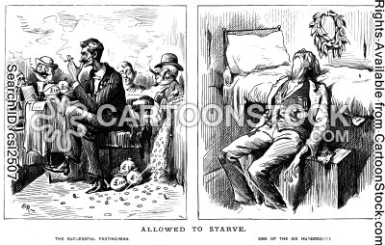
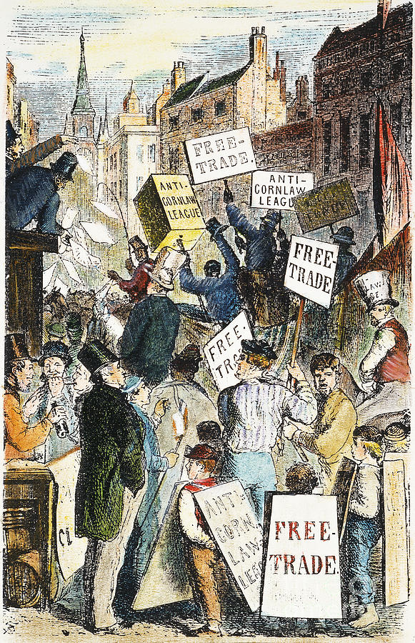
Christopher Hollis, The Two Nations, p. 157; “… the truth which Disraeli saw so clearly – the truth that the banker can freely choose which pockets he will fill with that purchasing power. The producer dare not raise a finger in protest against him, for to all protests he can answer, ‘Very well, then I will not issue the loans at all. I will make your goods unsaleable and thus drive you into bankruptcy.’ By consequence the banker, able to control the pockets of the purchasers, is able to dictate the sort of goods that a country must produce. It was this that Disraeli saw … Each country produced those goods which its bankers told it to produce. And the bankers had told England to stop producing food and instead to produce capital goods for export.”
Christianity Joins in the “Rescue”
In 1815, the Tory government passed the Corn Law to keep bread prices high. This resulted in serious rioting in London.]
In 1846, the Corn Laws were repealed.

Slide 34
Factory and Workshop Act 1878
Christianity Joins in the “Rescue”
The Factory and Workshop Act 1878 brought all the previous Acts together in one consolidation:
Now the Factory Code applied to all trades.
No child anywhere under the age of 10 was to be employed.
Compulsory education for children up to 10 years old.
10-14 year olds could only be employed for half days.
Women were to work no more than 56 hours per week.

Slide 35
Benjamin Disraeli, a Jew
Christianity Joins in the “Rescue”
“But deep down in his soul there was the immemorial teaching of his ancient race against usury – the teaching of Moses … identification of usury with the serpent’s bite of Eden.
No Jew has ever fallen into the foolish carelessness of so many silly Christians who think that it does not greatly matter whether usury be tolerated or not. Where a Jew is a friend of a society, he will wish to save it from that which will eat it up. And Disraeli … was yet the friend of England, her grateful guest.”
Christopher Hollis, Two Nations, pp. 139-140

Slide 36
PART 7
Usury in Trouble

Slide 37
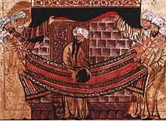
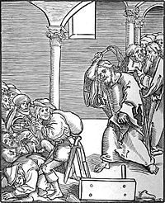
Usury in Trouble
The structural usury of the Bank of England’s operations, what we term “macro-usury,” was under heavy attack.
Even simple usury defined as the riskless charging of interest, had never been on firm ground. In 1822 it was still under formal ban of the Catholic Church, and the Old Testament and the Koran condemn it to this day.
MOHAMMAD
‘God has permitted trade but forbidden usury. Profit is the result of initiative, enterprise and efficiency – value creation. Not so with usury… interest is fixed, profit fluctuates’
Christ drives the Usurers out of the Temple,
a woodcut by Lucas Cranach the Elder

Slide 38
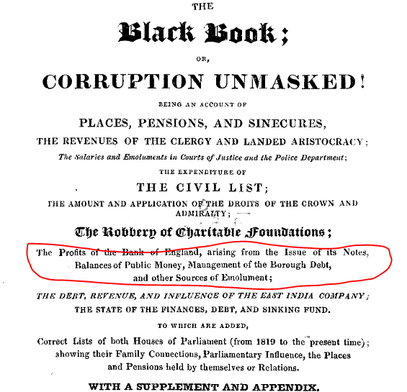
Usury in Trouble
John Wade's
Extraordinary Black Book; or,
Corruption Unmasked, 1819
Wade's book played a role in
the reform movement.
He focused on many abuses,
including:
“The Profits of the Bank of
England, arising from the
Issue of its Notes, Balances
of Public Money, Management
of the Borough Debt, and other
Sources of Emolument”

Slide 39
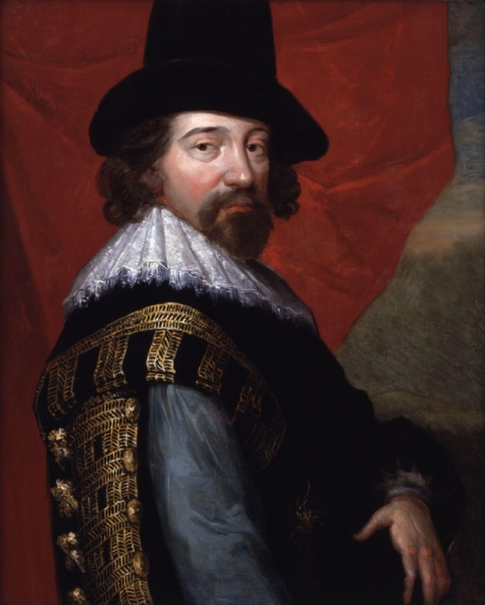
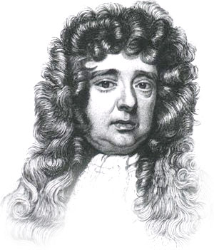
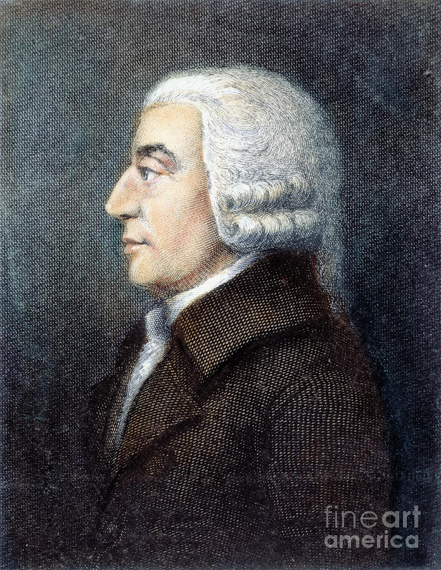
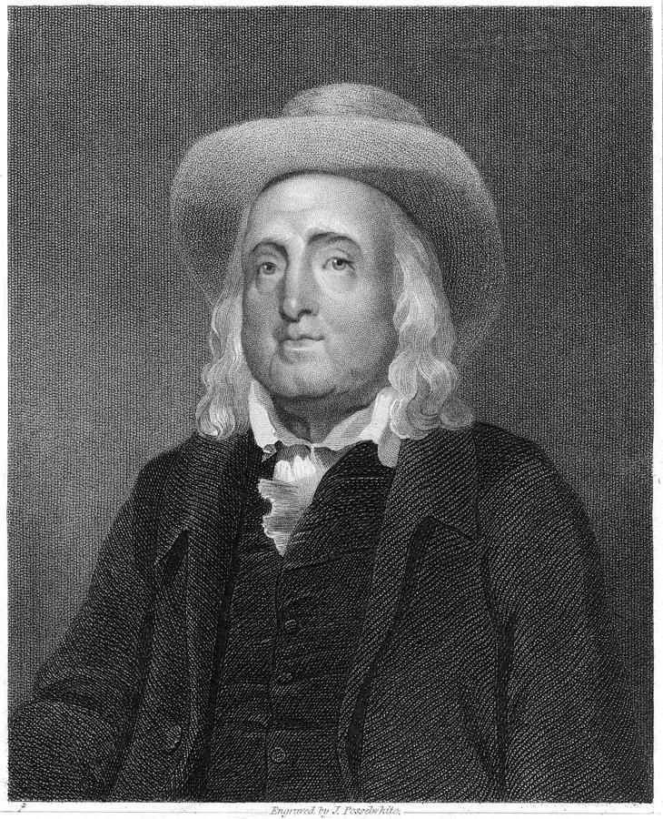
Usury in Trouble
Adam Smith’s attack on government money was the attempted justification for macro usury.
The changing secular rationale for simple usury can be traced through the writings of
Bacon, Petty, Smith and Bentham.
One recurrent theme was the need to attack Aristotle.
FRANCIS BACON
(1561–1626)
WILLIAM PETTY
(1623–1687)
ADAM SMITH
(1723-1790)
JEREMY BENTHAM
(1748–1832)

Slide 40
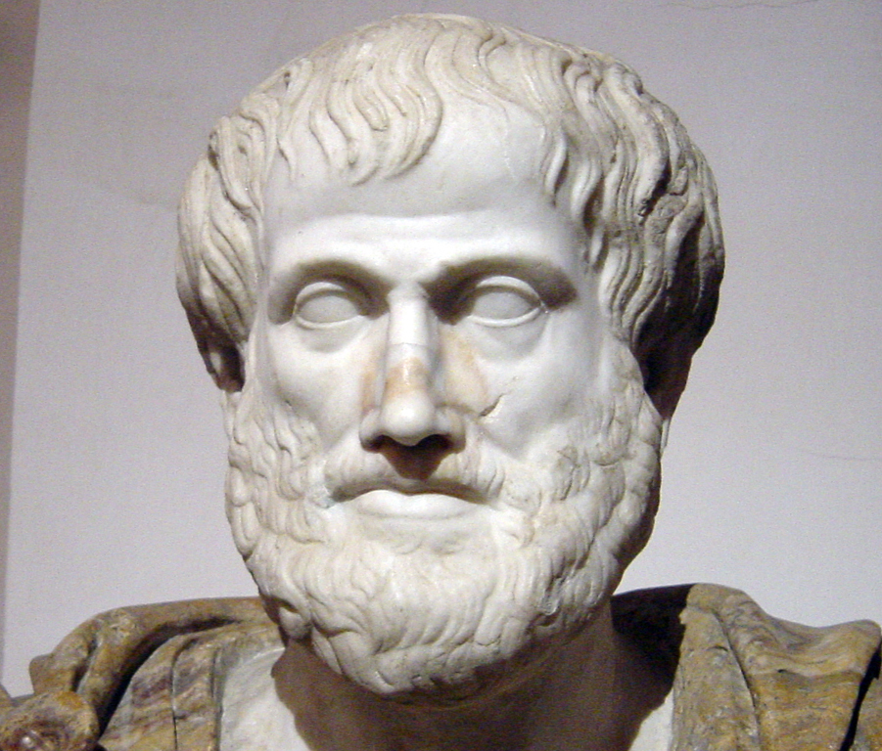
ANCIENT WESTERN PHILOSOPHER: ARISTOTLE
Usury in Trouble
“…The most hated sort, and with the greatest reason, is usury, which makes a gain out of money itself, and not from the natural object of it. For money was intended to be used in exchange, but not to increase at interest….
…And this term interest,
which means the birth of money from money…
this is the most unnatural.”
Politics, by Aristotle, Book 1
ARISTOTLE
(384 BC – 322 BC)

Slide 41
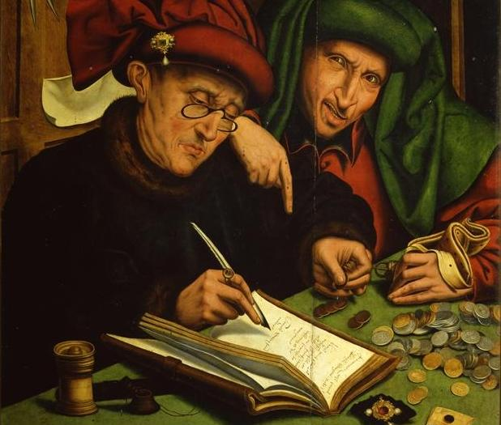
Usury in Trouble
Website, Luminarium.org
Bacon wrote prolifically … Yet their writer was a spendthrift, twice arrested for debt; and a scheming and ambitious political opportunist who turned faithlessly, and with diabolical erudition, upon his friend and benefactor, the Earl of Essex, and caused his execution. For this masterpiece of treachery he received £1200 from Queen Elizabeth, thereby relieving his own financial desperation caused by opulent extravagances and beginning his spectacular climb to power … He thirsted for the advancement of learning but never neglected the advancement of Bacon.
Bacon’s usury rationale was based on psychological terms.
OF USURY, Francis Bacon
“Many have made witty invectives against usury … that it is against nature for money to beget money, and the like. I say this only … for since there must be borrowing and lending, and men are so hard of heart as they will not lend freely, usury must be permitted.”

Slide 42
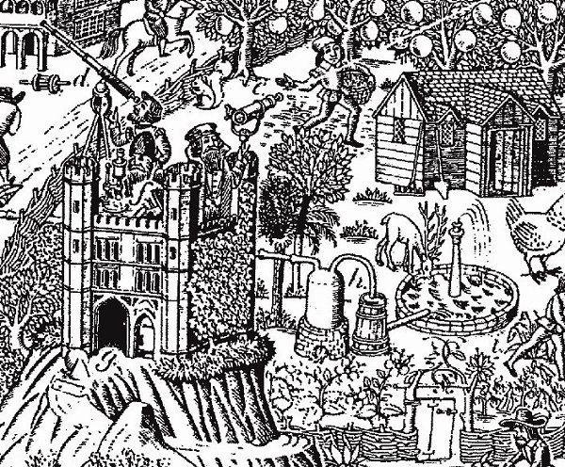
Usury in Trouble
Bacon attacked Aristotle
Bacon does not refute or discuss Aristotle’s views on money. But he attacks him:
He criticizes the Scholastics for “ … almost having incorporated the contentious philosophy of Aristotle into the body of Christian religion” Works, p 209
“Aristotle … full of ostentation …” Works, p. 800
“Aristotle so confident and dogmatical” Works, p 850
“Aristotle was “barren of the production of works for the benefit of the life of man.” New Atlantis

Slide 43
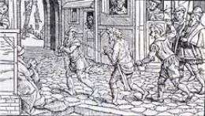
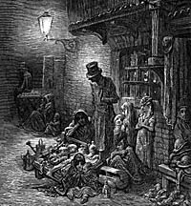
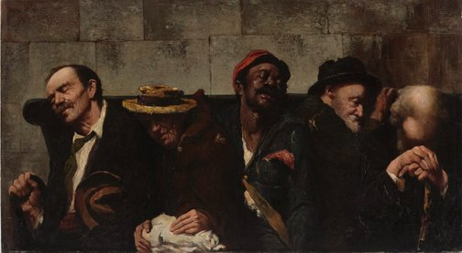
Usury in Trouble
Bacon was aware of problems caused by usury:
Of Usury, Francis Bacon:
“The discommodities of usury are …
it makes fewer merchants; for were it not for this lazy trade of usury, money would not lie still but would in great part be employed upon merchandising
it makes poor merchants; … the merchant cannot drive his trade so well if he sit at great usury
the decay of customs of kings or states
it bringeth the treasure of a realm or state into a few hands; … a state flourisheth when wealth is more equally spread
it beats down the price of land; for the employment of money is chiefly either merchandising or purchasing, and usury waylays both
it doth dull and damp all industries, improvements, and new inventions
it is the canker and ruin of many men's estates, which in process of time breeds a public poverty.”

Slide 44
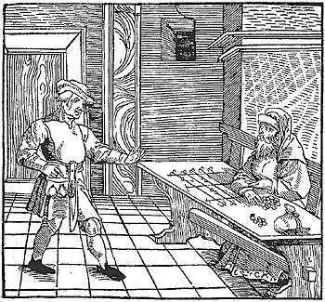
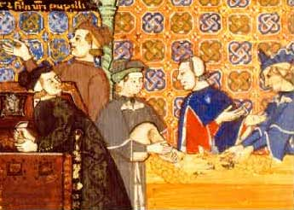
Usury in Trouble
Bacon’s defense of usury:
Of Usury, Francis Bacon:
“… usury in some respect hindereth merchandising, yet in some other it advanceth it; for it is certain that the greatest part of trade is driven by young merchants upon borrowing at interest …
… whereas usury doth but gnaw upon them, bad markets would swallow them quite up … I remember a cruel moneyed man in the country that would say … it keeps us from forfeitures of mortgages and bonds.
The third and last is, that it is a vanity to conceive that there would be ordinary borrowing without profit”

Slide 45
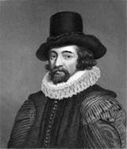
Usury in Trouble
Bacon’s solution
Of Usury, Francis Bacon:
“… two things are to be reconciled; the one that the tooth of usury be grinded that it bite not too much; the other that there be left open a means to invite moneyed men to lend to the merchants, for the continuing and quickening of trade.
… there be two rates of usury; the one free and general for all; the other under licence only to certain persons, and in certain places of merchandising. … Secondly, let there be certain persons licensed to lend to known merchants upon usury at a higher rate”
“But this would clearly only further accentuate the concentration power of usury.”
Stephen Zarlenga, LSM, p. 341

Slide 46
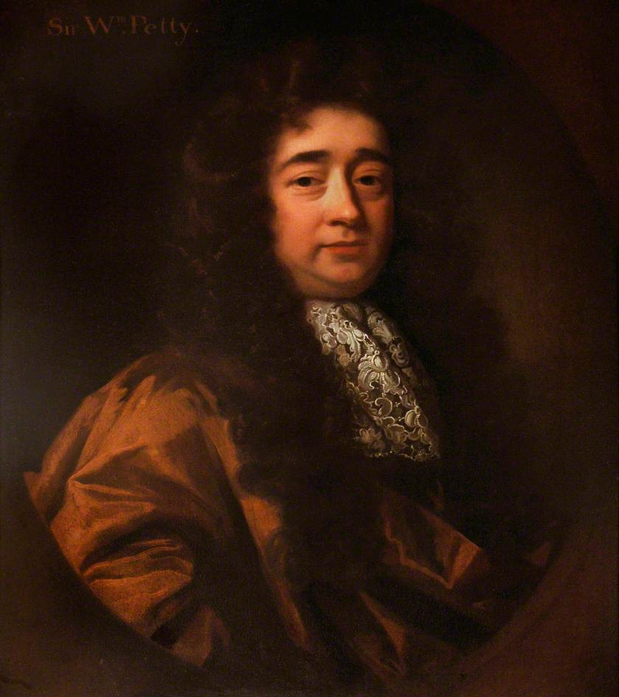
Usury in Trouble
Sir William Petty
REDEFINED USURY IN ECONOMIC TERMS
English economist, scientist and philosopher. It is for his theories on economics and his methods of political arithmetic that he is best remembered … to him is attributed the philosophy of ‘laissez-faire’ in relation to government activity.
Quantulumcunque Concerning Money, William Petty
Qu. 28. What is Interest or Use-Money?
Answ. A Reward for forbearing the use of your own Money for a Term of Time agreed upon, whatsoever need your self may have of it in the mean while.
Sir William Petty
(1623–1687)
“This ascetic rewarding of self denial, with religious overtones, is still used by some in the 20th century.” Stephen Zarlenga

Slide 47
Usury in Trouble
Sir William Petty
REDEFINED USURY IN ECONOMIC TERMS
Wikipedia:
Having established the justification for usury itself, that of forbearance, he then shows his Hobbesian qualities, arguing against any government regulation of the interest rate, pointing to the 'vanity and fruitlessness of making civil positive laws against the laws of nature‘.
USURY: A LAW OF NATURE

Slide 48
Usury in Trouble
ADAM SMITH
ALSO JUSTIFIED USURY IN ECONOMIC TERMS
ADAM SMITH: “The interest or the use of money…is the compensation which the borrower pays to the lender, for the profit which he has an opportunity of making by the use of the money. Part of that profit naturally belongs to the borrower who runs the risk and takes the trouble of employing it; and part to the lender, who affords him the opportunity of making this profit.”
STEPHEN ZARLENGA: “This is how interest is popularly viewed today. But Smith overlooked that the lender gets his profit even when the enterprise loses; he ignored the successful business structures used by Venice for centuries, where the lender’s return was based on actual profits. Smith’s endorsement did not remove the stigma against usury; and the debate continued.”

Slide 49
PART 8
Bentham’s Usury Rescue Squad

Slide 50
IN DEFENSE OF USURY: Bentham creates today’s mis-definition of usury
Bentham’s Usury Rescue Squad
BENTHAM, Letter II, In Defense of Usury:
“I know of but two definitions that can possibly be given of usury:
one is, the taking of a greater interest than the law allows of …
The other is the taking of a greater interest than it is usual for men to give and take: this may be stiled the moral one: and this, where the law has not interfered, is plainly enough the only one.”

Slide 51
Ignoring hundreds of years of the Scholastic’s work, Bentham defines usury out of existence
Bentham’s Usury Rescue Squad
BENTHAM, Letter II, In Defense of Usury:
“One thing then is plain; … there can be no such thing as usury: for what rate of interest is there that can naturally be more proper than another? what natural fixed price can there be for the use of money more than for the use of any other thing?
My neighbours, being at liberty, have happened to concur among themselves in dealing at a certain rate of interest. I, who have money to lend, and Titius, who wants to borrow it of me, would be glad, the one of us to accept, the other to give, an interest somewhat higher than theirs: why is the liberty they exercise to be made a pretence for depriving me and Titius of ours? ”

Slide 52
BENTHAM: “ … indeed, with regard to times past, it is from the legal rate, more readily than from any other source, that we collect the customary. Among the Romans, till the time of Justinian, we find it as high as 12 per cent.: in England, so late as the time of Hen. VIII, we find it at 10 per cent.: succeeding statutes reduced it to 8, then to 6, and lastly to 5, where it stands at present.” In Defense of Usury, Letter II.5
Bentham’s Usury Rescue Squad
Bentham neglects to inform his readers that usury was illegal before Henry VIII legalized it.
BUT …
Practically all important ethical teachers -- Moses, Aristotle,
Jesus, Mohammed, and Saint Thomas Aquinas, for instance –
have denounced lending at interest as usury and as morally wrong.
Beginning in the 4th century, the Catholic church placed bans on
usury and by the 8th century, usury was a general criminal offense.
The Church Scholastics of the 11th thru 16th centuries were deeply
influenced by the works of Aristotle – “money is barren”.

Slide 53
Bentham’s Usury Rescue Squad
Bentham’s works were then and are now touted as economic or philosophic achievements:
they justify the harmful effects of usury on common people
BENTHAM:
“Why a man who takes as much as he can get, be it six, or seven, or eight, or ten per cent. for the use of a sum of money should be called usurer, should be loaded with an opprobrious name, any more than if he had bought an house with it, and made a proportionable profit by the house, is more than I can see.” II, 6 “But in what degree soever a man's weakness may expose him to imposition, he stands much more exposed to it, in the way of buying goods, than in the way of borrowing money.” V, 4
“if I find I have given too high an interest to one man, I have no more to do than to borrow of another at a lower rate, and pay off the first: if I cannot find any body to lend me at a lower, there cannot be a more certain proof that the first was not in reality too high.” V, 5

Slide 54
Benthem’s attack on Aristotle
Bentham’s Usury Rescue Squad
BENTHAM:
“… Aristotle: that celebrated heathen, who … had established a despotic empire over the Christian world. As fate would have it, that great philosopher, with all his industry, and all his penetration, notwithstanding the great number of pieces of money that had passed through his hands (more perhaps than ever passed through the hands of philosopher before or since) … had never been able to discover, in any one piece of money, any organs for generating any other such piece. Emboldened by so strong a body of negative proof, he ventured at last to usher into the world the result of his observations, in the form of an universal proposition, that all money is in its nature barren.” X, 4
“ …he didn’t consider … though a daric (coin) would not beget another daric … yet for a daric which a man borrowed, he might get a ram and a couple of ewes, and that the ewes, were the ram left with them a certain time, would probably not be barren.” X, 5
ZARLENGA: “Thus Bentham spread the same erroneous justification that Calvin used. The Scholastics had clearly shown it was the ‘ewes,’ not the coins, that create more ewes.” LSM, p 344
IN THE BRONZE AGE CITY CIVILIZATIONS, SILVER METAL WAS LOANED
AT INTEREST REPAID IN MORE SILVER:
Inorganic materials were being treated as if they were
living organisms with the means of reproduction. Debt slavery
was the result.

Slide 55
PART 9
The “Anti-Jewish” Ploy

Slide 56
The “Anti-Jewish” Ploy
BENTHAM ATTACKS ARISTOTLE FOR CORRUPTING THE CHRISTIANS:
TO BE ANTI-USURY IS TO BE ANTI-JEWISH!
BENTHAM – TO BE ANTI-USURY IS TO BE ANTI-SEMITIC:
“ … but it was bad to lend upon any terms … it was acting like a Jew …” X. 2
“Christians were too intent upon plaguing Jews, to listen to the suggestion of doing as Jews did, even though money were to be got by it. Indeed the easier method, and a method pretty much in vogue, was, to let the Jews get the money any how they could, and then squeeze it out of them as it was wanted.” X 3
“In process of time … the anti-Jewish side of it found no unopportune support in a passage of Aristotle … ” X 4
ZARLENGA:
“Instead of criticizing the Jews for the activities of some of their most powerful members, activities
viewed as harmful by all prior moral systems, especially the Jewish Bible, Christians should simply have joined in
the infamy and done as the Jews did!
Bentham’s attack is an early example of the anti-Semitism smokescreen to protect improper monetary activities,
a tactic that has been used to block the search for knowledge for decades in America. To brand a concept
as ‘anti-Semitic,’ … has been sufficient to destroy theories without examining their merits.”
LSM, p. 344

Slide 57
The “Anti-Jewish” Ploy
BENTHAM’S UTILITARIANISM: “Nature has placed mankind under the governance of two sovereign masters, pain and pleasure. It is for them alone to point out what we ought to do …” An Introduction to the Principles of Morals and Legislation
“Charles Haney’s History of Economic Thought classified Bentham as a ‘hedonist’ – one who asserts that individual actions are solely motivated by a desire for pleasure and avoidance of pain.
‘The community, he (Bentham) states, is a fictitious body, and the common interest can be understood only by what is the interest of the individual … nothing ought to be done or attempted by the government … his rule of government is ‘be quiet’.’ “ LSM, p. 344

Slide 58
The “Anti-Jewish” Ploy
BENTHAM’S DEFENSE OF USURY – A DEFENSE OF CAPITALISM
BENTHAM:
RABID ON USURY
RABID AGAINST ARISTOTLE
RABID AGAINST THE GOVERNMENT

Slide 59
PART 10
John Whipple’s Enlightened Attack on Usury

Slide 60
John Whipple’s Enlightened Attack on Usury
FREE TRADE IN MONEY: THE GREAT AND PRINCIPAL CAUSE OF FRAUD,
POVERTY, AND RUIN.
--------
STRINGENT USURY LAWS: THE BEST DEFENCE OF THE PEOPLE
AGAINST HARD TIMES.
-------
AN ANSWER TO JEREMY BENTHAM
By Hon. John Whipple, LL.D. (Rhode Island)
Despite continuous pressure and support from the financial community, the various justifications for usury proved inadequate. in 1836, John Whipple, an American lawyer, wrote THE IMPORTANCE OF USURY LAWS -AN ANSWER TO JEREMY BENTHAM. Written in 1836, the book was published in 1850. The 1836 pamphlet led to the enactment of the stringent usury law of 1837 in New York State and was used
in other states to defend the usury laws.

Slide 61
John Whipple’s Enlightened Attack on Usury
Whipple argued theoretically from the nature of money.
WHIPPLE:
“… (the purpose of money is to facilitate exchange) It was never intended as an article of trade, as an article possessing an inherent value in itself, (but) as a representative or test of the value of all other articles. It undoubtedly admits of private ownership but of an ownership that is not absolute, like the product of individual industry, but qualified and limited by the special use for which it was designed….”
This view is clearly drawn from Aristotle’s concept of money that money exists not by nature but by law.
CONSTITUTION OF THE U.S., ARTICLE 1, SECTION 8:
… To coin Money, regulate the Value thereof, and of foreign Coin, and fix the Standard of Weights and Measures;

Slide 62
John Whipple’s Enlightened Attack on Usury
Whipple did the obvious and proved the impossibility
of sustaining long term compound usury
WHIPPLE:
“If 5 English pennies… had been… at 5 per cent compound interest from the beginning of the Christian era until the present time, it would amount in gold of standard fineness to 32,366,648,157 spheres of gold each eight thousand miles in diameter, or as large as the earth.”
THAT IS 32 BILLION
EARTH-SIZE BALLS!!!!
THE KIND OF UNNATURAL FORCE AT WORK
WHEN GEOMETRICALLY COMPOUNDING DEMAND
PLACED ON SOCIETY OR NATURE

Slide 63
John Whipple’s Enlightened Attack on Usury
STEPHEN ZARLENGA: MONEY’S NATURE MUST BE EXAMINED
Approaching the usury question intelligently requires a better understanding of the nature of money.
The Scholastics maintained that there was a distinction between money, and productive capital. Calvin’s Reformation argued against this. But the Scholastic view has been re-affirmed, for example by Knut Wicksell, the father of modern day interest rate theory who wrote in INTEREST AND PRICES: “It is not true that money is only one form of capital; that the lending of money constitutes the lending of real capital in the form of money. Money does not enter into the process of production, it is in itself as Aristotle showed, quite sterile.”
Re-examining these questions will also require more candor from the English speaking economics profession. For example, in the English translation of Wicksell’s book, that last sentence on Aristotle is significantly left out! Thus the English audience are denied the full benefit of his work and thought.

Slide 64
John Whipple’s Enlightened Attack on Usury
From the Introduction, by Nahum Capen, LL.D., to Whipple’s AN ANSWER TO JEREMY BENTHAM
“As a certain portion of the citizens of Massachusetts and of other States are constantly endeavoring to induce legislators to try the experiment of repealing the usury laws … The rich, or the possessors of money, propose to try an experiment which can cost them nothing, whatever may be the result; and the poor … will be made to suffer the accumulated penalties …
Besides, the people require no such experiment. The experiment has been frequently and sufficiently tried throughout the civilized world. The ultimate convictions of the people and the ultimate measures of government have been remarkably uniform; and hence we find usury laws in every civilized nation upon the face of the earth …”
THE RESULT OF THE USURY ERROR:
debt slavery

Slide 65
Q & A
WILL DECKER’S CONCLUSION:
THE CONTROL OF MONEY -- WITHOUT CONTROL FROM THE PUBLIC -- LEADS TO
CORRUPTION … USURPATION … SLAVERY.

Slide 66
POSTSCRIPT
Economics education, for 200 years, removed the creation of new money as a factor in economics.
They call it "demand for money", implying that money supply is related somehow to our demand for it.
They also call it "liquidity" or "savings", implying that it is already created money we are borrowing.
They are bald faced liars! And, finally that is being ferreted out. So, it is no surprise that these PHDs have no vocabulary about the function of the money system.
They want us to think that destruction comes from deep within us, instead of from these mechanistic institutions and their effects on us.
B.B., NEW YORK 2014

