Slide 1
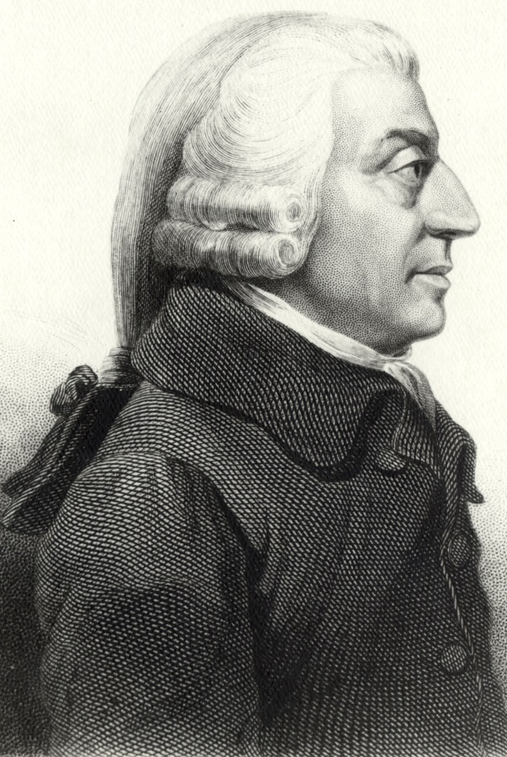
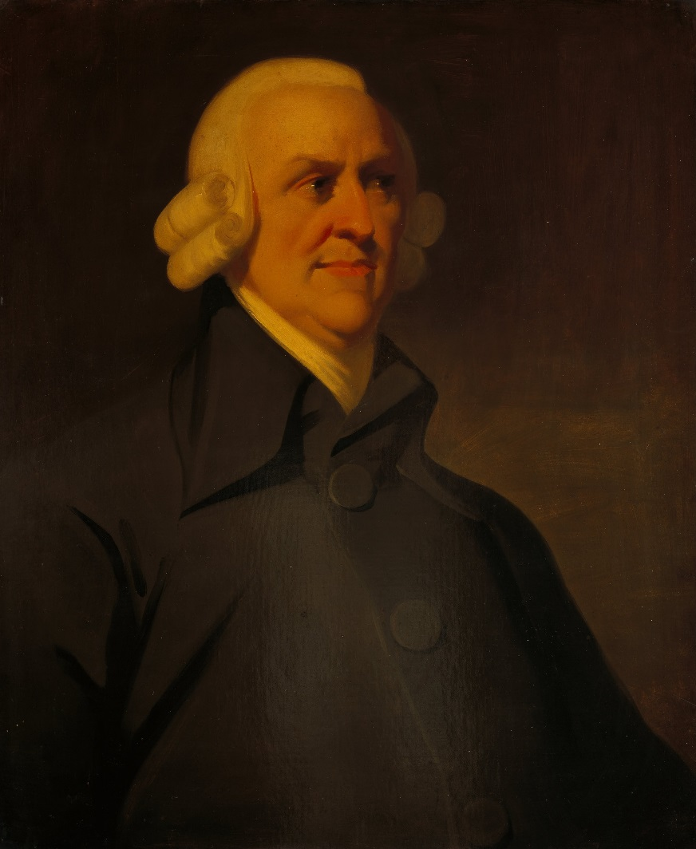
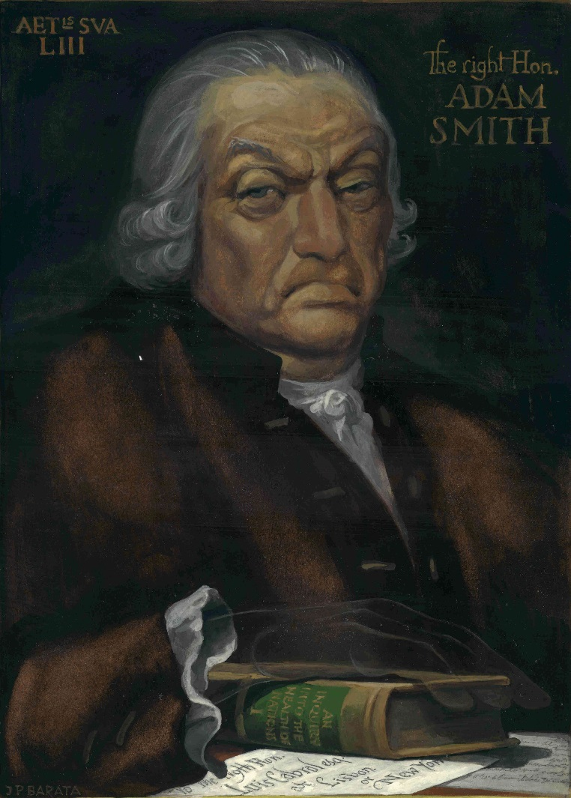
The Lost Science of Money
CHAPTER 12 – PART 2
POLITICAL ECONOMISTS: PRIESTHOOD OF THE BANKER THEOLOGY
ADAM SMITH
ADAM SMITH
ADAM SMITH

Slide 2
THEMES OF LOST SCIENCE OF MONEY BOOK
Primary importance of the money power (power to create money and regulate it)
Nature of money purposely kept secret and confused
How a society defines money determines who controls the society
Battle over control of money has raged for millennia: public vs private
The misuse of the monetary system causes tremendous misery and suffering for the ordinary working people. Will Decker & Martin Dunn, February 2014

Slide 3
PARTS OF PRESENTATION
Better Monetary Thought – Bishop George Berkeley
Better Monetary Thought – John Raithby (1811)
Better Monetary Thought - Charles de Montesquieu:
Charging interest on privately created money
Better Monetary Thought: the quantity of money and inflation – how much money is needed?
John Locke
David Hume
Adam Smith:
Hated governments issuing money: Colonial Money
Relentless attack on society
Evasion of the interest problem
Buildup of an un-payable national debt
Bank of England over-issuing money

Slide 4
PARTS OF PRESENTATION (Page 2)
Why do Adam Smith’s ideas prevail?
Adam Smith’s most vicious error: the selfishness error
1810 - suppressing the 1810 bullion report
1811 - The Bank shifts from expansion to contraction
“Currency School” vs the “Banking School”: THE FALSE DEBATE TACTIC
Summary

Slide 5
PART 1
Better Monetary Thought – Bishop George Berkeley

Slide 6
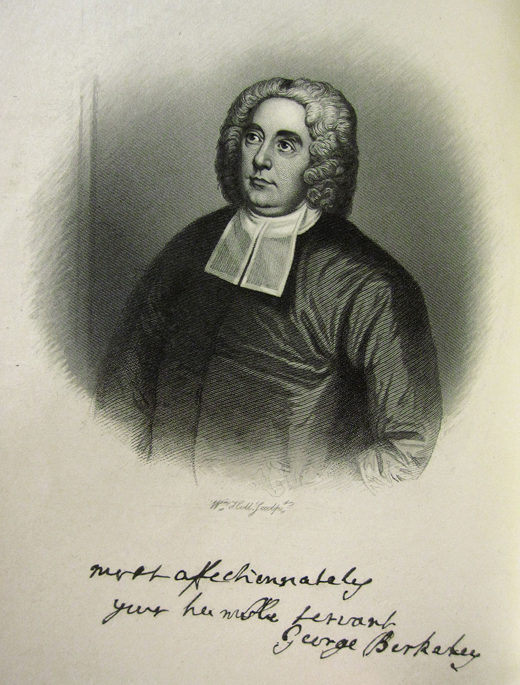
Better Monetary Thought – Bishop George Berkeley
George Berkeley (1685—1753), Bishop of Cloyne, Ireland
“…few would think it an extravagance to call him the greatest of English metaphysicians.”
Christopher Hollis, Two Nations, p. 55
George Berkeley, The Querist. 1735. Published in Dublin in three parts, 1735, 1736, 1737. Anonymous.
GEORGE BERKELEY: “I had determined with myself never to prefix my name to the Querist, but in the last edition was overruled by a friend, who was remarkable for pursuing the public interest with as much diligence as others do their own. I apprehend the same censure on this that I incurred upon another occasion, for meddling out of my profession; though to feed the hungry and clothe the naked, by promoting an honest industry, will, perhaps, be deemed no improper employment for a clergyman who still thinks himself a member of the commonwealth. As the sum of human happiness is supposed to consist in the goods of mind, body, and fortune, I would fain make my studies of some use to mankind with regard to each of these three particulars, and hope it will not be thought faulty or indecent in any man, of what profession soever, to offer his mite towards improving the manners, health, and prosperity of his fellow-creatures.”

Slide 7
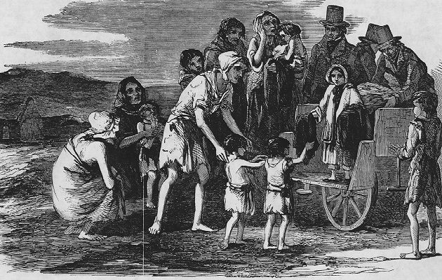
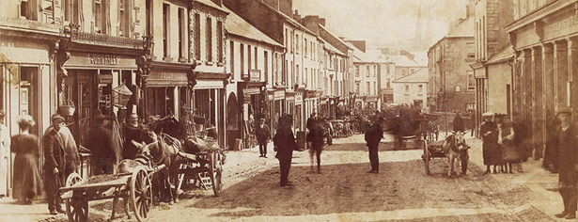
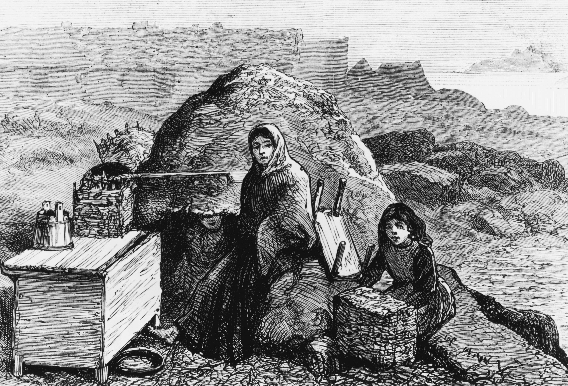
Better Monetary Thought – Bishop George Berkeley
A BREATH OF FRESH AIR … Stephen Zarlenga, Lost Science of Money, p. 316
QUERY 2 Whether a people can be called poor, where the common sort are well fed, clothed, and lodged?
QUERY 3 Whether the drift and aim of every wise State should not be, to encourage industry in its members? And whether those who employ neither heads nor hands for the common benefit deserve not to be expelled like drones out of a well-governed State?
QUERY 5 Whether money be not only so far useful, as it stirreth up industry, enabling men mutually to participate the fruits of each other's labour?
QUERY 6 Whether any other means, equally conducing to excite and circulate the industry of mankind, may not be as useful as money.

Slide 8
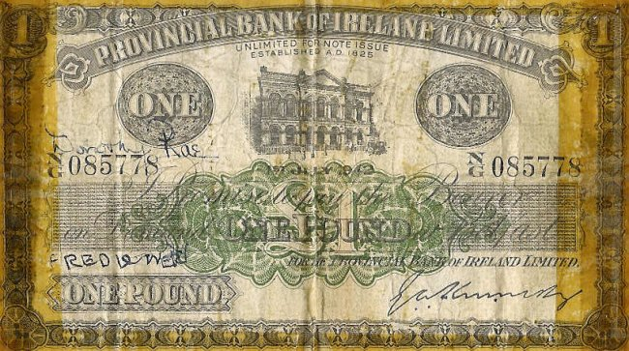
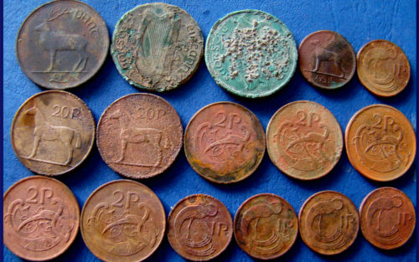
Better Monetary Thought – Bishop George Berkeley
“And it was not strange that the curiosity of such a man should have been aroused with desire to discover
exactly why the South Sea Bubble had burst.” Christopher Hollis, Two Nations, p. 56
STEPHEN ZARLENGA: Recognizing that money is an abstract power:
Query 23. Whether money is to be considered as having an intrinsic value, or as being a commodity, a standard, a measure, or a pledge, as is variously suggested by writers? And whether the true idea of money, as such, be not altogether that of a ticket or counter?
Query 26. Whether the denominations being retained, although the bullion were gone, things might not nevertheless be rated, bought, and sold, industry promoted, and a circulation of commerce maintained?
Query 30. Whether there be any virtue in gold or silver, other than as they set people at work, or create industry?
STEPHEN ZARLENGA: Recognizing the quantity aspect of money’s value:
Query 24. Whether the value or price of things be not a compounded proportion, directly as the demand, and reciprocally as the plenty?
Query 25. Whether the terms crown, livre, pound sterling, etc., are not to be considered as exponents or denominations of such proportion? And whether gold, silver, and paper are not tickets or counters for reckoning, recording, and transferring thereof?

Slide 9
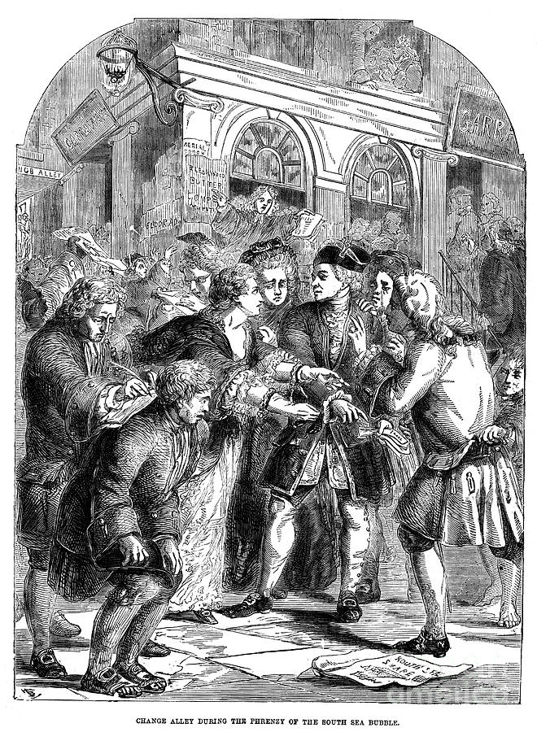
Better Monetary Thought – Bishop George Berkeley
“Therefore in the years, 1735, 1736, and 1737, Berkeley, by then the Bishop of Cloyne, published in three parts his
Queries … in which he put forward the monetary and economic reforms which were in his opinion necessary to prevent
such catastrophes as that of the South Sea Bubble and to bring prosperity to Ireland …”
Christopher Hollis, Two Nations, p. 56
Qu
Query 32 Whether if there was no silver or gold in the kingdom, our trade might not, nevertheless, supply bills of exchange, sufficient to answer the demands of absentees in England or elsewhere?
Query 33 Whether current bank-notes may not be deemed money? And whether they are not actually the greater part of the money of this kingdom?
Query 35 Whether power to command the industry of others be not real wealth? And whether money be not in truth tickets or tokens for conveying and recording such power, and whether it be of great consequence what materials the tickets are made of?

Slide 10
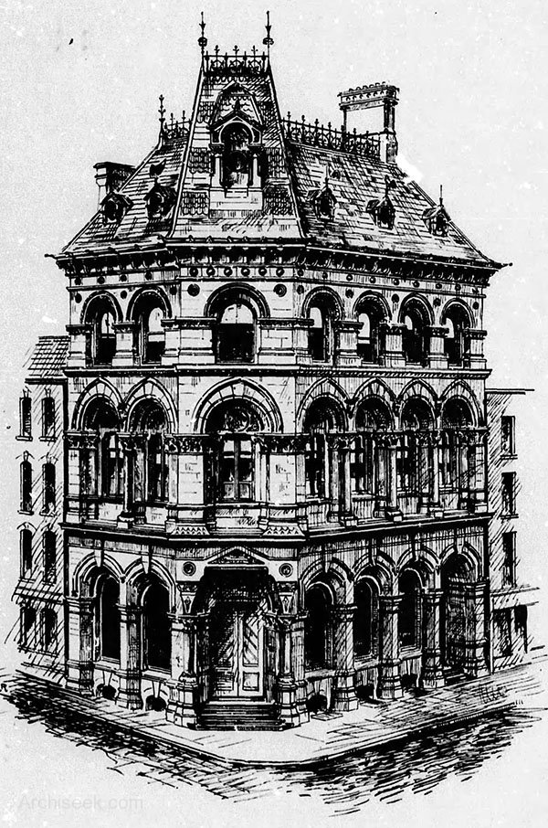
Better Monetary Thought – Bishop George Berkeley
STEPHEN ZARLENGA: George Berkeley argues that while the idea of a Bank was good, it must be a publicly owned and
controlled institution:
Query 219 Whether the abuse of banks and paper-money is a just objection against the use thereof? And whether such abuse might not easily be prevented?
Query 220 Whether national banks are not found useful in Venice, Holland, and Hamburg? And whether it is not possible to contrive one that may be useful also in Ireland?
Query 221 Whether the banks of Venice and Amsterdam are not in the hands of the public?
Query 222 Whether it may not be worth while to inform ourselves in the nature of those banks? And what reason can be assigned why Ireland should not reap the benefit of such public banks as well as other countries?
Query 223 Whether a bank of national credit, supported by public funds and secured by Parliament, be a chimera or impossible thing? And if not, what would follow from the supposal of such a bank?
Query 225 Whether the notes of such public bank would not have a more general circulation than those of private banks, as being less subject to frauds and hazards?
The original Irish National Bank,
a private corporation chartered
in 1781 by Parliament of Ireland.

Slide 11
Better Monetary Thought – Bishop George Berkeley
THE DANGERS OF A PRIVATE NATIONAL BANK
Query 244 Whether it be just to apprehend danger from trusting a national bank with power to extend its credit, to circulate notes which it shall be felony to counterfeit, to receive goods on loans, to purchase lands, to sell also or alienate them, and to deal in bills of exchange; when these powers are no other than have been trusted for many years with the bank of England, although in truth but a private bank?
Query 245 Whether the objection from monopolies and an overgrowth of power, which are made against private banks, can possibly hold against a national one?
Query 246 Whether the evil effects which of late years have attended paper-money and credit in Europe did not spring from subscriptions, shares, dividends, and stock-jobbing?

Slide 12
Better Monetary Thought – Bishop George Berkeley
ON AMERICAN COLONIES AND THEIR PAPER MONEY:
Query 251 Whether there are not to be seen in America fair, towns, wherein the people are well lodged, fed, and clothed, without a beggar in their streets, although there be not one grain of gold or silver current among them?
Query 252 Whether these people do not exercise all arts and trades, build ships and navigate them to all parts of the world, purchase lands, till and reap the fruits of them, buy and sell, educate and provide for their children? Whether they do not even indulge themselves in foreign vanities?
Query 253 Whether, whatever inconveniences those people may have incurred from not observing either rules or bounds in their paper money, yet it be not certain that they are in a more flourishing condition, have larger and better built towns, more plenty, more industry, more arts and civility, and a more extensive commerce, than when they had gold and silver current among them?
ON THE NATURE OF MONEY BEING NOT UNDERSTOOD:
Query 278 Whether the use or nature of money, which all men so eagerly pursue, be yet sufficiently understood or considered by all?
Query 279 What doth Aristotle mean by saying --"Coin seems to be something trivial." - De repub., ix. 9?

Slide 13
PART 2
Better Monetary Thought – John Raithby (1811)

Slide 14
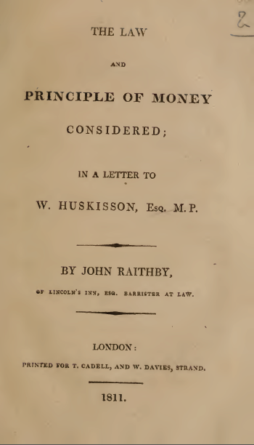
Better Monetary Thought – John Raithby (1811)
John Raithby (1766–1826): lawyer. Raithby practiced in the Court of Chancery, and his legal writings obtained for him a commissionership of bankruptcy. He was familiar with the many laws issued under William III.

Slide 15
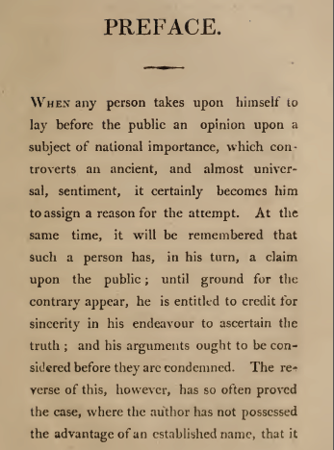
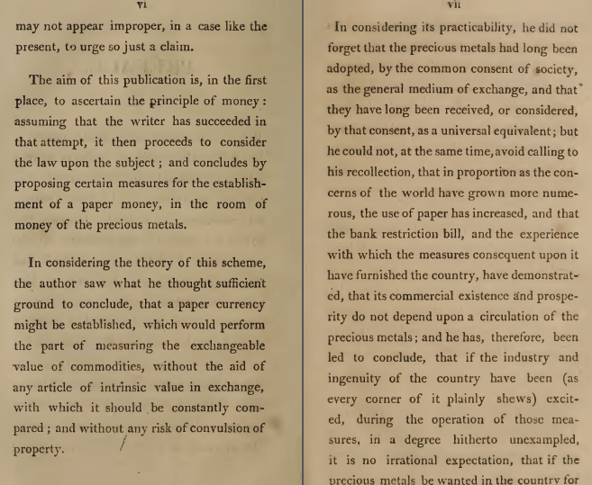
Better Monetary Thought – John Raithby (1811)
Raithby: intrinsic value is not needed for
money …
…

Slide 16
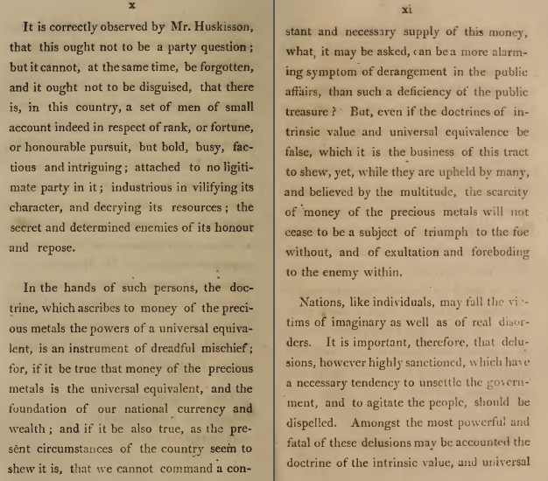
Better Monetary Thought – John Raithby (1811)
Raithby: there are internal enemies
of the people, their government,
and society – who use the doctrine
of precious metal money for
their own designs, against the government.
…

Slide 17
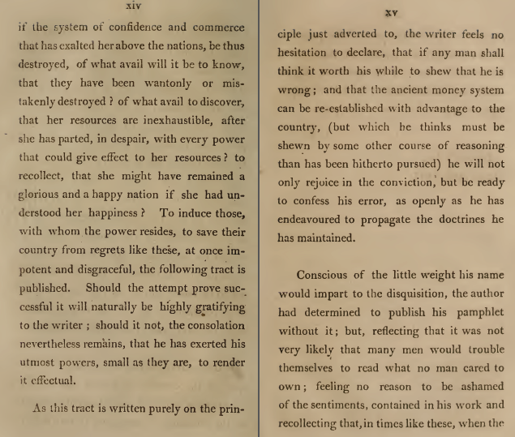
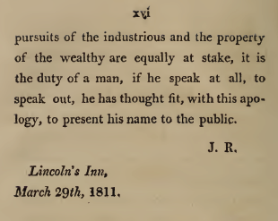
Better Monetary Thought – John Raithby (1811)
Raithby felt it was his duty
to write this treatise, and
put his name to it.

Slide 18
PART 3
Better Monetary Thought:
Charles de Montesquieu - Charging interest on privately created money

Slide 19
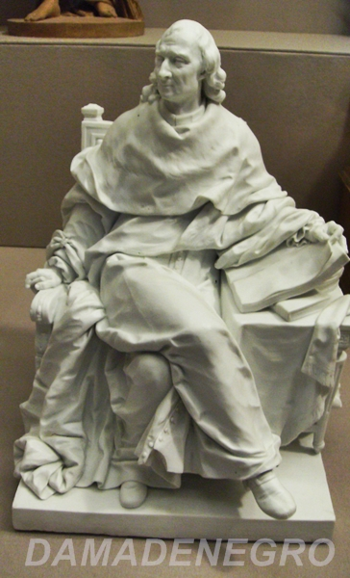
Charles de Montesquieu - Charging interest on privately created money
Montesquieu (1689 – 1755):
Through his education and travels he became a sharp social commentator
and political thinker who gained the respect of his fellow philosophers.
Montesquieu spent around twenty one years researching and writing De l'esprit des lois (The Spirit of the Laws), covering many things like the law, social life, and the study of anthropology and providing more than 3,000 commendations. He pleaded in favor of constitutional government, separation of powers, and the ending of slavery.

Slide 20
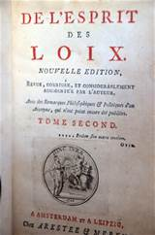
Charles de Montesquieu - Charging interest on privately created money
Writing in 1748, Charles de Montesquieu strongly supported the circulation of paper money, but condemned the circulation of paper credit:
“Some have imagined that it was for the advantage of a state to be indebted to itself: they thought that this multiplied riches by increasing the circulation. Those who are of this opinion have I believe confounded a circulating paper which represents money … with a paper which represents debt. The first (is) … extremely advantageous to the State; the last can never be so …
Montesquieu condemned the Bank of England’s type of funding system:
(for) … the taxes raised for the payment of the interest of the debt are an injury to the manufacturers … It takes the revenue of the State from those who have activity and industry to convey it to the indolent; that is it gives facilities for labor to those who do not work, and clogs with difficulties those who do work … These are its inconveniences. I know of no advantages.” Spirit of the Laws, vol. 38, Chapter 18, #17

Slide 21
PART 4
The quantity of money and inflation – how much money is needed?
John Locke
David Hume

Slide 22
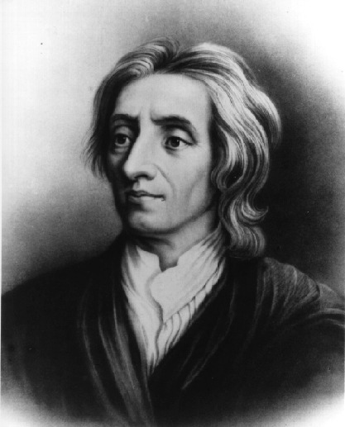
(4a) The quantity of money and inflation: John Locke
John Locke (1632 - 1704) was a British philosopher, Oxford academic and medical researcher.
Locke's monumental An Essay Concerning Human Understanding (1689) is one of the first great defenses of empiricism and concerns itself with determining the limits of human understanding in respect to a wide spectrum of topics. It thus tells us in some detail what one can legitimately claim to know and what one cannot.

Slide 23
(4a) The quantity of money and inflation: John Locke
Locke’s clear monetary observations – money as an abstract social institution:
“For mankind having consented to put an imaginary value upon gold and silver by reason of their durableness, scarcity and not being liable to be counterfeited; … and they procure what we want or desire only by their quantity, it is evident that the intrinsic value of silver and gold, used in commerce is nothing but their quantity.” Locke, Some Considerations of the Consequences of the Lowering of Interest
“Observe well these rules: It is a very common mistake to say money is a commodity …” “Bullion is valued by its weight … money is valued by its stamp.” Locke, Essay on Money and Bullion
“ … it depends not barely on the quantity of money but the quickness of its circulation … but to make some probable guess, we are to consider how much money it is necessary to suppose must rest constantly in each man’s hands, as requisite to the carrying of trade.”

Slide 24
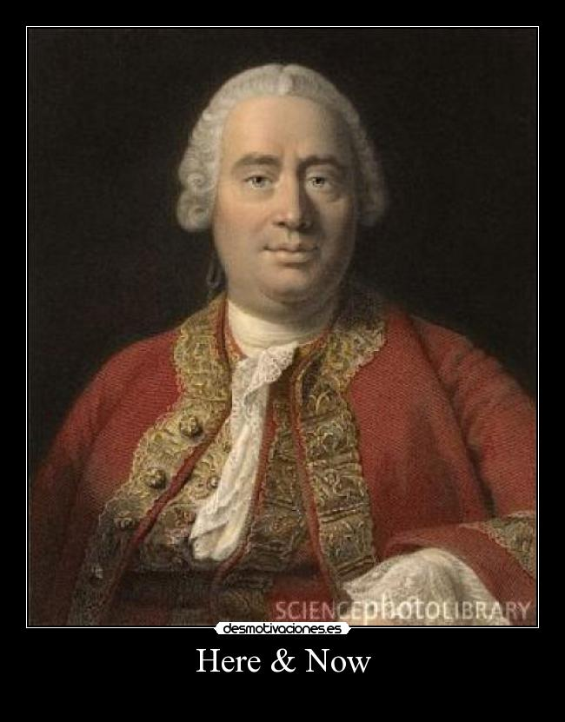
(4b) The quantity of money and inflation: David Hume
David Hume (1711 – 1776):
He was one of the most important figures in the history of Western philosophy and the Scottish Enlightenment. Hume is often grouped with John Locke, George Berkeley, and a handful of others as British empiricists. Part of Hume’s fame and importance owes to his boldly skeptical approach to a range of philosophical subjects.

Slide 25
(4b) The quantity of money and inflation: David Hume
Hume had a good understanding of the way quantity affects the value of money:
“… The prices of everything depend on the proportion between commodities and money, and that any alteration in either has the same effect either of heightening or lowering the price. Increase the commodities they become cheaper. Increase the money, they rise in their value … It is the proportion between the circulating money and the commodities in the market, which determines prices.” Hume, Essays, Moral, Political, and Literary
Hume understood that money’s role was active, not passive, upon economic activity:
“We find that in every kingdom into which money begins to flow in greater abundance than formerly, everything takes on a new face; the merchant becomes more enterprising, the manufacturers more diligent; and even the farmer follows his plough with greater alacrity and attention.” Hume, Essays, Moral, Political, and Literary

Slide 26
PART 5
Adam Smith:
Hated governments issuing money – Colonial Money
Relentless attack on society
Evasion of the interest problem
Buildup of an un-payable national debt
Bank of England over-issuing money

Slide 27
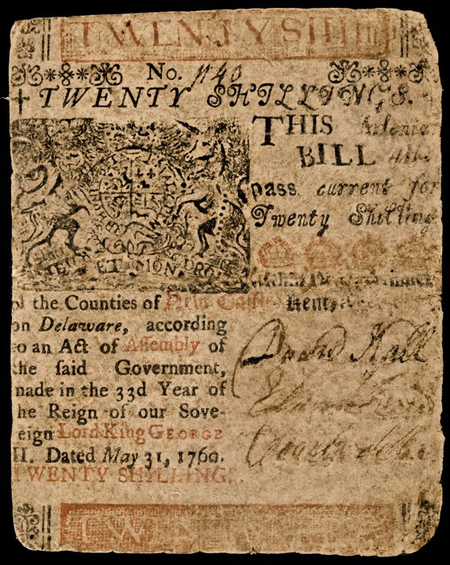
(5a) ADAM SMITH: Hated governments issuing money – Colonial Money
Smith:
“ … and though the colony governments paid no interest to the holders of this paper, they declared it to be and in fact rendered it a legal tender of payment for the full value for which it was issued.”
“To oblige a creditor, therefore to accept of this as full payment for a debt of a hundred pounds actually paid down in ready money was an act of such violent injustice as has scarce, perhaps, been attempted by the government of any other country which pretended to be free.”
Zarlenga:
Smith downplayed that the Bank was often in crisis, and had often suspended redemption of its notes into gold.

Slide 28
(5b) ADAM SMITH: Relentless Attack on Society
Smith:
“The orderly, vigilant, and parsimonious administration of such aristocracies as those of Venice and Amsterdam is extremely proper, it appears from experience, for the management of a mercantile project of this kind {profit of a public bank}. But whether such a Government as that of England – which, whatever may be its virtues, has never been famous for good economy; which, in time of peace, has generally conducted itself with the slothful and negligent profusion that is perhaps natural to monarchies; and in time of war has constantly acted with all the thoughtless extravagance that democracies are apt to fall into – could be safely trusted with the management of such a project, must at least be a good deal more doubtful.”
Zarlenga:
Adam Smith’s assault is one of the most vicious, elitist attacks on society as can be found anywhere from a “man of letters.”

Slide 29
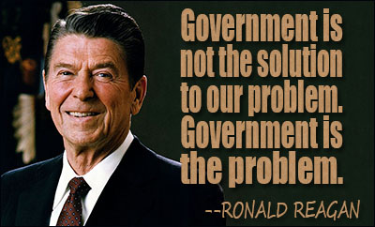
(5b) ADAM SMITH: Relentless Attack on Society
Zarlenga:
In Smith’s smearing of the English Government we see the beginnings of the relentless attack on society – the belittling and smearing of its organizational form – government. Today, this attack has reached a dangerous level.
Smith’s purpose for this attack – to keep the monetary power in private hands.
BUT WHAT MONEY IS CONTROLLING THE GOVERNMENT?

Slide 30
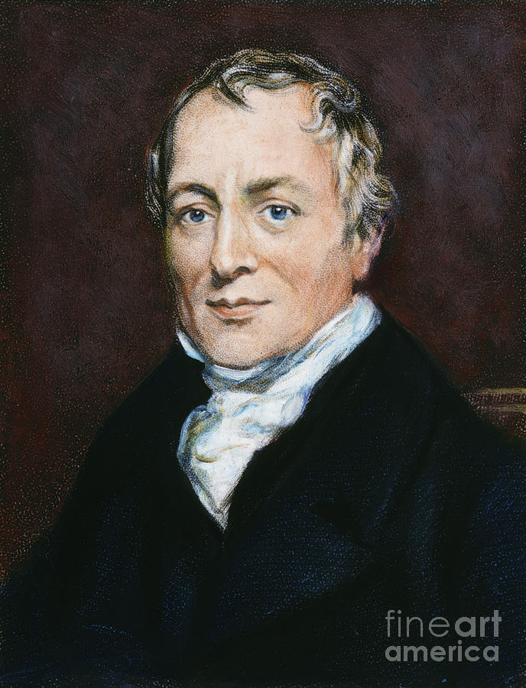
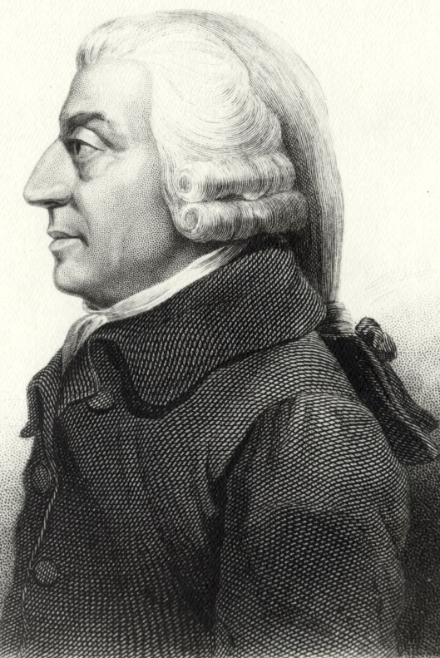
(5c ) ADAM SMITH: Evasion of the interest problem
Contrast Ricardo’s clear statement with Smith’s obtuse statement:
“The public, or the Government on behalf of the public, is indebted to the Bank in a sum of money larger than the whole amount of Bank notes in circulation; for the Government not only owes the Bank fifteen millions, its original capital, which is lent at 3 per cent. interest, but also many more millions which are advanced on Exchequer bills … It is evident therefore that if the Government itself were to be the sole issuer of paper money instead of borrowing it of the Bank, the only difference would be with respect to interest: the Bank would no longer receive interest and the Government would no longer pay it …” David Ricardo, Plan for the Establishment of a National Bank
David Ricardo
Adam Smith
“In the payment of interest of the public debt, it has been said, it is the right hand which pays the left … it is only a part of the revenue of one set of the inhabitants which is transferred to another, and the Nation is not a farthing poorer.”
Smith discusses paying ‘interest on the public debt’ and not on money creation, but a major part of government bonds was purchased by the Bank of England with new money creation.
Smith calls the holders of the public debt as ‘creditors of the public’, implying that something real was lent as in a normal creditor-debtor relationship.

Slide 31
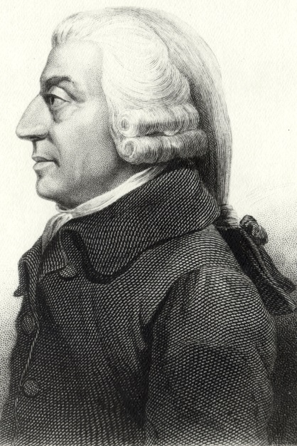
(5d) ADAM SMITH: Buildup of an un-payable national debt
Some people put forward plans to end the national debt …
“I would propose, then, some such plan as the following for the establishment of a National Bank: -- 1. Five Commissioners shall be appointed in whom the full power of issuing all the paper money of the country shall be exclusively vested. 2. On the expiration of the charter of the Bank of England in 1833 the Commissioners shall issue fifteen millions of paper money, the amount of the capital of the Bank lent to Government, with which that debt shall be discharged. From that time the annual interest of 3 per cent. shall cease and determine. … David Ricardo, Plan for the Establishment of a National Bank, 1824
David Ricardo
Adam Smith whined impotently about the debt but made no proposals to end it.
“To transfer from the owners of … land and capital stock … to another set of persons (the creditors of the public … The practice of funding has gradually enfeebled every state which has adopted it … Is it likely that in Great Britain alone a practice which has brought either weakness or desolation into every other country should prove altogether innocent?”
Adam Smith

Slide 32
(5e) ADAM SMITH: Bank of England over-issuing money
Nearly everyone realized that adding substantial amounts of paper notes to the money supply caused the value of money to drop. Adam Smith argued to the contrary:
“But as the quantity of gold and silver, which is taken from the currency, is always equal to the quantity of paper which is added to it, paper money does not necessarily increase the quantity of the whole currency.”
Smith proposed an ‘economic model’ - likening the circulation of money as flowing in a channel.

Slide 33
(5e) ADAM SMITH: Bank of England over-issuing money
SMITH’S ‘ECONOMIC MODEL’
The amount of money necessary to fill the channel depended on commercial activity – “That sum being then sufficient for circulating the whole annual produce of their land and labour.”
When paper notes are put into circulation by the Bank of England, an equal amount of the gold and silver component of the channel overflows – “It will therefore be sent abroad, in order to seek that profitable employment which it cannot find at home. But the paper cannot go abroad … because it will not be received in common payments. Gold and silver therefore to the amount of {the added Bank currency} will be sent abroad. They will exchange for foreign goods … but the revenue of idle people … cannot in the smallest degree, be increased by these operations of banking.”
Stephen Zarlenga: What if foreign banks were also printing foreign banknotes? Where would the gold and silver then overflow it? To Disneyland?

Slide 34
PART 6
Why do Adam Smith’s ideas prevail?

Slide 35
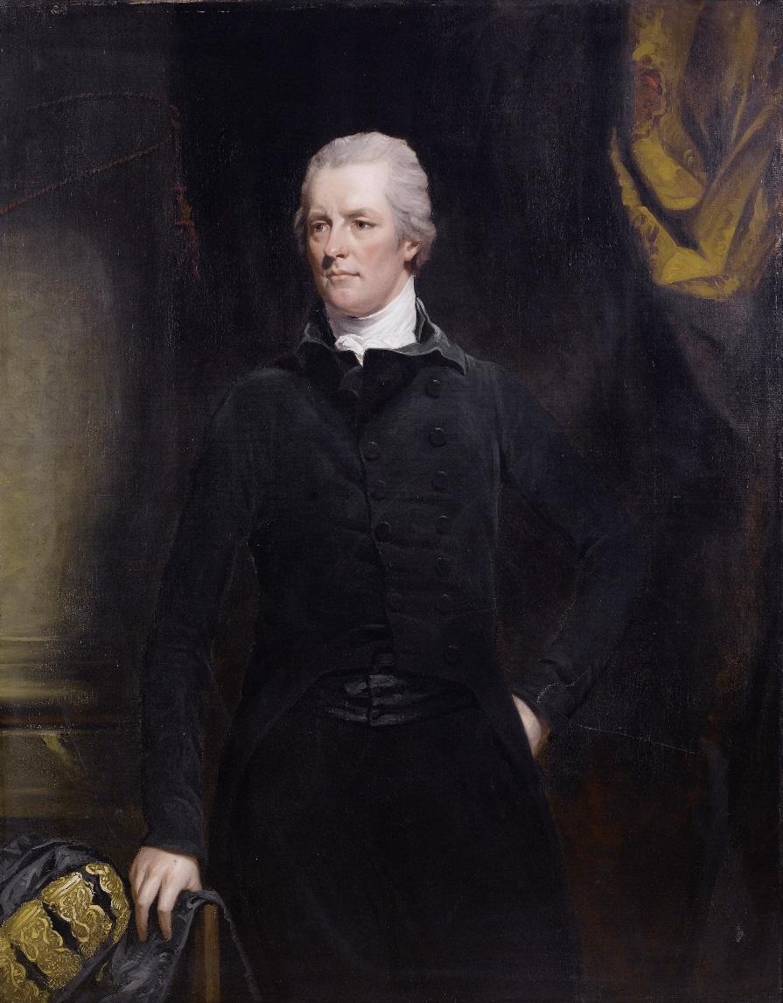
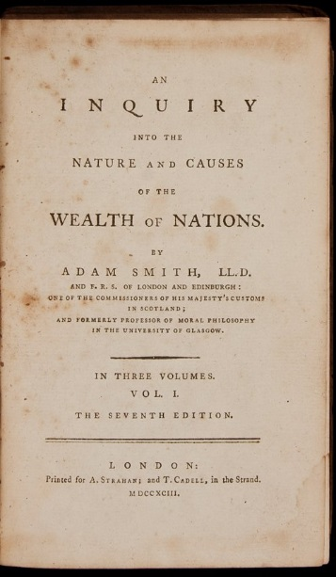
Why do Adam Smith’s ideas prevail?
Adam Smith’s views suited England’s financial/political plutocracy, so they lionized him.
At least one English Prime Minister, William Pitt, made a habit of carrying Smith’s book under his arm, promoting it.
But other writers examined Adam Smith’s weak economic reasoning:
John Maitland, 8th Earl of Lauderdale, The Nature and Origin of Public Wealth, 1804
Friedrich List, National System of Political Economy
John Rae, Sociological Theory of Capital
WILLIAM PITT, THE YOUNGER
(1759 – 1806)

Slide 36
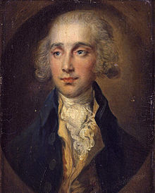
Why do Adam Smith’s ideas prevail?
John Maitland, 8th Earl of Lauderdale, The Nature and Origin of Public Wealth, 1804
Production, not parsimony, was the crucial factor in building national wealth.
“The terms we use, in talking of the wealth of a nation, or of the riches of the individuals, are in all languages exactly the same. They denote, that private riches are universally considered in no other light than as a portion of national wealth.” Intro
“That public wealth, however, ought not to be considered as merely representing the sum of individual riches, is undoubted and that much of obscurity, and the words Wealth and Riches are, in common language, used as synonymous … even of error, has existed in economical reasoning from confounding them, will be made apparent.
“An idea which has generally prevailed … that wealth may be increased by means by which it is not produced, in particular by parsimony, or deprivation of expenditure, has made it necessary to investigate this subject.
“Land, labour, and capital are separately treated of as the sources of wealth.
James Maitland,
8th Earl of Lauderdale
(1759 – 1839)

Slide 37
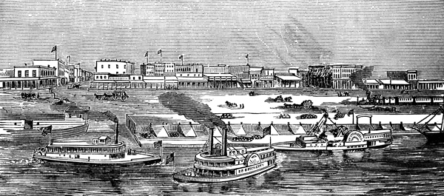
Why do Adam Smith’s ideas prevail?
Notably lacking in Smith’s Wealth of Nations was a role for the nation.
Friedrich List, National System of Political Economy, Author’s Preface, 1st Edition
“The contest was clearly being fought with unequal weapons. On one side a theory thoroughly elaborated and uncontradicted, a compact school, a powerful party which had advocates in every legislature and learned society, but above all the great motive power—money. On the other side poverty and want, internal divisions, differences of opinion, and absolute lack of a theoretical basis.
“When afterwards I visited the United States, I cast all books aside—they would only have tended to mislead me. The best work on political economy which one can read in that modern land is actual life. There one may see wildernesses grow into rich and mighty States; and progress which requires centuries in Europe, goes on there before one's eyes, viz. that from the condition of the mere hunter to the rearing of cattle—from that to agriculture, and from the latter to manufactures and commerce … the propounding of a system which, however defective it may as yet appear, is not founded on bottomless cosmopolitanism, but on the nature of things, on the lessons of history, and on the requirements of the nations.”

Slide 38
PART 7
Adam Smith’s most vicious error: the selfishness error

Slide 39
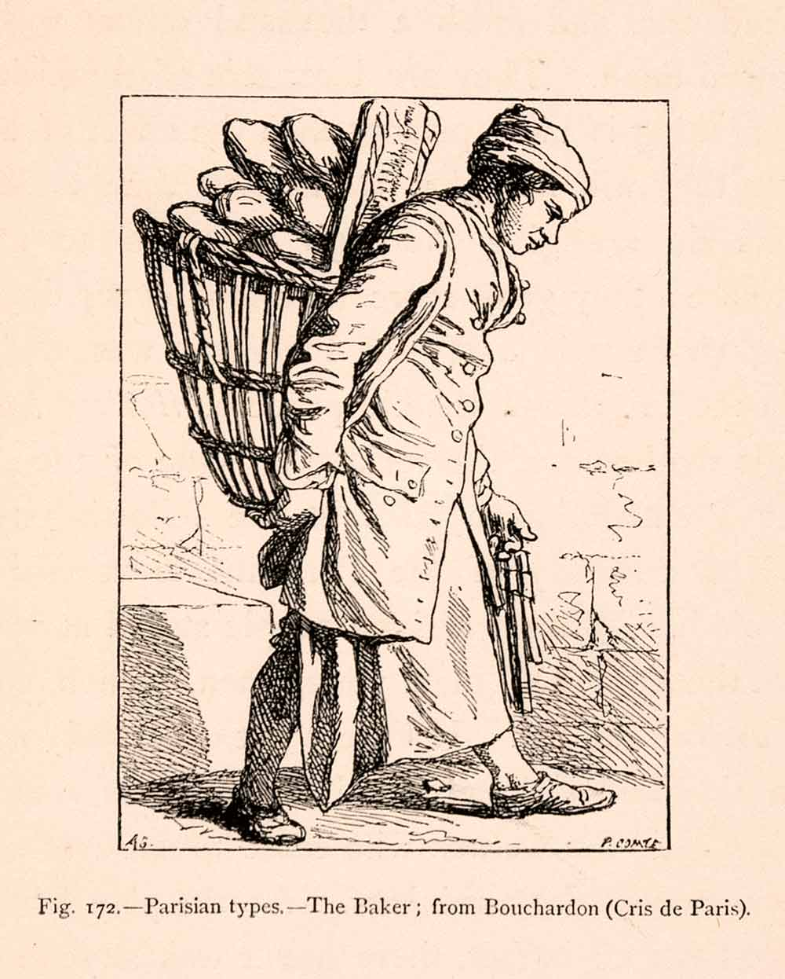
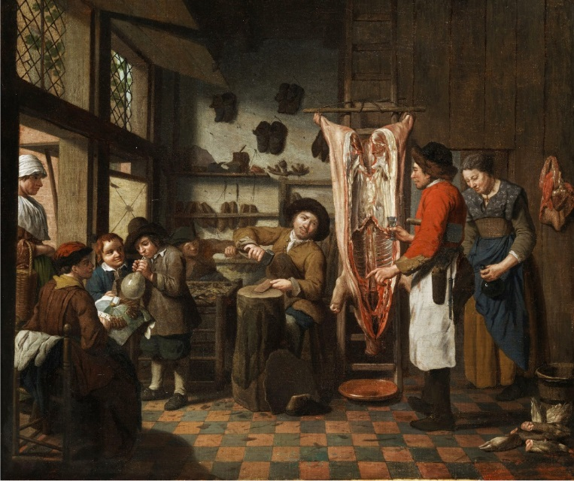
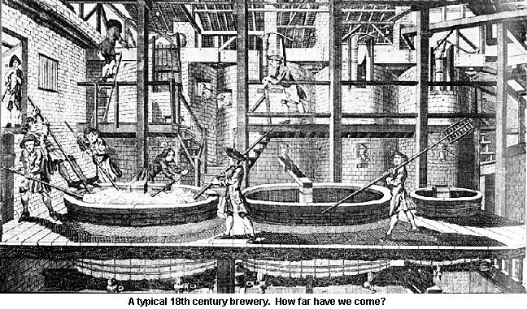
Adam Smith’s most vicious error: the selfishness error
SMITH’S MOST VICIOUS ERROR
“It is not from the benevolence of the butcher, the brewer, or the baker that we expect our dinner, but from their regard to their own interest.”

Slide 40
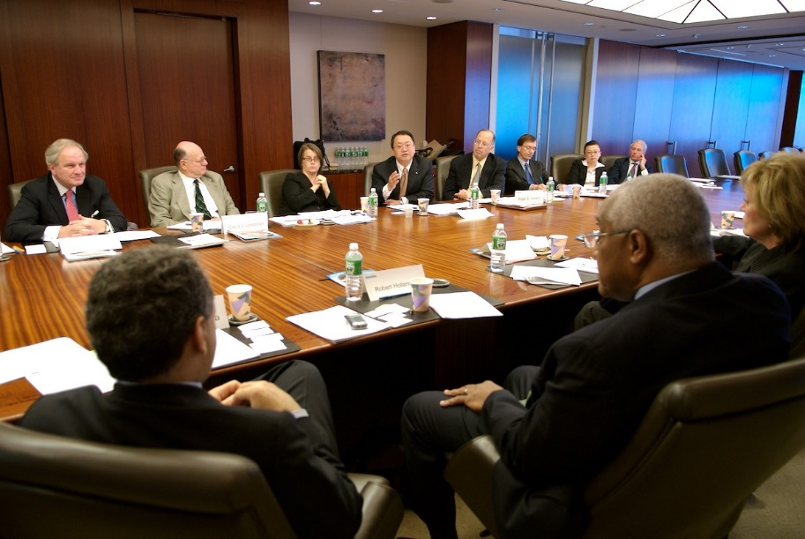
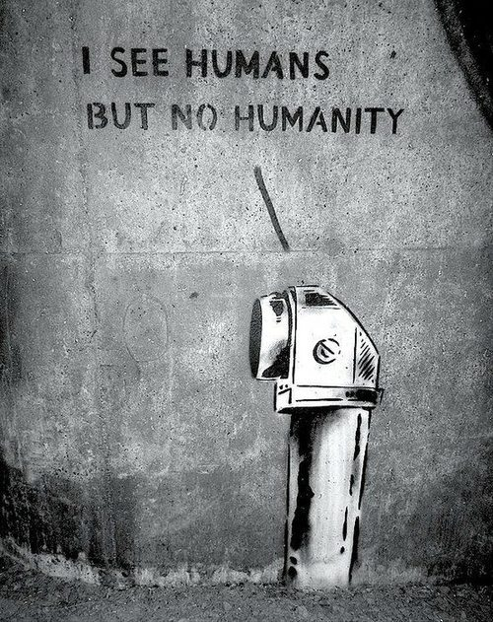
Adam Smith’s most vicious error: the selfishness error
Henry George from the 19th century wrote of Smith’s ‘selfishness’ in
The Science of Political Economy
Henry George, The Science of Political Economy p. 90:
“Its fundamental assumption is, that each man exclusively follows his own interest, or what he deems to be his own interest. ... In the ‘Wealth of Nations’ … Indeed, Adam Smith will hardly admit common humanity into his theory of motives. If a people emancipate their slaves, it is a proof, not that the people are acted on by high moral considerations, nor that their sympathy is excited by the cruelty inflicted on these unhappy creatures ... All that the emancipation proves, is, that the slaves were few in number, and, therefore, small in value. Otherwise they would not have been emancipated.
“This presumption, so well stated and defended by Buckle, that political economy must eliminate everything but the selfish feelings of mankind, has continued to pervade the accredited political economy up to this time …”
Corporate
Boardroom

Slide 41
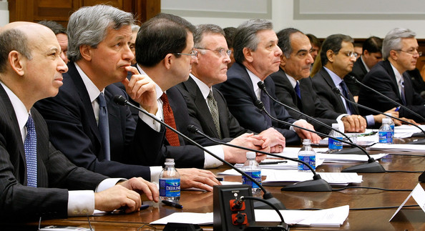
Adam Smith’s most vicious error: the selfishness error
The Words of Stephen Zarlenga
Lost Science of Money, p. 329
“Consider the negative impact on humanity of Smith’s selfishness assumption. Supporters of his doctrine argue that it is merely in harmony with the nature of humanity. But clearly, if Man is defined in such a base manner, and systems of laws with their rewards and punishments are enforced along those lines, then over time they will tend to create a form of humanity in ‘harmony’ with their initial false conception of an economic mankind.
“This de-evolutionary process, encouraging a lower form of humanity, has been ongoing especially in the English speaking world for well over two centuries.”
WALL STREET BEFORE THE SENATE COMMITTEE

Slide 42
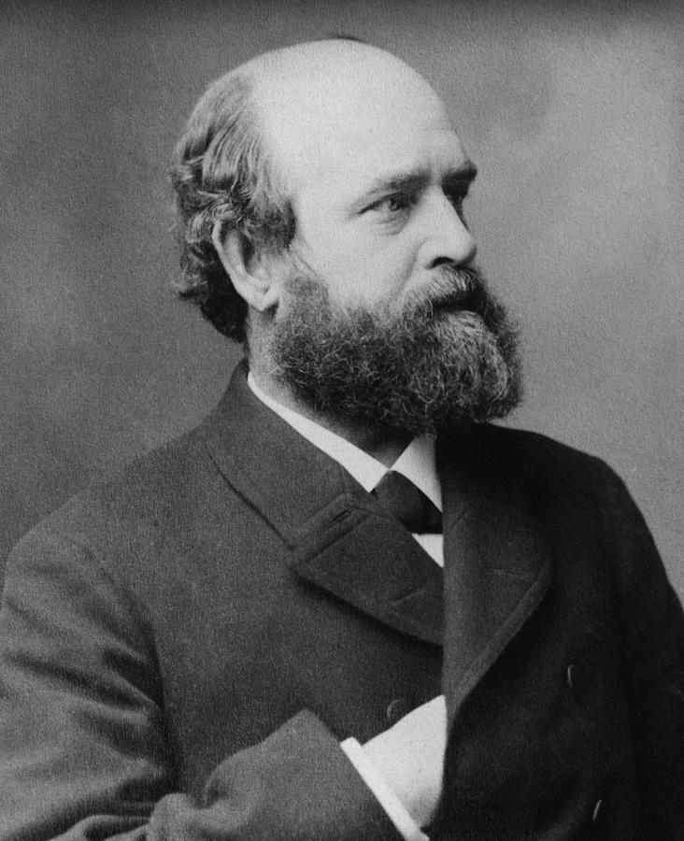
Adam Smith’s most vicious error: the selfishness error
“Henry George saw exactly where it would lead …”
Henry George, The Science of Political Economy, p. 99
“Now the law of nature which forms the postulate of a true science of political economy is not, as has been erroneously assumed, that men are invariably and universally selfish. As a matter of fact, this is not true. Nor can we abstract from man all but selfish qualities in order to make as the object of our thought on economic matters what has been called the " economic man," without getting what is really a monster, not a man.
“The law of nature which is really the postulate of a true science of political economy is that men always seek to gratify their desires with the least exertion, whether those desires are selfish or unselfish, good or bad. “
Henry George (1839 – 1897) was an American writer, politician and political economist. He inspired the economic
philosophy known as Georgism, whose main tenet is that people should own what they create, but that everything
found in nature, most importantly the value of land, belongs equally to all humanity.

Slide 43
Adam Smith’s most vicious error: the selfishness error
Henry George’s View of Mankind
Henry George talks to the humanity of all of us.
“The primary postulate on and from which its whole structure (a true political economy) is built is not that all men are governed only by selfish motives, or must for its purposes be considered as governed only by selfish motives ; it is that all men seek to gratify their desires, whatever those desires may be, with the least exertion. This fundamental law of political economy is, like all other laws of nature, so far as we are concerned, supreme. It is no more affected by the selfishness or unselfishness of our desires than is the law of gravitation. It is simply a fact.” The Science of Political Economy p. 91

Slide 44
PART 8
1810 - suppressing the 1810 bullion report

Slide 45
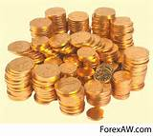
1810 - Suppressing the 1810 Bullion Report
THE FAMOUS 1810 BULLION REPORT
In February 1810, the House of Commons set up a Select Committee on the High Price of Gold Bullion to investigate why it had risen during the Napoleonic Wars. Since the Bank of England ceased to redeem its bank notes in gold in 1797, as its reserves were eroded by the war, the price was up 20% – extraordinary because it had been fixed at £4.25 per ounce in 1717 by Sir Isaac Newton, Master of the Mint, and this ‘gold standard’ had been stable for decades ever since. Now it was £4.65. What had caused the escalation?

Slide 46
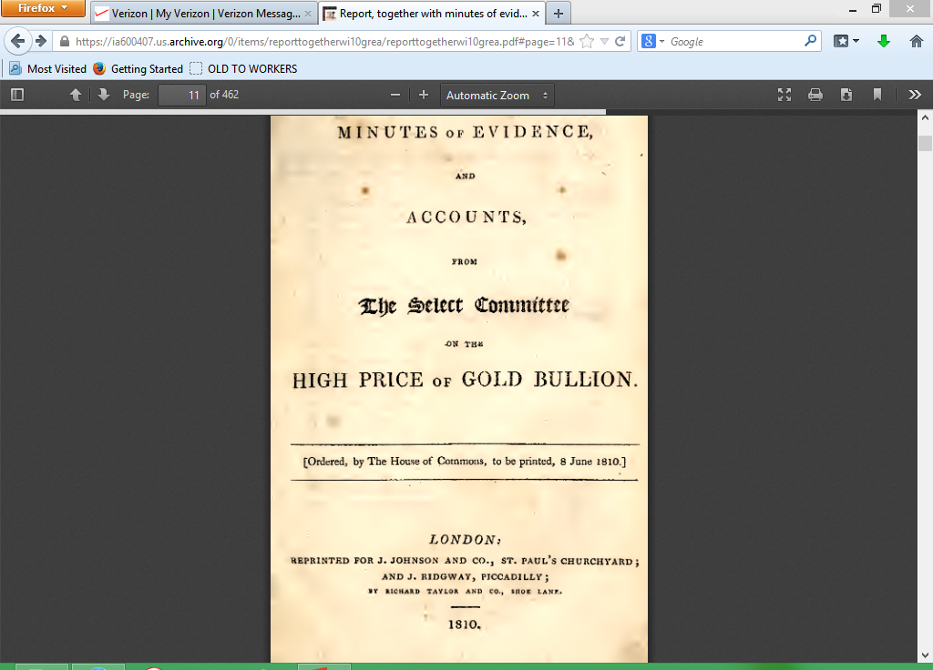
1810 - Suppressing the 1810 Bullion Report
THE BULLION COMMITTEE BLAMES THE BANK’S NOTE ISSUANCE
Prices rose about 40% from 1797 to 1809, a very unusual event for that time, and by 1810 there was strong political opposition to the Bank. The report of Parliament’s Bullion Committee placed the blame on the note-issuing activity of the Bank of England and the country banks.
Feaveryear, The Pound Sterling, p. 184
“The great conclusion that they drew from all the facts was that the rise in the price of bullion and the adverse exchanges had been caused solely by an over-issue of Bank of England notes … they did not rely upon the mere increase in the quantity of notes as shown by the figures. The volume of currency required by a people might vary with the activity of trade. But there was one infallible sign … (that) the currency was depreciated, and that was that the price of gold had risen.”

Slide 47
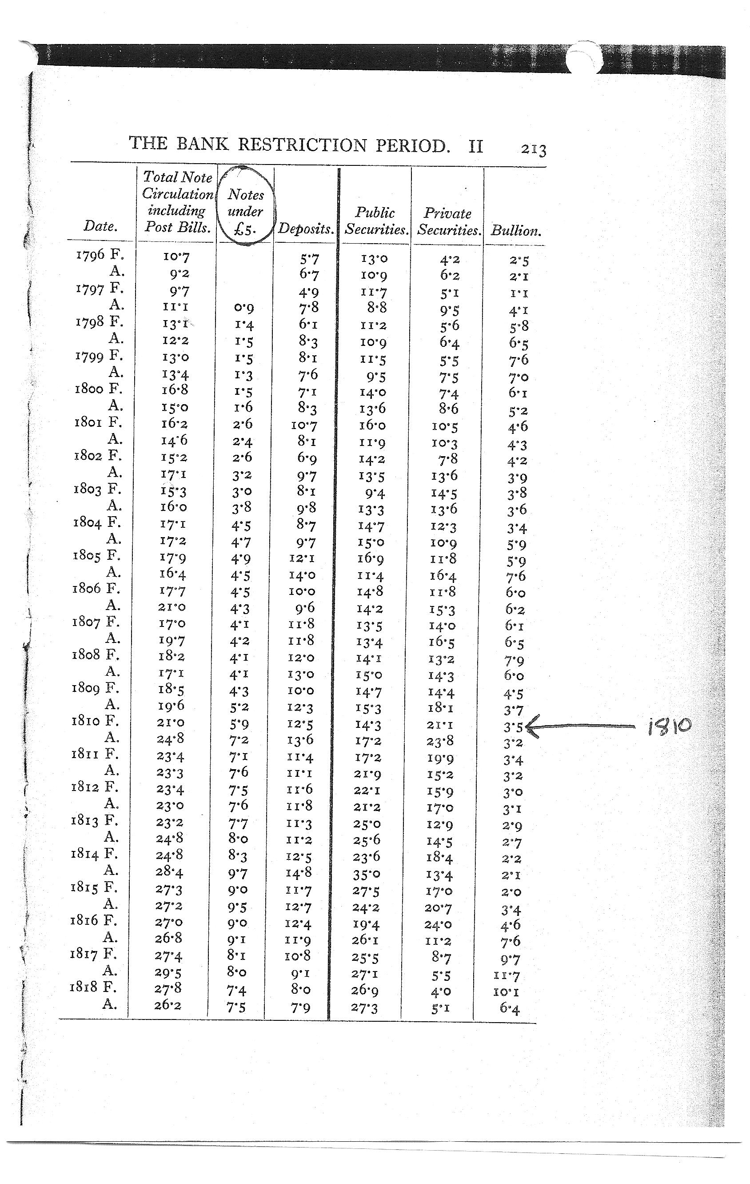
1810 - Suppressing the 1810 Bullion Report
1810 - Suppressing the 1810 Bullion Report
“Reared up upon the Bank’s reserve
of gold was a considerable edifice of
paper money, changes in the
quantity of which accentuated the
effects of the bullion movements. pp. 212-213
“… commercial discounts of the Bank, which were less than 4 millions in 1796, were over 20 millions in 1810. This, for the times, was an enormous figure. p. 190
“The Bank … still denied that it was in any way responsible for controlling
the value of the national currency, and
indeed doubted whether it had the
power even to influence it.” pp. 212-213
Feaveryear, THE POUND STERLING
convertibility
suspended in
1797 ➔
1810 Bullion Committee =>

Slide 48
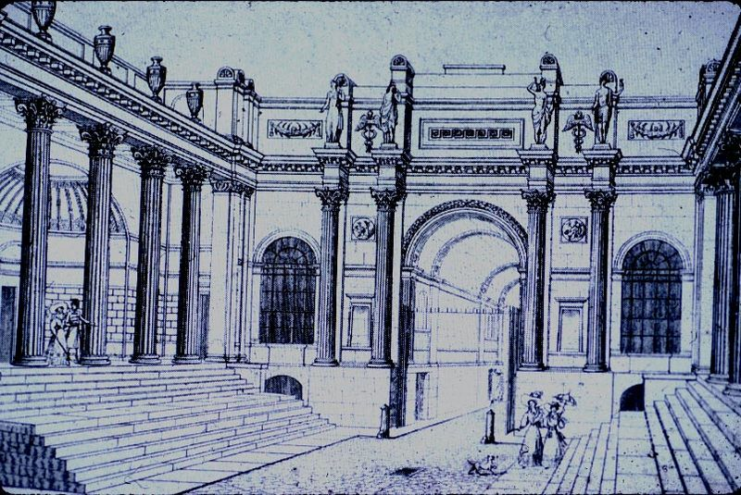
1810 - Suppressing the 1810 Bullion Report
Yet the people of the Bank stonewalled the Committee and cited Adam Smith’s monetary theories to defend the bank.
Parliament ignored the conclusion of its own committee and would not blame the Bank; yet thoughtful observers understood that bank created money was responsible.
An exasperated Ricardo wrote: “It will scarcely be believed fifty years hence, that Bank Directors and Ministers gravely contended in our times, both in Parliament and before committees of Parliament, that the issues of notes by the Bank of England … had not nor could have any effect on the prices of commodities, bullion or foreign exchanges.” Works, Principles of Political Economy, p. 214
Lothbury Court in the Bank of England,
with the Bullion Office just through the
archway.

Slide 49
PART 9
1811 - The Bank shifts from expansion to contraction

Slide 50
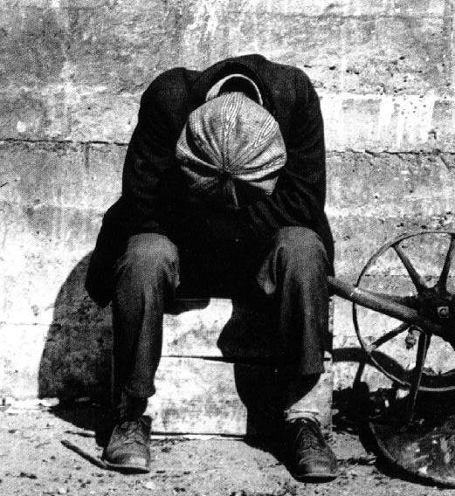
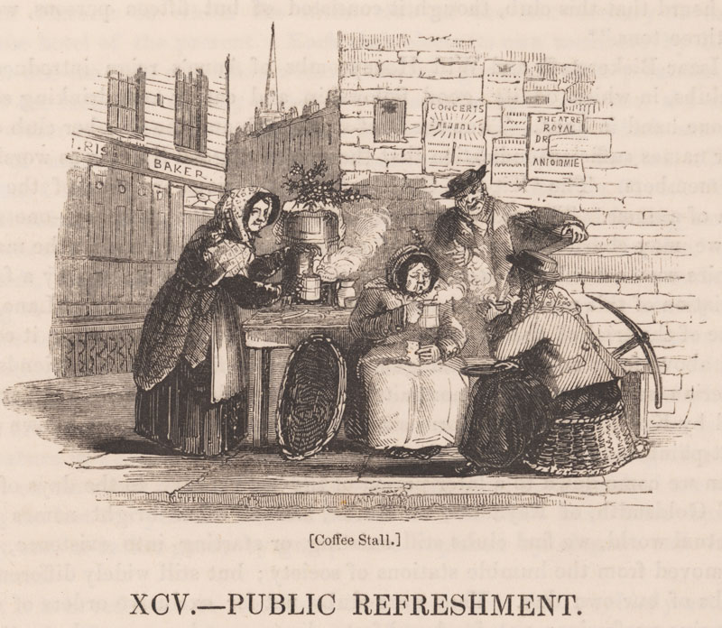
1811 - The Bank shifts from expansion to contraction
Faced with a situation where continued expansion would not be tolerated, the Bank could have stabilized at the new monetary level, but instead, the people of the bank quietly but purposely shifted to contraction of the money supply.
In the expansion process, the nation, through the government, as well as private parties became indebted to the Bank and to the other bondholders.
Contraction or deflation would limit additional indebtedness but would also increase the value of the currency. This would make the existing debts much more difficult or even impossible to re-pay, with less notes in circulation!

Slide 51
1811 - The Bank shifts from expansion to contraction
Monetary contraction began in 1811 with a fall in the Bank’s discounts – from 20 million in 1811 to 4 million in 1817.
<=1811
The price of gold fell and the bank bought reserves which were 11.7 million by August, 1817, the largest amount the
<= Bank had ever held.
1811 monetary
contraction begins=>

Slide 52
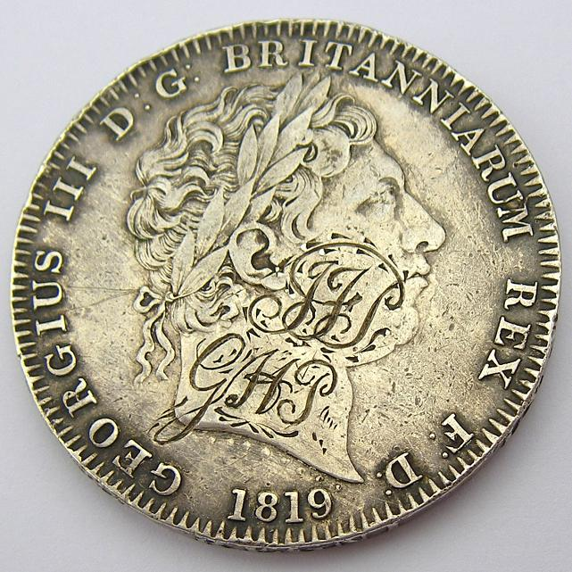
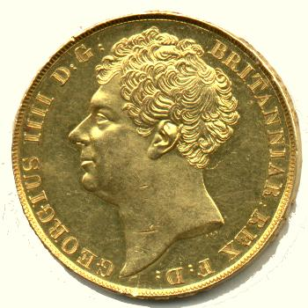
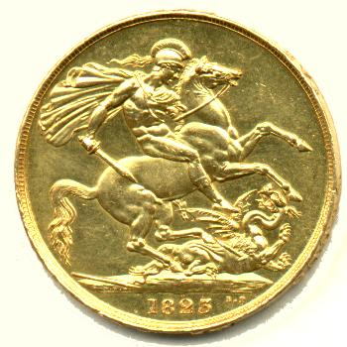
1811 - The Bank shifts from expansion to contraction
SILVER DEMONETIZED: Further aggravating this deflation, silver was de-monetized in 1816 for payments over two Pounds, rendering existing silver coinage and bullion un-usable in large commercial transactions.
These moves caused a dramatic contraction of the currency – a great deflation.
In addition, in 1819, Sir Robert Peel’s monetary committee adopted the conclusion of the Bullion Committee. Parliament passed an Act to return to gold payments in three stages between February 1820 and May 1823. The gold standard was restored on 1 May 1821 …
They decided to further contract the currency in order to make it convertible into gold at the old higher rates! The result was a fall in commodity prices and widespread unemployment!
SILVER CROWN 1819 =
5 SHILLINGS
George IV two pounds 1823
(FRONT & BACK)

Slide 53
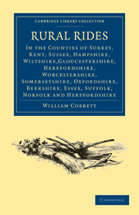
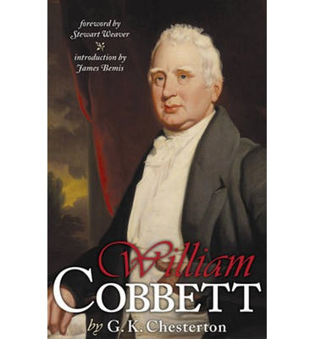
1811 - The Bank shifts from expansion to contraction
One commodity index which had been at 142 in April 1818 fell to 84 in September 1822.
Feaveryear, The Pound Sterling, p. 209
“William Cobbett returned from America in 1819, and began to tour England, noting the depressed condition of agriculture, attending distress meetings of farmers, and arousing them against the fund-holders who, under Peel’s Act (resuming convertibility of the Pound into gold) were to receive full payment of interest and principal in an appreciated currency even though the producer might be made bankrupt. Petitions came in during 1820 and 1821 from all over the country calling attention to the depressed state of industry and begging that something might be done to modify the effects of the resumption of cash payments.”
William Cobbett (1763 – 1835) was an English pamphleteer,
farmer, and journalist. He is best known for his book from
1830, Rural Rides, which is still in print today.

Slide 54
1811 - The Bank shifts from expansion to contraction
IT WAS NOT UNTIL THE EARLY 1830’S THAT A RECOVERY WAS IN PROGRESS…

Slide 55
PART 10
“Currency School” vs the “Banking School”:
THE FALSE DEBATE TACTIC

Slide 56
“Currency School” vs the “Banking School”: THE FALSE DEBATE TACTIC
CURRENCY SCHOOL
Only the Bank’s printed banknotes should be considered currency, not bank deposits.
(Similar to the medieval Scholastics, they failed to include bank created credits as money.)
BANKING SCHOOL
Bank credits created on a client’s account were also to be considered as money.
THE FALSE DEBATE: WHAT REALLY IS MONEY?
THE FALSE DEBATE: CURRENCY SCHOOL – QUANTITY OF MONEY DETERMINES PRICES
BANKING SCHOOL – PRICES DETERMINED THE QUANTITY OF MONEY

Slide 57
“Currency School” vs the “Banking School”: THE FALSE DEBATE TACTIC
THE REAL MONETARY ISSUE SHOULD HAVE BEEN:
WHETHER THE POWER TO CONTROL THE MONEY SYSTEM
BELONGED IN PRIVATE HANDS OR SOCIETY’S HANDS
That this debate is taught as an important monetary debate indicates the
artificial and superficial nature of monetary thought and training.

Slide 58
PART 11
SUMMARY

Slide 59
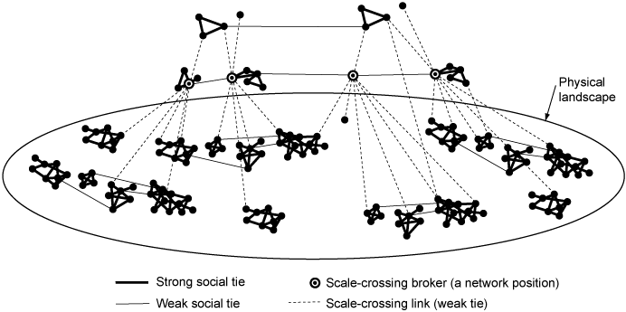
SUMMARY
EARLY ON, THE FINANCIAL ESTABLISHMENT REALIZED
THE NEED FOR A JUSTIFYING THEOLOGY.
THE POLITICAL ECONOMISTS SERVED AS ITS PRIESTHOOD,
ELIMINATING ALL MORAL CONSIDERATIONS.

Slide 60
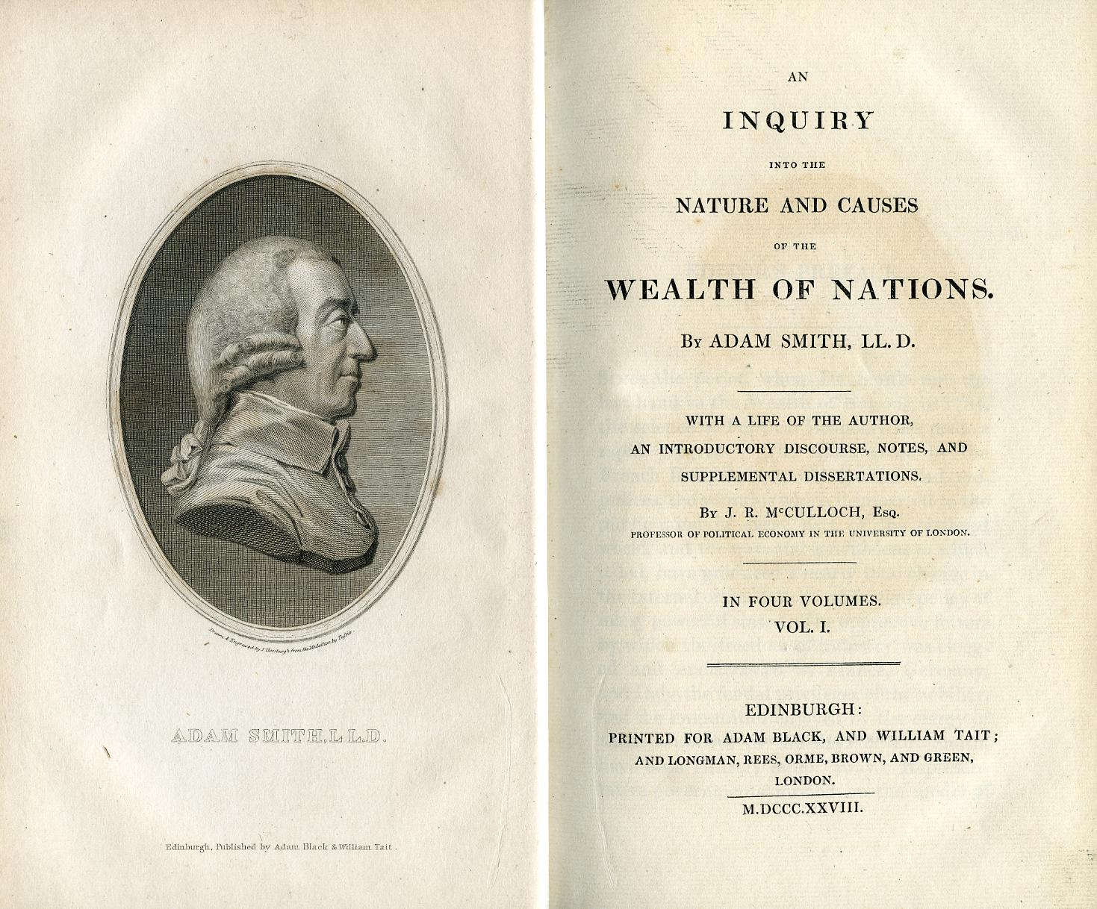
SUMMARY
ADAM SMITH’S WEALTH OF NATIONS canonized this amoral version of economics.
HIS PURPOSE, IN LARGE PART, WAS to keep the money-issuing power out of the hands of government and in private hands.

Slide 61
SUMMARY
Keeping the money power out of the hands of government was enough to undermine government and promote the concentration of power and wealth into the hands of a few that composed the financial establishment.
These few persons had the ability to perpetrate this fraud on their fellow man.
Court of Directors, 1903, Bank of England

Slide 62
SUMMARY
Adam Smith’s views served a particular clique or gang.
Worse than his deception, Smith’s false concept of humanity’s nature as motivated only by selfishness had self-fulfilling consequences.

Slide 63
Q & A
WILL DECKER’S CONCLUSION:
THE CONTROL OF MONEY -- WITHOUT CONTROL FROM THE PUBLIC -- LEADS TO
CORRUPTION … USURPATION … SLAVERY.

