Slide 1
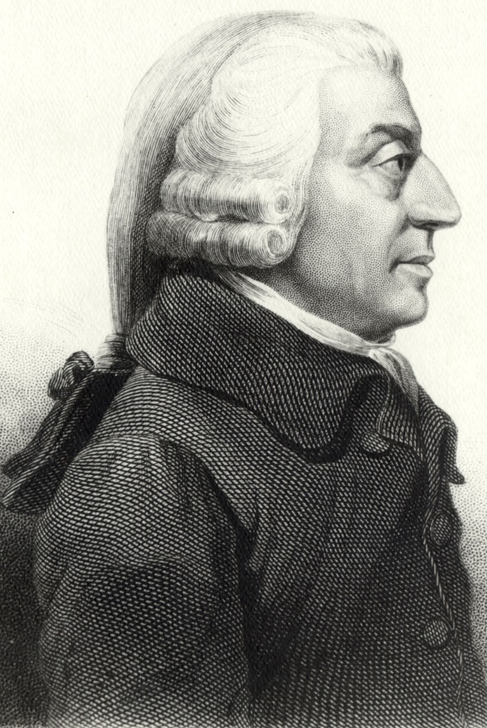
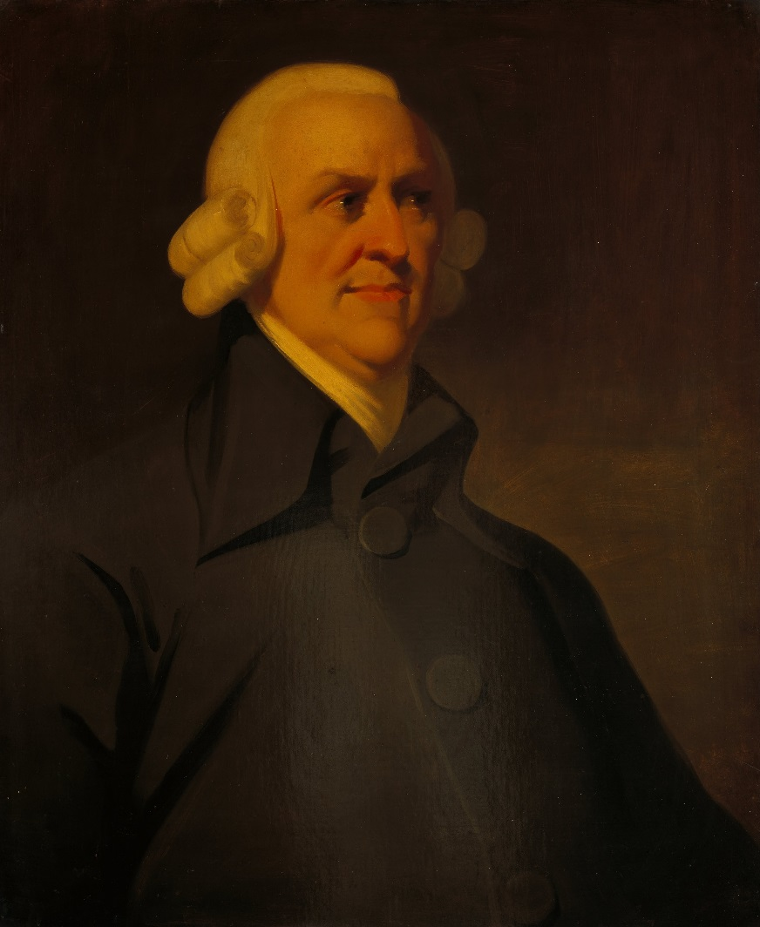
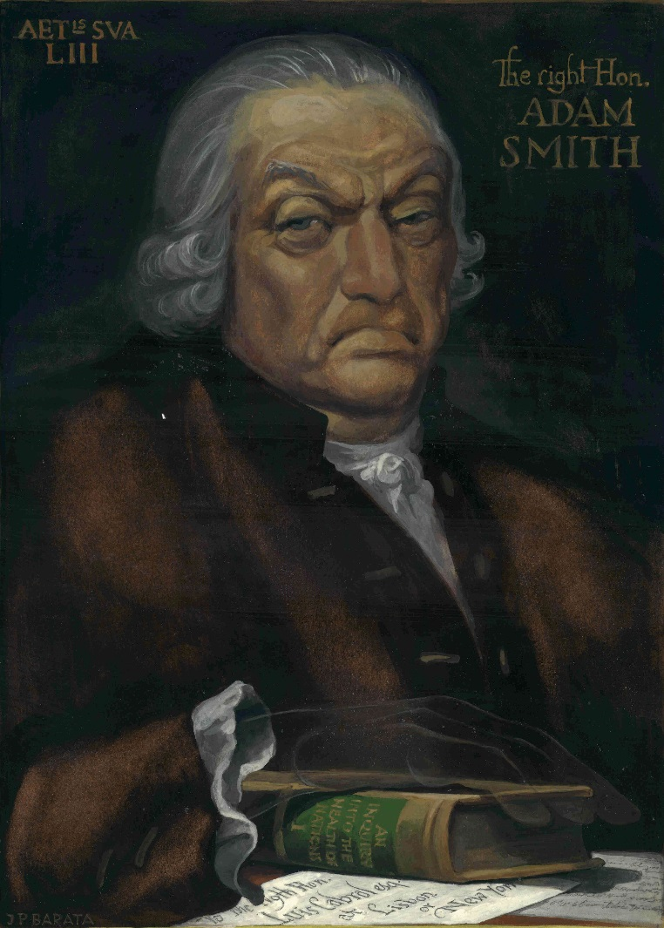
The Lost Science of Money
CHAPTER 12 – PART 1
POLITICAL ECONOMISTS: PRIESTHOOD OF THE BANKER THEOLOGY
ADAM SMITH
ADAM SMITH
ADAM SMITH

Slide 2
THEMES OF LOST SCIENCE OF MONEY BOOK
Primary importance of the money power
Nature of money purposely kept secret and confused
How a society defines money determines who controls the society
Battle over control of money has raged for millennia: public vs private
The misuse of the monetary system causes tremendous misery and suffering for the ordinary working people. Will Decker & Martin Dunn, February 2014

Slide 3
PRESENTATION
SOME HISTORY OF LAND ENCLOSURES IN ENGLAND

Slide 4
WAGE INCOME & RENT EXPENSE – DURING CHARLES II’S REIGN
Wages failed to keep pace with the rise in prices in the sixteenth and seventeenth centuries.
On the other hand, the amount of the rent, where there was rent to pay, was settled by custom.

Slide 5
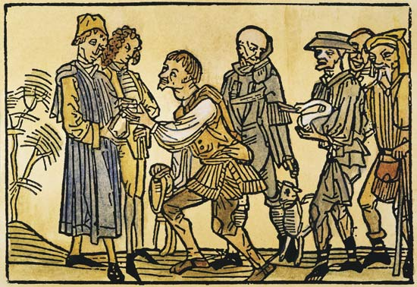
LANDOWNERS’ CUSTOMARY DUES TO CROWN – DURING CHARLES II’S REIGN
The landowner had been strong enough vis-à-vis the Crown, to keep their customary dues to the Crown from increasing with the increase in prices.
During Charles II’s reign, thinking the cause of monarchy was so beaten, the landowners abolished their feudal dues to the Crown.
But they preserved the yeoman’s feudal payments to them.

Slide 6
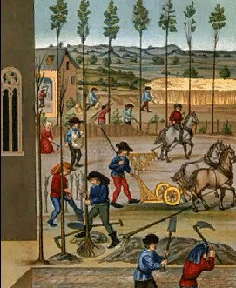
1679 STATUTE OF FRAUDS
By this Statute the landowners enacted that everyone must produce written evidence of his claim to his lands.
After the confusion of the Civil Wars there was about such an enactment a superficial appearance of justice.
But in truth, the gentlemen possessed written
titles and the peasants did not.

Slide 7
1679 STATUTE OF FRAUDS
STATUTE OF FRAUDS (1677) 29 Car. II c.3 FOR prevention of many Fraudulent Practices which are commonly endeavoured to be upheld by Perjury and Subornation of Perjury Bee it enacted by the Kings most excellent Majestie by and with the advice and Consent of the Lords Spirituall and Temporall and the Commons in this present Parlyament assembled and by authoritie of the same That from and after the fower and twentyeth day of June which shall be in the yeare of our Lord one thousand six hundred seventy and seven All Leases Estates Interests of Freehold or Termes of yeares or my uncertaine Interest of in to or out of any Messuage Mannours Lands Tenements or Hereditaments made or created by Liveny and Seisin onely or by Parole and not putt in Writeing and signed by the parties soe makeing or creating the same or their Agents thereunto lawfully authorized by Writeing, shall have the force and effect of Leases or Estates at Will onely and shall not either in Law or Equity be deemed or taken to have any other or greater force or effect, Any consideration for makeing my such Parole Leases or Estates or any former Law or Usage to the contrary notwithstanding.

Slide 8
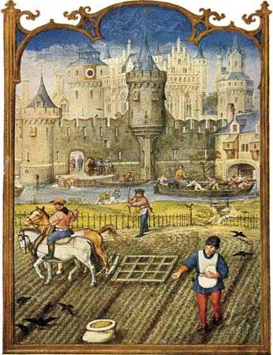
1679 STATUTE OF FRAUDS
The gentlemen possessed such titles, not because their claims were better than those of the peasants but because they were a great deal worse.
The gentlemen had acquired their estates at the time of the dissolution of the monasteries and, foreseeing that such titles might well be challenged, had been careful to obtain written evidence of them from the King.
The peasantry had inherited their lands by custom dating back to ancestors in the heart of the Middle Ages and had no written title.

Slide 9
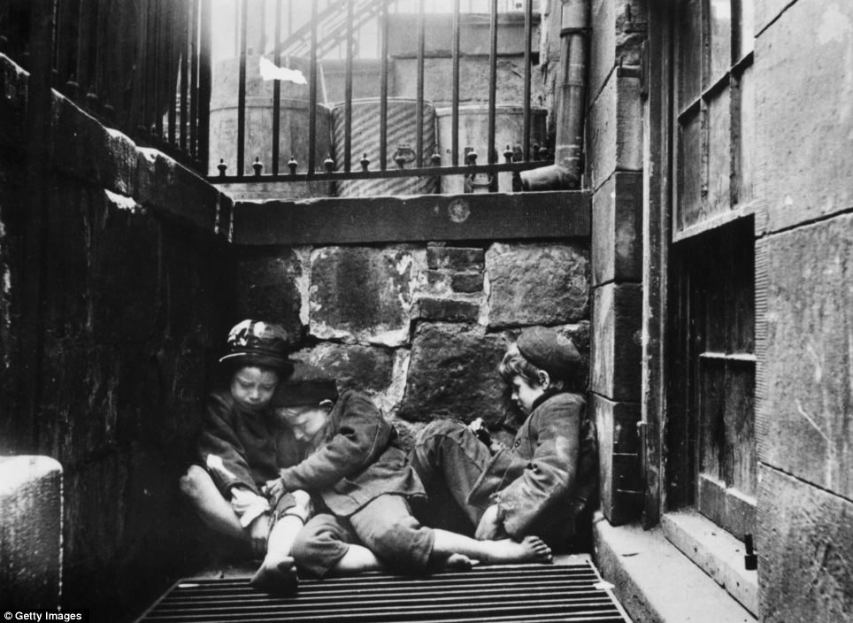
SEIZING THE LAND AND USING THE LAW
Thus the gentlemen were able to
acquire the land of the peasants and at will to re-let it to them for a fixed term of years and at a greatly increased rent
to seize the land and employ the former peasant as an agricultural labourer
to seize the land and turn the former peasant loose to fend for himself
George Orwell wrote in 1944, Tribune, 18 August 1944:
Stop to consider how the so-called owners of the land got hold of it. They simply seized it by force, afterwards hiring lawyers to provide them with title-deeds. In the case of the enclosure of the common lands, which was going on from about 1600 to 1850, the land-grabbers did not even have the excuse of being foreign conquerors; they were quite frankly taking the heritage of their own countrymen, upon no sort of pretext except that they had the power to do so.

Slide 10
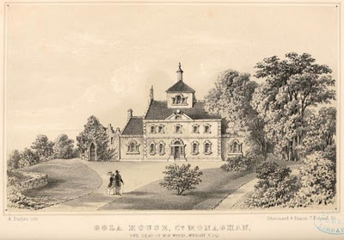
CONCENTRATION OF WEALTH
In his glorious Republic, which may have started it all, Plato causes Socrates to inform Glaucon and Adeimantus, twenty-four hundred years ago, that they can’t loll on couches eating grapes while others sweat to provide those grapes without first creating a fearsome security state to protect themselves from the commonality. It would appear that long ago some people realized that a substantial moral trade-off would be required to create ease for a fraction of the whole, while the balance of the whole, served that ease.

Slide 11
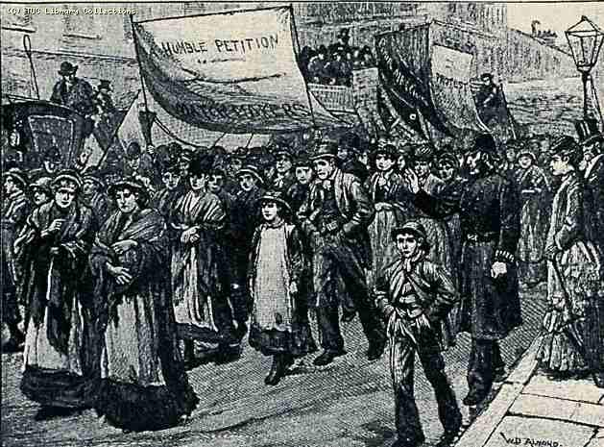
THOROLD ROGERS
Thorold Rogers:
“For more than two centuries and a half the English law and those who administered the law were engaged in grinding the English workman down to the lowest pittance, in stamping out every expression or act which indicated any organized discontent, and in multiplying penalties upon him when he thought of his natural rights.” Work and Wages, pp 65-66

Slide 12
Q & A

