Slide 1
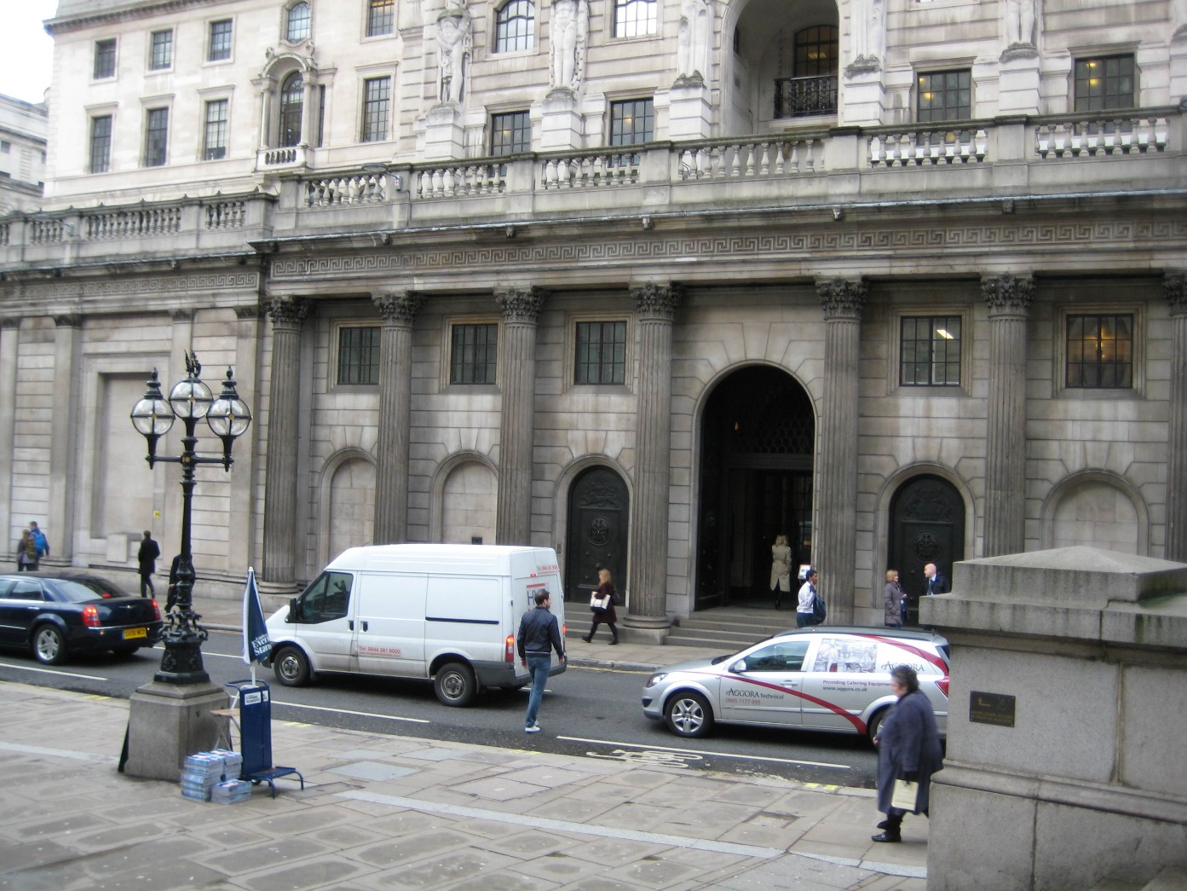
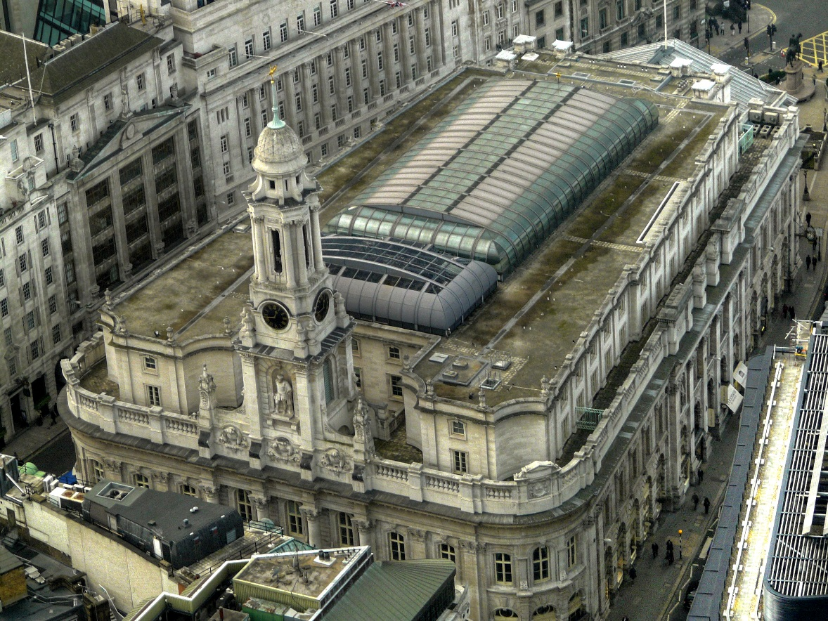
The Lost Science of Money
CHAPTER 10
THE TRANSFER OF CAPITALISM TO ENGLAND
BANK OF ENGLAND
ROYAL EXCHANGE

Slide 2
THEMES OF LOST SCIENCE OF MONEY BOOK
Primary importance of the money power
Nature of money purposely kept secret and confused
How a society defines money determines who controls the society
Battle over control of money has raged for millennia: public vs private
The misuse of the monetary system causes tremendous misery and suffering for the ordinary working people. Will Decker & Martin Dunn, February 2014

Slide 3
PARTS OF PRESENTATION
Timeline: England’s Monarch Families and Money Power
Fight between Parliament and Monarch over money
1604, Mixed Money Case of Ireland
British East India Company
The Undermining of the Monarchy
London Goldsmiths Funded with Dutch Money
Dutch Jewish Publishers of English Bible?
1660 Restoration – Charles II Money Battle
1666 ‘Free Coinage’ Act
1688 Glorious Revolution – Dutch Invasion of England

Slide 4
PART 1
Timeline: England’s Monarch Families and Money Power

Slide 5
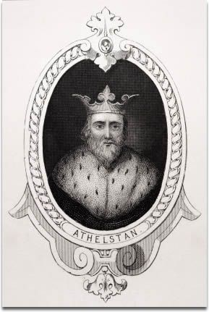
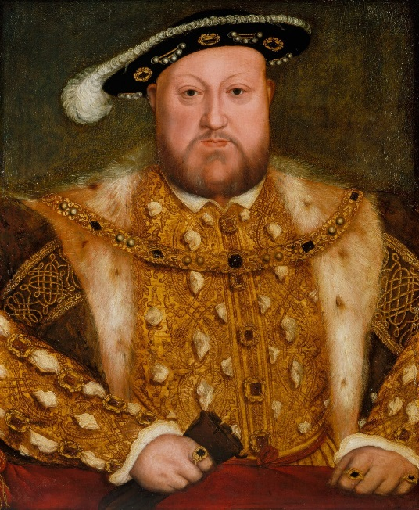
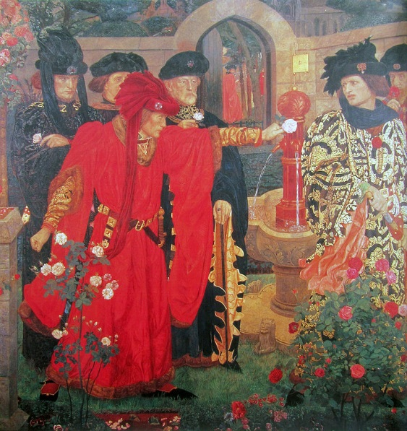
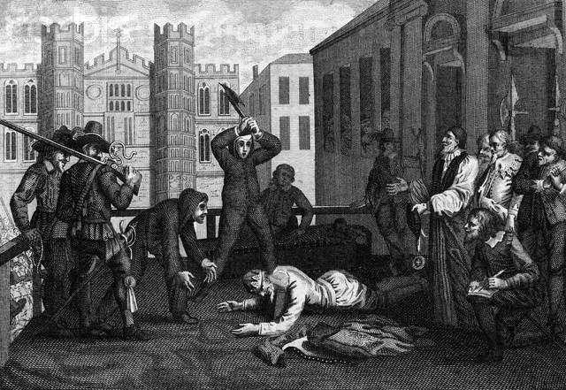
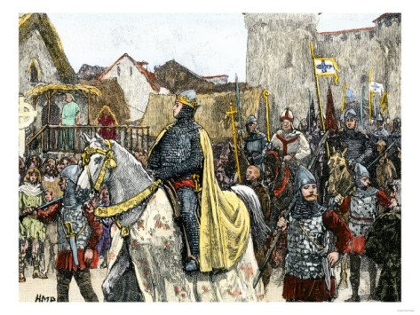
Timeline: England’s Monarch Families and Money Power
_________________________________________________________________
450 1066 1154 1485 1603 1707
Anglo-Saxons Normans Plantagenets House of Tudor House of Stuarts
William the Conqueror 1337-1453: 1509-1547: Henry VIII Catholic, Scottish
French 100 Years’ War (France) *break with Rome 1649-1660 Commonwealth
1455-1487: 1558-1603: Elizabeth I 1666 Free Coinage Law
War of the Roses 1688 Dutch William III
1694 Bank of England begins
King Athelstan
WILLIAM THE CONQUEROR
HENRY VIII
EXECUTION OF CHARLES I

Slide 6
Timeline: England’s Monarch Families and Money Power
House of Stuarts -- Catholic, Scottish
_________________________________________________________________
1603 1625 1649 1660 1685 1689 1702 1707
JAMES I CHARLES I Commonwealth CHARLES II JAMES II MARY II ANNE
DUTCH WILLIAM
1649 Executed 1663 -
Coin & bullion
freely exported
1666 –
Free Coinage
1688 Dutch invasion
1694 Bank of England

Slide 7
Timeline: England’s Monarch Families and Money Power
_________________________________________________________________
450 1066 1154 1485 1603 1707
Anglo-Saxons Normans Plantagenets House of Tudor House of Stuarts
“From the remotest time to the seventeenth century of our aera,
the right to coin money and to regulate its value (by giving it denominations)
and by limiting or increasing the quantity of it in circulation,
was the exclusive prerogative of the State.”
Alexander Del Mar, A HISTORY OF MONETARY CRIMES, p. 7

Slide 8
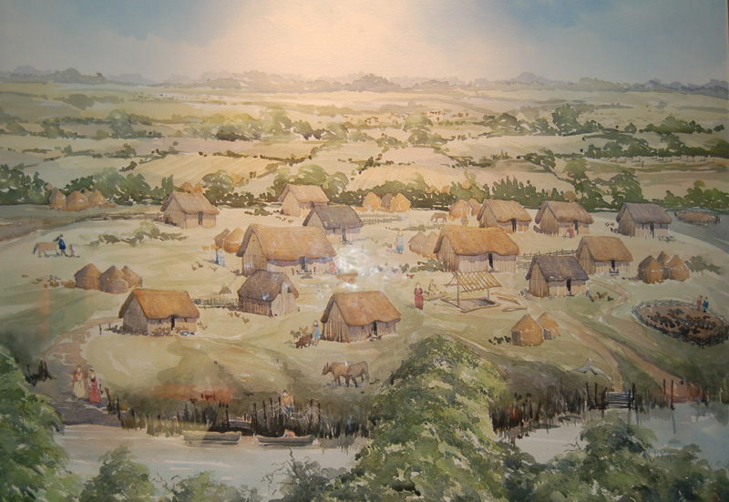
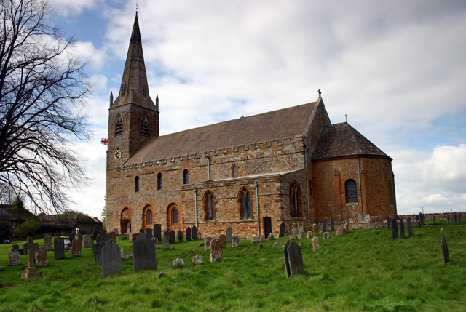
Timeline: England’s Monarch Families and Money Power
When the Western Roman Empire had degenerated, England’s money system had totally collapsed back to barter with no coinage circulating for two hundred years from about 430 to 630 AD.
Land was the most stable form of wealth. Land became the regular means of rewarding a faithful follower. In the English kingdoms, the king was the greatest landowner. He fed his court either by wandering from estate to estate eating its produce, or by arranging for produce to be brought to his halls.
In the late seventh century the laws in Wessex had the following list:
“As a food-rent, from 10 hides, 10 vats of honey, 300 loaves, 12 ‘ambers’ of Welsh ale, 30 of clear ale, 2 full-grown cows, or 10 wethers (castrated sheep or goat), 10 geese, 20 hens, 10 cheeses, an ‘amber’ full of butter, 5 salmon, 20 pounds of fodder and 100 eels.”
Typical anglo saxon village
Romanesque All Saints' Church, Brixworth,
late 7th–8th century

Slide 9
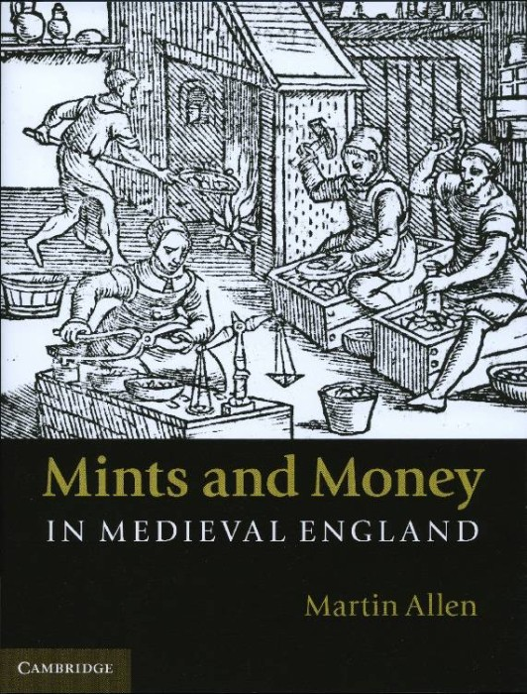
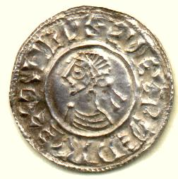
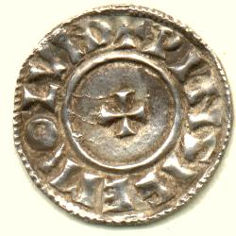
Timeline: England’s Monarch Families and Money Power
As silver reappeared in Europe, coinage also revived in England.
Many mints were established from 800-900 AD, with some central control – all the dies for stamping coins had to come from London.
The Anglo Saxon kings had as much control over the money of their realm as the Emperor in Byzantium had over his. The main Anglo Saxon coin was the silver penny.
Aethelred II, King of England AD 978-1016 Silver penny minted in London.

Slide 10
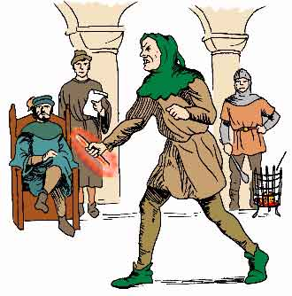
The Laws of King Athelstan 924-939 A.D.
Timeline: England’s Monarch Families and Money Power
That there be one money over all the king's dominion, and that no man mint except
within port. And if the moneyer be guilty, let the hand be struck off that wrought the offense,
and, be set up on the money-smithy, but if it be an accusation, and he is willing to clear himself;
then let him go to the hot-iron, and clear the hand therewith with which he is charged that fraud
to have wrought. And if at the ordeal he should be guilty, let the like be done as here before ordained.
In Canterbury seven moneyers; four the king's, and two the bishop's, one the abbot's. At Rochester three; two the king's, and one the bishop's. At London eight. At Winchester six. At Lewes two. At Hastings one. Another at Chichester. At Hampton two. At Wareham two. At Exeter two. At Shaftesbury two. Else, at the other burhs one.

Slide 11
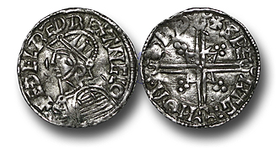
The Anglo Saxon kings re-coined the money about every six years, calling in all the coins and issuing three pennies for every four taken in. This represented a tax of about 4% a year. This revenue provided strength to the kings. This money system was adopted by the Norman conquerors. Attempts by ecclesiasticals to coin money were met with arrest and conviction.
Timeline: England’s Monarch Families and Money Power
Aethelred II, Penny, Helmet type

Slide 12
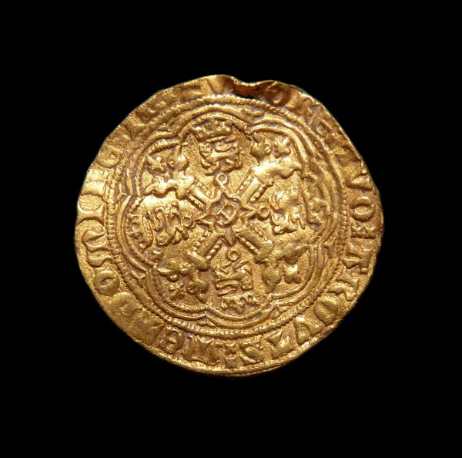
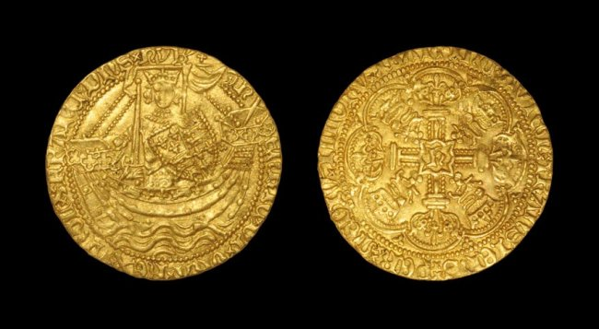
FIRST ENGLISH GOLD COINS WERE MINTED IN 1257 BY HENRY III. THEY WERE WITHDRAWN, AND IN 1343 THE “NOBLE” WAS INTRODUCED. SILVER, HOWEVER, REMAINED THE MAINSTARY OF ENGLAND’S COINAGE.
Timeline: England’s Monarch Families and Money Power

Slide 13
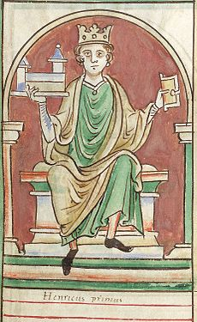
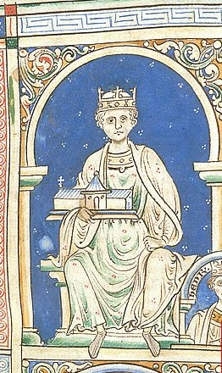
THE KEY MONETARY FEATURE OF ENGLAND AS IT EMERGED FROM MEDIEVAL TIMES WAS THAT THE MONETARY POWER WAS CONCENTRATED IN THE KINGS’ HANDS.
Timeline: England’s Monarch Families and Money Power
HENRY I
HENRY II

Slide 14
PART 2
Fight between Parliament and Monarch over Money

Slide 15
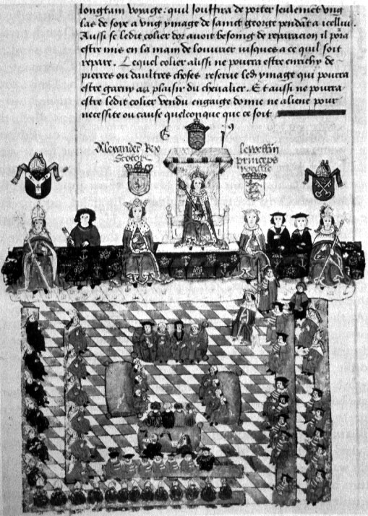
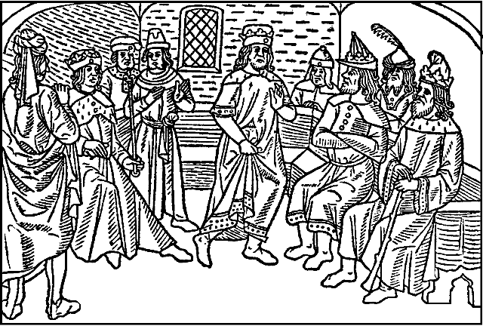
Fight between Parliament and Monarch over Money
PARLIAMENT
The antecedents of the House of Lords are to found in the Anglo-Saxon witan, which brought the leading men of the realm periodically together with the King for ceremonial, legislative and deliberative purposes.
‘Parliament’, first used as a technical term in 1236, was a gathering of the same type, an assembly of prominent men, summoned at the will of the King once or twice a year, to deal with matters of state and law.
Anglo Saxon witan
ENGLISH PARLIAMENT

Slide 16
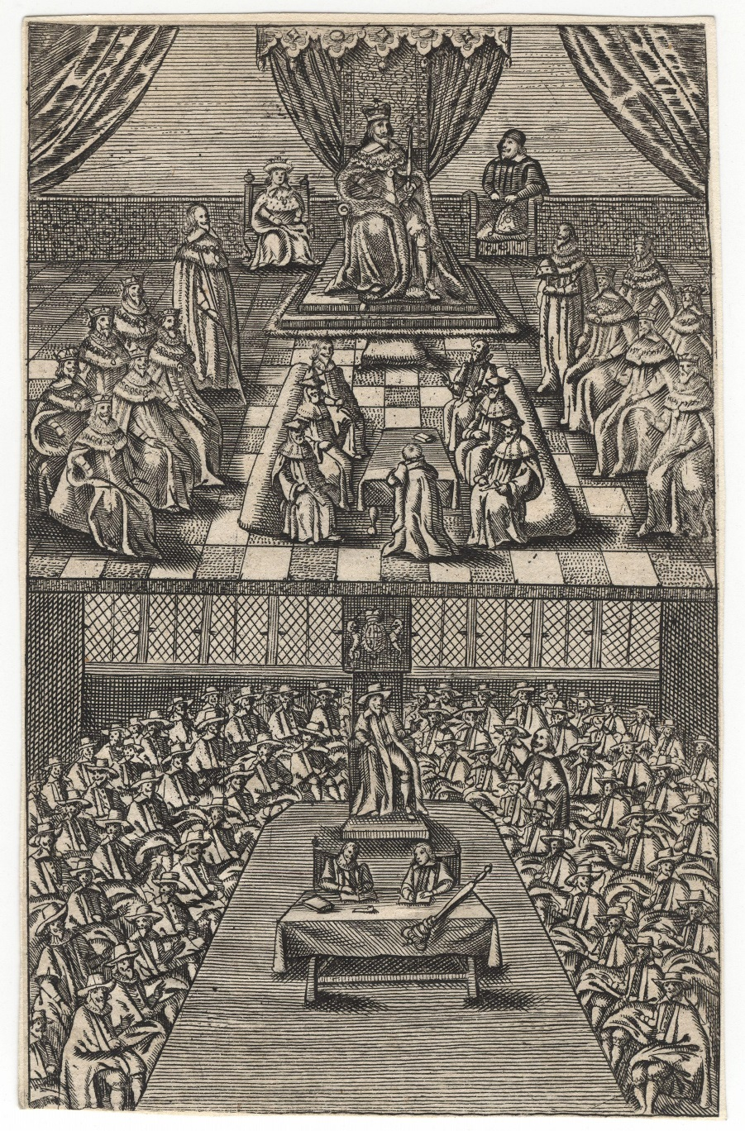
Fight between Parliament and Monarch over Money
THE COMMONS AND TAXATION
Occasionally, however, the parliaments were called with the summons of a wider grouping.
The decline in the real value of the Crown’s traditional revenues and the financial demands of war, transformed these local representatives from an occasional to a defining component of Parliament because the levy of taxation depended on their consent.
Hence, from the 1260s, no general tax was levied without the consent of the representatives of local communities specifically summoned for the purpose of giving their consent.
HOUSE OF COMMONS & LORDS
DURING CHARLES I REIGN

Slide 17
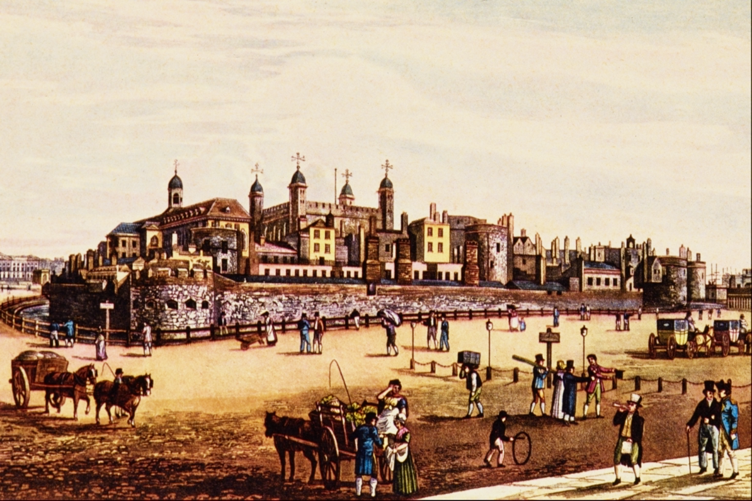
Fight between Parliament and Monarch over Money
COMMONS OBTAINED 3 POWERS BY 1377
Parliamentary consent to all taxes
Both houses to concur in all legislation
The right to investigate and amend administrative abuses
BUT PARLIAMENT WAS REFUSED ANY POWER OVER MONEY ISSUANCE
The Tower of London housed the Royal Mint,
under the direct control of the Monarch.

Slide 18
Fight between Parliament and Monarch over Money
THE MEDIEVAL CURRENRY WAS MANAGED:
The English King’s had used their long standing monetary prerogative responsibly. The only record of debasement is found under Henry VIII 1545-46, amounting to only 15%.
Prices sometimes rise but never fall. This is because a falling price level causes more widespread suffering
than a rising price: producers stop producing and compel society to suffer with them; debtors cannot pay debts.
A deflation is worse than an inflation.
In late medieval Europe, there was a shortage of silver. Therefore, the currency had to be managed to keep prices from falling.
This was because a country’s productivity as a rule increases from generation to generation. More money is needed.
Therefore, from time to time the weight of silver in every coin was reduced, and an increased money supply was issued. A fall
in price was prevented.

Slide 19
PART 3
1604, Mixed Money Case of Ireland

Slide 20
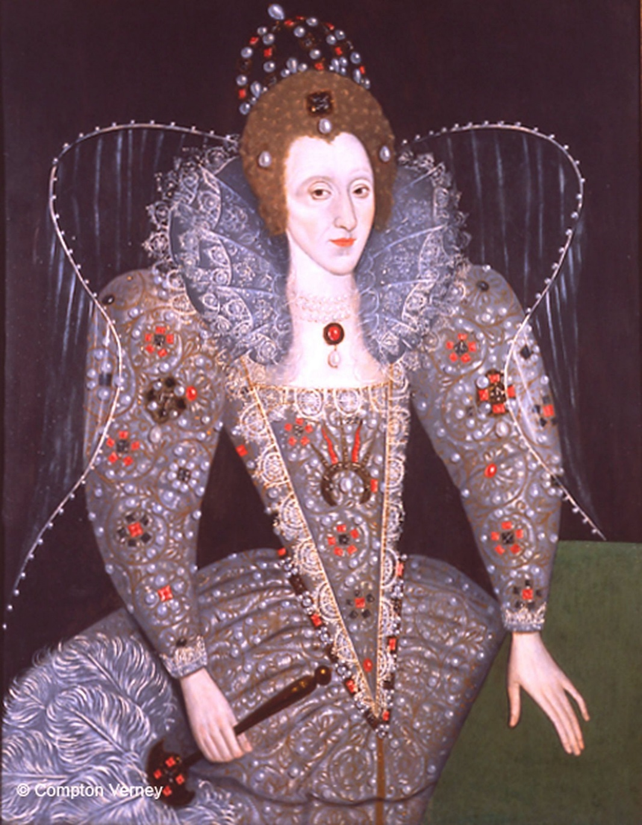
1604, Mixed Money Case of Ireland
In May 1600, Queen Elizabeth issued base metal coinage as legal tender in Ireland, annulling all other coins there and requiring they be returned to the mints. An Irishman paid a 100 pound debt to a London merchant in the new coinage. The merchant sued for the 100 pound in gold and silver.
The case was argued at the highest levels, and was decided in favor of the Irishman.
THE NATURE OF MONEY WAS IDENTIFIED AS A SOCIETAL INSTITUTION
RATHER THAN MERELY METAL:
A common law court confirmed the Queen’s sovereign authority
to declare the denomination, weight, and worth of money

Slide 21
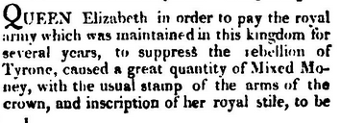
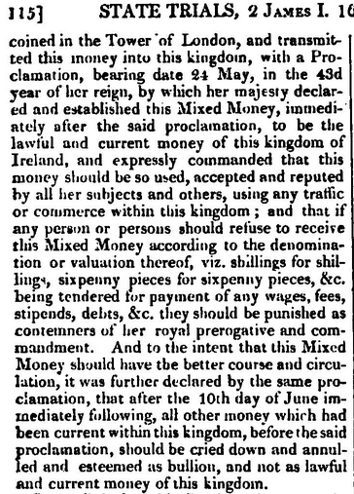
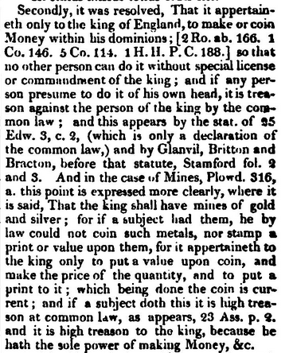
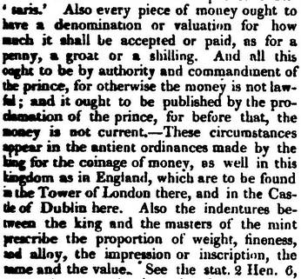
1604, Mixed Money Case of Ireland
"Cobbett's complete collection of state trials and proceedings for high treason
and other crimes and misdemeanors from the earliest period to the present time"

Slide 22
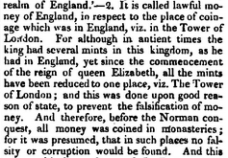
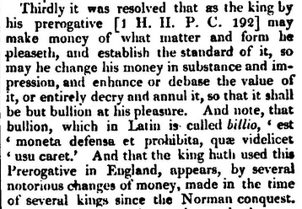
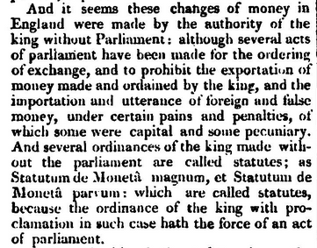
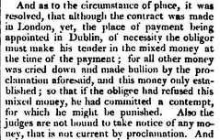
1604, Mixed Money Case of Ireland

Slide 23
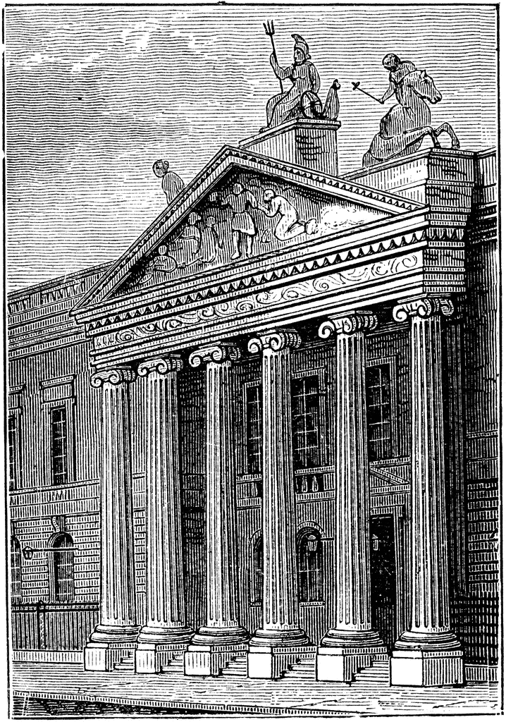
1604, Mixed Money Case of Ireland
THE MIXED MONEY CASE WAS DETESTED BY POWERFUL FORCES:
THE MERCHANT CLASSES
THE GOLDSMITHS (BANKERS), FUNDED BY DUTCH MONEY
BRITISH EAST INDIA COMPANY
Susan Boskey, The Quality Life Plan:
“For over half a century, this ruling alarmed the merchants of London who attempted to defeat the Mixt Moneys decision. The East India Company was the main instigator in the effort, because they were eager to turn a profit by shipping silver to India in exchange for gold. Success was achieved with the British Free Coinage Act of 1666, which, according to Del Mar, ‘altered the monetary systems of the world.’
The Old East India House

Slide 24
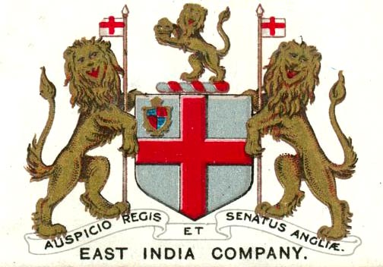
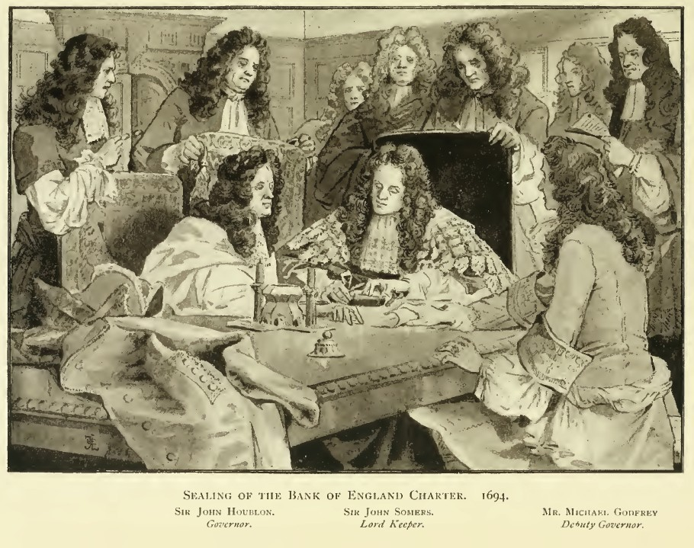
1604, Mixed Money Case of Ireland
THE MIXED MONEY CASE WAS DETESTED BY POWERFUL FORCES, WHO WORKED INCESSANTLY TO DESTROY THIS DECISION –
FIRST STAGE: undermine Crown and pass free coinage
act of 1666
“The British Free Coinage Act of 1666 marked a turning point in the role of currency creation as a public measure to one dominated by moneylenders.” Susan Boskey, The Quality of Life Plan
SECOND STAGE: put money prerogative in hands of a group of financiers (not elected, not representing
society, and in large part not even English),
i.e., creation of the private Bank of England
SEALING OF THE
BANK OF ENGLAND CHARTER, 1694
Bank of England

Slide 25
PART 4
British East India Company

Slide 26
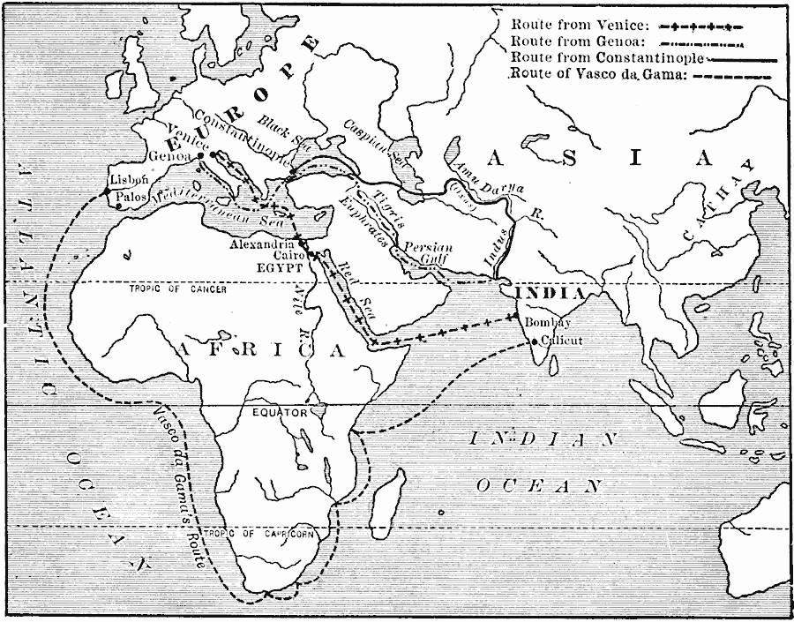
British East India Company
1600, the Queen granted a Royal Charter to “George, Earl of Cumberland, and 215 Knights, Aldermen, and Burgesses" under the name, Governor and Company of Merchants of London trading with the East Indies.
For a period of fifteen years, the charter awarded the newly formed company a monopoly on trade with all countries east of the Cape of Good Hope and west of the Straits of Magellan.
EUROPE
10/14 : 1
INDIA
6/8 : 1
The new company wanted to
compete for the Portuguese gold/silver
ratio trade.

Slide 27
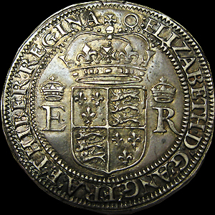
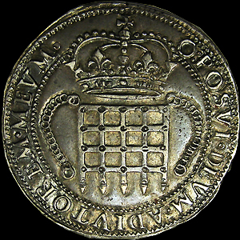
British East India Company
HOWEVER, THE ENGLISH CROWN WOULD ONLY PERMIT THE EIC TO EXPORT FOREIGN COIN OR
BULLION UP TO 30,000 POUNDS A YEAR, AND IMPORT SAME WITHIN SIX MONTHS.
Queen Elizabeth refused permission to the East India Company to circulate Spanish coins in
India, and required them to use coins with the Royal effigy -- the "portcullis " coins – trade
coinage. The policy of England was opposed to the melting or exportation of any portion
of its Measure of Value.
The EIC could import foreign silver, get it coined
at the Royal Mint into portcullis coins, and
export limited sum of these struck coins.
East India Company, Elizabeth I (1558-1603), Portcullis money, Royal Mint, London, 1600.

Slide 28
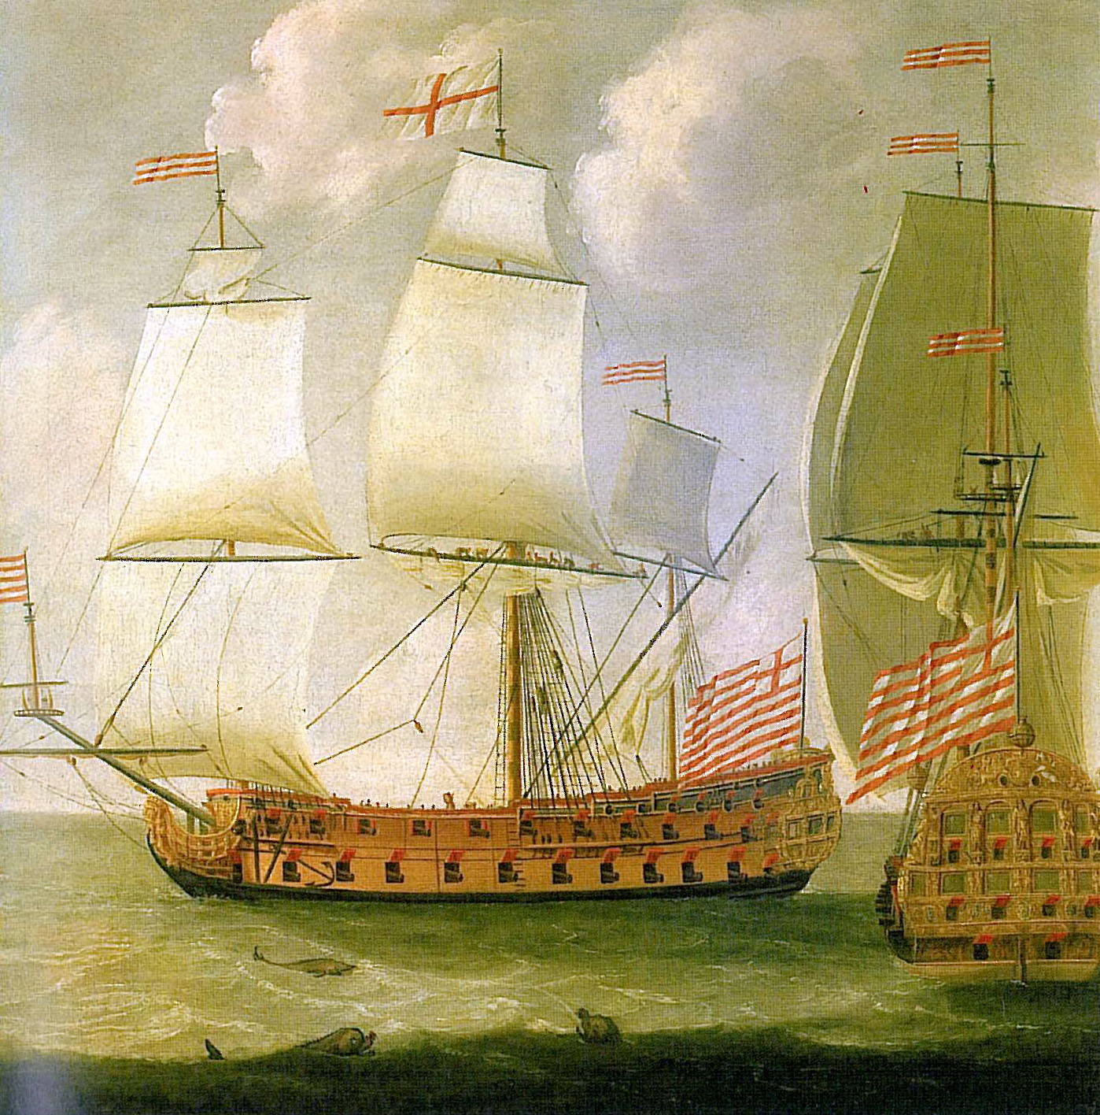
British East India Company
Crown turned down the enlargement of the privilege
of export
Charles I beheaded; EIC almost extinguished
Cromwell annuls EIC’s exclusive privileges and declares
Oriental trade open to all Englishmen
Cromwell renews EIC monopoly
Charles II confirms renewal of EIC charter; for a corrupt consideration, he “permanently establishes this company of money-changers, privateers, filibusters, and bullies” - Alexander Del Mar, A HISTORY OF MONETARY CRIMES
Initially the 80 guns on these merchantmen
were meant to defend the ships from unwanted
competitors and pirates. However, it would not
take long for the guns to be used in offensive manners.

Slide 29
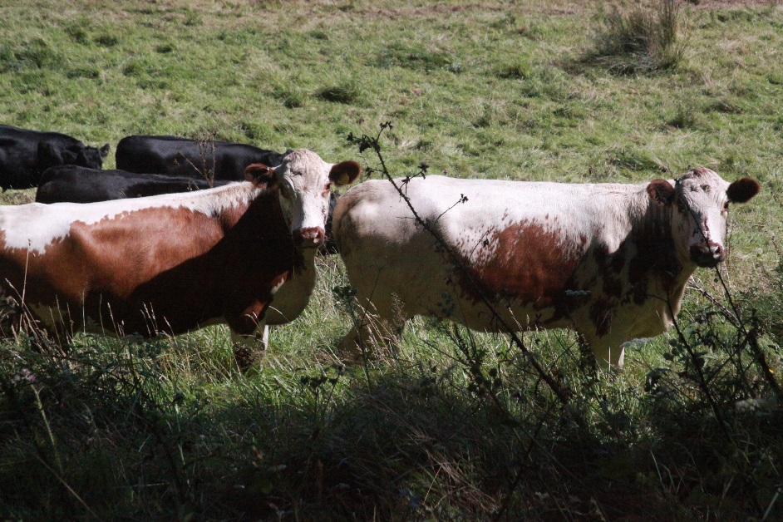
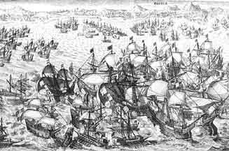
British East India Company
EIC PLOTS SUCCESSFULLY TO REMOVE RESTRICTION UPON EXPORTATION OF COINS AND BULLION
1663 - ‘An Act for the Encouragement of Trade’ had two provisions:
#1 cattle imported from Ireland, Wales or Scotland into England shall pay a duty of 20 shillings per head
#2 repealed provisions that forbade the export of coin or bullion from the kingdom!!!
“. . . Leave is given to export all foreign coins or bullion of gold or silver,
free of interdict, regulation, or duties of any kind. . .”

Slide 30
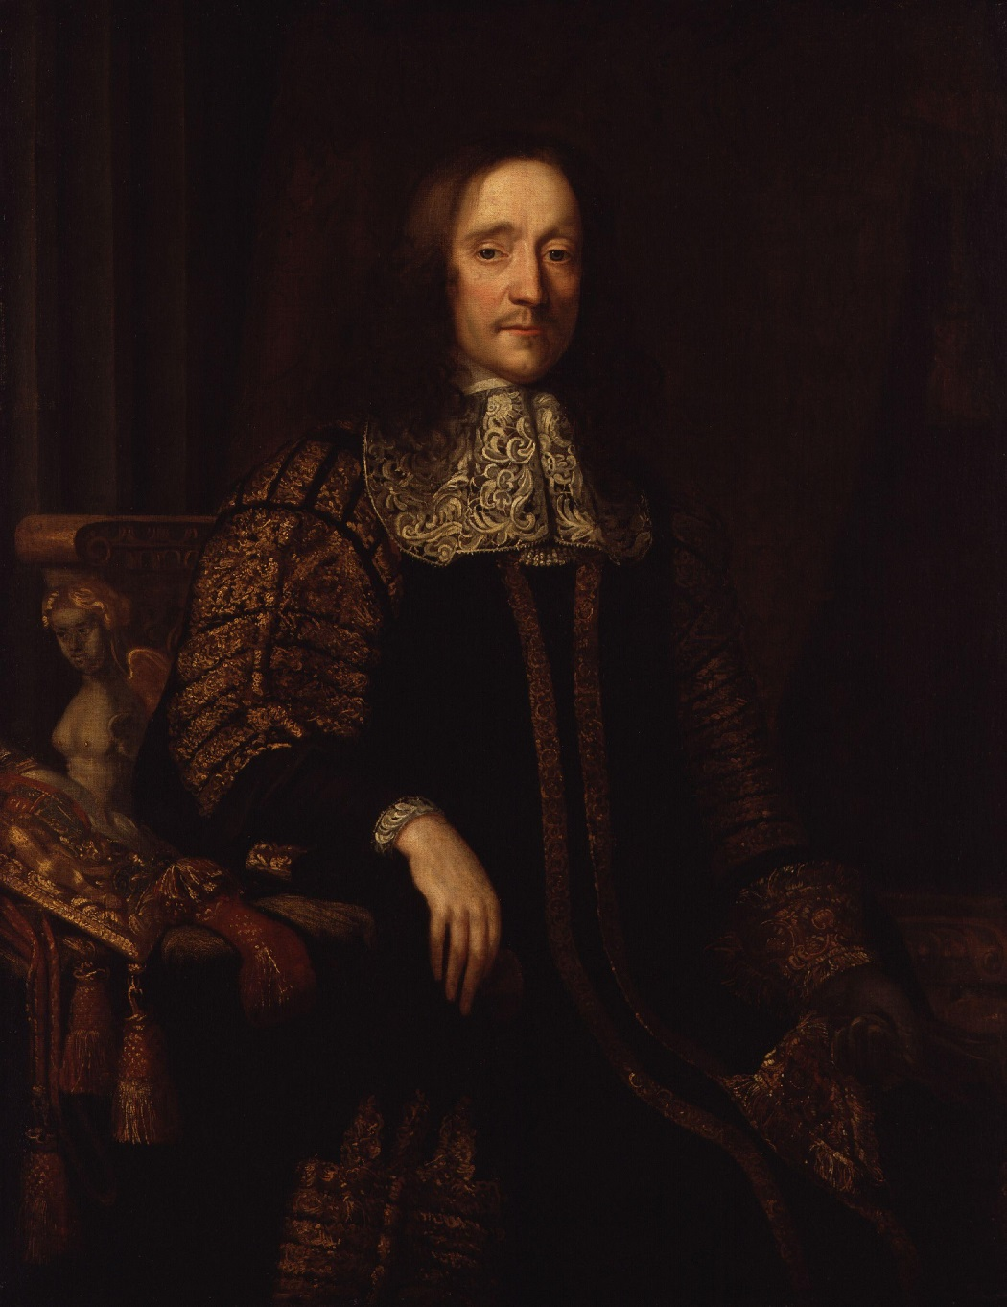
British East India Company
EIC PLOTS SUCCESSFULLY TO REMOVE RESTRICTION UPON EXPORTATION OF COINS AND BULLION
The bill passed the Commons, apparently without debate.
Patriotic Lords protested to the Commons:
“There appearing already great want of money in His Majesty’s dominions and almost all the gold of His Majesty’s stamp gone, notwithstanding the restraint made by law . . . It must necessarily follow by this free exportation” (the balance of trade being against us) “that our silver will also be carried away into foreign parts and all trade fail for the want of money, which is the Measure of it.” “It trencheth highly upon the king’s prerogative, he being by law the only exchanger of money . . . It is dangerous to the peace of the kingdom when it shall be in the power of half-a-dozen or half-a-score of rich, discontented, or factious persons to make a bank (meaning an accumulation) of our coin and bullion beyond the seas, for any mischief (this meant India) and leave us in want of money . . .”
The Earl of Anglesey protested the free exportation of silver

Slide 31
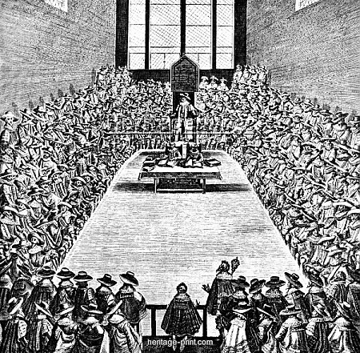
British East India Company
EIC PLOTS SUCCESSFULLY TO REMOVE RESTRICTION UPON EXPORTATION OF COINS AND BULLION
There was no power to which appeal could be made:
The king was a profligate and prey of panders and parasites
The people had been silenced
The press was without influence
The Commons were in the pockets of the East India Company
The Lords (landlords of England) were, many of them, suitors at the palace for forfeited estates, titles, benefices, monopolies and privileges which the king squandered, or his favorites offered for sale
London Goldsmiths backed this legislation
Parliament

Slide 32
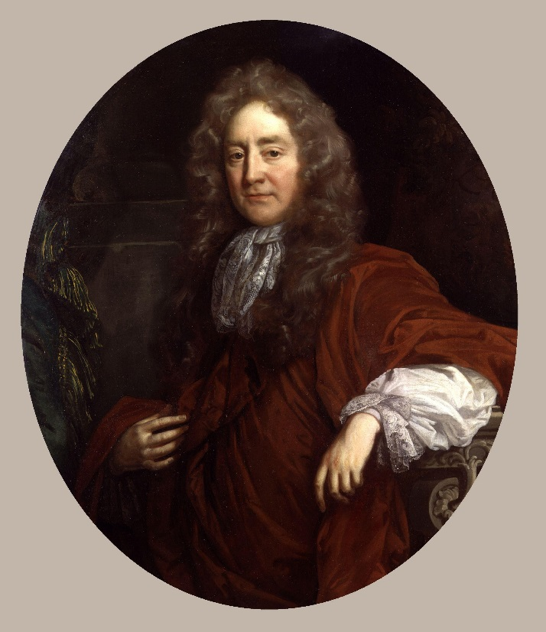
British East India Company
EIC PLOTS SUCCESSFULLY TO REMOVE RESTRICTION UPON EXPORTATION OF COINS AND BULLION
The whole debate upon the bill was so disorderly and unparliamentary that the like had never been before; no rules or order of the House for the course and method of the debate were observed. The members of the corrupt faction spoke out of their turn and more often than they had a right to speak, and this gave rise to many violent scenes.
In spite of all this and of many conferences between the Lords and Commons, whose obstinacy refused all accommodation. . . the bill was passed. . . after ‘foreign’ was prefixed to ‘coin and bullion’, although there are practically no means to distinguish the origin of an ingot of gold or silver metal.
The export of coin was solely for the benefit of the East India Company, whose active member and clever apologist was Sir Josiah Child. This arch intriguant succeeded in getting many of his co-partners (now numbering 556) returned as Members of the Commons, and . . . He kept a guilty hold upon them and others.
Sir Josiah Child was a Director of EIC in 1671,
and its Governor in 1681.

Slide 33
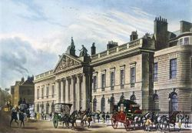
British East India Company
EIC PLOTS SUCCESSFULLY TO REMOVE RESTRICTION UPON EXPORTATION OF COINS AND BULLION
EFFECTS OF THE BILL
At a single bound, the exports of silver coin from England to the Orient increased:
. . . from 40,000 - 50,000 pounds per annum to . . .
400,000 – 500,000 pounds per annum
The best of the foreign and English silver coins, broad pieces of Spain, milled coins of England, were melted down and shipped to India by Sir Josiah Child and his patriotic associates.
Scarcity of silver in England ensued.
East India House

Slide 34
PART 5
The Undermining of the Monarchy

Slide 35
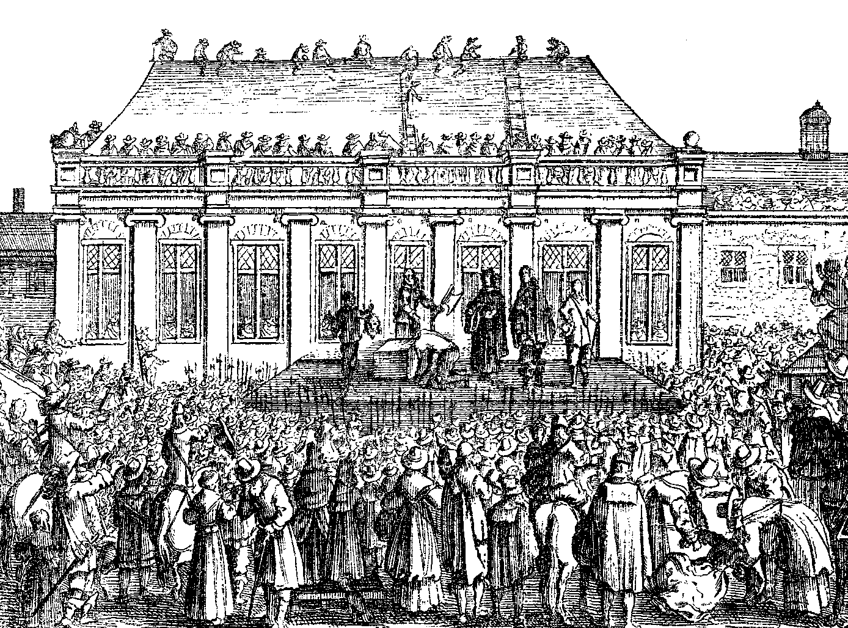
The Undermining of the Monarchy
THOMAS HOBBES -- BEHEMOTH: THE HISTORY OF THE CAUSES of THE CIVIL WARS OF ENGLAND, AND OF THE COUNSELS AND ARTIFICES BY WHICH THEY WERE CARRIED ON FROM THE YEAR 1640 TO THE YEAR 1660
Published posthumously in 1681. Hobbes was refused permission by King Charles II to publish Behemoth. While the king recognized the correctness of the account of events and issues, he was concerned that the book would not be well received and cause the author scandal.
The narrator in the book relates the seven factions who stoked the fires of rebellion against the monarchy, ending in the execution of King Charles I.
Papists
Presbyterians
Independents including other sects of religious faith
Those who were corrupted by their reading of the Latin and Greek classics
Centres of commerce and trade such as London
Those with no means of support who saw the war as a way to profit
Lack of understanding as to the important role played by the monarchy in society
EXECUTION OF CHARLES I, 1649

Slide 36
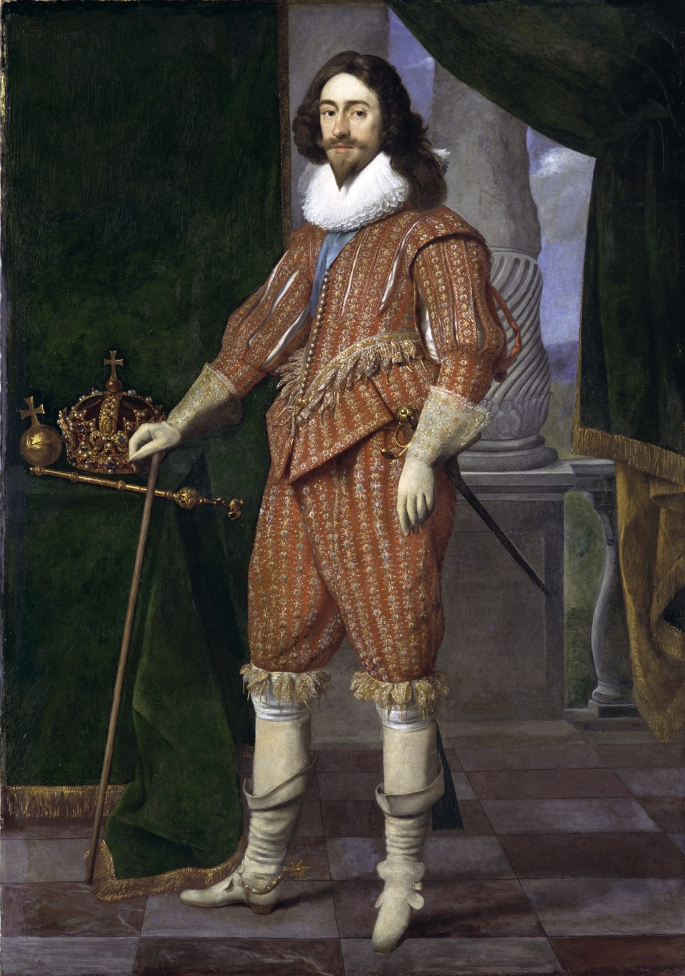
The Undermining of the Monarchy
“In the year 1640, the government of England was monarchical; and the King that reigned, Charles, the first of that name, holding the sovereignty, by right of a descent continued above six hundred years, and from a much longer descent King of Scotland, and from the time of his ancestor Henry II, King of Ireland;
a man that wanted no virtue, either of body or mind, nor endeavoured anything more than to discharge his duty towards God, in the well governing of his subjects.”
CHARLES I

Slide 37
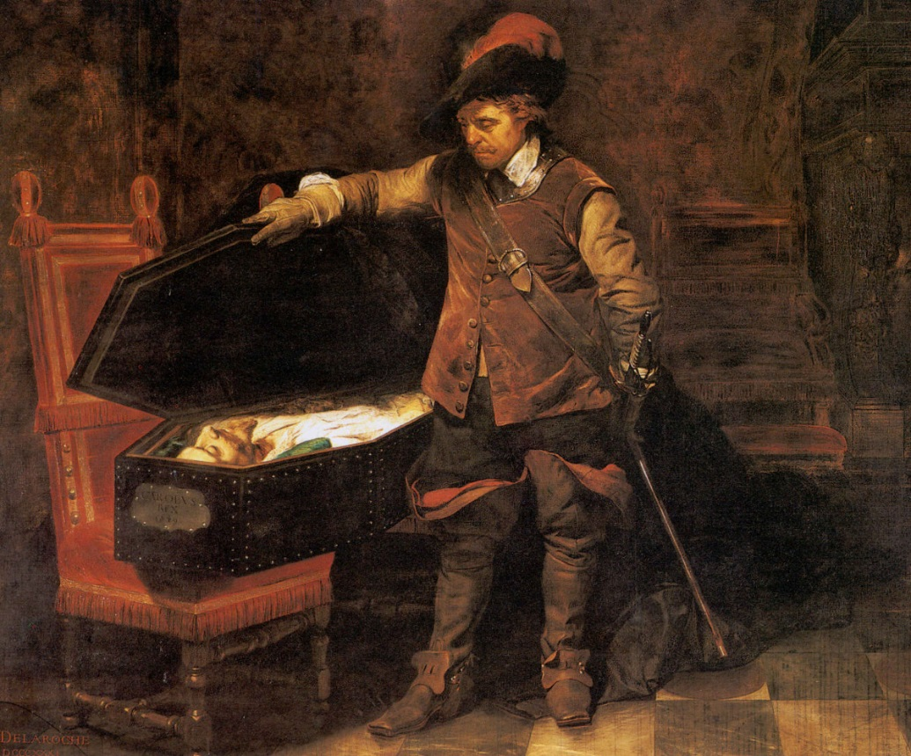
The Undermining of the Monarchy
THE KING’S NEED FOR MONEY
Truly, I think, if the King had had money, he might have had soldiers enough in England. For there were very few of the common people that cared much for either of the causes, but would have taken any side for pay or plunder.
But the King’s treasury was very low, and his enemies, that pretended the people’s ease from taxes, and other specious things, had the command of the purses of the city of London, and of most cities and corporate towns in England, and of many particular persons besides.”
CROMWELL BEFORE COFFIN OF CHARLES I

Slide 38
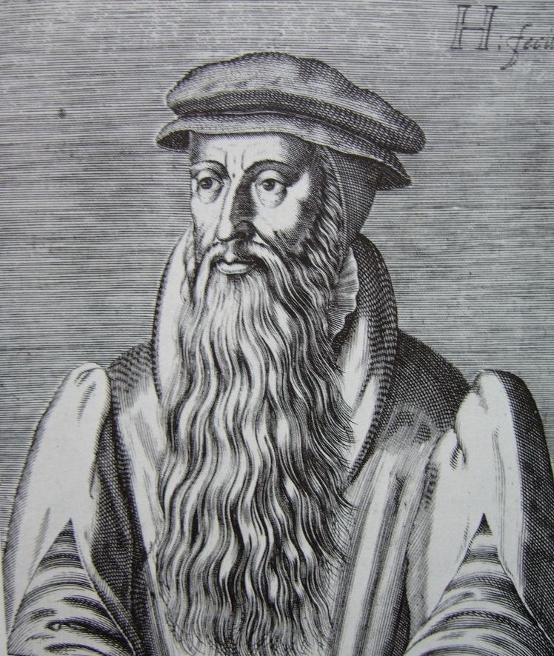
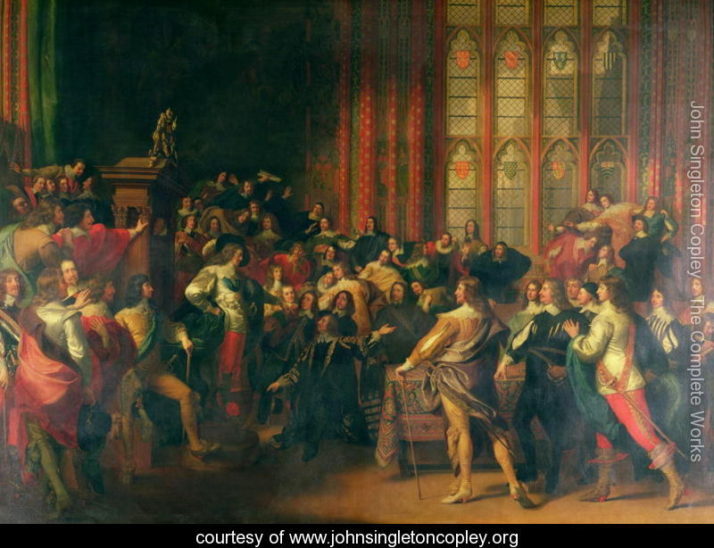
The Undermining of the Monarchy
PRESBYTERIANS
The seducers were of divers sorts. One sort were ministers; ministers, as they called themselves, of Christ; and sometimes, in their sermons to the people, God’s ambassadors; pretending to have a right from God to govern every one his parish, and their assembly the whole nation.
. . . the power of the Presbyterians was so very great . . . It was not their own art alone that did it, but they had the concurrence of a great many gentlemen, that did no less desire a popular government in the civil state than these ministers did in the Church. And as these did in the pulpit draw the people to their opinions, and to a dislike of the Church-government, Canons, and Common-prayer book, so did the other make them in love with democracy by their harangues in the Parliament, and by their discourses and communication with people in the country, continually extolling liberty and inveighing against tyranny, leaving the people to collect of themselves that this tyranny was the present government of the state.
JOHN KNOX
Presbyterianism was especially influenced
by the French theologian John Calvin, who
is credited with the development of Reformed
theology, and the work of John Knox, a Scotsman
who studied with Calvin in Geneva, Switzerland
and brought his teachings back to Scotland.
The Presbyterian church traces its ancestry back
primarily to England and Scotland.
Charles I in House of Commons

Slide 39
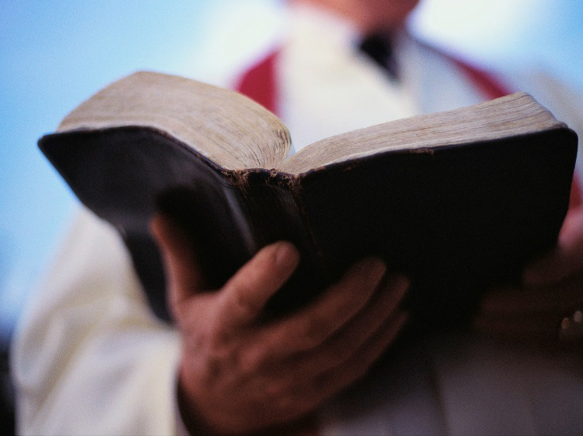
The Undermining of the Monarchy
PRESBYTERIANS: But you have not yet told me by what art and what degrees they became so strong.
. . . the power of the Presbyterians was so very great, that, not only the citizens of London were almost all of them at their devotion, but also the greatest part of all other cities and market towns of England. But you have not yet told me by what art and what degrees they became so strong.
1. And first, for the manner of their preaching; they so framed their countenance and gesture at their entrance into the pulpit, and their pronunciation both in their prayer and sermon, and used the Scripture phrase (whether understood by the people or not), as that no tragedian in the world could have acted the part of a right godly man better than these did; insomuch that a man unacquainted with such art, could never suspect any ambitious plot in them to raise sedition against the state, as they then had designed.
2. . . . before their sermons, their prayer was or seemed to be extempore, which they pretended to be dictated by the spirit of God within them, and many of the people believed or seemed to believe it.
3. . . . they did never in their sermons, or but lightly, inveigh against the lucrative vices of men of trade or handicraft; such as are feigning, lying, cozening, hypocrisy, or other uncharitableness, except want of charity to their pastors and to the faithful . . .

Slide 40
The Undermining of the Monarchy
PRESBYTERIANS
4. . . . by preaching up an opinion that men were to be assured of their salvation by the testimony of their own private spirit, meaning the Holy Ghost dwelling within them. And from this opinion the people that found in themselves a sufficient hatred towards the Papists.
5. . . . they did, indeed, with great earnestness and severity, inveigh often against two sins, carnal lusts and vain swearing . . . But the common people were thereby inclined to believe, that nothing else was sin . . . for men are not ordinarily said to lust after another man’s cattle, or other goods or possessions . . . and therefore never made much scruple of the acts of fraud and malice . . .
The pulpit did not teach their converts
who the true enemy was – those with fraud
and malice toward their society. The usurers.
The usurers could hide away.

Slide 41
The Undermining of the Monarchy
INDEPENDENTS
And these were the enemies which arose against his Majesty from the private interpretation of the Scripture, exposed to every man’s scanning in his mother-tongue.
. . . Anabaptists. Others that held that Christ’s kingdom was at this time to begin upon the earth, were called Fifth-monarchy-men; besides divers other sects, as Quakers, Adamites, &c., whose names and peculiar doctrines I do not well remember.
QUAKERS
ADAMITES
ANABAPTIST

Slide 42
The Undermining of the Monarchy
THOSE WHO WERE CORRUPTED BY THEIR READING OF THE LATIN AND GREEK CLASSICS
. . . there were an exceeding great number of men . . . in their youth having read the books written by famous men of the ancient Grecian and Roman commonwealths concerning their polity and great actions; in which books the popular government was extolled by that glorious name of liberty, and monarchy disgraced by the name of tyranny; they became thereby in love with their forms of government.
And out of these men were chosen the greatest part of the House of Commons, or if they were not the greatest part, yet by advantage of their eloquence, were always able to sway the rest.
CHARLES I BEFORE HOUSE OF COMMONS

Slide 43
The Undermining of the Monarchy
CENTRES OF COMMERCE AND TRADE SUCH AS LONDON
. . . the city of London and other great towns of trade, having in admiration the prosperity of the Low Countries after they had revolted from their monarch, the King of Spain, were inclined to think that the like change of government here, would to them produce the like prosperity.
17TH CENTURY LONDON
BEFORE THE GREAT FIRE

Slide 44
The Undermining of the Monarchy
IGNORANCE OF THE PEOPLE: Lack of understanding as to the important role played by the monarchy in society
Lastly, the people in general were so ignorant of their duty, as that not one perhaps of ten thousand knew what right any man had to command him, or what necessity there was of King or Commonwealth, for which he was to part with his money against his will; but thought himself to be so much master of whatsoever he possessed, that it could not be taken from him upon any pretence of common safety without his own consent.

Slide 45
The Undermining of the Monarchy
BUT OF JUSTICE AND CHARITY, THEY HAVE NEITHER KNOWLEDGE NOR PRACTICE
What have we then gotten by our deliverance from the Pope’s tyranny, if these petty men succeed in the place of it, that have nothing in them that can be beneficial to the public, except their silence?
For their learning, it amounts to no more than an imperfect knowledge of Greek and Latin, and an acquired readiness in the Scripture language, with a gesture and tone suitable thereunto . . .
. . . but of justice and charity, the manners of religion, they have neither knowledge nor practice.
MEDIEVAL USERERS
SIGNING OF BANK OF ENGLAND CHARTER
MODERN USURERS

Slide 46
PART 6
London Goldsmiths Funded with Dutch Money

Slide 47
London Goldsmiths Funded with Dutch Money
Who were the Goldsmiths?
The London goldsmiths first gained their riches by supplying Cromwell with “wants of money upon great advantage.”
Edward, Earl of Clarendon, 1827.
The goldsmiths emerged as bankers or money-lenders. They were a group of 5 or 6 men. In 1669, a Parliamentary
committee was being told that “Alderman Bucknill had above 100,000 pounds in his hands, Mr. Meynell above
30,000 pounds, Mr. Vandeput at one time 60,000 pounds, Mr. Dericost always near 200,000 pounds of Dutch money
lent to merchants at 7, 6 and 5 per cent when money was at 8 per cent”. Hist. MSS. Comm., part i, 134.
Money could be gotten in Holland 3% lower cost.
“. . . the London goldsmiths, who play so large a part in the story of Restoration England, were to a very great extent
mere agents, operating with Dutch money.” Christopher Hollis, THE TWO NATIONS, p. 22.

Slide 48
PART 7
Dutch Jewish Publishers of English Bible?

Slide 49
Dutch Jewish Publishers of English Bible?
Menasseh ben Israel (1604 – 1657), was a Portuguese Sephardic rabbi,
writer, diplomat, printer and publisher, founder of the
first Hebrew printing press in Amsterdam in 1626. His parents
left Portugal because of the Inquisition and settled in Amsterdam.
Menasseh turned his attention to England, whence the Jews had been
expelled since 1290. He worked to get them permission to settle
there again and thus provide a new haven for his brethren.

Slide 50
Dutch Jewish Publishers of English Bible?
Joseph Athias (1635-1700), a Marrano Jew born in Cordova, fled to Hamburg
and then Amsterdam. He became a publisher of books. His press
soon grew into one of the leading ones in that great publishing city,
printing books in Hebrew, Dutch, and Latin.
The Jewish press of Joseph Athias claimed to have printed one million
English Bibles for England and Scotland.

Slide 51
PART 8
1660 Restoration – Charles II Money Battle

Slide 52
1660 Restoration – Charles II Money Battle
THE RESTORATION -- THE NEW THEORY OF MONARCHY
The old theory of monarchy – the King should possess sufficient capital to give income to carry on the government. In abnormal times, he taxed the people.
The new theory of 1660 – the King should have no capital of importance and be entirely dependent on income voted by Parliament, to control his conduct. In practice, Parliament voted insufficient income to compel him to contract debts.

Slide 53
1660 Restoration – Charles II Money Battle
BALANCE SHEET – CHARLES II
PARLIAMENT CHEATING HIM OF MONEY
DEFICIT pounds
HOW FUNDED DEFICIT pounds
Cheated by Parliament 4.4 million
(ordinary revenue)
Cheated by Parliament
(for war revenue)
1st Dutch war 1.5 million
2nd Dutch war .1 million
intended French war .18 million
6.212 million
___________
Rendition of Dunkirk .290 million
Queen Catherine’s dowry .180 million
French King’s Money .742 million
Bankers debt (Goldsmiths) 2.00 million
Crown lands sold 1.00 million
Debts resting on executive
at death of Charles 2.00 million
6.212 million
___________

Slide 54
1660 Restoration – Charles II Money Battle
CHARLES II HAD A PLAN TO FUND HIS GOVERNMENT INDEPENDENTLY
To stop the clipping of coins, he began the coinage of milled coins
To remove gold and silver coins from the English money supply, and make room for his own paper money, he removed the restriction on the export of bullion and encouraged the East India Company
Charles II, like past monarchs, had used tally sticks for the issuance of royal debt. His creditors would present the tally sticks when taxes were collected and get the cash.
Now, instead of tally sticks, Charles II issued debt in negotiable paper orders, not tallies. They were legal tender convertible into gold at a specified future date.. As some were paid, others would be issued; there would always be negotiable paper in circulation.
HAD CHARLES’ EXPERIMENT SUCCEEDED:
WHEN NEW MONEY WAS REQUIRED, IT WOULD BE THE BUSINESS OF THE KING TO ISSUE IT.
TALLY STICK
NEGOTIABLE PAPER ORDERS

Slide 55
1660 Restoration – Charles II Money Battle
THE FAILURE OF CHARLES II PAPER MONEY PLAN
Charles II did manage to keep prices stable and not issue an excess of paper money; however, he blundered. He issued his negotiable paper in large amounts. His creditors needed smaller notes, and the London goldsmiths ‘offered’ to change them. They would give their own smaller notes which they were willing to cash on demand. But the goldsmiths would exchange only at a large discount.
“Thus in the year 1672 – in the middle of the Dutch War – Charles, saddled with heavy expenditure which Parliament refused to meet out of taxation, found his creditors reluctant to accept more of their payments in paper orders.”

Slide 56
1660 Restoration – Charles II Money Battle
THE BATTLE BETWEEN MONARCHY AND MONEY-POWER
WITH WHICH ALL SUBSEQUENT HISTORY HAS BEEN FILLED
The poet John Dryden was the first man to clearly comprehend this battle:
THE MEDAL (1682)
Then, Cyclop-like, in human flesh to deal, Chop up a minister at every meal: Perhaps not wholly to melt down the king, But clip his regal rights within the ring. From thence to assume the power of peace and war,
And ease him, by degrees, of public care.
JOHN DRYDEN

Slide 57
PART 9
1666 ‘Free Coinage’ Act

Slide 58
1666 ‘Free Coinage’ Act
1666-1667 MINT LEGISLATION: ‘FREE COINAGE’
‘THE MOST POWERFUL PREROGATIVE NEXT TO PEACE OR WAR SOLD FOR A SONG TO A CLASS OF USURERS TO THIS DAY!’
Alexander Del Mar, A HISTORY OF MONETARY CRIMES
Reasons for passing this Act.
Gold and Silver to be coined gratis. For every Pound Troy of Gold or Silver brought, there is to be delivered a Pound Troy of Current Coin.; For every Pound Troy of Gold and Silver finer than Standard so much more than a Pound Troy delivered; and for baser Gold or Silver so much less.

Slide 59
1666 ‘Free Coinage’ Act
The Charge of Coinage defrayed by a new Impost on certain Liquors.
THE MONEY POWER SOLD FOR LIQUOR FEE OF TEN SHILLINGS!
Wine, Vinegar, Cyder, and Beer imported, 10s. Per Ton; Brandy-wines and Strong Waters, 20s. per Ton; Over and above all other Duties; Collectors to pay Duty Quarterly into the Exchequer, to be kept distinct.
And whereas it cannot be reasonably expected that the Expence Waste and Charge in assaying melting downe and coynage be borne by Your Majestie And for the further encouragement of Coynage Bee it enaced And it is hereby enacted by the Authority aforesaid That for every Tunn of Wines Vinegar Syder or Beere that shall be imported or brought into the Port of London or into any other Port . . . there shall be levyed collected and paid the summe of Ten shillings . . .

Slide 60
1666 ‘Free Coinage’ Act
RESULTS OF THIS ACT: CONTROL OF COMMERCE
No Englishman would have listened to the giving away of the coining power. Through subterfuge and bribery, the goldsmiths and East Indies Company swept away the seignorage of the Crown and the control of the issue.
The EIC and goldsmiths brought metal to mint for ‘free coinage’. The mint refused any but large deposits.
1768 – made perpetual
TOWER OF LONDON MINT

Slide 61
PART 10
1688 Glorious Revolution – Dutch Invasion of England

Slide 62
1688 Glorious Revolution – Dutch Invasion of England
HISTORY OF WILLIAM III OF ORANGE
1672 -- during the disastrous 3rd Anglo-Dutch War and Franco-Dutch War, William III of Orange was made Stadtholder over Holland, Zeeland, Utrecht, Gelderland, Overrijssel of the Dutch Republic
Many Protestants heralded him as a champion of their faith. His wife Mary (married 1677) was the Protestant daughter of the Catholic Stuart King James II (reigned 1685-1688).
William and Mary

Slide 63
1688 Glorious Revolution – Dutch Invasion of England
WILLIAM WOULD NOT INVADE ENGLAND WITHOUT PROMINENT MEN SUPPORTING HIM
The Invitation to William was a letter sent by seven notable Englishmen to William III, Prince of Orange, received by him on 30 June 1688.
The letter informed William that if he were to land in England with a small army, the signatories and their allies would rise up and support him. Two of the signers were generally considered to be Tories, while the other five signatories were generally seen as Whigs.
Part of the text: “If upon a due consideration of all these circumstances your Highness shall think fit to adventure upon the attempt, or at least to make such preparations for it as are necessary (which we wish you may), there must be no more time lost in letting us know your resolution concerning it, and in what time we may depend that all the preparations will be ready, as also whether your Highness does believe the preparations can be so managed as not to give them warning here, both to make them increase their force and to secure those they shall suspect would join with you. We need not say anything about ammunition, artillery, mortar pieces, spare arms, &c.. because if you think fit to put anything in execution you will provide enough of these kinds. and will take care to bring some good engineers with you . . . ‘;

Slide 64
1688 Glorious Revolution – Dutch Invasion of England
The invitation convinced William to carry out his existing plans to land with a large Dutch army, culminating in the Glorious Revolution during which James was deposed and replaced by William and Mary as joint rulers.
William’s attack had heavy Jewish financing. Isaac Lopez Suasso of the Hague advanced him two million gold crowns, interest free.
ISAAC LOPEZ SUASSO
OF THE HAGUE
WILLIAM III OF ORANGE INVADING ENGLAND
WITH A LARGE DUTCH FLEET

Slide 65
Q & A
WILL DECKER’S CONCLUSION:
THE CONTROL OF MONEY -- WITHOUT CONTROL FROM THE PUBLIC -- LEADS TO
CORRUPTION … USURPATION … SLAVERY.

