Slide 1
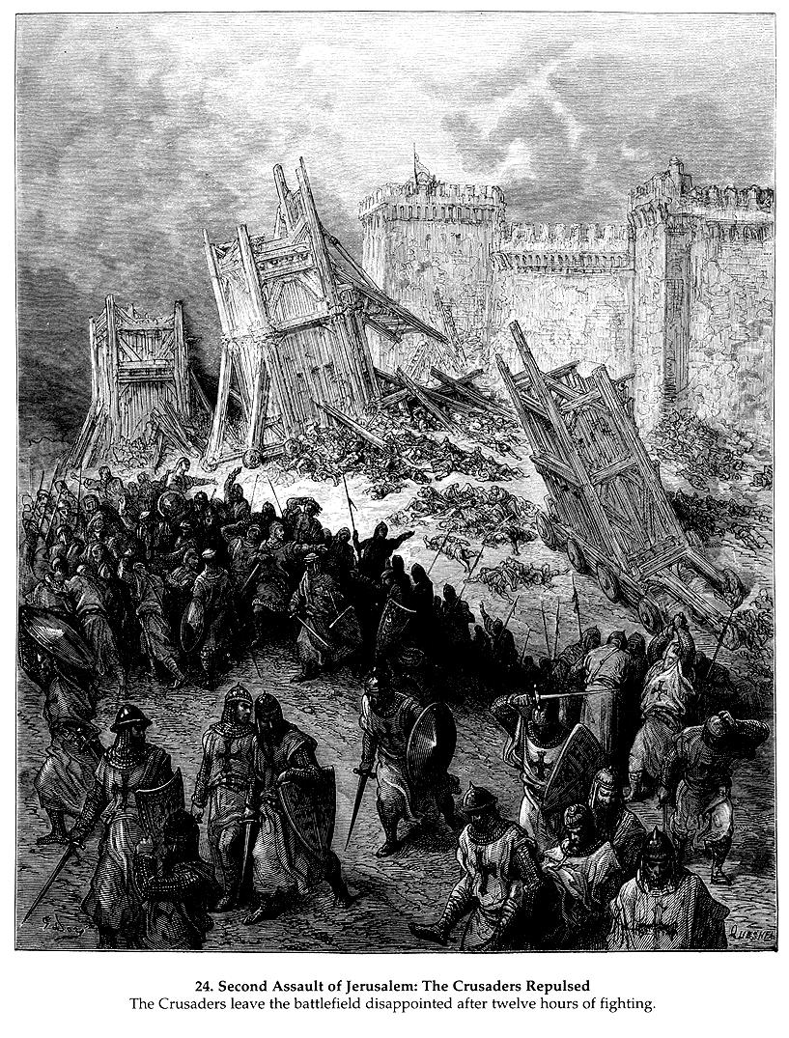
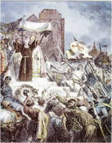
The Lost Science of Money
CHAPTER 5:
THE CRUSADES END BYZANTIUM’S MONETARY DOMINATION:
ALLOW MONETARY REBIRTH

Slide 2
THEMES OF LOST SCIENCE OF MONEY BOOK
Primary importance of the money power
Nature of money purposely kept secret and confused
How a society defines money determines who controls the society
Battle over control of money has raged for millennia: public vs private

Slide 3
PARTS OF PRESENTTION
CRUSADES: Timeline and Maps
CRUSADES: Geopolitical Motivations
The Jews
CRUSADES: West meets the East
Sack of Constantinople: Major World Monetary Event
The Knights Templar

Slide 4
PART 1
Timeline and Maps of the Crusades

Slide 5
THE CRUSADES
#1 Knights #2 #3 #4
Templar
|------------------------|------------|-----------|---------------|-------------|----------------------|
1095-1099 1145-1149 1189-1192 1204
1st Crusade:
Seljuk Turks threathen
Byzantium; Crusade
recaptures Jeruselum;
overland trade
route to India opened
2nd Crusade:
Failure of Knights
with possible
hindrance of
Byzantium
3rd Crusade:
Capture of
Acre, Jaffe,
but not
Jerusalem;
Byzantium makes
alliance with
Saladin.
4th Crusade
SACK OF
CONSTANTINOPLE
by Pope & Venice
632-661
Moslem
Conquests
include
Jerusalem
1129
Knights
Templar
begins
1187
Saladin
recaptures
Jerusalem
Venice joins 1st Crusade
late: gives up Alexandria
trade for overland route
Venice attacks
Constantinople

Slide 6
After Fall of Constantinople
Sovereign Right of Gold Coinage to Secular Rulers
|-------------------|--------------|-----------------|------------------------|
1204 1250 1284 1307 1345
WESTERN GOLD/SILVER RATIO FLUCTUATES
TURNING POINT IN
MONETARY HISTORY
INDIA TRADE REOPENED:
Venice applies to Egyptian
government for reduction
in tariff on silver imported
by Venice into Alexandria
from 10% to 2%
Venice taps into Eastern ratio:
gold floods Europe
Venice
coins
silver
GROSSO
Frederick II
‘Sacred Emperor’
issues gold coin
Pope calls him
The Antichrist.
Venice mints
first gold coin,
Ducat, meant
to continue
Bezant
Knights Templars
Suppressed
Levant trade to
India lost

Slide 7
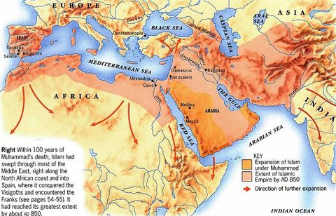
ISLAMIC WORLD
850 AD
MOSLEMS AT WALLS
OF ROME 846 AD

Slide 8
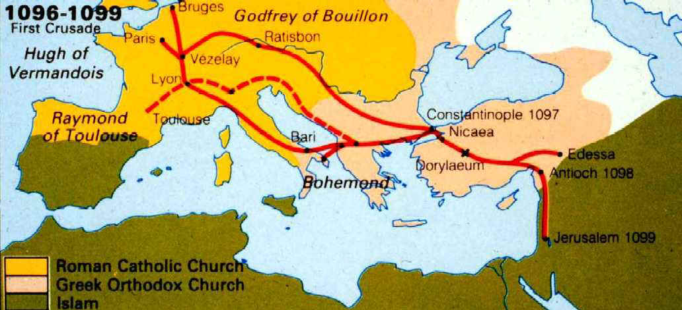

Slide 9
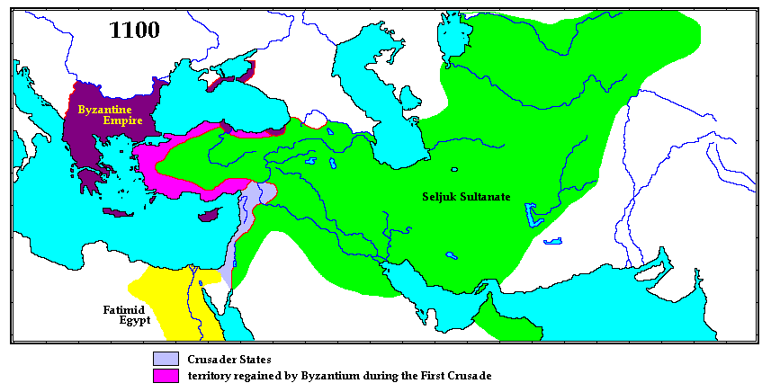

Slide 10
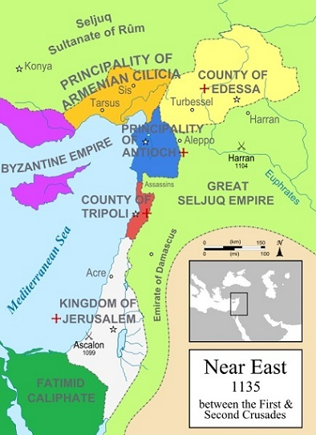
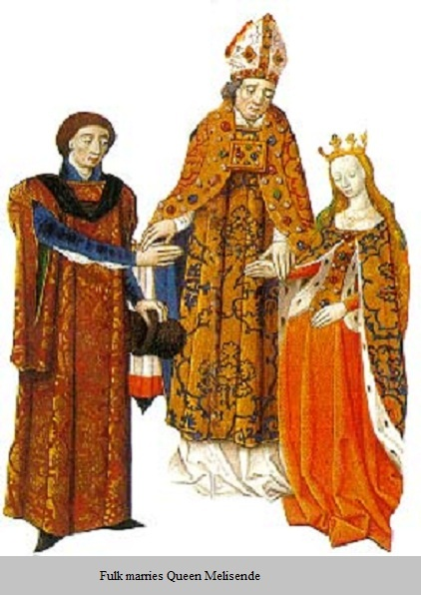
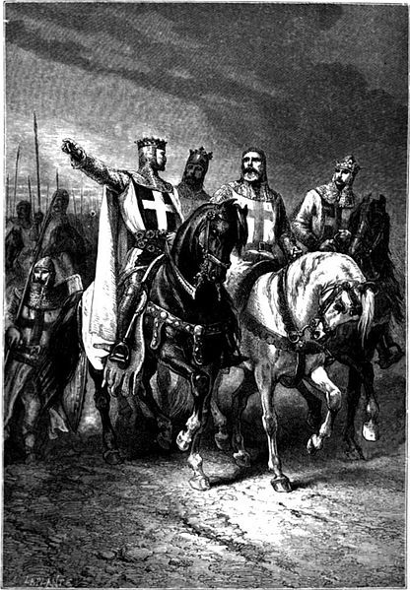

Slide 11
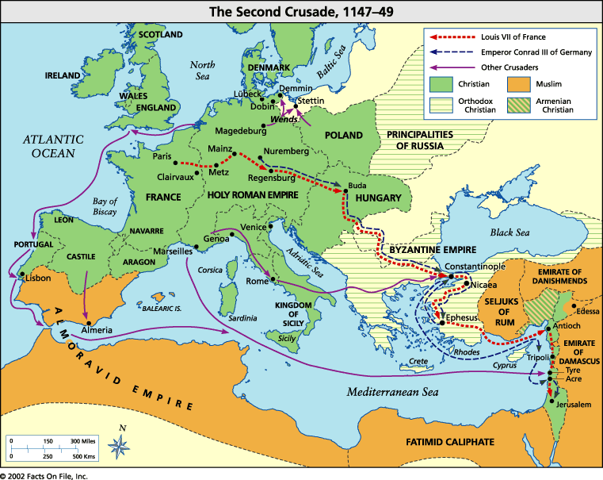

Slide 12
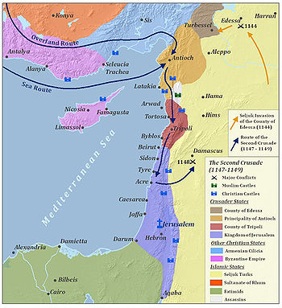
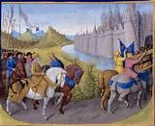
2ND CRUSADE
1147-1149
Latin States

Slide 13
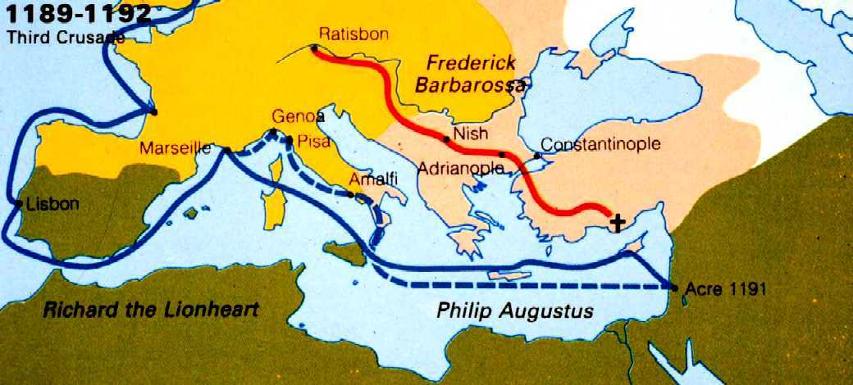
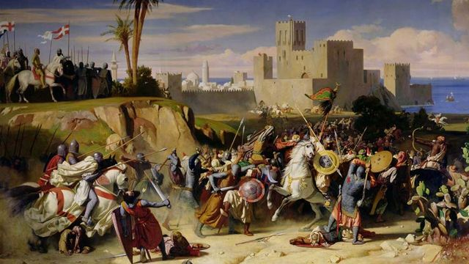
3RD Crusade
1189-1192

Slide 14
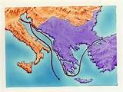
4TH CRUSADE
SACK OF CONSTANTINOPLE
1204

Slide 15
PART 2
Geopolitical Motivations for the Crusades

Slide 16
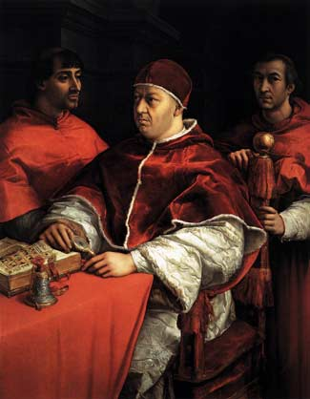
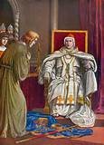
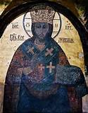
Geopolitical Motivations:
1. Not popular will

Slide 17
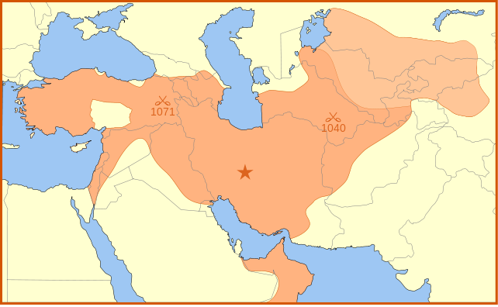
2. Seljuk Turks 1095 pressure Byzantium
Within one generation,
the Turks destroyed the landed wealth
of Byzantium in Asia Minor

Slide 18
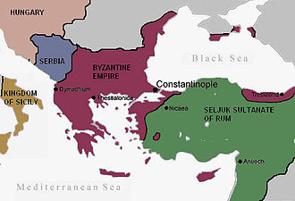
The Byzantine Empire and the Sultanate of Rûm before the First Crusade

Slide 19

3. To end Jewish trading dominance
|------------------------------------------------------------------|-----------------------------------|
750 1000 1095
Majority of Jews
living in Western
Asia under Moslem
rule
Muslims take
Spain
Wave of Jewish immigration
into Europe
Jews monopolize slave trade
from Europe to India/China
via Spain
Majority of Jews
living in Europe
1ST CRUSADE

Slide 20
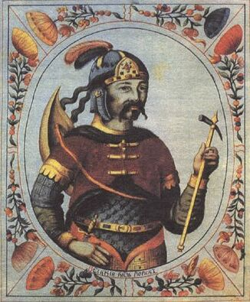
4. Defend Europe from Moslem Invasions
The attack on Rome of 846 is often referred to as the "Arab sack of Rome"

Slide 21
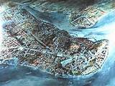
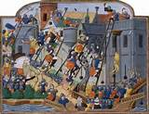
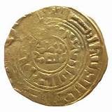
Papal Ambitions
to end Dominance of Basileus

Slide 22
ACHIEVEMENTS OF CRUSADES
MONETARY
REBIRTH
JERUSALEM
FREED FOR
90 YEARS
MOSLEMS
PUSHED OUT
OF SPAIN FOREVER
TRADE LINKS
WITH EAST
OPENED UP
JEWISH INTL
TRADE REDUCED

Slide 23
PART 3
The Jews

Slide 24
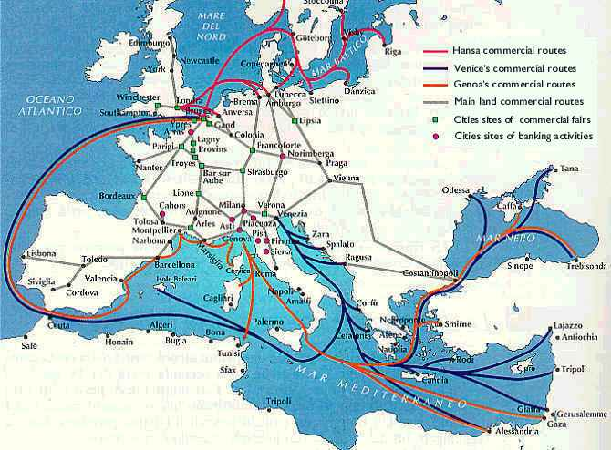
8TH – 11TH CENTURIES – SLAVE TRADE WITH MOSLEMS
Jewish medieval merchants were known as “Radanites.”
They included western European Jews from France and Germany, as well as those from Arab Spain.
The term “Radanites” was derived from the name of the
Arab-Christian border along the river Rhone because of an intense slave trade which was conducted across it.
The slaves were castrated in Verdun, Venice, and Lyon
and sold by Jewish Radanite slave-traders
to the Arabs of Spain.

Slide 25
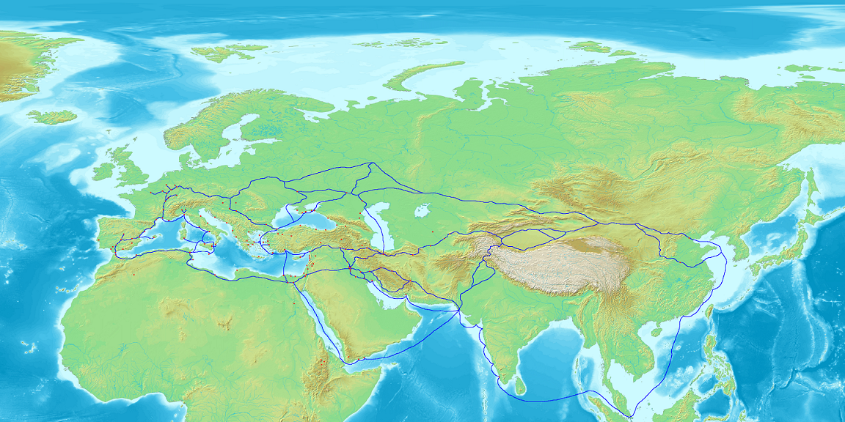
MEDIEVAL JEWISH TRADE ROUTES WITH EAST
All along the Radhanite
trade route were Jewish
culture and the credit
that made trade
possible.
Map of Eurasia showing the trade network of Radhanites, c. 870 CE

Slide 26
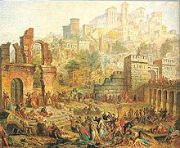
CRUSADERS MASSACRE THE JEWS
In the German city of Trier, the local bishop attempted to protect the Jews. The bishop was still new to the city, however, and did not have the political power necessary to band the town together. In the face of the crusader attack, the local bishop abandoned
his attempt to save the Jews and told them that
“You cannot be saved-your God does not wish to
save you now as he did in earlier day. Behold this
large crowd that stands before the gateway of the
palace”, as well as forcing them to choose between
conversion and removal from his palace.

Slide 27
PART 4
West meets the East

Slide 28
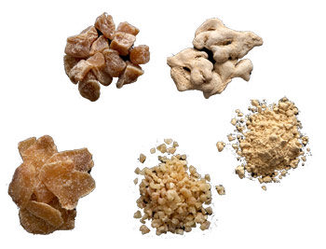
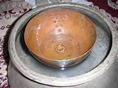
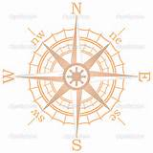
West meets the East: NEWFOUND RICHES
Crusades found natural riches and luxuries
Food products | rice, coffee, sherbet, dates, apricots, lemons, sugar, spices such as ginger, melons, rhubarb and dates.
Household goods | mirrors, carpets, cotton cloth for clothing, ships compasses, writing paper, wheelbarrows, mattresses and shawls.
New ideas | chess, Arabic figures 0 to 9, pain killing drugs, algebra, irrigation, chemistry, the colour scarlet, water wheels and water clocks

Slide 29
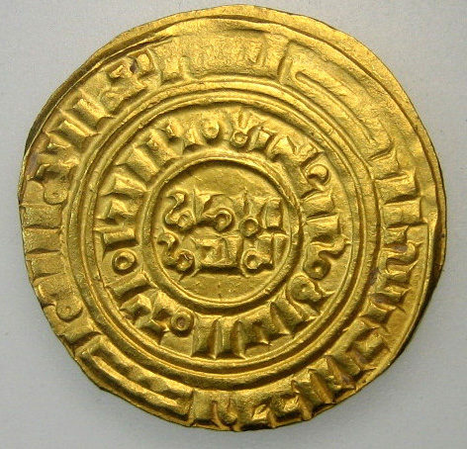
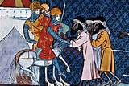
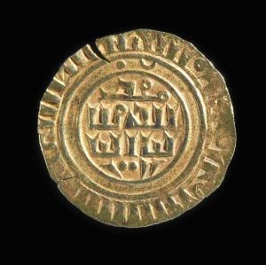
West meets the East: NEWFOUND RICHES
Crusaders traded with East:
A new coin was struck for use in commerce
New gold coinage was minted with Arabic legends.
Trade between Crusaders and Moslems flourished.

Slide 30
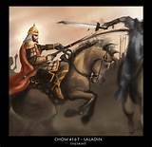
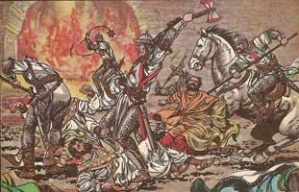
West meets the East: MOSLEM AS HUMANS
Christians treated better by Moslem Foe
SURRENDEN OF JERUSALIM – 1187
Balian (Latin leader) met with Saladin again and the sultan agreed to lower the ransom to ten bezants for men, five for women, and one for children. Balian argued that this would still be too great, and Saladin suggested a ransom of 100,000 bezants for all the inhabitants. Balian thought this was impossible, and Saladin said he would ransom seven thousand people for no lower than 50,000 bezants. Finally, it was decided that Saladin would free the seven thousand for 30,000 bezants; two women or ten children would be permitted to take the place of one man for the same price. Saladin's brother then released another 1,000 people unable to pay and 2,000 more people unable to pay were then released. Saladin then freed all of the elderly unable to pay.
CHRISTIAN KILLING CHRISTIAN.

Slide 31
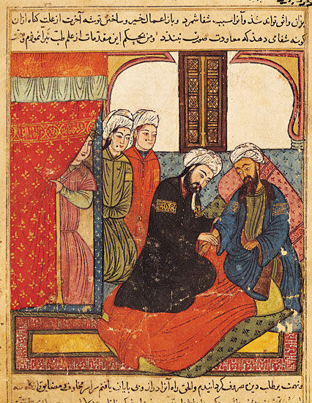
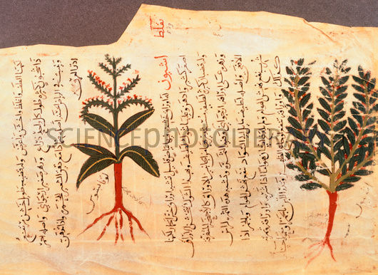
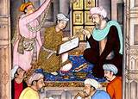
West meets the East: MOSLEM AS HUMANS
Some pilgrims and Crusaders like the ‘Infidels’
The Crusaders seemed crude and uncivilized compared to Moslems. Not ‘evil Saracens’ but Saracens advanced in science and technology.
The Christian crusaders and Moslem defenders intermarried.

Slide 32
PART 5
Sack of Constantinople:
Major World Monetary Event

Slide 33
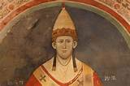
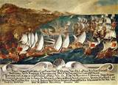
PART 5
Sack of Constantinople: Major World Monetary Event
Secret Alliance of Latin Church and Venetians
Pope Innocent III threatened income
tax on Western Knights if they did not
join the 4th Crusade. Powerful
church groups plotted attack.
Secret plan with Venetians to
take Crusaders to Constantinople
CHRISTIAN KILLING CHRISTIAN.

Slide 34

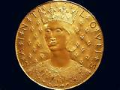
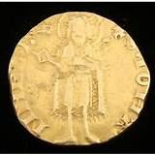
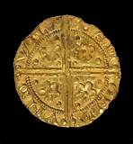
PART 5
Sack of Constantinople: Major World Monetary Event
Monetary System of Caesars Ended!
Frederick II, 1225
Minted gold coin
Lyon, 1225
Republic of Florence,
1250
Louis 9th,
France 1250
Pope John 22,
Avignon, 1316
Henry III,
England, 1257
Venetian Republic,
1284

Slide 35
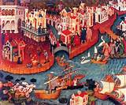
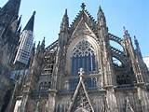
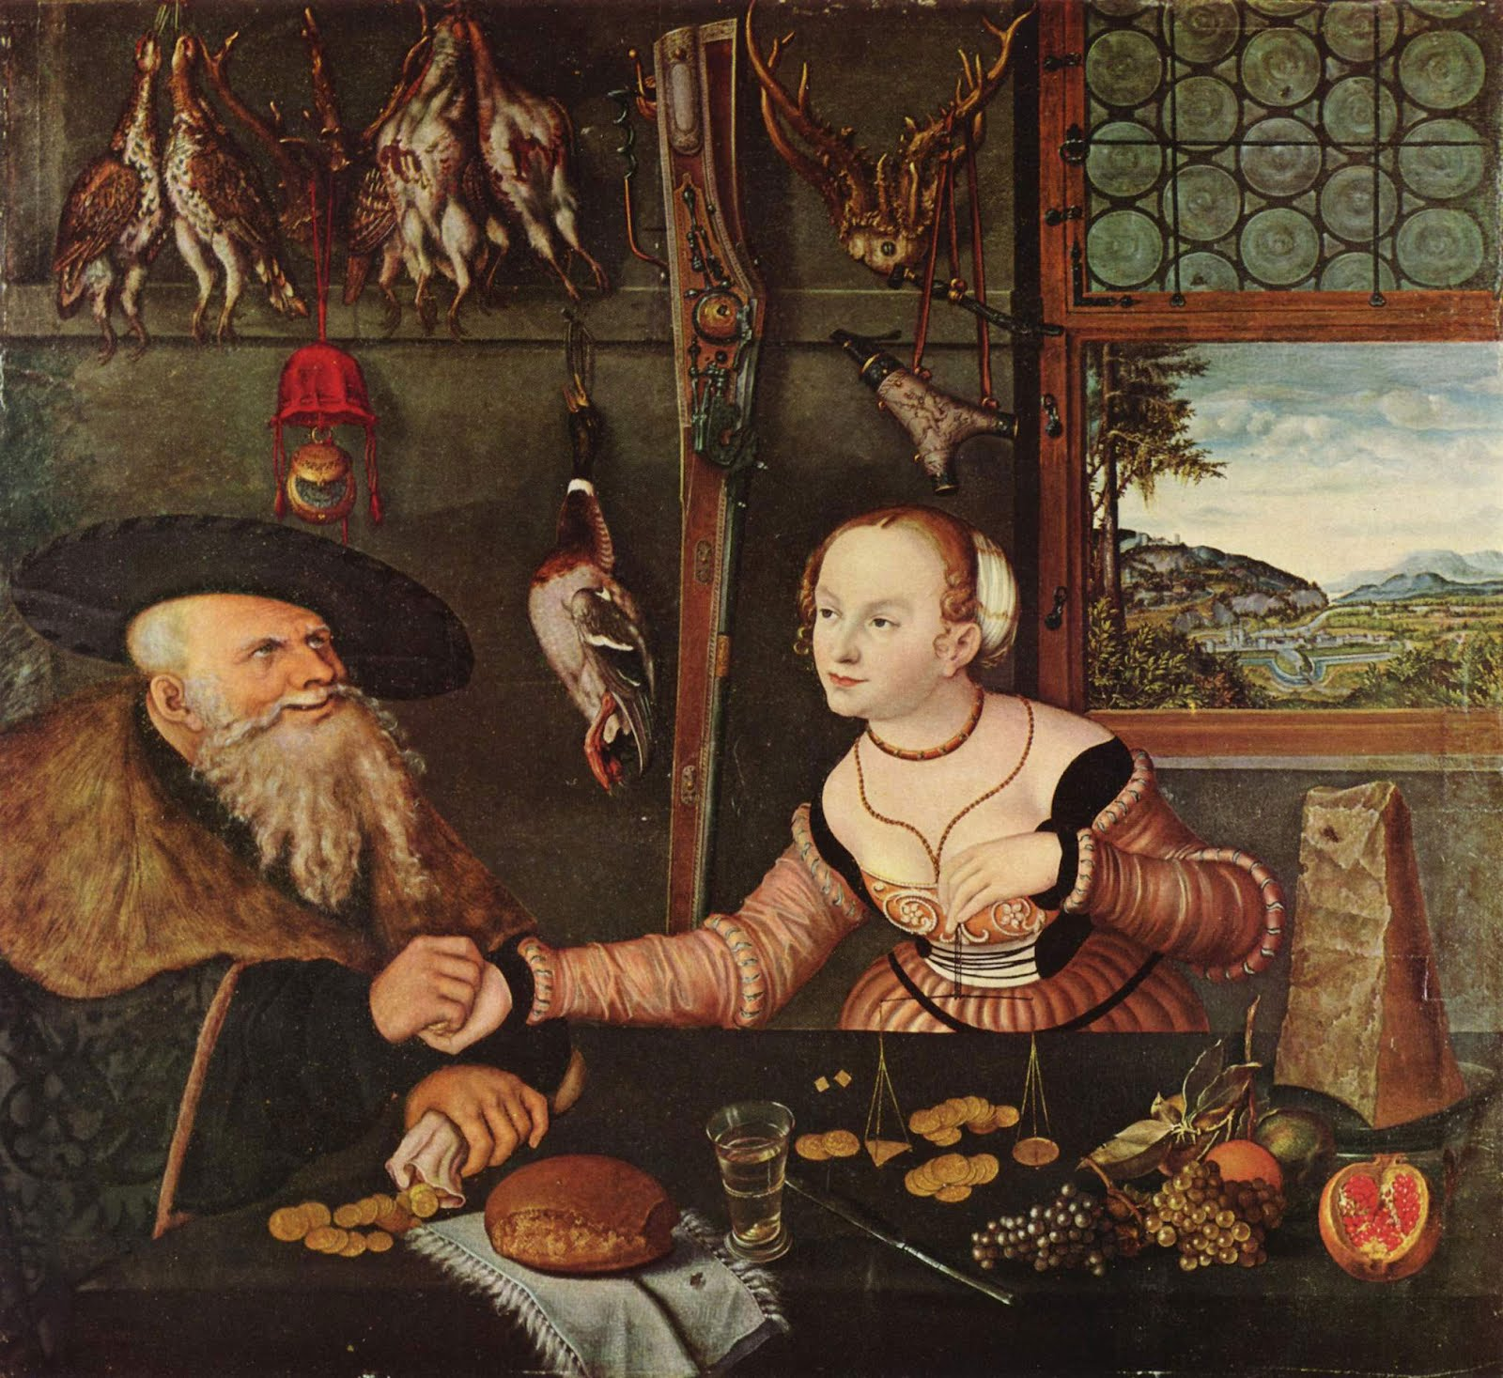
PART 5
Sack of Constantinople: Major World Monetary Event
Return of Metallic Plunder to Europe: Renaissance Possible

Slide 36
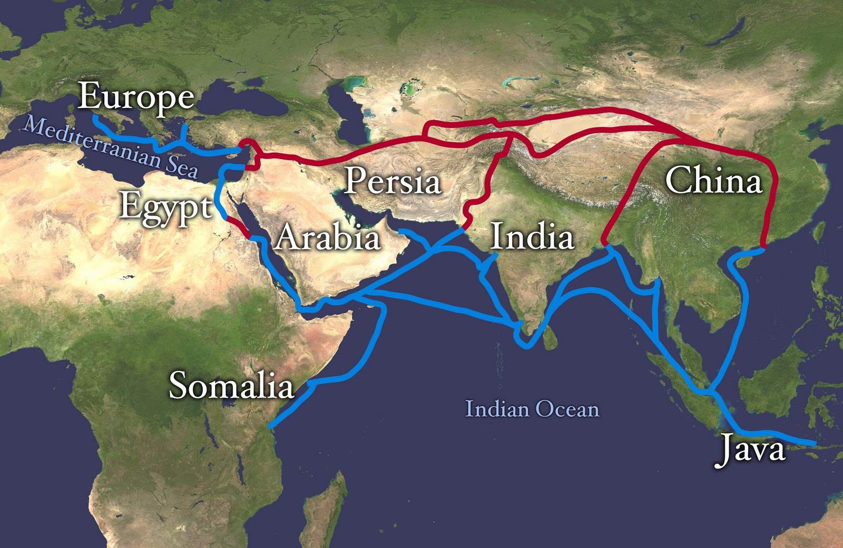
INCREASE IN COMMERCE AND TRADE POSSIBLE

Slide 37
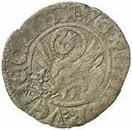
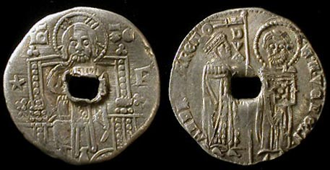
PART 5
Sack of Constantinople: Major World Monetary Event
This critical monetary mass allowed advanced monetary systems:
NOMISMA COULD BE REINTRODUCED
1353, Venetian Colonies
The tornesello was minted in Venice for use in its colonies only.
A mixed copper silver coin, valued at twice its silver content.
1379, Venice
Venice minted an ‘overvalued’ GROSSO coin. Nearly identical to
original GROSSO but with ‘star’. Legally valued
twice the old GROSSO.

Slide 38
PART 6
The Knights Templar

Slide 39

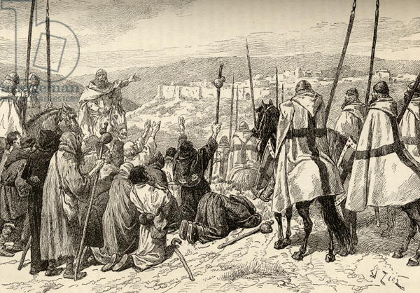
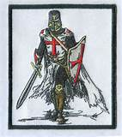
PART 6: Knights Templar
Organized after the 1st Crusade, the Order of the Temple grew by 1150 into an organization that rivalled the Western kings and the Roman Pope!
HOW?
PILGRIMS
UNDER ESCORT

Slide 40
PART 6: Knights Templar
Here is a description of their wealth & power from C.G. Addison, The Knights Templars, 1874 :
Palestine: “almost all Palestine was in the end divided between them and the Hospitallers of Saint John”
castles, houses, fortunes, farms, large tracts of land, towns, cities…..
Spain: endowed with cities, villages, splendid domains; many of the most important fortresses and castles
entrusted to their safekeeping; Sovereigns of Aragon endowed the with 10% of revenue of kingdom,
vast revenue, fortresses, taxes of some towns, privileges, immunities
Portugal: castles, citadels, fortresses, houses with rents, revenues, possessions
Sicily: valuable estates, large tracts of land, windmills, rights of fishery – pasturage – cutting wood in the forests, etc.
Upper and central Italy: numerous headquarters and establishments, convents, houses
Germany and Hungary: houses, headquarters, many fiefs with lands – tithes – large revenue
Greece: houses, establishments, chief house in Constantinople
CONTINUE

Slide 41

PART 6: Knights Templar
CONTINUE
France: preceptories, houses, lands dependent on them – ‘it would be a wearisome and endless task to repeat
the names of them”; same in Holland and Netherland
England: in every county of the realm, numerous preceptories and establishments for management of farms and
lands, collection of rent and tithes; churches, lands, watermills, locks on rivers, manors, farms, chapels,
rents, taxes, right to nominate parish priest (advowson); also in Scotland and Ireland
SUMMARY
Annual Income: 6 million sterling
9,000 manors or lordships
Rights: temples were sanctuaries
Privileges: no taxes, no excommunication
Master of Temple was sovereign prince, subject only to Pope
TEMPLE CHURCH, LONDON

Slide 42


PART 6: First European Bankers
Founders of order were aristocrats: founded by a French nobleman named Hugues de Payen in 1119 in Jerusalem. Hugues de Payen led the original order of nine knights, all nobles.
Order returned from 1st Crusade with knowledge of monetary and financial arts:
banking and credit techniques appear in Europe
TRAVELERS CHECKS TO PILGRIMS

Slide 43




PART 6: First European Bankers
800 castles served as full service banks
    Collected taxes for Crown
    Made loans to monarchs
    Funded wars
    Offered safe deposit boxes
    Practiced usury on loans
    Pawn brokers for wealthy

Slide 44

PART 6: First European Bankers
SAFE DEPOSIT
“Be it known to all that we, James, by the grace of God King of Aragon,
Majorca, and Valencia, Count of Barcelona and Urgel and Lord of
Montpellier… acknowledge that we have received and possess all and every
jewel that we had deposited and put in the safe keeping in the house
of the Temple of Monzon. Wherefore we declare the houses of the
Temple and all brothers freed from all chains from us and ours
concerning all the said jewels.....1240 AD

Slide 45
PART 6: First European Bankers
LOANS
“I, Robert, Count of Artios, declare to all who peruse this present document, that I owe the monk Brother John of Tour, Treasurer of the house of the Knights Templar in Paris, 1,578 livres parisis in respect of a legal loan in cash the said treasury made me for the furtherance of my affairs, of which we have full satisfaction, renouncing the receipt of non-cash property and moneys not yet received. In satisfaction and full payment of this said loan to the said treasurer, free of debts and having full legal rights, I assign specifically and in the name of a special attribution, and herewith ascribe to said treasurer, all and every one of my rents, proceeds and income from my castllary and townships of Domfront – en – Passais, and all their apprentices, i.e. reeveship, woods, waters, pannage, ovens, mills, pastures, hay, hens, capons, wheat and whatever else exists, pertaining to me in any matter in those said places… they shall be had, received, and enjoyed by the said treasurer or his representative annually from now on without break, in full, without any loss or opposition, quit and free, in payment
and discharge to said debt, until by the continuous payment of the rents, proceeds, and income, full and complete satisfaction for the whole of the said debt shall have been made to the said treasurer.”

Slide 46
PART 6: First European Bankers
BANKING HISTORY
“But there should be much more attention paid than there is to their influence on the modern system of banking. The Knights Templar set the bar for the use of safety deposit boxes, loans of great magnitude and travelers checks and bank notes and the efficiency with which these things were accomplished. ”
Webb, Jefferson P., The Order of the Temple: Influences on Modern Banking. Waco,TX: Webb Publishing. 2009

Slide 47

PART 6: First European Bankers
SUCH INCREDIBLE FINANCIAL GROWTH
PROBABLY DUE TO CONTROL OF WEST-EAST TRADE MECHANISM
TRAVELERS CHECKS TO PILGRIMS
SILVER 6:1
SILVER 12:1

Slide 48



PART 6: SUPRESSION OF TEMPLARS, 1307
POLITICAL POWER GREATER THAN MONETARY POWER
FRENCH KING, PHILIP LE BEL –
Owed much money to the Templars
POPE CLEMENT V –
historians say he was a pawn of French King

Slide 49
Q & A

