Slide 1
Chapter 3
A MONETARY VIEW OF
ROME’S DECLINE

Slide 2
LET’S REVIEW THE THEMES OF THIS BOOK
KEEP LSM’S THEMES IN MIND WHEN READING EVERY CHAPTER
Primary importance of the money power
Nature of money purposely kept secret and confused
How a society defines money determines who controls the society
Battle over control of money has raged for millennia: public vs private

Slide 3
TABLE OF CONTENTS
Monetary Mechanisms of Great Antiquity
Overview of Empire’s History and Money
Traditional Causes of Rome’s Decline
LSM’s Interpretation of the Empire’s Decline
What we can learn from Roman History

Slide 4
1.
Monetary Mechanisms of Great Antiquity

Slide 5
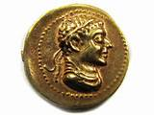
MONETARY MECHANISMS OF GREAT ANTIQUITY
#1 Sacred Gold Coinage Prerogative
#2 Difference in Gold/silver Ratio between West and East
12:1
6:1
WEST
EAST

Slide 6
#1
Sacred Gold Coinage Prerogative

Slide 7
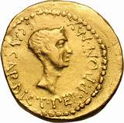
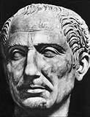
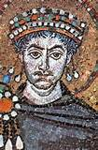
Sacred Gold Coinage Prerogative: Coining gold was EXCLUSIVE PREROGATIVE of the supreme religious sovereign – infringement met with death or warfare
Roman Caesars as Pontifex Maximus
(46 BC – 284 AD, PRINCIPATE, sole ruler)
Byzantine Roman Emperors as Basileus
(284 – 1204 AD)

Slide 8
Sacred Gold Coinage Prerogative: Sign of ultimate authority
Local rulers could mint only silver coins
Official ratio was 12:1 -- from Caesar until sack of Constantinople, 1204
12:1
WEST

Slide 9
Sacred Gold Coinage Prerogative
Institutional/legal nature of money

Slide 10
#2
Difference in Gold/silver Ratio
between West and East

Slide 11
Difference in Gold/Silver Ratio (WEST & EAST)
Western owners of trade mechanism gained vast wealth:
12:1
6:1
SILVER to EAST
WEST
EAST
100% more gold returned

Slide 12
Difference in Gold/Silver Ratio (WEST & EAST)
Eastern owners of trade mechanism gained vast wealth:
12:1
GOLD TO WEST
6:1
WEST
EAST
100% more silver returned

Slide 13
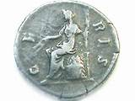
Difference in Gold/Silver Ratio (WEST & EAST)
East and West shared ownership of trade mechanism gained vast wealth:
12:1
6:1
9:1
GOLD
SILVER
WEST
EAST
SILVER DRAINS EAST
GOLD TO WEST
more gold
more silver

Slide 14
Difference in Gold/Silver Ratio (WEST & EAST)
WHO WERE THE OWNERS OF THE MECHANISM?
323 BC ALEXANDER THE GREAT (Asia Minor, Egypt, India)
305 BC PTOLEMAIC EGYPT (Arabian caravan trade to India)
69 BC JEWISH DIASPORA - OVERLAND BY PALMYRA
(shares Egypt-India trade)
63 BC POMPEY CREATES ROMAN PROVINCE, Judaea
48 BC ROME TAKES EGYPT (EGYPT-INDIA trade)
70 AD 1st Jewish revolt
AD 2nd Jewish revolt
306 AD BASILEUS IN CONSTANTINOPLE
695 AD MOSLEM TAKES OVER (EGYPT-INDIA trade)

Slide 15
Difference in Gold/Silver Ratio (WEST & EAST)
WHO MAINTAINED THE RATIO?
DEL MAR: PRIESTHOOD
IN EAST
BRAHMA
BUDDHA
CYRUS
DARIUS
TIGLATH
NEBU MAZARU
OSIRIS

Slide 16
Difference in Gold/Silver Ratio (WEST & EAST)
HEART OF THE POWER OF BASILEUS:
Exchanges gold for locally minted silver.
Sends silver to India for 100% more gold.

Slide 17
2.
OVERVIEW OF THE EMPIRE’S HISTORY AND MONEY

Slide 18
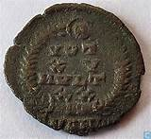
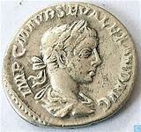
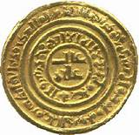
ALEXANDER DEL MAR HISTORY OF MONEY IN ANCIENT COUNTRIES, p. 314
…the science of numismatics … has to deal with the law (nomos);
it relates … to monuments of legal institutions, whose establishment, growth, and decay, have never failed to keep even pace with the other phases and marks of national civilizations; it thus holds the key to the study of these civilizations…

Slide 19
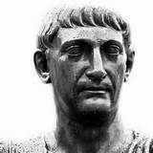
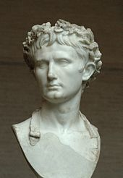
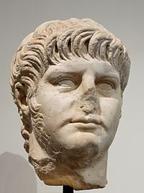
GOVERNMENT OF EMPIRE
PRINCIPATE (sole ruler)
--------------|----|-----|-------------------|---|-----------------------------------|----|------|---|-----------|
46 27 0 14 54 68 115 117 132 135 235
27 BC - 14 AD
Reign of Augustus
54 – 68 AD
Reign of Nero
115 – 117 2ND Roman-Jewish War
132 – 135 3rd Roman-Jewish War
JULIUS
CAESAR,
DICTATOR,
AT END OF
REPUBLIC,
PONTIFEX-
MAXIMUS
Founder of Roman Empire
first emperor, careful to maintain
the facade of republican rule
concentrated pre-existing powers
of Roman magistrates
Negotiated peace with
Parthian Empire
1st Roman-Jewish War

Slide 20
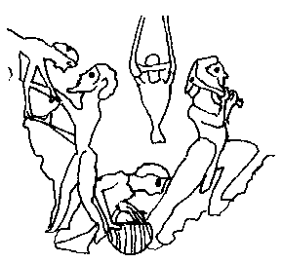
MONEY OF EMPIRE: PRINCIPATE (sole ruler)
--------------|----|-------------------|-----|---|----------------|------------------------------------------------|
46 31 0 41 54 68 100 235
46 BC +
CHANGE IN MONETARY SYSTEM:
Gold made legal tender;
mines under state control.
Copper mines privatized.
41 AD +
Gold, silver, bronze money valued as commodity
Copper sesterces fabricated until 268 AD. Legal tender.
Value never fluctuated in denarii or aureii.
Gold and silver become scarce: mines not producing;
no more plunder
slaves worked to death
GOLD
INFLATION==➔
DEBASED GOLD & SILVER COINS ===➔
SILVER DRAINS EAST
DEFLATION ===============➔
31 BC – 41 AD Augustus’ money -- mixed system:
Gold harder to find – placer gold exhausted:
Bronze sesterces, overvalued & made legal
tender, ex senator consulto. Dominant money.
Copper numerary system of BC 385-269 but no
limit on volume.
Emperor coins gold and silver independently from Senate. Commodity money.
100 AD +
Practice of debasing gold & silver coins
becomes common
Copper mines show signs of exhaustion

Slide 21
GOVERNMENT OF EMPIRE
PRINCIPATE (sole ruler)
--------------------------------|-----------------------------|---|---------|------------------
-------------------------------------------235----------------------------------271--274---------284-----------------------
235 – 284 AD
CRISIS OF 3RD CENTURY
Roman Empire nearly
collapsed under the
combined pressures of
invasion, civil war, plague,
and economic depression.
20–25 claimants to the title
of Emperor assumed imperial
power over all or part
of the Empire
271-274 AD
Reign of Aurelian
His successes effectively ended the Roman Empire's Crisis of the Third Century:
defeated the Alamanni, Goths, Vandals, Juthungi, Sarmatians, Carpi, Palmyrene Empire, Gallic Empire.

Slide 22
--------------------------------|-----------------------------|---|---------|------------------
-------------------------------------------235----------------------------------271--274---------284-----------------------
MONEY OF EMPIRE: PRINCIPATE (sole ruler)
SILVER DRAINS EAST
DEFLATION ====================➔
DEBASED GOLD & SILVER COINS ===➔
MONEYERS REVOLT
235 – 284 AD
CRISIS OF 3RD CENTURY
271-274 AD
Reign of Aurelian
Aurelius fought ‘Moneyers’ in Rome
During the Julio-Claudian dynasty, the Denarius contained approximately 4 grams of silver, and continued to shrink in size and purity, until by the second half of the third century, it was only about 2% silver.

Slide 23
270 – 274 AD REVOLT OF MONEYERS
The Moneyers had coined base money (the bulk of which was copper) for 50 years. They stole silver and produce coins of inferior quality.
Aurelian (reign AD 270 – 274) crushed them with a war in Rome that killed 7 thousand of his battle hardened soldiers.
The Moneyers were supplying circulating medium for the ‘world’, not just Rome. They removed themselves to provinces. The evils of an unlimited and continually debased coinage were no longer to be remedied.
Gibbon: secret conspiracy of Senate, wealthy Equestrians, arms of Praetorian Guard

Slide 24
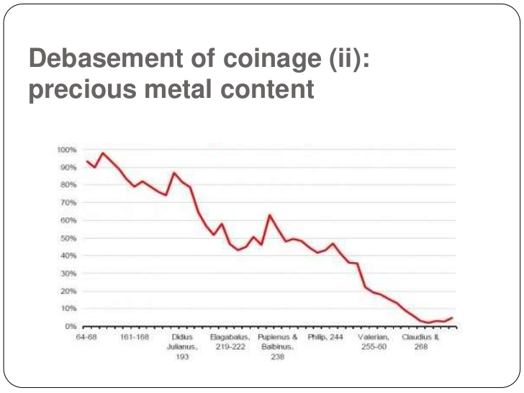
MONEY OF EMPIRE
http://www.slideshare.net/woodjamie/the-third-century-crisis

Slide 25
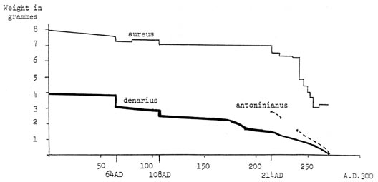
MONEY OF EMPIRE
For the antoninianus and the denarius the actual weight of silver
content is shown not the weight of the coin.
http://www.accla.org/actaaccla/kramer.html

Slide 26
MONEY OF EMPIRE
https://www.startpage.com/do/search

Slide 27
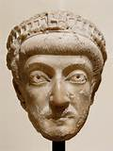
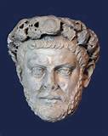
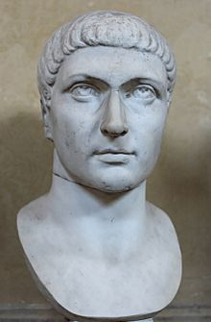
GOVERNMENT OF EMPIRE
DOMINATE (co-rulers)
|-------------------------------------------------------------------------------------------------------|
284 – 305 306 - 337 379 - 395
Openly displayed the naked face of Imperial power.
They ceased using the more modest title of princeps;
they adopted the veneration of the potentates
of ancient Egypt and Persia
Reign of
Diocletian
Reign of
Constantine
Reign of
Theodosius
established Christianity
as the state religion
Upon his death, his sons
proclaimed Emperors
in separate Eastern and
Western Empires.
increase of authority
in person of Emperor
Co-rulers
Adopted Christianity
Moved capital to
Constantinople
Council of Nicaea: Nicene Creed

Slide 28
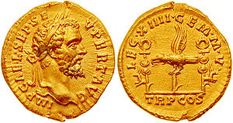
MONEY OF EMPIRE
DOMINATE (co-rulers)
|-------------------------------------------------------------------------------------------------------|
284 – 305 306 - 337 379 - 395
SILVER DRAINS EAST
DEFLATION =======================➔
300 AD +
Scarcity of copper
known to be
irremediable
The first "bezants" were the Byzantine solidi coins,
minted at a constant weight and purity
since the time of Constatine I (died 337)
until the mid-11th century.
The sovereign-pontiff
alone enjoyed the prerogative of
coining gold throughout the Empire,
and that the princes of the Empire
respected this prerogative.

Slide 29
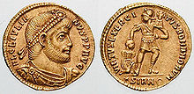
Alexander Del Mar A HISTORY OF MONETARY SYSTEMS, P 40
|--------------------------------------------------------------------------------------------------------------------------------------------------------------|
306 - 337 1204
“From the second coinage of Constantine to the fall of the Empire, a period of nearly 900 years, the aureus was seldom degraded, and but once debased; it never ceased to be regarded as money… they passed … by tale, and … it was unlawful to refuse, criminal to alter, and death to deface them or to reduce them to bullion.”

Slide 30
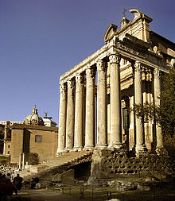
PAGAN RELIGION AND THE EMPIRE
The Sacred College and Pontifex Maximus – pagan ecclesiastical corporation with origin traced back to mythical Numa
Construction and repair of all public works claimed for pagan church
Ecclesiastical power commonly manifested in fines and penalties, and occasionally in trials for heresy
With the downfall of the republic’s liberties, limits to authority of church swept away
Power in sovereign-pontiff (Caesar)
Vast number of temples, edifices, landed estates
Numerous benefices
Vast wealth of church
Support derived from taxation
Widespread belief in tenets, myths, superstitions, rites, festivals, sacrifices, miracles, auguries, oracles relics
Exempt from military service, civic duties, taxation
Absolute power over education of youth

Slide 31
PAGAN RELIGION TO CHRISTIANITY
“During the three centuries which elapsed between the establishment of the hierarchy and the reign of Aurelian, the pagan church had acquired, through testamentary gifts, etc., a large proportion of all the private estates embraced in the empire.
Theodosius granted the ecclesiastical estates and living of the church to incumbents of the true faith. Such of the bishops and priests as had not embraced Christianity (for many of the latter had done so already) were expelled from their offices and replaced by others.”
Alexander Del Mar, THE MIDDLE AGES REVISITED, p 110.

Slide 32
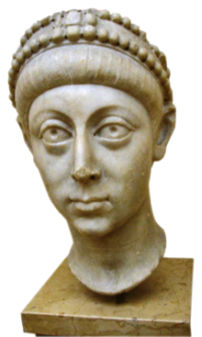
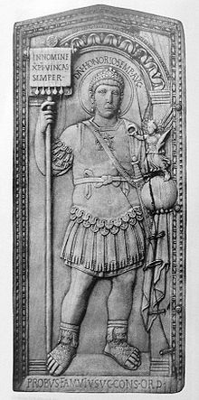
GOVERNMENT OF EMPIRE
5TH C: FRAGMENTING & COLLAPSE OF
WESTERN ROMAN EMPIRE
|-------------------------------------------------------------------------------------------------------|
395 480
Separate
Empires
with own
emperors
End of Western Roman Empire:
first non-Roman emperor
recognizes Byzantine Emperor
as sole emperor of unitary
empire.
WEST
EAST

Slide 33
MONEY OF EMPIRE
5TH C: FRAGMENTING & COLLAPSE OF
WESTERN ROMAN EMPIRE
|-------------------------------------------------------------------------------------------------------|
395 480
SILVER DRAINS EAST
DEFLATION =======================➔
400 AD +
Scarcity of copper known to be irremediable

Slide 34
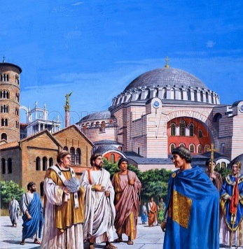
GOVERNMENT OF EMPIRE
BYZANTINE ROMAN EMPIRE (10 centuries)
|---------------------|------------------------------------------|-----------------------------------------------|
480 610 1204 1453
One emperor ruling
from Constantinople:
474 - 491
Reign of Zeno
Eastern emperor took Greek
title of basileus.
610-641
Reign of Herakleios
Constantinople sacked
End of Eastern Roman Empire:
Capture of Constantinople
by the Ottoman Empire
ONE EMPIRE: BYZANTINE ROMAN EMPIRE
maintaining claim to the increasingly
unstable territories in the west.
multiple claims to the imperial title meant civil war

Slide 35
MONEY OF EMPIRE
BYZANTINE ROMAN EMPIRE (10 centuries)
|-------------------610----------------------------------------1204-------------------------------------------|
480 1453
SILVER DRAINS EAST
DEFLATION =======================➔
“From the second coinage of Constantine
to the fall of the Empire, a period of nearly
900 years, the aureus was seldom degraded…
it was unlawful to refuse, criminal to alter,
and death to deface them or to reduce them to bullion.”
Constantinople sacked:
money sovereignty
overturned.

Slide 36
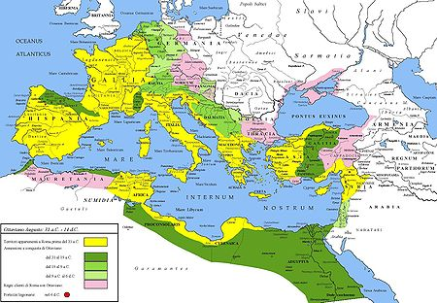
Yellow - extent of Republic in 31 BC
Green - conquered territories by Augustus
Pink - Client states
Extent of Roman Empire under Augustus
Reign: 27 BC – 14 AD

Slide 37
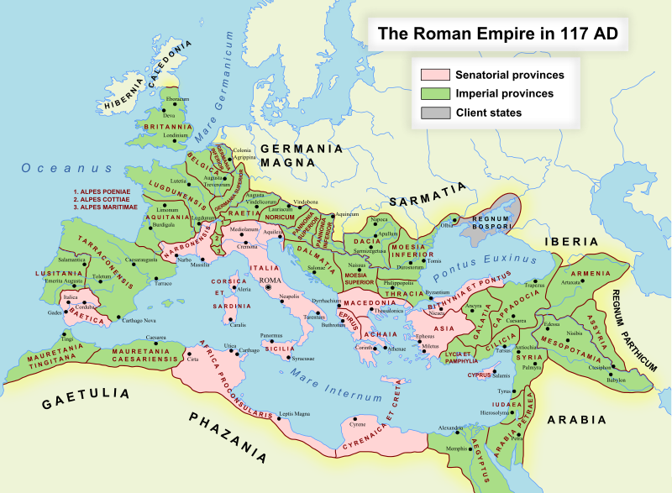
ROMAN PROVINCES
Achaea
Aegyptus
Africa
Alpes Cottiae
Alpes Maritimae
Alpes Poeninae
Arabia Petraea
Armenia
Asia
Assyria
Bithynia et Pontus
Britannia
Cappadocia
Cilicia
Corsica et Sardinia
Creta et Cyrenaica
Cyprus
Dacia
Dalmatia
Epirus
Galatia
Gallia Aquitania
Gallia Belgica
Gallia
Lugdunensis
Gallia
Narbonensis
Germania Inferior
Germania Superior
Hispania Baetica
Hispania
Tarraconensis
Italia
JUDAEA
Lusitania
Lycia et
Pamphylia
Macedonia
Mauretania Caesariensis
Mauretania Tingitana
Mesopotamia
Moesia Inferior
Moesia Superior
Noricum
Pannonia
Inferior
Pannonia
Superior
Raetia
Sicilia
Syria
Thracia
JUDAEA

Slide 38
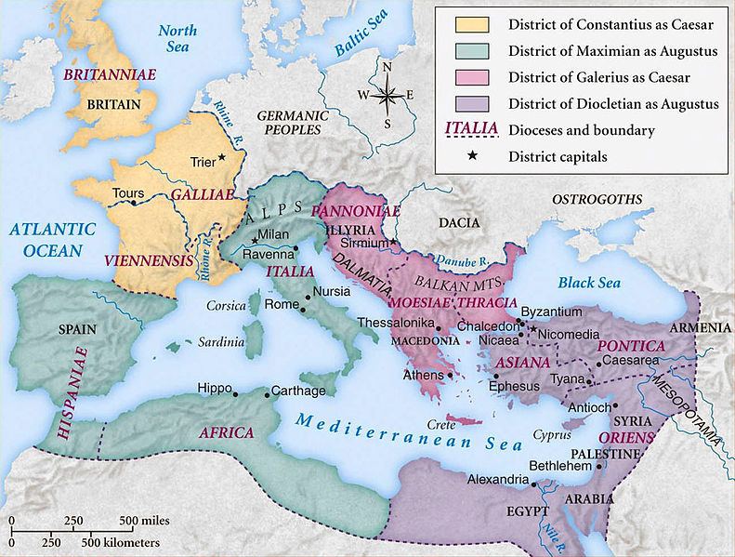
Map of the Roman Empire
under the tetrarchy
(instituted by Diocletian in 293),
showing the dioceses and the
four tetrarchs' zones of influence.
ROMAN EMPIRE IN 293 AD: 4 TETRARCHS

Slide 39
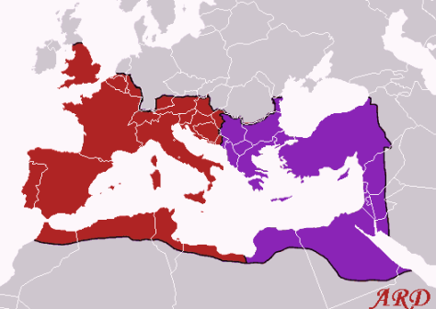
Death of Theodosius in 395
split Roman Empire in two:
his two sons separately
became emperors of
Western Roman Empire
and Eastern Roman Empire.
Roman Empire in 395:
Western Empire Eastern Empire

Slide 40
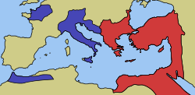
480 AD: One emperor ruled
one Byzantine Roman Empire
from Constantinople.
The Western and Eastern Roman Empires by 476

Slide 41
3.
TRADITIONAL CAUSES OF ROME’S DECLINE

Slide 42
TRADITIONAL CAUSES OF ROME’S DECLINE:
CAN’T TALK ABOUT MONETARY SYSTEM AS CAUSE….
THAT WOULD EXPOSE TODAY’S SYSTEM….
FALL OF ROMAN REPUBLIC’S
FIAT MONEY SYSTEM
PRIVATE Federal Reserve Bank:
COMMODITY MONEY
NEW YORK FEDERAL
RESERVE BANK
PRIVATE member commercial banks:
GOLDMAN SACHS
BANK OF
AMERICA
CITIGROUP
J.P.MORGAN
CHASE
DEUTSCHE BANK
HSBC
UBS
CONCENTRATION OF WEALTH
ETC.

Slide 43
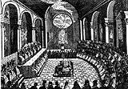
TRADITIONAL CAUSES OF ROME’S DECLINE: 1. CHRISTIANITY
The church glorified poverty and celibracy
Other worldly attitude
But Rome influenced Christianity – 325 AD Council of Nicaea called
by Constantine and declares Jesus a God

Slide 44
TRADITIONAL CAUSES OF ROME’S DECLINE: 2. BARBARIANS
Not enough invaders
Del Mar: monks invented to cover up role of church
Roman church estates survived and prospered as self-sufficient units

Slide 45
TRADITIONAL CAUSES OF ROME’S DECLINE: 3. GROWING SLAVERY
Average Roman citizen: penury, taxes, service in the army
Land held by rich and run by slaves instead of freemen
Lightest slavery category were citizens compelled to work out a debt or ransom – isn’t this today’s plight of ordinary man!
Worst slavery category were the serfs – but even here the serfs were not made landless or homeless – what about the homeless of today?

Slide 46
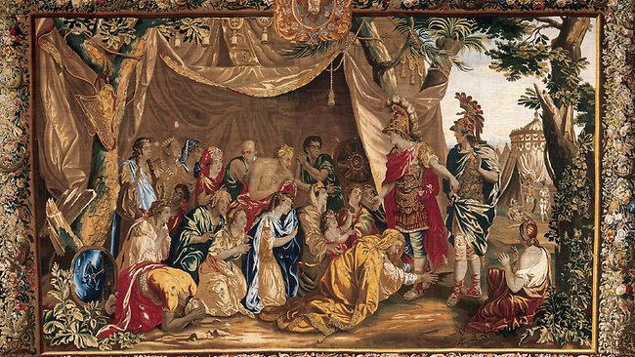
TRADITIONAL CAUSES OF ROME’S DECLINE: 4. ORIENTAL SATRAPY DESOLVED INTO FEUDALISM
Alexander the Great adopted Oriental kingship concepts – for example, all approached on one knee to the king
Alexander the Great adopted the rule of vassal states:
Local vassals governed independent fiefdoms, i.e. King Herod of Judaea
Local vassals had unlimited power as long as payments flowed to Rome
Local law was not Roman
Local people’s allegiance was to vassal, not Rome
Theory: over time this devolved into feudal structure

Slide 47
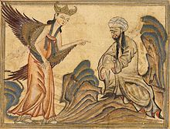
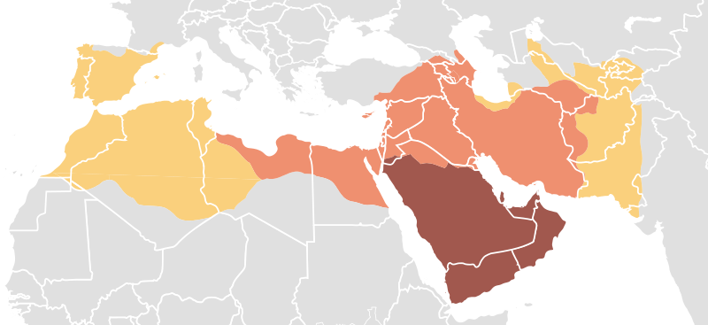
TRADITIONAL CAUSES OF ROME’S DECLINE: 5. MOSLEMS
Muhammed lived 570 – 630 AD
Moslem army conquered from 638 – 711 AD
Timing wrong: Rome’s decline a fact already
711
638
651
709
651
638 – 711 AD
The Muslim armies in the space of a
hundred years were able to establish
The largest pre-modern empire until that time.

Slide 48
4. LSM’S INTERPRETATION OF THE ROMAN EMPIRE’S DECLINE

Slide 49
ALEXANDER DEL MAR A HISTORY OF MONEY IN ANCIENT COUNTRIES

Slide 50
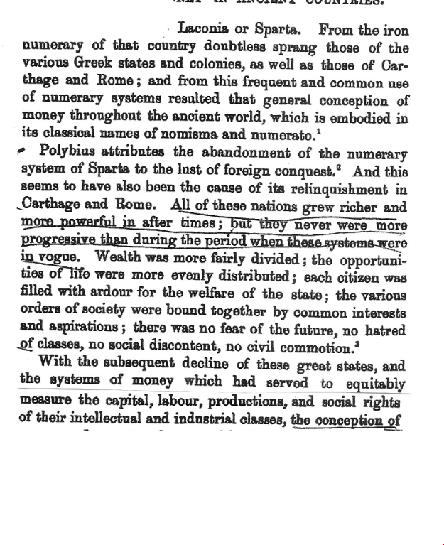

Slide 51
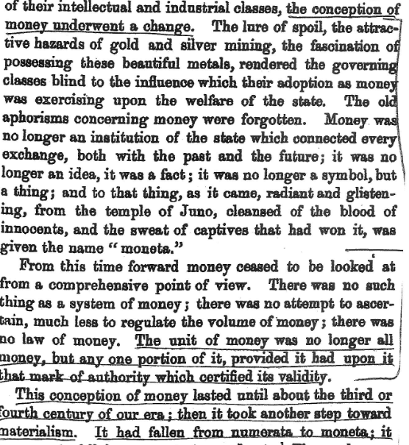

Slide 52
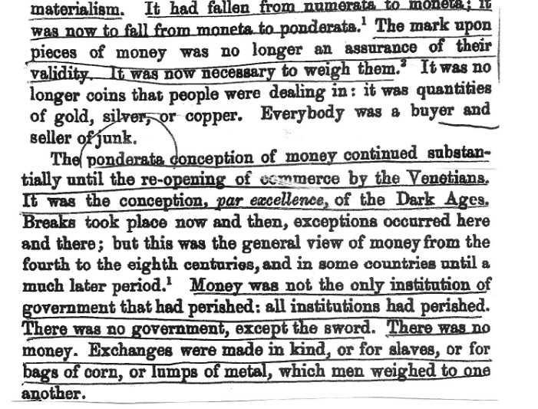

Slide 53
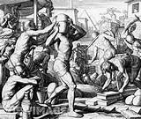
1. THE TRUE DECLINE WAS THE REPUBLICAN DECLINE
The society lost control of its money system in the Punic Wars.
With the growth of latifundia was the destruction of Roman Law.
Growth of concentration of wealth
Slaves replaced citizens

Slide 54
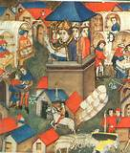
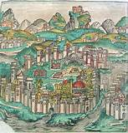
2. EMPIRE’S DECLINE FROM CONSTANTINE’S REFORMS
DEFLATION: Diminished supply of precious metals
Commerce and industry stagnated
Large sailing vessels disappeared
Arts and sciences lost
Wealth concentrated into church and small elite
Absence of legal money diminished rule of law

Slide 55
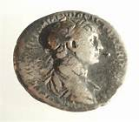
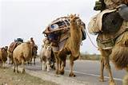
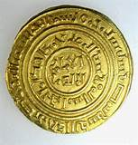
3. INADEQUATE SUPPLY OF MONEY WAS MAJOR FACTOR IN EMPIRE’S DECLINE
2 monetary mechanisms created DEFLATION
only Basileus coined gold – without debasement
gold concentrated into church and elites
local princes coined silver, which drained to East
no new mines of gold and silver and copper
normal erosion of coinage thru usage
MAJOR MONETARY ERROR
MONEY NOT BASED IN LAW
BUT
COMMODITY, RIGIDLY CONTROLLED

Slide 56
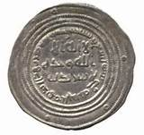
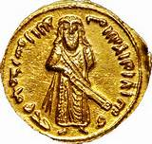
4. MOSLEM MONETARY ATTACK ON PRECIOUS METALS RATIO
695 AD Abd El Melik – coins ‘Bezant’ gold with his image and
with ratio of 7:1
Moslem 7:1 ratio was an attack against Constantinople’s
12:1 ratio:
Byzantinum soon stopped minting silver and
forbade trade with the Moslems
The only economic link between Byzantinum and the
Moslems were Jews, then Venice after 800 BC

Slide 57
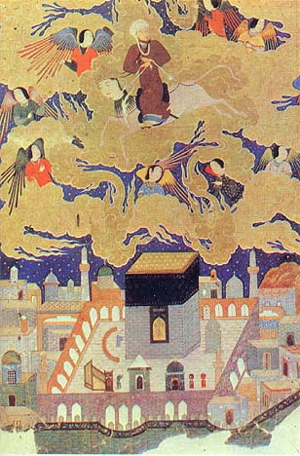
4. MOSLEM MONETARY ATTACK ON PRECIOUS METALS RATIO
Muhammed had taught the legal, abstract nature of money: that overvalued bronze money was the same as gold and silver
Moslems used the law (and their enforcement power) to keep a high value of abundant silver coins (the Moslems plundered 20 times more silver than gold)
Spanish Empire (1493 – 1690) set their silver value high also by law (their ratio was set to 13-15: 1)
The Eastern temples could monetize their abundant gold
Mohammed flying over Mecca,
at the beginning of his “Night Journey.”
Currently in the British Museum.

Slide 58
5.
WHAT WE CAN LEARN FROM ROMAN HISTORY

Slide 59
SOCIAL JUSTICE
GOVERNMENT ESTABLISHES MONEY BASED ON LAW:
CONTROL OF MONEY IN SOVEREIGN GOVERNMENT
ECONOMISTS TODAY IGNORE THE LAW
AND SOVEREIGN’S POWER TO ENFORCE THE LAW

Slide 60
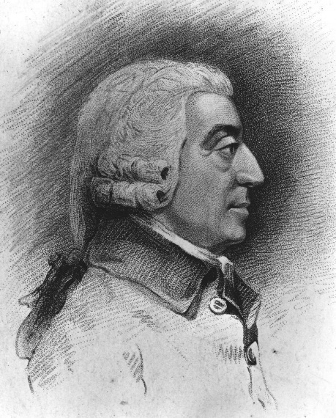
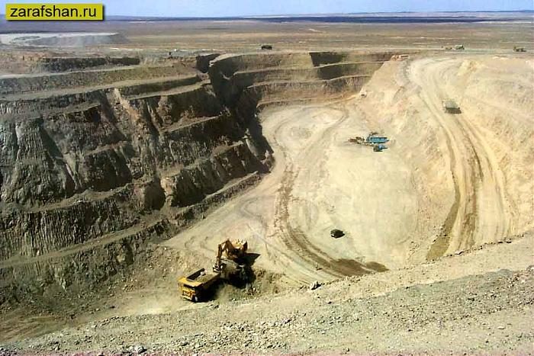
SOCIAL JUSTICE
HISTORY OF RATIO CHALLENGED ADAM SMITH’S
LAW OF SUPPLY AND DEMAND
ECONOMISTS TODAY SAY VALUE OF GOLD & SILVER
BASED ON COSTS OF MINING
AND SUPPLY AND DEMAND

Slide 61
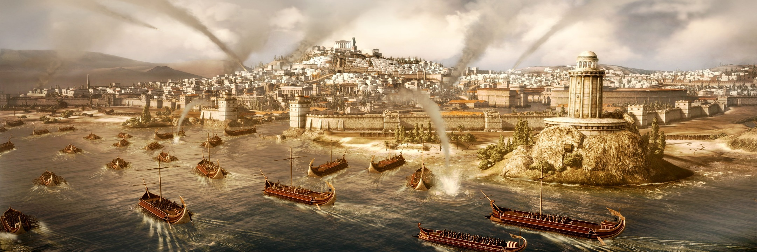
SOCIAL JUSTICE
MAJOR WARFARE CAN CAUSE LAWFUL MONEY
TO DEGENERATE TO COMMODITY MONEY
THIRD PUNIC WAR
CONCENTRATION OF WEALTH
LOSS OF SOCIAL JUSTICE

Slide 62
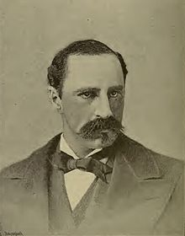
WITH MONEY BASED ON LAW
COMES SOCIAL JUSTICE
Alexander Del Mar
Monetary Historian
“History records no such disastrous transition as that from the Roman
Empire to the Dark Ages. Various explanations have been given of
this entire breaking down of the framework of society, but it was certainly coincident with a shrinkage in the volume of money, which was
also without historical parallel.
The crumbling of institutions kept even step and pace with the shrinkage in the stock of money and the falling of prices. All other attendant circumstances than these last have occurred in other historical periods unaccompanied and unfollowed by any such mighty disasters.
It is a suggestive coincidence that the first glimmer of light only came with the invention of bills of exchange and paper substitutes, through which the scanty stock of the precious metals was increased in efficiency.”
From the Silver Commission of 1876

Slide 63
THE DELIBERATE NATURE OF THE ‘MONEY POWER’

Slide 64
THE MANIPULATION OF MONEY BY THE ‘MONEY INTERESTS’
CONTINUED FROM THE EARLIEST PERIODS OF HISTORY
“Whenever and wherever the mutterings of discontent were hushed by
the fear of increased standing armies, the foundations of society were
honeycombed by powerful secret political associations. The cause at
work to produce this state of things was so subtle, and its advance so
silent, that the masses were entirely ignorant of its nature. They had
come to regard money as an institution fixed and immovable in value,
and when the price of property and the wages of labor fell, they charged
the fault, not to the money, but to the property and the employer.
They were taught that the mischief was the result of overproduction.
Never having observed that overproduction was complained of only
when the money stock was decreasing, their prejudices were aroused
against labor saving machinery. They were angered at capital, be-
cause it either declined altogether to embark in industrial enterprises
or would only embark in them upon the condition of employing labor
at the most scanty remuneration. They forgot that falling prices compelled capital to avoid such enterprises on any other condition, and for
the most part to avoid them entirely.
They did not comprehend that money in shrinking volume was the prolific parent of enforced idleness and poverty, and that falling prices divorced money, capital, and labor, but they none the less felt the paralyzing pressure of the shrinking metallic shroud that was closing around industry.
Alexander Del Mar
Monetary Historian
From the Silver Commission of 1876

Slide 65
THE END

