Slide 1
MONEY SYSTEMS & ROMAN HISTORY
WITH SPECIAL FOCUS ON THE
BRONZE FIAT MONEY OF THE ROMAN REPUBLIC

Slide 2
LET’S REVIEW THE THEMES OF THIS BOOK
KEEP LSM’S THEMES IN MIND WHEN READING EVERY CHAPTER
Primary importance of the money power
Nature of money purposely kept secret and confused
How a society defines money determines who controls the society
Battle over control of money has raged for millennia: public vs private

Slide 3
ANCIENT ROMAN TIMELINE
|_____________| |____________________________| |___|___________|_____|_______________|____|
753 510 27 0 330 385 1204 1453
KINGDOM
REPUBLIC
EMPIRE
KINGDOM
717-673 reign of King Numa – 2nd king (8th century)
578-534 reign of King Tullius – 6th king (6th century)
REPUBLIC
385 – 263 Unification of Italian peninsula
264 – 241 First Punic War
218 – 201 Second Punic War
264 - 27 Growth of wealth and power in plutocracy
Annexation of provinces
Growth of latifundia
EMPIRE – AUGUSTUS FIRST EMPEROR
27 – 476 Western Roman Empire
330 – 1204 Eastern Roman (Byzantine) Empire - to sack of Constantinople by Crusaders
1453 Fall of Constantinople to Ottoman Empire

Slide 4
ROMAN KINGDOM

Slide 5
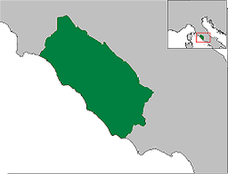
Roman Kingdom 753-510 BC
Rome had 7 kings.
2nd King Numa Pompilius 8th Century: reign: 717-673 BC
6th King Servius Tullius 6th Century: reign: 578-534 BC

Slide 6
KING NUMA

Slide 7
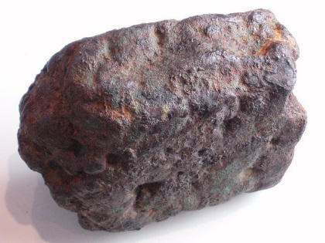
BEFORE KING NUMA…
Before NUMA:
metal lumps of bronze called Aes rude were
traded by weight
(Aes = bronze)
AES RUDE

Slide 8
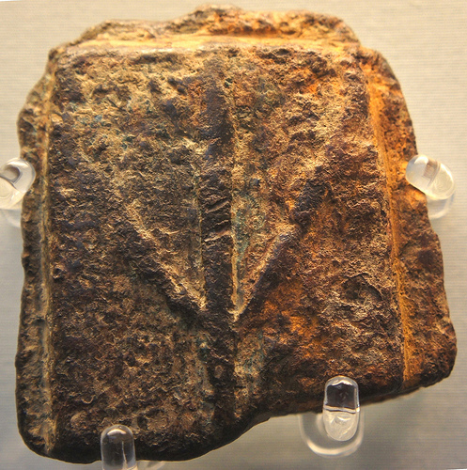
KING NUMA’S Monetary Decision! Monetize Bronze – NOT Gold or Silver
Plutarch’s Lives: “Numa was descended of the Sabines, who declared themselves to be a colony of the Lacedaemonians (Spartans).” Lycurgus of Sparta lived prior to Numa. Plutarch chose to make Numa and Lycurgus parallel lives.
Numa began casting of rough bronze bars and created monetary unit:
nomisma (nummi) = 2 ½ pounds of bronze = 2 ½ Aes
Monetization of bronze bars indicates
some state control
A leap from using unworked bronze to casting
bronze bars with a recognisable design
CAST BRONZE BAR

Slide 9
KING NUMA’S Monetary Decision! Monetize Bronze – NOT Gold or Silver
Consequences of making bronze the only legal tender:
Disenfranchise gold and silver of Eastern temples and merchants
Gold limited to jewelry and payment in foreign trade

Slide 10
KING SERVIUS

Slide 11
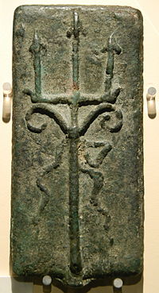
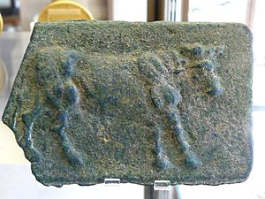
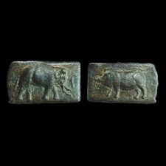
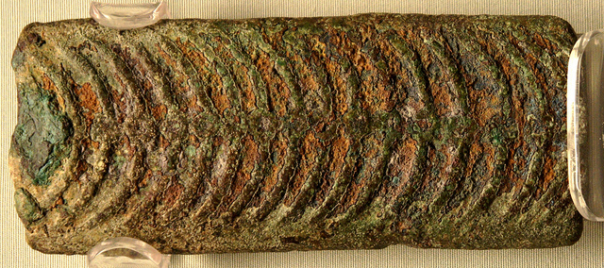
KING SERVIUS TULLIUS Commodity Bronze Money
bronze bars cast in more pure form – Aes Signatum (=“stamped bronze”)
became legal tender in Rome
circulated in peninsula
Aes Signatum

Slide 12
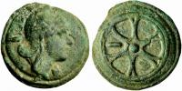
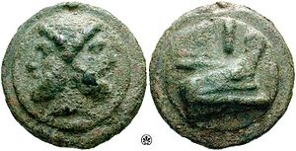
KING SERVIUS TULLIUS Bronze Monetized by First Census
BC 554 – first census – Servius required everyone to
contribute a certain coin per head, men paying
one kind, women another, and children yet another….
The census payments were bars or smaller, more coin-like forms –
their weight was either:
1 Aes = 1 pound of copper
or 1 nummus = 2 ½ Aes = 2 ½ pounds of copper
Aes Signatum
Aes Grave

Slide 13
ROMAN REPUBLIC

Slide 14
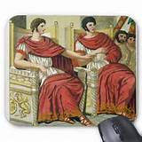
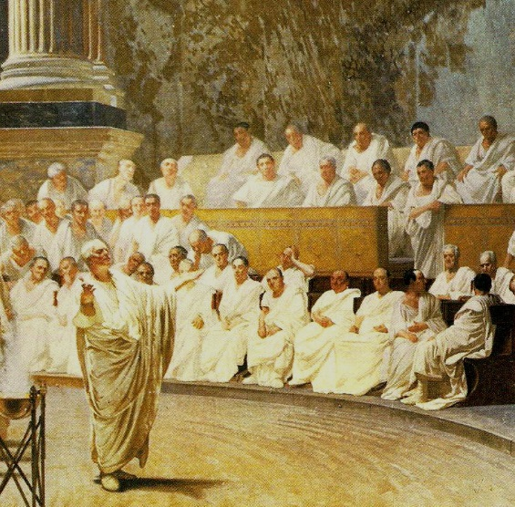
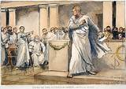
ROMAN REPUBLIC 509 BC–27 BC
CONSULS
SENATE
TRIBUNE
Government headed by two consuls, elected annually by citizens and advised by a senate.
494 BC a struggle took place during which the lower class plebs seceded from the city. The secession led to a negotiated settlement with the upper class patricians, and as a result the plebeians were given increased rights including the right to elect their own magistrates, named tribunes.
A constitution centered on the principles of separation of powers and checks and balances.

Slide 15
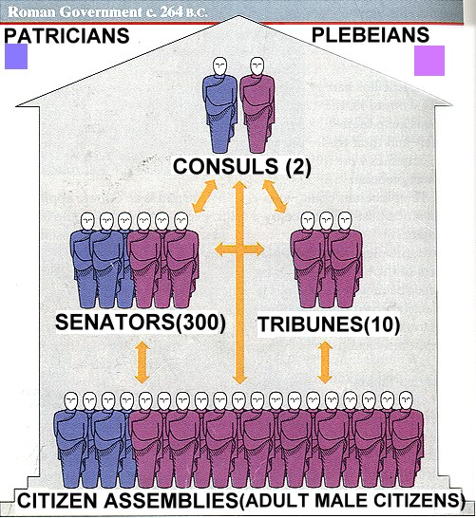
264 BC ROMAN GOVERNMENT

Slide 16
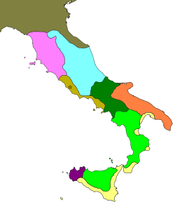
400 BC - Italy
prior to unification of the
Italian peninsula.
NOTE:
In 406 BC, marked bronze pieces
were the only legal tender
Celts
Etrurians
Umbrians
Samnites
ROMAN REPUBLIC
Messapes and Apulians
Various Italians
Carthagians
Greeks

Slide 17
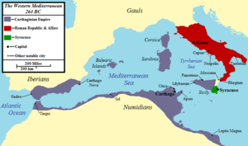
ROMAN REPUBLIC
264 BC - Italy
after unification of the
Italian peninsula and
prior to Punic Wars.

Slide 18
REPUBLIC’S MONEY SYSTEM

Slide 19
Question - When did fiat system start?
385 BC – Gaulish invasion sacks Rome
The invasion caused Romans to change many particulars of policy.
Among these would very likely have been the system of money…. Servian system of money terminated.

Slide 20
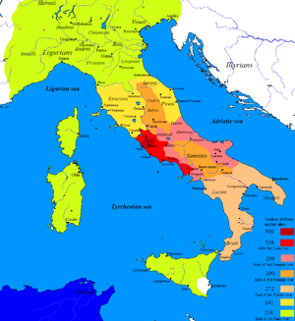
338 – 266 BC UNIFICATION OF ITALIAN PENINSULA INTO A COMMONWEALTH
Roman struck copper coins = nummus = 2 ½ Ases by law
and nummi’s value became several multiples
of its bronze content value
Gold and silver money of other tribes disappeared
Roman copper money with Roman weights and
measures took their place

Slide 21
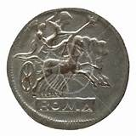
338 – 266 BC UNIFICATION OF ITALIAN PENINSULA INTO A COMMONWEALTH
BULLION SILVER COINS MINTED
During political and military unification of peninsula,
silver bullion coins were minted by Rome, but not
circulated in the city.
Not part of regular monetary system
No value markings
Circulated in southern regions.
Used with ‘foreigners’
ROMANO COIN
ROMA COIN

Slide 22
MONEY SYSTEM, BC 385-207 BRONZE NOMISMA: Fiat Money – Valued by Law
The details of this extraordinary money system are lost.
Decrees of the Roman Senate were recorded in the Treasury.
Its records, however, have perished.

Slide 23
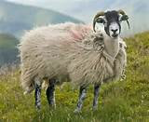
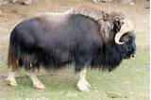
Question - Where did fiat system come from?
454 BC - Roman ambassadors sent to Athens to study the laws of Solon and Greek political institutions
They must have been appraised of the Greek system of money which provided numeraries for home use, and the precious metals for foreign service. One of Solon’s contributions to Athenian law was a provision that made animals legal tender.
454 BC – the Roman Lex Aternia Tarpia monetized cattle and sheep, which could be tendered directly for fines.
1 sheep = 10 Aces
1 ox = 100 Aces

Slide 24
OVERVIEW: BC 385-207 BRONZE NOMISMA
The Republic’s money system was abstract and legal:
tale of money overvalued copper content
Monopolization of fabrication of money by government:
monetary system of Rome consisted of copper nummi, formerly known as Ases
Specific limitation of emissions:
senate limited the whole number of nummi
Only one kind of money for all purposes:
nummi were full and exclusive legal tender for all purposes
Peculiarity of material for fabrication: COPPER
Means taken to secure against counterfeiting: STRUCK NOT CAST PIECES
USED MECHANICAL EXCELLENCE – HIGH ART
SEVERE PENALTIES IN LAW

Slide 25
PROOF FOR THE EXISTENCE OF THE FIAT SYSTEM

Slide 26
DEL MAR’S SUPPORT FOR EXISTENCE OF A REPUBLIC FIAT MONEY
The following are the 19 reasons
Alexander Del Mar gave to support
the existence of this fiat money of the Roman Republic.
A HISTORY OF MONEY IN ANCIENT COUNTRIES
FROM THE EARLIEST TIMES TO THE PRESENT, 1885

Slide 27
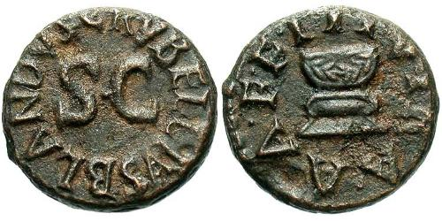
MONOPOLY, RESTRICTED EMISSION, AND OVERVALUATION OF BRONZE PIECES
1
Fabrication of pieces monopolized by state. All stamped S.C. meaning Ex senatus consulto – by decree of the Senate. To the end of the Empire, the Senate was in charge of this coinage.
Pieces were uniform design and executed with much art and mechanical skill. These facts point to monopoly and limitation of the coinage.
We are informed different pieces were fabricated in each district or colony, and were distinguished from others by peculiar mint marks and kept in each place. Such control and restriction would not have been necessary with a commodity system.

Slide 28
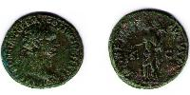
ABSENCE OF COMPLAINTS ABOUT REPEATED REDUCTIONS
2
The copper As was reduced many times, yet nowhere in Roman history do there appear any complaints.
Not a problem with a numerical, fiat system. For an intrinsic, commodity system, this would have caused great consequences.

Slide 29
Unrestricted private coinage of silver and gold (by gentes?)
3
Not legal tender. Coined 269 BC and 207 BC.
Used to reward soldiers of gentes in armies of republic.
Not permitted to form part of monetary system of republic. Copper As accepted as fiat money besides unrestrained emissions (of gentes?)

Slide 30
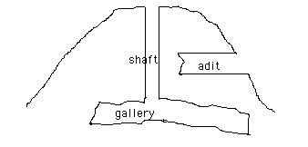
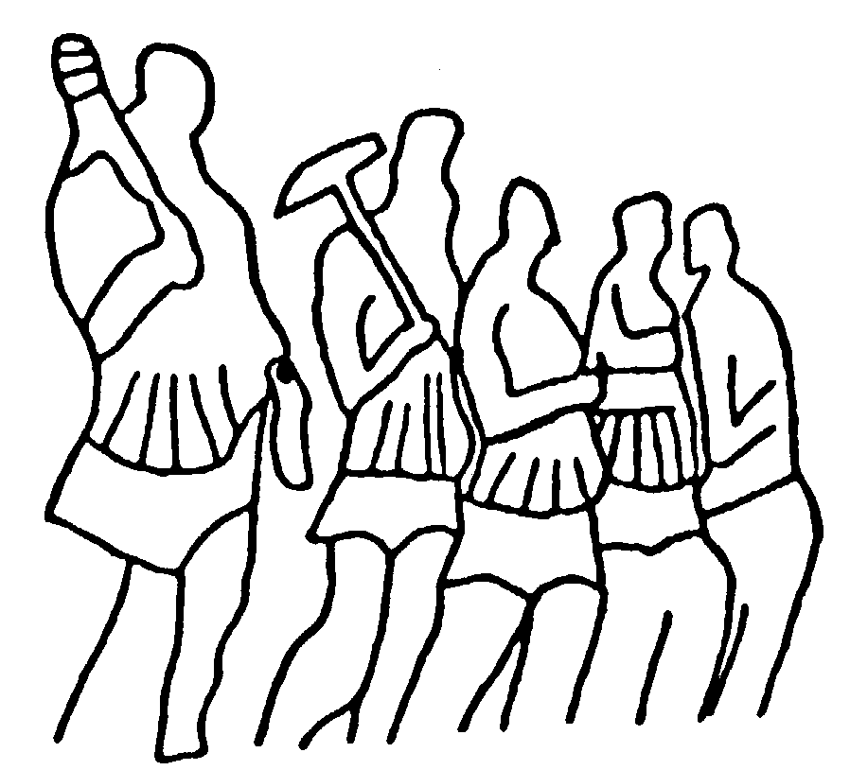
Monopoly of copper mines by the state.
4
No mining was permitted to private individuals. Mines were under the sole control of the state.

Slide 31
Restrictions upon commerce in copper.
5
It appears from a passage in Cicero that the Romans were not unfamiliar with the policy of restricting the commerce in the substances of which the symbols of money were composed. (Orat. Pro L. Flacco, cap. 28)
It is therefore not improbable, though we are without any positive evidence on this point, that they restricted the commerce of copper during the consular republic and the prevalence of the numerical system of money.

Slide 32
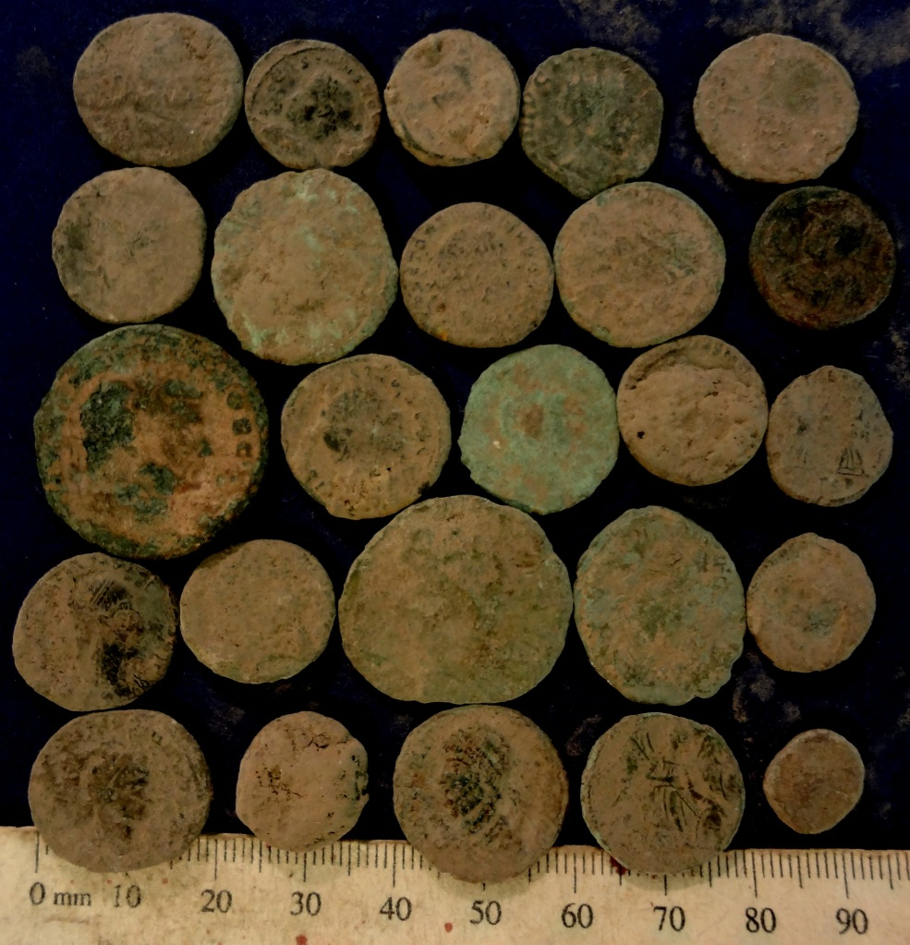
Variety of qualities of copper employed in fabricating the pieces.
6
Assays of the coins still extant show that
the material of which the various copper
coins of this period were made was
different. These inferences and facts
are fatal to the theory of a commodity
or “intrinsic” system of money.

Slide 33
Lack of uniformity in the weights of the pieces.
7
It is essential to all “intrinsic”
or commodity systems of
money that every piece of
like nominal value shall be
of the same weight and
fineness of metal or other material.

Slide 34
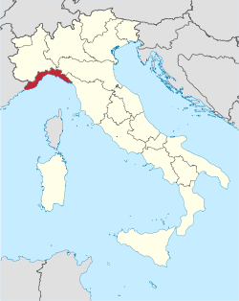
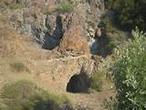
Abundance and cheapness of copper metal.
8
Copper was abundantly produced in various parts of Italy, in Campania, Tuscany, and Sicily, and many of the mines worked at that period, at first by the Etruscans, and afterwards by the Romans, remain productive at the present day (1885).
Copper thus would be unfit for commodity money, since Rome did not exercise substantial control over it.
Monte Loreto in the Liguria region of Italy are some of the earliest known copper mines in Europe

Slide 35
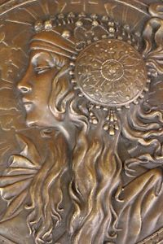
Plentifulness of copper implements and utensils.
9
Had the monetary system been “intrinsic” an enormous mass of copper or bronze would have stood ready at all times for conversion into money, and this fact endangers the steadiness of prices.
Del Mar – “The usual material for the fabrication of weapons, tools, implements, utensils, and works of art, was copper or bronze.
Roman Girl Bronze Sculpture

Slide 36
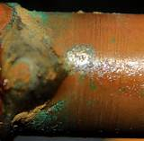
Inferiority of copper for commodity money.
10
Copper:
* corrodes
* plentiful
* difficult to protect from counterfeiting

Slide 37
Amplitude of gold and silver supplies.
11
If Romans wanted a commodity system, it would be gold & silver.
Rome possessed considerable quantity of precious metals: in public treasury, commercial payments to foreign merchants, religious purposes, for use of soldiers. These coins were not money, but merchandise.
Rome was not destitute of gold and silver mines.
Rome traded with Greece, Carthage, and the Gauls – all of whom had silver or gold.

Slide 38
Preposterous relation of copper to silver.
12
Market ratio of copper to silver in Rome was 140:1,
Not 720:1 as deduced from text of Pliny.
If copper coins were intrinsic, it must be believed that Sicilian mint would exchange a pound of silver for 140 pounds copper, but Roman mint – not 300 miles away – was willing to pay 720 pounds of copper for it.

Slide 39
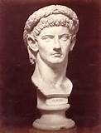
Difficulty in accounting for the subsequent operations of Caligula, reign AD 37-41.
13
Nummi was overvalued in Caligula’s time.
He was the first to break through emission restrictions of Senate and monopolize the nummi himself and proceed to coin them as rapidly as possible.
If nummi was overvalued in Caligula’s time, this supports that nummi overvalued in prior times – during Commonwealth when power of Senate to keep emissions within specific limit was greater.

Slide 40
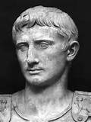
Incredibility of prices and sums mentioned in ancient authors.
14
Translating sums and prices in Roman history as a commodity money, makes them too large. Not reconcilable with truth.
Example: “Augustus is said to have received by the testaments of his friends 32,291,666 British pounds.”

Slide 41
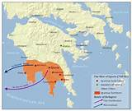
The example of other states.
15
Monetary systems of numerical character had been tried in several of the states with which Rome was connected through commerce, notably in Greece and Carthage.
The Romans adopted the Greek name for money; they called it nummus, after the Greek nomisma. They would have understood the significance of this term.
SPARTA

Slide 42
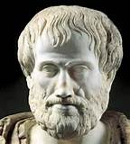
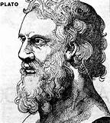
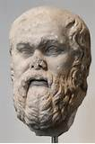
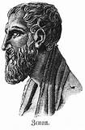
The advice of publicists.
16
Socrates, Plato, Aristotle, Zeno, and other great teachers of philosophy and politics, had all written of numerical systems of money, and the most revered of them all had recommended such a system for his Ideal Republic.

Slide 43
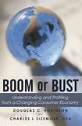
Extreme danger of a commodity system at this period.
17
An enemy could quietly withdraw the precious metal in circulation, or quietly add illegally fabricated coins to the circulation, to alter the entire relations of society.

Slide 44
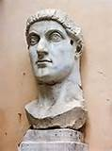
Allusions to a numerical system in the Corpus Juris Civilis
18
Julius Paulus, 3rd century AD:
“A device was chosen, whose legal and permanent value remedied the difficulties of barter. This device being officially promulgated, circulated and maintained its purchasing power, not so much from its substance, as from its quantity. “

Slide 45
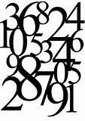
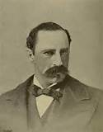
The terminology of money.
19
The generic name for money during the Servian period was aes, referring to the principal material of which money was composed. During the Commonwealth its name was nummus, which as plainly refers to its numerical character.

Slide 46
ROMAN REPUBLIC
AND
THE PUNIC WARS

Slide 47
264 BC
AT THE OUTBREAK
OF THE FIRST PUNIC WAR
CIRCULATION OF SILVER BULLION COINS –
NOT LEGAL TENDER
269 – 250 BC 1 silver coin = 10 ases
250 – 216 BC 1 silver coin = 16 ases
ROMAN REPUBLIC
CARTHAGE
SYRACUSE

Slide 48
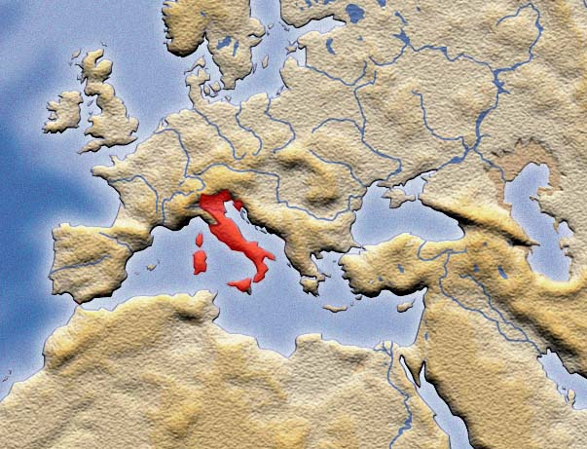
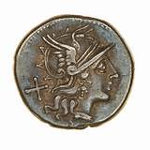
218 BC
AT THE OUTBREAK
OF THE SECOND PUNIC WAR
Silver Denarius Coined
As Legal Tender
Marked value of 10 Ases
Silver seterce @ 4 to denarius =
2 ½ As
Existing bronze coins linked
to silver denarius

Slide 49
218 BC
Silver Denarius valued by law –
but issue not limited
When introduced, silver denarius Aes coin contained
1/72 of a pound of silver but was valued at 10 Ases.
A two ounce bronze coin was valued at 1 Aes
(12 ounces bronze)
However, over time, the issues of the silver coins
were unlimited. Over time, they were reduced to
their commodity value, and Rome lost control of
its money system.
After 150 BC, little bronze coinage issued
SILVER DENARIUS
SILVER SESTERCE

Slide 50
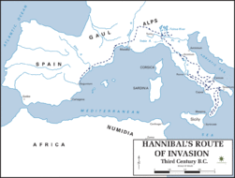
HANNIBAL’S INVASION
AT THE OUTBREAK
OF THE SECOND PUNIC WAR
FIRST GOLD COINAGE
218 BC –Rome borrowed gold jewelry from its citizens and used 4,000 pounds of treasury gold to mint first gold coinages
204 BC – Eastern cult into Rome

Slide 51
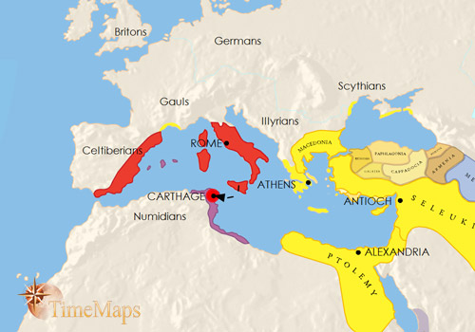
201 BC
AT END OF PUNIC WARS
Conquests
Syracuse - 211 BC Carthaginian Spain - 206 BC

Slide 52
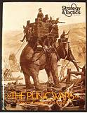
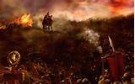
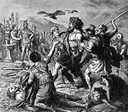
264 – 201 BC: PUNIC WARS
Growing concentration of wealth and power in plutocracy.
Profits from first Punic War 264-241 BC, with commodity money:
old aristocracy and new capitalists rule with wealth.
Plutocracy financed second Punic War 218-201 BC: “contractors commanded sufficient reserves to make deliveries to Roman Government on credit from 215 BC onwards” (war funded by government debt)

Slide 53
ROMAN REPUBLIC
AFTER THE PUNIC WARS

Slide 54
201 – 27 BC
Conquests
Macedonia - 148 BC Greece - 146 BC Carthage - 146 BC Inheritance of kingdom of Pergamum
- 133 BC (129 BC) Illyricum - 129 BC Balearic Islands - 123 BC Gallia (SOUTHERN) - 121 BC Cilicia (south ASIA MINOR) - 102 BC

Slide 55
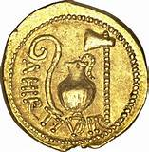
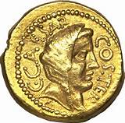
201 – 27 BC
END OF ROME’S MONETARY ISOLATION:
COMMODITY MONEY SYSTEM
Silver issues ignore limitation of issue.
Silver coins would eventually have a commodity-based market value.
157 BC + substantial amounts of silver coined
150 BC + little bronze coinage
Lost control to temple establishments and associated private merchants
who controlled commodities.
46 BC – Caesar coined gold aureus with unlimited issue
Gold became sole standard of value
Silver and copper became qualified tenders
GOLD AUREUS COINS
OF JULIUS CAESAR

Slide 56
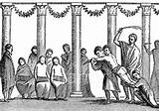
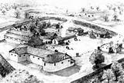
201 – 27 BC
LATER ROMAN REPUBLIC: The Rise of Latifundia –
Money liquidity converted to permanent land holdings
The first latifundia were accumulated from the spoils of war, confiscated from conquered peoples beginning in the early 2nd century BC.
Pliny the Elder (died AD 79) – was distressed as he travelled, seeing only slaves working the land, not the sturdy Roman farmers who had been the backbone of the Republic's army.

Slide 57
201 – 27 BC
LATER ROMAN REPUBLIC: The Rise of Latifundia –
Money liquidity converted to permanent land holdings
Plutarch reported the first outbreak of civil strife
in Rome was the assassination of Tiberius Gracchus
and his supporters – 133 BC.
Tiberius and his brother Gaius (killed over the
same issue a decade hence) were land
reformers. Tiberius passed a law to take back
illegally occupied lands and distribute them to
landless Romans.
Perhaps a monetary reform would have paved
the way for the land reform.
TIBERIUS GRACCHUS,
TRIBUNE AND LAND REFORMER

Slide 58
44 BC Roman provinces at the assassination of Julius Caesar

Slide 59
EASTERN CULTS – DESTRUCTION OF ROMAN ETHOS
James Frazer’s Golden Bough – how eastern cults destroyed Rome’s social fabric:
“…a multitude of… oriental faiths in the latter days of paganism spread over the Roman Empire, and by saturating the European peoples with alien ideals of life gradually undermined the whole fabric of ancient civilization. Greek and Roman society…set the safety of the commonwealth as the supreme aim of conduct, above the safety of the individual… All this was changed by the spread of Oriental religions which inculcated the communion of the soul with God and its eternal salvation as the only object worth living for… A general disintegration of the body politic set in. “

Slide 60
ROMAN EMPIRE

Slide 61
The Roman Empire at its greatest extent in 117 AD

Slide 62
PRECIOUS METALS DRAIN TO THE EAST
Trade with India (perfumes, spices, etc.) drains monetary metals from the empire.
Religious dues drained money supply to Asia.
Loans of gold drain interest to eastern holders of metal.
A steady deflation and scarcity of money most likely plagued Rome.

Slide 63
DIVISION OF EMPIRE in 285 AD:
Rule by Two Emperors
Western Roman Empire
Eastern Roman Empire (Byzantine Roman Empire)
285 AD Roman Empire's administration partitioned
into eastern and western halves
330 AD main capital transferred from Rome
to Byzantium, later known as Constantinople
380 AD Nicene Christianity becomes official state religion
c. 640 AD Greek adopted as official language, instead of Latin

Slide 64
CONSTANTINE THE GREAT MOVE CAPITAL TO BYZANTIUM, RENAMED CONSTANTINOPLE
Constantine used gold appropriated from the temples to
inaugurate the famous Bezant gold coin – the solidus – the
Nomisma.
The solidus/Nomisma contained 68 grains of gold, half the ancient 130-135 grain ox/cow standard.
For 900 years, the Nomisma : seldom degraded, always money; passed by tale; was unlawful to refuse, criminal to alter, and death to deface or reduce them to bullion.

Slide 65
RULE OF LAW CONTINUED TO DEGENERATE
IN WESTERN EMPIRE
Western Roman Empire
The Western and Eastern Roman Empires by 476
Sack of Rome by the Visigoths on 24 August 410 by Joseph-Noël Sylvestre

Slide 66
The Eastern Empire at its greatest extent in 555 AD under Justinian the Great
In the East, the Pontifex Maximus office
was called the Basileus.
The Basileus exercised internal control
over the Empire’s money System
until it fell in 1204 AD.
Gold solidus with the image of Justinian the Great (527-565)

Slide 67
ANCIENT ROMAN TIMELINE
|_____________| |____________________________| |___|___________|_____|_______________|____|
753 510 27 0 330 385 1204 1453
KINGDOM
REPUBLIC
EMPIRE
KINGDOM COMMODITY MONEY
Casted rough bronze bars; created monetary unit:
nomisma/nummi = 2 ½ pounds of bronze = 2 ½ Aes
Bronze bars Aes Signatum became legal tender in Rome
and circulated in peninsula
REPUBLIC FIAT MONEY, VALUED BY LAW
Overvalued bronze bars and coins
Legal tender silver ignores limitation of issue.
First gold coinage
EMPIRE COMMODITY MONEY
Commodity money: gold, silver, and finally bronze
Gold solidus/Nomisma replaces gold aureus.

Slide 68
Q & A

