Slide 1
TIMELINE:
THE IRON AGE &
GREEK CIVILIZATION
A FEW OF THE SIGNIFICANT EVENTS

Slide 2
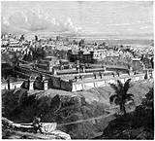
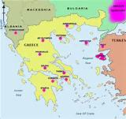
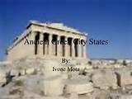
3,500 to 1,400 BC BRONZE AGE
1,400 to 300 AD IRON AGE
TIMELINE
CITY CIVILIZATIONS
GREEK CITY STATES

Slide 3

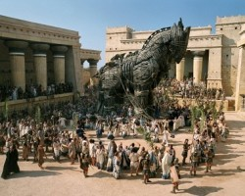
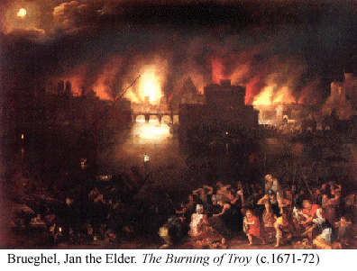
1194 – 1184 BC (1250 BC ?)
TROJAN WAR – A MYTH?
Kingdom of Troy versus Greek Alliance
c 850 BC: HOMER is author of ILIAD and ODYSSEY

Slide 4
THREE PERIODS OF GREEK HISTORY
799 – 500 BC ARCHAIC
    Greek City States develop and colonize
510 – 323 BC CLASSICAL
    Golden Age – Pericles, Aristotle
323 – 31 BC HELLENISTIC
    Spreading of Greek culture

Slide 5
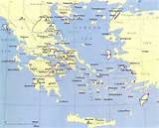
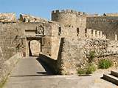
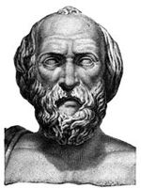
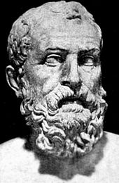
ARCHAIC PERIOD
799 – 500 BC ARCHAIC
Greek city-states spread. Each city-state was independent.
Economics based on farming: land basis of wealth.
Ruled by wealthy aristocrats and then by autocrats.
Money reforms in Sparta and in Athens
LYCURGUS
OF SPARTA
SOLON
OF ATHENS

Slide 6

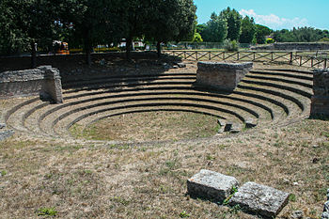
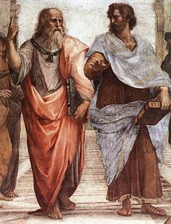
CLASSICAL PERIOD
510 – 323 BC CLASSICAL
  508 BC – ATHENS CONSTITUTION MADE DEMOCRATIC
    CITIZENSHIP EXTENDED TO ALIEN MANUFACTURING AND TRADING FOLK
    10,000 CITIZENS IN ASSEMBLY, HEADED BY COUNCIL OF 500 CITIZENS CHOSEN AT RANDOM
  GRECO-PERSIAN WARS 499 – 449 BC
  GOLDEN AGE OF GREECE 480 – 404 BC
  AGE OF PERICLES 461 – 429 BC
    EMERGENCE OF WIDER DEMOCRACY
  FIRST PELOPONNESIAN WAR 460 – 446 BC (ATHENS VS. SPARTA)
  PEACE 445 – 431 BC
  SECOND PELOPONNESIAN WAR 431 – 404 BC (ATHENS VS. SPARTA)
  ALEXANDER THE GREAT 336 – 323 BC
THE ACROPOLIS
PUBLIC ASSEMBLY
PLATO AND ARISTOTLE

Slide 7
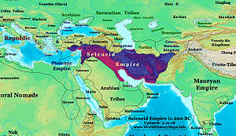
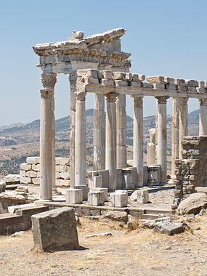
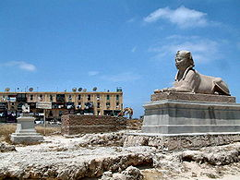
HELLENISTIC PERIOD
323 – 31 BC HELLENISTIC
Greek culture was spread by the breakup of Alexander the Great’s empire into 3 kingdoms:
Seleucid: Babylonia, Persia, Central Turkey, etc.
Pergamon: city in Asia Minor
Ptolemaic: Egypt
SELEUCID EMPIRE
PERGAMON,
ASIA MINOR
PTOLEMAIC
EGYPT

