Slide 1
The Lost Science of Money by Stephen A. Zarlenga
The Mythology of Money –
the Story of Power

Slide 2
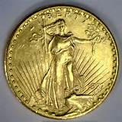
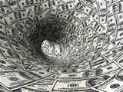
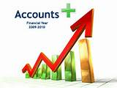
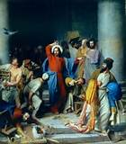
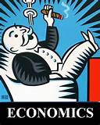
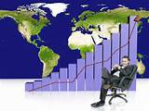
The Mythology of Money
WHAT IS MONEY?

Slide 3
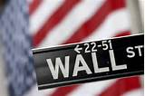
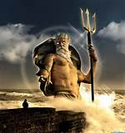
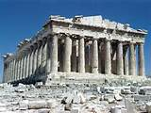
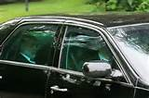
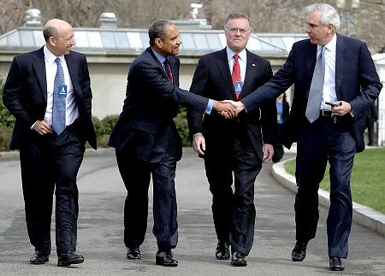
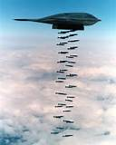
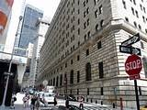
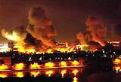
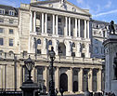
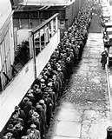
MONEY is the Story of Power

Slide 4
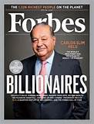
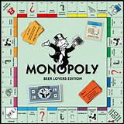
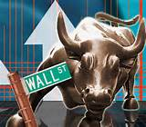
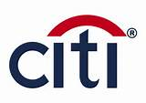
WHAT’S GONE WRONG? OBSCENE CONCENTRATION OF WEALTH

Slide 5
W H A T IS T H E R O O T C A U S E? SECRET SYSTEM OF DEBT MONEY FROM PRIVATE BANKING

Slide 6
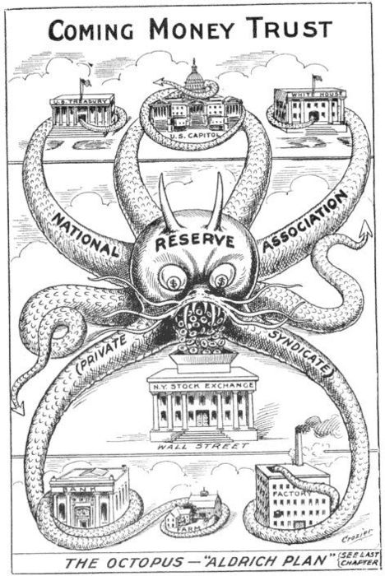
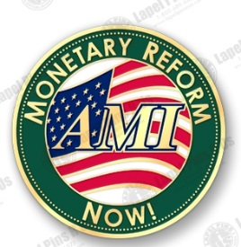
LOST SCIENCE OF MONEY THESIS The primary importance of the monetary power.
“Over time, whoever controls the money system, controls the nation.”
- Stephen Zarlenga, Director, American Monetary Institute

Slide 7
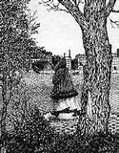
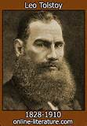
LOST SCIENCE OF MONEY THESIS The nature of money has been purposely kept secret and confused.
“History can only be explained by introducing a power which they apparently do not recognize.” Leon Tolstoy, WAR AND PEACE

Slide 8
LOST SCIENCE OF MONEY THESIS The battle to control the Money Power has raged for millennia: public control vs. private control

Slide 9
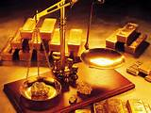
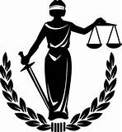
LOST SCIENCE OF MONEY THESIS How a society defines money determines who controls it.
* Define money as wealth, and the wealthy will control. * Define it as credit, the “lenders” will be in control. * Define it as Aristotle did - an abstract legal power –
and government can control it to promote the general welfare.

Slide 10
THE ECONOMICS PROFESSION EITHER IGNORES OR MISDEFINES MONEY …using theoretical and logical reasoning…ignoring empirical data

Slide 11
THE ECONOMICS PROFESSION WILL NOT TEACH THE SCIENCE OF MONEY
Mr Graham Towers, Governor of the Central Bank of Canada (from 1934 to 1955), before the Canadian Government's Committee on Banking and Commerce, in 1939:
Question by Gerald McGeer:
Will you tell me why a government with power to create money, should give that power away to a private monopoly, and then borrow at interest that which parliament can create itself, to the point of national bankruptcy?
Mr. Towers:
If parliament wants to change the form of operating the banking system, then certainly that is within the power of parliament. (p. 394)

Slide 12
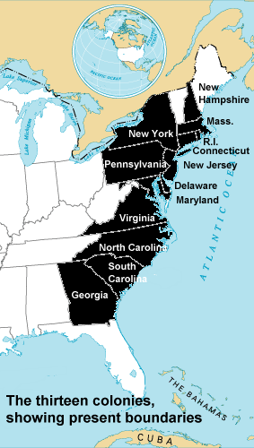
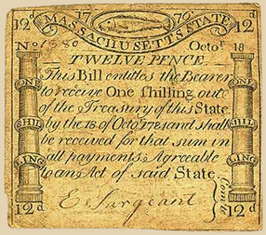
THE ECONOMICS PROFESSION “DOES NOT TAKE THE TROUBLE TO STUDY THE HISTORY OF MONEY” Alexander Del Mar, 19th century monetary historian
Colonial
Bills of Credit

Slide 13
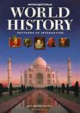
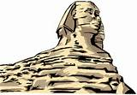
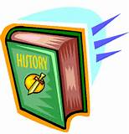
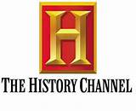
MONETARY HISTORY HAS BEEN CENSORED
The intellectual faculties however are not of themselves sufficient to produce external action;
they require the aid of physical force, the direction and combination of which are wholly at the disposal of
MONEY, THAT MIGHTY SPRING BY WHICH THE TOTAL FORCE OF HUMAN ENERGIES IS SET IN MOTION.
Augustus Boeckh (Translated) The Public Economy of Athens, p. 7, Book I, London, 1828.

Slide 14
MONETARY HISTORY HAS BEEN CENSORED

Slide 15
MONETARY HISTORY HAS BEEN CENSORED
“In all the writings of these great and practical scholars, the workings of that mighty engine which injects the unit of exchange amongst the peoples, and without which no civilization as we know it can come to be, is only indicated by a profound silence.”
David Astle, THE BABYLONIAN WOE

Slide 16
MONETARY HISTORY HAS BEEN MISINTERPRETED
“By the money price of goods it is to be observed, I understand always, the quantity of pure gold or silver for which they are sold, without any regard to denomination of the coin.”
Adam Smith

Slide 17
MONETARY HISTORY HAS BEEN MISINTERPRETED
History and thought shows money’s essence to be an abstract legal power…
…but economists still argue whether
it should be a commodity like gold;
or a credit issued by private banks.

Slide 18
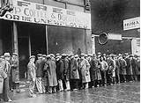
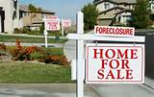
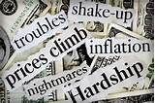
MONETARY HISTORY HAS BEEN MISINTERPRETED
Economists promote the myths and disregard its bad effects on the people.
PRIVATE BANK CREDIT
‘USED AS MONEY’

Slide 19
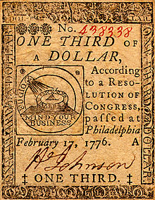
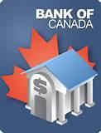
PURPOSE OF BOOK
Study important principles of the science of money,
derived from the history of money systems.
Propose American monetary reforms.
Continental Currency
Colloquial acronym(s) | NEED Act
Nickname(s) | House Bill 2990
Legislative history
Introduced in the House of Representatives as H.R. 2990 by Dennis Kucinich (D-OH) on September 21, 2011 Committee consideration by: House Committee on Financial Services

Slide 20
THE SCIENCE OF MONEY: Principles and Laws
Aristotle – money has value due to law, and not to nature.
Money is distinguished by its Mark of Authority - issued, circulated, and made payable for debts, services, fines, taxes, and commodities, by Law.
The volume determines the value of each piece.
Today the law omits a limit on money’s volume.
Money as a measure of value is thus impaired.
When Aristotle wrote, the volume of money was limited by law in several of the Greek States.
In each was a definite and precise measure of value.

Slide 21
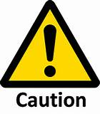
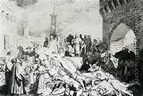
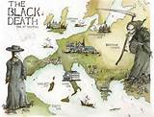
Sometimes primary importance of other factors, occasionally even of chance,
determines the unfolding course of human events.

