Slide 1
1

Slide 2
TOPICS
I WHAT IS MONEY?
Notes:
We need to define our terms so we all know what we are talking about. People have a lot of different ideas of what money is. This is the way we will define it.

Slide 3
MONEY IS UNIQUE – It has the power of life and death over each and every person
ESSENTIAL FOR SOCIETY TO EXIST AND FUNCTION
A HUMAN INVENTION
EXISTS IN LAW

Slide 4
MONEY CAN BE DEFINED BY ITS FUNCTIONS
#1 Means of exchange – a ticket. Not wealth.
#2 Unit of value –
RULE: QUANTITY MUST BE CONTROLLED.
#3 Store of value –
denominated by law & stamped by sovereign authority
#4 A means of payment –
legal power to pay debts -- public and private

Slide 5
WHAT MONEY IS NOT
MONEY IS NOT WEALTH -- NOT A COMMODITY.
MONEY IS NOT BANK CREDIT:
WE PAY OUR DEBTS WITH MONEY.
DEBT IS NOT MONEY.
DEBT IS DESTRUCTIBLE; MONEY IS NOT.

Slide 6
A SOCIETY DEFINES ITS MONEY IN THE LAW
Edward Kellogg, 1861, A New Monetary System:
“The most important fundamental law in any nation is that which institutes money; for money governs the distribution of property, and thus affects in a thousand ways the relations of man to man.”

Slide 7
2

Slide 8
TOPICS
WHAT DO WE USE FOR MONEY?

Slide 9
WE HAVE PRIVATELY ISSUED BANK CREDIT

Slide 10
PRIVATE commercial banks
create bank credit…..
which functions as money
but is DEBT.

Slide 11
PRIVATE COMMERCIAL BANKS –
Do not lend your deposits to borrowers
NO
DEPOSITS
LOANS

Slide 12
IT IS THE EXACT OPPOSITE !!!

Slide 13
A borrower signs a loan contract,
and the BANK CREATES A DEPOSIT
in the borrower’s account
LOANS
CREATE
DEPOSITS

Slide 14
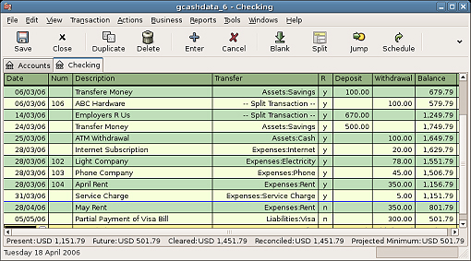
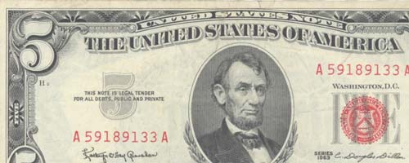
OUR MONEY SUPPLY
3% COIN AND BILLS
97% CHECKING DEPOSITS -- BOOKKEEPING ENTRIES ONLY
CREATED WHEN A PRIVATE BANK MAKES A LOAN TO A BORROWER
REPAID WITH INTEREST
DISAPPEARS WHEN THE LOAN IS REPAID; THE INTEREST REMAINS WITH THE PRIVATE BANK
MINTED BY GOVERNMENT
SPENT BY GOVERNMENT
PRINTED BY GOVERNMENT
NOT SPENT BY GOVERNMENT
ISSUED BY PRIVATE FEDERAL RESERVE BANKS to member banks

Slide 15
THIS BANK CREDIT (DEBT-MONEY) SYSTEM WAS IMPLMENTED BY THE 1913 FEDERAL RESERVE LAW
NEW YORK FEDERAL RESERVE BANK:
OWNED BY ITS MEMBER BANKS
COMMERCIAL BANKS:
OWNERS OF NY FED BANK
NEW YORK FEDERAL RESERVE BANK
GOLDMAN SACHS
BANK OF
AMERICA
CITIGROUP
J.P.MORGAN
CHASE
DEUTSCHE BANK
HSBC
UBS
ETC.

Slide 16
3

Slide 17
TOPICS
WHAT ARE THE EFFECTS OF THE
CURRENT MONETARY SYSTEM?

Slide 18
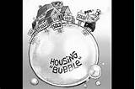
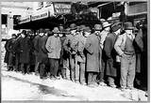
LET’S THINK ABOUT THIS
OUR MONEY SUPPLY: 97% BANK CREDIT
WHEN BANKS MAKE A LOT OF LOANS -
“THE MORTGAGE BUBBLE”
“THE STOCK MARKET BUBBLE”
asset prices rise…..
people go into debt easily…..
WHEN BANKS STOP GIVING LOANS –
“THE RECESSION”
“THE DEPRESSION”
unemployment….
poverty…
foreclosure
bankruptcies
banks acquire assets

Slide 19
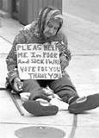
BOOM & BUST CYCLE CONCENTRATES WEALTH
“THE BUST”
HOMELESSNESS
UNEMPLOYMENT
BUSINESS BANKRUPTCIES
FORECLOSURES

Slide 20
THERE IS NO STABILITY TO OUR ECONOMY CAUSES GRIEF, FEAR, POVERTY, DEATH

Slide 21
INTEREST concentrates wealth. Has done so since the first civilization in the Near East. Interest creates debt slaves.

Slide 22
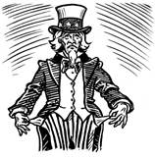
Why does our government borrow money, when it can create it constitutionally?
BANKERS, 1%
INTEREST PAID ON DEBT
(hundreds of billions per year)
The major owners of the debt
are the Federal Reserve Banks
and their private owners, the
commercial banks.
16.7 TRILLION $ DEBT

Slide 23
INTEREST CONCENTRATES WEALTH………..
HOUSEHOLDS
RETAILERS
MORTGAGE, CC, STUDENT, ETC. INTEREST
SMALL BUSINESS LOAN INTEREST
PRIVATE
BANKS
FEDERAL DEBT
INTEREST
CORPORATE LOAN INTEREST
LABOR
PRODUCTION
DISTRIBUTION

Slide 24
THE BANKS’ DECIDE WHO GETS MONEY (LOANS)…..
CONCENTRATES POWER
DERIVATIVES
TRADERS
HEDGE FUNDS
GOLDMAN, CITIBANK, MORGAN CHASE, BOA, ETC.
LOANS
BOND MARKET
CURRENCY
TRADERS

Slide 25
CONCENTRATION OF WEALTH…..
LEADS TO CONCENTRATION OF POWER
ECONOMICS
TEACHING
HISTORY
TEACHING
TOO BIG
TO FAIL BANKS
GIVE LOANS TO
MEDIA
CONCENTRATION
BIG
PHARMA
WRITING LAWS
PACS
MONSANTO
LOBBYISTS
ELECTIONS
COURTS
(CITIZENS’ UNITED)

Slide 26
PRIVATELY-ISSUED DEBT-MONEY KEEPS EVERYONE IN DEBT
STUDENT DEBT | $ 1.0 TRILLION
CREDIT CARD DEBT | $ .8 TRILLION
MORTGAGE DEBT | $ 13.0 TRILLION
CORPORATE DEBT | $ 8.7 TRILLION
STATE, LOCAL GOVT DEBT | $ 3.0 TRILLION
FEDERAL GOVT DEBT | $ 16.4 TRILLION
TOTAL PRIVATE, CORP, GOVERNMENT DEBT | $ 42.9 TRILLION

Slide 27
TOPICS
Q & A

