Slide 1
BANKERS MONEY IS NOT CONCRETE
OUR BANKS STARTED IN THE MIDDLE AGES

Slide 2
MEDIEVAL BANKERS CREATED MONEY OUT OF THIN AIR FROM BOOKKEEPING ENTRIES

Slide 3
MEDIEVAL BANKERS CREATED MONEY OUT OF THIN AIR FROM BOOKKEEPING ENTRIES

Slide 4
MEDIEVAL BANKERS CREATED MONEY OUT OF THIN AIR FROM BOOKKEEPING ENTRIES

Slide 5
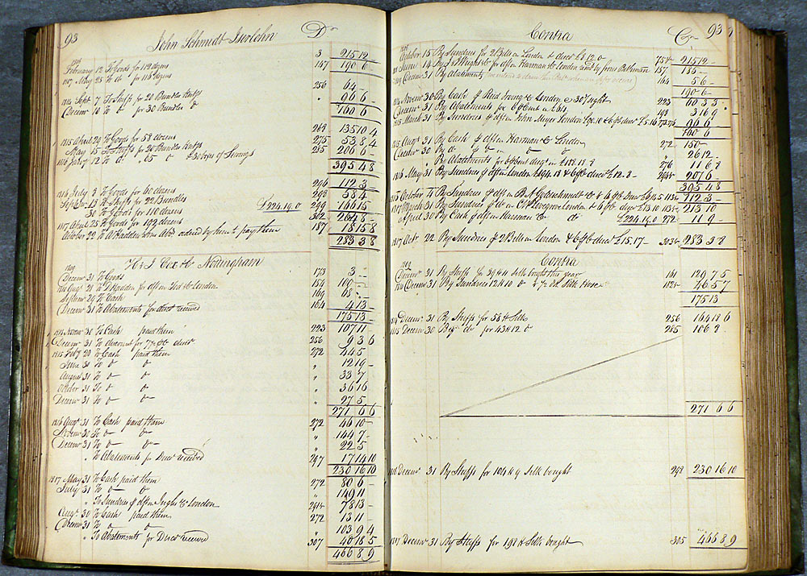
MEDIEVAL BANKERS CREATED MONEY OUT OF THIN AIR FROM BOOKKEEPING ENTRIES
DOUBLE-ENTRY BOOKKEEPING WAS
BROUGHT BACK FROM THE MOSLEMS
BY THE KNIGHTS TEMPLARS
AFTER THE FIRST CRUSADE - 1096–1099 AD.
THE KNIGHTS TEMPLARS BECAME THE FIRST
EUROPEAN MEDIEVAL BANKERS – 1118-1307 .
IT WAS ADOPTED BY THE ITALIAN MERCHANT
BANKERS AND THE LOCAL DOMESTIC BANKERS.
BOTH INTERNATIONAL BANKERS &
LOCAL BANKERS CREATED MONEY
OUT OF THIN AIR USING THESE ENTRIES ON PAPER.

Slide 6
TODAY
MISS PAULA PACE GETS
A LOAN FROM THE BANK
LOAN PRINCIPAL
$20,000
WHEN THE LOAN DOCUMENT IS SIGNED,
THE BANK CREATES A DEPOSIT IN THE
CHECKING ACCOUNT OF THE BORROWER.
NEW BANK CREDIT. NEW ‘MONEY’ IN
OUR ECONOMY.
WHEN THE LOAN PRINCIPAL IS REPAID,
OR DEFAULTS,
THE ‘MONEY’ DISAPPEARS!
CHECKING ACCOUNT OF
MISS PAULA PACE

